Slide 1
SHIELD Meeting 11/7
Tripledemic Modeling Updates

Slide 2

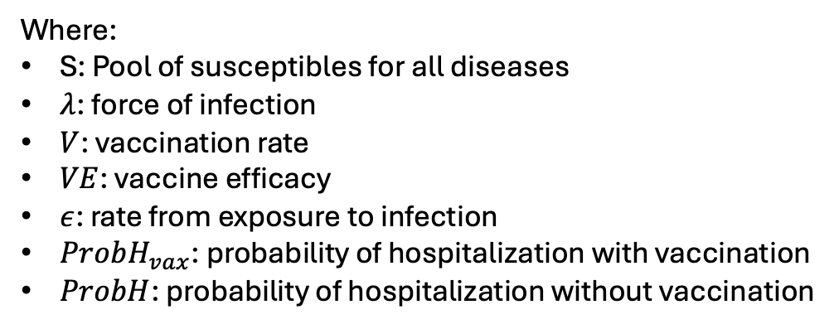












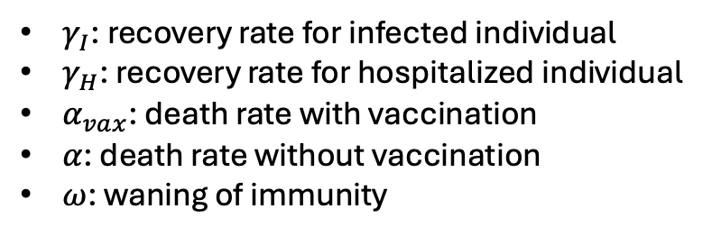
Model Structure:
H_{vax}
$$α_{vax}⋅γ_{H}$$
D_{vax}
$$λ⋅V⋅VE$$
$$ε$$
$$ProbH_{vax}⋅γ_{I}$$
E_{vax}
I_{vax}
$${(1−α}_{vax})⋅γ_{H}$$
S
$$(1−ProbH_{vax})γ_{I}$$
R
$$λ⋅(1−V)$$
E
$$ϵ$$
I
$$(1−ProbH)γ_{I}$$
$$(1−α)⋅γ_{H}$$
D
$$ProbH⋅γ_{I}$$
H
$$α⋅γ_{H}$$
$$ω$$
Where:
S: Pool of susceptibles for all diseases
$λ$: force of infection
$V$: vaccination rate
$VE$: vaccine efficacy
$ε$: rate from exposure to infection
$ProbH_{vax}$: probability of hospitalization with vaccination
$ProbH$: probability of hospitalization without vaccination
$γ_{I}$: recovery rate for infected individual
$γ_{H}$: recovery rate for hospitalized individual
$α_{vax}$: death rate with vaccination
$α$: death rate without vaccination
$ω$: waning of immunity
COVID
RSV

Slide 3
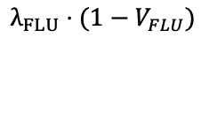



































RSV
H_{vax}
$$α_{RSVvax}⋅γ_{H_RSV}$$
D_{vax}
$$λ_{RSV}⋅V_{RSV}⋅VE_{RSV}$$
$$ϵ_{RSV}$$
$$ProbH_{RSVvax}⋅γ_{I_RSV}$$
E_{vax}
I_{vax}
$$(1−ProbH_{RSVvax})γ_{I_RSV}$$
$${(1−α}_{RSVvax})⋅γ_{H_RSV}$$
R
$$λ_{RSV}⋅{(1−V}_{RSV})$$
E
$$ϵ_{RSV}$$
I
$$(1−ProbH_{RSV})γ_{I_RSV}$$
$${(1−α}_{RSV})⋅γ_{H_RSV}$$
$$ProbH_{RSV}⋅γ_{I_RSV}$$
H
D
$$α_{RSV}⋅γ_{H_RSV}$$
COVID
H_{vax}
$$α_{COVvax}⋅γ_{H_COV}$$
D_{vax}
$$λ_{COV}⋅V_{COV}⋅VE_{COV}$$
E_{vax}
$$ϵ_{COV}$$
I_{vax}
$$ProbH_{COVvax}⋅γ_{I_COV}$$
$$(1−ProbH_{COVvax})γ_{I_COV}$$
$${(1−α}_{COVvax})⋅γ_{H_COV}$$
S
R
$$λ_{COV}⋅{(1−V}_{COV})$$
E
$$ϵ_{COV}$$
I
$$(1−ProbH_{COV})γ_{I_COV}$$
$${(1−α}_{COV})⋅γ_{H_COV}$$
H
D
$$ProbH_{COV}⋅γ_{I_COV}$$
$$α_{COV}⋅γ_{H_COV}$$
FLU
H_{vax}
$$α_{FLUvax}⋅γ_{H_COV}$$
D_{vax}
$$λ_{FLU}⋅V_{FLU}⋅VE_{FLU}$$
E_{vax}
$$ϵ_{FLU}$$
I_{vax}
$$ProbH_{FLUvax}⋅γ_{I_FLU}$$
$$(1−ProbH_{FLUvax})γ_{I_FLU}$$
$${(1−α}_{FLUvax})⋅γ_{H_FLU}$$
R
$$λ_{FLU}⋅{(1−V}_{FLU})$$
E
$$ϵ_{FLU}$$
I
$$(1−ProbH_{FLU})γ_{I_FLU}$$
$${(1−α}_{FLU})⋅γ_{H_FLU}$$
$$ProbH_{FLU}⋅γ_{I_FLU}$$
H
D
$$α_{FLU}⋅γ_{H_FLU}$$

Slide 4
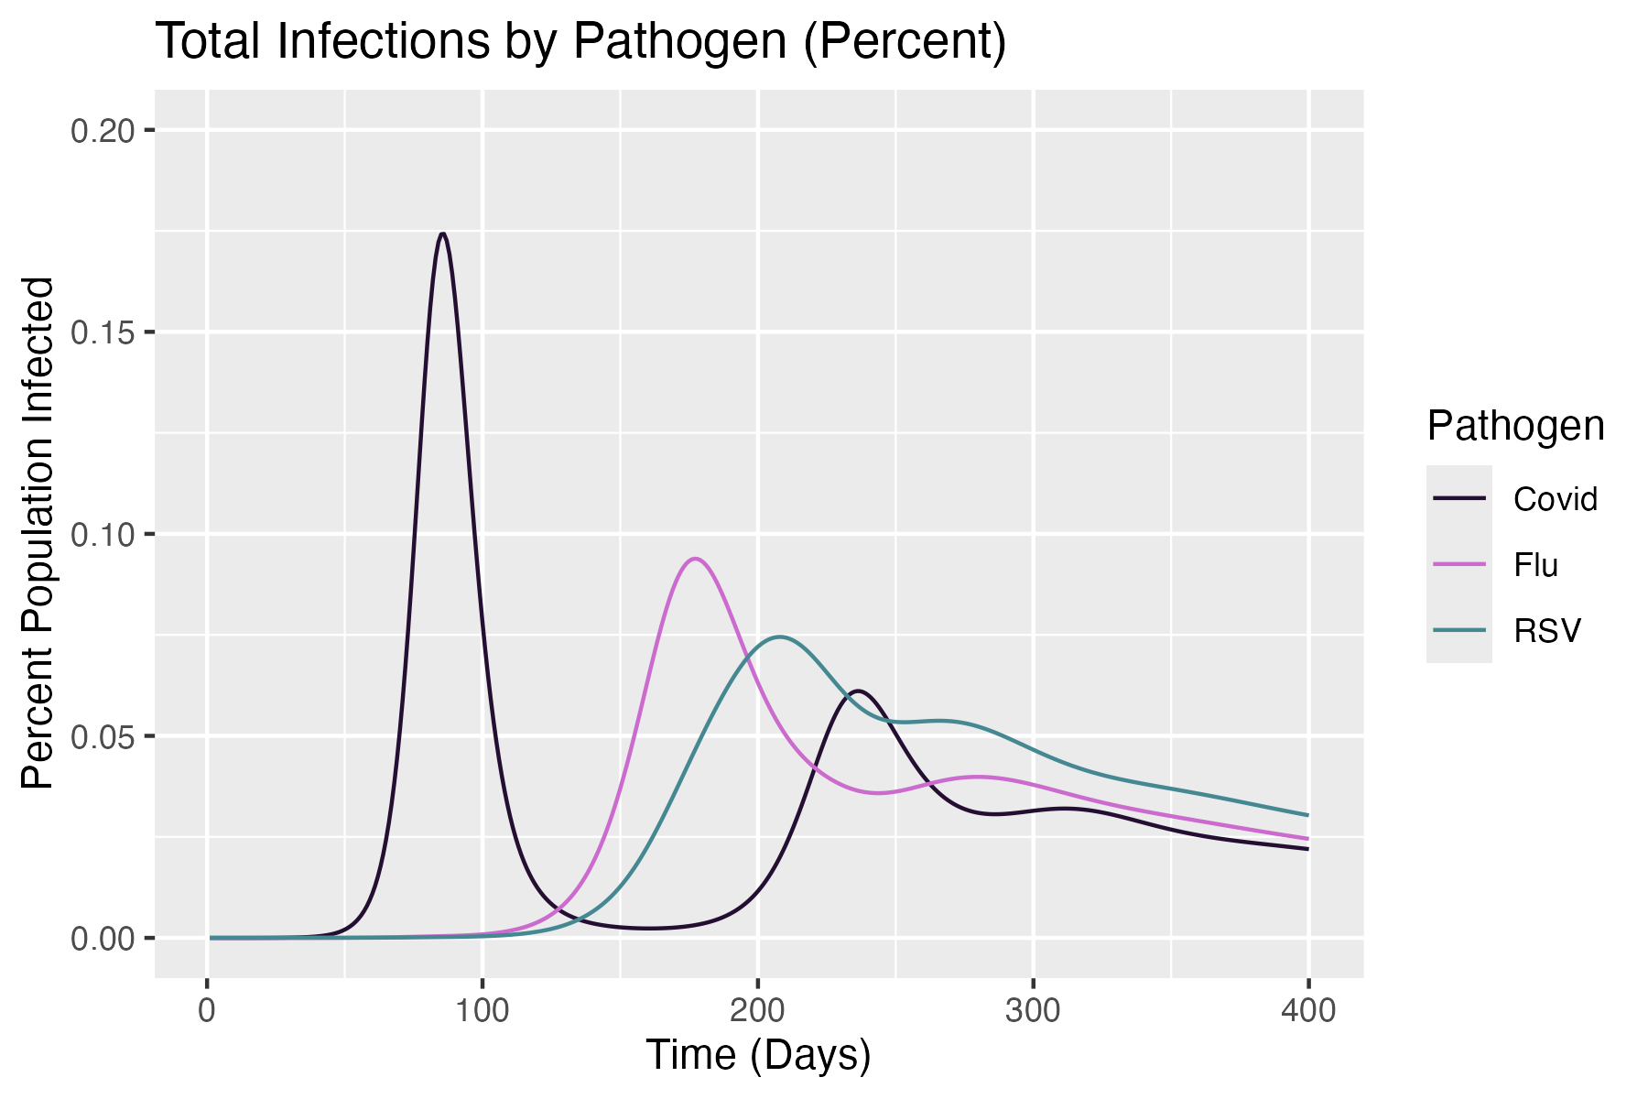
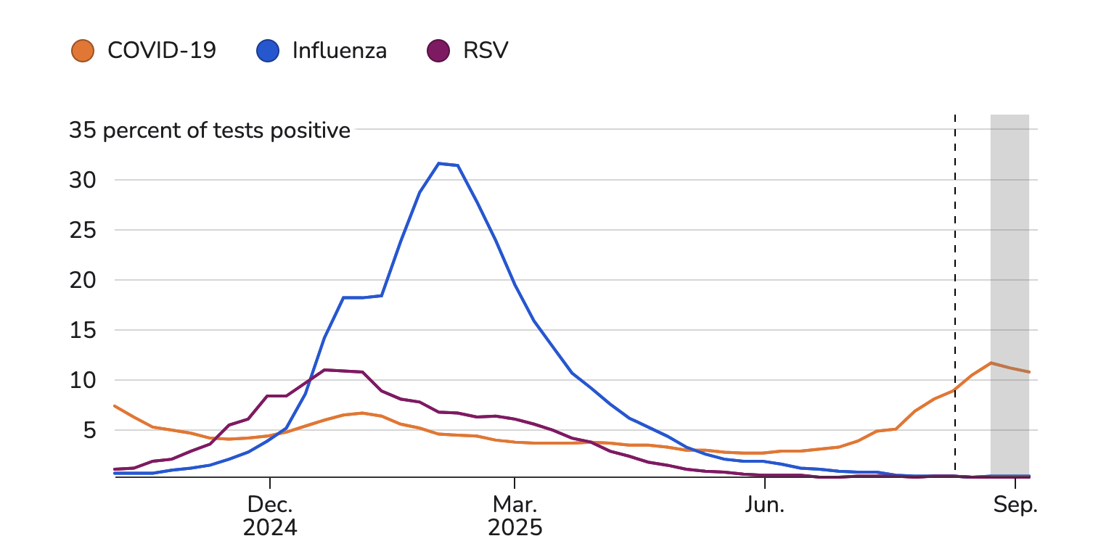
Last Time:
USA Respiratory Illness Dashboard
(Source: CDC)
SEIR Model
Notes:
Questions:
→ Delay R0, Add seasonality element

Slide 5
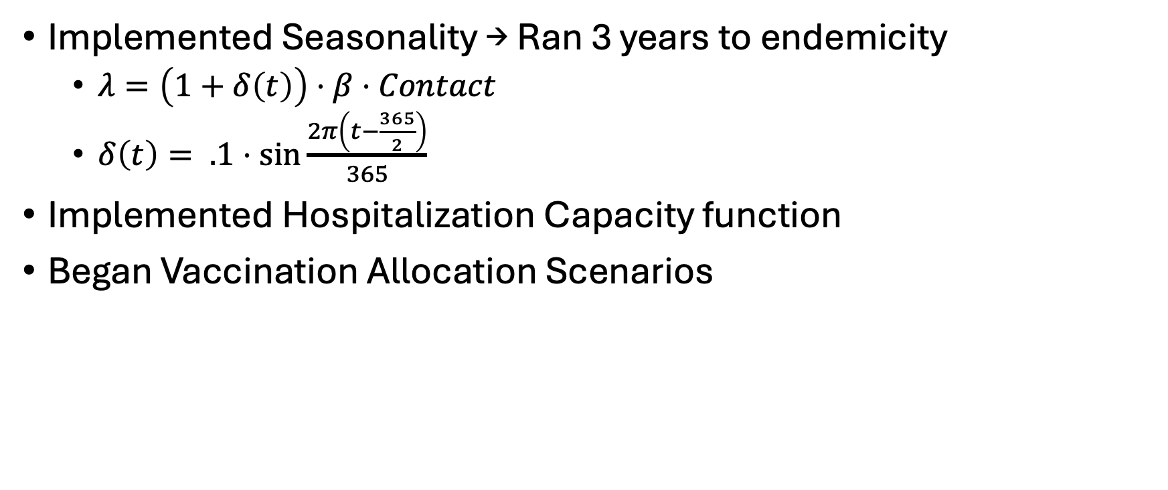
Updates
Implemented Seasonality → Ran 3 years to endemicity
  $λ=\left(1+δ\left(t\right)\right)⋅β⋅Contact$
  $δ\left(t\right)= .1⋅\sin{\frac{2π\left(t−\frac{365}{2}\right)}{365}}$
Implemented Hospitalization Capacity function
Began Vaccination Allocation Scenarios

Slide 6
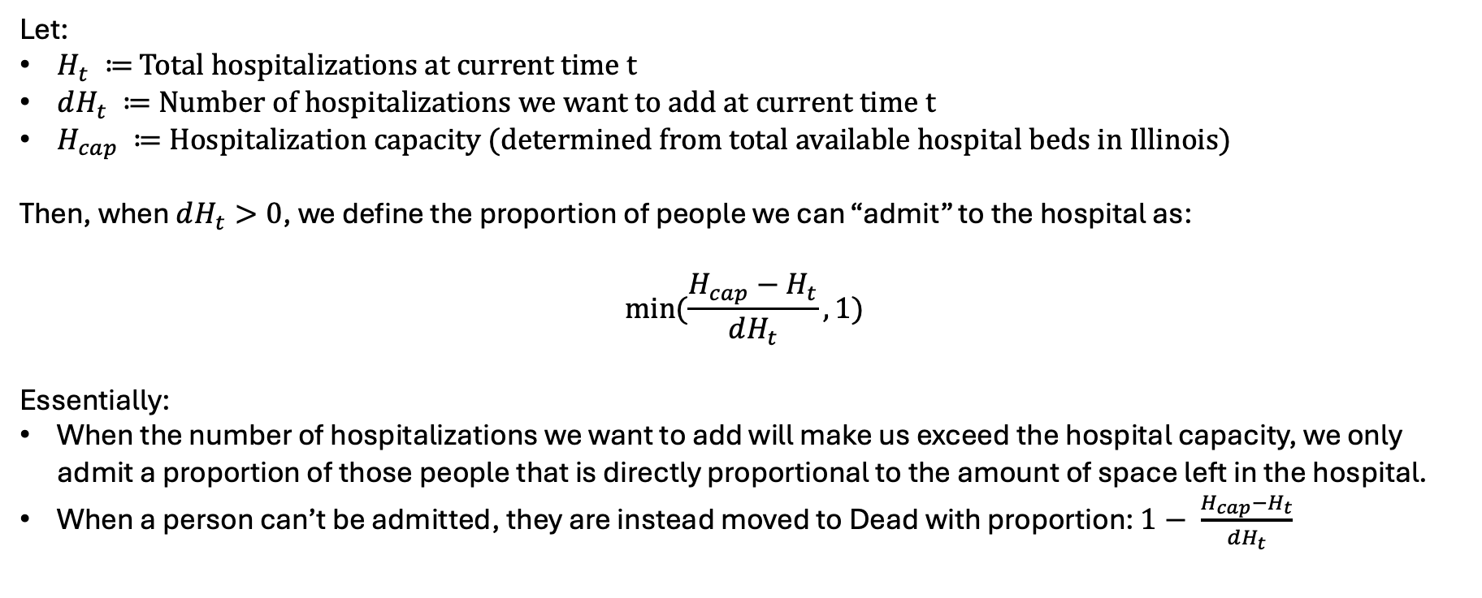
Hospitalization Term
Goal: Simulate finite healthcare resources in Illinois during tripledemic season
Let:
$H_{t} ≔$ Total hospitalizations at current time t
$dH_{t} ≔$Number of hospitalizations we want to add at current time t
$H_{cap} ≔$Hospitalization capacity (determined from total available hospital beds in Illinois)
Then, when $dH_{t}>0$, we define the proportion of people we can “admit” to the hospital as:
$$min⁡(\frac{H_{cap}−H_{t}}{dH_{t}}, 1)$$
Essentially:
When the number of hospitalizations we want to add will make us exceed the hospital capacity, we only admit a proportion of those people that is directly proportional to the amount of space left in the hospital.
When a person can’t be admitted, they are instead moved to Dead with proportion: $1− \frac{H_{cap}−H_{t}}{dH_{t}}$

Slide 7
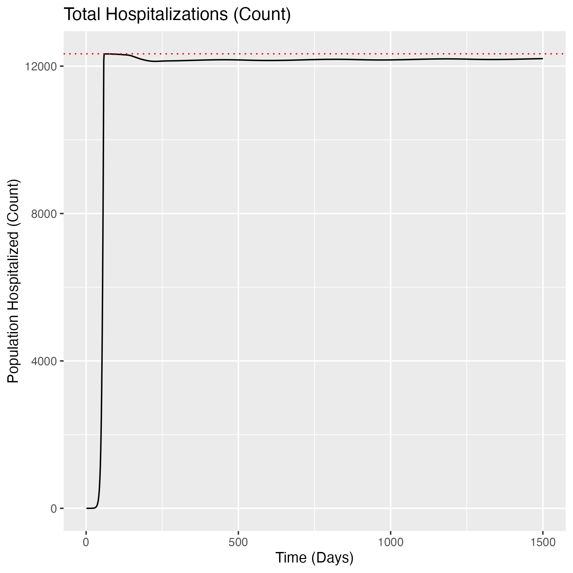
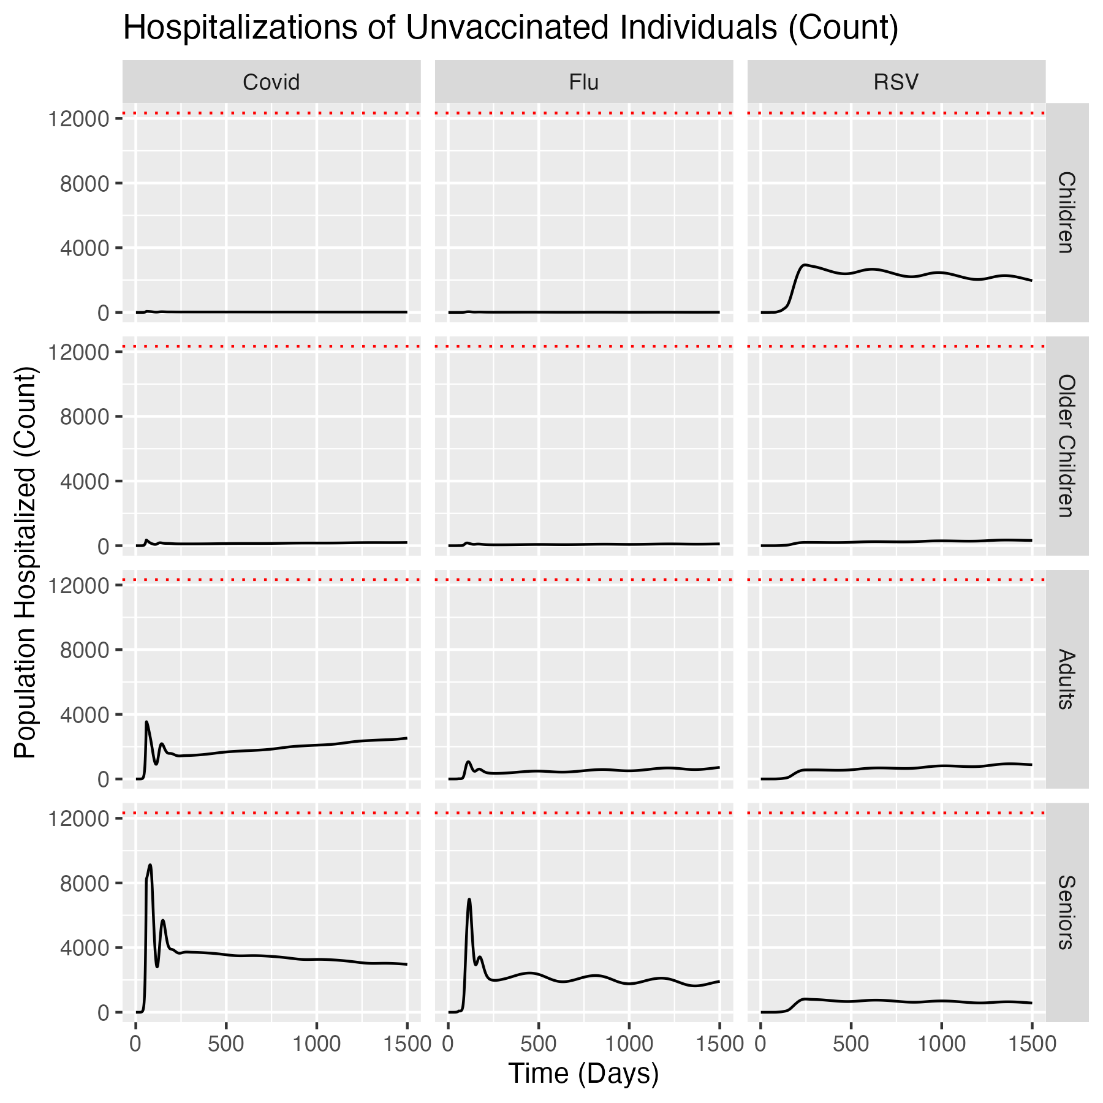
Example: No Vaccination Scenario

Slide 8
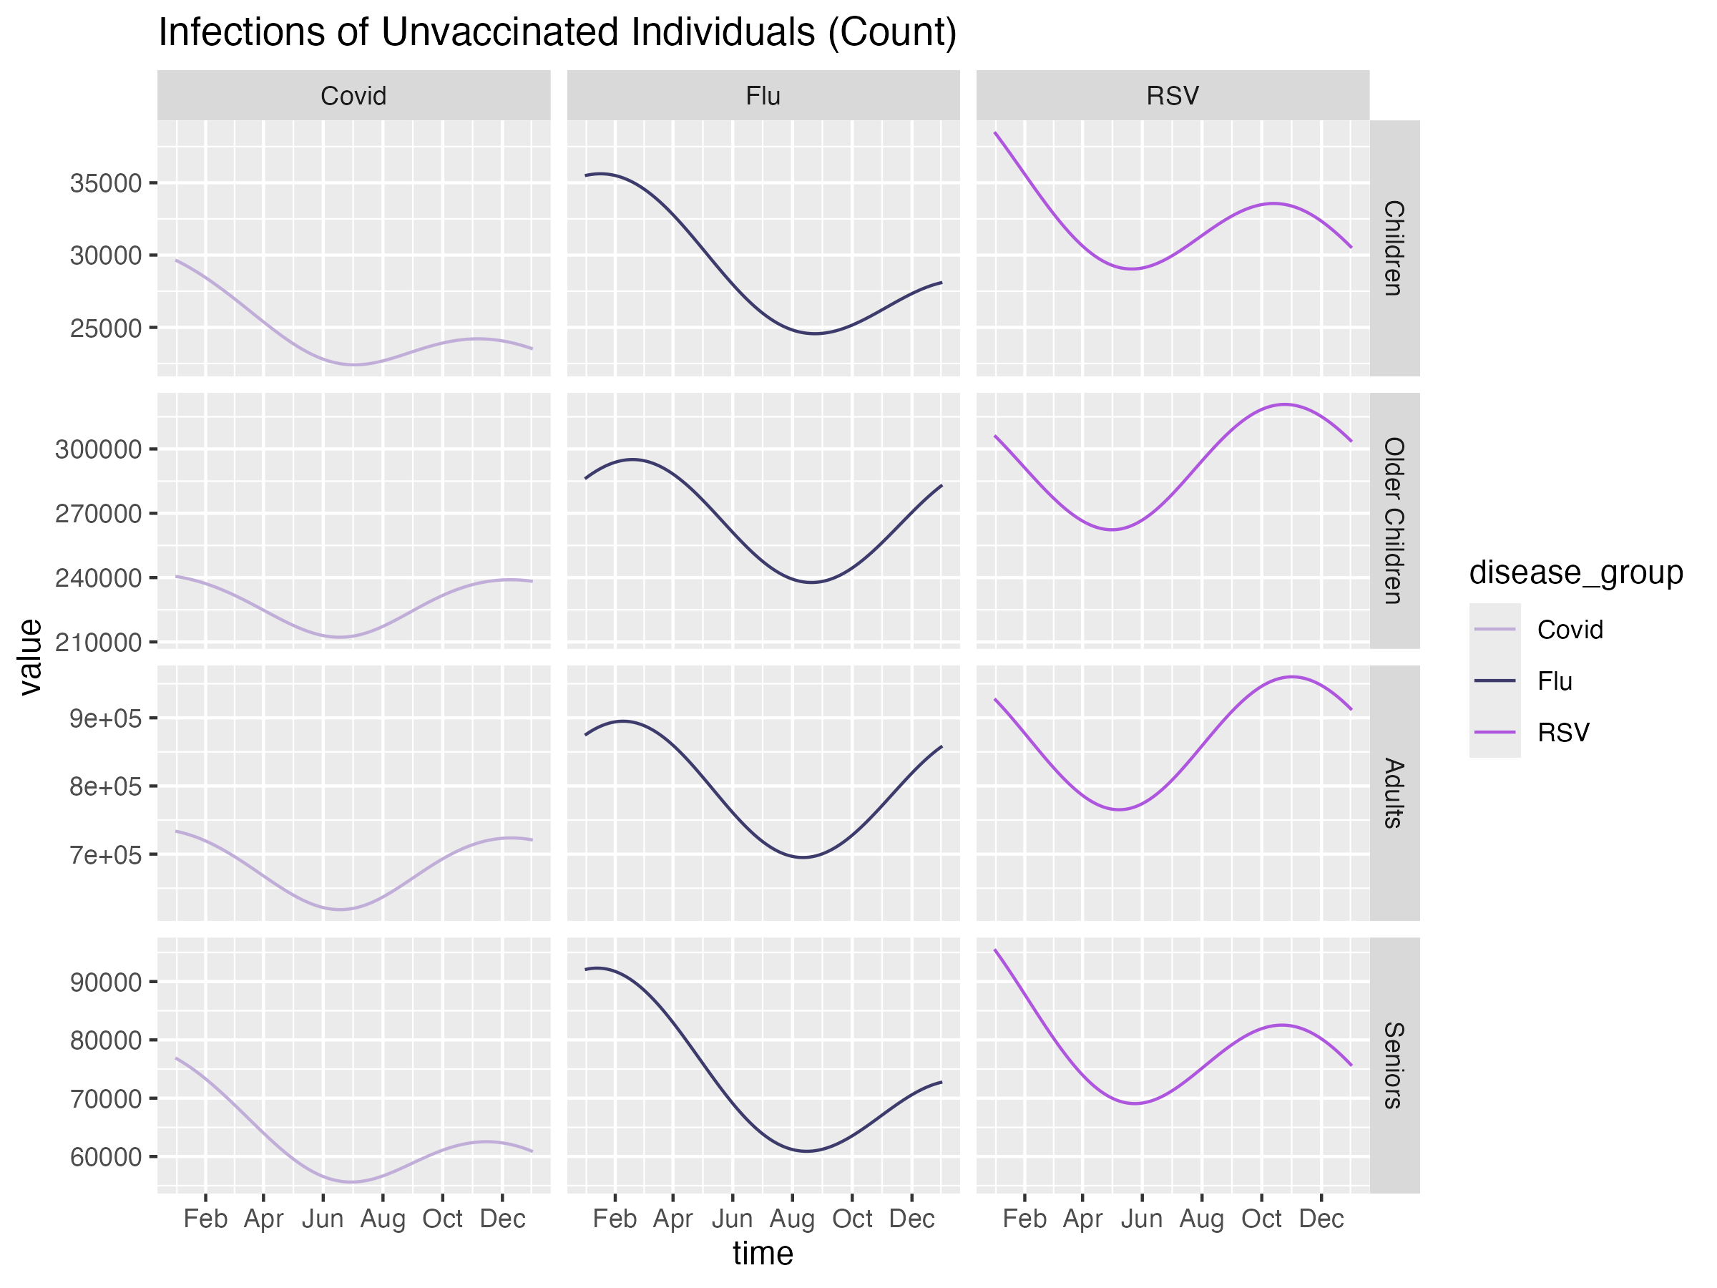
No Vaccination - Infections
Covid
Age Group | Vacc. Rate
Children (0-5) | 0%
Older Children (6-18) | 0%
Adults (19-64) | 0%
Seniors (65+) | 0%
Flu
Age Group | Vacc. Rate
Children (0-5) | 0%
Older Children (6-18) | 0%
Adults (19-64) | 0%
Seniors (65+) | 0%
RSV
Age Group | Vacc. Rate
Children (0-5) | 0%
Older Children (6-18) | 0%
Adults (19-64) | 0%
Seniors (65+) | 0%

Slide 9
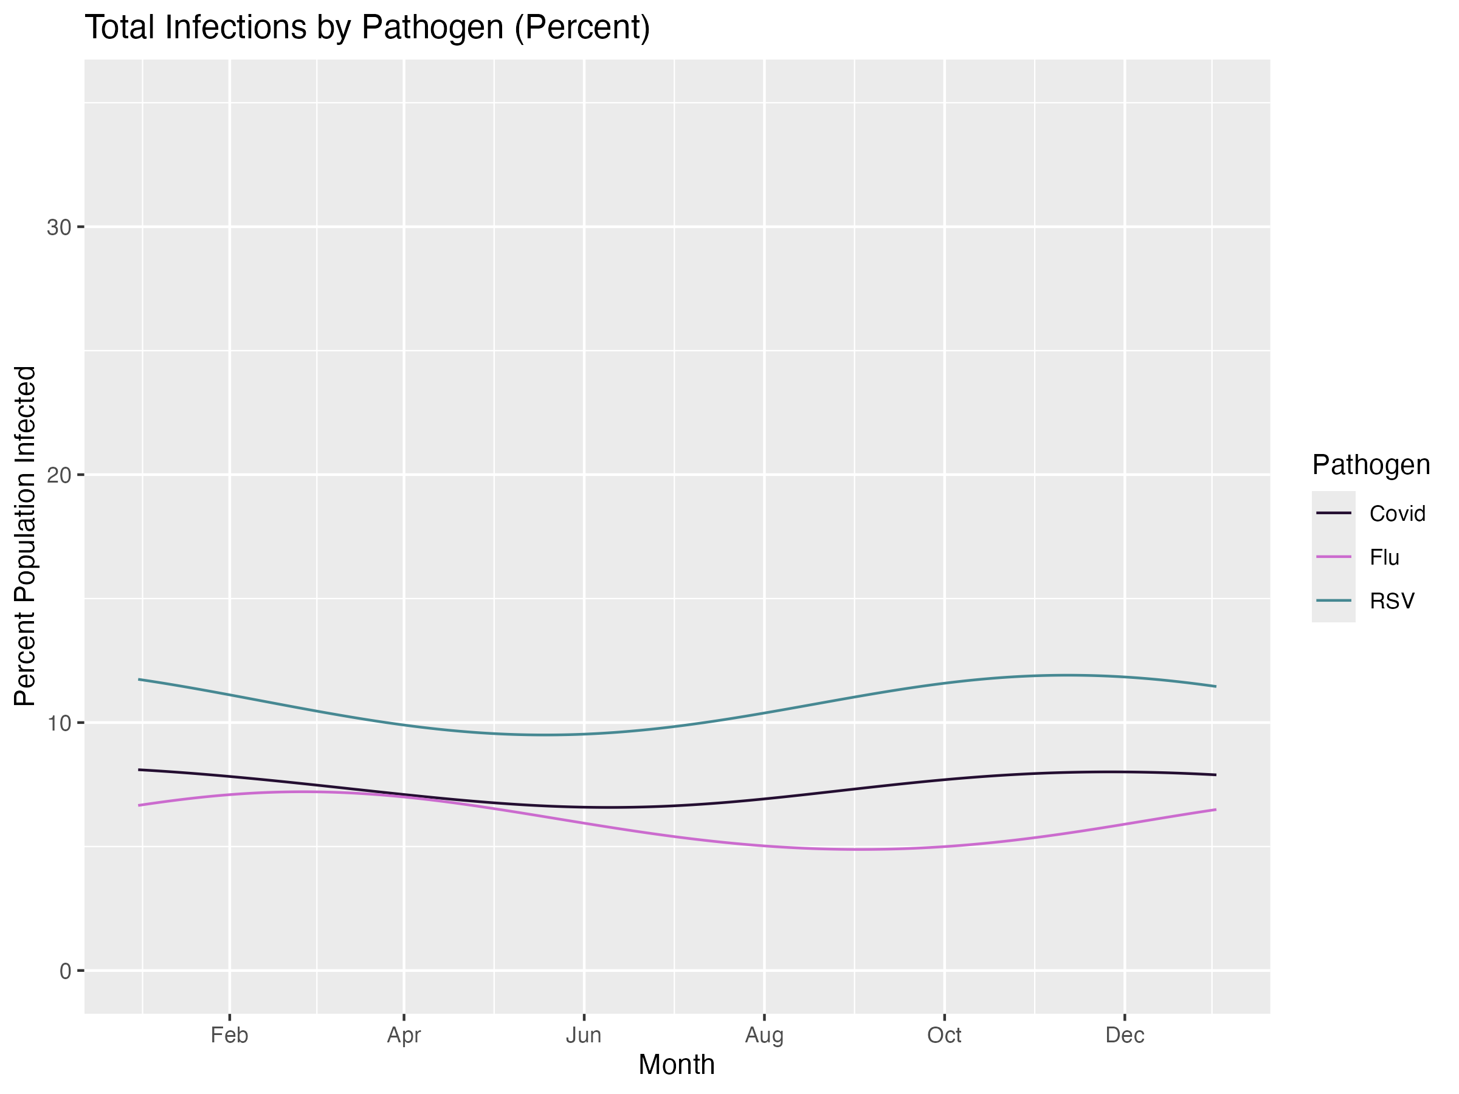
Current Vaccination Scenario
USA Respiratory Illness Dashboard
(Source: CDC)
SEIR Model
Notes:
Questions:
→ RSV overestimated, Flu underestimated?

Slide 10
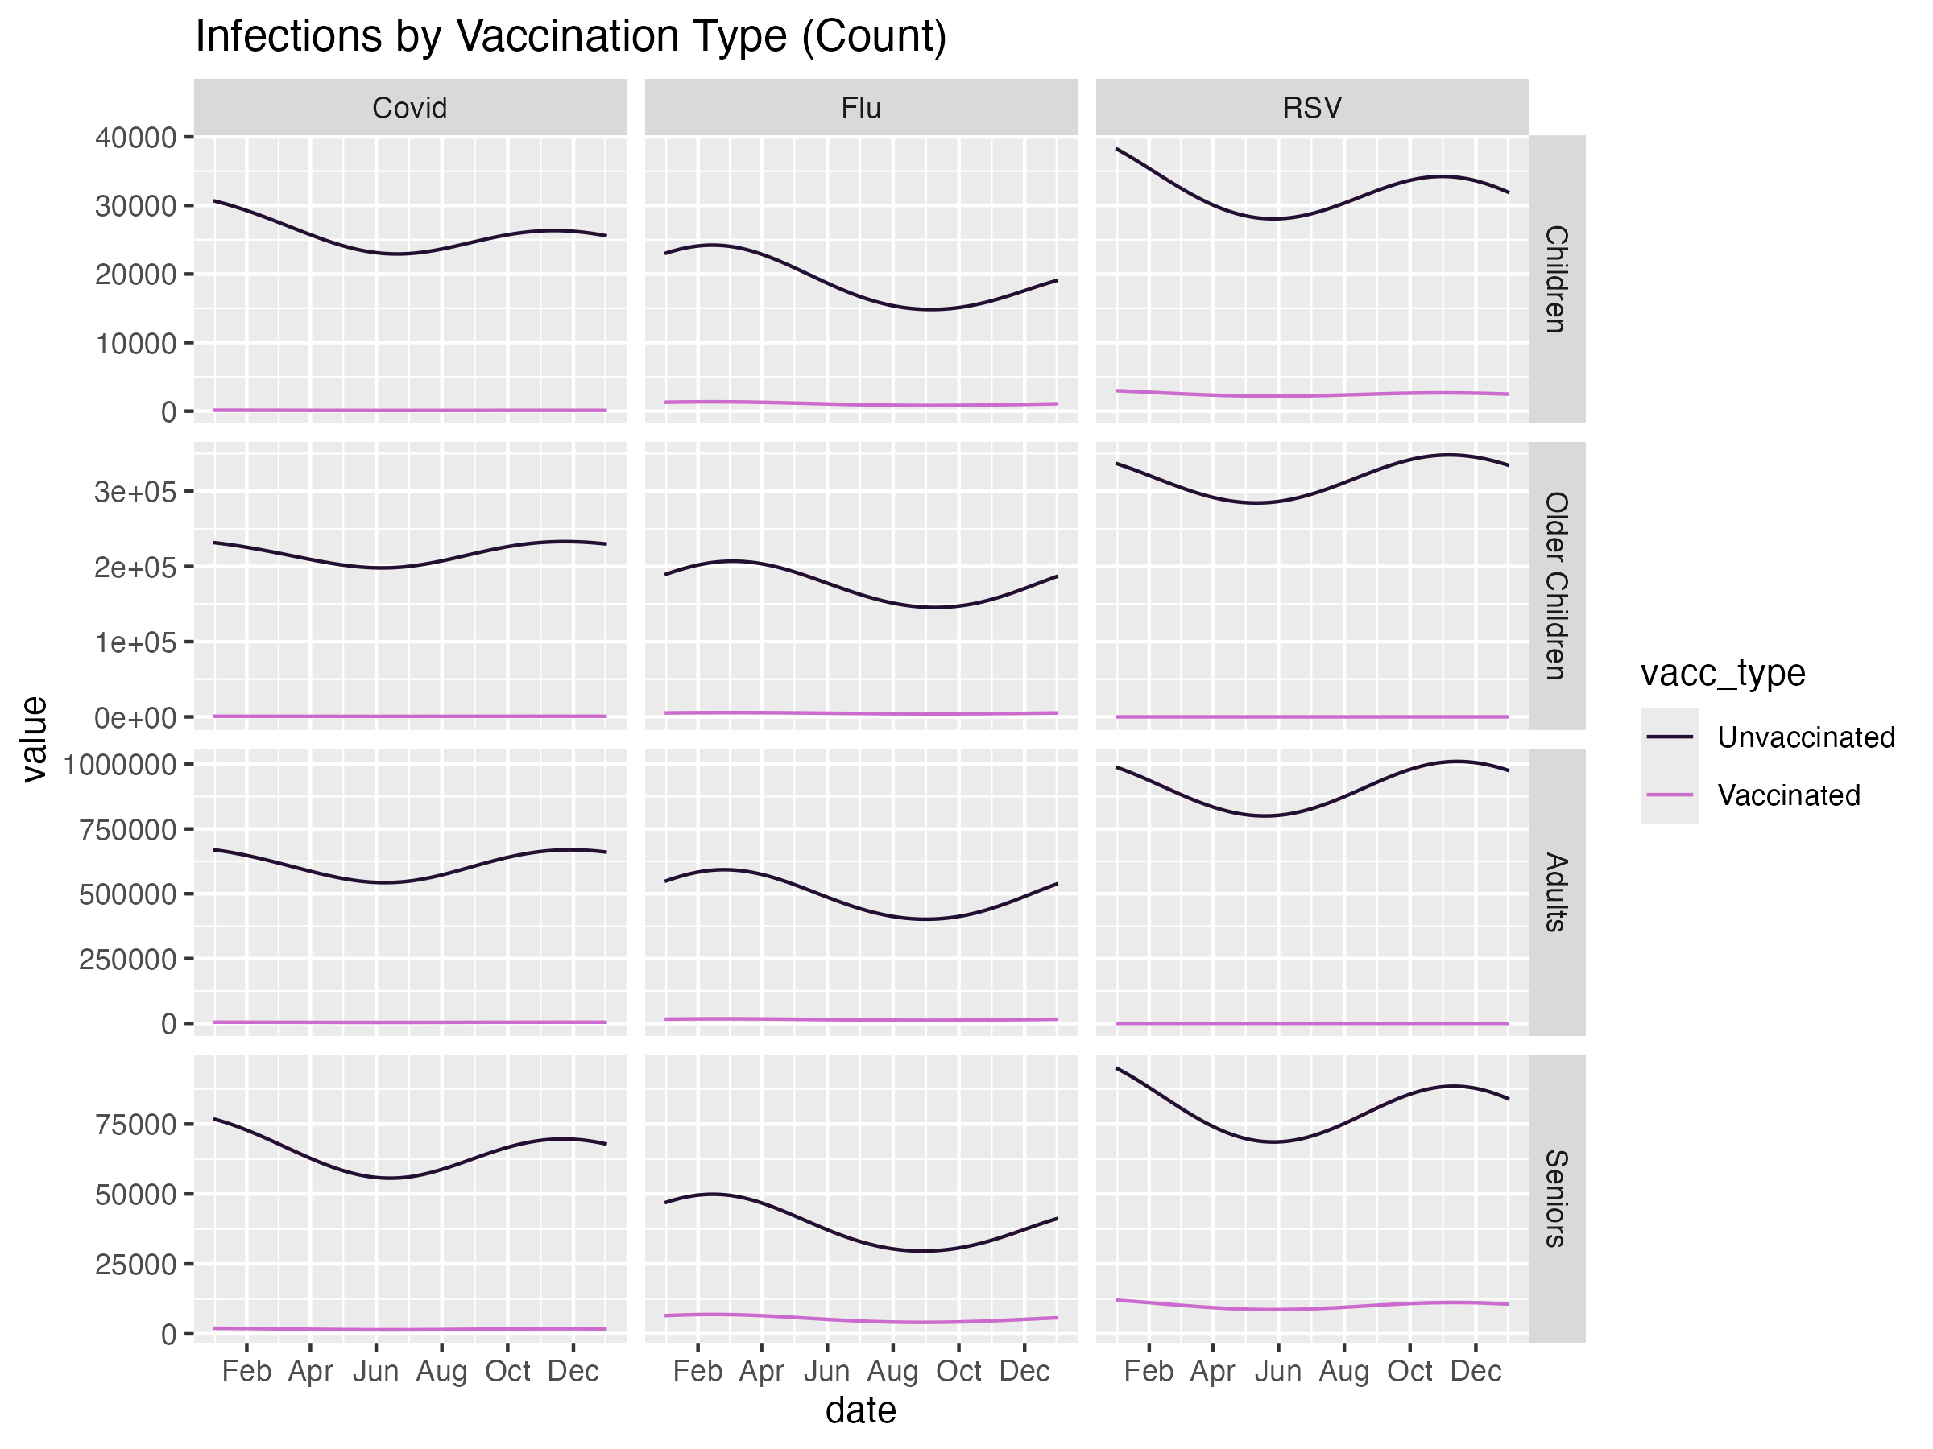
Current Vaccination - Infections
Covid
Age Group | Vacc. Rate
Children (0-5) | 6.8%
Older Children (6-18) | 5.4%
Adults (19-64) | 10.1%
Seniors (65+) | 30.3%
Flu
Age Group | Vacc. Rate
Children (0-5) | 35.9%
Older Children (6-18) | 21.6%
Adults (19-64) | 23%
Seniors (65+) | 58.2%
RSV
Age Group | Vacc. Rate
Children (0-5) | 29%
Older Children (6-18) | 0%
Adults (19-64) | 0%
Seniors (65+) | 40%
Notes:
Source: IDPH Vaccination Coverage Dashboard, defined as population who has the most recent booster
Opinions: Should these be any vaccine for COVID, or only current booster?
What is the best way to look at RSV Vaccination for adults? Considering that RSV vaccinations are not recommended for young adults, what rates would you recommend?

Slide 11
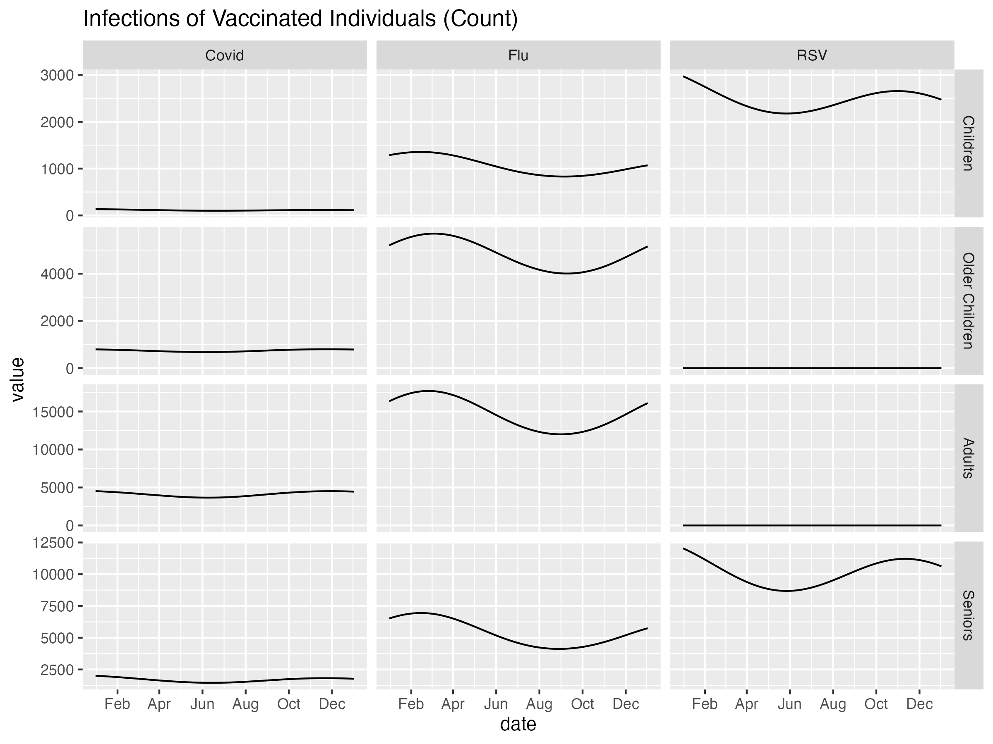
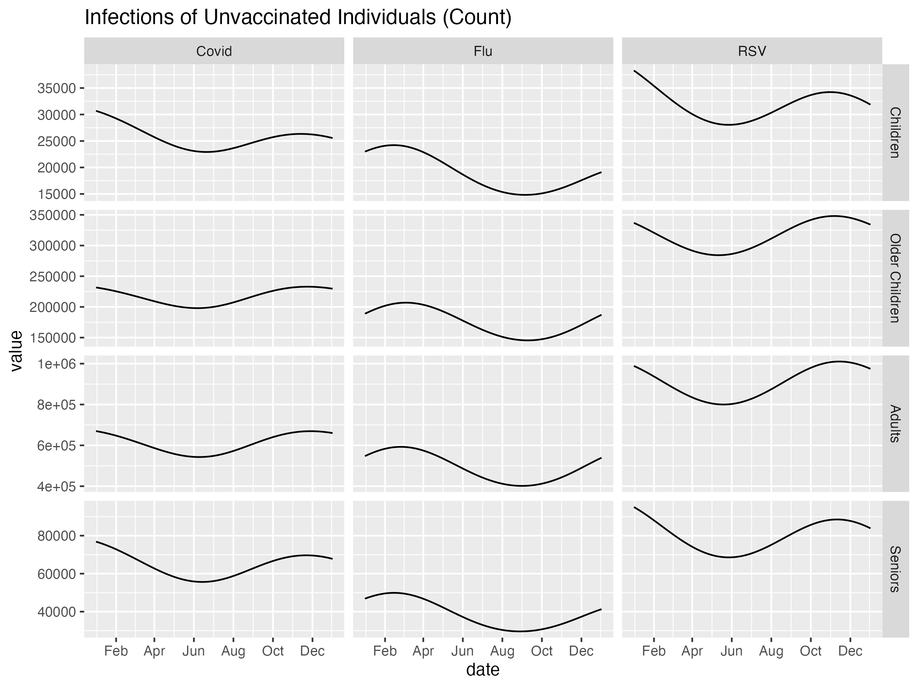
Current Vaccination - Infections
Notes:
Overestimating/Underestimating? How to address?

Slide 12
Supplementary

Slide 13
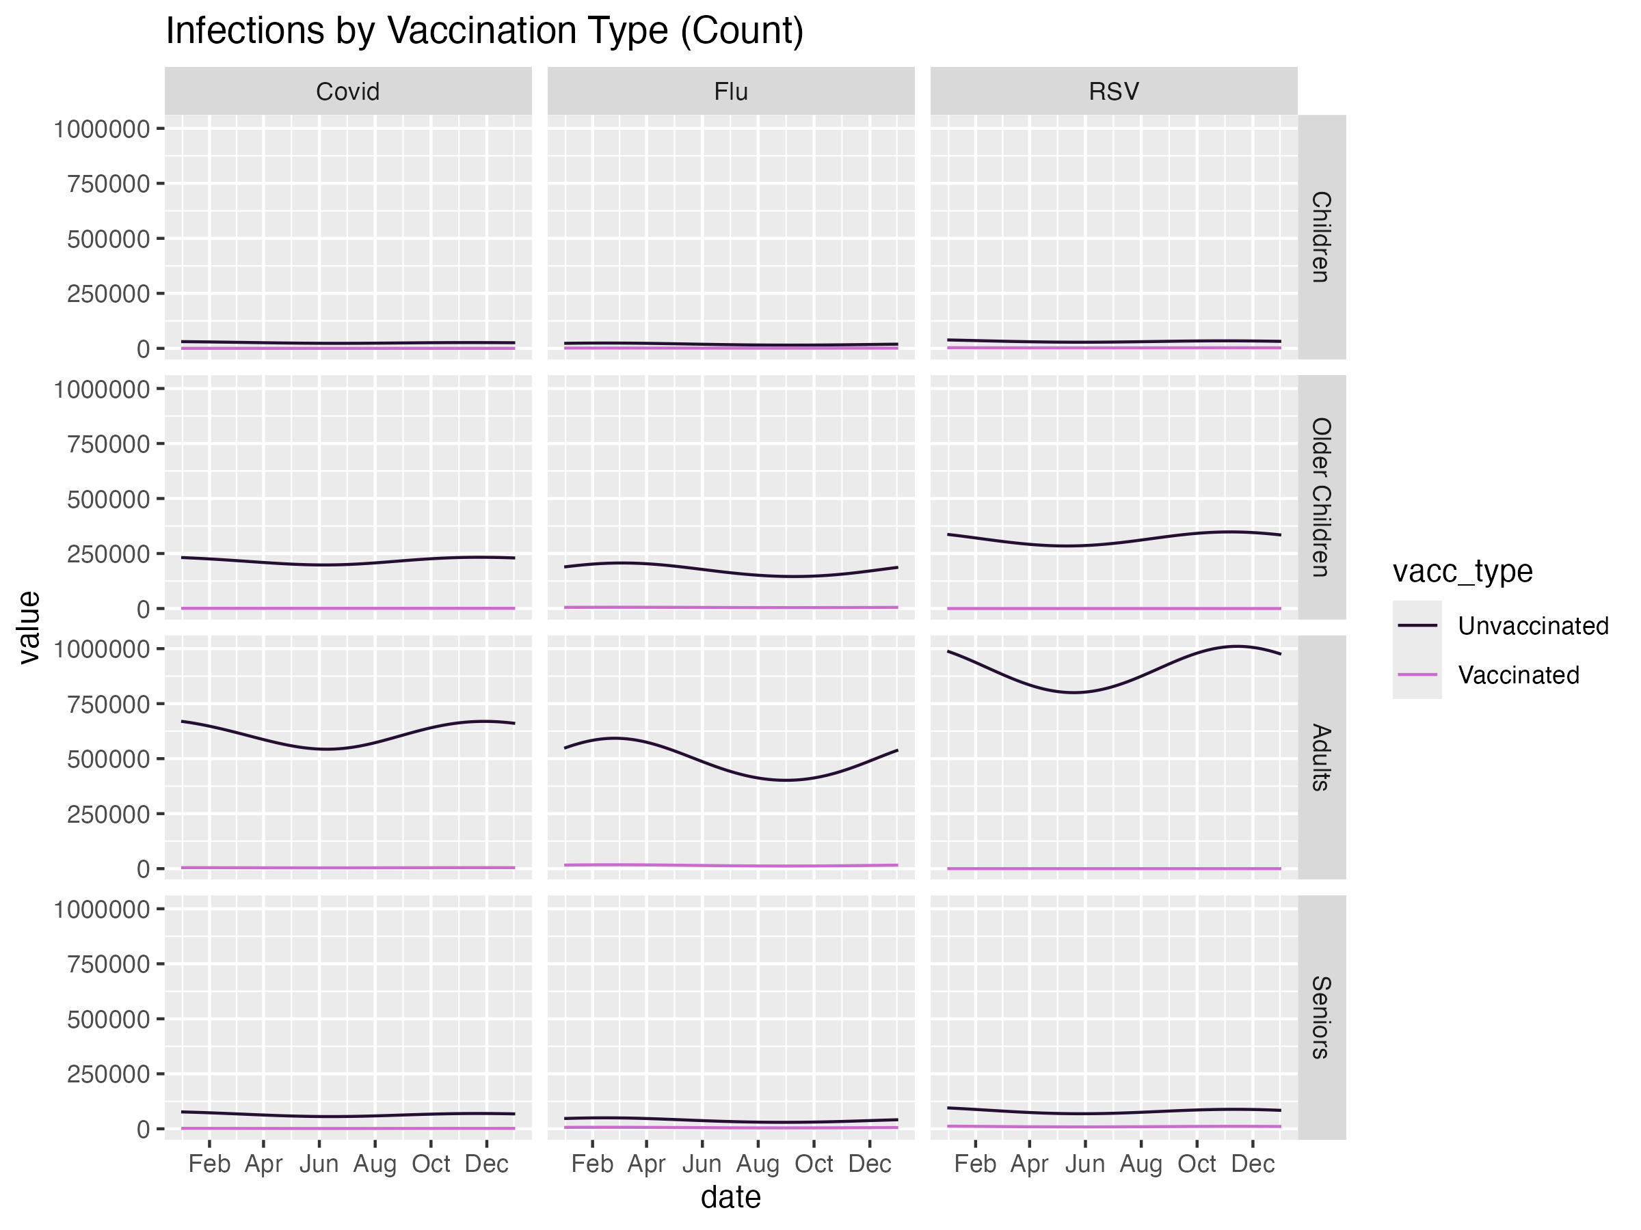
Current Vaccination by Vacc Type (Count)

Slide 14
Aim
To characterize the optimal age-based distribution of vaccines for RSV, influenza, and COVID-19 – diseases with different age profiles of severity – in a tripledemic season with finite healthcare resources in Illinois
Approach
Age-stratified Tripledemic SEIR
  4 age groups: Children (0-5), Older Children (6-18), Adults (19-64), Seniors (65+)
  3 pathogens: COVID-19, Flu, RSV
Model discrete vaccination scenarios:
  Baselines: No Vaccination, Current Vaccination Levels
  Add X% more vaccine doses in the population and vary which age populations they are given to

Slide 15





Flow out of R
Example: Flu
S
R_{FLU}
$$ω_{FLU}$$
$$λ_{COV}⋅V_{COV}⋅VE_{COV}$$
$$λ_{RSV}⋅{(1−V}_{RSV})$$
$$λ_{COV}⋅{(1−V}_{COV})$$
$$λ_{RSV}⋅V_{RSV}⋅VE_{RSV}$$
E_{COV_vax}
E_{COV}
E_{RSV_vax}
E_{RSV}

Slide 16
Overall Model
Children
SEIR
Older Children
SEIR
Adults
SEIR
Seniors
SEIR
Essentially 4 separate SEIR models
Note: No aging component is used because we are only modeling one season of the tripledemic

