Slide 1
A Web-Based Introduction to Programming
Chapter 11
Structured Data –
Working with Arrays

Slide 2
Intended Learning Outcomes
Summarize key characteristics of arrays.
Create an array using index value.
Create an array using the array() function.
Assign values to array elements.
Access array elements in expressions.
Create and work with arrays of strings.
Use a variable to reference an array index.
Use a FOR loop to process an array.
Use the sizeof() function to control a FOR loop.
Use a WHILE loop to read data from a file into an array
Chapter 11

Slide 3
Introduction
So far we have created separate variables each value that our program needs to store.
For a program that must work with three scores, we create three separate variables.
What if we need to work with 1,000 scores?
We can use arrays to store any number of data values using a single variable name…
Chapter 11

Slide 4
What is an Array?
Consider a program that needs to work with 5 scores….
Chapter 11

Slide 5
Without an Array..
We could create 5 separate variables, and store our scores in each variable:
$score1 = 90;
$score2 = 87;
$score3 = 74;
$score4 = 80;
$score5 = 94;
This works OK for 5 scores but would not work so well for larger numbers of scores (for example 500).
Chapter 11

Slide 6
Using an Array..
A better solution is to use an array. Each of the five scores is stored in an indexed location using a single variable:
$scores[0] = 90;
$scores[1] = 87;
$scores[2] = 74;
$scores[3] = 80;
$scores[4] = 94;
Each index is numbered (0, 1, 2, 3, 4)
We often refer to each indexed location as an array element
Chapter 11

Slide 7
Array Elements
Each array element is identified using its index position:
  $scores[2] refers to the third array element, which contains 74.
Note that the array index begins with 0 and not 1.
Note that the index position is enclosed in square brackets [ ]
Do not use parentheses or curly braces around array indices
Chapter 11

Slide 8
The array() Function
You can also assign values to array elements using the array function:
$scores = array (90, 87, 74, 80, 94);
This performs exactly the same assignments as:
$scores[0] = 90;
$scores[1] = 87;
$scores[2] = 74;
$scores[3] = 80;
$scores[4] = 94;
Chapter 11

Slide 9
Assigning Values to Array Elements
You can assign a value to any position in an array. Just as with any variable, if an array element already contains a value, the previous value is replaced:
$scores[2] = 85;
$scores[3] = $exam1 * 0.85;
$scores[4] = $scores[2] + 5;
Chapter 11

Slide 10
Array Elements in Expressions
You can use an array element in an expression:
$revisedScore = $scores [0] + 10;
$avg = ($scores[0] + $scores[1] + $scores[2] +
$scores[3] + $scores[4]) / 5;
if ($scores [1] >= 60)
print “PASS!”);
else
print “FAIL!”);
Chapter 11

Slide 11
Updating Array Elements
You can update the value previously stored in an array element:
$scores[4] = $scores[4] + 5;
$scores[2] = $scores[2] + 1;
$scores[2] = $scores[2] * $someValue;
Chapter 11

Slide 12
Extending an Array
PHP allows you to add new element at any time:
$scores[5] = 75;
$scores[6] = 65;
PHP also allows you to add new elements without specifying the index position:
$scores[] = 80;
$scores[] = 55;
These two elements are added to the end of the existing array with appropriate index positions.
Chapter 11

Slide 13
Displaying Array Values
You can display array just as any other variables:
print ("<p> SCORE 1: $scores[0]</p>");
To display all values in a table:
print("<table>
<tr><td>SCORE 1</td><td>$scores[0]</td></tr>
<tr><td>SCORE 2</td><td>$scores[1]</td></tr>
<tr><td>SCORE 3</td><td>$scores[2]</td></tr>
<tr><td>SCORE 4</td><td>$scores[3]</td></tr>
<tr><td>SCORE 5</td><td>$scores[4]</td></tr>
</table>");
Chapter 11

Slide 14
No Spaces Between Array Name and Square Brackets!
When referring to an array variable directly in a print statement, be sure that there are no spaces between the array name and the square brackets containing the index:
  print ("<p> SCORE 1: $scores[0]</p>");
Alternatively use string concatenation:
print ("<p> SCORE 1:".$scores[0]."</p>");
Chapter 11

Slide 15
Receiving Array Values from a Form
Let’s see how an array can be used to receive values from an HTML form, and apply all the array syntax and operations covered so far..
Chapter 11

Slide 16
arrays1 Requirement
Create an application that provides a form for the user to submit five scores. The first three scores are exam scores, the fourth score is an essay score and the fifth score is a project score.
The applications should receive the five scores and calculate the average of the three exam scores. If this average is 90 or above, a 5 point bonus should be added to the project score, but the project score should not exceed 100.
Continues..
Chapter 11

Slide 17
arrays1 Requirement (continued)
The application should display the five scores, the total of the five scores, the average of the three exam scores, and an explanatory message concerning the project score.
Chapter 11

Slide 18
Form for arrays1.html
<form action = "arrays1.php" method = "post" >
<label>Score for Exam 1:
<input type = "text" size = "5" name = "exam1"></label>
<label>Score for Exam 2:
<input type = "text" size = "5" name = "exam2"></label>
<label>Score for Exam 3:
<input type = "text" size = "5" name = "exam3"></label>
<label>Essay Score:
<input type = "text" size = "5" name = "essay"></label>
<label>Project Score:
<input type = "text" size = "5" name = "project"></label>
<input class = "submit" type = "submit"
value = “Submit the Scores ">
</form>
Chapter 11

Slide 19
Code for arrays1.php (page 1 of 3)
<?php
$scores[0] = $_POST['exam1'];
$scores[1] = $_POST['exam2'];
$scores[2] = $_POST['exam3'];
$scores[3] = $_POST['essay'];
$scores[4] = $_POST['project’];
// note: variables that receive values from a form do not
// need to have the same name used in the $_POST array
$averageExamScore = ($scores[0] + $scores[1] +$scores[2]) / 3;
Chapter 11

Slide 20
Code for arrays1.php (page 2 of 3)
If ($averageExamScore >= 90)
{
if ($scores[4] > 95)
$scores[4] = 100;
else
$scores[4] = $scores[4] + 5 ;
}
$totalScore = $scores[0] + $scores[1] + $scores[2] +
$scores[3] + $scores[4];
Chapter 11

Slide 21
Code for arrays1.php (page 3 of 3)
print ("Exam 1: $scores[0]<br>");
print ("Exam 2: $scores[1]<br>");
print ("Exam 3: $scores[2]<br>");
print ("Essay : $scores[3]<br>");
print ("Project: $scores[4]<br>");
print ("<p>Your total score is: <strong>$totalScore </strong>
out of a possible 500 points.</p>");
print ("<p>Your average for the three exams is: <strong>
$averageExamScore</strong>. If this average is
90 or above, 5 points has been added to your project
score (up to a maximum of 100 points).</p>");
?>
Chapter 11

Slide 22
Using [] to add each array element
The $scores elements could also have been extracted from the $_POST array without assigning indexes since PHP will do this:
$scores[] = $_POST['exam1'];
$scores[] = $_POST['exam2'];
$scores[] = $_POST['exam3'];
$scores[] = $_POST['essay'];
$scores[] = $_POST['project’];
Chapter 11

Slide 23
Using the array() function in arrays1
The $scores array could also have been created using the array() function:
$scores = array ($_POST['exam1'], $_POST['exam2'],
$_POST['exam3'], $_POST['essay'],
$_POST['project']);
Chapter 11

Slide 24
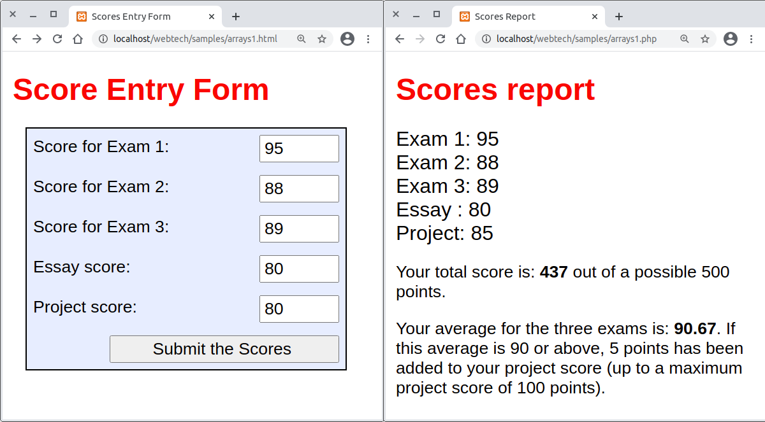
Sample Interaction: arrays1
Chapter 11

Slide 25
Arrays of Strings
Arrays can be used to store any type of data, including character strings. It can be useful to use standard messages in multiple applications, for example, an array of error messages:
$errorMessage [0] = "ERROR: Form includes empty fields";
$errorMessage [1] = "ERROR: Non-numeric data found";
$errorMessage [2] = "ERROR: The value is out of range";
$errorMessage [3] = "ERROR: Incorrect User ID";
$errorMessage [4] = "ERROR: Incorrect Password”;
Chapter 11

Slide 26
Using an Array of Error Messages
Three examples:
if (empty ($hoursWorked) OR empty ($hourlyWage))
print ("<p>$errorMessage[0] </p>");
if ($score[0] < 0 OR $score[0] > 100)
print ("<p>$errorMessage[2] </p>");
if ($password != $correctPassword)
print ("<p>$errorMessage[4] </p>");
Chapter 11

Slide 27
Using a Variable as an Array Index
book-keeping: write a program that assigns a student to appropriate book-keeping course based on their estimated skill level as follows:
Level 0 BKG 101:Getting Started
Level 1 BKG 115: Book-Keeping Fundamentals
Level 2 BKG 120: Working with Spreadsheets
Level 3 BKG 130: Business Processes 1
Level 4 BKG 230: Business Processes 2
Level 5 BKG 240: Final Project, Starting a Business
Chapter 11

Slide 28
Form for book-keeping.html
<form action = "book-keeping.php" method = "post" >
<label>Rate your book-keeping experience:
<select name = "experience">
<option>0</option>
<option>1</option>
<option>2</option>
<option>3</option>
<option>4</option>
<option>5</option></select></label>
<input class = "submit" type = "submit" value = “Submit">
</form>
Chapter 11

Slide 29
Code for book-keeping.php
(Uses a variable as an array index)
$module[0] = "BKG 101:Getting Started";
$module[1] = "BKG 115: Book-Keeping Fundamentals";
$module[2] = "BKG 120: Working with Spreadsheets";
$module[3] = "BKG 130: Business Processes 1";
$module[4] = "BKG 230: Business Processes 2";
$module[5] = "BKG 240: Final Project, Starting a Business";
$experience = $_POST["experience"];
print("<p>Based on your experience, you should begin with</p>
<p><strong>".module[$experience]."</strong></p>");
Chapter 11

Slide 30
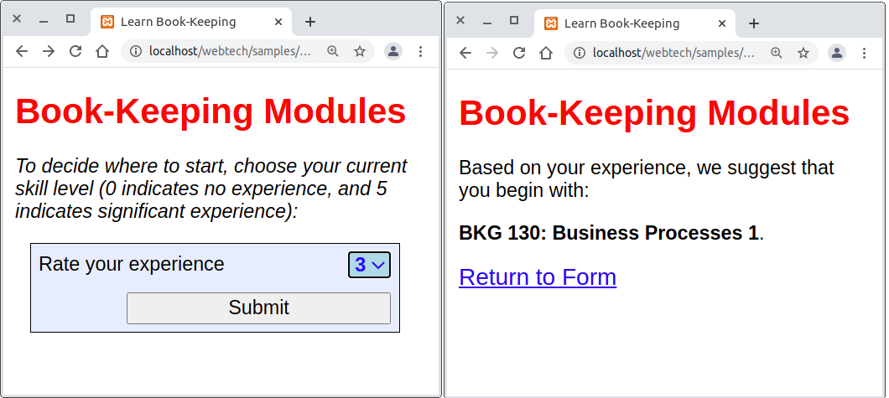
Book-keeping Example
Chapter 11

Slide 31
How Large is the Array?
Often termed the array length
In PHP, use the sizeof() function to obtain the length:
  sizeof($scores) will return 5 if there are 5 elements in the $scores array.
  The function returns the total number of elements in the array, not the value of the last index position (which would be 4 in this case).
Chapter 11

Slide 32
Why is the First Array Index 0?
All variables are names for memory locations.
The index value indicates how far is offset from the 1st memory location of the array.
$scores[2] is in a location that is 2 elements from the array's 1st memory location.
The 1st index position is 0 because this element is in a location that is 0 elements from the array's 1st memory location.
Chapter 11

Slide 33
Using FOR Loops with Arrays
We often want to process all of the values stored in an array. For example:
print ("<h1>SCORES</h1>
<table>
<tr><td>SCORE 1</td><td>$scores[0]</td></tr>
<tr><td>SCORE 2</td><td>$scores[1]</td></tr>
<tr><td>SCORE 3</td><td>$scores[2]</td></tr>
<tr><td>SCORE 4</td><td>$scores[3]</td></tr>
<tr><td>SCORE 5</td><td>$scores[4]</td></tr>
</table>");
Chapter 11

Slide 34
Using FOR Loops with Arrays
Another example. The following statement finds the sum of the five values in the $scores array:
$totalScore = $scores[0] + $scores[1] + $scores[2] +
$scores[3] + $scores[4];
What if we needed to modify the code to handle 6 scores, or 100 scores, or 1000 scores?
Chapter 11

Slide 35
Using FOR Loops with Arrays
We can use a FOR loop to count from 0 to the last index position in an array.
The loop variable can be used to refer to the next array index each time the loop repeats:
for ($index = 0; $index < 5; $index = $index + 1)
{
print("<p>$scores[$index ]</p>");
}
Chapter 11

Slide 36
Using FOR Loops with Arrays
The loop variable $index is used inside the loop as the array index.
Note that the loop condition is $index < 5 and not $index <= 5 since the last array index is 4.
For 100 elements, just change $index < 5 to $index < 100 in the loop heading.
Often programmers use very simple names such as $i or $j for loop counting variables.
Chapter 11

Slide 37
Using the sizeof() Function
You can use the sizeof() function to control the number of times that the loop repeats:
for ($i = 0; $i < sizeof($scores); $i = $i + 1)
{
print("<p>$scores[$i]</p>");
}
Now the loop processes the entire array no matter how many elements are in the array!
Chapter 11

Slide 38
Summing and Averaging Array Values
  $sum = 0;
  for ($i = 0; $i < sizeof($scores); $i = $i + 1)
  {
  $sum = $sum + $scores [$i];
  }
  $average = $sum / sizeof($scores);
This code uses sizeof() so it will work for any size array.
Chapter 11

Slide 39
Counting Selected Values in an Array
This FOR loop includes an IF structure to count the number of passing scores in the $scores array:
$numPassingScores = 0;
for ($i = 0; $i < sizeof($scores); $i = $i + 1)
{
if ($scores [$i] >= 60)
$numPassingScores = $numPassingScores + 1;
}
Chapter 11

Slide 40
Multiple Operations on an Array
The following example (arrays2) uses a single FOR Loop to:
  Create an array of 10 scores
  Display the scores in a table
  Calculate the sum and average
  Count the number of passing and failing scores
  Display the results
Chapter 11

Slide 41
Code for arrays2.php (page 1 of 3)
<?php
$scores = array(80, 55, 75, 97, 88, 82, 59, 60, 96, 78);
$sum = 0;
$numPassingScores = 0;
print("<h1>SCORES REPORT</h1>");
print("<table>");
Chapter 11

Slide 42
Code for arrays2.php (page 2 of 3)
for($i = 0; $i < sizeof($scores); $i = $i + 1)
{
$scoreNum = $i + 1;
print ("<tr><td>SCORE $scoreNum</td>
<td>$scores[$i]</td></tr>");
$sum = $sum + $scores[$i];
if ($scores[$i] >= 60)
$numPassingScores = $numPassingScores + 1; }
print("</table>");
Chapter 11

Slide 43
Code for arrays2.php (page 3 of 3)
$numFailingScores = sizeof($scores) - $numPassingScores;
$average = $sum / sizeof($scores);
print ("<p>AVERAGE SCORE: $average <br>");
print ("NUMBER OF PASSING SCORES:
$numPassingScores <br>");
print ("NUMBER OF FAILING SCORES:
$numFailingScores </p>");
?>
Chapter 11

Slide 44
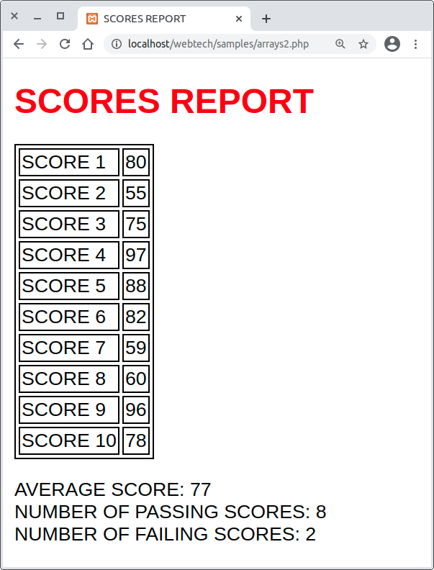
Output from arrays2
Chapter 11

Slide 45
Reading Data from a File into an Array
We have already seen how to read and process lines of data stored in a file.
We can also first read data from a file into an array, then process the data in the array.
  The file can be closed before the data is processed
  .. And this means we can separate the code to read the file from the code to process the data
  .. But this requires more memory to store the array, which might an issue working with very large files.
Chapter 11

Slide 46
Reading Data from a File into an Array
arrays3 requirement (look familiar?):
Write a program that processes a file named rainfall2007.txt. The file contains the year followed by 12 monthly rainfall amounts, each on a separate line. The program should display the year, total rainfall for the year, the average monthly rainfall, highest monthly rainfall amount and lowest monthly rainfall amount.
Chapter 11

Slide 47
Code for arrays3.php (page 1 of 3)
<?php
// first read the data from the file into an array
$rainDataFile =fopen("rainfall2007.txt","r");
$year = trim(fgets($rainDataFile));
for ($i = 0; $i < 12; $i = $i + 1)
{
$rainfall [$i] = trim(fgets($rainDataFile));
}
fclose($rainDataFile); // now we can release the file faster
Chapter 11

Slide 48
Code for arrays3.php (page 2 of 3)
// next process the array
$totalRainfall = 0;
for ($i = 0; $i < sizeof($rainfall); $i = $i + 1)
{
$totalRainfall = $totalRainfall + $rainfall [$i];
if ($i == 0 OR $rainfall [$i] > $highestRainfall)
$highestRainfall = $rainfall [$i] ;
if ($i == 0 OR $rainfall [$i] < $lowestRainfall)
$lowestRainfall = $rainfall [$i] ; }
Chapter 11

Slide 49
Code for arrays3.php (page 3 of 3)
$avgRainfall = $totalRainfall / sizeof($rainfall);
print ("<h1>RAINFALL SUMMARY FOR $year</h1>");
print("<p>TOTAL RAINFALL: $totalRainfall.</p>");
print("<p>AVERAGE MONTHLY RAINFALL:
$avgRainfall.</p>");
print("<p>HIGHEST MONTHLY RAINFALL:
$highestRainfall.</p>");
print("<p>LOWEST MONTHLY RAINFALL:
$lowestRainfall.</p>");
?>
Chapter 11

Slide 50
Reading Data into an Array from a File of Unknown Length
Use a counting variable with a WHILE loop:
$scoreFile =fopen("scores1.txt", "r");
$i = 0;
$score[$i] = trim(fgets($scoreFile));
while (!feof($scoreFile))
{
$scores[$i] = trim(fgets($scoreFile));
$i = $i + 1;
}
fclose($scoreFile);
Chapter 11

Slide 51
Using [] with no Index Value
This improved code uses [] to automatically increment the array index:
$scoreFile =fopen("scores1.txt", "r");
$score[] = trim(fgets($scoreFile));
while (!feof($scoreFile))
{
$score[]=trim(fgets($scoreFile));
}
fclose($scoreFile);
Chapter 11

Slide 52
Reading Selected Data into an Array (Passing Scores Only)
  $scoreFile = fopen("scores1.txt", "r");
  $nextScore = trim(fgets($scoreFile));
  while (!feof($scoreFile))
  {
  if ($nextScore >= 60)
  $passingScores[] = $nextScore;
  $nextScore = trim(fgets($scoreFile));
  }
  fclose($scoreFile);
Chapter 11

Slide 53
Reading from a File into Multiple Arrays (Passing and Failing Scores)
  $scoreFile = fopen("scores1.txt", "r");
  $nextScore = trim(fgets($scoreFile));
  while (!feof($scoreFile))
  {
  if ($nextScore >= 60)
  $passingScores [] = $nextScore;
  else
  $failingScores [] = $nextScore;
  $nextScore = trim(fgets($scoreFile));
  }
  fclose($scoreFile);
Chapter 11

Slide 54
Reading Selected Data from a File of Records into an Array
scores5.txt contains the gender and score of each student, for example :
    m:70
    f:85
    f:69
(other genders might be included)
To read all the scores (any gender) from this file into an array, use the explode() and list() functions to extract gender and score, but only use the score…
Chapter 11

Slide 55
Reading Selected Data from a File of Records into an Array
  $scoreFile = fopen("scores5.txt", "r");
  $nextRecord = trim(fgets($scoreFile));
  while (!feof($scoreFile))
  {
  list($gender, $score) = explode(":", $nextRecord);
  $scores[] = $score;
  $nextRecord = trim(fgets($scoreFile));
  }
  fclose($scoreFile);
Chapter 11

Slide 56
Extracting Male and Female Scores into Different Arrays (arrays6)
    $scoreFile = fopen("scores5.txt", "r");
    $nextRecord = trim(fgets($scoreFile));
    while (!feof($scoreFile))
    {
    list($gender, $score) = explode(":", $nextRecord);
    if ($gender =="f")
    $femaleScores[] = $score;
    else
    $maleScores[] = $score;
    $nextRecord = trim(fgets($scoreFile));
    }
    fclose($scoreFile);
Chapter 11

Slide 57
More About the explode() and list() Functions
Assume $appointment contains a string containing four values:
    $appointment = "Dentist:10:15:AM ";
We can use list() and explode() to extract the four values and store these in variables:
  list($appointmentType, $hour, $minutes, $timeOfDay) = explode(":", $appointment);
But what is actually happening here?
Chapter 11

Slide 58
More About the explode() and list() Functions
explode() receives ":" and "Dentist:10:15:AM" and returns an array containing four values:
  Array element [0] contains "Dentist"
  Array element [1] contains "10"
  Array element [2] contains "15"
  Array element [3] contains "AM"
list() receives the array from explode() and stores each array value into one of the variables listed as an argument.
Chapter 11

Slide 59
The explode() Function can be Used Independently of list()
We can assign the array returned by the explode() function to a variable:
    $myAppointment = explode(":", $appointment);
The $myAppointment variable now contains an array with four values, for example:
  $myAppointment[0] contains "Dentist"
  $myAppointment[1] contains "10"
  $myAppointment[2] contains "15"
  $myAppointment[3] contains "AM"
Chapter 11

Slide 60
The list() Function can be Used Independently of explode()
list() can be used to store values from any array into separate variables, for example :
    $regionalSales = array(3245, 4674, 1674, 5878);
You canto assign these array values into separate named variables using list():
    list($northRegion, $southRegion, $westRegion, $eastRegion) = $regionalSales;
Chapter 11

Slide 61
Using the FOREACH Loop
The FOREACH loop can be used to easily process array elements in turn:
foreach ($arrayName as $variable)
{
loop instructions here
}
$variable will automatically receive the value of the next element of $arrayName for each repetition of the loop.
Chapter 11

Slide 62
Example of a FOREACH Loop
$total = 0;
foreach ($scores as $nextScore)
{
$total = $total + $nextScore;
}
A FOREACH loop can only be used:
  When the entire array is to be processed
  When the loop code does not need to modify an element
  When there is no need to refer to more than one element in a single repetition
Chapter 11

Slide 63
Multi-Dimensional Arrays
Our array examples have stored a single value in each element
  A "1-dimensional" array...
But each array element can be assigned an entire array, not just a single value
  An array of arrays (a "2-dimensional" array)...
And these arrays can also contain arrays
  Multi-dimensional arrays may have any number of dimensions
Chapter 11

Slide 64
Multi-dimensional Arrays
Multi-dimensional arrays are extremely important for storing and processing data of all kinds:
  Topological data
  Weather data
  Flight trajectories and paths through 3-dimensional space
  Mathematical models
  Game environments
Chapter 16 shows how to create and work with multi-dimensional arrays.
Chapter 11

Slide 65
Chapter 11

