Slide 1
FIO Stop Data

Slide 2
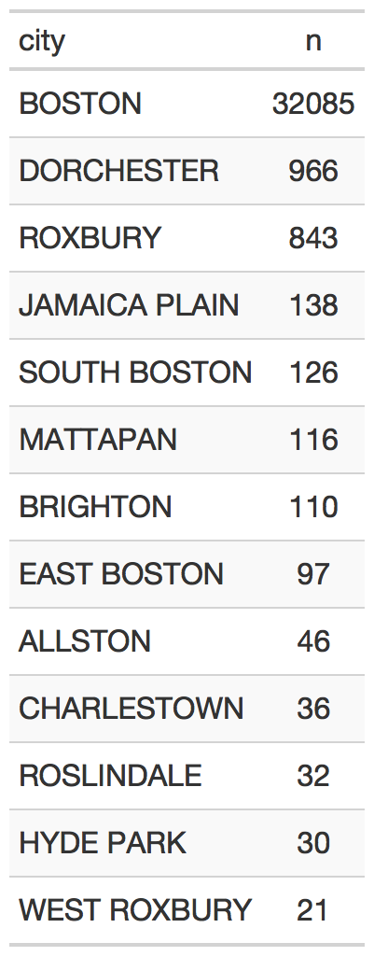
Info about data
2016* - 12/31/2019
Two databases:
Event-level database includes:
Date, officer, location**
Activities: frisking, search person, search vehicle, issue summons
Circumstance, basis, contact reason
Individual level database (linked to event database)
Sex
Race, ethnicity
(Sometimes) other appearance details: hair style, build, clothing, skin tone
Activities: frisking/searching
*Up through 2015, data is incomplete and messy because BPD transitioned databases in 2015. I’m focusing analysis on 2016-2019
** We always have the zip code, and in 9048/34902 (26%) we also have street address, but we don’t have street address for any 2019 data
*Includes only events where location is listed and cities with more than 5 events

Slide 3
Summary
 | 2016 | 2017 | 2018 | 2019
Encountered | 2,050 | 2,053 | 2,128 | 1,947
Observed | 1,332 | 1,408 | 1,312 | 1,231
Stopped | 5,666 | 5,348 | 5,268 | 5,159
Total | 9,048 | 8,809 | 8,708 | 8,337
Events
 | 2016 | 2017 | 2018 | 2019
Frisked | 2,659 | 2,275 | 2,295 | 1,773
Searched | 1,180 | 940 | 1,029 | 787
 | 2016 | 2017 | 2018 | 2019
Total | 14,994 | 15,017 | 14,093 | 14,444
Individuals*
*Not unique individuals. In other words, if an individual is stopped more than once, each stop is counted as another “individual”

Slide 4
Race
 | 2016 | 2017 | 2018 | 2019
Black | 10,398 (69%) | 10,429 (69%) | 9,179 (65%) | 9,974 (69%)
White | 3,653 (24%) | 3,625 (24%) | 3,959 (28%) | 3,579 (24%)
Other/Unknown | 792 (5%) | 835 (5%) | 859 (6%) | 807 (5%)
Asian | 120 (1%) | 115 (1%) | 90 (1%) | 73 (1%)
Native Hawaiian/ Pacific Islander | 20 | 6 | 1 | 7
Native American/ Alaskan Native | 11 | 7 | 5 | 4

Slide 5
Ethnicity
 | 2016 | 2017 | 2018 | 2019
Of Hispanic Origin | 2,265 (15%) | 2,333 (16%) | 2,311 (16%) | 2,146 (15%)
Not of Hispanic Origin | 6,920 (46%) | 7,891 (52%) | 7,150 (51%) | 7,545 (52%)
Other/Unknown | 5,809 (39%) | 4,793 (32%) | 4,632 (32%) | 4,753 (33%)

Slide 6
Black or Hispanic
 | 2016 | 2017 | 2018 | 2019
Black or Hispanic | 11,800 | 11,862 | 10,609 | 11,263
 | (79%) | (79%) | (75%) | (78%)
Takes a one if the individual is identified as black or Hispanic, even if the individual is identified as white Hispanic

Slide 7
Stop Breakdowns- what additional info would be helpful?
By location, by year
By zip code- are stops representative by race at the zip code level?
Ideally, we’d want to match crime data by zip code to the fio data; I have to look into whether we can find that

