Slide 1

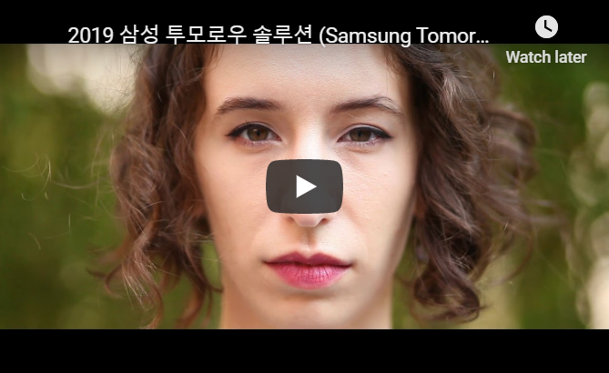
What It Does
How It works
Who We Are
Contact Us
SeeSure is a mobile application that allows patients with epilepsy manage their seizures and health better.
What It Does

Slide 2
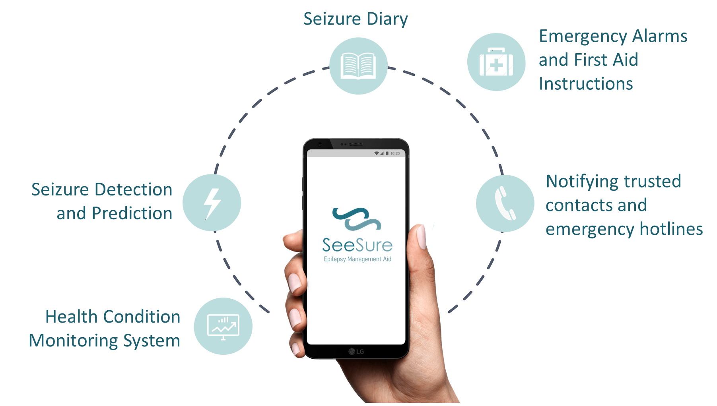
What It Does
How It works
Who We Are
Contact Us
What It Does

Slide 3
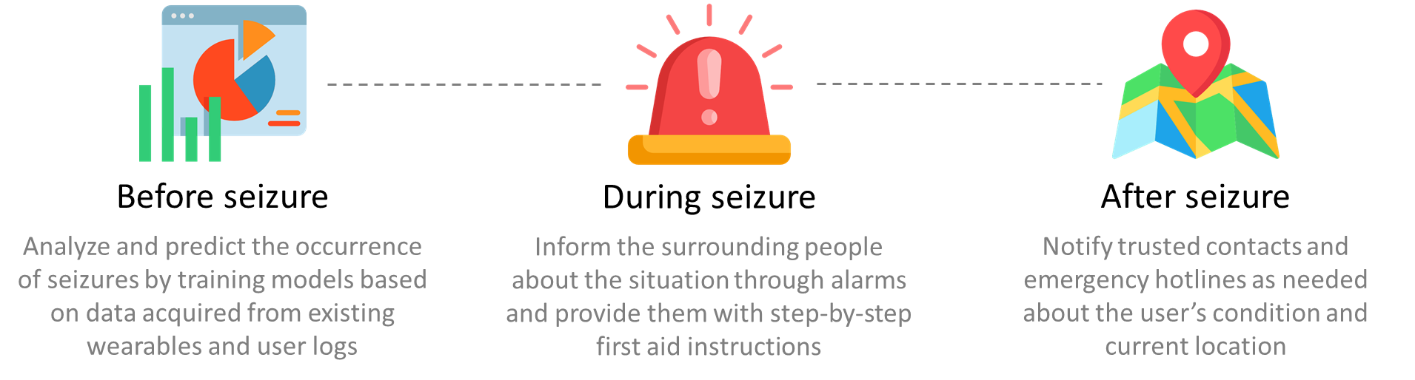
What It Does
How It works
Who We Are
Contact Us
The application is able to monitor the health condition of the patient through the data from the Seizure Diary and sensor data from a smartwatch. Using a specialized algorithm it also aims to detect and predict seizure occurrences. Once a seizure is detected, emergency mode will be activated.

Slide 4
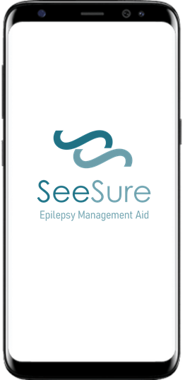

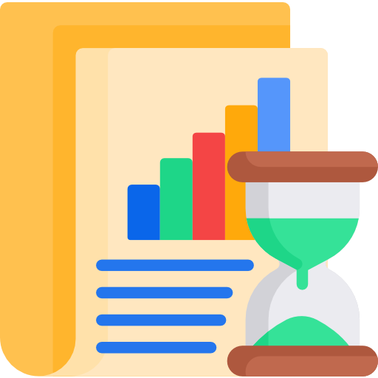
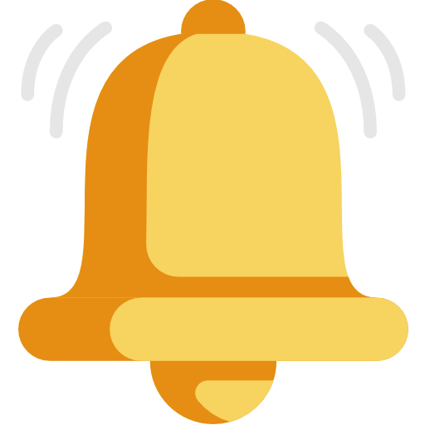

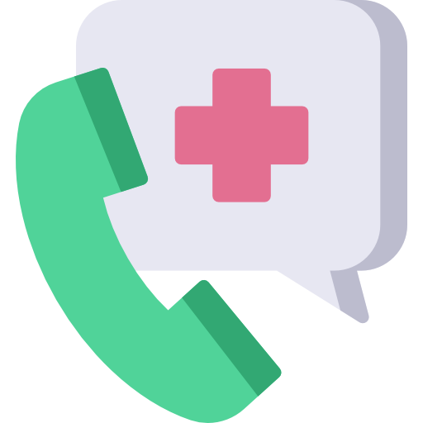
What It Does
How It works
Who We Are
Contact Us
How It Works
Collects data from user input and health bands
Provides seizure analysis and predictions
Notifies bystanders through alarms
Provides first aid instructions
Notifies emergency hotlines and trusted contacts, if necessary
Collects data from seizure occurrence to improve forecasts

Slide 5
What It Does
How It works
Who We Are
Contact Us
Data collected from the smartwatch and seizure diary are analyzed through a machine learning algorithm that will predict possible seizure occurrences. The longer the patient uses the application the predictive accuracy will increase and patient-specific seizure patterns can be identified.
Check out how we handle and analyze data

Slide 6
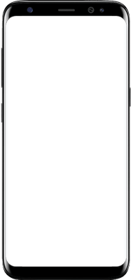
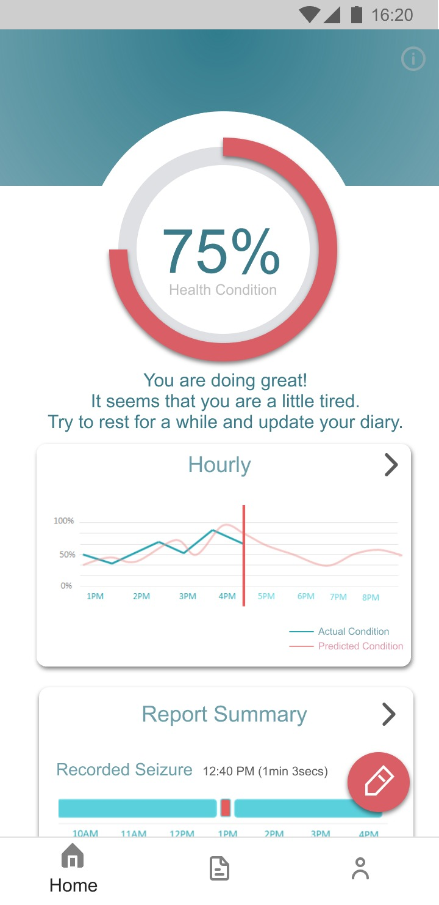
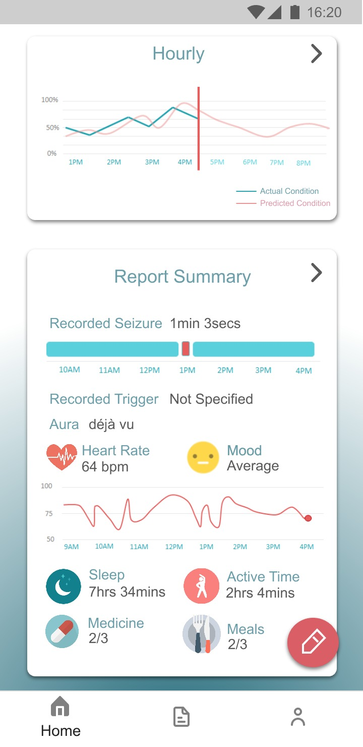
What It Does
How It works
Who We Are
Contact Us
DAILY FORECAST
HEALTH CONDITION
Through the prediction algorithm the app displays an hourly forecast of the user’s health condition, helping them get hints about incoming seizures
Instead of displaying the probability of having a seizure, the app will display the user’s current health condition. In this way, it focuses on motivating the users to improve and maintain one’s health condition and it also helps to reduce their anxiety.
SEIZURE RECORD
Seizure data occurrences are recorded. Triggers and auras are also reported in order for the user to gain insight about their seizure patterns
DETAILED FEEDBACK
The app provides feedback according to the user’s current health condition. The feedback includes suggestions in order to improve one’s health condition
HEALTH-RELATED INFO
Data gathered from the in-app diary and smartwatches are summarized and displayed in the app’s main page
Check out our mobile app wireframes

Slide 7
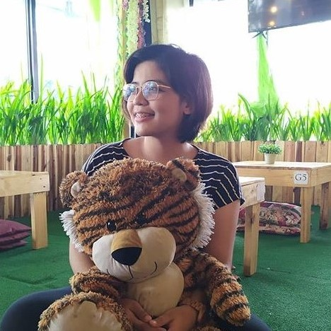

What It Does
How It works
Who We Are
Contact Us
Who We Are
Alysson Alvaran
May Jorella Lazaro (엘라)
Software Engineer. Python Tech Lead at Women Who Code Manila. Board Member at Python Philippines.
Psychometrician. Cognitive Science and UX Researcher at Human Interface Systems Lab, Seoul National University.
Personal Website | LinkedIn | Instagram
HIS Website | LinkedIn | Instagram

