Slide 1

Construction Spendings Predictions and Analysis
COMPREHENSIVE ANALYSIS OF CONSTRUCTION SPENDING USING MACHINE LEARNING: AN XG BOOST APPROACH

Slide 2
Introduction
The construction industry is a cornerstone of economic growth, significantly impacting GDP and national development projects.
Effective construction spending decisions are vital for optimizing resources and ensuring project success.
Predictive analytics, using machine learning models like XGBoost, enables stakeholders to anticipate future spending trends with high accuracy.
This report provides a comprehensive analysis, focusing on understanding past spending patterns and developing robust models for future predictions.
Structure:
Problem statement
Literature review
Data preparation
Model implementation and results

Slide 3
Problem Statement
Construction spending involves a dynamic interplay of various factors, including economic conditions, material costs, and labor availability.
Two core objectives drive this study:
Identify patterns and trends in historical data to gain insights into seasonal and sectoral variations.
Build a reliable predictive model to forecast future spending, aiding resource planning and strategic investments.
Addressing these objectives equips policymakers and businesses with data-driven insights for decision-making, improving budget allocation and resource management.
Example Problems Addressed:
Seasonal fluctuations causing resource misalignment.
Lack of reliable forecasting methods for public infrastructure projects.

Slide 4
Literature Review
The construction sector has traditionally relied on time-series analysis for trend forecasting; however, this method falls short when dealing with complex, multivariate datasets.
Machine learning techniques, especially ensemble methods like XGBoost, offer advanced predictive capabilities:
Consideration of external factors such as weather, material prices, and labor availability.
Enhanced ability to handle nonlinear relationships and large datasets.
Studies have demonstrated XGBoost's effectiveness in sectors requiring complex forecasting, highlighting its potential in the construction industry.
Key finding: Incorporating machine learning into construction planning can reduce costs, optimize schedules, and improve resource allocation.

Slide 5
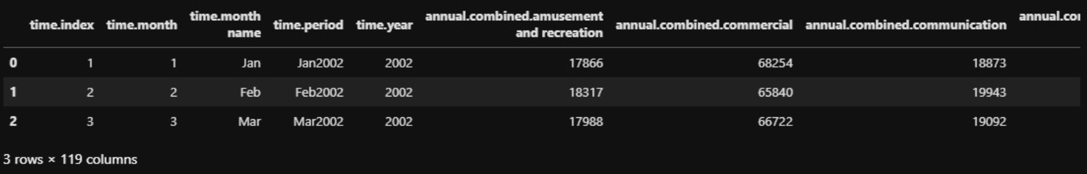
Dataset Description
The dataset comprises 169 rows and 119 columns, detailing construction spending across various sectors over time.
Features include:
Time Information: Year, month, quarter, and specific periods (e.g., Jan 2002).
Spending Categories: Annual and monthly expenditures on amusement, recreation, education, infrastructure, and more.
Public vs Private Spending: Distinction between government-funded and privately funded projects.

Slide 6
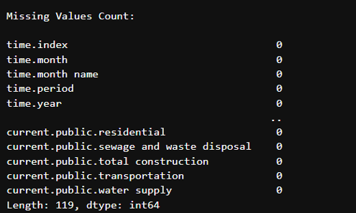
Data Cleaning
Comprehensive cleaning ensures data integrity and model accuracy.
Observations:
No missing values detected in the dataset.
Columns with constant or non-contributory values were removed to enhance model efficiency.

Slide 7
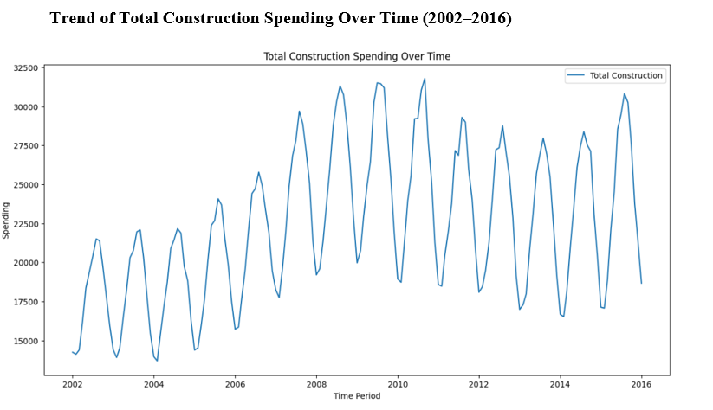
Exploratory Data Analysis (EDA)
EDA reveals critical patterns and relationships in construction spending:
Trend Analysis: A consistent upward trend over the years, with seasonal peaks and troughs.

Slide 8
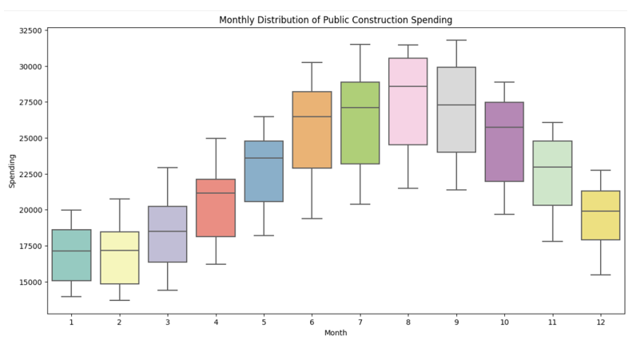
Monthly Variations: Higher spending in summer (June–October), with noticeable declines in winter (November–January).

Slide 9
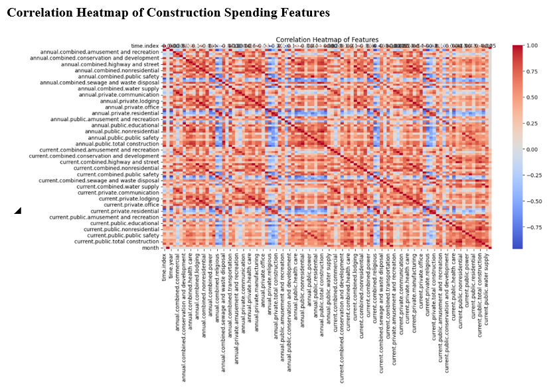
Correlation Analysis: Identifies strong relationships among sectoral spending categories, aiding feature selection.

Slide 10
Feature Engineering
Techniques used to create new features and improve model performance:
Time-Based Features: Year, month, quarter, and seasonal indicators provide temporal context.
Lagged Features: Capture dependencies on past spending patterns.
Rolling Averages: Smooth short-term fluctuations for better trend detection.
Growth Rates: Highlight sectoral performance over time.
Cyclic Transformations: Sine and cosine encoding captures month-to-month continuity.

Slide 11
Preprocessing Steps
Preparing the dataset for machine learning:
Numeric and categorical data transformations.
One-hot encoding for non-numeric data.
Cyclic transformation for months to capture seasonality.
Aligning training and testing datasets to ensure consistency.

Slide 12
Implementation of XGBoost
XGBoost workflow:
Data preparation: Splitting into training and testing sets.
Model training: Parameter tuning for optimal performance.
Prediction: Forecasting total construction spending with high accuracy.
Advantages of XGBoost:
Handles complex, high-dimensional data effectively.
Captures nonlinear relationships and interactions between features.

Slide 13
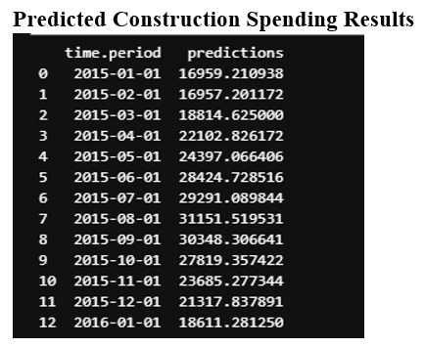
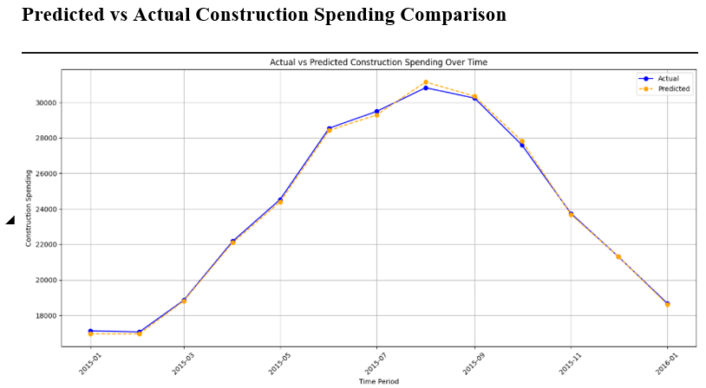
Results
Predicted vs actual spending values indicate strong model accuracy.
Seasonal trends (e.g., mid-year peaks) are captured effectively.
High correlation between predictions and actual values demonstrates model reliability.

