Slide 1
Carbon Emission Analysis
DATA 5100, Final Project
By: Alyssa, Ben, Travis
Notes:
Hello everyone, and thank you for being here.
In this presentation we will be sharing our final group project for data 5100, briefly titled “Carbon Emission Analysis”

Slide 2
Agenda
Data Description
Introduction
Analysis
Domain Problem
Libraries Used
Data Sources
Collection + Preparation
Methodology
Timeline of Analysis
EDA Overview
Results
Conclusion
Model Results
Testing Results
Expansions
Key Takeaways
Notes:
Here’s a quick overview of what we’ll cover today:
Introduction
We’ll start by framing the problem and explaining why understanding renewable energy transitions matters.
Data Description
Next, we’ll describe the datasets we used — where they come from, what variables we focused on, and how we prepared the data through cleaning and merging.
Analysis
Then we’ll walk through our methodology and an overview of our analysis, including initially observed relationships..
Results
After that, we’ll summarize the key results from our analysis — what the trends show, how strong the relationships are, and any statistical patterns that emerged.
Discussion
Finally, we’ll interpret what these results might mean, address limitations, and offer possible extensions for future analysis.
And with that structure in mind, let’s begin.

Slide 3
Introduction
Domain Problem
Libraries Used

Slide 4
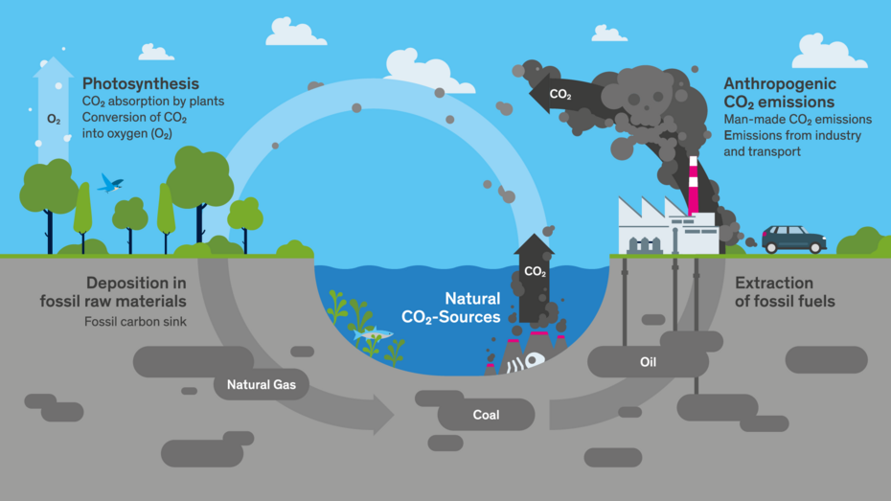
What is Carbon Dioxide Emission?
https://www.myclimate.org/en/information/faq/faq-detail/what-is-co2-and-where-does-it-come-from/
Notes:
Carbon dioxide (CO₂) is a colourless and odourless gas that is a natural component of the air and part of the global carbon cycle. It plays an important role in photosynthesis, in which plants convert CO₂ into oxygen. At the same time, CO₂ is a significant greenhouse gas that contributes to global warming and climate change

Slide 5

Domain Problem
“Is higher share of renewable energy in total energy supply associated with lower per-capita CO₂ emissions?”
Notes:
Our project explores how renewable energy use relates to a country’s CO₂ emissions.
Climate change is a global issue, and understanding the factors that drive carbon emissions is essential for planning sustainable energy transitions.
In this analysis, we focus specifically on the question: Do higher shares of renewable energy actually help countries reduce their emissions per capita?
To answer this, we combined international renewable energy datasets, cleaned and merged them, and then used visual and statistical methods to study the relationship.
Today, we’ll walk you through what we found, how we approached the analysis, and what it might mean for policymakers and future researchers.”

Slide 6
Python Libraries
Data Processing
Cleaning and Standardization
Visualization
Statistical plots and Styling
Modeling
Regression and Features
pandas - ETL and Merging
seaborn - Heatmaps, Scatterplots
Statsmodels - Fixed Effects, Robust SE
numpy - Numerical operations
matplotlib - Fine tuning, styling
Scikit-Learn - Lagged features
pycountry - ISO-3 codes
Notes:
Python Libraries
For data processing, we relied heavily on `pandas` for cleaning, transforming, and merging the different datasets, and `numpy` for numerical operations, especially when creating log-transformed variables. We also used `pycountry` to standardize country names and ISO-3 codes, which was important because our data came from multiple international sources that didn’t always use consistent naming.
For our visualizations, we used seaborn and matplotlib.
`Seaborn` was able to give us clean, statistical plots like scatterplots, histograms, and heatmaps, and `Matplotlib` allowed us to fine tune figure sizes and styling so the visuals would be consistent in the final report.
On the modeling side, we used `statsmodels` to run the fixed effects regressions and apply cluster robust standard errors. We also used some utilities from `scikit-learn`, mainly for generating lagged features and basic preprocessing.
Finally, since our team worked in a shared environment, we used Google Colab to run the notebooks and manage files in a cloud-based workspace.
Overall, these libraries gave us our complete workflow: from data cleaning, to visualization, to statistical modeling.

Slide 7
Data
Data Sources
Data Preparation

Slide 8
Data Sources
International Energy Agency (IEA) - Global Energy Review
  Electricity generation by source
  Annual country level data, 2010 - 2024
Global Carbon Atlas - Global Carbon Atlas Database
  CO2 emissions per capita
  Cross country reporting
World Bank Group - World Development Indicators
  Gross Domestic Product (GDP)
  Population
  Country level indicators
Notes:
Data Sources
For our project, we combined data from three major international sources to build a multi-country panel covering the years 2010 through 2024.
First, the International Energy Agency, provided electricity generation data broken down by source—hydroelectric, wind, solar, nuclear, bioenergy, and fossil fuels. From this, we calculated each country’s renewable energy share, which is our main predictor variable.
Next, we used the Global Carbon Project, which reports CO₂ emissions per capita. This served as our main outcome variable, and it gave us consistent, comparable measurements across countries and years.
Finally, we pulled economic and demographic indicators from the World Bank Group’s World Development Indicators, including Gross Domestic Product or GDP, GDP per capita, and population data. These variables help us control for economic scale and structural differences between countries.
Together, these datasets allow us to build a dataset where each country-year has information on renewable energy, emissions, and economic factors.

Slide 9
Data Preparation
Standardization
Merge and Filter
Engineering
Cleaned individual data sets
Kept only countries in all 3 sources.
Log transformations
Removed regions / aggregates
Lagged features 1 and 2 years
Applied ISO-3 Codes
Merged on ISO-3 and Year
Final data set - 140 countries
Notes:
Data Preparation
For data preparation, we first cleaned each dataset separately and standardized all country identifiers using ISO-3 codes, which is the international standard for country codes. Once everything was standardized, we checked which countries were actually present in all three datasets — the IEA data, the Global Carbon Atlas data, and the World Bank Groups’ data.
This step was important because not every country appears consistently across all sources. We also removed entries that weren’t true individual countries, like grouped regions or territories with incomplete reporting.
After identifying the shared set of countries, we merged the datasets using the ISO-3 code and year. This produced a single data set where each row corresponds to one country-year with complete information on renewable energy, CO₂ emissions, and GDP.
From there, we engineered the variables needed for analysis. We performed a log-transformation on CO₂ per capita and GDP per capita to reduce skew and make coefficients a little easier to interpret. We also created one-year and two-year lags of renewable share, since the impact of renewable adoption may not be immediate.
After all these steps, we ended up with a data set of roughly 140 countries ranging from 2010 to 2024 that we could use in our full analysis.

Slide 10
Analysis
Methodology
Timeline of Analysis
EDA Overview

Slide 11
Methodology
Study Design
  Comparative observational study
  Quantitative, correlational analysis
  Multi-country panel data set
Key Variables
  CO2 emissions per capita
  Renewable energy share
  Gross Domestic Product per Capita
  Population
  Country identifiers
    ISO - 3 Codes
  Year
Notes:
Methodology
Our methodology is based on a comparative observational study using quantitative, correlational analysis. We constructed a multi-country panel dataset covering annual observations from 2010 to 2024. This structure allowed us to examine how renewable energy shares and CO₂ emissions change over time within countries, rather than relying only on cross-sectional comparisons.
The key variables we focused on were CO₂ emissions per capita, renewable energy share, GDP per capita, and population, along with country and year identifiers. These variables allow us to control for country-specific characteristics and economic conditions while exploring the relationship between renewable adoption and emissions.

Slide 12
Timeline of Analysis
Initial analysis of the data sources used.
Exploratory analysis of relationships between key variables + Testing accuracy.
Key takeaways from our analysis
Initial Analysis
Preparation
Analysis
Expansions
Conclusions
Data Collection & Data Preparation
Explore into the “why” and “how” to possibly explain/expand on observations.
Notes:
Here you can see a timeline of our analysis process…starting off with the initial analysis of our imported data, the steps taken to clean/prep/merge the data, and the EDA, statistical testing, and expansions that lead us to the results we are sharing today.

Slide 13
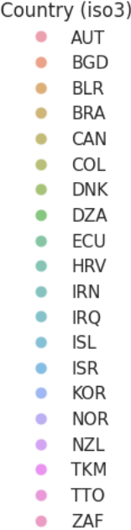
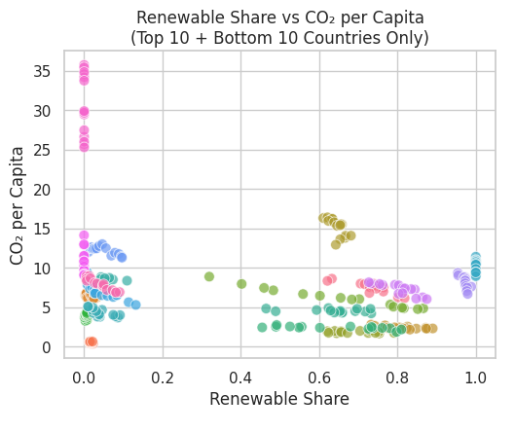
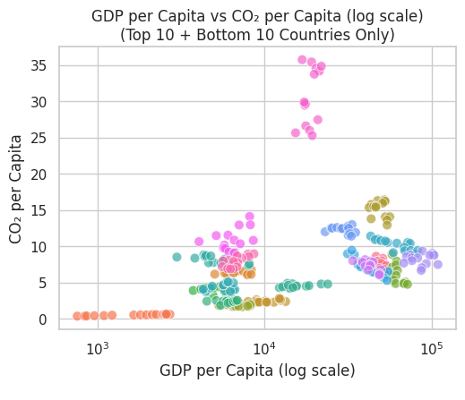
Exploratory Data Analysis
Notes:
We began our exploratory data analysis (EDA) by comparing relationships amongst the 3 variables of interest – CO₂ emissions, renewable energy shares, and economic growth/GDP per capita .
We found the ten countries with the highest and lowest renewable electricity shares within our dataset… all color coded based off the key to the right,
Visual 1 on the left– shows how the relationship between CO₂ emissions and renewable energy shares per capita changed over time for these 20 countries. You can see many data points of the same colors, which represent that countries data point for each year in 2010-2024?
Visual 2 on the right displays – The relationship between CO2 emissions and economic growth (GDP) for these same 20 countries across the same timespan.
Comparing renewable energy share and CO₂ emissions per capita suggests an overall negative relationship between the two – meaning that countries with more renewable electricity tend to have lower CO₂ emissions. This relationship, however, is more complex with the data showing significant variation: countries with similar renewable energy shares and economic output… often show different CO₂ emissions per capita. This finding sparked deeper analysis which will be explained further in the expansions portion of this presentation.

Slide 14
Results
EDA
Fixed Effects Panel Regression
Model Quality & Statistical Results
Lag Analysis
Robustness Checks
Interpretation of Model Performance
Expansion Analysis

Slide 15
Fixed Effects Panel Regression Results
Do Renewables Reduce CO₂ emissions?
Country-year panel model (2010-2024)
Controls for all time-invariant country factors + global year shocks
Key predictors
  Renewable energy share
  GDP per capita
Main finding: Higher renewable share → lower CO₂ emissions per capita
Effects remain after controlling for economic conditions

Slide 16
Model Quality & Statistical Results
What’s our evaluation of the model quality?
High explanatory power (R² ≈ 0.985 in baseline fixed effects model)
Strong statistical significance for key variables
Renewable share coefficient
  Negative, statistically significant (p < 0.001)
  Suggests measurable emissions reduction
GDP per capita: positive and significant, consistent with higher energy demand

Slide 17
Lag Analysis
Do Renewables Reduce Emissions Immediately or Over Time?
Tested 1-year and 2-year lags of renewable share
Current-year coefficient: large, negative significant
1-year lag: smaller but still negative and significant
2-year lag: negative but not statistically significant
Interpretation: strongest impact occurs in year of adoption and the following year

Slide 18
Robustness Checks
Do the Results Hold Under Different Assumptions?
Removed outlier countries (very high/low emissions or renewable share)
Re-estimated the lag model
Effects remain negative and stable
  Signs of coefficients unchanged
  Magnitudes highly similar
  Main conclusions remain intact
Confirms findings are not driven by a few extreme cases
Strengthens confidence in overall conclusions

Slide 19
Interpretation of Model Performance
How Well Do the Models Answer the Research Question?
Clear and consistent evidence across all models
Renewable share increase → lower CO₂ per capita
Effect appears to be both immediate and with a short-term lag
Supported by statistical significance and robustness
Models effectively answer the central research question

Slide 20
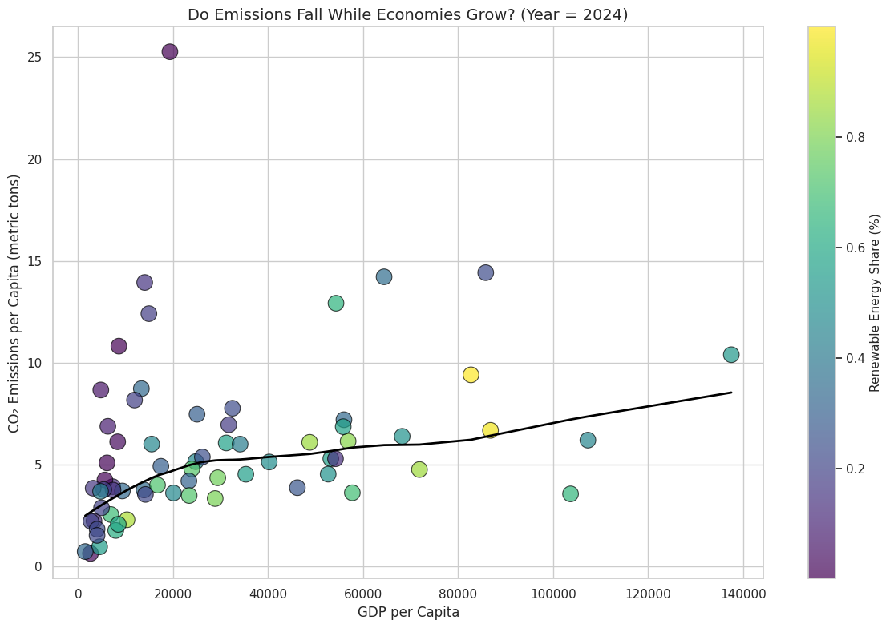
Expansions
Is it possible for CO₂ emissions to fall even when economies grow?
Higher renewable share →
generally lower CO₂ per capita
Emissions can flatten or decline at mid/high GDP levels
Economic growth does not automatically mean higher emissions
Clean energy makes “decoupling” growth from emissions possible
Notes:
The graph on the screen displays the relationship between GDP per capita and CO₂ emissions per capita in the most recent year of our data;
each point represents a country. And as you can see…Countries with a higher renewable share (lighter/larger points) tend to have lower emissions, even at similar GDP levels to other economies. The black trend line helps us see that at acertain economic output level, carbon dioxide emissions do not always keep rising and can even decline.
This suggests that, although CO₂ emissions are reported to increase as countries become wealthier, they do not have to.
If renewable energy adoption is high enough, CO₂ emissions per capita can level off or even go down while GDP continues to increase.

Slide 21
Conclusion
Key Takeaways

Slide 22
Key Takeaways
Higher renewable shares → lower CO₂ emissions per capita
Emissions can decline even with economic growth
Lag analysis shows reductions persist over future years
“Decoupling” the relationship: Renewable energy breaks the historic GDP–emissions link
Clean energy expansion supports sustainable development
Notes:
We set out to evaluate whether increasing the share of renewable energy in national electricity generation is meaningfully linked to reductions in carbon dioxide (CO₂) emissions.
our analysis consistently showed that countries with higher renewable electricity shares have lower CO₂ emissions per person.
Importantly, these reductions are observed to persist even when accounting for economic expansion, demonstrating that cleaner energy systems can indeed support climate progress without halting economic growth.
The results also suggest that the benefits of renewable shares are not limited to the year they are adopted. Evidence from our lag analysis indicates that emissions continue to decline in the years following increases in renewable electricity production.
Finally, although GPD per capita remained positively associated with carbon dioxide emissions overall, our analysis support a negative and statistically significant relationship between renewable energy adoption and CO₂ emissions per capita –
This supports the idea that renewable energy helps weaken the historic link between a population's growth and pollution (carbon emissions) … a key observation made that can support advocating for more aggressive transitions towards sustainable development, such as increasing renewable energy shares in electricity.

Slide 23
Thank You!
Notes:
Hello everyone, and thank you for being here.
In this presentation we will be sharing our final group project for data 5100, briefly titled “Carbon Emission Analysis”

