Slide 1
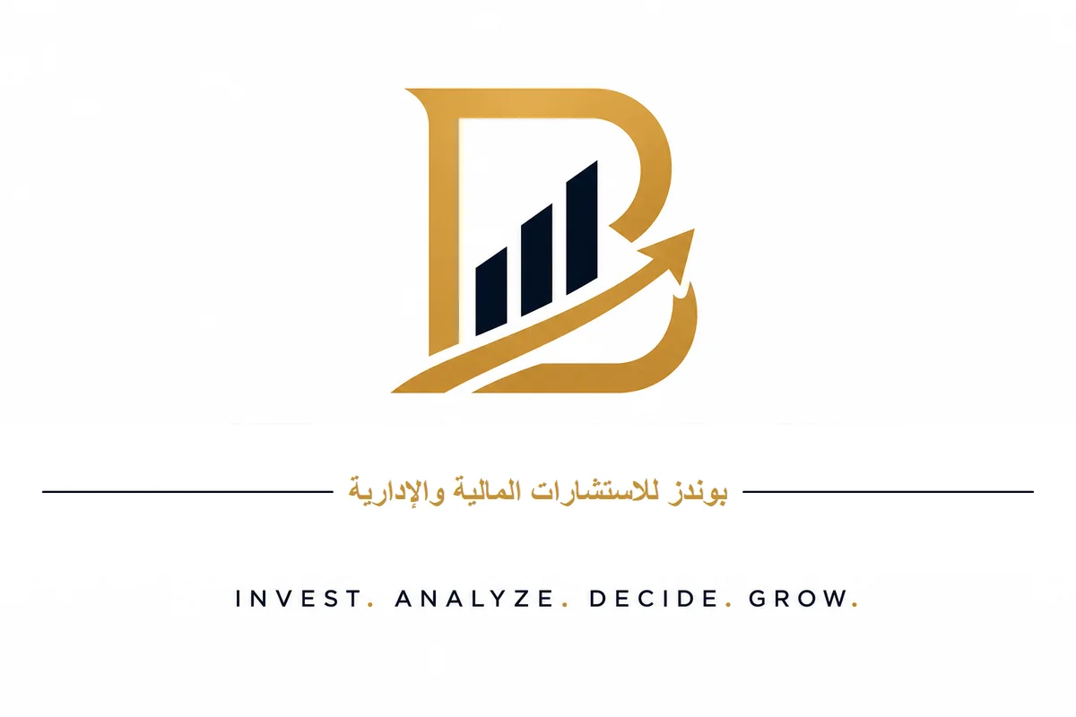
Business Plan
Real Estate Asset Revitalization Company
Financial Advisor
Dr. Talal bin Hassan Al-Zahrani
+966 56 756 6616

Slide 2
Executive Summary
• Unique investment model for revitalizing incomplete real estate assets
• Partnership agreements with owners without purchasing land
• Self-funded by founding shareholders
• Compliance with Saudi Building Code and comprehensive insurance
• Expected IRR of 19% - 20% over 10 years

Slide 3
Problem & Opportunity
Problem
• Thousands of incomplete buildings
• Owners lack liquidity
• Difficulty accessing reliable contractors
• Complex legal procedures
Opportunity
• Vision 2030 and real estate growth
• Demand exceeds supply in major cities
• High rental yields
• Flexible and profitable partnership model

Slide 4
Solution: Business Model
• Identify incomplete real estate assets in target locations
• Conduct engineering, legal, and financial assessment
• Negotiate and sign clear partnership contract
• Execute finishing works to highest quality standards
• Market and sell units at market prices
• Distribute profits between company and owner

Slide 5
Real Estate Market Indicators
• Rental yield in Riyadh: 8.89%
• Rental yield in Jeddah: 7.89%
• Real estate transaction growth (2025): +14.2%
• Real estate financing volume: SAR 730 billion
• Price-to-demand gap: 6%
• New construction premium: +25%

Slide 6
Target Areas
Riyadh
• Premium North: Al-Aqeeq, Hittin, Al-Malqa
• Northeast: Al-Munsiyah, Al-Rimal
• Al-Yasmin, Al-Narjis
• High rental yields
Jeddah
• North Coast: Abhur, Al-Sawari
• Vibrant Center: Al-Hamra, Al-Naeem
• Al-Zahra, Al-Salama
• Continuous residential and commercial demand

Slide 7
Partnership Models
• Full Muhassah: Company handles finishing and marketing for profit share
• Partial Purchase: Company buys part of units after finishing
• Management Fee: Fixed fee for finishing and marketing
• Hybrid Model: Mix of Muhassah, purchase, and management fees

Slide 8
Key Financial Indicators
• Authorized Capital: SAR 200 million
• Total Target Investment: SAR 226 million
• Initial Investment: SAR 25 million
• Expected IRR: 19% - 20%
• Capital Return Multiple at Exit: 2.5x - 4x
• Payback Period: 5.5 years

Slide 9
Revenue Sources
• Muhassah revenues: 60%
• Resale and purchase profits: 25%
• Management and marketing fees: 10%
• Consulting and administrative services: 5%

Slide 10
Implementation Timeline
• Years 1-2: Proof of Concept (3-5 projects)
• Years 3-5: Growth and Replication (6-10 projects annually)
• Years 5-7: Strategic Exit
• Options: Sale of controlling stake, partial IPO, or buyback

Slide 11
Risk Management
• Comprehensive insurance (CAR, liability, hidden defects)
• Engineering and legal inspection before contracting
• Clear contracts with binding arbitration
• Bank guarantees from contractors
• 10% risk reserve
• Geographic diversification and multiple target segments

Slide 12
Management Team
• CEO: Strategy and investor relations
• COO: Project management and quality
• CFO: Cash flows and reporting
• Commercial Director: Marketing and sales
• Legal Director: Contracts and compliance
• Hiring plan: 10-15 employees in Year 1

Slide 13
Why Invest?
• Unique model requiring no land purchase
• Large market of incomplete assets
• Self-funded without debt or sukuk
• Attractive returns with calculated risks
• Specialized management team and strong network
• Clear and flexible exit options

Slide 14
Be a Partner in Success
Real Estate Asset Revitalization Company
Financial Advisor
Dr. Talal bin Hassan Al-Zahrani
+966 56 756 6616

