Slide 1

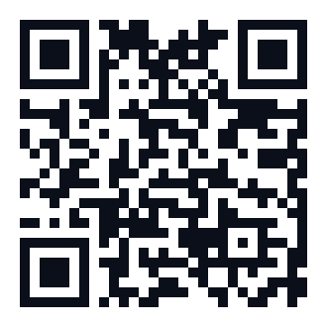
Business Plan
Real Estate Asset Revitalization Company
Financial Advisor
Dr. Talal bin Hassan Al-Zahrani
+966 56 756 6616
info@bonds-global.com
www.bonds-global.com

Slide 2
Executive Summary
• Unique investment model for incomplete assets
• Partnership agreements without land purchase
• Self-funded by founding shareholders
• Saudi Building Code and insurance compliance
• Expected IRR 19% - 20%
Financial Advisor | Dr. Talal bin Hassan Al-Zahrani | +966 56 756 6616 | info@bonds-global.com

Slide 3
Problem & Opportunity
Problem
• Thousands of incomplete assets
• Liquidity shortage
• Reliable contractor access
Opportunity
• Vision 2030
• Demand exceeds supply
• High rental yields
Financial Advisor | Dr. Talal bin Hassan Al-Zahrani | +966 56 756 6616 | info@bonds-global.com

Slide 4
Solution
• Identify incomplete assets
• Engineering and legal assessment
• Clear partnership contract
• High-standard finishing
• Marketing and sales
• Profit distribution
Financial Advisor | Dr. Talal bin Hassan Al-Zahrani | +966 56 756 6616 | info@bonds-global.com

Slide 5
Financial Highlights
• Authorized Capital: SAR 200 million
• Target Investment: SAR 226 million
• Initial Investment: SAR 25 million
• IRR: 19% - 20%
• Exit Return: 2.5x - 4x
Financial Advisor | Dr. Talal bin Hassan Al-Zahrani | +966 56 756 6616 | info@bonds-global.com

Slide 6
Business Model
• Full Muhassah
• Partial Purchase
• Management Fee
• Hybrid Model
Financial Advisor | Dr. Talal bin Hassan Al-Zahrani | +966 56 756 6616 | info@bonds-global.com

Slide 7
Implementation
• Years 1-2: Proof of Concept
• Years 3-5: Growth and Replication
• Years 5-7: Strategic Exit
Financial Advisor | Dr. Talal bin Hassan Al-Zahrani | +966 56 756 6616 | info@bonds-global.com

Slide 8
Risk Management
• Comprehensive insurance
• Engineering and legal inspection
• Clear contracts with arbitration
• Bank guarantees
• 10% risk reserve
Financial Advisor | Dr. Talal bin Hassan Al-Zahrani | +966 56 756 6616 | info@bonds-global.com

Slide 9
Be a Partner in Success
Real Estate Asset Revitalization Company
Financial Advisor
Dr. Talal bin Hassan Al-Zahrani
+966 56 756 6616
info@bonds-global.com
www.bonds-global.com

