Slide 1
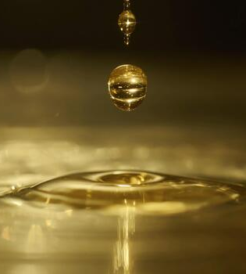
02/17/26
Liquid-Liquid Extraction
Group 3
Angelica Ramirez, Hiba-Batool Naqvi, Jazmin Aca, Basil Hashim, Noah Guale

Slide 2
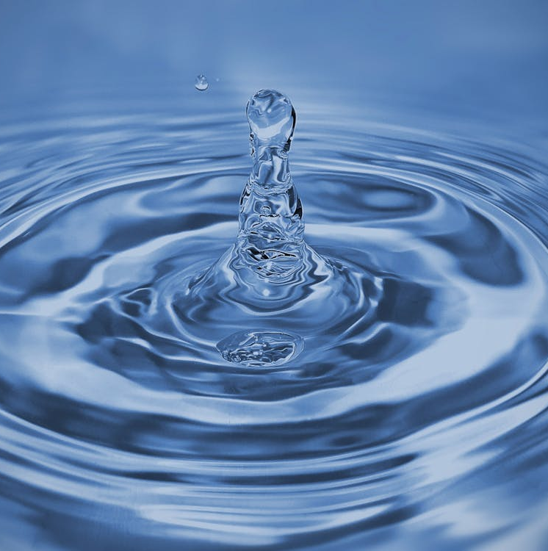
Table of Contents
Introduction
Theory
Apparatus
Materials and Supplies
Procedure
Dangers
Challenges

Slide 3
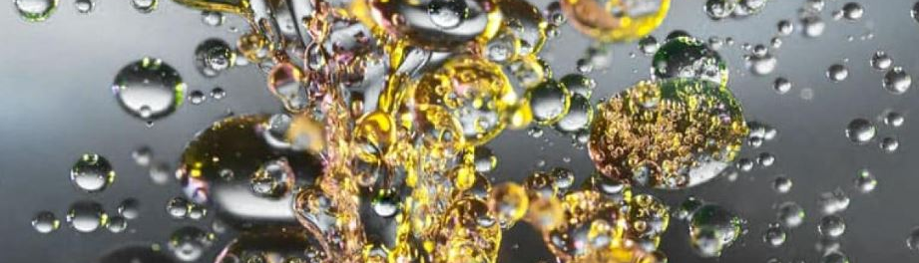
Introduction
The objective of this lab is to understand the effect of mixing on the efficiency of extraction of the unit and the theoretical number of stages. This lab operates a three-stage mixer settler system to extract acetic acid from white oil using water as the solvent. The time it took for the oil to reach the system will be measured as well as the composition of the resulting streams will be measured by titrating using a NaOH solution using phenolphthalein as the endpoint indicator. With these measurements, plots of acetic acid concentration as a function of agitator speed will be analyzed to find the effect of agitator speed on the efficiency of separation. Furthermore, the McCabe-Thiele and Murphree efficiencies will determine the stages and efficiencies.

Slide 4
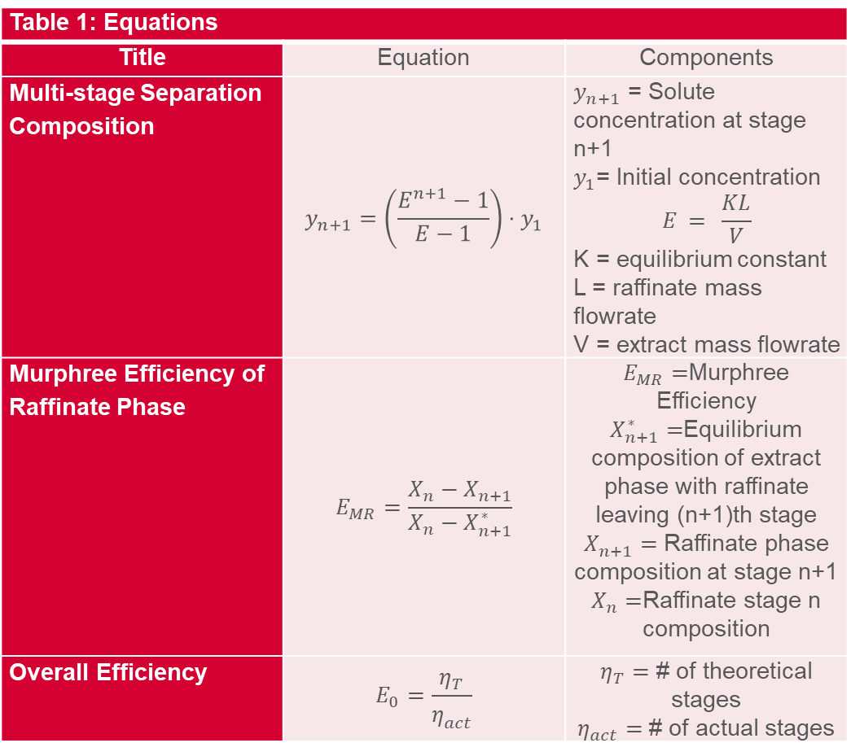
Theory
Table 1: Equations
Title | Equation | Components
Multi-stage Separation Composition | $$y_{n+1}=\left(\frac{E^{n+1}−1}{E−1}\right)⋅y_{1}$$ | $y_{n+1}$ = Solute concentration at stage n+1 $y_{1}$= Initial concentration $$E = \frac{KL}{V}$$ K = equilibrium constant L = raffinate mass flowrate V = extract mass flowrate
Murphree Efficiency of Raffinate Phase | $$E_{MR}=\frac{X_{n}−X_{n+1}}{X_{n}−X_{n+1}^{∗}}$$ | $E_{MR}=$Murphree Efficiency $X_{n+1}^{∗}=$Equilibrium composition of extract phase with raffinate leaving (n+1)th stage $X_{n+1}^{ }=$ Raffinate phase composition at stage n+1 $X_{n}^{ }=$Raffinate stage n composition
Overall Efficiency | $$E_{0}=\frac{η_{T}}{η_{act}^{}}$$ | $η_{T}=$ # of theoretical stages $η_{act}=$ # of actual stages
Contact between feed and solvent leads to feed separation
Component being separated + solvent → raffinate phase
Other phase → extracting phase
Calculations are analogous to those for a distillation system
Multiple stages increase efficiency and separation efficacy

Slide 5
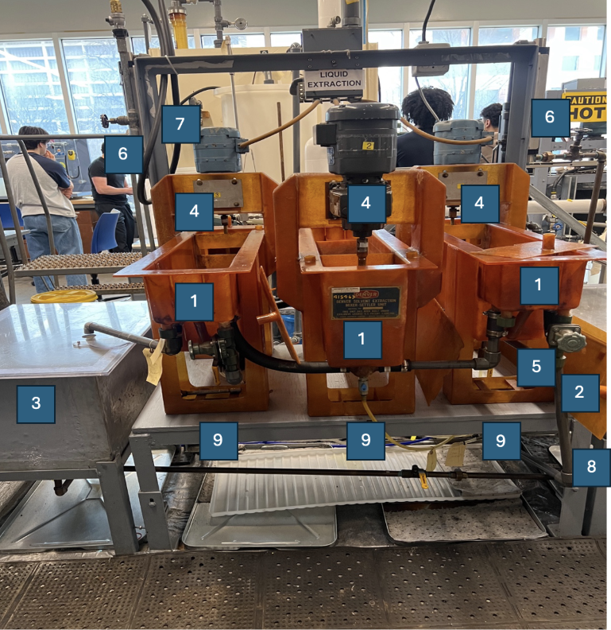
Apparatus
Table 1: Apparatus for Liquid-Liquid Experiment
No. | Component | Description
1 | Denver mixer-settler unit | Three extraction stages, each containing a mixer/settler section
2 | Feed tank | 25-gallon tank that holds the mineral oil and acetic acid mixture
3 | Product tank | Tank that collects the residual mineral oil/acetic acid mixture after the extraction
4 | Impellers | Three impellers on top of each of the Denver mixer-settler units; controlled with a circuit breaker. Speeds are measured with a tachometer
5 | Centrifugal pump | Used for mixing the feed and feeds from the tank to the extraction units
6 | Rotameters | Two rotameters (flow meters); measures the flow rates for the mineral oil and water
7 | Solvent circuit | Inlet for the water supplied from the top
8 | Recycle valve | Yellow below the feed tank
9 | Reflux valves | Under each stage; kept fully closed reflux valves are on the end of the stage in the middle.
10 | Drain valves | Drain valves are under each stage, two per stage.

Slide 6

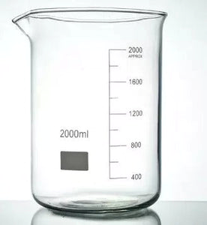
Materials and Supplies
Burette Stand & Clamp
Burette
Erlenmeyer Flask
Stir Bars and Plates
Standardized NaOH Solution
Phenolphthalein
White Oil
Acetic Acid
Tap Water
Tachometer
Timer
Safety Glasses
Gloves
Parafilm

Slide 7

Take a titration of the oil in the feed tank
Calculate the concentration of acetic acid
Calculate the amount of acetic acid need to have 1wt% acetic acid in oil
Add the acetic acid and turn the pump on
At this point, the pump should be on the recirculation setting
If faster mixing is needed, mix with a spatula
Before starting the water, be sure that the valves are closed.
Start the water, wait for the system to fill entirely with water.
Do not have the agitators on at this point
Measure the first agitator speed with the tachometer (before beginning the oil stream)
Begin the oil stream. Be sure to start timing as soon as the oil hits the first stages water sump
It will look foggy
Stop the timer as soon as the water breaks surface tension in the last stage
Record this time.
Begin taking samples from the oil and water stages
Extract (water) on the inside, raffinate (oil) on the outside
Titrate these. For samples that are oil, dilute them in water for easier titrations. Use the stir bar.
Quickly measure the next agitator speed and allow the system to run for the resonance time noted above. Repeat for a total of 3 speeds. Be fast.
Procedure

Slide 8
Dangers
Don’t run the pump dry
Working with a pump can cause over-pressurization if valves are incorrectly closed.
Acetic acid is highly corrosive and its vapor highly flammable.
Mineral oil is flammable.
Floor can get slippery because of the oil.

Slide 9
Challenges
Wait for the system to reach steady state before taking samples (around 20-25 min.)
Impellers are noisy so ear plugs might be needed.
Oil is highly viscous so mixing the acetic acid manually might be required.
Titrations should be done carefully since it is very easy to overshoot them (concentration of NaOH is also important).
Data for titrations should be recorded in an organized way since the experiment requires a total of 18 titrations.

