Slide 1
Heat Transfer
By: Cesearo Dilosa, Javier Silva, Ify Bidokwu, and Joshua Laforest
Chemical Engineering Lab II​
02/03/2026​

Slide 2
Purpose of Lab
The purpose of this lab is to explore heat transfer in different scenarios that would mimic stirring and cooling in industrial settings. Lab will explore how much heat transfer will occurring the system after different degrees of impeller stirring and cooling water flow rates from heat exchangers.
The lab will focus on building of heat transfer coefficients and data collected from different areas of the system where the experiment is collected. Equations involving Nusselt's, Prandtl's and Reynold's numbers will set the bases of explaining heat transfer trends over different stirring speeds and cooling rates.
Industrial Applications:
The industrial application of this lab is in the design of reactors in industry as stirring reactors modeled just like the lab are used for initial reactions. CSTR reactors are closely related to this design of the lab Apparatus.
CSTR reactors are used in multiple industries where a fast and heat intensive reactions are needed for the process. Such industries such as polymer, and pharmaceuticals use CSTR reactors to begin the initial reaction of the process.

Slide 3
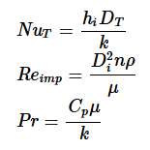
Theory
The concept of heat transfer across a solid wall using two fluids involves a series of thermal resistances. Once at steady state, the heat transferred is continuous across the interface. For this specific stirred tank, heat transfer from the condensed steam in the steam jacket will provide the heat that will be measured for the heat transfer.
To explore heat, transfer the use Nusselt's (Nu), Prandtl's (Pr) and Reynold's (Re) numbers will be derived recorded from temperature. With the the values sourced from different trials they must be compared to the literature theory from "Transport Phenomena, Bird 2005".
Theoretically the trend of having stirring and cooling interring in a steady state system tends to lower the Ui and h0 as higher speeds in stirring and cooling flow rates influence the system.

Slide 4
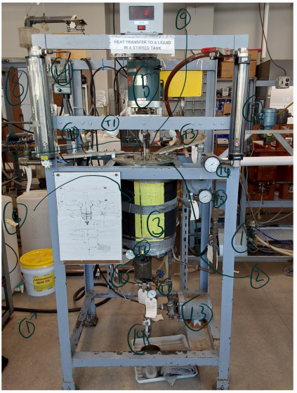
Apparatus
Number: | Name: | Description:
1 | Water Supply | Water used to conduct the experiment.
2 | Tank | Vessel to hold water.
3 | Steam Jacket | Surrounds tank with hot steam.
4 | Motor | Controls the propeller inside of the tank.
5 | Propeller mechanism. | Used to apply the spinning movement in the tank.
6 | Propeller | Used to spin in the water.
7 | Coil | A coil that has cooling water runs through the system.
8 | Flow Meter for Coil | Measures water flow in a coil.
9 | Steam Line | Add steam inside the jacket for heating.
10 | Steam Trap | Collects steam and condensates it to be reused in the system.
11 | External Heat Exchanger | Cools water from inside the tank to add back.
12 | Flow meter for Cooling water | Measures the amount of water going into the tank.
13 | Pump | Pumps water back into the tank.
14 | Drain | Drain water out.

Slide 5
Thermometer list
Thermometer: | Description:
T1 | Water for coil
T2 | Water in the tank
T3 | Water leaving coil
T4 | Cool water leaving heat exchanger
T5 | Water entering heat exchanger
T6 | Cooling water for the steam trap
T7 | Cooling water leaving the steam trap

Slide 6
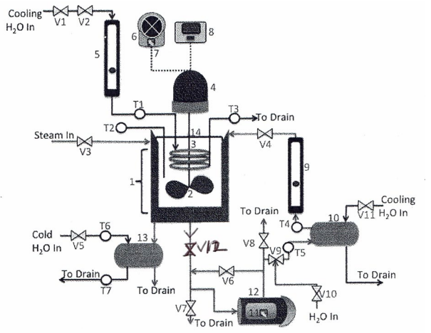
Valve list
Valve: | Description:
V1 | Opens cooling water for tank
V2 | Controls water going into the tank
V3 | Allows steam to enter the steam jacket
V4 | Allows water from the heat exchanger to flow into the system
V5 | Allows water to enter the steam trap
V6 | Allows water to flow into the pump and system
V7 | Allows water to drain from the system.
V8 | Allows water to leave the pump
V9 | Directs water to enter or leave the heat exchange system
V10 | Allows water to enter the heat exchange system
V11 | Allows cooling water to enter the heat exchanger
V12 | Controls the flow of water leaving the tank

Slide 7
Materials & supplies
Item: | Description:
Jacketed Vessel | This gives the main container for the fluid allowing heat transfer from the stream jacket across the wall surface.
Baffles | These are removable plates used to stop vortex formation and improve heat transfer and radial mixing.
Impeller (Stirrer) | Provides mechanical mixing to make sure the fluid is well mixed or at constant bulk properties.
Centrifugal Pump | This continuously removes the fluid from the vessels bottom to recirculate it through the external heat exchanger back into the tank.
External Heat Exchanger | A shell and tube unit where the recirculated tank water is a cooled down by a different cold-water stream.
Cooling coil | An internal coil in the tank used to remove heat from the bulk fluid.
Steam Condenser | A unit that cools and traps the exit steam turning it into liquid condensate for measurement.
Variac | A power supply used to adjust the rotational speed of the impeller (stirrer).
Thermometers | These are gauges used to observe the temperature at the inlets and outlets of all the heat exchange parts.
Rotameters | These are flow meters used to show the water flow rates for the cooling coil and the recirculating water.
Graduated Cylinder | This is used to collect the volume of steam over a specific time.
Tap Water | The fluid used to fill tank. Also, for cooling in the coils and exchanger.
Saturated Steam | This enters the jacket to give thermal energy to the vessel.

Slide 8
Procedure
Preparation:
Fill tank 2-inches from the top and put on the lids.
Next, turn on the impeller and let it stabilize around 300 RPMs. Note the direction (ccw or cw) the impeller rotates.
Then manipulate the proper valves to allow for cooling water flow for the coils, external H.E., and steam trap.
Finally, prime the pump, then let it operate normally.
Experiment:
Slightly open the steam valve to heat the tank. A quarter turn should be a good start.
Choose 3 impeller speeds between 300 RPM & 900 RPM to operate at. When operating at a chosen RPM, let the system reach steady-state.
Once steady-state is achieved, collect steam condensate for a chosen amount time to get steam flowrate into the jacket. Also, note down the recirculation & cooling coils flowrates. Record T1-T7 as well.
Do this at all 3 impeller RPMs. Then install baffles for part 2 and follow the same steps.
NOTE: the temperature in the tank needs to stay between 65 ℃ and 85 ℃. Adjust cooling coil flowrate, recirculation flowrate, and/or the steam flow to stay within this temperature range.

Slide 9
Safety
The lab involves temperatures up to 85 degrees Celsius therefore usage of insulated gloves is encouraged to prevent burns when handling the vessel lid and valves
If ran dry the pump can potentially cause the water to overflow
Electric supplies are present in the forms of the pump and variac variable power supplies, avoid contract with water
Be cognizant of water level in the tank. A spill may cause a slipping hazard.
If you decide to have the impeller running as you install the baffles, be sure to not hit the blades and cause damage.

Slide 10
Experimental challenges & lessons learned
Many valves are present, main difficulties arise from understanding their primary functions in relation to the system
Lengthy experiment, large amounts of time is spent waiting for the system to reach steady state in addition changing the vessel configurations (impeller speed, applying/reapplying baffles, valve adjustment, etc.)
Need to be attentive to temperature gauges as they are in different units, Fahrenheit and Celsius.

Slide 11
References
[1] Fryer, P. J.; Robbins, P. T. Heat Transfer in Food Processing: Ensuring Product Quality and Safety. Applied Thermal Engineering 2005, 25 (16), 2499–2510. https://doi.org/10.1016/j.applthermaleng.2004.11.021.
[2] Antognoli, M.; Qeysari, H.; Alberini, F.; Paglianti, A.; Singh, P.; Albano, A. Power and Fluid Stress in Disposable Square Stirred Tank to Streamline Pharmaceutical Process Development. International Journal of Pharmaceutics 2025, 685, 126243. https://doi.org/10.1016/j.ijpharm.2025.126243.
[3] Bird, R. Byron, et al. Transport Phenomena. 2nd ed., John Wiley and Sons, Inc., 2002.
[4] Perry, Robert H., and Don W. Green, editors. Perry's Chemical Engineering Handbook. 8th ed., McGraw-Hill, 2008.
[5] Department of Chemical Engineering. 2025. ChE 382: Unit Operations Laboratory: Heat Transfer to a Fluid in a Stirred Tank. University of Illinois at Chicago.

