Slide 1
Process Control
Group #3
Rishabh S. Patel, Kyle Hankosky, Khoa Nguyen, Alexis Guillen, Miguel Piza
Chemical Engineering Lab I
02/03/26

Slide 2
Introduction
Purpose
To make use of the Armfield level-control unit to understand and evaluate how manual control & PID control maintain a desired liquid level under setpoint changes and flow disturbances
Process Hardware & instrumentation
Armfield PCT50 water level process
Level measurement via pressure sensor
Disturbance/flow elements
Control modes & controller structure
Open-loop/manual control by directly adjusting pump speed to match outflow and hold level
Closed-loop feedback control using a single PID loop →level being measured var. & pump speed being manipulated
Experimental method & data analysis
Apply repeatable disturbances and observe dynamic response
Record time-series data through the software’s data/acquisition logging
Evaluate performance offset

Slide 3
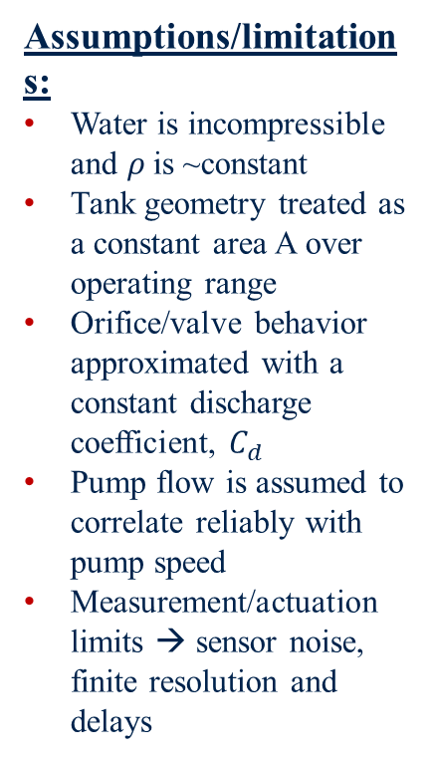
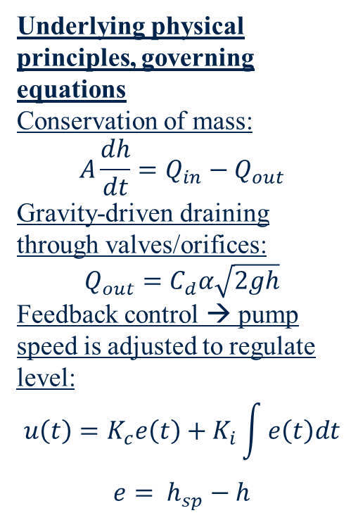
Theory
Underlying physical principles, governing equations
Conservation of mass: $$A\frac{dh}{dt}=Q_{in}−Q_{out}$$
Gravity-driven draining through valves/orifices:
$$Q_{out}=C_{d}α\sqrt{2gh}$$
Feedback control → pump speed is adjusted to regulate level: $$u\left(t\right)=K_{c}e\left(t\right)+K_{i}\int{e\left(t\right)dt}$$
$$e= h_{sp}−h$$
Assumptions/limitations:
Water is incompressible and $ρ$is ~constant
Tank geometry treated as a constant area A over operating range
Orifice/valve behavior approximated with a constant discharge coefficient, $C_{d}$
Pump flow is assumed to correlate reliably with pump speed
Measurement/actuation limits → sensor noise, finite resolution and delays
Connection
Experiment A→manually change pump speed and observe level rise/fall
Experiment B→set I=0, vary proportional band and measure steady-state offset after disturbances/setpoint changes
Experiment C→keep P fixed, vary integral time and observe offset reduction vs. onset of instability/windup
Data link→ software logs level vs. time, letting you compare response speed, stability and offset.

Slide 4
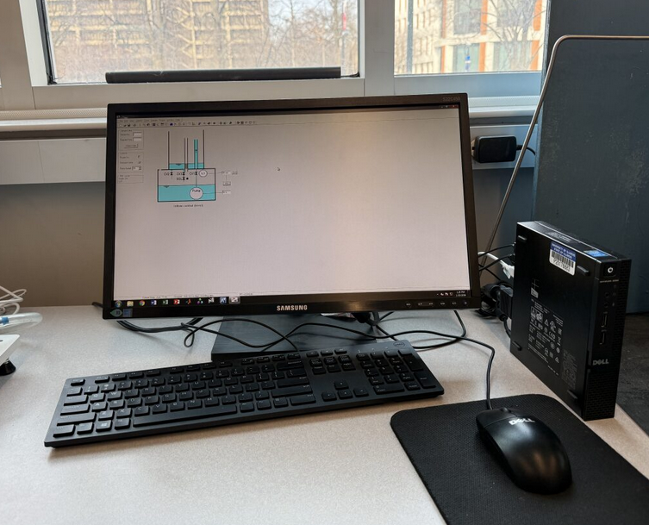
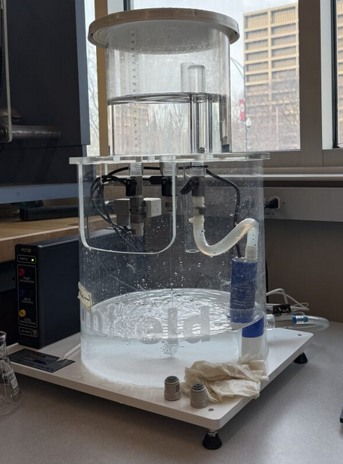
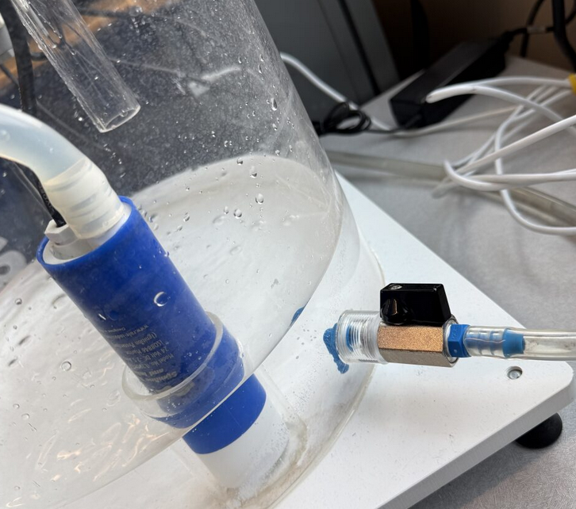
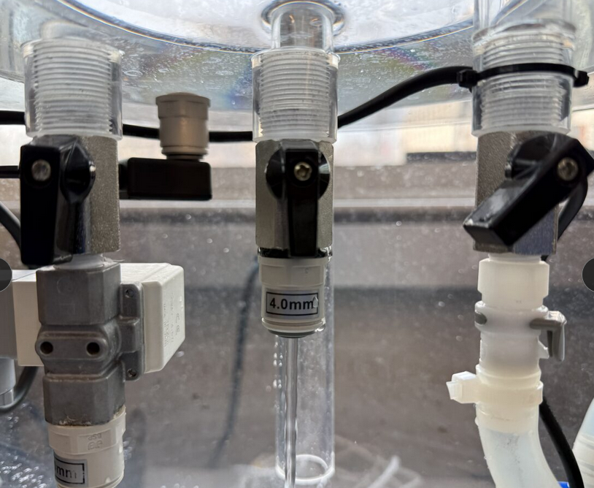
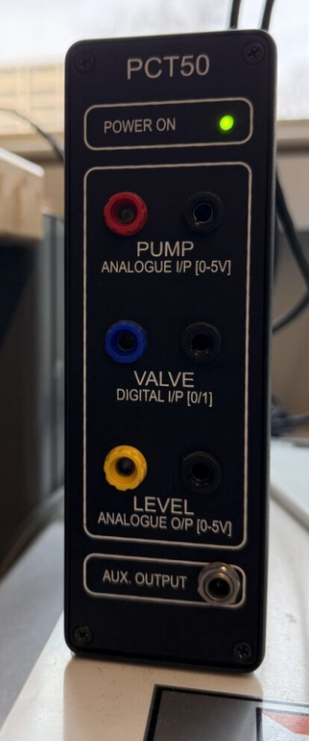
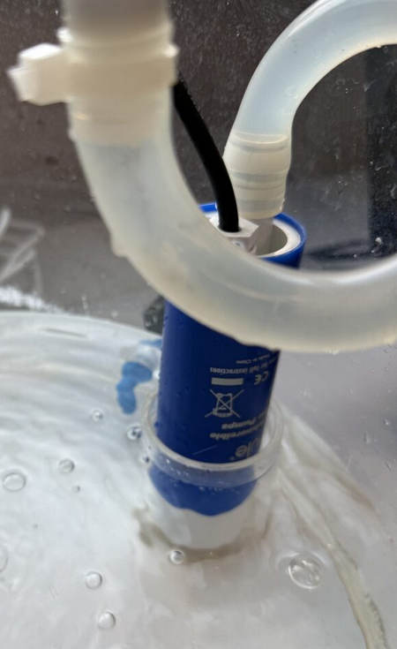
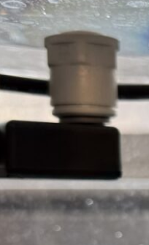
Apparatus
picture
Computer | Armfield PCT 50 level Control | Drain Valve | Solenoid valve (left) Experiment valve (right) Something (middle)
Pump | Pressure Sensor

Slide 5
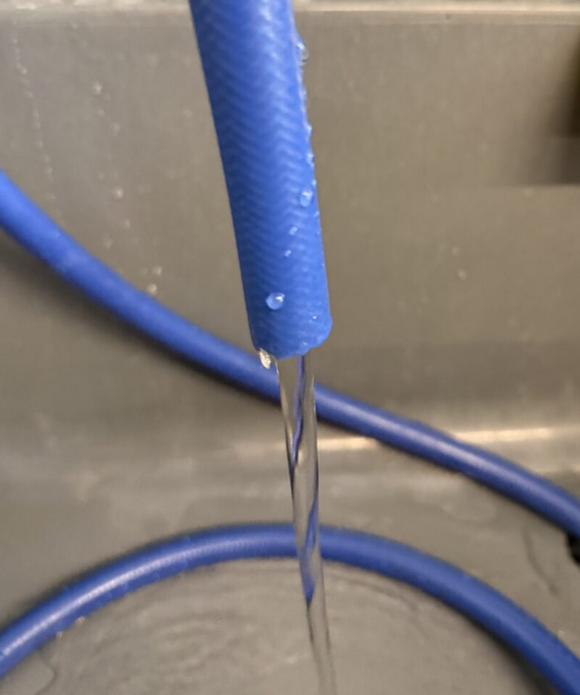
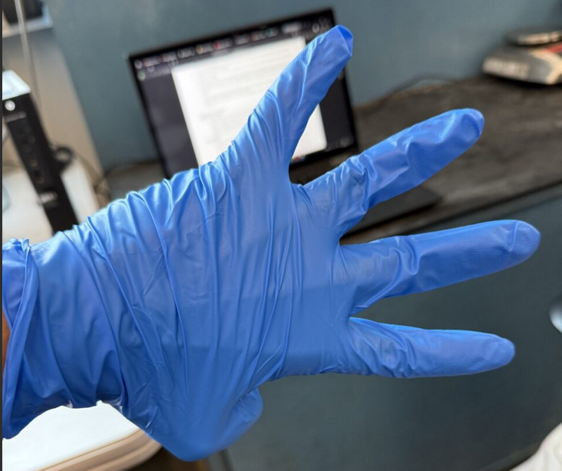
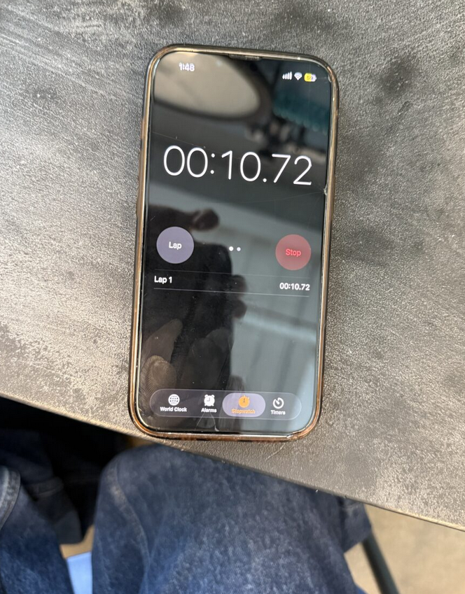
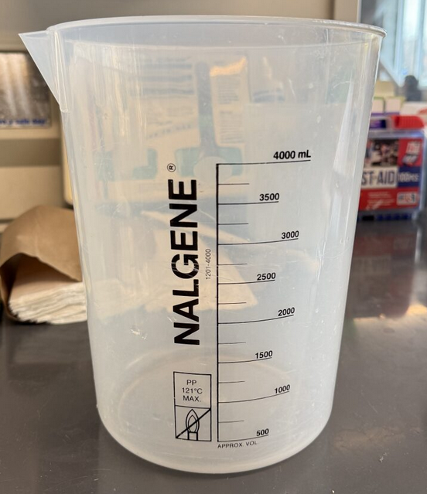
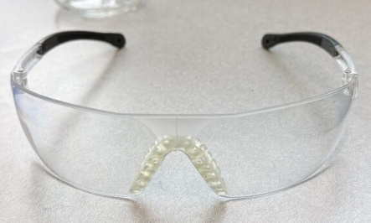
Material & Supplies
picture
DI Water | Gloves | Timer | Beaker
Safety Goggles

Slide 6
Procedure
Setup
Turn on computer, start PCT50 software (make sure to click experiment 1)
Fill sump tank with deionized water, then fully open CV2
Adjust for CV1 → pump speed to 50%→adjust until level remains steady
Initial Level Control:
Empty process vessel, increase pump speed
Observe that level remains constant, record pump speed and press “GO” icon
Record data for ~5 mins and proceed to next step
Disturbances:
Using same pump speed and level values, open solenoid valve
Wait for level to drop to ~20mm and note pump speed
Increase pump speed so level reaches original reading
Close valve→after level rises by 20mm, record pump speed→reduce speed to reach original level→after several minutes turn off pump and let drain

Slide 7
Procedure Cont.
Experiment 2
Open PID menu
Set P value to 200%
Set integral time to 0
Change derivative time to 0
Set setpoint to 75
Ensure controller is in automatic control and hit GO
Once steady behavior is observed open solenoid valve
Wait for steady behavior then close solenoid valve and set the setpoint to 100.
Wait until steady and set the setpoint to 75 and observe the changes
Repeat steps 2-5 for P values of 100%,50%,20%,10%,5%,2% .

Slide 8
Procedure Cont.
Experiment 3
Open PID menu
Set P value to value selected from exp 2
Set integral time to 0
Change derivative time to 0
Set setpoint to 75
Choose automatic mode and hit GO
Once steady behavior is observed set I value to 100 and observe the changes
Open the solenoid valve and wait for new steady behavior is reached and observe the changes. After a few minutes close the solenoid valve and allow level to settle.
Adjust the setpoint to 100 and wait until a stable level is reached and then set the set point back to 75.
Repeat steps 2-5 for I values starting at 50s and decreasing until the level becomes unstable
Ensure STOP is hit after each trial and data is saved.

Slide 9
Experimental Challenges
Difficulties:
System struggles to maintain control at high proportional bands
System can take a while to reach steady state
Lessons Learned:
Always stay in experiment 1 on the UPC software
Ensure GO is pressed before each run
Ensure the appropriate band values and integral values are set before collecting data

Slide 10
Safety
Pressure hazards:
Pump
DO NOT run the pump dry
Mechanical hazards:
Water
Potential slipping if system tank overflows
Avoid ingestion of DI water
Electrical hazards
Water near electronics presents shock hazard if the tank is overfilled.
`

