Slide 1
Gas Absorption
Group 2
Joshua Olusoji, Omar Zaruk, Sanad Abu Hweij, Qussay Suleiman
Chemical Engineering Lab II
3/16/2026

Slide 2
Introduction
The objective of this experiment is to study gas absorption in a packed-bed column by characterizing packed-bed hydrodynamics and CO₂ mass transfer coefficients. Air, CO₂, and water flow rates are controlled while the pressure drop across the packing is measured with a red-oil manometer to identify the flooding point and appropriate operating conditions.
The packed-bed void fraction is first determined, and pressure drop is measured as a function of air and water flow rates. CO₂ absorption by water is then studied in closed-loop and open-loop systems to evaluate absorber performance and determine mass transfer coefficients.

Slide 3
Theory
Theory: Gas Absorption in a Packed Bed
Gas absorption is a process where a gas dissolves into a liquid. In this experiment, carbon dioxide is removed from air by absorbing it into water. This process is commonly used in chemical engineering to separate or remove gases
Flooding
At high gas flow rates, flooding can occur. This is when the gas starts pushing the liquid upward. The liquid can no longer flow down properly. At this point, the pressure drop increases quickly.
Mass Transfer of CO₂
Carbon dioxide moves from the gas phase into the liquid phase. This happens at the gas–liquid interface. The rate of transfer depends on the concentration difference.
N = Ka*deltaC. Where N is transfer rate and Delta C is the driving force
Notes:
Graphs are sourced from the lab manual

Slide 4
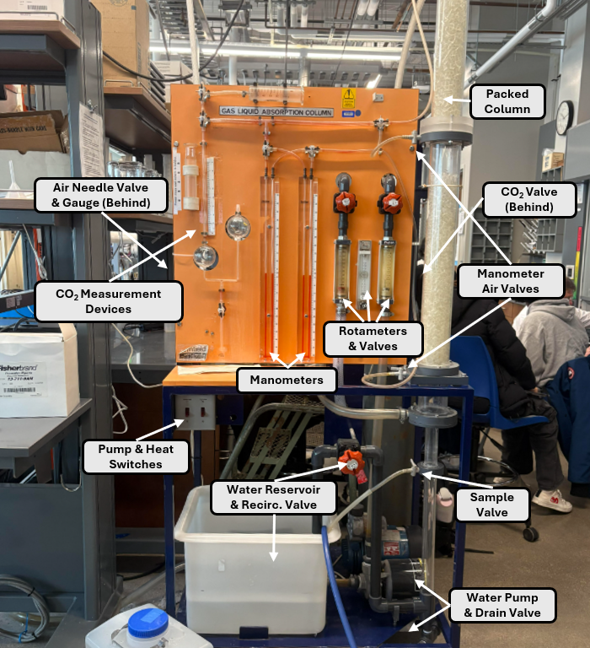
Apparatus
Full Apparatus

Slide 5
Material & Supplies
Digital thermometer
Deionized Water Supply Line
Deionized Water Container
Plastic Packings
Graduated Cylinder
Safety Goggles
Carbon Dioxide Gas Cylinder + Two-Stage Pressure Regulator + CO₂ Heater
Magnetic Hot Plate
Titration Stand
Parafilm Sealing Film
Phenolphthalein Indicator
Sodium Hydroxide
Compressed Air Supply Line + Pressure Regulator
Magnetic Stir Bars
50 mL flasks

Slide 6
Procedure
Part 1 – Packed bed characterization: Measure a known volume of 1 cm Raschig ring packing and slowly add deionized water until the void spaces are filled. Record the water volume and calculate the void fraction.
Fill the liquid reservoir to about three quarters full with deionized water and record the temperature. Open the compressed air supply and set airflow to 20 L/min, allowing air to flow for 5 minutes to dry the packing. Measure pressure drop across the packed bed using the red-oil manometer for several air flow rates with no liquid flow.
Start the liquid pump and adjust water flow to 1.5 L/min while maintaining the liquid level above the sampling port and below the gas inlet. Gradually increase airflow from 20 L/min and record pressure drop until flooding occurs. Repeat flooding measurements for water flow rates of 3 L/min, 6 L/min, and 8 L/min, monitoring the manometer to prevent red oil from entering the tubing.

Slide 7
Procedure-contd.
Part 2 – CO₂ absorption in a closed-loop water system: Fill the reservoir to about three quarters full with deionized water and record the temperature. Collect an initial 50 mL water sample and determine the initial CO₂ concentration by titration. Start the liquid pump and adjust water flow to 6 L/min, then set the airflow to 20 L/min.
Part 2 – CO₂ absorption in a closed-loop water system: Fill the reservoir to about three quarters full with deionized water and record the temperature. Collect an initial 50 mL water sample and determine the initial CO₂ concentration by titration. Start the liquid pump and adjust water flow to 6 L/min, then set the airflow to 20 L/min.
Part 2B – CO₂ desorption: Shut off the CO₂ flow, reduce the liquid flow to 1.5 L/min, and adjust the drain to maintain liquid level above the sampling port. Immediately collect water samples at about 1-minute intervals and continue titration analysis until the CO₂ concentration decreases and stabilizes.

Slide 8
Procedure-contd.
Part 3 – Open-loop CO₂ absorption: Refill the reservoir with deionized water and record the water temperature. Measure the initial dissolved CO₂ concentration by titration. Start the liquid pump and adjust the water flow to 1.5 L/min. Configure the column for open-loop operation by opening the column drain and adjusting the liquid level so it remains above the sampling port but below the air inlet.
Refill the reservoir with deionized water and record the water temperature. Measure the initial dissolved CO₂ concentration by titration. Start the liquid pump and adjust the water flow to 1.5 L/min. Configure the column for open-loop operation by opening the column drain and adjusting the liquid level so it remains above the sampling port but below the air inlet.

Slide 9
Experimental Challenges
Water leaks: Small leaks occurred in the system during operation, requiring buckets to collect draining water and frequent cleanup to prevent spills and maintain safe working conditions.
Air flow drift: The air flow rate tended to decrease slightly during operation, requiring periodic adjustments to maintain the target flow rate and ensure consistent experimental conditions.
Simultaneous tasks: The experiment required multiple tasks at once including sample collection, timing intervals, titration analysis, and cleanup, which required good coordination and time management to avoid missing sampling points.

Slide 10
Safety
To stay safe:
Prevent slipping and spills: Fill and drain the system carefully and clean spills immediately. Use the water shut-off valve if overfilling or leaks occur.
Prevent electrical hazards: Keep electrical cords and powered equipment dry, and shut off the main power switch before cleaning if liquid contacts electrical components.
Handle chemicals safely: Wear nitrile gloves and eye protection when working with sodium hydroxide, phenolphthalein indicator, or red oil, and keep flammable indicator solutions away from ignition sources.
Handle chemicals safely: Wear nitrile gloves and eye protection when working with sodium hydroxide, phenolphthalein indicator, or red oil, and keep flammable indicator solutions away from ignition sources.

