Slide 1
Continuous Distillation
Group #1
Aaron Casas
Anna Cai
Hussein Rezk
Adil Feradovic
Chemical Engineering Lab Il
Date 3-17-26

Slide 2
Introduction
Purpose of the Lab is to examine continuous distillation of a binary solution (Ethanol, Water) at steady state
Tray efficiency would be analyzed based on feed location.

Slide 3

Theory
McCabe- Thiele Analysis
Equilibrium line, operating lines, theoretical stages
Murphree Efficiency
Distillation Mass Balances
Overall Mass balance
Component mass balance
Equilibrium stage balance
Energy balance

Slide 4
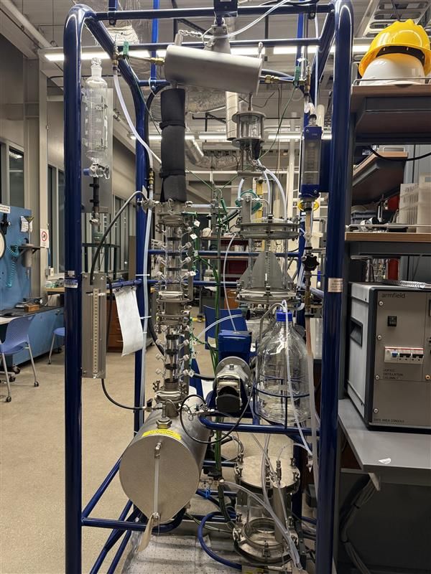
Apparatus
Reboiler
Pump
Column
Condenser
Feed tanks
Armfield UOP3CC
Top and bottom product receiver

Slide 5
Material & Supplies
Graduated Cylinder
Stopwatch
Bucket
Funnel
Snap 41 Densitometer
Sample Flasks
Parafilm
DI water
200 Proof Ethanol
Cooling Water

Slide 6
Procedure
Experiment A: Calibration
Used to get the flowrate of the pump at different turn settings.
Experiment B : Steady State Distillation
Reflux ratio: 5 to 1
Reboiler Power: 0.75 kW
Feed in the middle of the column
Take 3 samples of tops and bottoms after the column reaches steady state.

Slide 7
Procedure continued
Experiment C Varying the Feed position
Disconnect the feed tube, but first temporally turn of the reboiler power.
Reconnect the tube to the top plate
Turn reboiler power to .75kW and wait for column to stabilize
Set reflux to 5:1
Set feed pump to about 30-35 mL per minute
After feeding 400 mL take samples from the tops and bottoms
Take two more samples five minutes apart.

Slide 8
Experimental Challenges
Making sure the nut is tightened at the feed location
Bottoms flow comes out fast, so turn valve slowly
Collecting tops product can result in alcohol reading difficulties

Slide 9
Safety
Electrical Hazards
Use a funnel when pouring the mixtures into their respected location
Mechanical Hazards
Pump could experience issues
Pressure and Temp Hazards
Make sure to temp is around 96 degress Celsius
Wear heat resistant gloves when collecting samples
Chemical Hazards
200 proof ethanol is used, so create the mixure inside the fume hood, wear chemical gloves, and glasses at all times

