Slide 1
Fluidized Bed
Group #2
Kendall Johnson, Lindsey Meisch, Christian Salinas, Srija Bomma
Chemical Engineering Lab I
2/3/2026

Slide 2
Introduction
Purpose of lab
Investigate gas-solid fluidization behavior
Measure pressure-drop vs superficial gas velocity
Technical nature
Widely used in catalytic cracking, combustion and gasification, and drying and coating
Critical for reactor design, pressure drop estimation, scale-up, and process control

Slide 3
Theory
Fluidization Fundamentals
Gas flows upward through a particle bed
At low velocity > packed bed behavior
At minimum fluidization velocity > drag force = effective bed weight
Above minimum fluidization velocity > bed expands, pressure drop plateaus

Slide 4


Theory
Governing Equations
Ergun equation (packed bed)
Minimum fluidization condition

Slide 5
Theory
Assumptions/Limitations
Resin sphericity = 1
Uniform size distribution
Uniform gas distribution
Steady-state behavior
Connection to experiment
Pressure-drop plateau at fluidization
Hysteresis between increasing/decreasing flow
Agreement with theory within experimental uncertainty

Slide 6
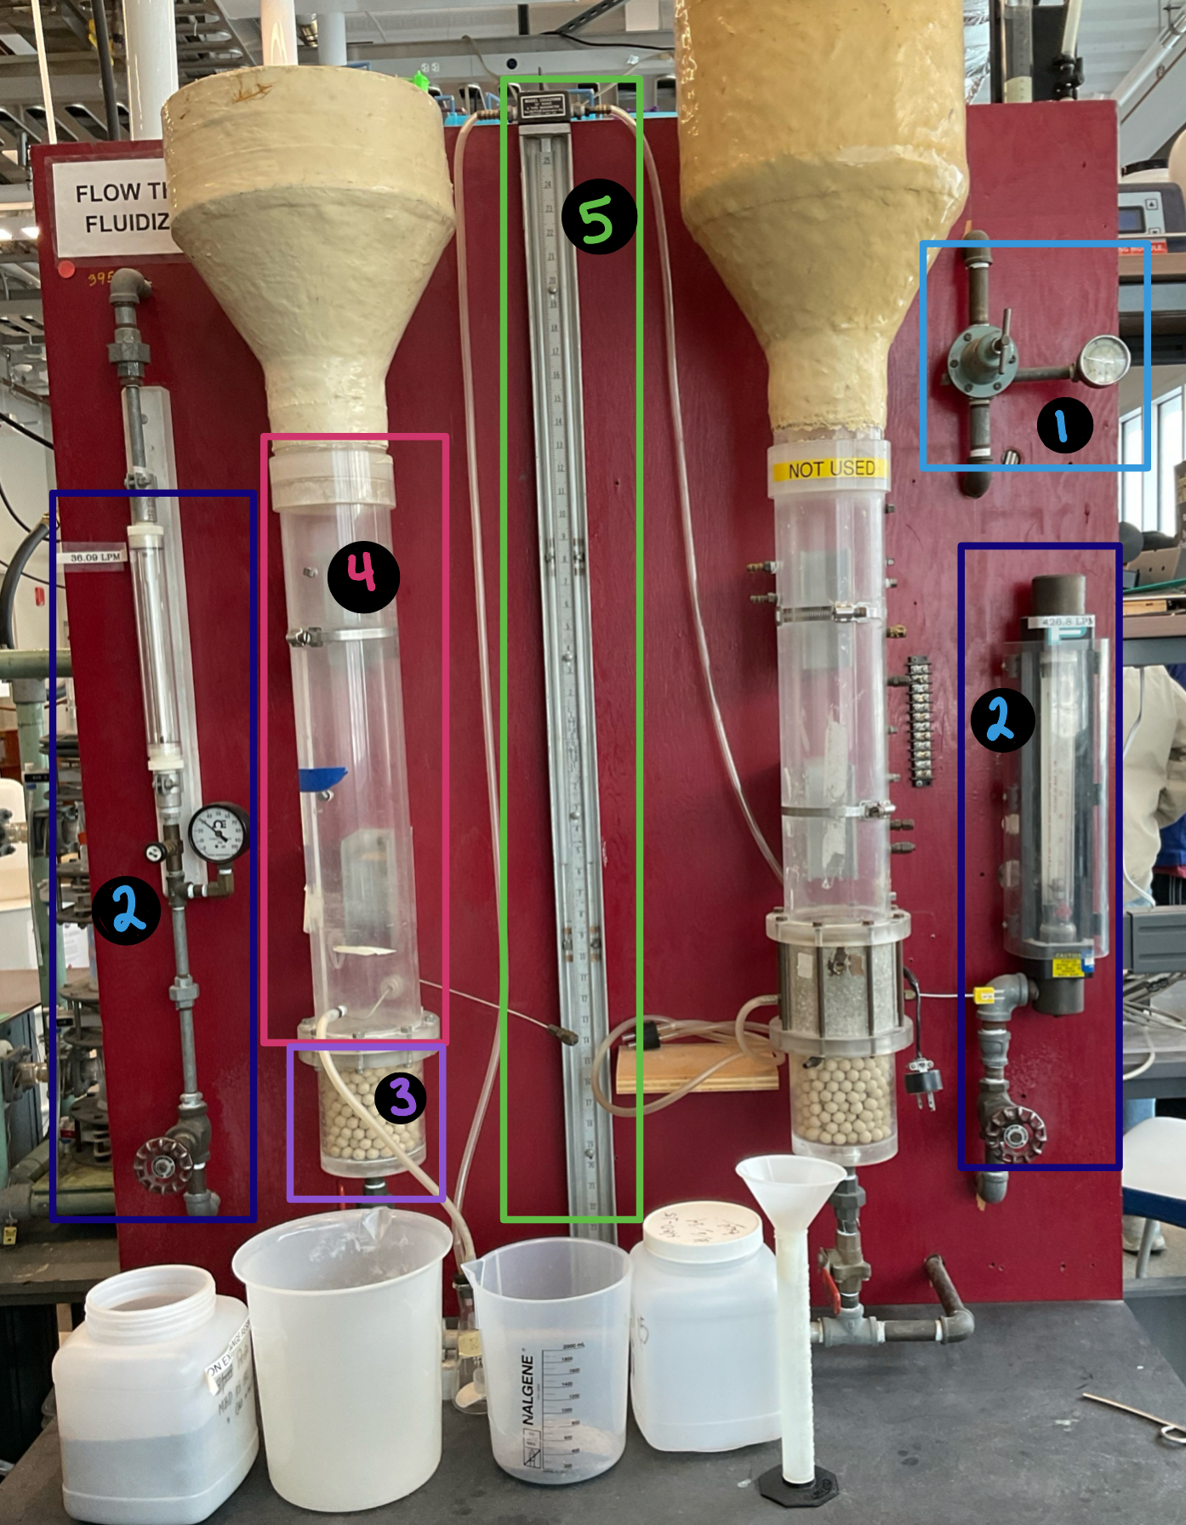
Apparatus
1: Compressed air inlet gauge
2: Rotameter(s) to control fluid flow through the column
3: Air distributor plate
4: Plexiglass fluidized bed column
5: Manometer

Slide 7
Material & Supplies
Ion-resin
Sand
Balance
Graduated cylinder
Funnel
Compressed air
Vacuum cleaners
Sieves

Slide 8
Procedure
Pre-Lab Preparation
Performed sieve analysis on sand and resin
Determined average particle diameter
Measured void fraction using water displacement
Fluidization Experiment
Loaded bed to 6 and 10 inch heights
Gradually increase flow
Record pressure drop, flow rate, and visual bed behavior
Continued until pressure drop plateaued

Slide 9
Experimental Challenges
Identifying exact onset of fluidization
Manometer resolution – limited precision
Rotameter accuracy
Bed instability at higher velocities

Slide 10
Experimental Challenges
Things to watch for
Small increments for air flow
Allow system to stabilize
Read manometer at eye level
Ensure uniform particle loading and level bed surface
Avoid sudden valve adjustments

Slide 11
Experimental Challenges
Lessons learned
Perform replicate trials earlier for better statistics
Use lower flow increments around transition region

Slide 12
Safety
Compressed air
Pressure
Sand/resin slip hazard

