Slide 1
Detecting Wikipedia Misinformation Campaigns
Can we use change logs to detect the addition of misinformation into Wikipedia?
Notes:
Hello everyone, and welcome.

Slide 2
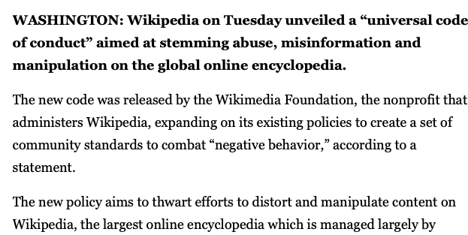
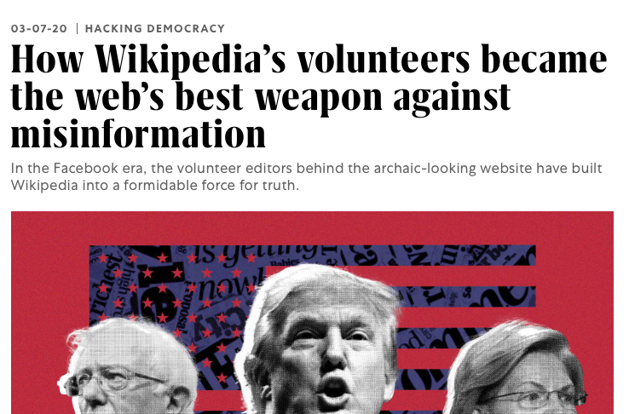
Misinformation and Moderators
Notes:
In the current social climate, misinformation has become a tool for election tampering, conspiracy theories, and general distrust of the media. It becomes hard to know what is true. Wikipedia is well known source of honest information on the internet, and people frequently use it as a source of truth.
However, Wikipedia is moderated by volunteers, who can’t possibility be everywhere at once. This means that malicious actors can overwhelm the moderators or write misinformation into smaller pages that don’t get as much visibility.
My goal is to create a tool that can use meta-data and change logs to find changes that might be problematic, and alert moderators to these potential problems or stop some changes before they are even added to the page.

Slide 3
Project
Collect data from Wikipedia
Meta-data (tags, comments, username, lines changed, etc)
Change logs
Find where moderators thought the information was incorrect, and therefore marked items as reverts, returning to prior versions, or vandalism
Side effect: finding the breaking of rules
Build a model that detects similar changes
Create a tool that lists changes that should be reviewed by moderators
Notes:
Information has been collected from wikipedia, from controversial pages that would have the greatest number of changes.
Whenever a change is made to a page, that change is logged, and moderators can flag changes with "reverted”, "returning to prior versions”, or ”vandalism”, these are the most likely changes to include misinformation. By following these items I have found the side effect of also locating rule breakers, such as change being too long or edit not containing reasoning for change.
Comments, change logs, and number of changes have been used to show which edits are most likely to be reverted using Bayesian and Ridge algorithms. Moderators are then able to find this list in my tool.

Slide 4
Thank you for your time
https://wikipedia-tool.herokuapp.com
Amanda.Leah.Zulas@mg.thedataincubator.com
https://www.linkedin.com/in/alzulas/
Notes:
With this tool, hopefully we can help moderators keep Wikipedia as a source of truth in a sea of misinformation.
Thank you.

Slide 5
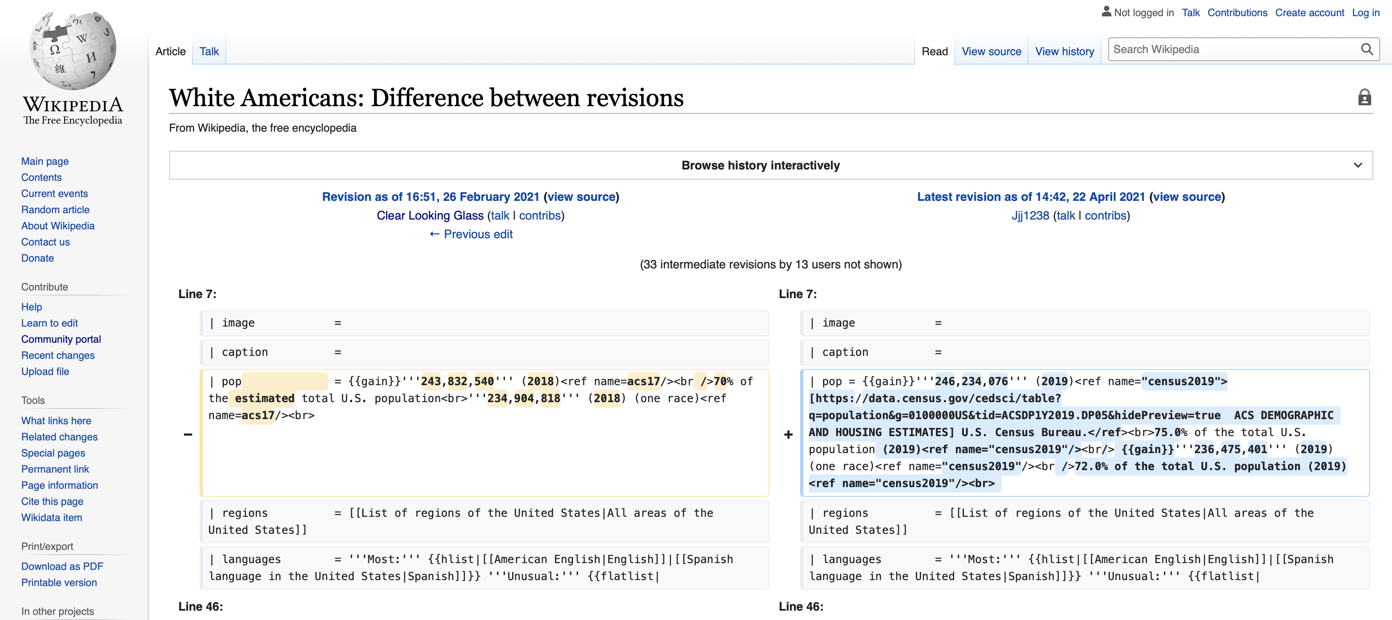
Link forwards to the issue
Notes:
Each link will take the moderator to the specific change log that needs to be reviewed. They can then make the appropriate changes, or return to the tool to mark it as ok.

Slide 6
Tool dashboard
Tool that will depict all the most likely locations of misinformation
Based on similar Wikipedia moderator pages
DEMO!
Notes:
To combat these issues I have created a tool that will depict all of the most likely locations of misinformation . This is based on similar Wikipedia moderator pages for things like grammar, link, and citation fixes

