Slide 1
CS611 - MLE
Assignment 1
Data Processing Pipelines
Apr - Jul 2025
Submitted by: Alvin Lee Ze Xian

Slide 2
Background
Context
Our financial institution provides cash loans to individual customers.
A key business challenge is mitigating the risk of loan default by accurately assessing the creditworthiness of applicants at the point of loan application.
Business Objective
To develop a machine learning model that predicts whether a customer is likely to default on a loan before the loan is approved.
This enables more informed, data-driven credit decisions and helps reduce financial risk.

Slide 3
Approach
Before model development, the data is pre-processed which includes engineering reliable and reusable feature and label datasets, that will serve as the foundation for model training.
The Medallion Architecture is adopted to structure the data pipeline into three layers:
Bronze: Raw data ingestion from diverse sources (e.g., user profiles, transactions, financials, clickstream)
Silver: Cleaned, validated, and joined data with consistent formatting and semantic meaning
Gold: Curated features and labels specifically engineered for machine learning model consumption
This structured approach ensures data traceability, reusability, and production-readiness for downstream machine learning workflows.

Slide 4
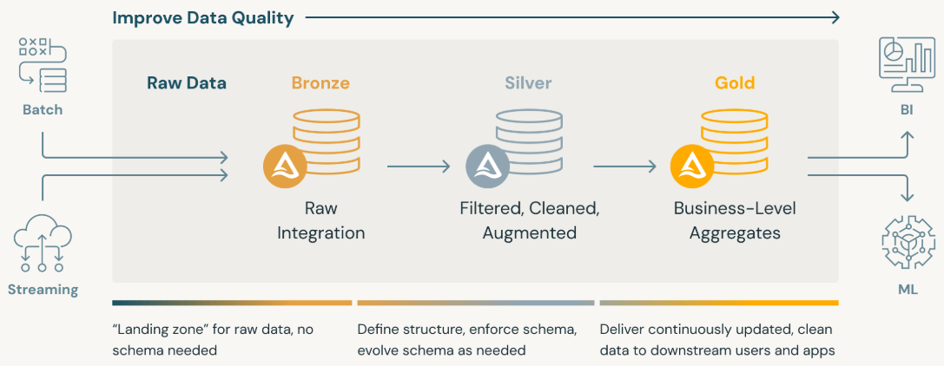
What is Medallion Architecture?
The Medallion Architecture is a data design pattern that organizes data pipelines into layered stages - Bronze, Silver, and Gold, to improve data quality, reliability, and usability for analytics and machine learning.
Layer | Purpose | Characteristics
Bronze | Raw Data Ingestion | “Landing zone” for raw data; no schema enforcement
Silver | Data Refinement | Cleaned, validated, structured, and joined data
Gold | Business-Ready Data for Analytics | Aggregated and enriched data optimized for ML & BI use
Ensures data traceability and governance, Promotes modular and scalable pipeline design,
Enables faster experimentation and production deployment
Reference: https://www.databricks.com/glossary/medallion-architecture

Slide 5
Dataset
Dataset | Description | Key Columns | Rows × Columns | Remarks
features_attributes | Customer demographic & profile attributes | Customer_ID, Age, Occupation, snapshot_date | 12,500 × 6 | Allow customer profiling to assess individual risk
features_financials | Detailed financial metrics and credit behavior | Credit_Mix, Outstanding_Debt, Credit_History_Age | 12,500 × 22 | Allow customer profiling to assess individual risk
feature_clickstream | User digital interaction signals during application process | fe_1 to fe_20 (engineered behavior features) | 215,376 × 22 | Provides behaviour signals and insights into customer intent and engagement pattern
lms_loan_daily | Daily loan installment records used for label generation | loan_amt, paid_amt, overdue_amt, tenure | 137,500 × 11 | Allow tracking of repayment behaviour to derive the target variable (labels)

Slide 6
What was done – Bronze Layer
Raw data was ingested from source files and filter by relevant snapshot dates to establish a reproducible and time-consistent data foundation.
Raw data written to Bronze tables as CSV files, partitioned by date
No transformations was performed, only filtering
Action Taken | Explanation | Rationale & Justification
Raw Data Ingestion | Load CSVs from source systems without transformation | Preserves full fidelity of raw data for traceability
Data Filtering | Keep only rows matching the given processing date | Aligns features temporally with label generation and avoids data leakage
Data Conversion | Use to_date() and lit() functions to enforce date type | Prevents type mismatches and enables consistent filtering
Saving as CSV | Stored extracted and transformed data in efficient format partitioned by snapshot | Supports reproducibility and organized data staging
Ensures data lineage, reproducibility, and traceability for downstream layers
Purpose - Lay the foundation for structured processing in the Silver layer while preserving original data fidelity.

Slide 7
What was done – Silver Layer
Transforming raw Bronze data into clean, validated, and semantically structured datasets ready for feature engineering and label generation.
Action Taken | Explanation | Rationale & Justification
Column Dropping | Dropped unnecessary columns like Name, SSN, and snapshot_date | Improves data security and reduces data footprint; snapshot filtering is already applied
Data Normalization | Trimmed and lowercased across all datasets | Ensures reliable join keys and prevents mismatches due to formatting inconsistencies
Data Type Casting | Casted fields to appropriate numeric and categorical types | Enables mathematical operations and avoids schema inference errors downstream
Cleaning Numeric Columns | Removed symbols, invalid characters and inconsistencies in monetary/percentage fields (e.g., $10,000 → 10000.0) | Prevents nulls and incorrect values during modeling; ensures usable features
Data Conversion | Converted “X Years Y Months” into numeric total months (Credit_History_Age) | Transforms text into a usable numerical feature for time-based credit behavior modeling
Cleaning Categorical Fields | Trimmed, lowercased, and replaced blanks/symbols with 'na’ | Improves consistency, reduces cardinality, and avoids null handling issues
Data Decomposition | Split composite strings (e.g., "auto and home loan") into lists, remove ‘not specified’, and counted distinct types (Type_of_loan) | Converts unstructured input into structured, model-ready features with interpretable meaning
Data Standardizing | Normalized to known categories or labeled as 'unknown’ (Payment_Behaviour) | Controls the impact of noise and unseen values, improves model generalization
Joining Tables | Joined attribute, financial, and clickstream data on Customer_ID | Combines complementary information from multiple domains into one holistic feature view
Saving as Parquet | Stored clean, joined data in efficient format partitioned by snapshot | Ensures fast, scalable access for training, reproducibility, and lineage tracking

Slide 8
What was done – Gold Layer
Performs final feature engineering, selection, and reduction to create a clean, enriched, and modeling-ready dataset.
Transforms data into meaningful features, removes redundant or multicollinear variables, and standardizes formats to ensure optimal performance for machine learning models.
Action Taken | Explanation | Rationale & Justification
Data Types Enforcement | Casts float and integer columns to correct | Ensures consistency and prevents modeling
Outlier Filtering | Filter out extreme values across numeric | Removes noise and reduces model bias from invalid outliers
Log transformation | Apply log1p to skewed financial variables | Reduces skewness and stabilizes variance
Financial ratio engineering | Calculate ratios like Debt-to-Income, EMI-to-Income | Adds meaningful, interpretable indicators of financial health
Drop multicollinear raw fields | Remove raw variables that are strongly correlated with engineered ones | Prevents overfitting and redundancy in model training
Categorical normalization | Standardize unknown/missing values in key categorical columns | Improves model robustness and reduces noise
Feature engineering | Derive binary `is_employed` indicator from occupation | Encodes employment status for predictive modeling
Saving as Parquet | Stored processed and feature engineered data in efficient format partitioned by snapshot | Prepare processed and feature engineered data for model development

Slide 9
Conclusion - Data Readiness for ML
Successfully implemented a production-grade data processing pipeline using the Medallion Architecture, progressing through:
Bronze Layer: Ingested and snapshot-filtered raw data from multiple domains (attributes, financials, clickstream, loan events)
Silver Layer: Cleaned, standardized, and integrated multi-source data into unified and trustworthy feature and label foundations
Gold Layer: Engineered high-quality, interpretable features and generated consistent supervised learning labels for predictive modeling
All datasets are now clean, consistent, and ML-ready, enabling accurate model training for loan default prediction at the point of application.

Slide 10
features_attributes.csv
features_financials.csv
Bronze Tables (Features)
Raw Data Ingestion &
Snapshot Filtering
features_clickstream.csv
Bronze Tables (Label)
lms_loan_daily.csv

