Slide 1

CS611 – MLE Assignment 2 ML Pipeline Jun 2025
Submitted by: Alvin Lee Ze Xian

Slide 2


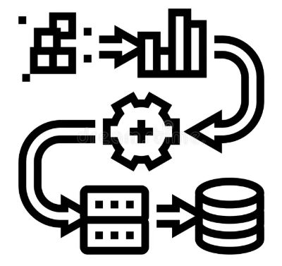

Background & Objective
As a financial institution providing cash loans, a key business challenge is to mitigate the risk of loan default by accurately assessing the creditworthiness of applicants at the point of loan application.
To develop a machine learning model that predicts whether a customer is likely to default on a loan before the loan is approved. Enabling more informed, data-driven credit decisions and helps reduce financial risk.
CONtext
Objective
Recap on Assignment 1:
Data processing pipeline built
Raw data processed
Gold standard data prepared
What was achieved in Assignment 2:
Machine learning pipeline developed
Model training, inference, selection
Performance monitoring and dashboarding

Slide 3

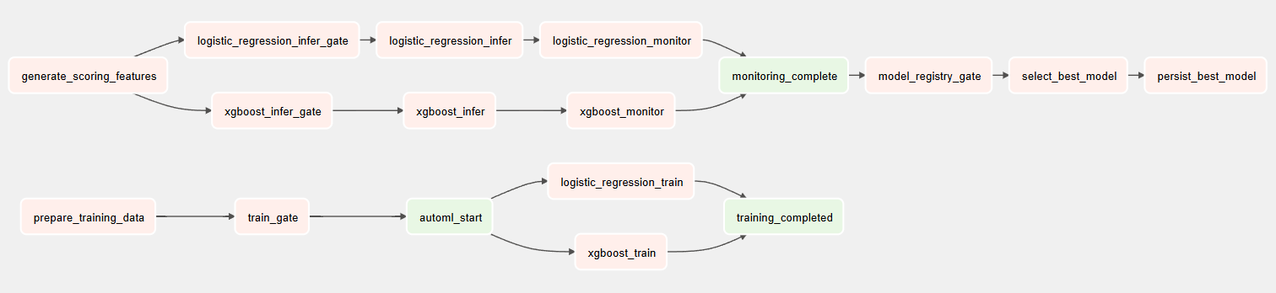
End-to-End ML Pipeline
This DAG orchestrated a full machine learning pipeline for loan default prediction using Apache Airflow, handling both training and inference paths for two models in parallel — Logistic Regression and XGBoost.
Consist of 3 key segments – 1) Training, 2) Inference & Monitoring, and 3) Model Selection
Parallelization
Both Logistic Regression and XGBoost were handled independently from training to monitoring.
DAG ensured modularity and fault isolation - if one model fails, the other can still complete.
Backfilling and Scheduling
Airflow supported monthly execution and backfilling across historical time windows.
Pipeline is stateless across runs - governed by snapshot month.

Slide 4
End-to-End ML Pipeline
Training Segment
Executes only on the scheduled training snapshot
prepare_training_data: Loads and combines monthly data
train_gate: Ensures training runs only once
automl_start: Marks training kickoff for both models
logistic_regression_train/ xgboost_train: Trains both models and logs them to Mlflow
training_completed: Marks training success
Inference & Monitoring Segment
Runs for OOT months
generate_scoring_features: Loads current month's snapshot for inference
*_infer_gate: Ensures inference only runs post-training
*_infer: Scores data using persisted models
*_monitor: Evaluates prediction quality and logs performance/drift
Model Selection Segment
monitoring_complete: Waits for both model monitors to finish
model_registry_gate: Logic to determine if new best model should be selected
select_best_model: Compares OOT performance (F1 score, etc.)
persist_best_model: Saves the selected model to the model registry

Slide 5


Model Training & Inference Strategy
Train/ Val/ Test Split
OOT (6 x 1 month)
12 months
Jan 2023
Dec 2023
Jun 2024
Dec 2024
Training Strategy
Training Data Period: Jan 2023 – Dec 2023 (12 months)
Labels: Labels were revealed 6 months later (label lag)
Models Trained:
Logistic Regression – Interpretable, fast to train and baseline for comparison, useful for understanding linear relationships and coefficient weights
XGBoost – Handles nonlinear interactions and feature interactions well, strong performance on structured/tabular data, robust to class imbalance, missing values, and outliers
Parallel Training: Both models trained simultaneously
Evaluation Metrics: F1 score, AUC, accuracy (via MLflow logging)
Logged Artifacts: Feature schema, model weights, config, plots
Output: Models stored as versioned artifacts in model_store
Training triggered only once using a train_gate to avoid duplicate runs
Inference Strategy
Inference Period: Jan 2024 – Jun 2024 (OOT window)
Labels: Labels were revealed 6 months later (label lag)
Feature Snapshot: Monthly gold datasets (scoring features)
Pipeline Steps:
Load trained model from registry
Align input schema
Score batch data for each customer
Output predictions with probability scores
Storage: Predictions saved as prediction_{snapshot_date}.parquet
Models are applied independently per month, allowing backfilling and tracking.

Slide 6

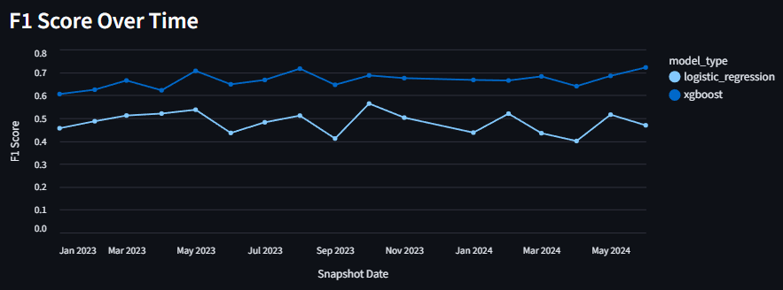
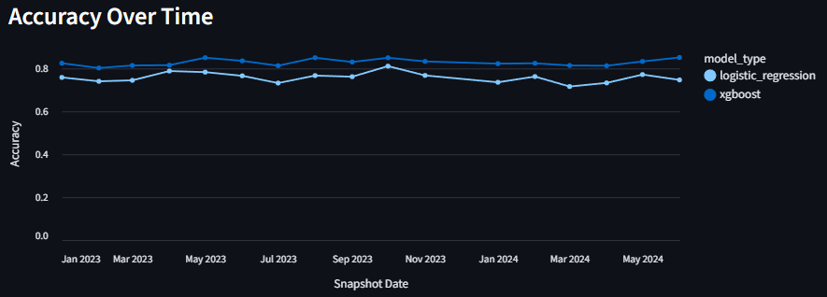
Model Monitoring
Tracking model behavior both pre-deployment (backfilled) and post-deployment (live inference)
Timeline
Jan–Dec 2023: Retrospective (backfilled) evaluation using historical data
Jan–Jun 2024: Live OOT inference with delayed labels
Performance Metrics
F1 Score: Measures prediction quality under class imbalance
Accuracy: Measures overall correctness
Observations
XGBoost consistently outperformed Logistic Regression on F1 score
Accuracy remained stable for both models across time
Backfilled insights enabled us to benchmark baseline performance prior to deployment, facilitated the assessment of model robustness on unseen historical data, providing confidence model selection

Slide 7
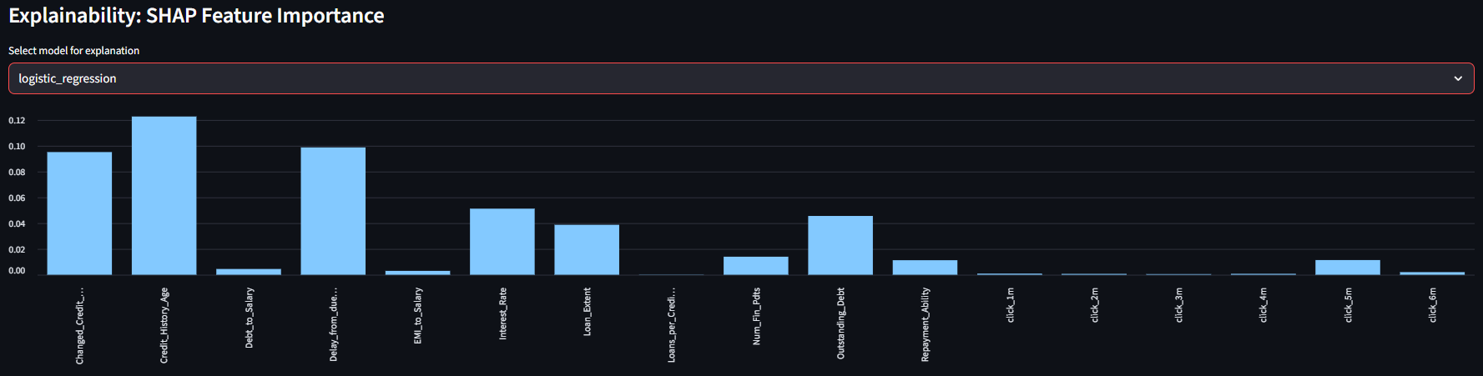
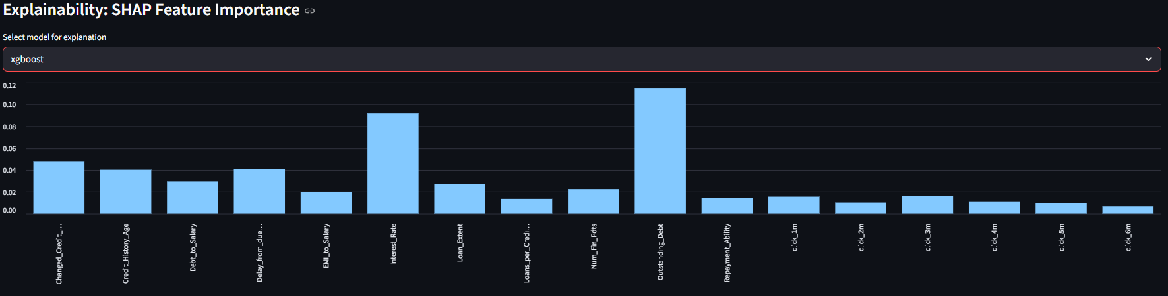
Model Monitoring
Showcasing model interpretability using SHAP values
Logistic Regression
SHAP values quantified the average contribution of each feature to the model's prediction.
Logistic Regression (Interpretability):
Top contributors: Credit_History_Age, Delay_from_due_date, Changed_Credit_Limit
Indicates reliance on well-understood, linear financial risk drivers
XGBoost (Performance):
Broader spread of feature contributions
Heavier weight on: Interest_Rate, Outstanding_Debt, Repayment_Ability
Captures complex, nonlinear interactions
XGBoost
SHAP supports explainability required in regulated environments, explainability boosts trust with credit risk analysts & compliance teams

Slide 8
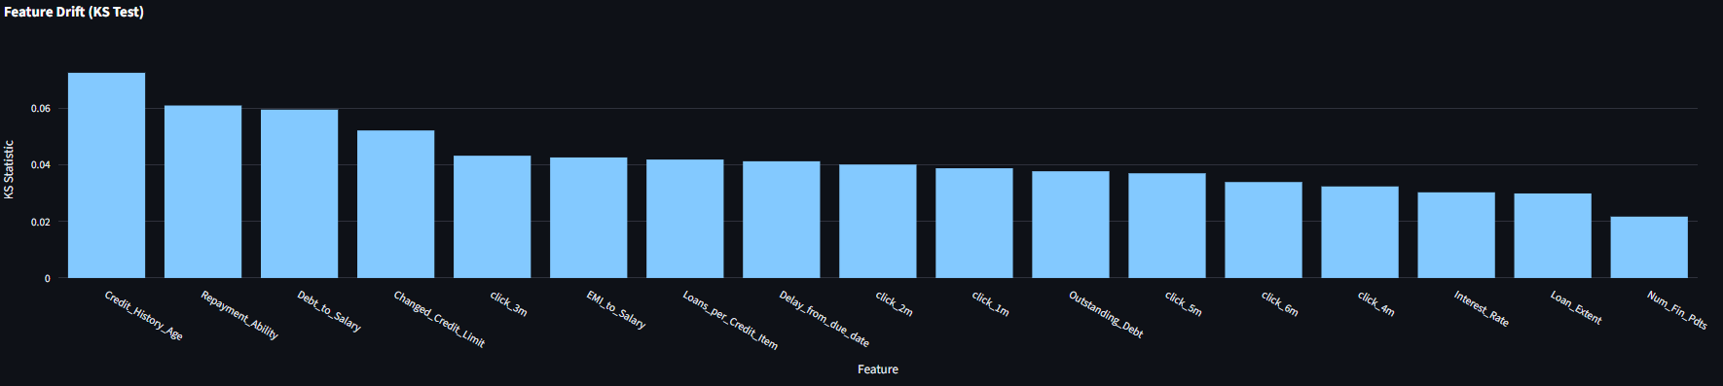
Model Monitoring
Showcasing data stability using KS-statistics
KS-statistics measured how much a feature’s distribution shifted compared to the training set (2023-12-01 baseline)
Drift is monitored monthly; KS > 0.2 triggers alerts
Current snapshot: All features show KS < 0.1 → No severe drift
Notable minor drift: Credit_History_Age, Repayment_Ability, and Debt_to_Salary with KS ≈ 0.06 - 0.07
KS-statistics validates input stability; model still operating within learned distribution, drift monitoring ensures predictions remain reliable as data evolves

Slide 9




Model Governance
Ensuring robust management of models in production with clear SOPs for refreshing, evaluating, and deploying models responsibly.
Model Governance Framework
Versioning & Registry Models tracked and versioned using Mlflow, enables reproducibility, rollback, and auditability
Model Selection Logic After each inference cycle, models are evaluated based on F1 and Accuracy, best-performing model (on latest OOT) is auto-selected
Artifact Management Artifacts (model weights, schema, config) stored, standardized storage with metadata
Model Refresh SOP
Trigger Conditions for Retraining
Performance Degradation: F1 score drop > 5% from trailing average
Feature Drift Detected: KS-stat > 0.2 on multiple key features
Business Changes: Introduction of new credit products, regulation updates
Retraining Steps
Collect most recent 12-months labeled data
Re-run training pipeline
Log & compare with existing models in registry
Deploy only if new model outperforms previous in OOT evaluation
Deployment Options
Batch Scoring (Current) Monthly prediction using Airflow DAG, suitable for periodic loan approvals
Realtime API (Future-Ready) Wrap model inference in FastAPI or Flask for integration into credit app workflow, enables instant loan decisioning

Slide 10




Conclusion
End-to-End ML Pipeline Achieved
Built a full pipeline covering training, inference, monitoring, and explainability.
Modular structure orchestrated using Airflow, integrated with MLflow for tracking and reproducibility.
Model Performance & Monitoring
XGBoost outperformed Logistic Regression on F1 score across backfilled and OOT periods.
Monitoring dashboards provide visibility on:
Performance trends (F1, accuracy)
Feature impact explainability (via SHAP)
Data drift detection (KS-statistics)
Business Trust through Transparency
SHAP visualizations promote interpretability and trust for credit risk teams.
KS-statistics confirm model stability over time, ensuring reliable deployment.
Scalable Design
Monthly batch inference supports backfilling and future scoring use cases.
Models versioned and persisted using a registry for reproducibility and governance.

Slide 11

Thank You

