Slide 1
SOCIAL DEVELOPMENT, CIVIC GOVERNANCE
& HUMAN SECURITY CONTINUUM
60 Comprehensive Applied Frameworks, M&E Architectures & Multilateral Policy Treatises
OPERATIONAL STATUS: WORKING DRAFTS // NON-AUTHORITATIVE ACADEMIC REFERENCE
Prepared for Institutional Capacity Development & Multi-Sectoral Systems Modeling

Slide 2
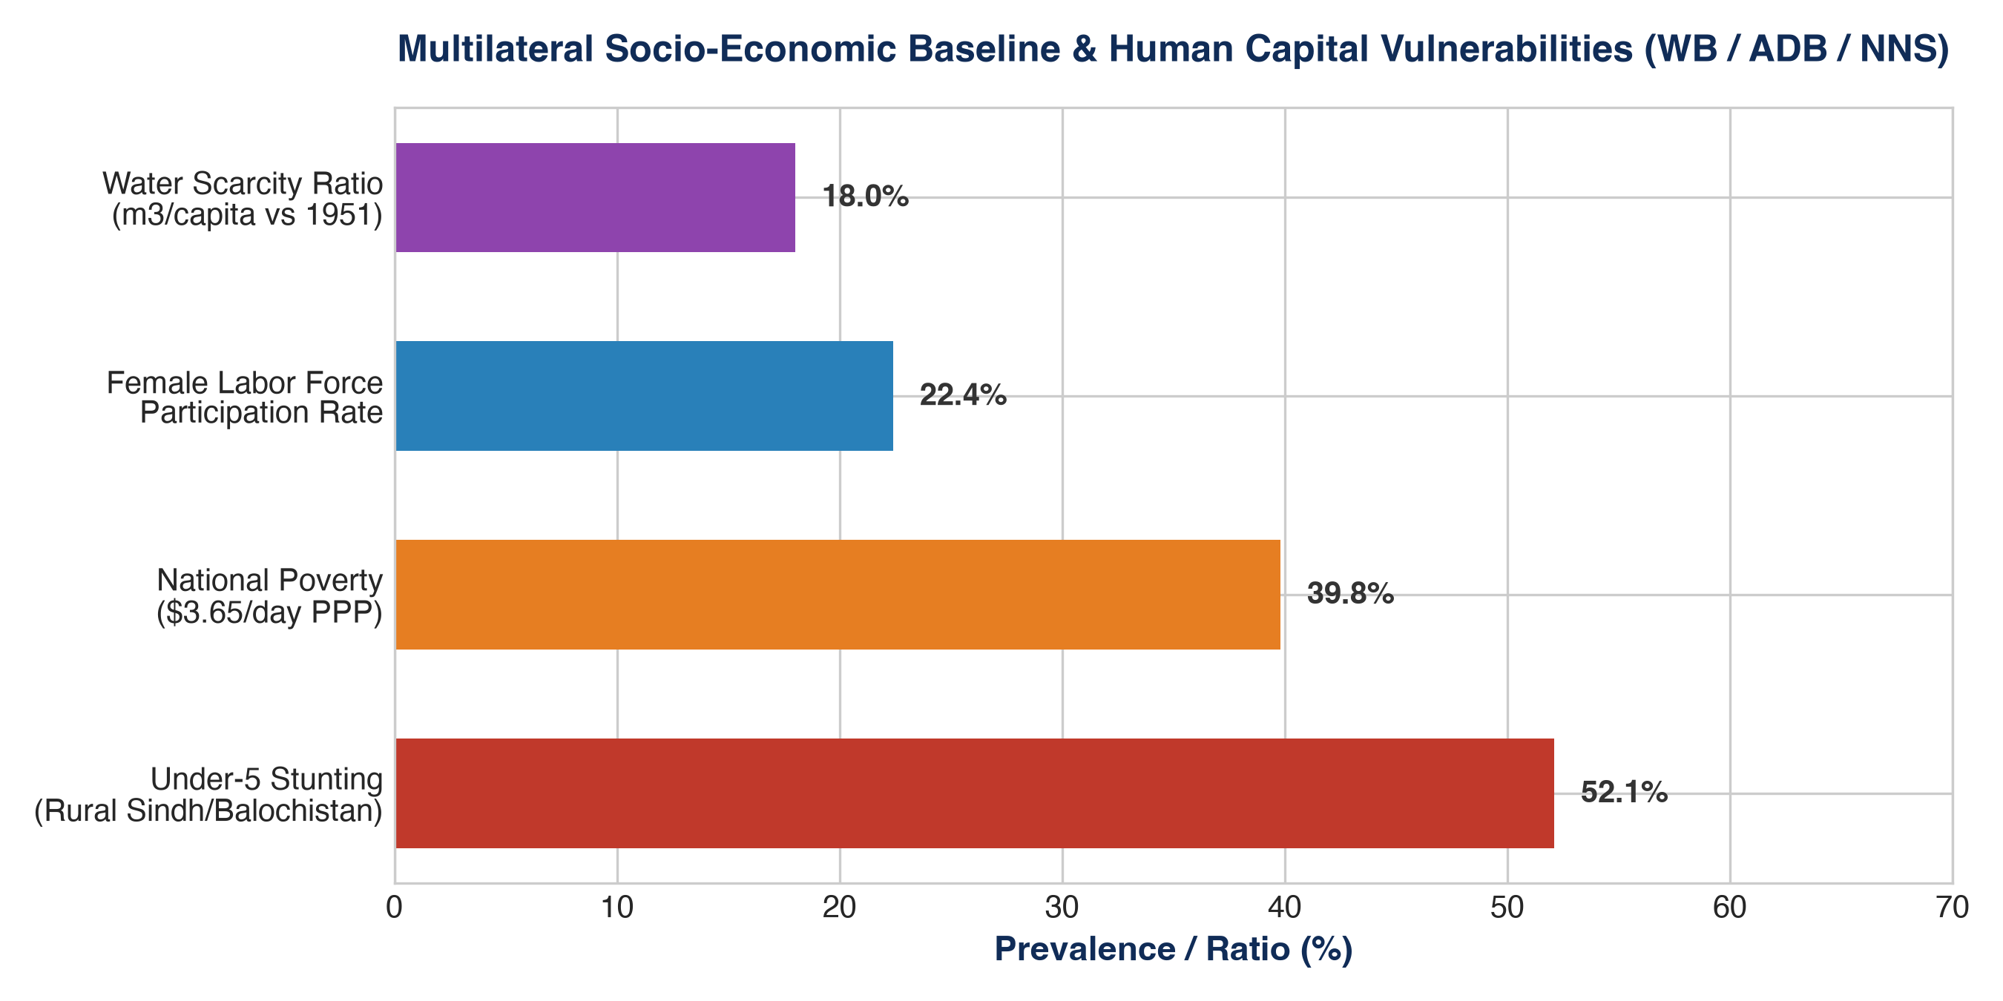
MULTILATERAL INTELLIGENCE (WORLD BANK, IMF, ADB & NNS)
Multilateral Socio-Economic Baseline & Structural Shocks
CORE MULTILATERAL TELEMETRY:
• 39.8% Poverty Headcount: Post-2022 macroeconomic shocks & flood devastation (WB $3.65/day PPP).
• 52.1% Stunting in Rural Children: Acute nutritional deprivation in lower Sindh & eastern Balochistan (NNS).
• 22.4% Female Labor Participation: One of the largest gender economic participation divides in South Asia.
• Water Scarcity Threshold: Per-capita water drop from >5,000 m3 in 1951 to <900 m3 today (ADB PDNA).

Slide 3
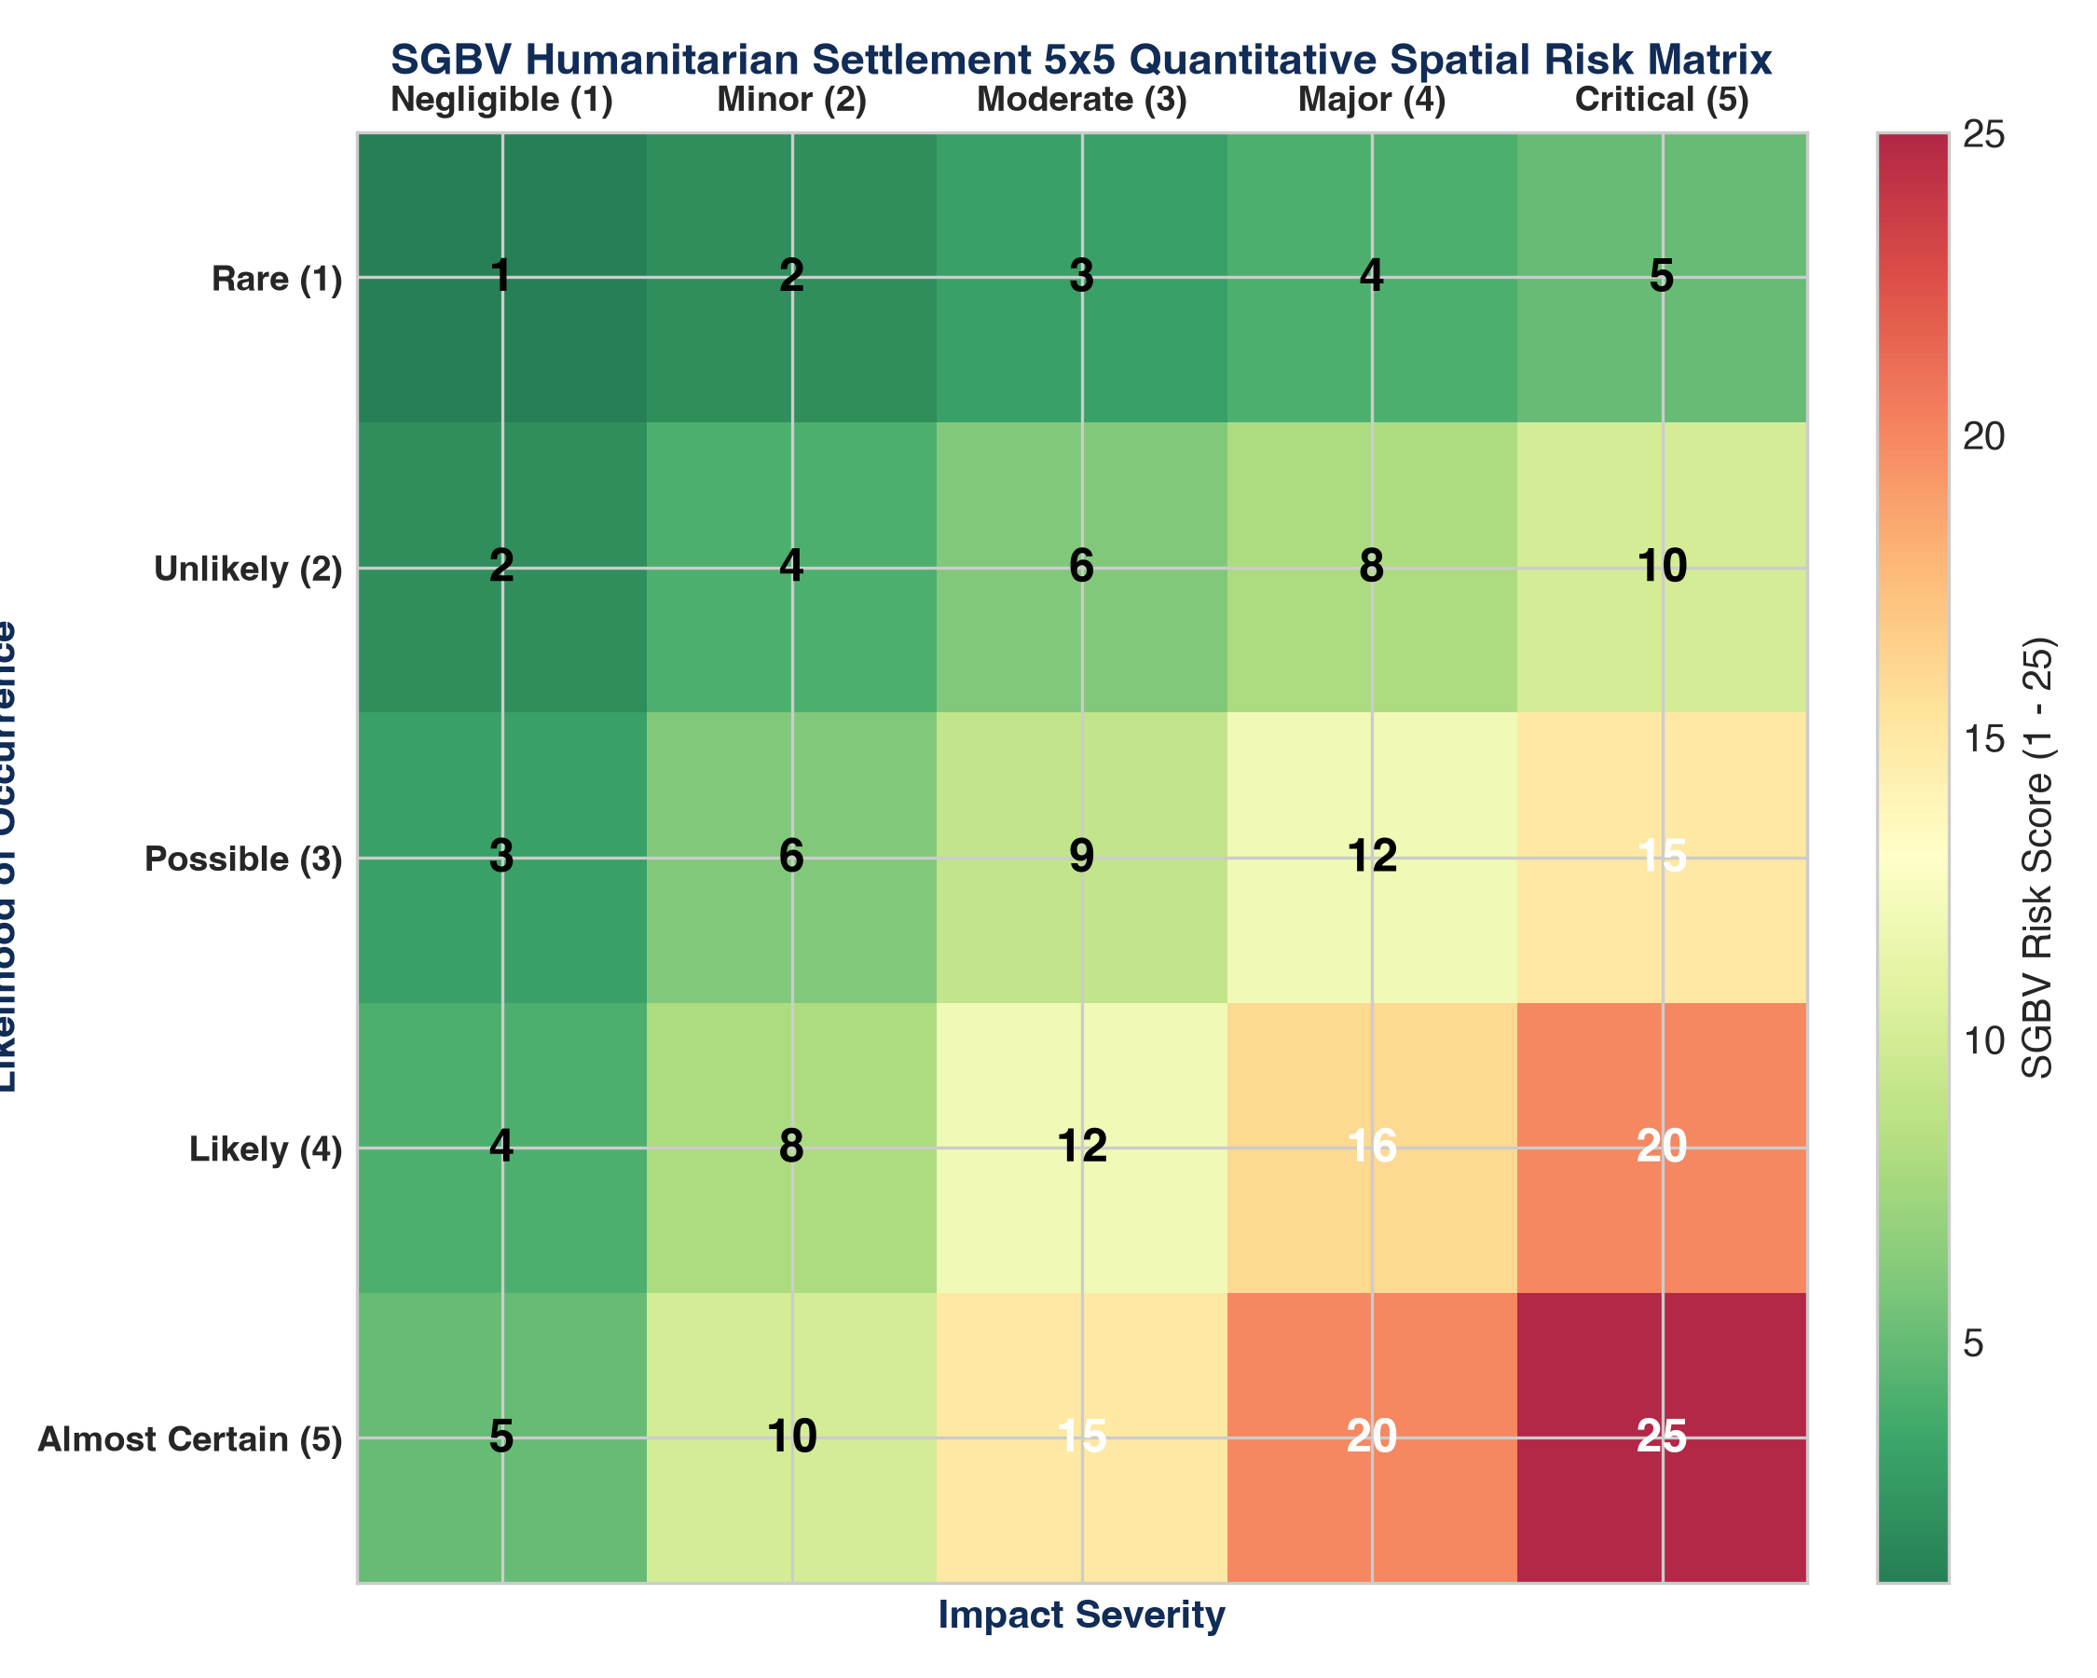
PILLAR IV: SGBV PREVENTION & PROTECTION ARCHITECTURE
SGBV Humanitarian Settlement 5x5 Quantitative Spatial Exposure Matrix
MATHEMATICAL FORMULATION & APPLICATION:
• Mathematical Model: Risk Score = Vulnerability Factor x Exposure Duration x (1 - Mitigation Efficiency).
• High-Hazard Danger Zones: Latrine corridors >50m without solar lighting, remote firewood foraging routes.
• 72-Hour Clinical Pathway: Mandatory non-stigmatizing emergency contraception & HIV PEP within 72h window.
• Forensic Chain of Custody: Confidential evidence sealing protecting survivor identities from retaliation.

Slide 4
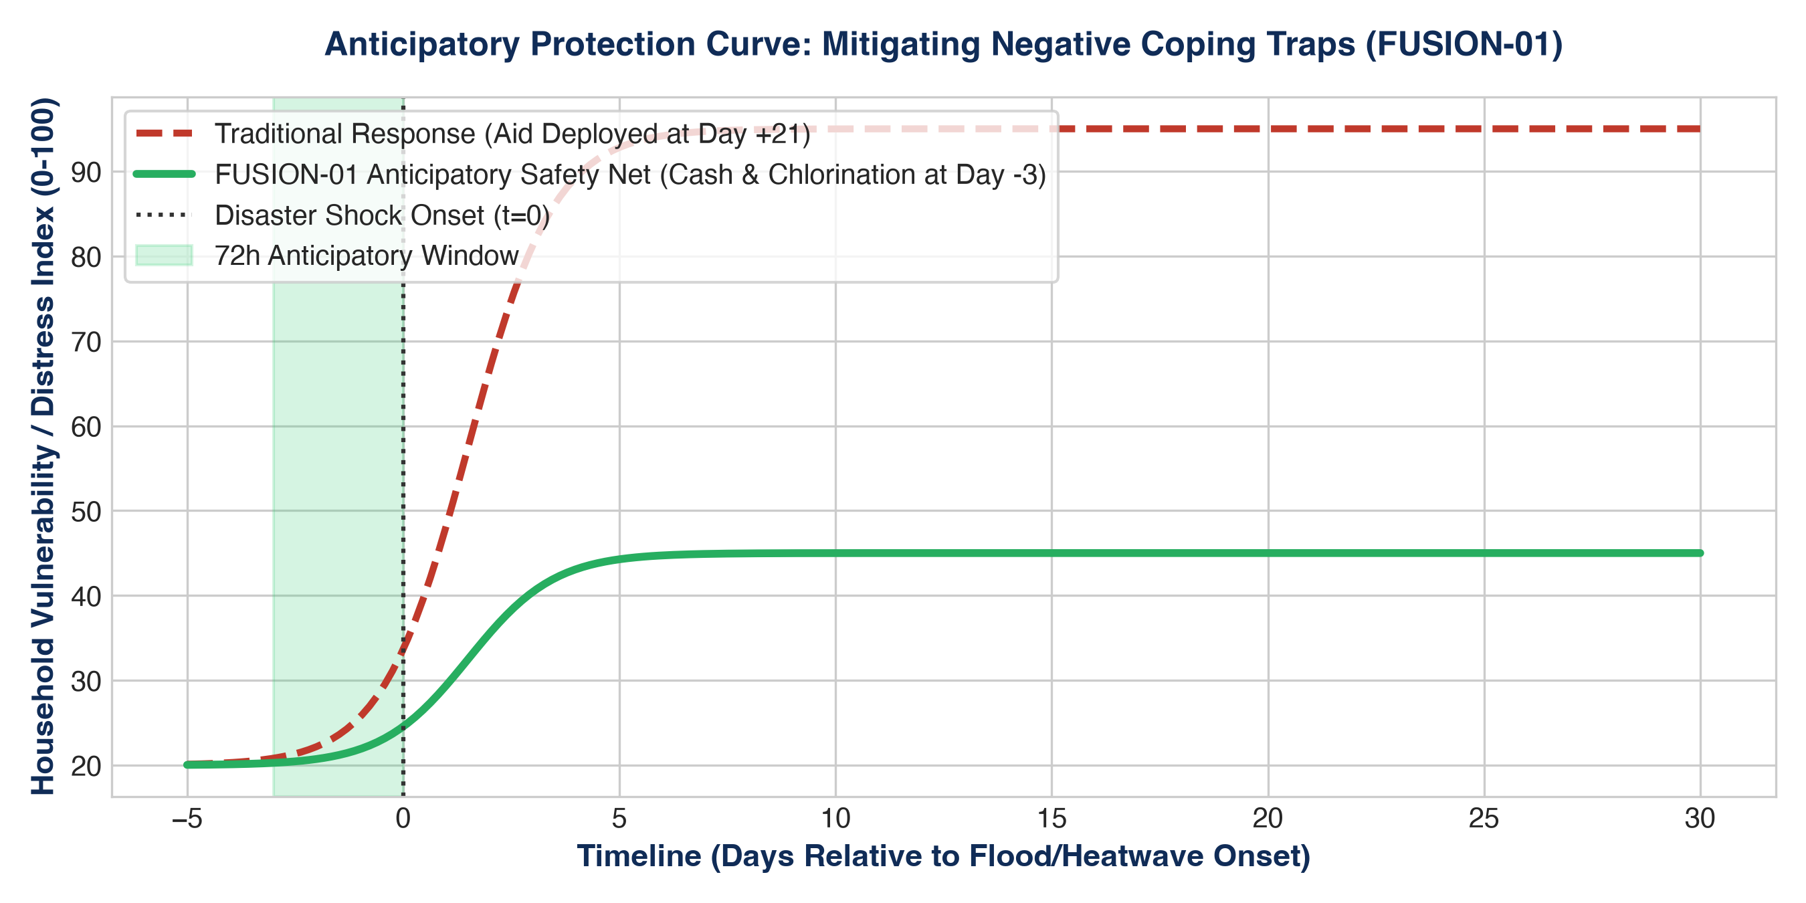
MASTER CROSS-DISCIPLINARY TREATISES (5W+1H)
FUSION-01: National Climate-Adaptive Social Safety Net & Anticipatory Protection
SYSTEMS PARADIGM SHIFT:
• Ex-Post Aid Failure: Traditional relief arrives Day +21 to +45, forcing distress sales and child marriage.
• Pre-Emptive 72h Trigger: Satellite remote sensing flags flood crests; triggers $45 cash grants 72h early.
• Multilateral Nexus: Integrates UNICEF water purification, WFP emergency food, and BISP mobile wallets.
• Zero Waste & Transparency: Smart contract escrow rules with dual-signoff and independent AGP audits.

Slide 5
PORTFOLIO OVERVIEW & IMPLEMENTATION ROADMAPS
Executive Index: The 60 Integrated Development Frameworks
Pillar I: Cyber/AI in Orphanages (5 Projects): Air-gapped cyber hygiene labs, local quantized LLMs, decentralized ERP, sensory play. | Pillar VII: Inclusive Microfinance (5 Projects): Predatory APR calculator, village Kameti modernization, low-literacy visual business canvas.
Pillar II: WASH & Climate (5 Projects): Community water audits, sponge cities for slums, aquifer rationing, 72h camp sanitation. | Pillar VIII: Disaster Risk & Food (5 Projects): Urban heatwave early action, communal grain reserves, pastoralist satellite drought insurance.
Pillar III: PMEL & Public Governance (5 Projects): Master MEL manual, PC-1 proposal playbook, gender-lens evaluations, ethical AI safeguards. | Pillar IX: Civic Tech & Disinformation (5 Projects): RTI procurement audit kits, federal media cell threat taxonomies, prison bail audits.
Pillar IV: SGBV Prevention (5 Projects): 5x5 spatial exposure risk matrices, predictive vulnerability forecasting, 72h clinical SOP. | Pillar X: Multilateral Programs (5 Projects): World Bank HCI district models, IMF social spending monitors, UNHCR refugee inclusion.
Pillar V: Child Protection in Crisis (5 Projects): Unaccompanied minor case protocol, zero-child marriage escrow, Child-Friendly Spaces. | Pillar XI: QHSE & Risk Governance (5 Projects): ISO integrated manual (9001/14001/45001), HAZID bow-tie models, heat stress code.
Pillar VI: Women's Rights & Health (5 Projects): Maternal obstetric tele-triage, menstrual WASH standards, mobile CNIC registration. | Pillar XII: 5 Master Fusion Treatises: Holistic frameworks combining all 55 sector projects into unified national architectures.

