Slide 1
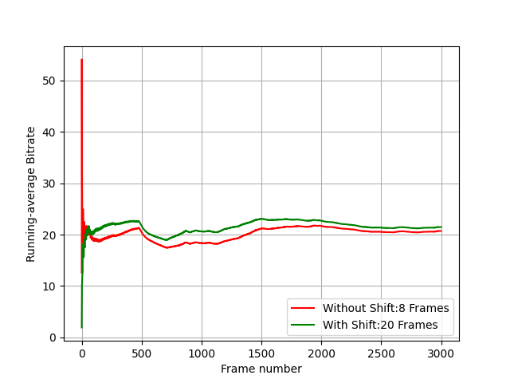
Running Average of Bitrate (60fps)

Slide 2
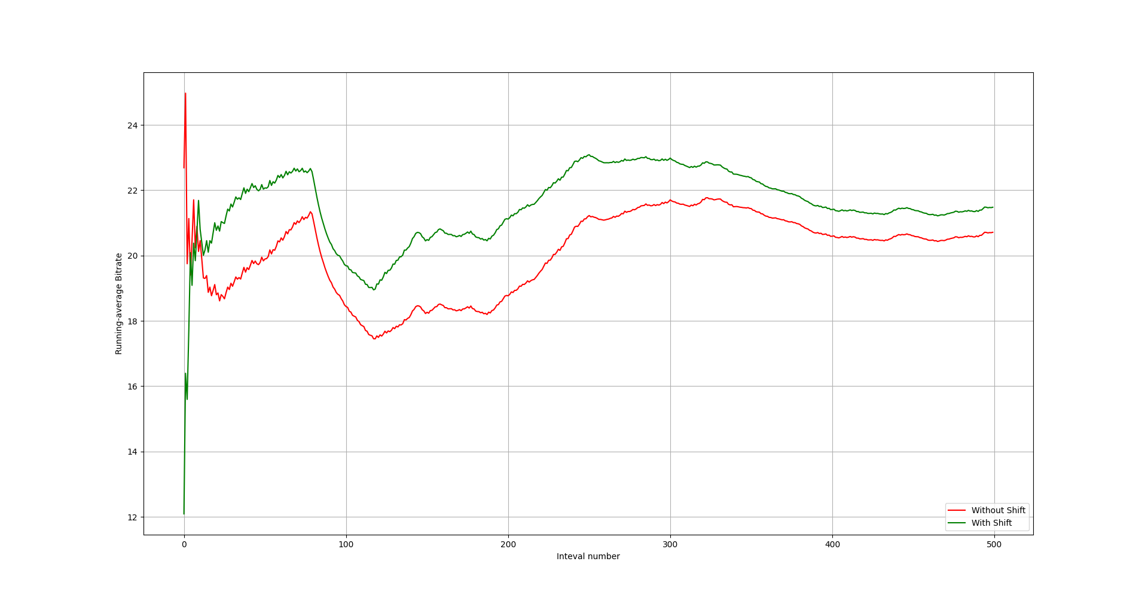
100-ms intervals

Slide 3
Frames Taken to Reach Running average of 20Mbps.
Interval | Frames taken in Without shift condition | Frames Taken in With shift condition
19Mbps - 21Mbps | 8 | 20
19.9Mbps – 20.1Mbps | 27 | 30
19.99Mbps – 20.01Mbps | Never | Never

Slide 4
Some experiments with ffmpeg mode
We Experimented with rate control methods and other options in ffmpeg to find out if we can get more suitable settings.

Slide 5
Effect of GOP size
With Higher GOP size We got Smoother variation in Bitrate.

Slide 6
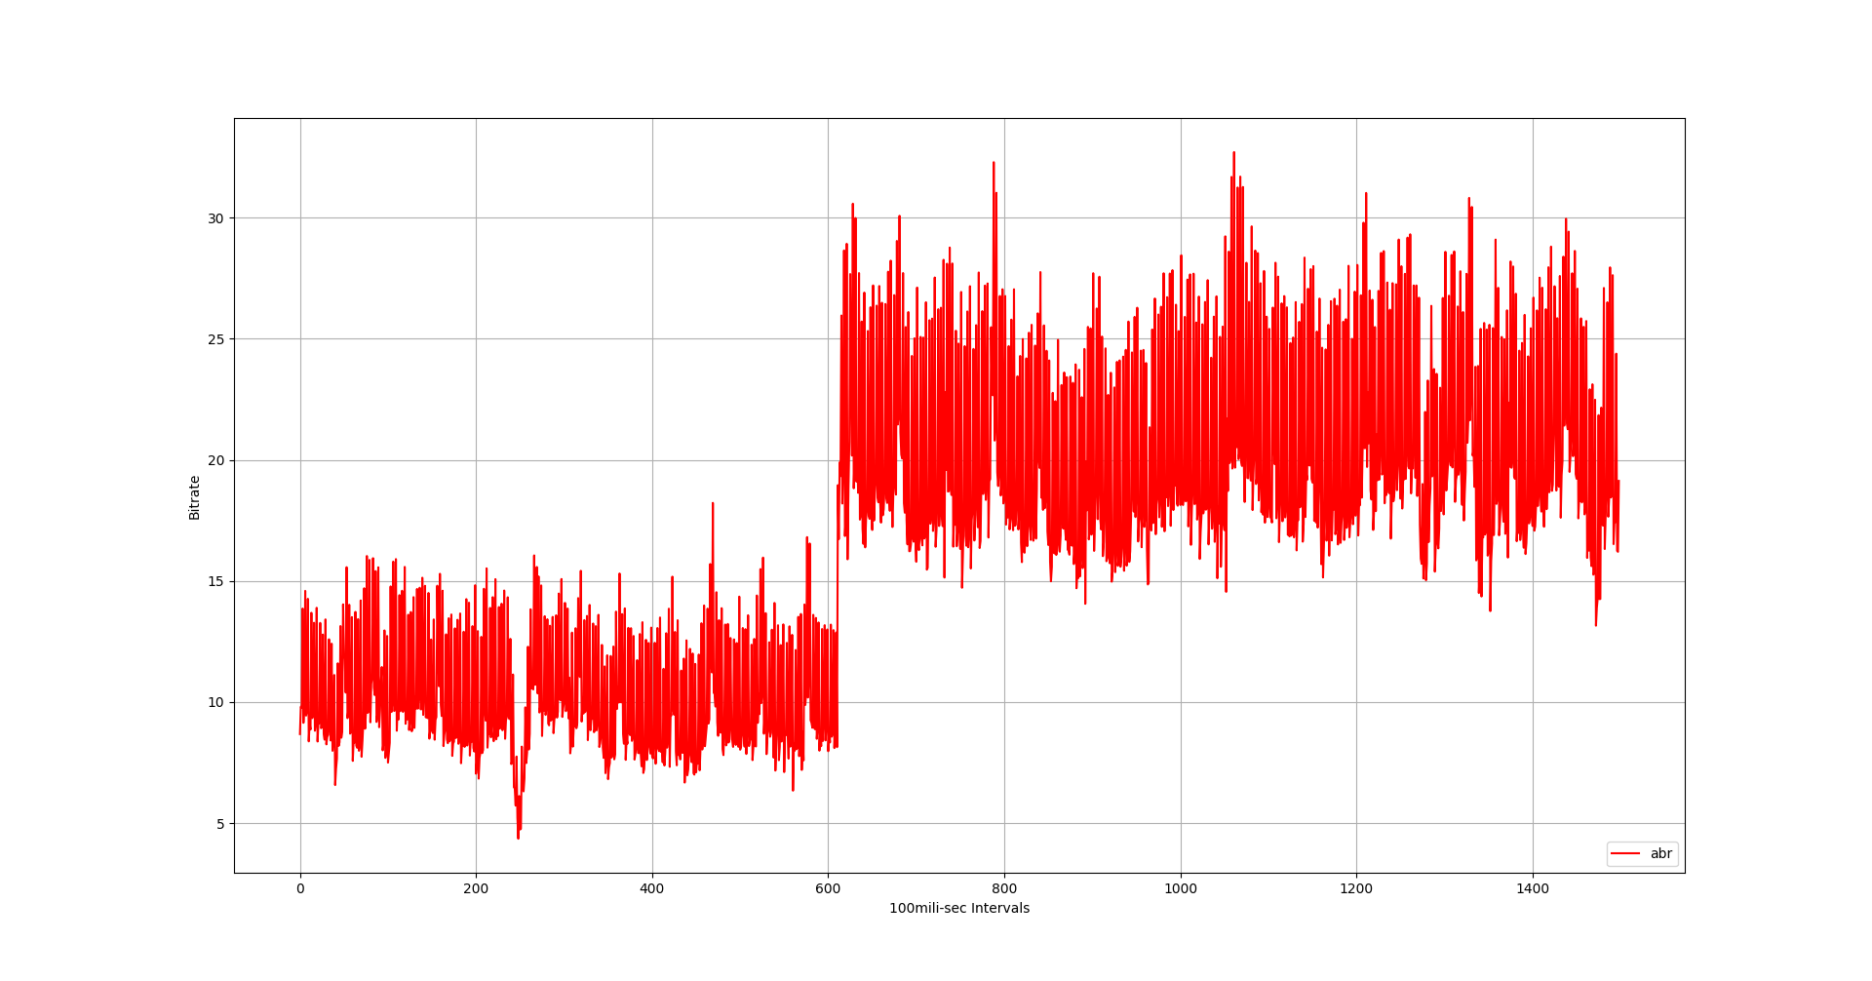
GOP = 10

Slide 7
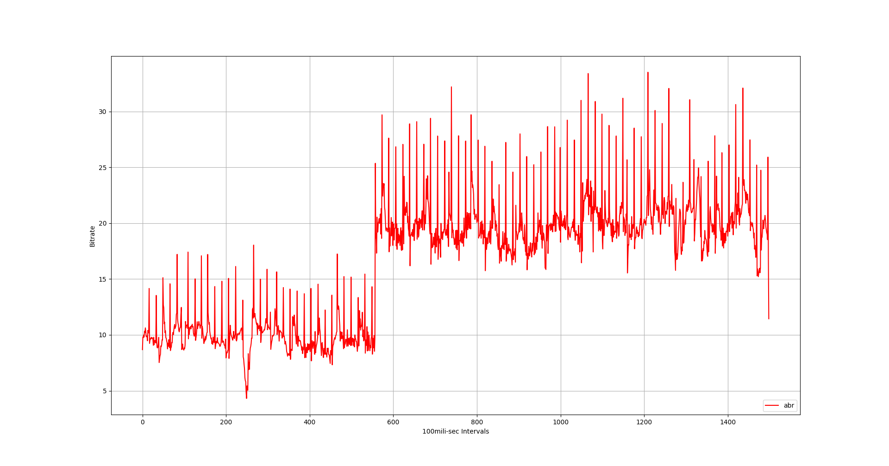
GOP = 50

Slide 8
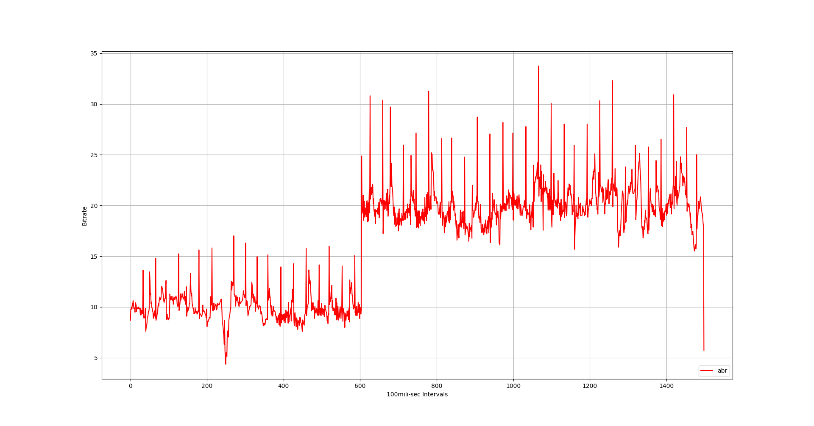
GOP = 100

Slide 9
Effect of buffer-Size
If we use buffer using “-bufsize” option, we get smaller overshooting and undershooting.

Slide 10
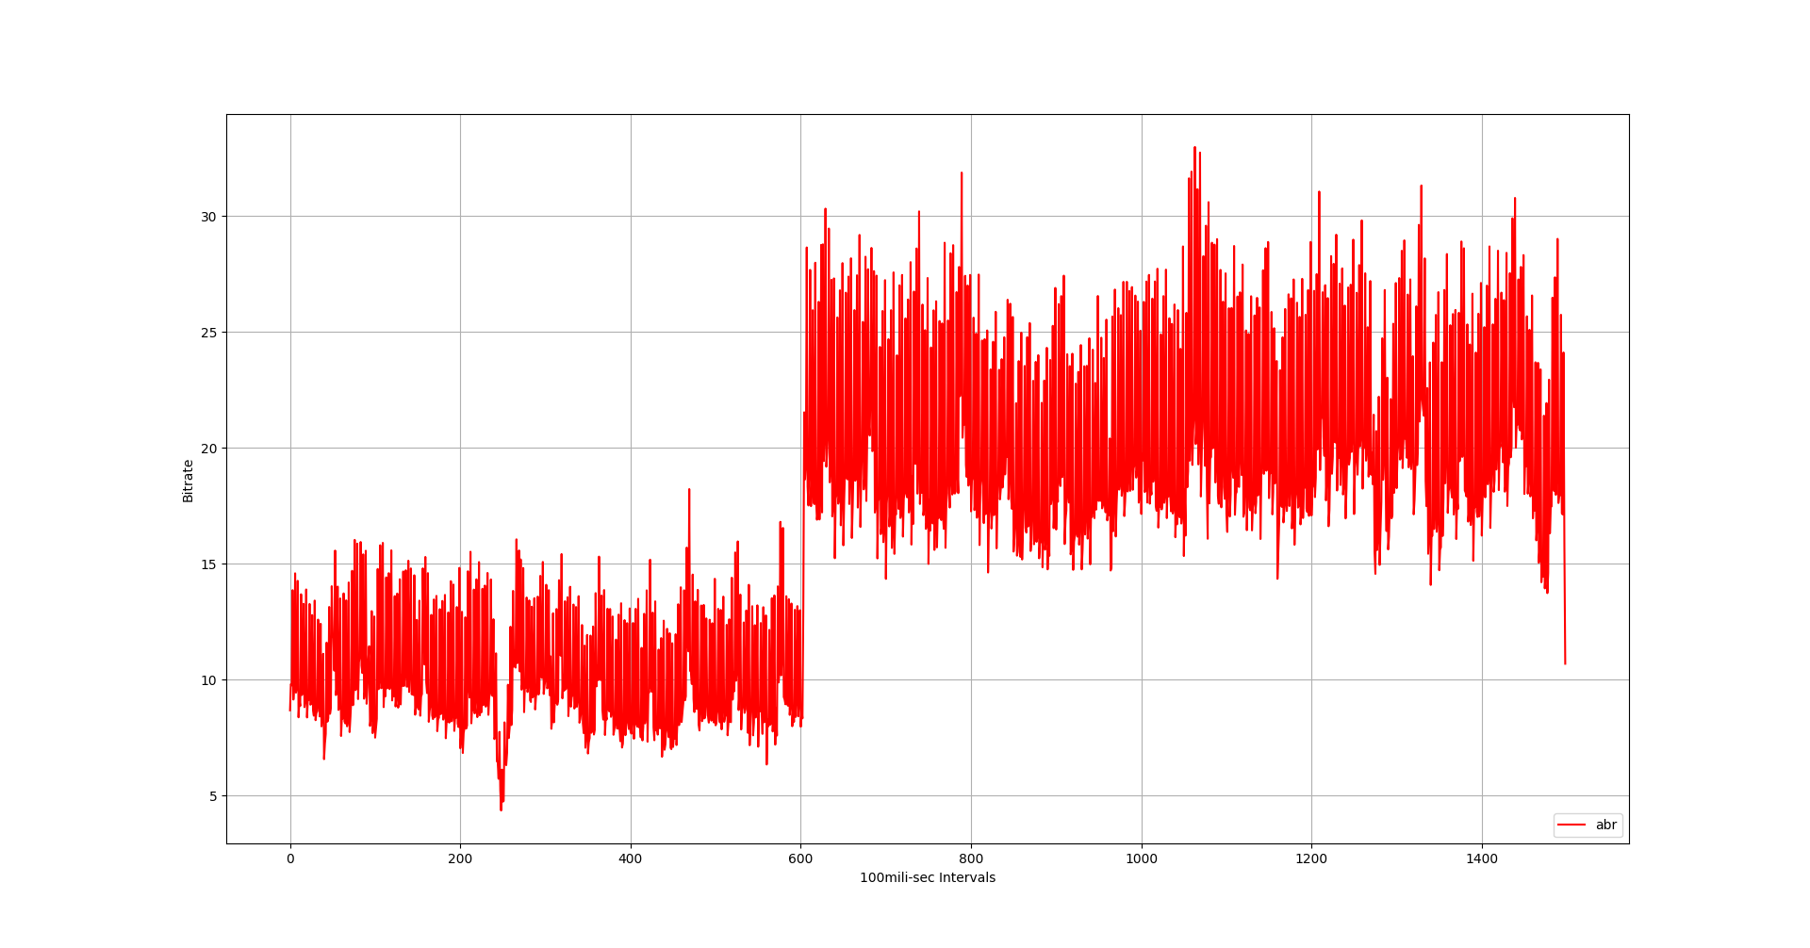
Without Buffer

Slide 11
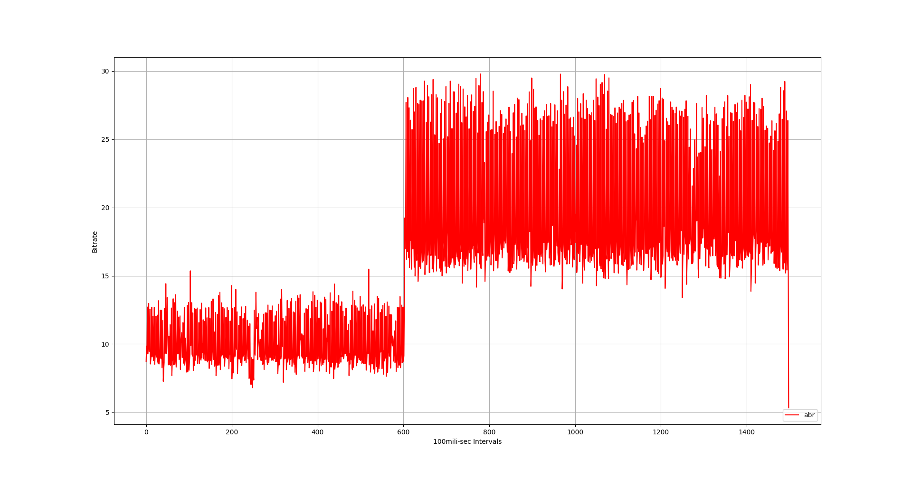
With 2Mb Buffer

Slide 12
CBR Mode in ffmpeg
Ffmpeg tries to simulate CBR mode using ABR rate control with specified “minrate” and “maxrate”.
It can give us almost constant bitrate.
But we can not change the bitrate during runtime.

Slide 13
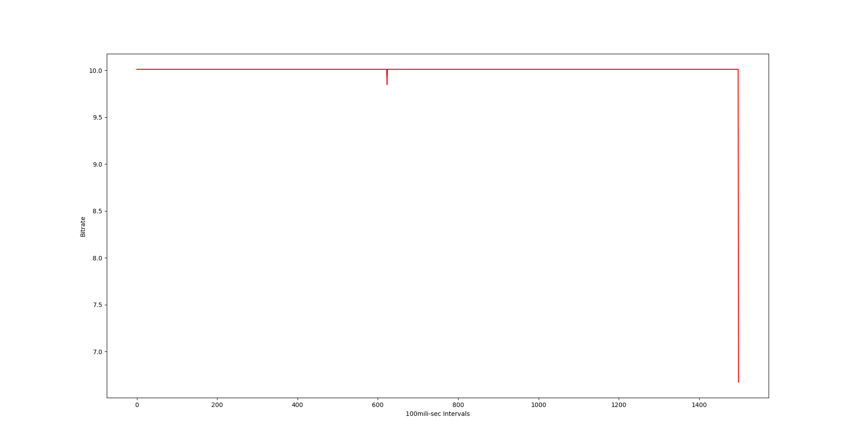
Graph of CBR Mode (10, 10)

Slide 14
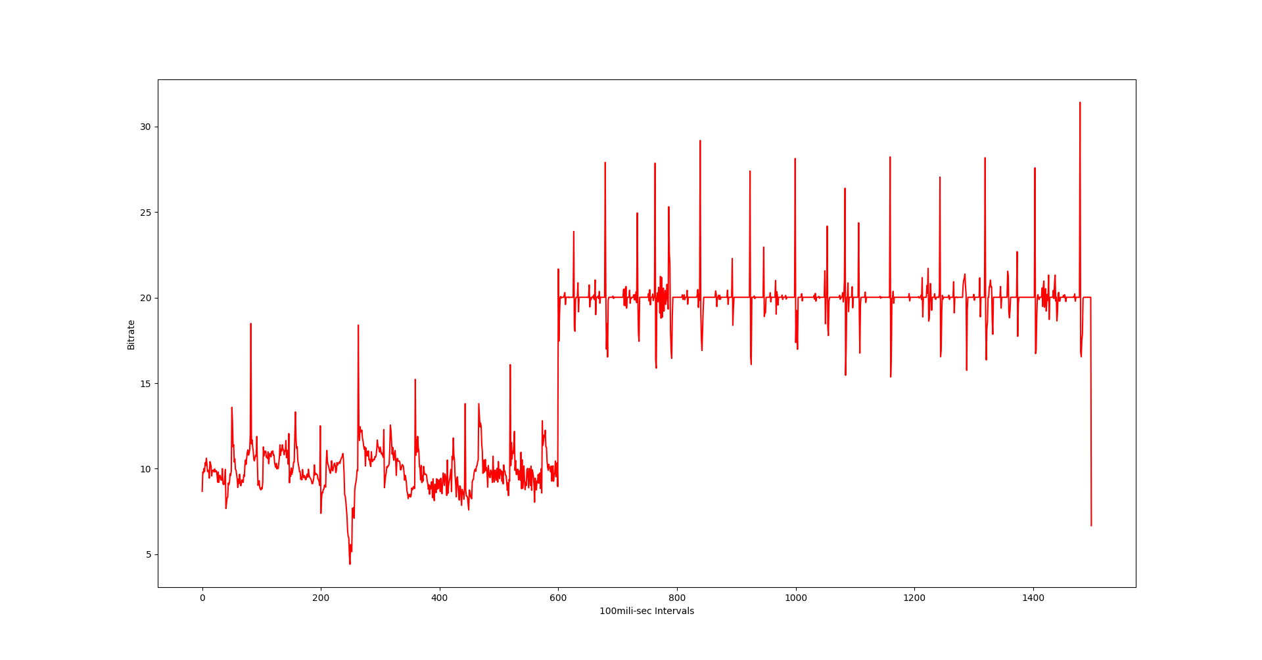
CBR (10, 20)

