Slide 1
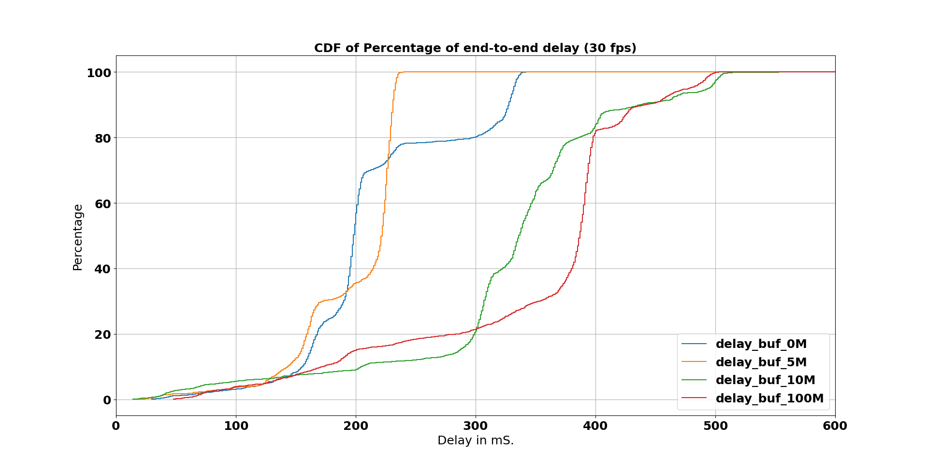
End-to-end delay CDF-plot

Slide 2
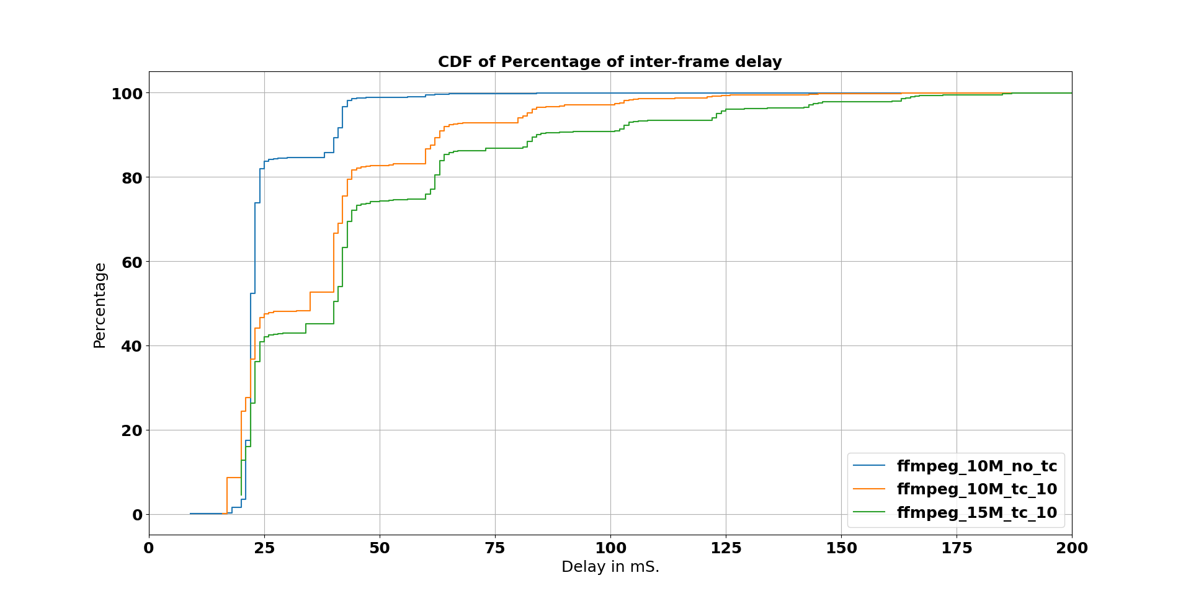
Plot for different throughputs.
Duration

Slide 3
Conclusions.
Traffic shaping causes a drop in FPS.
This happens regardless of ffplay, which suggests that there is a feedback from Operating System to ffmpeg process.

Slide 4
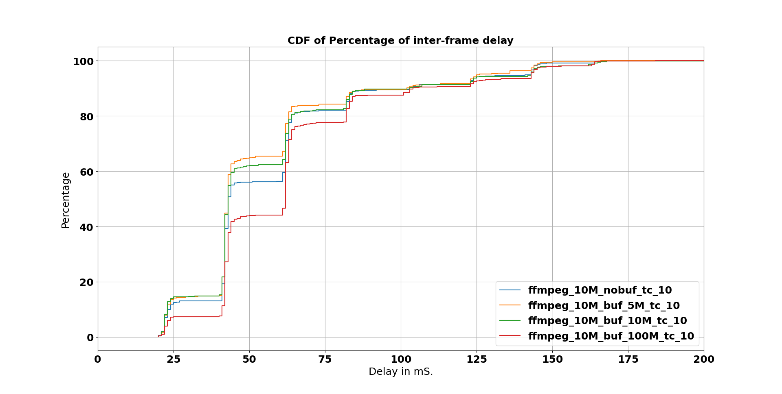
Plots for different Buffersize (30fps)

Slide 5
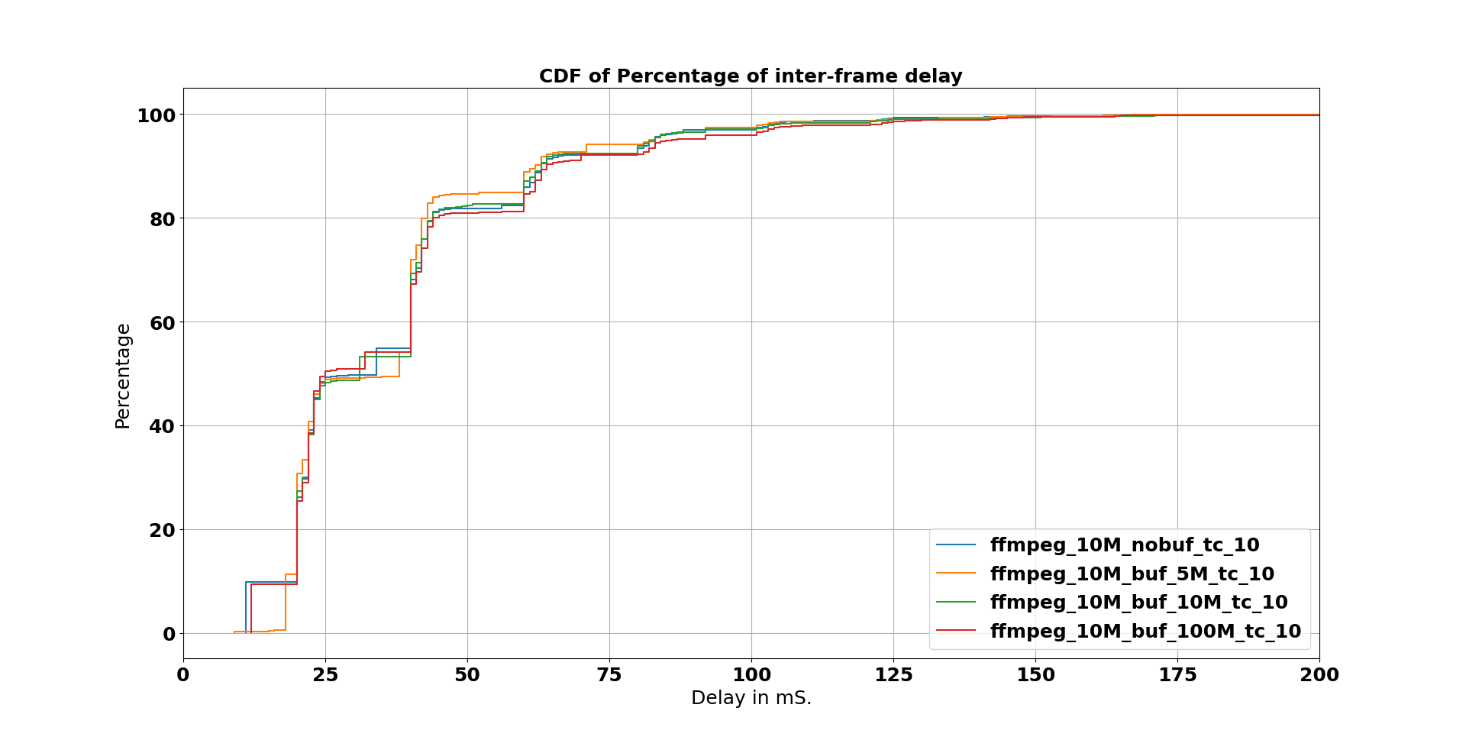
60fps

Slide 6
Ffmpeg stats for 30fps video
Bufsize | Total I-frames | Total P-frames | <QP> I-frames | <QP> P-frames | I-frame Total size (KB) | P-frame Total size (KB) | <Bitrate> (Kb / S)
0M | 125 | 1106 | 18.77 | 22.0 | 99061 | 36206 | 10211
5M | 164 | 1456 | 18.72 | 21.96 | 98469 | 35438 | 10026
10M | 160 | 1421 | 18.68 | 21.88 | 99036 | 35714 | 10099
100M | 142 | 1267 | 18.13 | 21.31 | 105306 | 38576 | 10861

Slide 7
Ffmpeg stats for 60fps video
Bufsize | Total I-frames | Total P-frames | <QP> I-frames | <QP> P-frames | I-frame Total size (KB) | P-frame Total size (KB) | <Bitrate> (Kb / S)
0M | 402 | 3110 | 16.18 | 19.29 | 68645 | 15642 | 10420
5M | 458 | 3432 | 16.66 | 19.73 | 64127 | 14609 | 9810
10M | 428 | 3289 | 16.83 | 19.93 | 66877 | 14929 | 10036
100M | 382 | 2960 | 15.80 | 18.93 | 73153 | 16474 | 11017

Slide 8
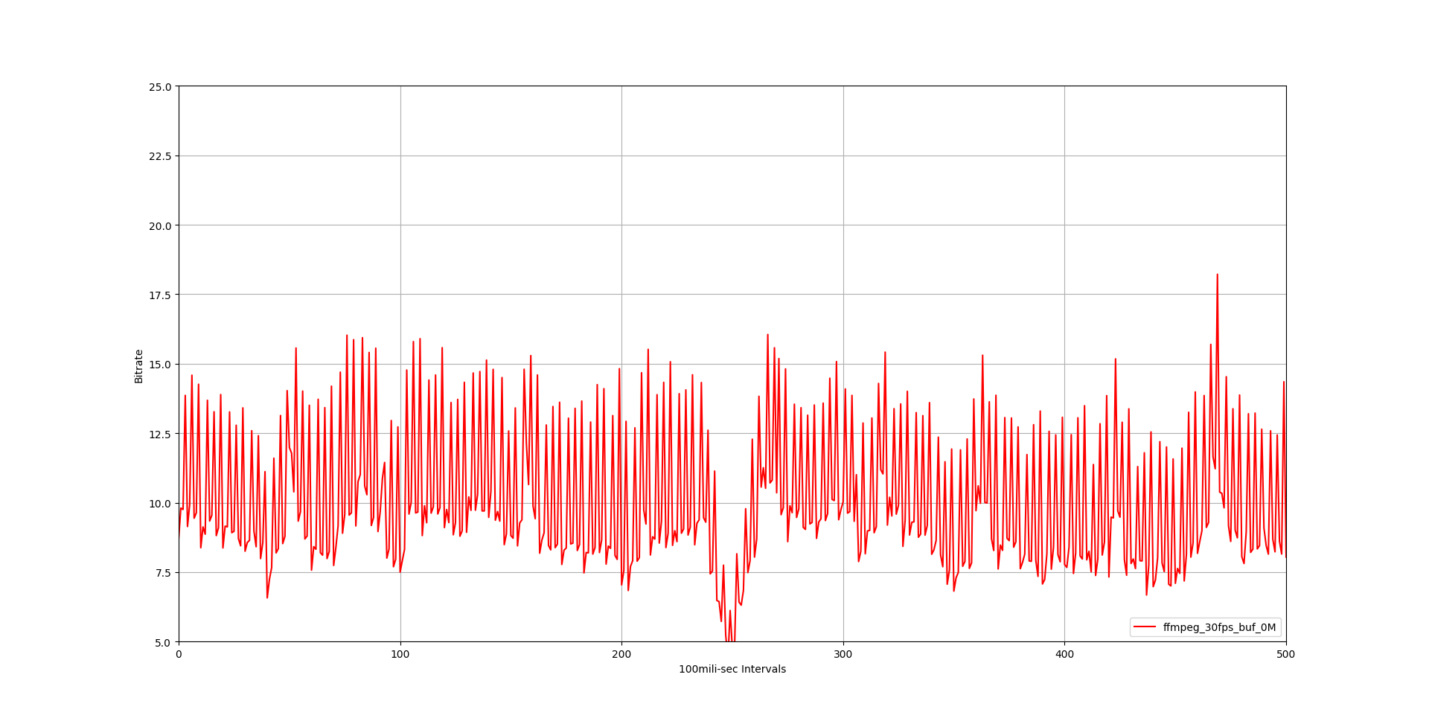
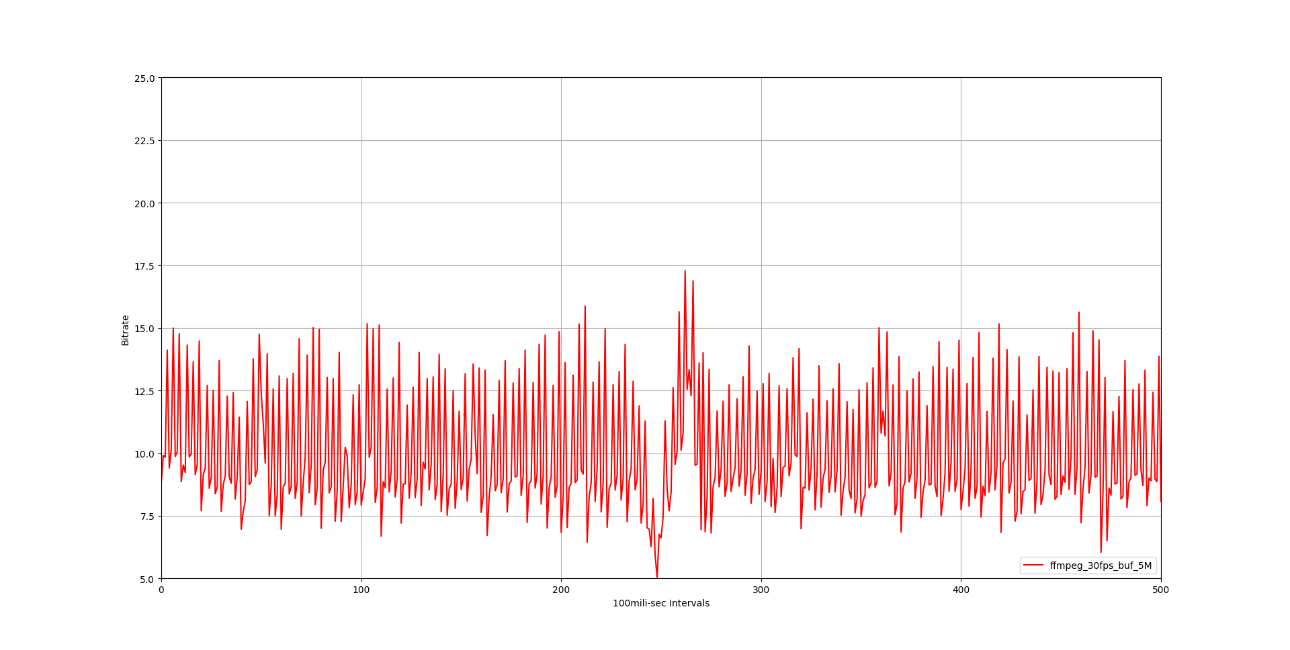
30fps
0Mb Buffer
5Mb Buffer

Slide 9
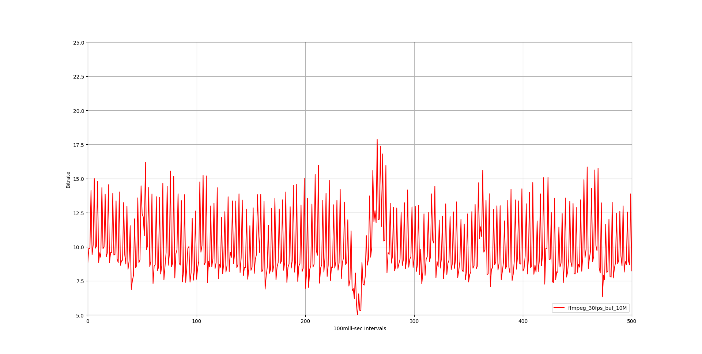
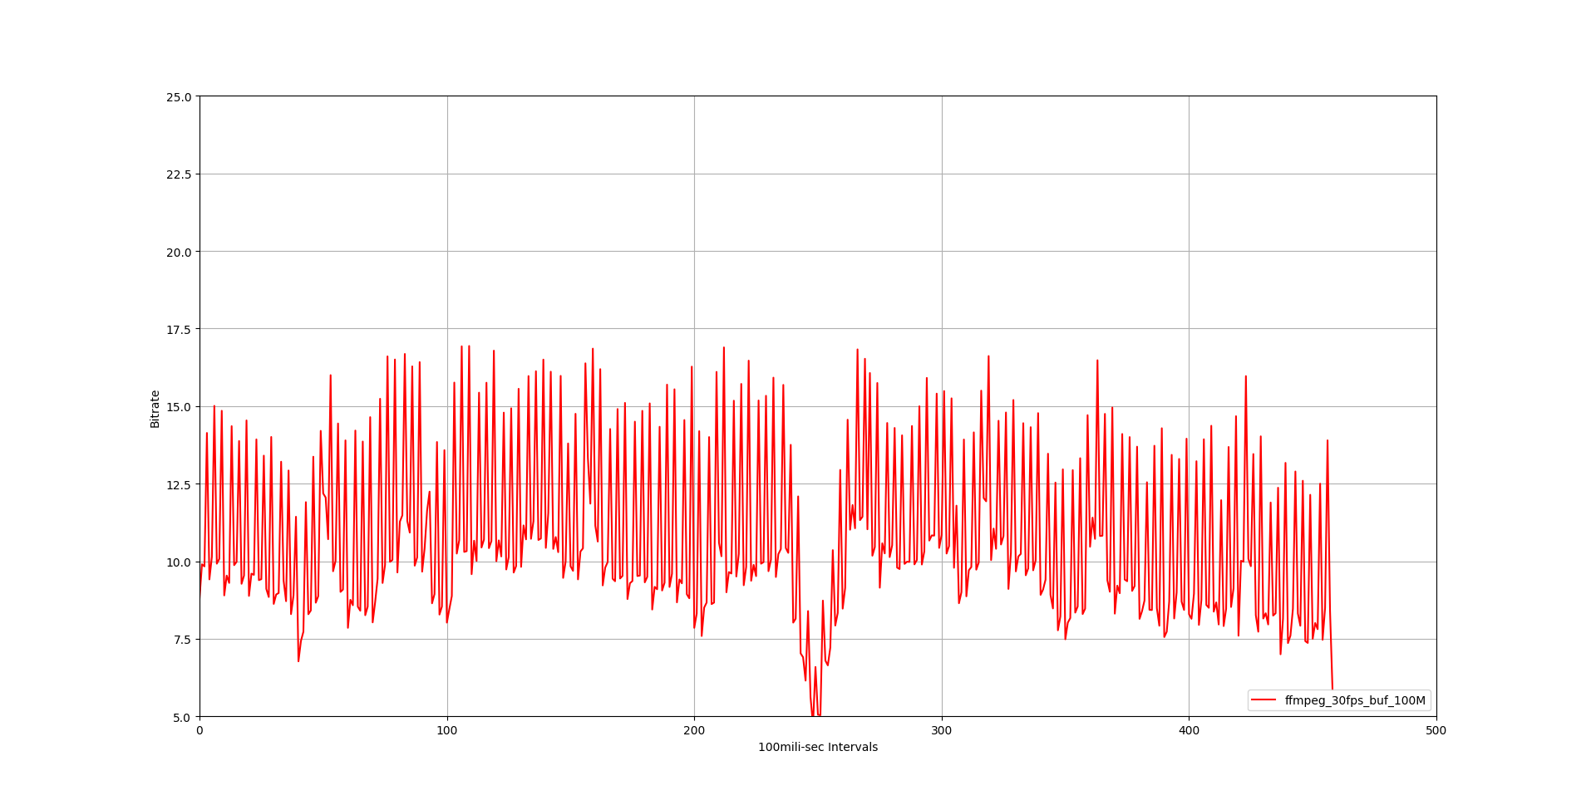
100Mb Buffer
10Mb Buffer

Slide 10
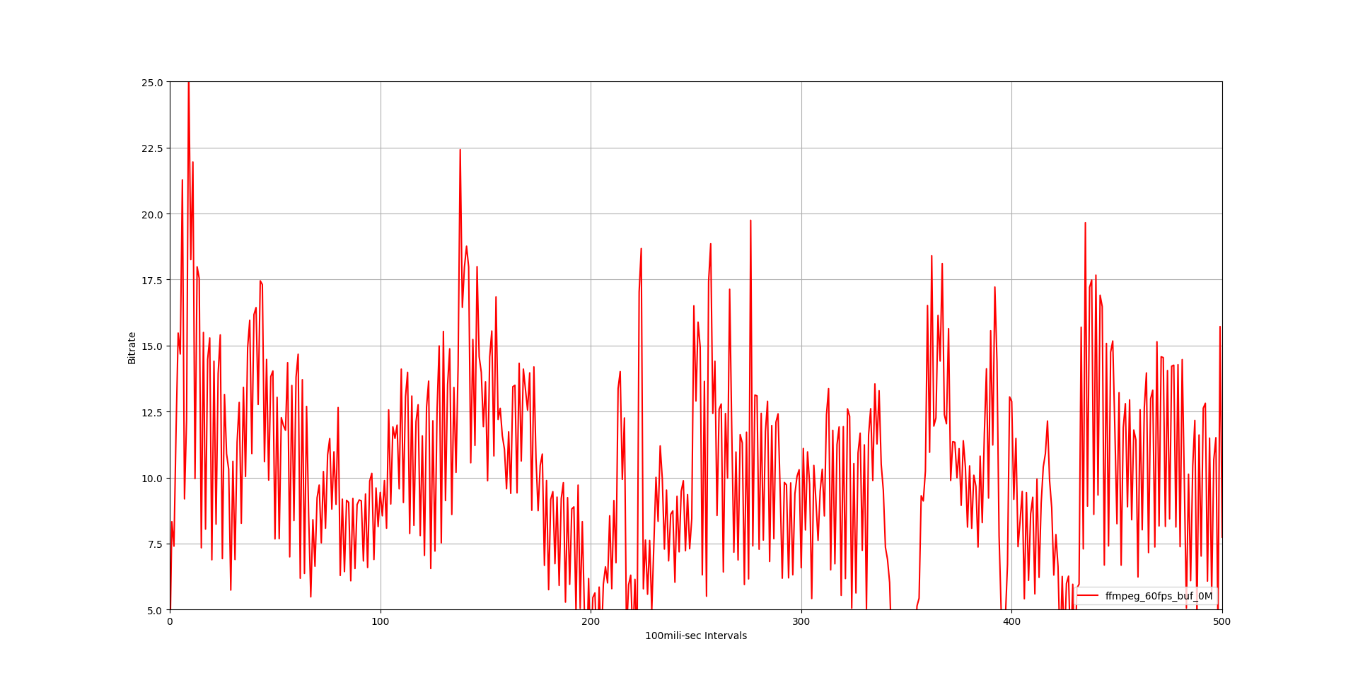
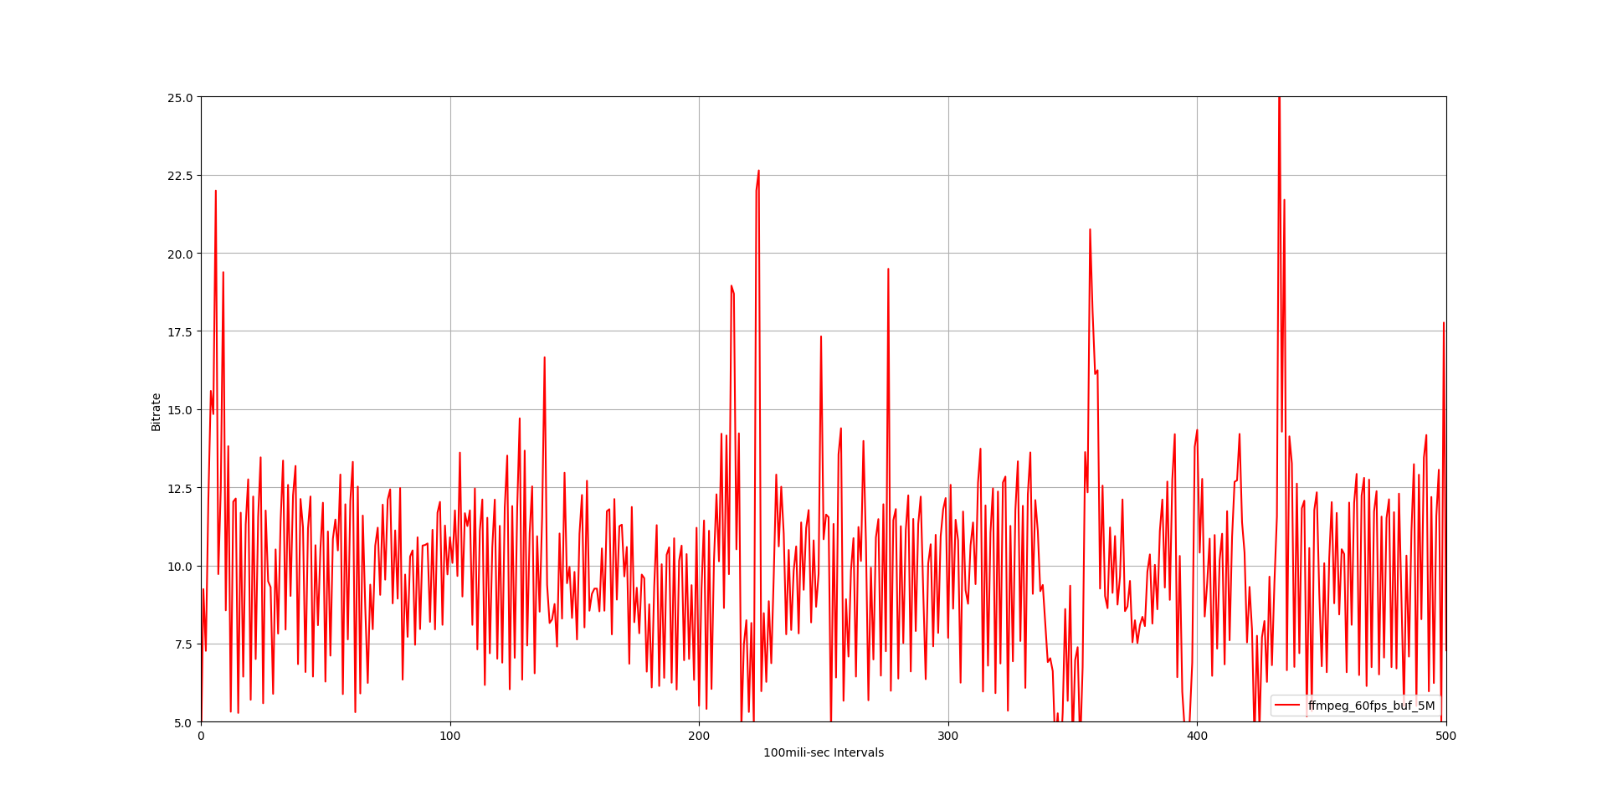
60fps
0M Buffer
5m Buffer

Slide 11
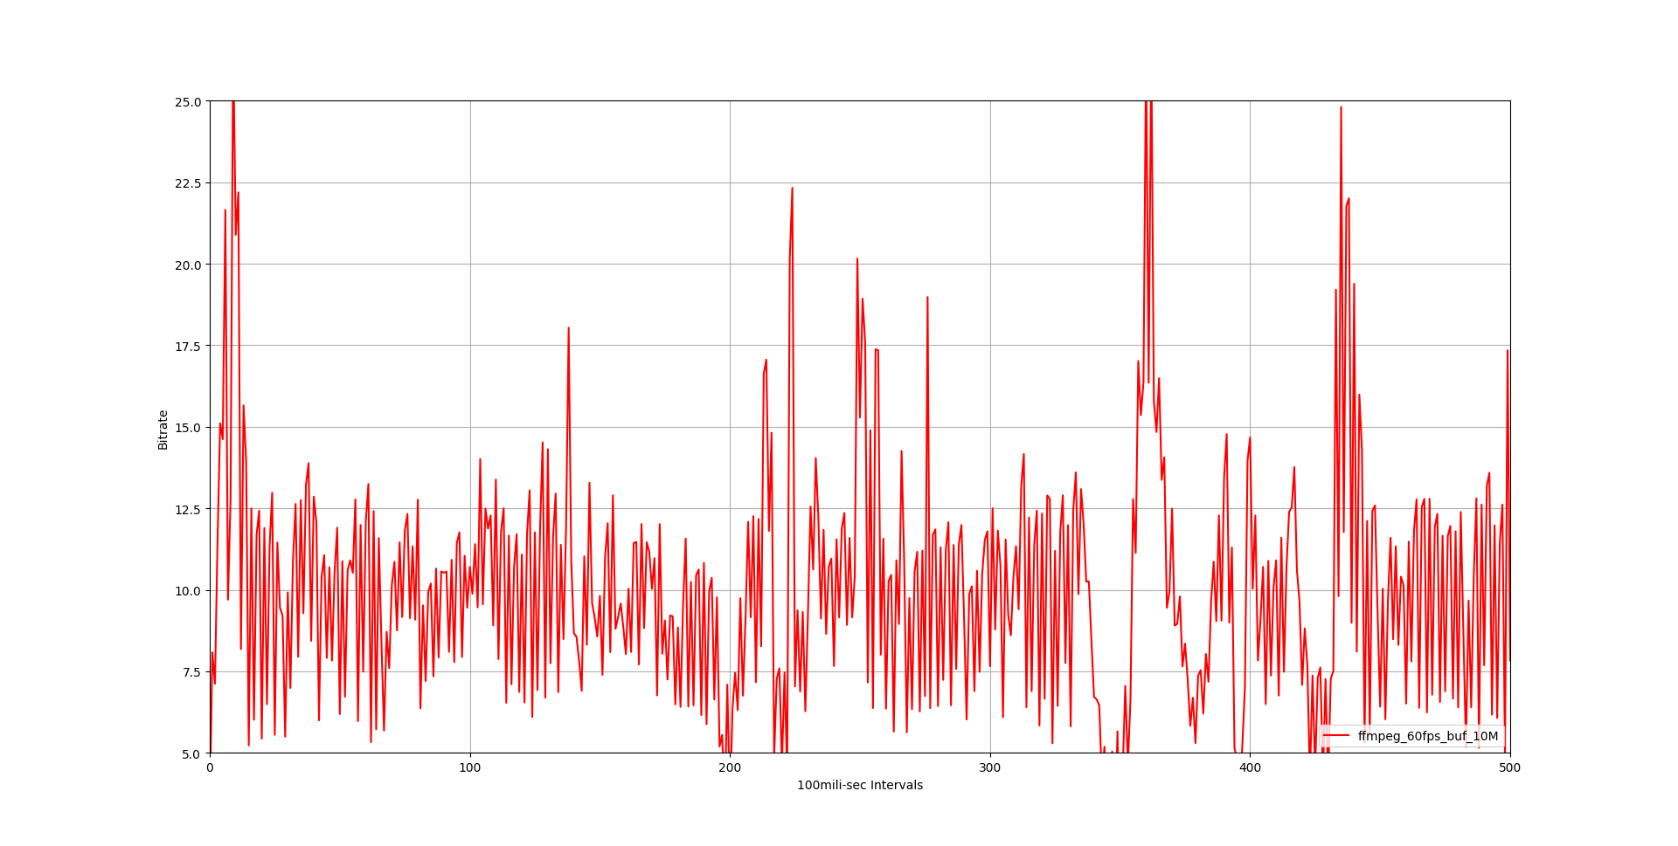
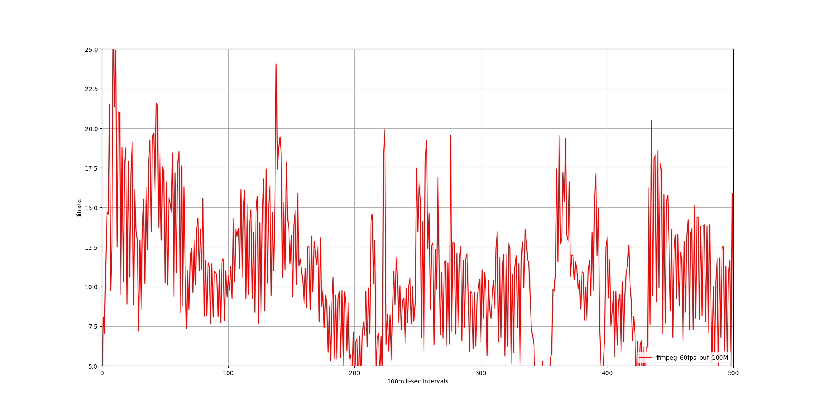
10M Buffer
100M Buffer

