Slide 1
Learning to Play Chess Using Deep Reinforcement Learning

Slide 2
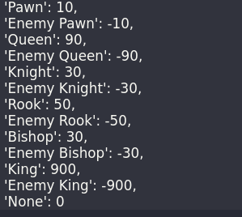
States
Size of states = 64
Assign 64 integer values to represent the current chess piece occupying each location on the chess board.

Slide 3
Actions
Set of possible moves that a player can make from the current state
Represented by an int value corresponding to the move
During training, each new move will be added to an object containing the move and the corresponding int value.

Slide 4
Reward
The reward at each step (Reward_i) will be determined by multiplying a time factor (Gamma) with the winner's reward.
Reward_i := (Gamma*i) * Winner_Reward
A malus (Malus_i) will be calculated for the loser by multiplying Gamma with the loser's malus (a negative value).
Malus_i := (Gamma*i) * Loser_Malus (negative value)

Slide 5
Quality
Represents the evaluation of the quality for a given action (Ai) in a specific state (Si). (Q(Si, Ai))
Initially, all quality values will be initialized with zeros.
Represented as a matrix where the columns correspond to actions and the rows correspond to states.
After each batch of games, the quality values will be updated with the corresponding rewards/malus, reflecting the agent's learning.

Slide 6
Deep-Q-Network (DQN)
Associate each (state_i, action_i) pair with a corresponding Q-value
Consists of four dense layers.
The input shape of the network is (65,):
First 64: the current state of the chessboard
Last dimension: The chosen move.
The model predicts the Q-values for each possible move from the given state and selects the move that maximizes the predicted Q-value
At the end of each game, the DQN is trained using a new batch of data updating the network's weights

Slide 7
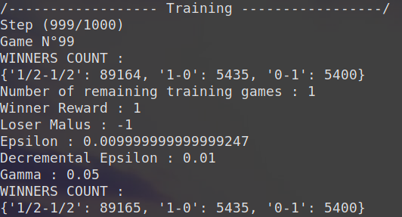
Training Results
Use self-play to generate training data
Winner count:
What’s the problem?
Self-play is unstable
How to improve the results:
Number of games should be much higher
Train with stable opponent
Train with deeper network

Slide 8
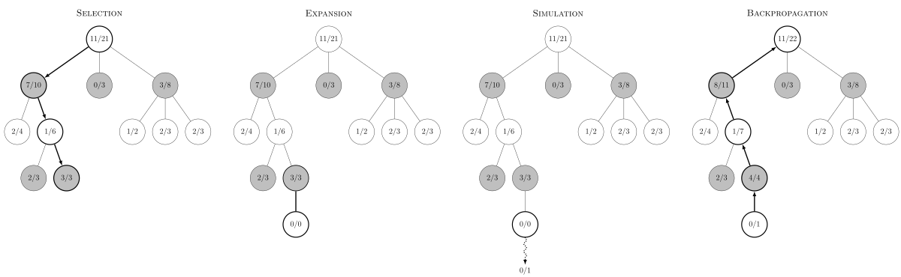
Monte Carlo Tree Search
Search algorithm that approximates the value of a position by constructing a search tree through random exploration of promising moves.
Selection
Expansion
Simulation/Rollout
Backpropagation

Slide 9
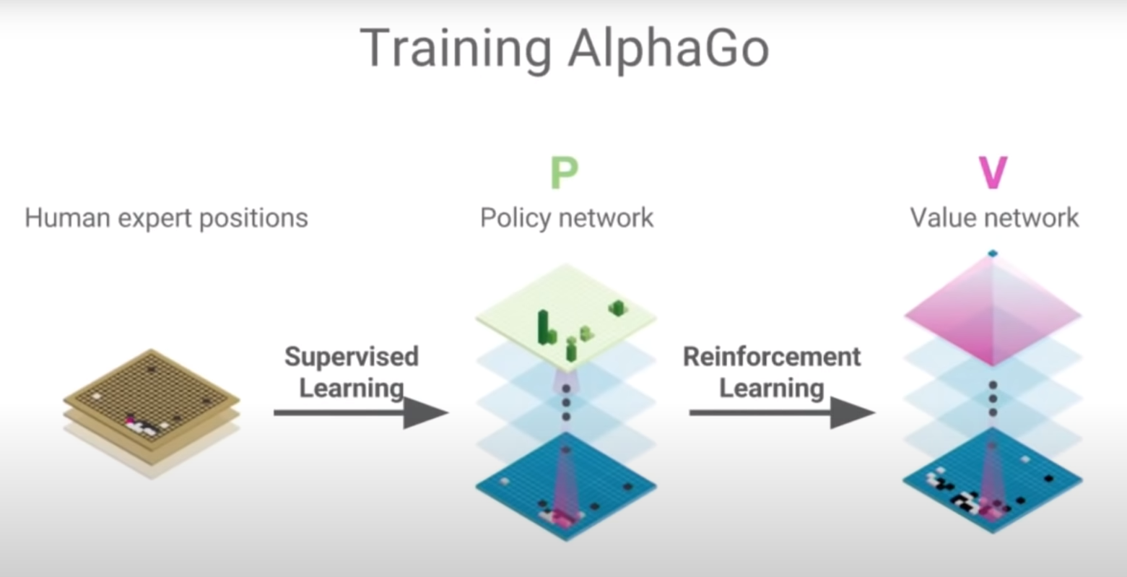
AlphaGo and AlphaZero Go

Slide 10
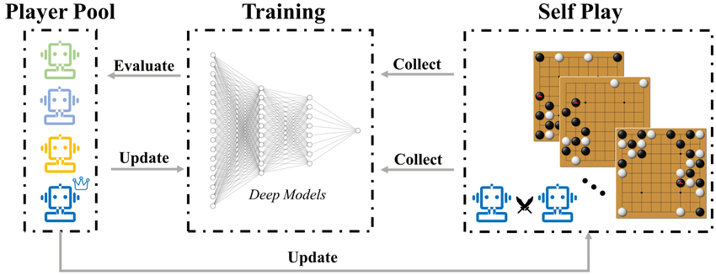
AlphaZero
Represents a broader iteration of the AlphaGo Zero system, designed to excel in various board games, including chess.

Slide 11
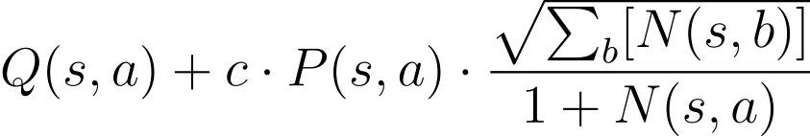
AlphaZero (2)
Upper Confidence Bound formula used in Monte Carlo Tree Search:
Q(s,a): average evaluation of move a across all the simulations which explored it
P(s,a): How promising move a is, or the extent to which it is worth exploring
N(s,a): Number of times that move a has been visited from position s

Slide 12
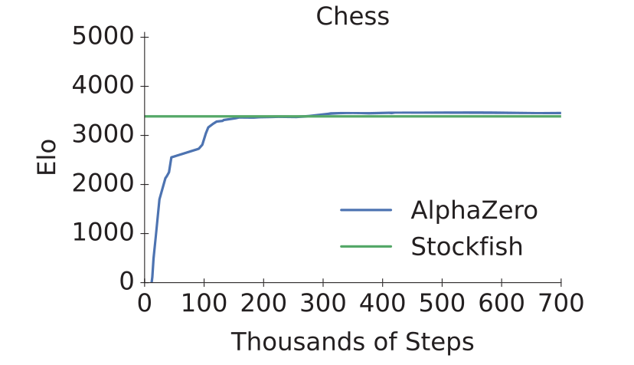
Results

