Slide 1
Facial Expression Recognition

Slide 2

Goal
Goal: determine facial expressions of faces detected in an image
Sample result:

Slide 3
Known Methods
Some well-known methods:
  Use face image texture
  Use geometric information of faces
  Active Appearance Models
All the above methods use Machine Learning for classification
Chosen method: Using geometric information of faces

Slide 4
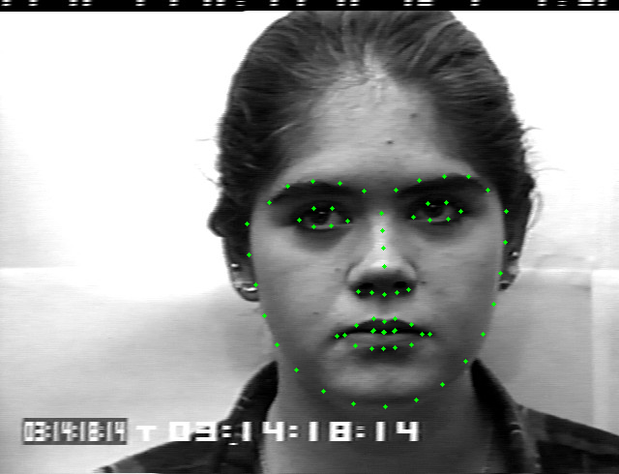
Procedure (1)
Detect faces in an image with dlib library
Extract facial landmarks with the help of dlib library

Slide 5
Procedure (2)
Calculate mean point of landmarks for each face
Calculate relative coordinates wrt mean point (x and y in Cartesian)
Calculate relative distance and angle wrt mean point (r, θ in Polar)
Feature vector: Relative Cartesian and Polar coordinates (272 elements)
Train an SVM classifier with extracted features

Slide 6
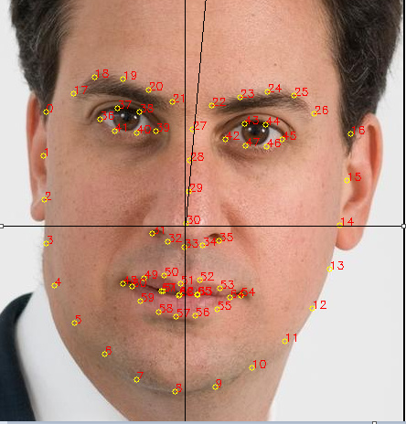
Head Pose
Calculate the angle between vertical line and the line connecting landmarks on the nose
Rotate all landmark points to remove head pose

Slide 7
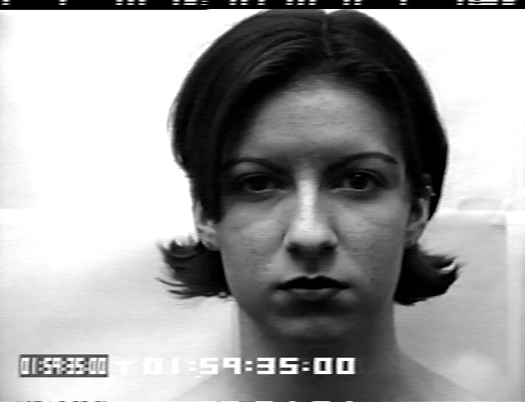
Dataset
Cohn-Kanade dataset of faces
Containing face images with labels.
Emotion Labels:
  Anger
  Contempt
  Disgust
  Fear
  Happiness
  Neutral
  Sadness
  Surprise

Slide 8
Confusion Matrix
 | Neutral | Anger | Contempt | Disgust | Fear | Happiness | Sadness | Surprise
Neutral | 57 | 1 | 0 | 0 | 0 | 0 | 1 | 0
Anger | 2 | 1 | 0 | 0 | 0 | 1 | 0 | 0
Contempt | 0 | 0 | 1 | 0 | 0 | 0 | 0 | 0
Disgust | 1 | 0 | 0 | 4 | 0 | 0 | 0 | 0
Fear | 0 | 0 | 0 | 0 | 2 | 0 | 0 | 0
Happiness | 0 | 0 | 0 | 0 | 0 | 6 | 0 | 0
Sadness | 0 | 0 | 0 | 0 | 0 | 0 | 2 | 0
Surprise | 0 | 0 | 0 | 0 | 0 | 0 | 0 | 8
Accuracy: 0.93103448

Slide 9
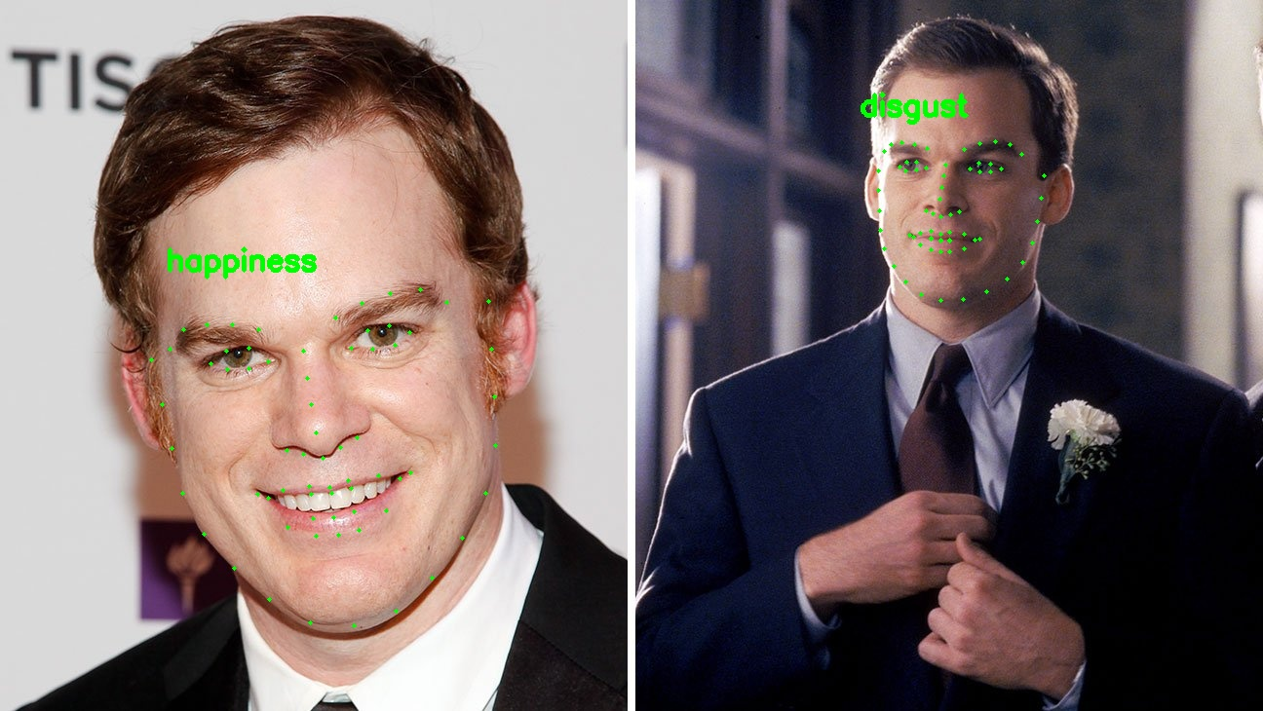
Results (1)

Slide 10
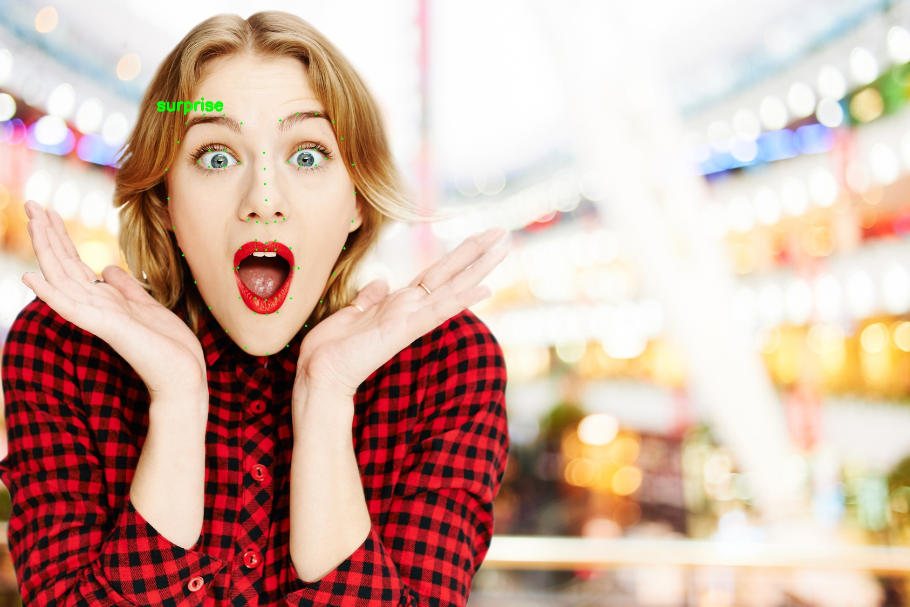
Results (2)

Slide 11
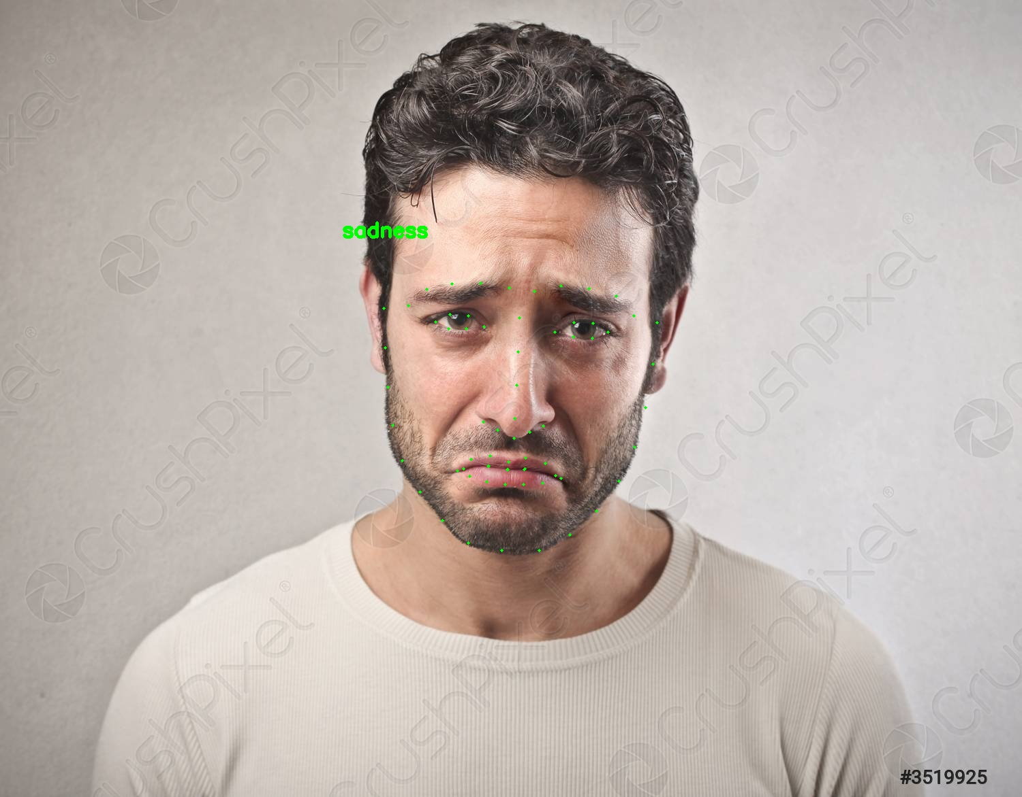
Results (3)

