Slide 1
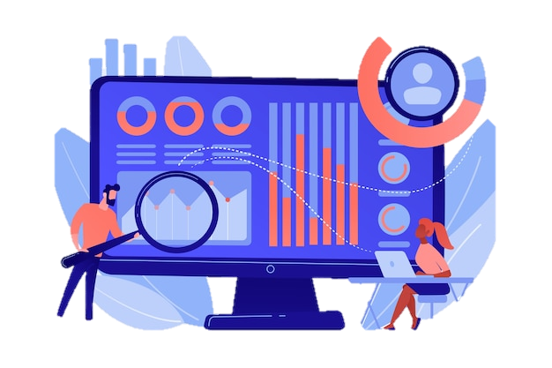
Customer Transaction Data
Case Study Analysis & Deriving Insights
May 2024 Sai Ram K

Slide 2

Outline
Data Summary
Introduction
Methodology
Results
Visualizations
Dashboards
Discussion
Conclusion

Slide 3
Data Summary
Dataset Dimensions – 1067371 Rows and 8 Columns
Column Description:
InvoiceNo - Invoice number. Nominal. StockCode - Product (item) code. Nominal.
Description - Product (item) name. Nominal.
Quantity - The quantities of each product (item) per transaction. Numeric.
InvoiceDate - Invoice date and time. Numeric. The day and time when a transaction was generated.
UnitPrice - Unit price. Numeric. Product price per unit in sterling.
CustomerID- Customer number. Nominal. A 5-digit integral number uniquely assigned to each customer.
Country - Country name. Nominal. The name of the country where a customer resides.

Slide 4
Introduction
About:
Analysing the customer transaction data of 2 years and deriving insights.
Questions to be answered?
What is the global distribution of Customers?
What are the most selling Products?
What are the impacts of Product Cancellation?
How is the Revenue spanned over Time?
Is there Effective customer retention?

Slide 5
Methodology
Loading of Raw Data from Source
Exploration of Data
Data Cleaning
Data Visualization
Post Data Visualization and presenting of insights to the team K-Means Clustering can be used for knowing the Customer Behaviour by using Apriori Algorithm and also Customer Churn Prediction.

Slide 6
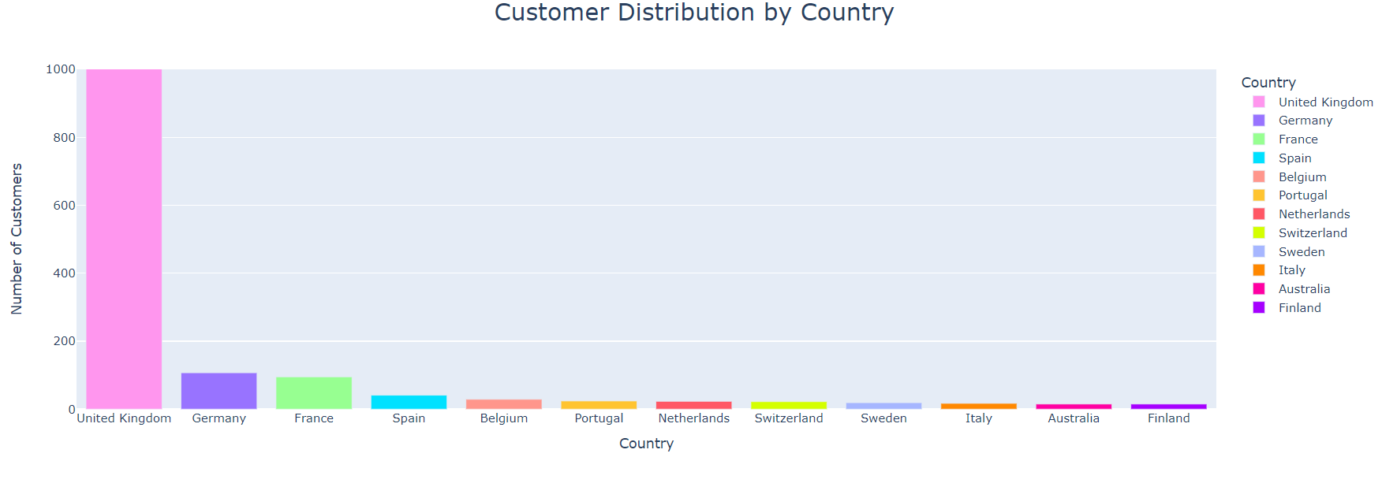
Visualization
We derive that the maximum customer base that has purchased products belong to the United Kingdom.
It also conveys that enough emphasis should be provided to tap the other countries as well.

Slide 7
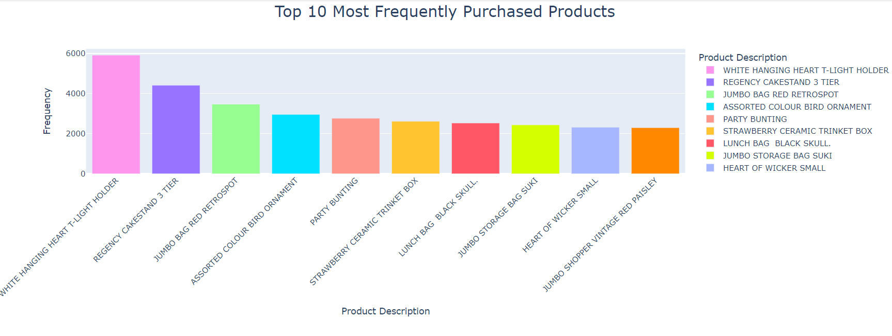
Top 10 Purchased Products
The top 10 purchased products indicate the preference of the customers and helps in taking action on inventory management. These can also be used for Pricing and Promotions to optimize inventory and maximize Revenue.

Slide 8
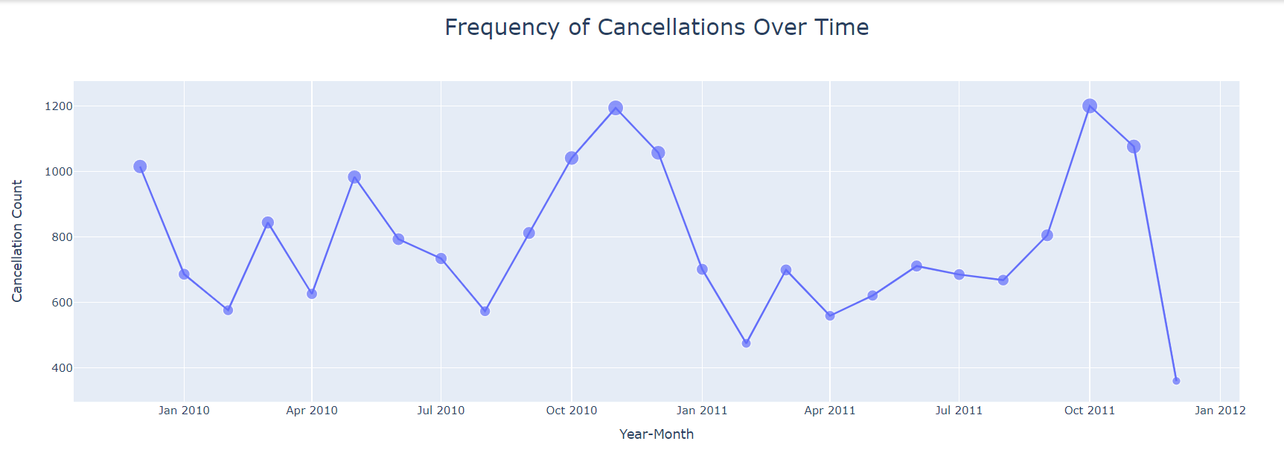
Frequency of Cancellations
It is one of the important metric as it can affect the Customer Satisfaction & Experience, Operational Efficiency, Customer Retention & Loyalty and Competitive Landscape. Additional data can be used in combination with ML as a separate track of analysis for this case.

Slide 9
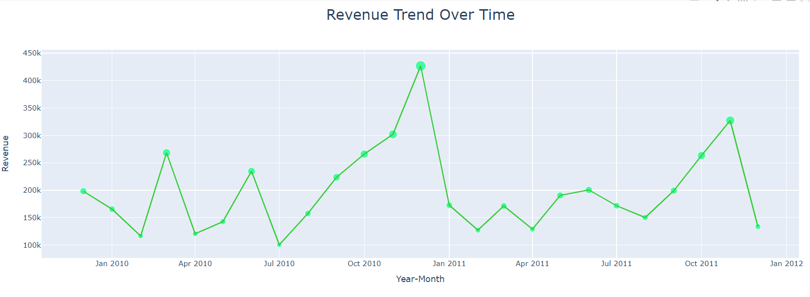
Revenue over Time
The Revenue-Time Plot gives an insight on Revenue growth or decline, seasonal patterns, Impact of any particular Business Strategy. Additionally Understanding historical revenue trends provides valuable insights for forecasting future revenue and planning business strategies.

Slide 10
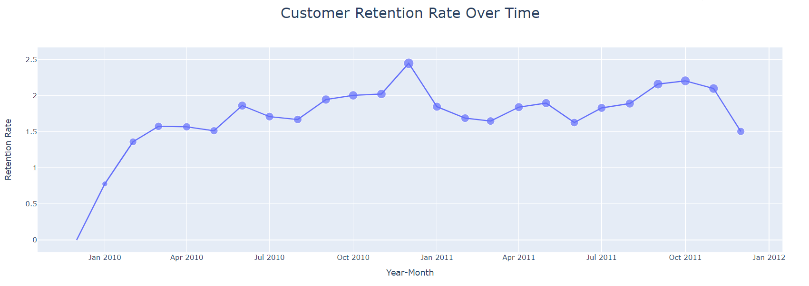
Customer Retention
This metric serves as a critical tool for monitoring customer loyalty, evaluating retention strategies, and informing strategic decision-making processes aimed at fostering long-term customer relationships and maximizing customer lifetime value.

Slide 11
Discussion
Findings
Pondering on the reason for cancellations leads to better Customer Experience and Inventory Management.
A market research focused on other competitive products needs to be conducted to take actions.
Seasonal Revenue Pattern observed along certain months can be considered to evaluate business strategies across forthcoming months.
Actions
Better data collection needs to be employed for maximum data collection and data integrity.
Introduction of Customer Loyalty Programs would definitely increase the Customer Retention Rate.
Global markets beyond United Kingdom needs to be tapped to increase overall Revenue and Sales.
Deploying models to understand buying behaviour and customer churn analysis can be incorporated to unlock the full potential of the data.

Slide 12
Conlusion
Recommendations based on Analysis
Markets outside United Kingdom needs to be tapped in to maximise Customer Reach and Revenue generation.
Deployment of models to observe buying behaviour will increase the ease of Inventory management and forecasting.
Introduction of Customer Retention Strategies like membership cards and benefits could be employed for better engagement and withholding.

Slide 13
Thank You.
A case study presentation by Sai Ram

