Slide 1
Panic Alarm For Elders
A wearable device that calls for help in one – click.
20181CSE0621 – Sai Ram. K
20181CSE0643 – Satyam Mourya
20181CSE0660 – Shaiq Iqbal
20181CSE0669 – Shivam Singh
20181CSE0670 – Shlaghana J.S.

Slide 2
Abstract
The core functionality of this device is to alert the care-takers when a person who is differently abled, elderly or are in need of help.
The device is wearable and has a simple interface and is capable of sending a pre saved message template in case of distress.
The use of this device is aimed for the elderly being the top priority followed by any individual needing assistance for safety purposes.

Slide 3
Introduction
There can be any sudden situation of panic. It could be because of an intruder entering our house or bad health status. Situations can be many for panicking and may vary from person to person.
During these situations we employ the use of a panic alarm that alerts the provided care-taker to rush for help.

Slide 4
Statement
The purpose of a panic alarm is to allow a person under distress to quickly and silently call for help in the event of an emergency. Panic alarms are also called "distress alarms", "hold-up alarms", or "panic buttons".
Panic alarms are used when it may be unsafe or uncomfortable to call for help in other ways.
For example, if a belligerent person is standing in your lobby, it may be unwise to further escalate the situation by picking up a phone to call for assistance. A panic alarm can provide a quick and convenient way to summon help without drawing attention

Slide 5
Literature Survey
Citation :
1. B. Choudhury, T. S. Choudhury, A. Pramanik, W. Arif and J. Mehedi, "Design and implementation of an SMS based home security system," 2015 IEEE International Conference on Electrical, Computer and Communication Technologies (ICECCT), Coimbatore, India, 2015, pp. 1-7, doi: 10.1109/ICECCT.2015.7226115.
2. S. D. Damayanti, M. Suryanegara, I. K. A. Enriko and M. I. Nashiruddin, "Designing A LoRa-Based Panic Button for Bali Smart Island Project," 2019 7th International Conference on Smart Computing & Communications (ICSCC), Sarawak, Malaysia, 2019, pp. 1-5, doi: 10.1109/ICSCC.2019.8843614.
Improvements :
1. Compressed the proto-type into a wearable watch.
2. Containerize and scale the web-client using Docker.
3. React Native App for controlling the watch and in app notifications.

Slide 6
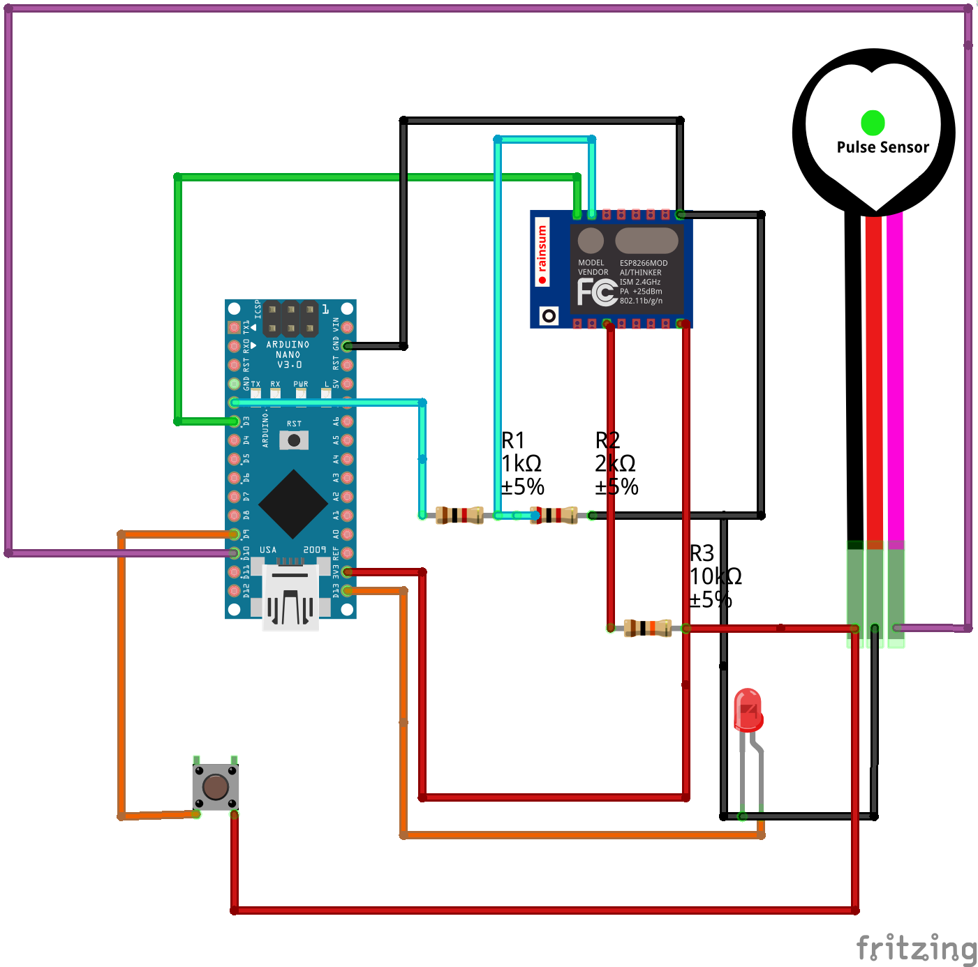
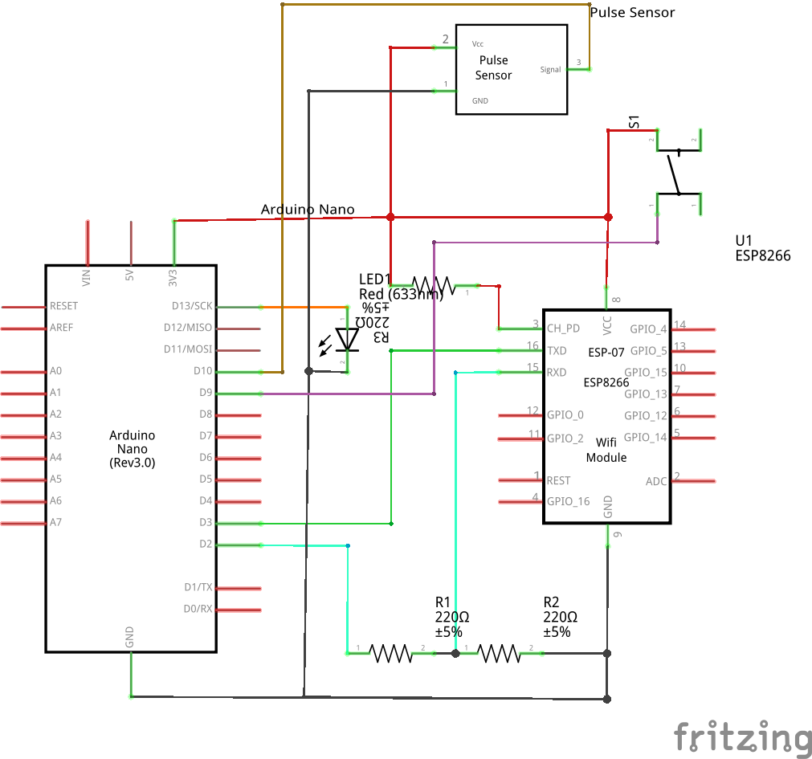
Architecture
A. Circuit Diagram
B. Wireframe Diagram

Slide 7
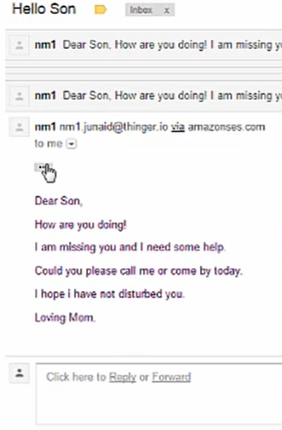
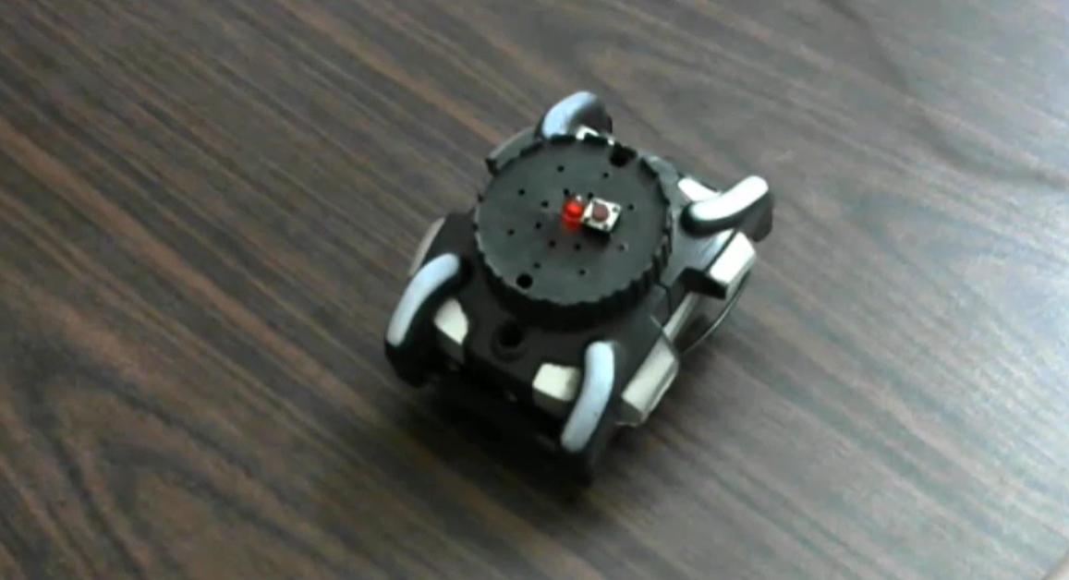
Output
A. The watch sends out an email to the dependent’s address, so as to alert him/her that they are in distress and need immediate assistance.
B. The prototype of the wearable panic alarm watch.

Slide 8
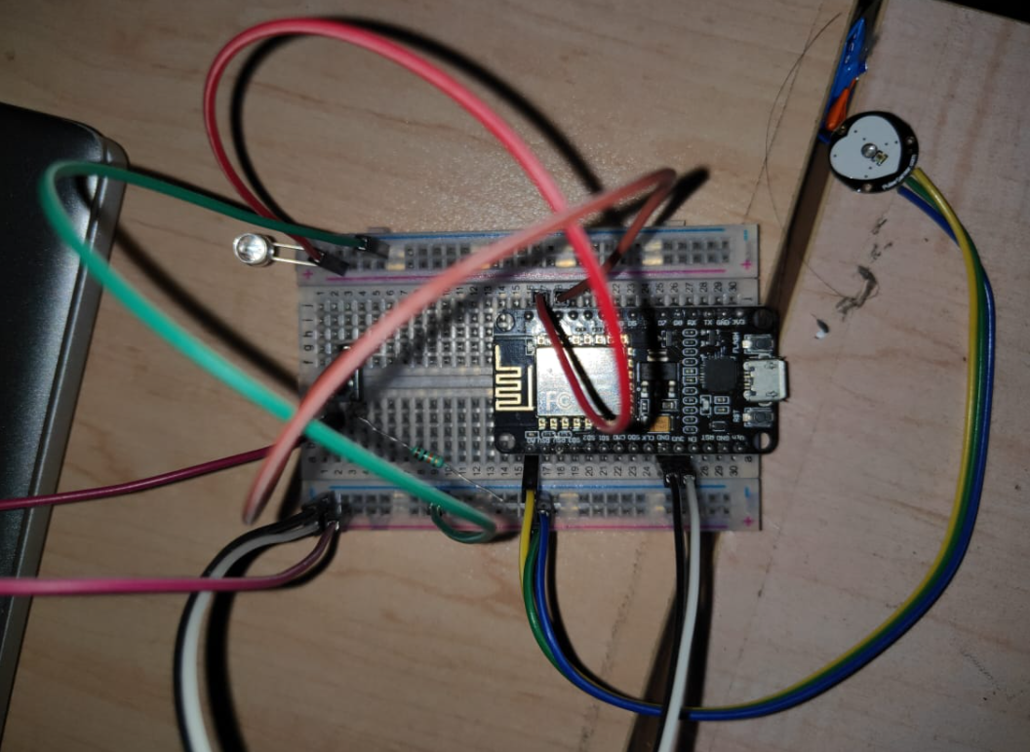
Circuit Design
Components Used :-
LED
Resistor 10 kΩ
Pulse Sensor
Jumper Wires
ESP8266 Node MCU
Breadboard Small

Slide 9
Design of the WebApp
To analyze the alerts and to provide an easy interface for users we have developed a WebApp using JavaScript Frameworks.
The WebApp does has the following features :
1. Allows the user to login and create an account
2. Provides each user with an unique ID for recognition.
3. Displays the time and date of each alert that is triggered and differentiates between a manual alert and automatic alert.
4. Provides directions to the location where the alert was triggered.
5. Sends an e-mail to the dependents and the registered e-mail with the location and time of the alert triggered.
The working of the app can be found on this clickable link - Panic Alarm WebApp

Slide 10
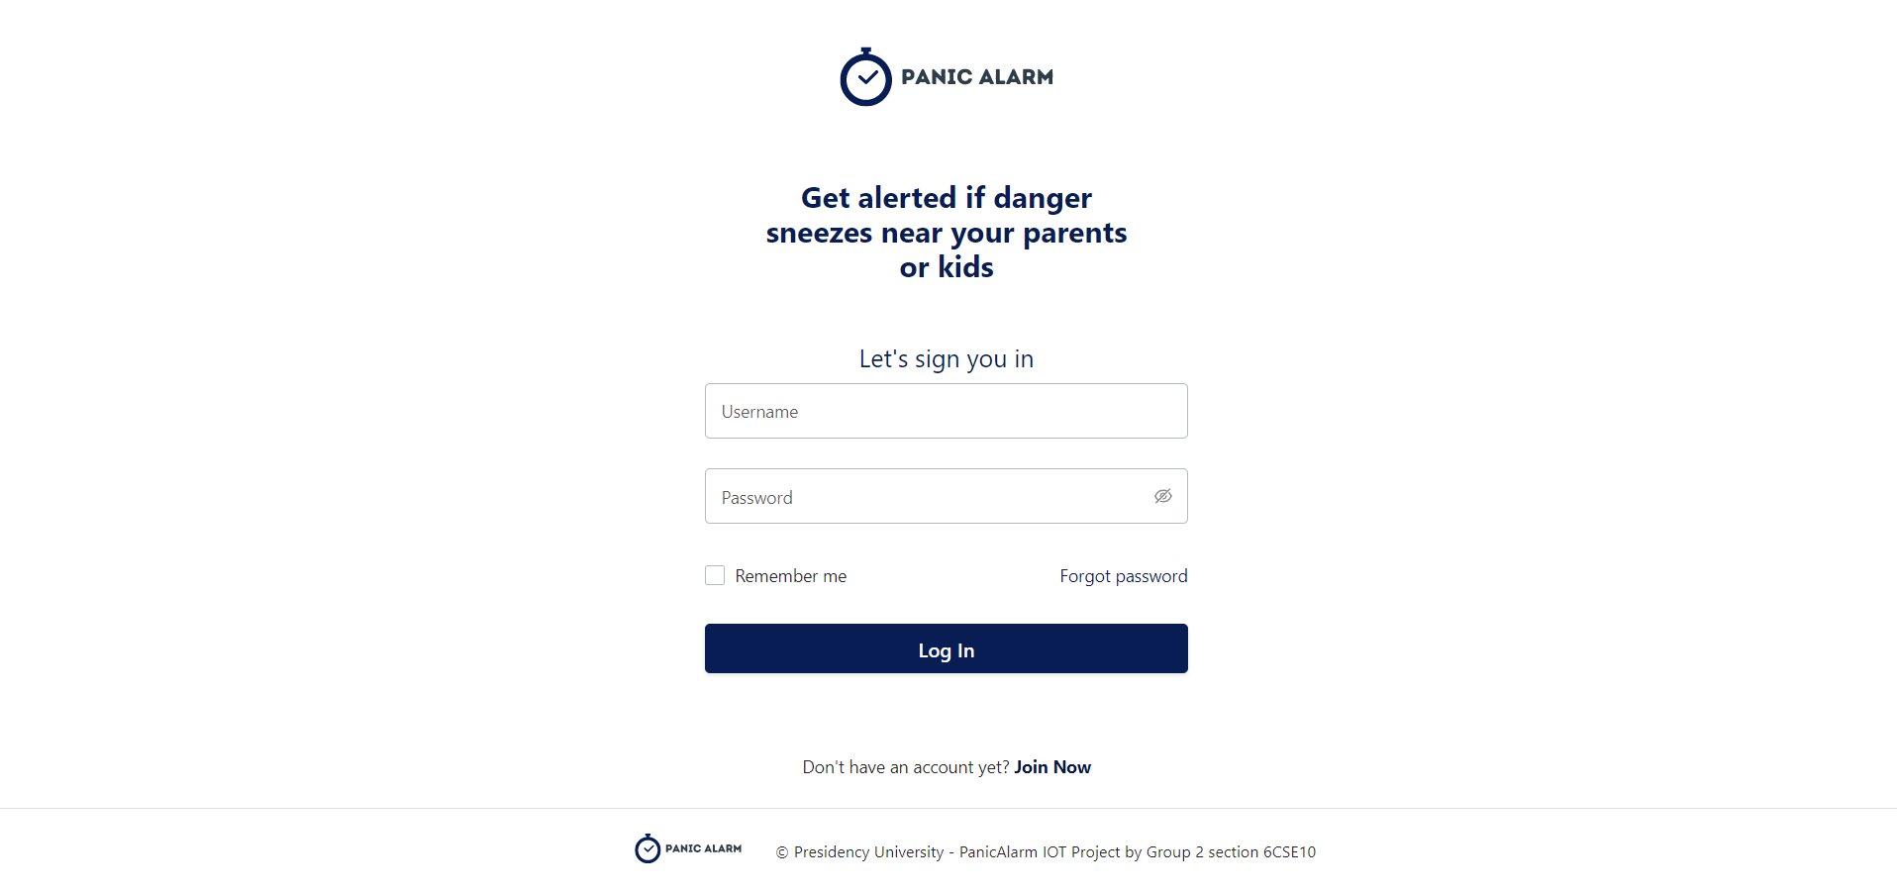
Panic Alarm WebApp
The login page of the WebApp that allows users to login or create a new account.

Slide 11
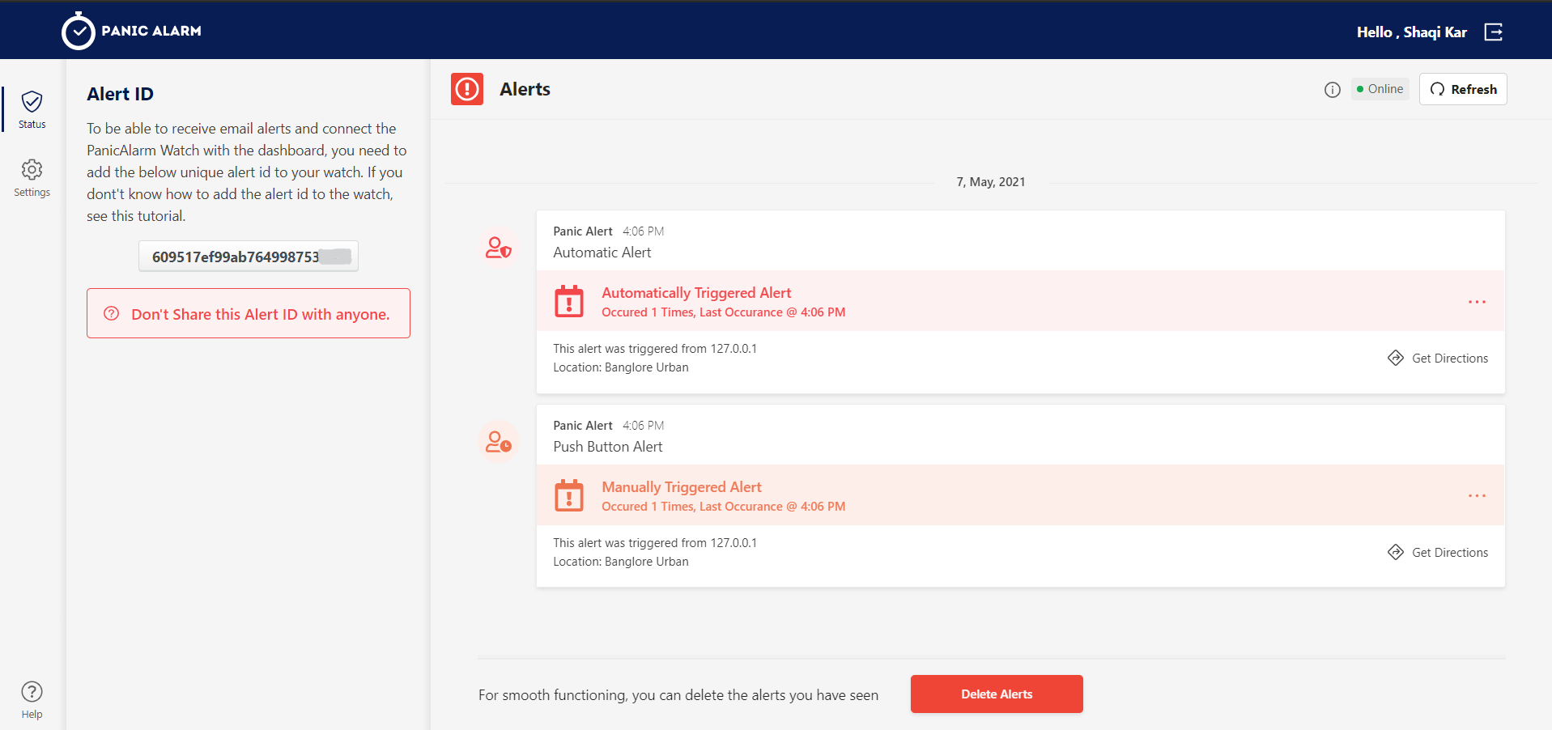
Alerts Dashboard
Alerts Dashboard that appears when a user logs into their account and displays the triggers.

Slide 12
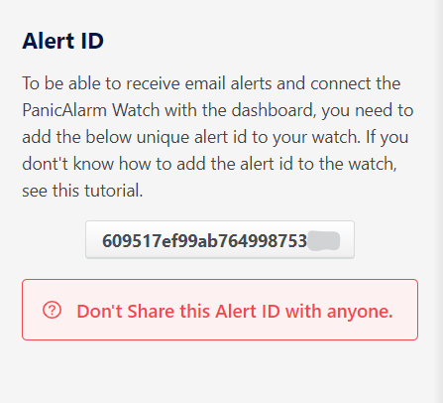
Alert ID
An alert ID pane that has an unique ID for each user and is expected to be confidential.

Slide 13
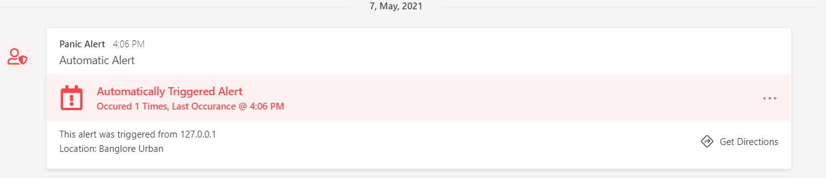
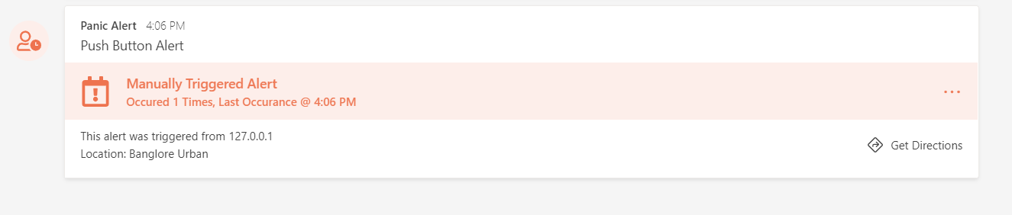
Alerts Display Pane
A. An alert that was generated automatically based on the monitoring.
B. An alert that was generated when a person triggered the push button.

Slide 14
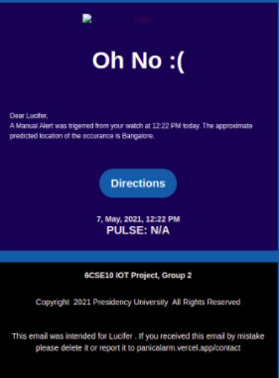

Alert E-mail
Screenshot of the e-mail as sent by the panic alarm when the alert was triggered.

Slide 15
Thank You.
A Mini – Project By : -
20181CSE0621 – Sai Ram. K
20181CSE0643 – Satyam Mourya
20181CSE0660 – Shaiq Iqbal
20181CSE0669 – Shivam Singh
20181CSE0670 – Shlaghana J.S.

