Slide 1
MODULE - 3
DIVIDE AND CONQUER ALGORITHMIC DESIGNING TECHNIQUE

Slide 2
Introduction- Divide-and-conquer
Divide-and-conquer algorithms work according to the following general plan:
A problem is divided into several sub problems of the same type, ideally of about equal size.
The sub problems are solved (typically recursively, though sometimes a different algorithm is employed, especially when sub problems become small enough).
If necessary, the solutions to the sub problems are combined to get a solution to the original problem.

Slide 3
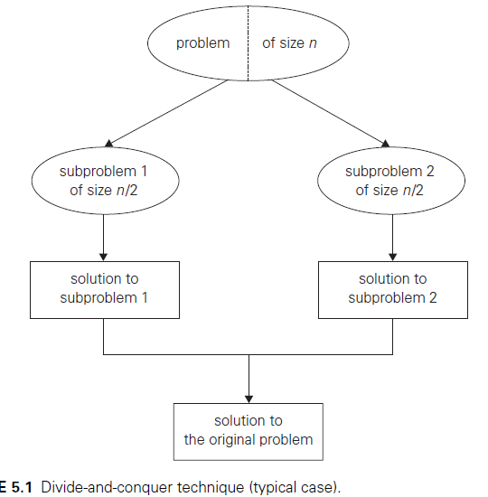
Divide-and-conquer

Slide 4
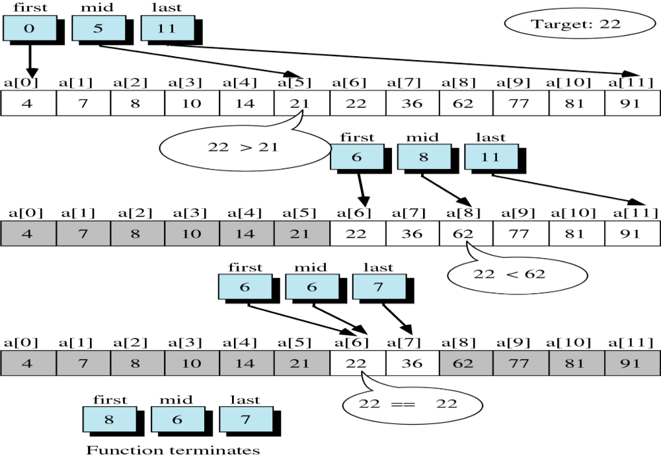
6
Copyright © 2000 by Brooks/Cole Publishing Company
A division of International Thomson Publishing Inc.

Slide 5
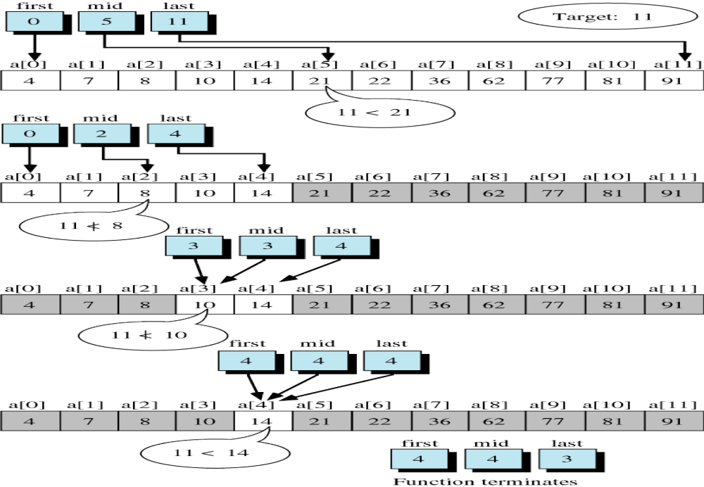

Slide 6
Binary search cond….
While(low<=high)
{
Mid=(low+high)/2
If(a[mid]==key)
Return mid;
If(a[mid]>key)
High =mid-1;
Else low = mid+1;
}
If(low>high) return -1;

Slide 7
Bs(int a[], int low, int high, int key)
{
If(low<=high)
{Mid=(low+high)/2
If(a[mid]==key)
Return mid;
If(a[mid]>key)
Bs(a,0,mid-1,key);-------→ t(n/2)+1
Else bs(a,mid+1,n-1,key) }
If(low>high) return -1;

Slide 8
If n=1--→ t(1)=1
If n>1 ….> t(n)=t(n/2)+1
T(n/2)=t(n/4)+1
T(n) = t(n/4)+1+1=t(n/2²)+2
T(n) = t(n/2³)+3
T(n)=t(n/2^{i})+i
2^{i} = n---→ log(2^{i}) = log(n)→i=log(n)
T(n)= t(1)+log(n)--→log(n)

Slide 9
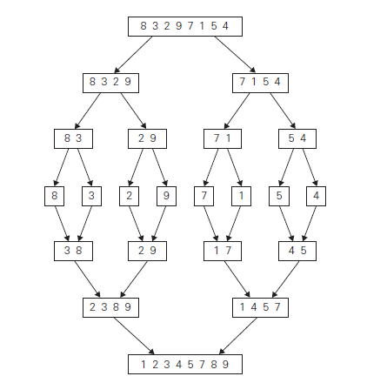
Merge Sort Algorithm

Slide 10
1
2
3
4
5
6
7
8
9
10
11
Divide
4
7
2
6
1
4
7
3
5
2
6
q = 6
1
2
3
4
5
6
7
8
9
10
11
q = 3
4
7
2
6
1
4
7
3
5
2
6
q = 9
1
2
3
4
5
6
7
8
9
10
11
4
7
2
6
1
4
7
3
5
2
6
1
2
3
4
5
6
7
8
9
10
11
4
7
2
6
1
4
7
3
5
2
6
1
2
4
5
7
8
4
7
6
1
7
3

Slide 11
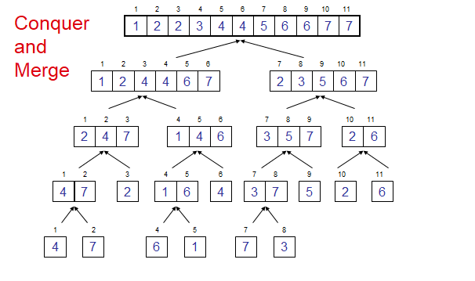

Slide 12
Partition(a[],low,high)
{ if(low<high){
mid=(low+high)/2
Partition(a,low,mid)-----→ t(n/2)
Partition(a,mid+1,high)----→t(n/2)
Mergesort(a,low,mid,high)} --→n
}

Slide 13
Mergesort(a,low,mid,high)
{ l=low, i=low, j=mid+1
While(l<=mid and j<=high)
{If(a[l]<=a[j])
Temp[i] = a[l] i++, l++
Else temp[i] = a[j] i++, j++}
If(l>mid)
For(k=j;k<=high;k++) temp[i]=a[k] i++;
Else For(k=l;k<=mid;k++) temp[i]=a[k] i++;
}

Slide 14
If n=1 t(1)=1
If n>1 t(n) = 2t(n/2)+n
T(n/2)=2(n/4)+n/2
T(n) = 2(2(n/4)+n/2)+n= 2²t(n/2²)+2n
T(n)= 2³t(n/2³)+3n…
T(n)= 2^{i}t(n/2^{i})+i.n
n/2^{i =1 -→}
N= 2 ^{i-----→log(n)= I}
^{T(n) = n+nlog(n)--→ n.log(n)}

Slide 15
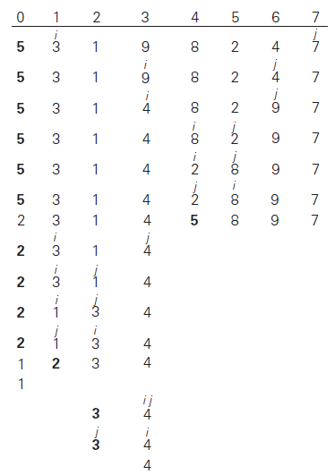
Quick sort algorithm

Slide 16
Partition(a,low,high)
{pivot=a[low],i=low+1, j=high
while(Pivot >a[i]) i++
While(pivot<a[j]) j—
If(i<j) swap(a[i],a[j]) else swap(a[low],a[j]) return j}……..
Qsort(a,low,high)
{ if(low<high)
{j=Partition(a,low,high)
Qsort(a,low,j-1)
Qsort(a,j+1,high)

Slide 17


Slide 18
There is no algorithm for creativity.
-Andy Hargreaves
Thank You

