Slide 1
Analysis of Algorithms (CSE212) Module 4
Dynamic programming and greedy technique

Slide 2
Dynamic programming

Slide 3
Dynamic Programming: Introduction
Dynamic Programming is a general algorithm design technique
for solving problems defined by or formulated as recurrences with
overlapping sub instances
Invented by American mathematician Richard Bellman in the 1950s to
solve optimization problems and later assimilated by CS.
“Programming” here means “planning”.
Main idea:
set up a recurrence relating a solution to a larger instance to solutions of some smaller instances
- solve smaller instances once
record solutions in a table
extract solution to the initial instance from that table

Slide 4
Example: Fibonacci numbers
Recall definition of Fibonacci numbers:
F(n) = F(n-1) + F(n-2)
F(0) = 0
F(1) = 1
Computing the n^{th} Fibonacci number recursively (top-down):
F(n)
F(n-1) + F(n-2)
F(n-2) + F(n-3) F(n-3) + F(n-4)
...

Slide 5
Example: Fibonacci numbers (cont.)
Computing the n^{th} Fibonacci number using bottom-up iteration and recording results:
F(0) = 0
F(1) = 1 Efficiency:
- time
- space
F(2) = 1+0 = 1
…
F(n-2) =
F(n-1) =
F(n) = F(n-1) + F(n-2)
n
n
What if we solve it recursively?

Slide 6
Examples of DP algorithms
Computing a binomial coefficient
Longest common subsequence
Warshall’s algorithm for transitive closure
Floyd’s algorithm for all-pairs shortest paths
Constructing an optimal binary search tree
Some instances of difficult discrete optimization problems:
- traveling salesman
- knapsack

Slide 7
Computing a binomial coefficient by DP
Binomial coefficients are coefficients of the binomial formula:
(a + b)^{n} = C(n,0)a^{n}b⁰ + . . . + C(n,k)a^{n-k}b^{k} + . . . + C(n,n)a⁰b^{n}
Recurrence: C(n,k) = C(n-1,k) + C(n-1,k-1) for n > k > 0
C(n,0) = 1, C(n,n) = 1 for n ≥ 0
Value of C(n,k) can be computed by filling a table:
0 1 2 . . . k-1 k
0 1
1 1 1
.
.
n-1 C(n-1,k-1) C(n-1,k)
n C(n,k)

Slide 8
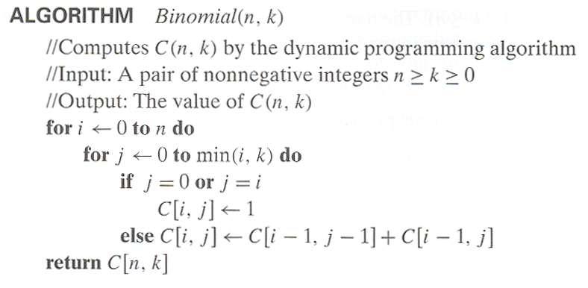
Computing C(n,k): pseudocode and analysis
Time efficiency: Θ(nk)
Space efficiency: Θ(nk)

Slide 9
0/1 Knapsack Problem by DP
Given n items of
integer weights: w₁ w₂ … w_{n}
values: v₁ v₂ … v_{n}
a knapsack of integer capacity W
find most valuable subset of the items that fit into the knapsack
Consider instance defined by first i items and capacity j (j ≤ W).
Let V[i,j] be optimal value of such an instance. Then
max {V[i-1,j], v_{i} + V[i-1,j- w_{i}]} if j- w_{i} ≥ 0
V[i,j] =
V[i-1,j] if j- w_{i} < 0
Initial conditions: V[0,j] = 0 and V[i,0] = 0
{

Slide 10
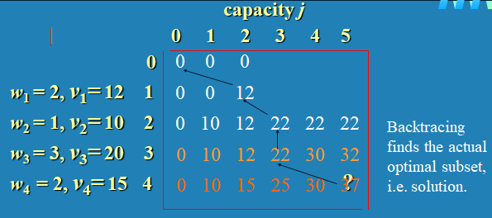
0/1 Knapsack Problem by DP (example)
max {V[i-1,j], v_{i} + V[i-1,j- w_{i}]} if j- w_{i} ≥ 0
V[i,j] =
V[i-1,j] if j- w_{i} < 0
Initial conditions: V[0,j] = 0 and V[i,0] = 0
Example: Knapsack of capacity W = 5
item weight value
1 2 $12
2 1 $10
3 3 $20
4 2 $15

Slide 11
Knapsack Problem by DP (pseudocode)
Algorithm DPKnapsack(w[1..n], v[1..n], W)
var V[0..n,0..W], P[1..n,1..W]: int
for j := 0 to W do
V[0,j] := 0
for i := 0 to n do
V[i,0] := 0
for i := 1 to n do
for j := 1 to W do
if w[i] ≤ j and v[i] + V[i-1,j-w[i]] > V[i-1,j] then
V[i,j] := v[i] + V[i-1,j-w[i]]; P[i,j] := j-w[i]
else V[i,j] := V[i-1,j]; P[i,j] := j
return V[n,W] and the optimal subset by backtracking.
Running time and space: O(nW).

Slide 12
Warshall’s Algorithm: Transitive Closure
Computes the transitive closure of a relation
Alternatively: existence of all nontrivial paths in a digraph
Example of transitive closure:
3
3
1
1
0 0 1 0
1 0 0 1
0 0 0 0
0 1 0 0
0 0 1 0
1 1 1 1
0 0 0 0
1 1 1 1
4
4
2
2

Slide 13
Warshall’s Algorithm
Constructs transitive closure T as the last matrix in the sequence of n-by-n matrices R⁽⁰⁾, … , R^{(k)}, … , R^{(n)} where
R^{(k)}[i,j] = 1 iff there is nontrivial path from i to j with only the first k vertices allowed as intermediate
Note that R⁽⁰⁾ = A (adjacency matrix), R^{(n)} = T (transitive closure)
3
3
3
3
3
1
1
1
1
1
2
4
2
4
2
4
2
4
4
2
R⁽⁰⁾
0 0 1 0
1 0 0 1
0 0 0 0
0 1 0 0
R⁽¹⁾
0 0 1 0
1 0 1 1
0 0 0 0
0 1 0 0
R⁽²⁾
0 0 1 0
1 0 1 1
0 0 0 0
1 1 1 1
R⁽³⁾
0 0 1 0
1 0 1 1
0 0 0 0
1 1 1 1
R⁽⁴⁾
0 0 1 0
1 1 1 1
0 0 0 0
1 1 1 1

Slide 14
Warshall’s Algorithm (recurrence)
On the k-th iteration, the algorithm determines for every pair of vertices i, j if a path exists from i and j with just vertices 1,…,k allowed as intermediate
R^{(k-1)}[i,j] (path using just 1 ,…,k-1)
R^{(k)}[i,j] = or
R^{(k-1)}[i,k] and R^{(k-1)}[k,j] (path from i to k
and from k to j
using just 1 ,…,k-1)
{
k
i
Initial condition?
j

Slide 15
Warshall’s Algorithm (matrix generation)
Recurrence relating elements R^{(k)} to elements of R^{(k-1)} is:
R^{(k)}[i,j] = R^{(k-1)}[i,j] or (R^{(k-1)}[i,k] and R^{(k-1)}[k,j])
It implies the following rules for generating R^{(k)} from R^{(k-1)}:
Rule 1 If an element in row i and column j is 1 in R^{(k-1)}, it remains 1 in R^{(k)}
Rule 2 If an element in row i and column j is 0 in R^{(k-1)}, it has to be changed to 1 in R^{(k)} if and only if the element in its row i and column k and the element in its column j and row k are both 1’s in R^{(k-1)} .

Slide 16
Warshall’s Algorithm (example)
3
0 0 1 0
1 0 0 1
0 0 0 0
0 1 0 0
0 0 1 0
1 0 1 1
0 0 0 0
0 1 0 0
1
R⁽⁰⁾ ⁼
R⁽¹⁾ ⁼
2
4
0 0 1 0
1 0 1 1
0 0 0 0
1 1 1 1
0 0 1 0
1 0 1 1
0 0 0 0
1 1 1 1
0 0 1 0
1 1 1 1
0 0 0 0
1 1 1 1
R⁽²⁾ ⁼
R⁽³⁾ ⁼
R⁽⁴⁾ ⁼

Slide 17
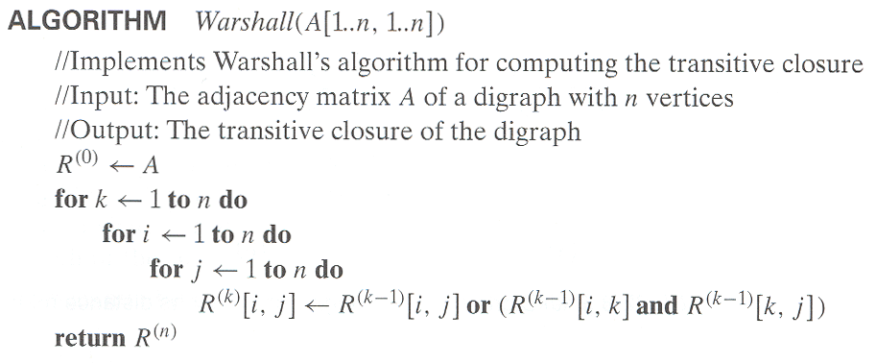
Warshall’s Algorithm (pseudocode and analysis)
Time efficiency: Θ(n³)
Space efficiency: Matrices can be written over their predecessors
(with some care), so it’s Θ(n^2).

Slide 18
Floyd’s Algorithm: All pairs shortest paths
Problem: In a weighted (di)graph, find shortest paths between every pair of vertices
Same idea: construct solution through series of matrices D⁽⁰⁾, …, D ^{(n)} using increasing subsets of the vertices allowed as intermediate
Example:
4
3
1
0 ∞ 4 ∞
0 4 3
∞ ∞ 0 ∞
∞ 5 1 0
1
6
1
5
4
2
3

Slide 19
Floyd’s Algorithm (matrix generation)
On the k-th iteration, the algorithm determines shortest paths between every pair of vertices i, j that use only vertices among 1,…,k as intermediate
D^{(k)}[i,j] = min {D^{(k-1)}[i,j], D^{(k-1)}[i,k] + D^{(k-1)}[k,j]}
D^{(k-1)}[i,k]
k
i
D^{(k-1)}[k,j]
Initial condition?
D^{(k-1)}[i,j]
j

Slide 20
Floyd’s Algorithm (example)
2
1
2
0 ∞ 3 ∞
2 0 ∞ ∞
∞ 7 0 1
6 ∞ ∞ 0
0 ∞ 3 ∞
2 0 5 ∞
∞ 7 0 1
6 ∞ 9 0
3
6
7
D⁽⁰⁾ ⁼
D⁽¹⁾ ⁼
3
1
4
0 ∞ 3 ∞
2 0 5 ∞
9 7 0 1
6 ∞ 9 0
0 10 3 4
2 0 5 6
9 7 0 1
6 16 9 0
0 10 3 4
2 0 5 6
7 7 0 1
6 16 9 0
D⁽²⁾ ⁼
D⁽³⁾ ⁼
D⁽⁴⁾ ⁼

Slide 21
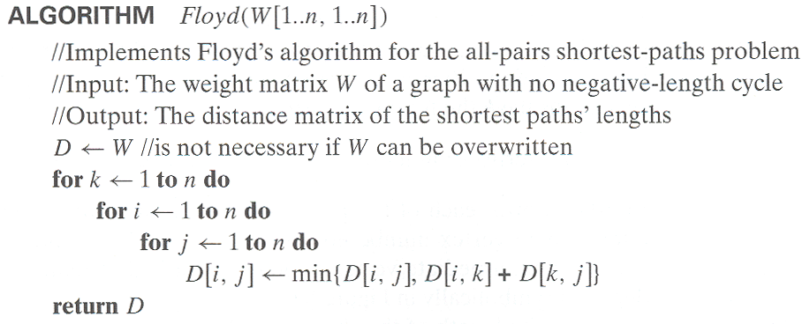
Floyd’s Algorithm (pseudocode and analysis)
If D[i,k] + D[k,j] < D[i,j] then P[i,j] ← k
Since the superscripts k or k-1 make no difference to D[i,k] and D[k,j].

Slide 22
Time efficiency: Θ(n³)
Space efficiency: Matrices can be written over their predecessors
Note: Works on graphs with negative edges but without negative cycles.
Shortest paths themselves can be found, too. How?

Slide 23
Greedy Technique

Slide 24
Greedy Technique
Constructs a solution to an optimization problem piece
by piece through a sequence of choices that are:
feasible, i.e. satisfying the constraints
locally optimal (with respect to some neighborhood definition)
greedy (in terms of some measure), and irrevocable
For some problems, it yields a globally optimal solution for every instance. For most, does not but can be useful for fast approximations. We are mostly interested in the former case in this class.
Defined by an objective function and a set of constraints

Slide 25
Applications of the Greedy Strategy
Optimal solutions:
change making for “normal” coin denominations
minimum spanning tree (MST)
single-source shortest paths
simple scheduling problems
Huffman codes
Approximations/heuristics:
traveling salesman problem (TSP)
knapsack problem
other combinatorial optimization problems

Slide 26
Change-Making Problem
Given unlimited amounts of coins of denominations d₁ > … > d_{m} ,
give change for amount n with the least number of coins
Example: d₁ = 25c, d₂ =10c, d₃ = 5c, d₄ = 1c and n = 48c
Greedy solution:
Greedy solution is
optimal for any amount and “normal’’ set of denominations
may not be optimal for arbitrary coin denominations
Q: What are the objective function and constraints?
<1, 2, 0, 3>
Ex: Prove the greedy algorithm is optimal for the above denominations.
For example, d1 = 25c, d2 = 10c, d3 = 1c, and n = 30c

Slide 27
Minimum Spanning Tree (MST)
Spanning tree of a connected graph G: a connected acyclic subgraph of G that includes all of G’s vertices
Minimum spanning tree of a weighted, connected graph G: a spanning tree of G of the minimum total weight
Example:
6
c
6
c
c
a
a
a
4
1
1
4
1
2
2
d
d
d
b
b
3
b
3

Slide 28
Prim’s MST algorithm
Start with tree T₁ consisting of one (any) vertex and “grow” tree one vertex at a time to produce MST through a series of expanding subtrees T₁, T₂, …, T_{n}
On each iteration, construct T_{i+1} from T_{i} by adding vertex not in T_{i} that is closest to those already in T_{i} (this is a “greedy” step!)
Stop when all vertices are included

Slide 29
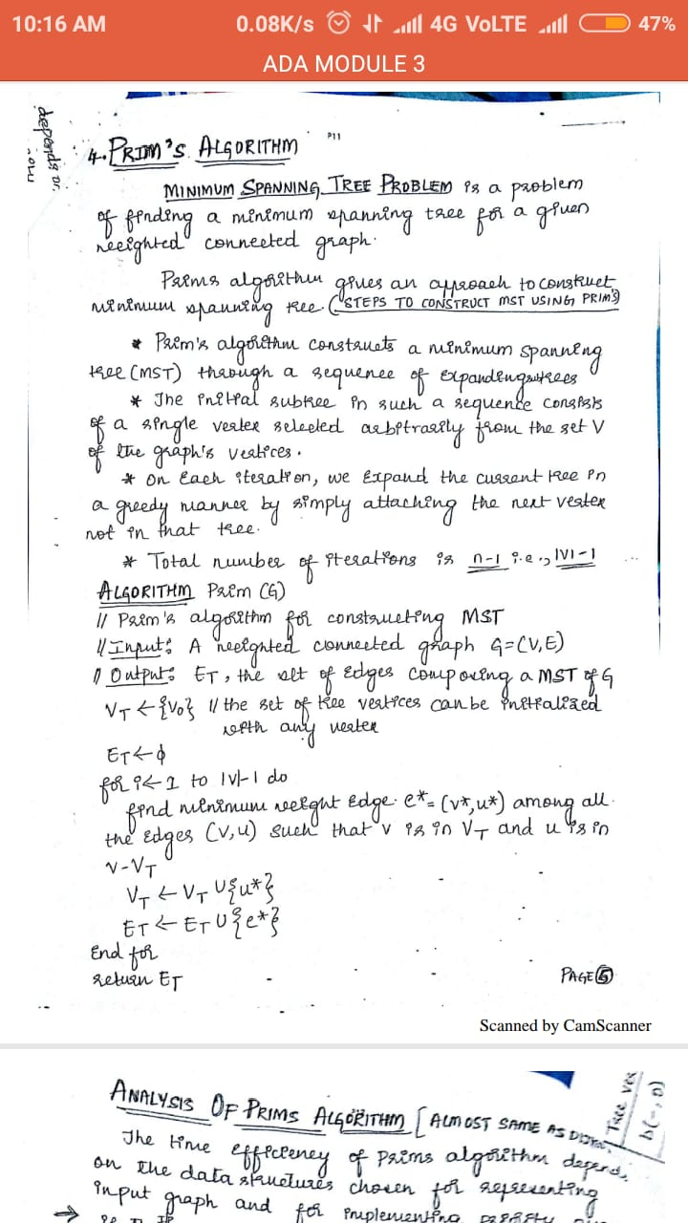

Slide 30
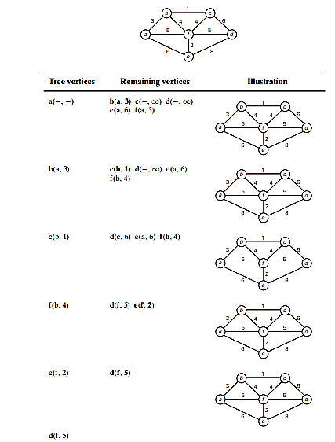

Slide 31
Example
4
c
4
c
4
c
a
a
a
1
1
1
6
6
6
2
2
2
d
d
d
b
3
b
3
b
3
4
c
4
c
a
a
6
1
1
2
6
2
b
3
d
d
b
3

Slide 32
Efficiency
O(n²) for weight matrix representation of graph and array implementation of priority queue
O(m log n) for adjacency lists representation of graph with n vertices and m edges and min-heap implementation of the priority queue

Slide 33
Another greedy algorithm for MST: Kruskal’s
Sort the edges in nondecreasing order of lengths
“Grow” tree one edge at a time to produce MST through a series of expanding forests F₁, F₂, …, F_{n-1}
On each iteration, add the next edge on the sorted list unless this would create a cycle. (If it would, skip the edge.)

Slide 34
ALGORITHM Kruskal(G) //Kruskal’s algorithm for constructing a minimum spanning tree
//Input: A weighted connected graph G=V,E //Output: ET , the set of edges composing a minimum spanning tree of G sort E in nondecreasing order of the edge weights w(ei1)≤...≤w(ei|E|)
ET ←∅; ecounter ←0 //initialize the set of tree edges and its size
k←0 //initialize the number of processed edges while ecounter <|V|−1do
k←k+1
if ET ∪{ eik}is acyclic
ET ←ET ∪{ eik}; ecounter ←ecounter +1 return ET

Slide 35
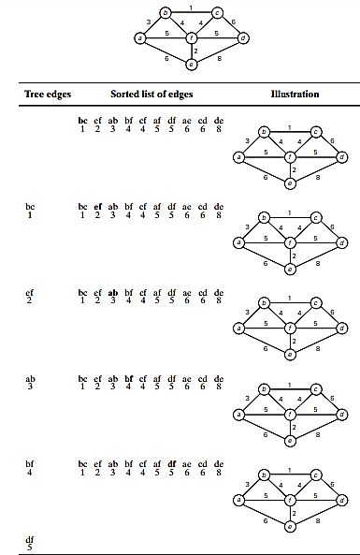

Slide 36
Example
4
c
4
c
4
c
a
a
1
6
1
a
6
6
1
2
2
2
d
b
3
d
b
3
b
3
d
c
c
4
c
a
a
1
a
1
1
6
2
6
2
2
d
d
b
3
d
b
3
b
3

Slide 37
Notes about Kruskal’s algorithm
Algorithm looks easier than Prim’s but is harder to implement (checking for cycles!)
Cycle checking: a cycle is created iff added edge connects vertices in the same connected component
Runs in O(m log m) time, with m = |E|. The time is mostly spent on sorting.

Slide 38
Shortest paths – Dijkstra’s algorithm
Single Source Shortest Paths Problem: Given a weighted connected (directed) graph G, find shortest paths from source vertex s to each of the other vertices
Dijkstra’s algorithm: Similar to Prim’s MST algorithm, with a different way of computing numerical labels: Among vertices not already in the tree, it finds vertex u with the smallest sum
d_{v} + w(v,u)
where
v is a vertex for which shortest path has been already found on preceding iterations (such vertices form a tree rooted at s)
d_{v} is the length of the shortest path from source s to v w(v,u) is the length (weight) of edge from v to u

Slide 39
Example
b
4
c
3
6
7
2
5
4
a
d
d
e
Tree vertices Remaining vertices
a(-,0) b(a,3) c(-,∞) d(a,7) e(-,∞)
4
b
c
3
2
6
5
a
7
d
4
e
b(a,3) c(b,3+4) d(b,3+2) e(-,∞)
b
4
c
3
6
2
5
a
7
d
4
e
d(b,5) c(b,7) e(d,5+4)
b
4
c
3
6
2
5
a
7
d
4
e
c(b,7) e(d,9)
4
b
c
3
6
2
5
a
7
d
4
e
e(d,9)

Slide 40
Notes on Dijkstra’s algorithm
Correctness can be proven by induction on the number of vertices.
Doesn’t work for graphs with negative weights (whereas Floyd’s algorithm does, as long as there is no negative cycle). Can you find a counterexample for Dijkstra’s algorithm?
Applicable to both undirected and directed graphs.
We prove the invariants: (i) when a vertex is added to the tree, its correct distance is calculated and (ii) the distance is at least those of the previously added vertices.

Slide 41
Thank you

