Slide 1
Analysis of Algorithms
(CSE212)
Module 5
Limitations of Algorithm & BACKTRACKING
1

Slide 2
Module 5-Content
Introduction, Lower Bound Arguments
Decision Trees
P, NP ,NP complete problems
3. Backtracking- Introduction
N Queens Problem
N Queens Algorithm
Sum of Subsets

Slide 3
Lower Bounds
Lower bound: an estimate on a minimum amount of work needed to solve a given problem
Examples:
number of comparisons needed to find the largest element in a set of n numbers
number of comparisons needed to sort an array of size n
number of comparisons necessary for searching in a sorted array
number of multiplications needed to multiply two n-by-n matrices

Slide 4
Lower Bounds (cont.)
Lower bound can be
  an exact count
  an efficiency class (Ω)
Tight lower bound: there exists an algorithm with the same efficiency as the lower bound
Methods of Lower Bound are: Trivial, Information Theoretic arguments,Adversary argument, Problem Reduction (Refer class notes for in detail explanation)
Problem Lower bound Tightness
sorting (comparison-based) Ω(nlog n) yes
searching in a sorted array Ω(log n) yes
element uniqueness Ω(nlog n) yes
n-digit integer multiplication Ω(n) unknown
multiplication of n-by-n matrices Ω(n²) unknown

Slide 5
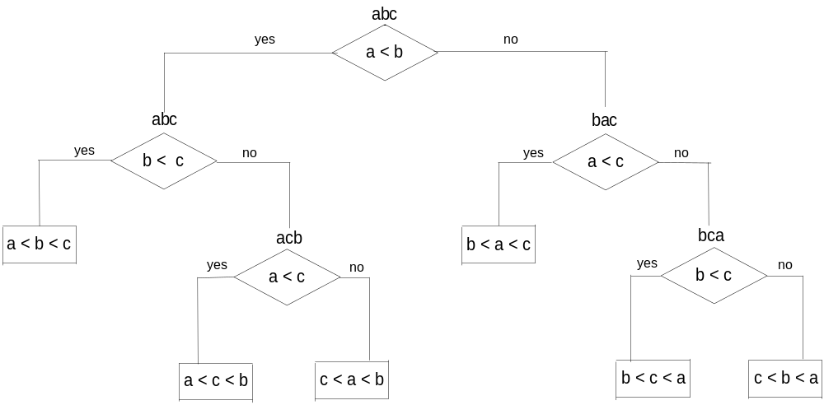
Decision Trees
Decision tree — a convenient model of algorithms involving comparisons in which:
internal nodes represent comparisons
leaves represent outcomes (or input cases)
Decision tree for 3-element insertion sort

Slide 6
Decision Trees and Sorting Algorithms
Any comparison-based sorting algorithm can be represented by a decision tree (for each fixed n)
Number of leaves (outcomes) ≥ n!
Height of binary tree with n! leaves ≥ ⎡log₂n!⎤
Minimum number of comparisons in the worst case ≥ ⎡log₂n!⎤ for any comparison-based sorting algorithm, since the longest path represents the worst case and its length is the height
⎡log₂n!⎤ ≈ n log₂n (by Sterling approximation)
This lower bound is tight (mergesort or heapsort)

Slide 7
Problem Types: Optimization and Decision
Optimization problem: find a solution that maximizes or minimizes some objective function
Decision problem: answer yes/no to a question
Many problems have decision and optimization versions.
E.g.: traveling salesman problem
optimization: find Hamiltonian cycle of minimum length
decision: find Hamiltonian cycle of length ≤ L
Decision problems are more convenient for formal investigation of their complexity.

Slide 8
Class P
P: the class of decision problems that are solvable in O(p(n)) time, where p(n) is a polynomial of problem’s input size n
Examples:
searching
element uniqueness
graph connectivity
graph acyclicity
primality testing (finally proved in 2002)

Slide 9
Class NP
NP (nondeterministic polynomial): class of decision problems whose proposed solutions can be verified in polynomial time = solvable by a nondeterministic polynomial algorithm
A nondeterministic polynomial algorithm is an abstract two-stage procedure that:
generates a solution of the problem (on some input) by guessing
checks whether this solution is correct in polynomial time
By definition, it solves the problem if it’s capable of generating and verifying a solution on one of its tries
Why this definition?
led to development of the rich theory called “computational complexity”

Slide 10
Example: CNF satisfiability
Problem: Is a boolean expression in its conjunctive normal form (CNF) satisfiable, i.e., are there values of its variables that make it true?
This problem is in NP. Nondeterministic algorithm:
Guess a truth assignment
Substitute the values into the CNF formula to see if it evaluates to true
Example: (A | ¬B | ¬C) & (A | B) & (¬B | ¬D | E) & (¬D | ¬E)
Truth assignments:
A B C D E
0 0 0 0 0
. . .
1 1 1 1 1
Checking phase: O(n)

Slide 11
What other problems are in NP?
Hamiltonian circuit existence
Partition problem: Is it possible to partition a set of n integers into two disjoint subsets with the same sum?
Decision versions of TSP, knapsack problem, graph coloring, and many other combinatorial optimization problems.
All the problems in P can also be solved in this manner (but no guessing is necessary), so we have:
    P ⊆ NP
Big (million dollar) question: P = NP ?

Slide 12
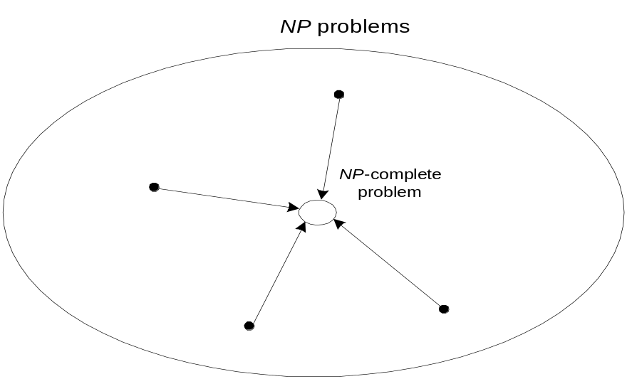
NP-Complete Problems
A decision problem D is NP-complete if it is as hard as any
problem in NP, i.e.,
D is in NP
every problem in NP is polynomial-time reducible to D
Cook’s theorem (1971): CNF-sat is NP-complete

Slide 13
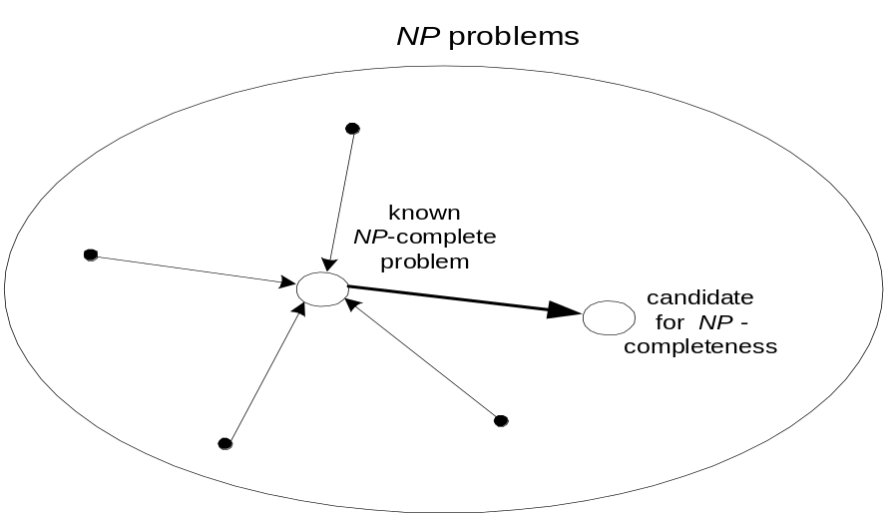
NP-Complete Problems (cont.)
Other NP-complete problems obtained through polynomial-
time reductions from a known NP-complete problem
Examples: TSP, knapsack, partition, graph-coloring and
hundreds of other problems of combinatorial nature

Slide 14
P = NP ? Dilemma Revisited
P = NP would imply that every problem in NP, including all NP-complete problems, could be solved in polynomial time
If a polynomial-time algorithm for just one NP-complete problem is discovered, then every problem in NP can be solved in polynomial time, i.e. P = NP
Most but not all researchers believe that P ≠ NP , i.e. P is a proper subset of NP. If P ≠ NP, then the NP-complete problems are not in P, although many of them are very useful in practice.

Slide 15
Backtracking
A given problem has a set of constraints and possibly an objective function
The solution optimizes an objective function, and/or is feasible.
We can represent the solution space for the problem using a state space tree
  The root of the tree represents 0 choices,
  Nodes at depth 1 represent first choice
  Nodes at depth 2 represent the second choice, etc.
  In this tree a path from a root to a leaf represents a candidate solution
An example for Backtracking is N Queens problems, Sum of subset, Hamiltonian circuit problem.

Slide 16
N Queens Problem
1. The n-queens problem defines to place n queens on an n×n chessboard so that no two queens attack each other by being in the same row or in the same column or on the same diagonal.
2. For n=1, the problem has a trivial solution, and it is easy to see that there is no solution for n=2 and n=3.
3. So let us consider the four-queens problem and solve it by the backtracking technique.

Slide 17
We start with the empty board and then place queen 1 in the ﬁrst possible position of its row, which is in column 1 of row 1.
Then we place queen 2, after trying unsuccessfully columns1 and 2,in the ﬁrst acceptable position for it,which is square (2, 3), the square in row 2 and column 3.
This proves to be a dead end because there is no acceptable position for queen 3. So, the algorithm backtracks and puts queen 2 in the next possible position at (2, 4).
Then queen 3 is placed at (3, 2), which proves to be another dead end.
The algorithm then backtracks all the way to queen 1 and moves it to (1, 2).
Queen 2 then goes to (2, 4), queen 3 to (3, 1), and queen 4 to (4, 3), which is a solution to the problem

Slide 18
Queens Algorithm
AlGORITHM Backtrack(X[l..i])
//Gives a template of a generic backtracking algorithm
//Input: X[Li] specifies first i promising components of a solution
//Output: All the tuples representing the problem's solutions
if X[Li] is a solution write X[l..i]
else
for each element x E S;+J consistent with X[Li] and the constraints do
X[i + 1] *-X
Backtrack(X[1..i + 1 ]J

Slide 19
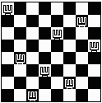
Problem on 8 Queens
Find an arrangement of 8 queens on a single chess board such that no two queens are attacking one another.
In chess, queens can move all the way down any row, column or diagonal (so long as no pieces are in the way).
Due to the first two restrictions, it's clear that each row and column of the board will have exactly one queen.

Slide 20

The backtracking strategy is as follows:
  Place a queen on the first available square in row 1.
  Move onto the next row, placing a queen on the first available square there (that doesn't conflict with the previously placed queens).
  Continue in this fashion until either:
    you have solved the problem,or
    you get stuck,When you get stuck, remove the queens that got you there, until you get to a row where there is another valid square to try.
Q
Q
Q
Q
Q
Continue…

Slide 21
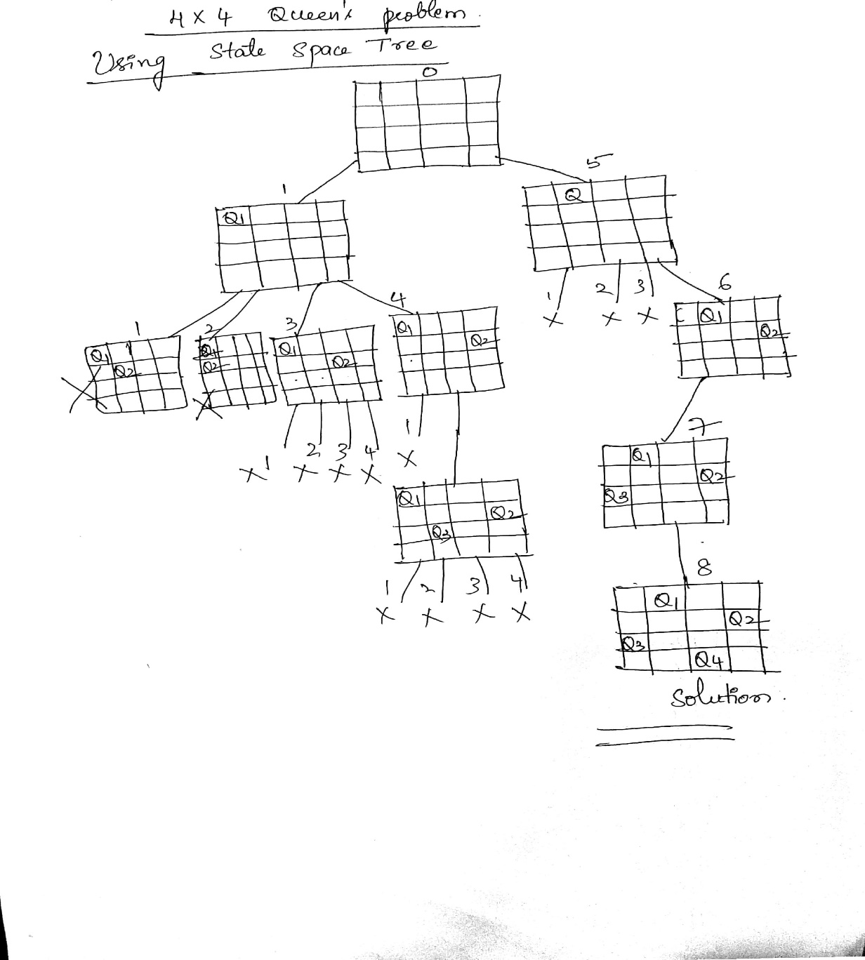
4*4 Queen Problem using State space tress

Slide 22
Thank You

