Slide 1
Analysis of Algorithms(CSE212)
MODULE 1
INTRODUCTION TO ALGORITHMS
1-<number>

Slide 2
What is an algorithm?
An algorithm is a sequence of unambiguous instructions for solving a problem, i.e., for obtaining a required output for any legitimate input in a finite amount of time.
Step by step procedure to solve the given problem..
Notion of Algorithm
problem
algorithm
input
“computer”
output
1-<number>

Slide 3
Features/ Properties of Algorithm
Input: Should accept 0 or more inputs
Output: Should produce at least one output
Effectiveness: Every instruction should transform the given I/P to desired output
Finiteness/termination: Algorithm should terminate after finite number of steps
Definiteness: Each Instruction should be clear and unambiguous
1-<number>

Slide 4
Why study algorithms?
Theoretical importance
  the core of computer science
Practical importance
  A practitioner’s toolkit of known algorithms
  Framework for designing and analyzing algorithms for new problems
Example: Google’s PageRank Technology
1-<number>

Slide 5
Algorithms to find GCD of 2 Numbers
3 different algorithms to find GCD of 2 numbers are
Euclid’s Algorithm
Consecutive Integer checking
Middle School Procedure
1-<number>
Notes:
Euclid’s algorithm is good for introducing the notion of an algorithm because it
makes a clear separation from a program that implements the algorithm.
It is also one that is familiar to most students.
Al Khowarizmi (many spellings possible...) – “algorism” (originally) and then
later “algorithm” come from his name.

Slide 6
1. Euclid’s Algorithm to find GCD
M=60 n= 24
Gcd(60,24)=gcd(24, 60mod24)->gcd(24,12)
G(24,12)=g(12,24%12)
=g(12, 0)
Gcd(60,24)=12
Problem: Find gcd(m,n), the greatest common divisor of two nonnegative, not both zero integers m and n
Examples: gcd(60,24) = 12, gcd(60,0) = 60,gcd(0,0) = ?
Euclid’s algorithm is based on repeated application of equality gcd(m,n) = gcd(n, m mod n) until the second number becomes 0, which makes the
Problem trivial.
Example: gcd(60,24) = gcd(24,12) = gcd(12,0) = 12

Slide 7
Euclid’s algorithm(Contd..)
While(n!=0)
{
r=m%n;
m=n;
n=r;
}
Return m
Tracing:
60 and 24
W(24!=0)
{
r=60%24 r=12
m=24
n= 12
}
W(12!=0)
{
r=24%12 r=0
m=12
n=0
}
W(0!=0)
False
Return 12
Step 1 If n = 0, return m and stop; otherwise go to Step 2
Step 2 Divide m by n and assign the value of the remainder to r
Step 3 Assign the value of n to m and the value of r to n. Go to
while n ≠ 0 do
r ← m mod n
m← n
n ← r
return m T(n)=O(log(n))
M | N | R=M%N
2 | 6 | 2%6=>gcd is 2
6 | 2 | 6%2=> gcd is 2
2 | 0 | Since N is 0, M(i.e., 2) is returned as GCD of 2 numbers
1-<number>

Slide 8
2. Consecutive integer checking algorithm to find GCD
Step 1 Assign the value of min{m,n} to t
Step 2 Divide m by t. If the remainder is 0, go to Step 3;
otherwise, go to Step 4
Step 3 Divide n by t. If the remainder is 0, return t and stop;
otherwise, go to Step 4
Step 4 Decrease t by 1 and go to Step 2
Is this slower than Euclid’s algorithm? How much slower?
O(n), if n <= m , vs O(log n)
1-<number>

Slide 9
Consecutive integer checking problem contd…
60 24
Min=24
60%24=12
60%23=14
60%22=16
60%21=18
60%20=0
20 24%20=4
24%19=5
24%18=6
24%17=7
24%16=8
24&15=9
24%14=10
24%13=11
24%12=0
Return t=12
Gcd(9=m,6=n)=> min is 6 , t = 6
t m%t
6 9%6=3
5 9%5=4
4 9%4=1
3 9%3=0
n%t
6%3=0 Therefore gcd is t=3

Slide 10
3. Middle-school procedure to find GCD
2=m n= 6
2= 1 2
6= 1 2 3 6
Common factors 1 and 2
1*2= 2 -> gcd
Step 1 Find the prime factorization of m
Step 2 Find the prime factorization of n
Step 3 Find all the common prime factors
Step 4 Compute the product of all the common prime factors
and return it as gcd(m,n)
Is this an algorithm?
How efficient is it?
Time complexity: O(sqrt(n))
1-<number>

Slide 11
Sieve of Eratosthenes to find the prime numbers in the given range
N=10
2 to 10
2 3 0 5 0 7 0 0 0
A[2]=2
A[3]=3
A[4]=4
A[5]=5
..
A[10]=10
Sqrt(10)=3
3 0 5 0 7 0 0 0
i=2, 4 6 8 10
i=3, 6, 9
i=4, failed
Print prime numbers
PROCEDURE:
Generate the list of integers from 2 to n
Eliminate multiples of i between 2 to sqrt(n)
Output the remaining numbers as prime numbers
ALGORITHM
Input: Integer n
Output: List of primes less than or equal to n 9=sqrt(9)=3
for i ← 2 to n do A[i] ← i 2 3 4 5 6 7 8 9 10 i=2
for i ← 2 to sqrt(n) do 4<=3 fails
if A[i] ≠ 0 //i hasn’t been previously eliminated from the list
j ← i* I =9 when i=2 j=4 6 8 10 i=3 j=9
while j ≤ n do 12<=10 fails it ll go to for loop
A[j] ← 0 //mark element as eliminated
j ← j + i
Print prime numbers if a[i]!=0 2 3 5 7
Time complexity: O(n)
1-<number>

Slide 12
Analysis of algorithms
How good is the algorithm?
  time efficiency: amount of time required for the program to execute.
  space efficiency: Memory required
  correctness ignored in this course
Does there exist a better algorithm?
  lower bounds
  optimality
1-<number>

Slide 13
Important problem types
sorting
searching
string processing
graph problems
1-<number>

Slide 14
Sorting (I)
Rearrange the items of a given list in ascending order.
  Input: A sequence of n numbers <a₁, a₂, …, a_{n}>
  Output: A reordering <a´₁, a´₂, …, a´_{n}> of the input sequence such that a´₁≤ a´₂ ≤ … ≤ a´_{n.}
Why sorting?
  Help searching
  Algorithms often use sorting as a key subroutine.
Sorting key
  A specially chosen piece of information used to guide sorting. E.g., sort student records by names.
1-<number>

Slide 15
Sorting (II)
Examples of sorting algorithms
  Selection sort
  Bubble sort
  Insertion sort
  Merge sort
  Heap sort …
Evaluate sorting algorithm complexity: the number of key comparisons.
Two properties
  Stability: A sorting algorithm is called stable if it preserves the relative order of any two equal elements in its input.
  In place : A sorting algorithm is in place if it does not require extra memory, except, possibly for a few memory units.
1-<number>

Slide 16
Selection Sort
Algorithm SelectionSort(A[0..n-1])
//The algorithm sorts a given array by selection sort
//Input: An array A[0..n-1] of orderable elements
//Output: Array A[0..n-1] sorted in ascending order
for i ← 0 to n – 2 do
min ← i
for j ← i + 1 to n – 1 do
if A[j] < A[min]
min ← j
swap A[i] and A[min]
1-<number>

Slide 17
Searching
Find a given value, called a search key, in a given set.
Examples of searching algorithms
  Sequential search
  Binary search …
Input: sorted array a_i < … < a_j and key x;
m ←(i+j)/2;
while i < j and x != a_m do
if x < a_m then j ← m-1
else i ← m+1;
if x = a_m then output a_m;
Time: O(log n)
1-<number>

Slide 18
String Processing
A string is a sequence of characters from an alphabet.
Text strings: letters, numbers, and special characters.
String matching: searching for a given word/pattern in a text.
Examples:
searching for a word or phrase on WWW or in a Word document
searching for a short read in the reference genomic sequence
1-<number>

Slide 19
Graph Problems
Informal definition
  A graph is a collection of points called vertices, some of which are connected by line segments called edges.
  Types of graphs
    Adjacency matrix
    Cost adjacency matrix
    Spanning tree
1-<number>

Slide 20
Graphs
Formal definition
  A graph G = <V, E> is defined by a pair of two sets: a finite set V of items called vertices and a set E of vertex pairs called edges.
Undirected and directed graphs (digraphs).
What’s the maximum number of edges in an undirected graph with |V| vertices?
Complete, dense, and sparse graphs
  A graph with every pair of its vertices connected by an edge is called complete, K_{|V|}
1
2
3
4
1-<number>

Slide 21
Graph Representation
Adjacency matrix
  n x n boolean matrix if |V| is n.
  The element on the ith row and jth column is 1 if there’s an edge from ith vertex to the jth vertex; otherwise 0.
  The adjacency matrix of an undirected graph is symmetric.
Adjacency linked lists
  A collection of linked lists, one for each vertex, that contain all the vertices adjacent to the list’s vertex.
0 1 1 1
0 0 0 1
0 0 0 1
0 0 0 0
2
3
4
4
4
1-<number>

Slide 22
Weighted Graphs
Weighted graphs
  Graphs or digraphs with numbers assigned to the edges.
5
1
2
6
9
7
3
8
4
1-<number>

Slide 23
Graph Properties -- Paths and Connectivity
Paths
  A path from vertex u to v of a graph G is defined as a sequence of adjacent (connected by an edge) vertices that starts with u and ends with v.
  Simple paths: All edges of a path are distinct.
  Path lengths: the number of edges, or the number of vertices – 1.
Connected graphs
  A graph is said to be connected if for every pair of its vertices u and v there is a path from u to v.
Connected component
  The maximum connected subgraph of a given graph.
1-<number>
Notes:
Examples of a simple path and a not simple path.
Connected graphs: starting from any vertex, we can always find a path to reach all the other vertices. (Ball-String example.)
From NIST:
Connected graphs:
Definition: An undirected graph that has a path between every pair of vertices.
Strongly connected graphs:
Definition: A directed graph that has a path from each vertex to every other vertex.
Connected component: …
Strongly connected component:
a strongly connected component of a digraph G is a maximal strongly connected subgraph of G.

Slide 24
Graph Properties -- Acyclicity
Cycle
  A simple path of a positive length that starts and ends a the same vertex.
Acyclic graph
  A graph without cycles
  DAG (Directed Acyclic Graph)
1
2
3
4
1-<number>

Slide 25
Algorithm design strategies
Brute force
Divide and conquer
Decrease and conquer
Transform and conquer
Greedy approach
Dynamic programming
Backtracking and branch-and-bound
Space and time tradeoffs
1-<number>

Slide 26
Theoretical analysis of time efficiency
Time efficiency is analyzed by determining the number of
repetitions of the basic operation as a function of input size
Basic operation: the operation that contributes the most towards the running time of the algorithm
T(n) ≈ c_{op}C(n)
input size
running time
execution time
for basic operation
or cost
Number of times basic operation is executed
Note: Different basic operations may cost differently!

Slide 27
Input size and basic operation examples
Problem | Input size measure | Basic operation
Searching for key in a list of n items | Number of list’s items, i.e. n | Key comparison
Multiplication of two matrices | Matrix dimensions or total number of elements | Multiplication of two numbers
Checking primality of a given integer n | n’size = number of digits (in binary representation) | Division
Typical graph problem | #vertices and/or edges | Visiting a vertex or traversing an edge

Slide 28
Empirical analysis of time efficiency
Select a specific (typical) sample of inputs
Use physical unit of time (e.g., milliseconds)
or
Count actual number of basic operation’s executions
Analyze the empirical data

Slide 29
Best-case, average-case, worst-case
Key=a[i]
10 20 30
K=10
Best case
omega(1)
20 30 40
Worst case n
Average= n/2
For some algorithms, efficiency depends on form of input:
Worst case: C_{worst}(n) – maximum over inputs of size n Big oh
Best case: C_{best}(n) – minimum over inputs of size n Big omega
Average case: C_{avg}(n) – “average” over inputs of size n Big theta
  Number of times the basic operation will be executed on typical input
  NOT the average of worst and best case
  Expected number of basic operations considered as a random variable under some assumption about the probability distribution of all possible inputs. So, avg = expected under uniform distribution.

Slide 30
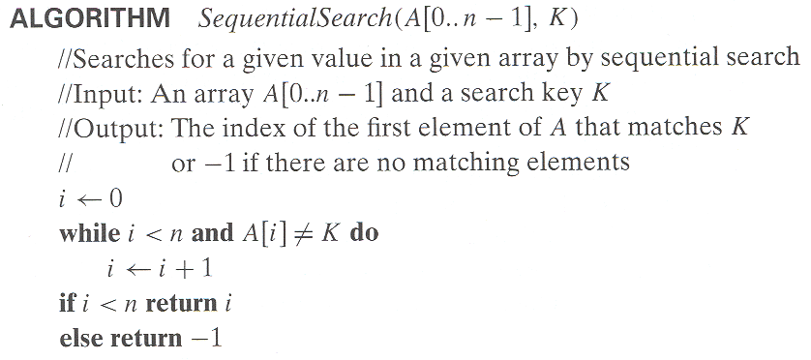
Example: Sequential search
n key comparisons
Worst case
Best case
Average case
1 comparisons
(n+1)/2, assuming K is in A

Slide 31
Types of formulas for basic operation’s count
Exact formula
e.g., C(n) = n(n-1)/2
Formula indicating order of growth with specific multiplicative constant
e.g., C(n) ≈ 0.5 n²
Formula indicating order of growth with unknown multiplicative constant
e.g., C(n) ≈ cn²

Slide 32
Order of growth
As the value of n(input size) increases, time required for execution also increases i.e., behavior of algorithm changes with the increase in the value of n. This change in the behavior is called orders of growth
Most important: Order of growth within a constant multiple as n→∞
Example:
  How much faster will algorithm run on computer that is twice as fast?
  How much longer does it take to solve problem of double input size?
Notes:
Example: cn²
how much faster on twice as fast computer? (2)
how much longer for 2n? (4)

Slide 33
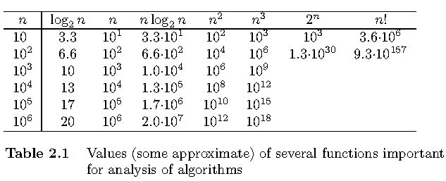
Values of some important functions as n → ∞

Slide 34
Basic asymptotic efficiency classes
nlogn< belongs to O(n)
F(N)<=cg(N)
nLogn<=c* n fails
10*0.6>n =10
1 | constant
log n | logarithmic
n | linear
n log n | n-log-n
n² | quadratic
n³ | cubic
2^{n} | exponential
n! | factorial

Slide 35
Asymptotic order of growth
F(n)=2n+8
g(n)=5n
Theta?
C2*g(n)<=f(n)<=c1g(n)
1*5n<=2n+8<=1*5n
1*5(1)<2*1+8<=2*5*1
5<=10<=10
For all n>=1
c2=1
c1=2
A way of comparing functions that ignores constant factors and small input sizes (because?)
O(g(n)): class of functions f(n)(time function) that grow no faster than g(n) (basic opertion)
Θ(g(n)): class of functions f(n) ot t(n) that grow at same rate as g(n)
Ω(g(n)): class of functions f(n) that grow at least as fast as g(n)

Slide 36
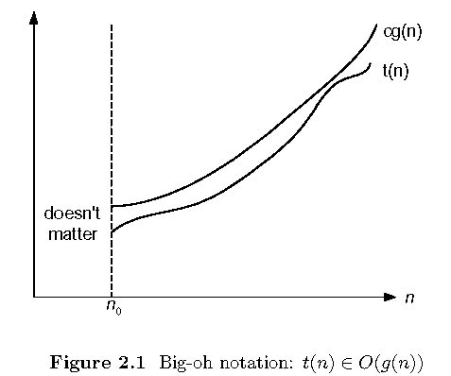
Big-oh

Slide 37
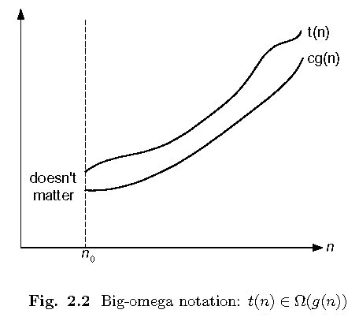
Big-omega

Slide 38
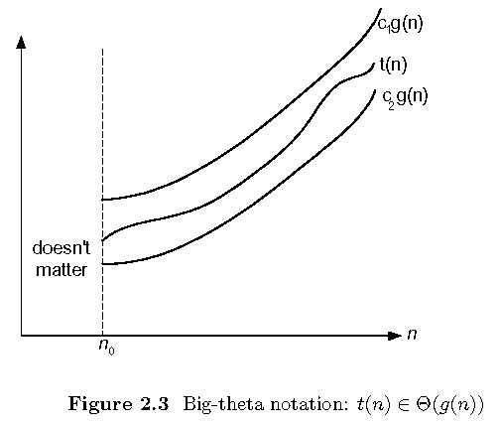
Big-theta

Slide 39
Establishing order of growth using the definition
Definition: f(n) is in O(g(n)), denoted f(n) ∈ O(g(n)), if order of growth of f(n) ≤ order of growth of g(n) (within constant multiple), i.e., there exist positive constant c and non-negative integer n₀ such that
Examples: f(n) ≤ c g(n) for every n ≥ n₀
10n is in omega(n²)
=c1*(n²)<=10n<=c2*(n)^2 n=1 10*1>=1*1^2=1 n>=1
If n=4, 10*10<=c*(10^2)
= 100<=1*100 So, 10n<=c*(n²) for = all n>=10 and c=1
5n+20 is in O(n)
Notes:
Examples:
10n is O(n²)
since 10n ≤ 10n² for n ≥ 1 or 10n ≤ n² for n ≥ 10
c n₀
5n+20 is O(10n)
since 5n+20 ≤ 10 n for n ≥ 4
c n₀

Slide 40
2. 5n+20 is in O(n)
f(n)=5n+20 and g(n)=n
f(n)<=c*g(n)
5n+20<=c*n
if n=1
5*1+20<=1*1…. Not possible. So increase n value and check
5*2+20<=1*

Slide 41
O-notation (Worst case and Upper bound)
Formal definition
  A function t(n) is said to be in O(g(n)), denoted t(n) ∈ Ω(g(n)), if t(n) is bounded above by some constant multiple of g(n) for all large n, i.e., if there exist some positive constant c and some nonnegative integer n₀ such that
  t(n) <= cg(n) for all n ≥ n₀
Exercises: prove the following using the above definition
  10n² ∈ O(n²)
  0.3n- 2n ∈ O(n³)
  0.1n²∈ O(n³)

Slide 42
Ω-notation (Best case or Lower bound)
Formal definition
  A function t(n) is said to be in Ω(g(n)), denoted t(n) ∈ Ω(g(n)), if t(n) is bounded below by some constant multiple of g(n) for all large n, i.e., if there exist some positive constant c and some nonnegative integer n₀ such that
  t(n) ≥ cg(n) for all n ≥ n₀
Exercises: prove the following using the above definition
  10n² ∈ Ω(n²)
  0.3n² - 2n ∈ Ω(n²)
  0.1n³ ∈ Ω(n²)

Slide 43
Θ-notation (Average case)
Formal definition
  A function t(n) is said to be in Θ(g(n)), denoted t(n) ∈ Θ(g(n)), if t(n) is bounded both above and below by some positive constant multiples of g(n) for all large n, i.e., if there exist some positive constant c₁ and c₂ and some nonnegative integer n₀ such that
  c₂ g(n) ≤ t(n) ≤ c₁ g(n) for all n ≥ n₀
Exercises: prove the following using the above definition
  10n² ∈ Θ(n²)
  0.3n² - 2n ∈ Θ(n²)
  (1/2)n(n+1) ∈ Θ(n²)

Slide 44
Establishing order of growth using limits
0 order of growth of T(n) < order of growth of g(n)
lim T(n)/g(n) =
c > 0 order of growth of T(n) = order of growth of g(n)
n→∞
∞ order of growth of T(n) > order of growth of g(n)
Examples:
10n vs. n²
n(n+1)/2 vs. n²

Slide 45
Time efficiency of nonrecursive algorithms
General Plan for Analysis
Decide on parameter n indicating input size
Identify algorithm’s basic operation
Determine worst, average, and best cases for input of size n
Set up a sum for the number of times the basic operation is executed. Apply rules/formulas to deduce efficiency and represent the same using asymptotic notations

Slide 46
Useful summation formulas and rules
Σ_{l≤i≤n}1 = 1+1+…+1 = n - l + 1
In particular, Σ_{l≤i≤n}1 = n - 1 + 1 = n ∈ Θ(n)
Σ_{1≤i≤n} i = 1+2+…+n = n(n+1)/2 ≈ n²/2 ∈ Θ(n²)
Σ_{1≤i≤n} i² = 1²+2²+…+n² = n(n+1)(2n+1)/6 ≈ n³/3 ∈ Θ(n³)
Σ_{0≤i≤n} a^{i} = 1 + a +…+ a^{n} = (a^{n+1} - 1)/(a - 1) for any a ≠ 1
In particular, Σ_{0≤i≤n} 2^{i} = 2⁰ + 2¹ +…+ 2^{n} = 2^{n+1} - 1 ∈ Θ(2^{n} )
Σ(a_{i} ± b_{i} ) = Σa_{i} ± Σb_{i} Σca_{i} = cΣa_{i} Σ_{l≤i≤u}a_{i} = Σ_{l≤i≤m}a_{i} + Σ_{m+1≤i≤u}a_{i}

Slide 47
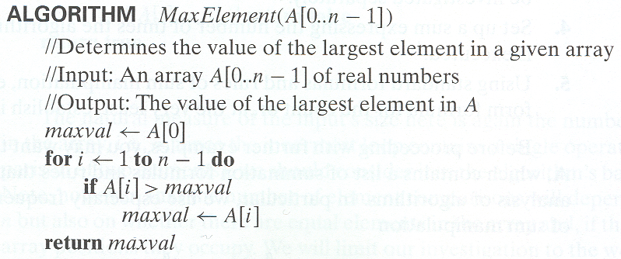
Example 1: Maximum element
T(n) = Σ1≤i≤n-1 1 = n-1 = Θ(n) comparisons

Slide 48
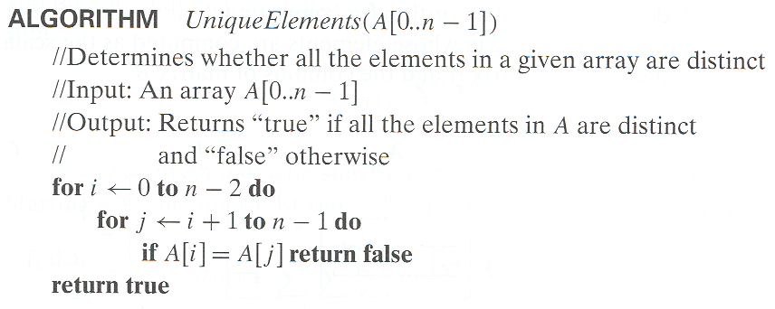

Example 2: Element uniqueness problem
T(n) = Σ0≤i≤n-2 (Σi+1≤j≤n-1 1)
= Σ0≤i≤n-2 n-i-1 = (n-1+1)(n-1)/2
= Θ( ) comparisons

Slide 49
Plan for Analysis of Recursive Algorithms
Decide on a parameter indicating an input’s size.
Identify the algorithm’s basic operation.
Check whether the number of times the basic op. is executed may vary on different inputs of the same size. (If it may, the worst, average, and best cases must be investigated separately.)
Set up a recurrence relation with an appropriate initial condition expressing the number of times the basic op. is executed.
Solve the recurrence (or, at the very least, establish its solution’s order of growth) by backward substitutions or another method.

Slide 50
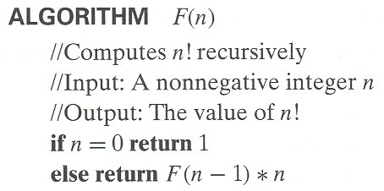
Example 1: Recursive evaluation of n!
Definition: n ! = 1 ∗ 2 ∗ … ∗(n-1) ∗ n for n ≥ 1 and 0! = 1
Recursive definition of n!: F(n) = F(n-1) ∗ n for n ≥ 1 and
F(0) = 1
Size: n
Basic operation:
multiplication
Recurrence relation:
M(n)=M(n-1) + 1
M(0) = 0
Notes:
Note the difference between the two recurrences. Students often confuse these!
F(n) = F(n-1) n
F(0) = 1
for the values of n!
------------
M(n) =M(n-1) + 1
M(0) = 0
for the number of multiplications made by this algorithm

Slide 51
Solving the recurrence for M(n)
M(n) = M(n-1) + 1, M(0) = 0
M(n) = M(n-1) + 1
= (M(n-2) + 1) + 1 = M(n-2) + 2
= (M(n-3) + 1) + 2 = M(n-3) + 3
…
= M(n-i) + i
= M(0) + n
= n
The method is called backward substitution.

Slide 52
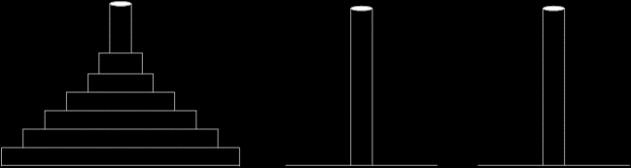
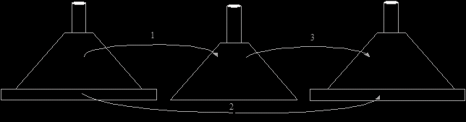
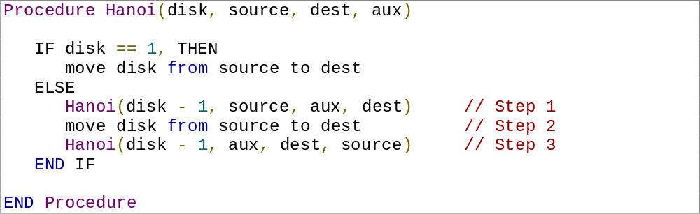
Example 2: The Tower of Hanoi Puzzle
Recurrence for number of moves:
M(n) = 2M(n-1) + 1

Slide 53
Solving recurrence for number of moves
M(n) = 2M(n-1) + 1, M(1) = 1
M(n) = 2M(n-1) + 1
= 2(2M(n-2) + 1) + 1 = 2^2*M(n-2) + 2^1 + 2^0
= 2^2*(2M(n-3) + 1) + 2^1 + 2^0
= 2^3*M(n-3) + 2^2 + 2^1 + 2^0
= …
= 2^(n-1)*M(1) + 2^(n-2) + … + 2^1 + 2^0
= 2^(n-1) + 2^(n-2) + … + 2^1 + 2^0
= 2^n - 1

Slide 54
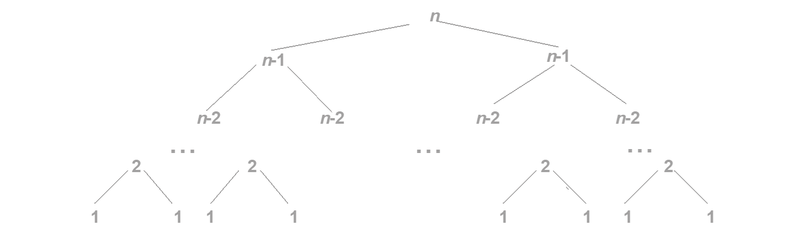
Tree of calls for the Tower of Hanoi Puzzle

