Slide 1
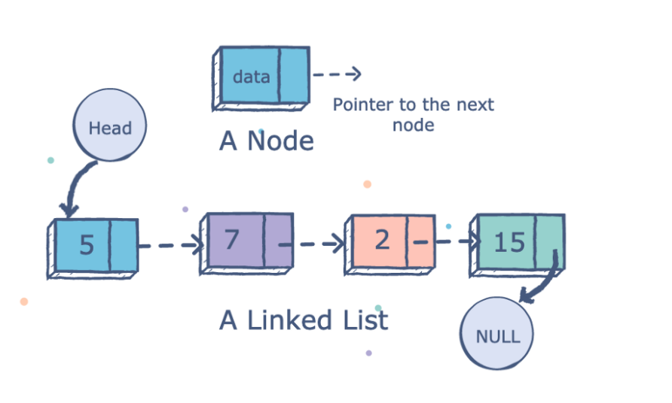
Linked Lists

Slide 2
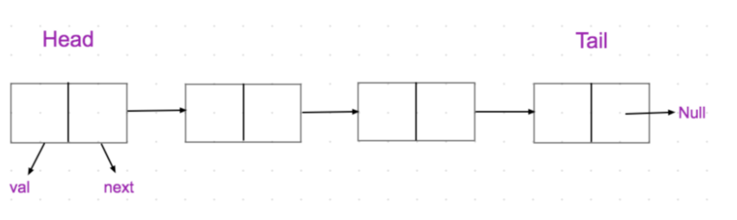
Introduction
A linked list is a linear data structure. It consists of many nodes where each node has a data field and a link or reference to the next node.
The first node is usually termed as Head and the last node as Tail.
These nodes interconnect and form a sequence.

Slide 3
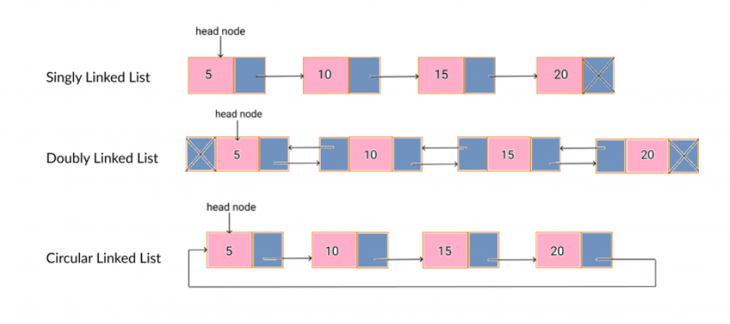
Types of Linked Lists
There are primarily 3 types of linked lists :
Singly linked list : -
In this type of linked list the navigation is forward only.
Doubly linked list :-
In this type of linked list navigated forward and backward.
Circular linked list :-
In this type the last item contains link of the first element as next and every node has link to another node.

Slide 4
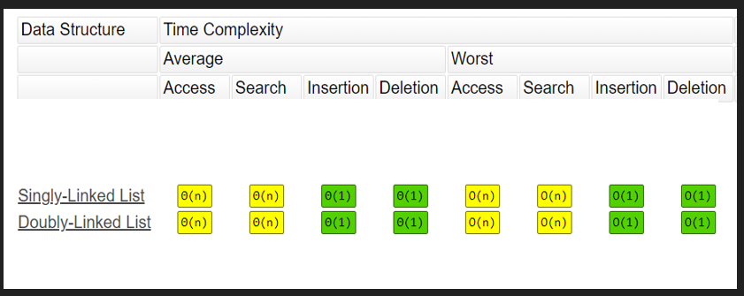
Why use a Linked List ?
It is a Dynamic Data Structure.
Insertion and deletion are quick and easier at any position.
They have efficient memory utilization.
Memory is allocated whenever required and de-allocated when no longer needed.
Provides efficient way to implement stacks and queues.
Time complexity of Linked Lists :-

Slide 5
Arrays Vs Linked Lists
Arrays | Linked Lists
An array is a collection of elements of a similar data type. Array elements store in a contiguous memory location. Accessing any element in an array is faster as the element in an array can be directly accessed through the index. In the case of an array, memory is allocated at compile-time. Insertion and deletion cannot be performed at specific desired location. | A linked list is a collection of objects known as a node where node consists of data and address. Linked list elements can be stored anywhere in the memory or randomly stored. Accessing an element in a linked list is slower as it starts traversing from the first element of the linked list. In the case of a linked list, memory is allocated at run time. Insertion and deletion can be performed at specific desired location.

Slide 6
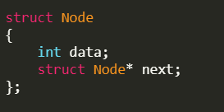
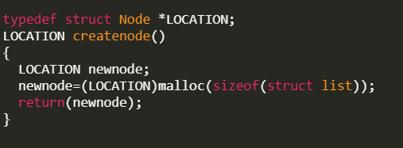
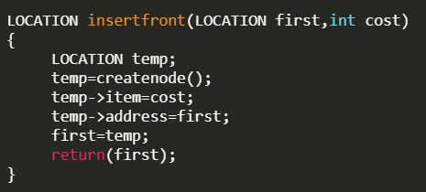
Implementation
1. We create a data field and a pointer in a structure for implementing linked lists
2. createnode() allocates the memory dynamically and returns a new node consisting of a data field and a pointer field
3. A basic function to insert a node at the start of the linked list.

Slide 7
Applications of Linked Lists
Used in Implementation of graphs, stacks & queues.
The adjacency list representation of a graph is through a linked list.
Real world application include Image viewer, web page traversal and music players.
Circular double linked lists are used for implementation of an advanced data structure called Fibonacci Heap.

Slide 8
Your patient listening is much appreciated
Thank you !!

