Slide 1
Network Layer
The network layer is responsible for the source-to-destination delivery of a packet, possibly across multiple networks (links). Whereas the data link layer oversees the delivery of the packet between two systems on the same network (links).
the network layer ensures that each packet gets from its point of origin to its final destination.
The network layer adds a header that includes the logical addresses/IP address of the sender and receiver to the packet corning from the upper layer.
If a packet travels through the Internet, we need this addressing system to help distinguish the source and destination.

Slide 2
IPv4 Address
An IPv4 address is a 32-bit address that uniquely and universally defines the connection of a device (for example, a computer or a router) to the Internet.
IPv4 addresses are unique.
They are unique in the sense that each address defines one, and only one, connection to the Internet.
Two devices on the Internet can never have the same address at the same time.
If a device operating at the network layer has m connections to the Internet, it needs to have m addresses.

Slide 3
Address space
A protocol such as IPv4 that defines addresses has an address space.
An address space is the total number of addresses used by the protocol.
If a protocol uses N bits to define an address, the address space is 2N because each bit can have two different values (0 or 1) and N bits can have 2N values.
IPv4 uses 32-bit addresses, which means that the address space is 2^32 or 4,294,967,296 (more than 4 billion).
This means that, theoretically, if there were no restrictions, more than 4 billion devices could be connected to the Internet.
We will see shortly that the actual number is much less because of the restrictions imposed on the addresses.

Slide 4
Notations
There are two prevalent notations to show an IPv4 address: binary notation and dotted-decimal notation.
Binary Notation
In binary notation, the IPv4 address is displayed as 32 bits. Each octet is often referred to as a byte.
The following is an example of an IPv4 address in binary notation:
01110101 10010101 00011101 00000010
Dotted-Decimal Notation
To make the IPv4 address more compact and easier to read, Internet addresses are usually written in decimal form with a decimal point (dot) separating the bytes.
The following is the dotted-decimal notation of the above address:
117.149.29.2

Slide 5
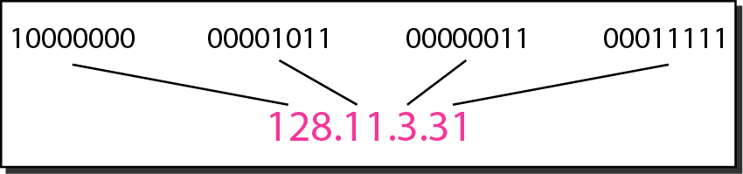
Dotted-decimal notation and binary notation for an IPv4 address

Slide 6
Example Problems
Change the following IPv4 addresses from binary notation to dotted-decimal notation.

Slide 7
Solution
We replace each group of 8 bits with its equivalent decimal number and add dots for separation.

Slide 8
Example Problems
Change the following IPv4 addresses from dotted-decimal notation to binary notation.

Slide 9
Solution
We replace each decimal number with its binary equivalent.

Slide 10
Example Problems
Change the following IPv4 addresses from dotted-decimal notation to binary notation.

Slide 11
Solution
a. There must be no leading zero (045).
b. There can be no more than four numbers.
c. Each number needs to be less than or equal to 255.
d. A mixture of binary notation and dotted-decimal
notation is not allowed.

Slide 12
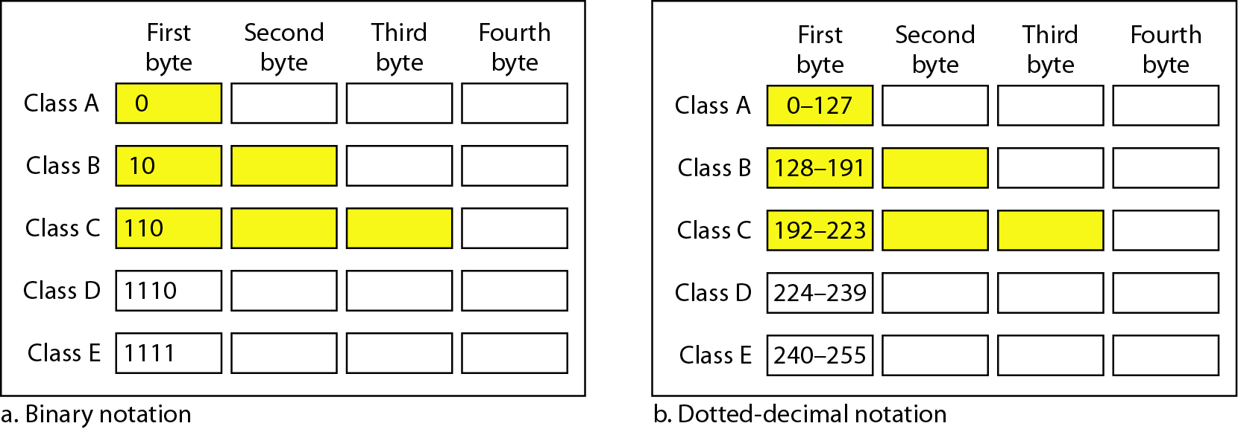
Classful addressing
In classful addressing, the address space is divided into five classes: A, B, C, D,
and E.
Each class occupies some part of the address space.
If the address is given in binary notation, the first few bits can immediately tell us the class of the address.
If the address is given in decimal-dotted notation, the first byte defines the class.

Slide 13
Example Problems
Find the class of each address.
a. 00000001 00001011 00001011 11101111
b. 11000001 10000011 00011011 11111111
c. 14.23.120.8
d. 252.5.15.111

Slide 14
Solution
a. The first bit is 0. This is a class A address.
b. The first 2 bits are 1; the third bit is 0. This is a class C
address.
c. The first byte is 14; the class is A.
d. The first byte is 252; the class is E.

Slide 15
Cont….
Number of blocks and block size in classful IPv4 addressing
Default masks for classful addressing

Slide 16
Subnet
During the era of classful addressing, subnetting was introduced.
If an organization was granted a large block in class A or B, it could divide the addresses into several contiguous groups and assign each group to smaller networks (called subnets).
Subnetting increases the number of 1’s in the mask
NOTE: Refer PDF for subnet Problems

Slide 17
Classless Addressing
To overcome address depletion and give more organizations access to the Internet,
classless addressing was designed and implemented.
In this scheme, there are no classes, but the addresses are still granted in blocks.
In classless addressing, when an entity, small or large, needs to be connected to the
Internet, it is granted a block (range) of addresses.
The size of the block (the number of addresses) varies based on the nature and size of the entity.
Restriction
To simplify the handling of addresses, the Internet authorities impose three restrictions on classless address blocks:
1. The addresses in a block must be contiguous, one after another.
2. The number of addresses in a block must be a power of 2 (I, 2, 4, 8, ... ).
3. The first address must be evenly divisible by the number of addresses.

Slide 18
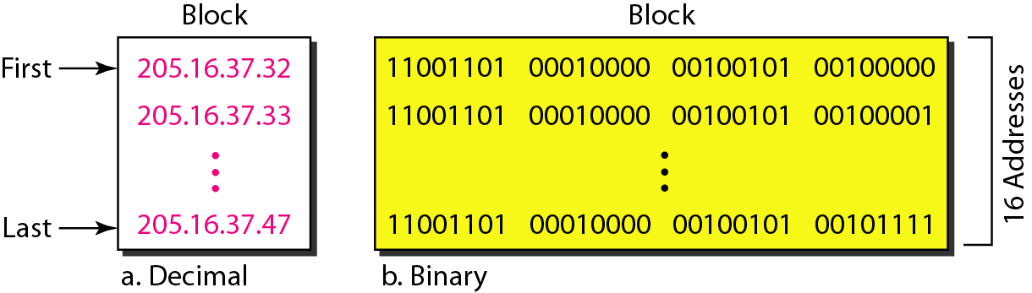
A block of 16 addresses granted to a small organization
https://www.slideshare.net/WayneJonesJnr/ch19-3361671

Slide 19
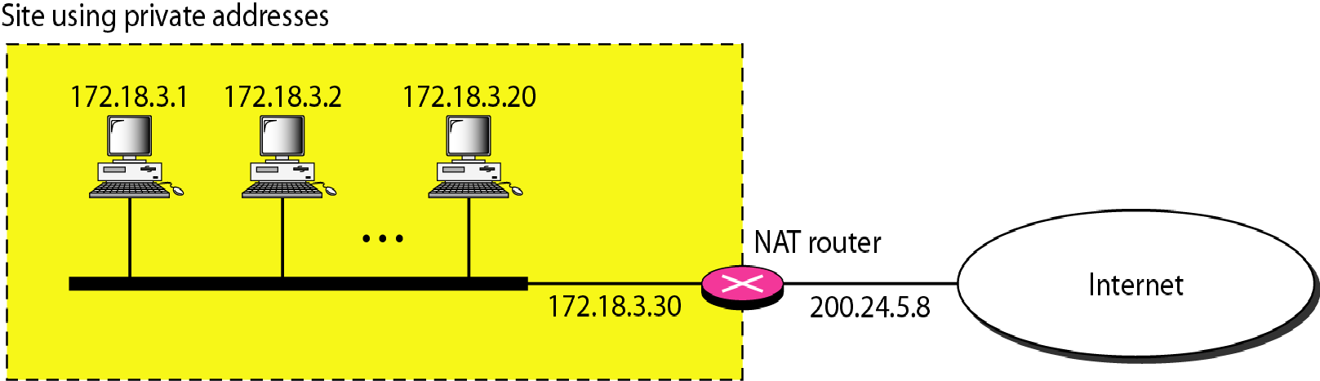
Network Address Translation (NAT)
Network Address Translation (NAT) is a process in which one or more local IP address is translated into one or more Global IP address and vice versa in order to provide Internet access to the local hosts

Slide 20
NAT inside and outside addresses
Inside local address – An IP address that is assigned to a host on the Inside (local) network. The address is probably not a IP address assigned by the service provider i.e., these are private IP address. This is the inside host seen from the inside network.
Inside global address – IP address that represents one or more inside local IP addresses to the outside world. This is the inside host as seen from the outside network.
Outside local address – This is the actual IP address of the destination host in the local network after translation.
Outside global address – This is the outside host as seen form the outside network. It is the IP address of the outside destination host before translation.

Slide 21
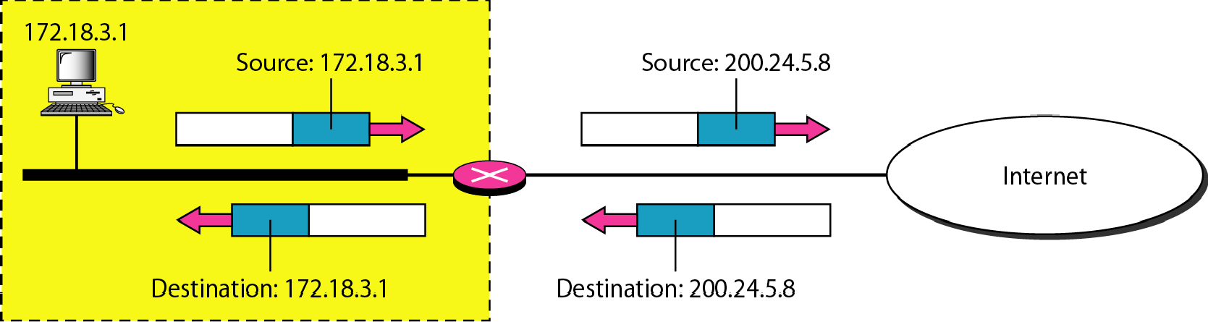
Addresses in a NAT

Slide 22
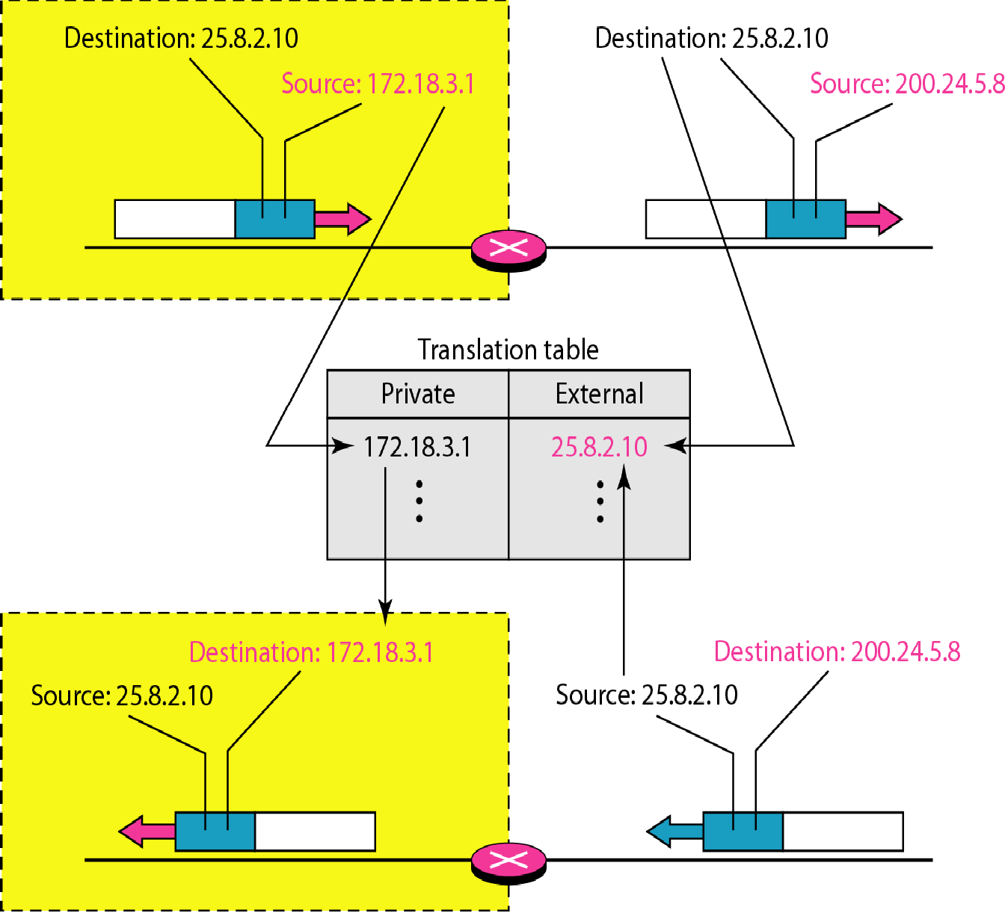
NAT address translation

Slide 23
NAT Types
Static NAT
Dynamic NAT
Port Address Translation (PAT)
Advantages of NAT :
NAT conserves legally registered IP addresses .
It provides privacy as the device IP address, sending and receiving the traffic, will be hidden.
Eliminates address renumbering when a network evolves.
Disadvantage of NAT :
Translation results in switching path delays.
Certain applications will not function while NAT is enabled.
Also, router being a network layer device, should not tamper with port numbers(transport layer) but it has to do so because of NAT.

Slide 24
What is DHCP ?
Dynamic Host Configuration Protocol
  Used for dynamic allocation of IP addresses
    used for hosts that run only client applications
  Allows for host-specific configuration parameters to be delivered from a DHCP server to a host
DHCP can also be used to convey permanent IP address assignments to hosts
  Server interfaces need permanent addresses because clients need to be able to reach them
  Also, router interfaces should have permanent addresses for stability of routing data
Notes:
The dynamic host configuration protocol provides configuration parameters to Internet Hosts. DHCP consists of two components; a protocol for delivering host-specific configuration parameters from a DHCP server to a host and a mechanism for allocation of network addresses to hosts.

Slide 25
Where is DHCP used?
Since class B and class C address spaces have been exhausted, service providers and enterprises use dynamically allocated IP addresses
  e.g., a cable modem service provider who has many customers
    since not all customers are simultaneously on the Internet, a client host dynamically obtains an address for a short period of time and releases it for use by some other client
  e.g., used on the university campus on our 802.11 wireless network, where many students, faculty and staff members can access to the campus network
Notes:
Ease of getting an IP address as opposed to manually configuring the IP address.
Client configuration is simplified using dynamic allocation, because it specifies an option to obtain an IP address.

Slide 26
Switching Network
A switched network consists of a series of interlinked nodes, called switches.
Switches are devices capable of creating temporary connections between two or more devices linked to the switch.
In a switched network, some of these nodes are connected to the end systems (computers or telephones, for example). Others are used only for routing.

Slide 27
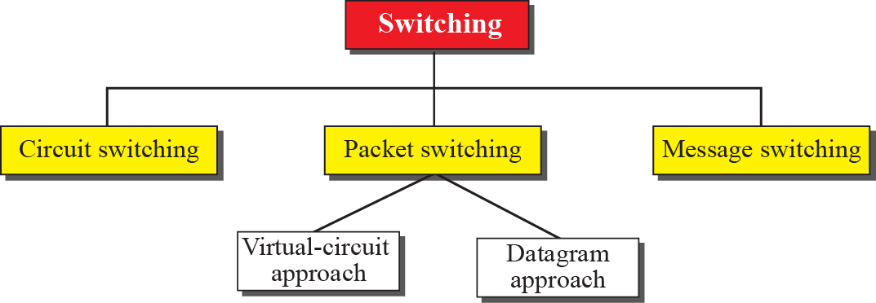
Switched Networks
Notes:
8.#

Slide 28
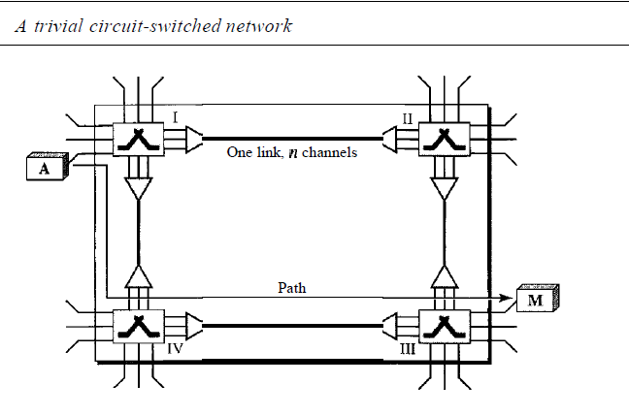
Cont….
A circuit-switched network consists of a set of switches connected by physical links.
A connection between two stations is a dedicated path made of one or more links.
However, each connection uses only one dedicated channel on each link. Each link is normally divided into n channels by using FDM or TDM.
Figure shows a trivial circuit-switched network with four switches and four links. Each link is divided into n (n is 3 in the figure) channels by using FDM or TDM.

Slide 29
Cont….
In data communications, we need to send messages from one end system to another.
If the message is going to pass through a packet-switched network, it needs to be divided into packets of fixed or variable size.
The size of the packet is determined by the network and the governing protocol.
In packet switching, there is no resource allocation for a packet. This means that there is no reserved bandwidth on the links, and there is no scheduled processing time for each packet.
Resources are allocated on demand. The allocation is done on a firstcome, first-served basis.
When a switch receives a packet, no matter what is the source or destination, the packet must wait if there are other packets being processed.

Slide 30
Datagram
Each packet treated independently
Packets can take any practical route
Packets may arrive out of order
Packets may go missing
Up to receiver to re-order packets and recover from missing packets

Slide 31
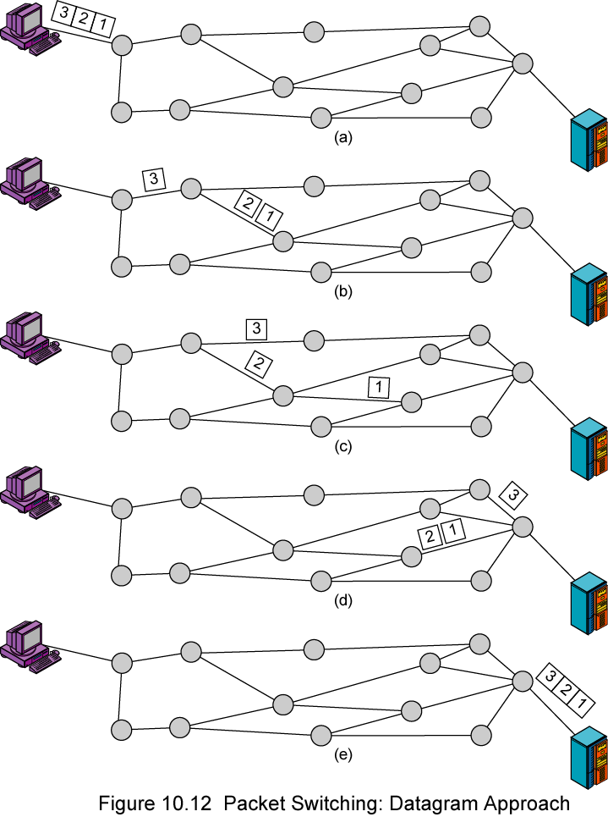
Datagram
Diagram

Slide 32
Virtual Circuit
Preplanned route established before any packets sent
Call request and call accept packets establish connection (handshake)
Each packet contains a virtual circuit identifier instead of destination address
No routing decisions required for each packet
Clear request to drop circuit
Not a dedicated path

Slide 33
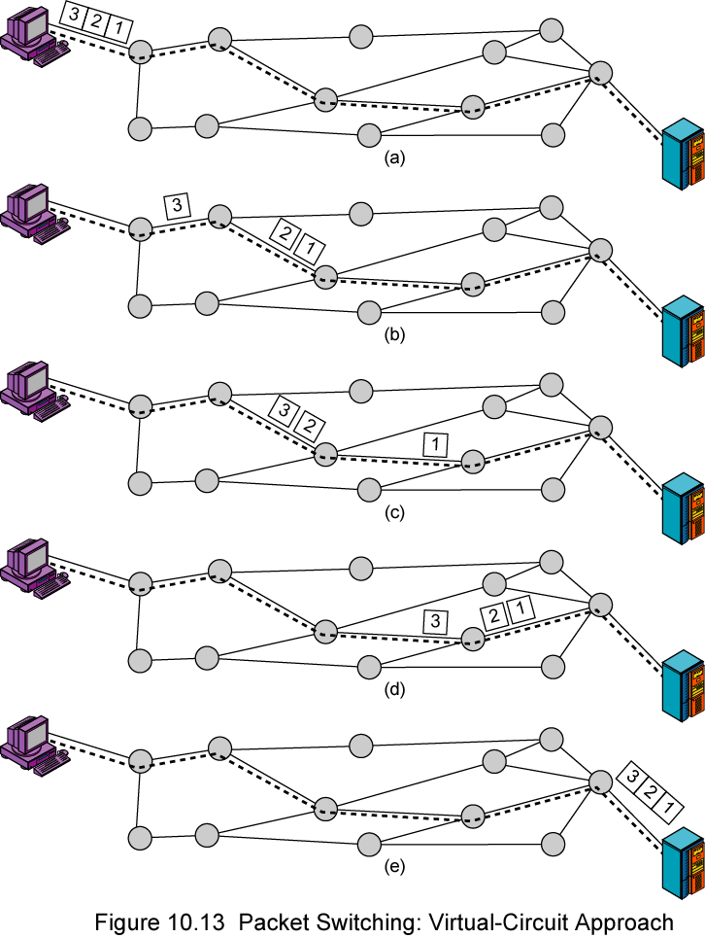
Virtual
Circuit
Diagram

Slide 34
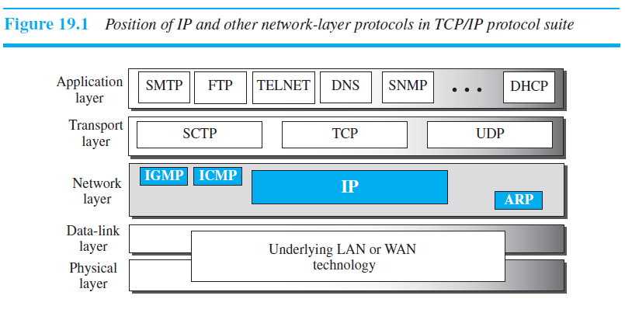
Internet Protocol
The network layer in version 4 can be thought of as one main protocol and three auxiliary ones. The main protocol, Internet Protocol version 4 (IPv4), is responsible for packetizing, forwarding, and delivery of a packet at the network layer. The Internet Control Message Protocol version 4 (ICMPv4) helps IPv4 to handle some errors that may occur in the network-layer delivery.

Slide 35
IPv4 Protocol
IPv4 is an unreliable datagram protocol—a best-effort delivery service.
If reliability is important, IPv4 must be paired with a reliable transport-layer protocol such as TCP.
An example of a more commonly understood best-effort delivery service is the post office.
IPv4 is also a connectionless protocol that uses the datagram approach. This means that each datagram is handled independently, and each datagram can follow a different route to the destination.
This implies that datagrams sent by the same source to the same destination could arrive out of order.

Slide 36
Datagram Format
In this section, we begin by discussing the first service provided by IPv4, packetizing.
We show how IPv4 defines the format of a packet in which the data coming from the upper layer or other protocols are encapsulated.
Packets used by the IP are called datagrams.
Figure below shows the IPv4 datagram format.
A datagram is a variable length packet consisting of two parts: header and payload (data).
The header is 20 to 60 bytes in length and contains information essential to routing and delivery.

Slide 37
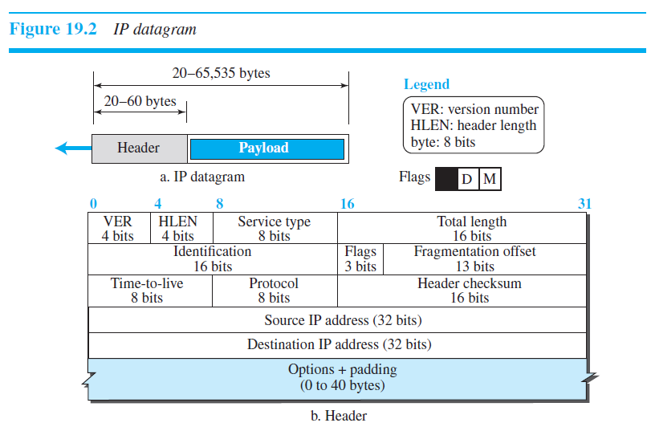
Datagram Format

Slide 38
Description of each field
Version (VER): This 4-bit field defines the version of the IPv4 protocol. Currently the version is 4. However, version 6 (or IPng) may totally replace version 4 in the future.
Header Length: The 4-bit header length (HLEN) field defines the total length of the datagram header in 4-byte words. The IPv4 datagram has a variable-length header. However, to make the value of the header length (number of bytes) fit in a 4-bit header length, the total length of the header is calculated as 4-byte words. The total length is divided by 4 and the value is inserted in the field. The receiver needs to multiply the value of this field by 4 to find the total length.

Slide 39

Cntd…
Service Type: In the original design of the IP header, this field was referred to as type of service (TOS), which defined how the datagram should be handled.
Total Length: This 16-bit field defines the total length (header plus data) of the IP datagram in bytes. This field helps the receiving device to know when the packet has completely arrived. To find the length of the data coming from the upper layer, subtract the header length from the total length. The header length can be found by multiplying the value in the HLEN field by 4.

Slide 40
Cntd…
Identification, Flags, and Fragmentation Offset: These three fields are related to the fragmentation of the IP datagram when the size of the datagram is larger than the underlying network can carry. We discuss the contents and importance of these fields when we talk about fragmentation in the next section.
Time-to-live: Due to some malfunctioning of routing protocols a datagram may be circulating in the Internet, visiting some networks over and over without reaching the destination. This may create extra traffic in the Internet. The time to-live (TTL) field is used to control the maximum number of hops (routers) visited by the datagram. When a source host sends the datagram, it stores a number in this field. Each router that processes the datagram decrements this number by one. If this value, after being decremented, is zero, the router discards the datagram.

Slide 41
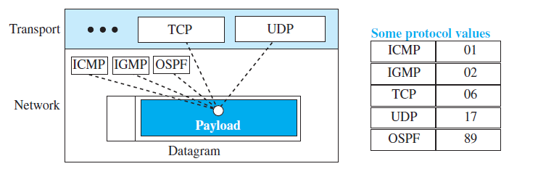
Cntd…
Protocol: This 8-bit field defines the higher-level protocol that uses the services of the IPv4 layer. An IPv4 datagram can encapsulate data from several higher-level protocols such as TCP, UDP, ICMP, and IGMP. When the payload is encapsulated in a datagram at the source IP, the corresponding protocol number is inserted in this field; when the datagram arrives at the destination, the value of this field helps to define to which protocol the payload should be delivered.

Slide 42
Cntd…
Header checksum: IP is not a reliable protocol; it does not check whether the payload carried by a datagram is corrupted during the transmission. The datagram header, however, is added by IP, and its error-checking is the responsibility of IP. Errors in the IP header can be a disaster.
For example, if the destination IP address is corrupted, the packet can be delivered to the wrong host. If the protocol field is corrupted, the payload may be delivered to the wrong protocol. If the fields related to the fragmentation are corrupted, the datagram cannot be reassembled correctly at the destination, and so on. For these reasons, IP adds a header checksum field to check the header, but not the payload.

Slide 43
Cntd…
Source and Destination Addresses: These 32-bit source and destination address fields define the IP address of the source and destination respectively. Note that the value of these fields must remain unchanged during the time the IP datagram travels from the source host to the destination host.
Options: A datagram header can have up to 40 bytes of options. Options can be used for network testing and debugging.

Slide 44
Example 1
Q.) An IPv4 packet has arrived with the first 8 bits as shown:
01000010
The receiver discards the packet. Why?
Solution:
There is an error in this packet. The 4 leftmost bits (0100) show the version, which is correct. The next 4 bits (0010) show an invalid header length (2 x 4 =8). The minimum number of bytes in the header must be 20. The packet has been corrupted in transmission.

Slide 45
Example 2
Q.) In an IPv4 packet, the value of HLEN is 1000 in binary. How many bytes of options are being carried by this packet?
Solution:
The HLEN value is 8, which means the total number of bytes in the header is 8 x 4, or 32 bytes. The first 20 bytes are the base header, the next 12 bytes are the options.

Slide 46
Example 3
Q.) In an IPv4 packet, the value of HLEN is 5, and the value of the total length field is 40 bytes. How many bytes of data are being carried by this packet?
Solution
The HLEN value is 5, which means the total number of bytes in the header is 5 × 4, or 20 bytes (no options). The total length is 40 bytes, which means the packet is carrying 20 bytes of data (40 − 20).

Slide 47

Example 4
Q.) An IPv4 packet has arrived with the first few hexadecimal digits as shown.
How many hops can this packet travel before being dropped? The data belong to what upper-layer protocol?
Solution
To find the time-to-live field, we skip 8 bytes (16 hexadecimal digits). The time-to-live field is the ninth byte, which is (01)₁₆. This means the packet can travel only one hop. The protocol field is the next byte (02)₁₆, which means that the upper-layer protocol is IGMP.

Slide 48
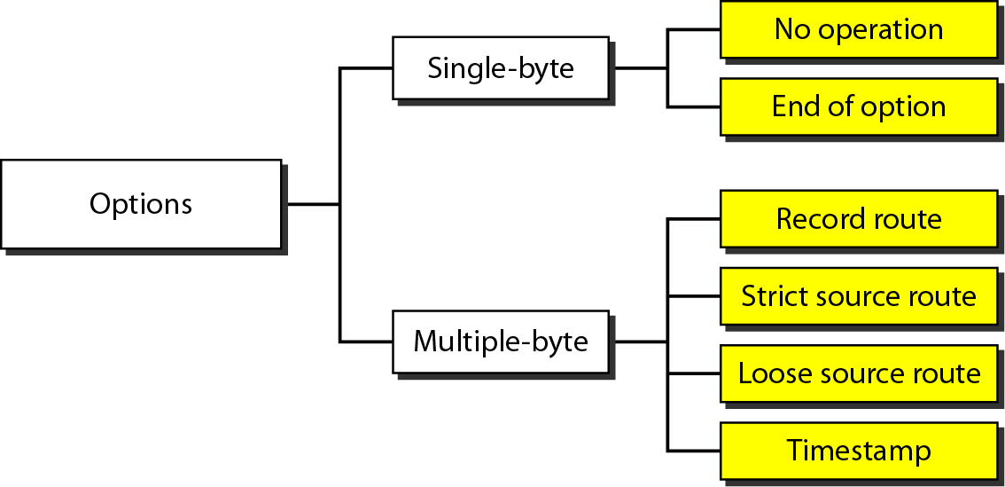
Options
The header of the IPv4 datagram is made of two parts: a fixed part and a variable part. The fixed part is 20 bytes long and was discussed in the previous section. The variable part comprises the options that can be a maximum of 40 bytes.
Options, as the name implies, are not required for a datagram. They can be used for network testing and debugging. Although options are not a required part of the IPv4 header, option processing is required for the IPv4 software. This means that all implementations must be able to handle options if they are present in the header.

Slide 49
Cntd…
No Operation: A no-operation option is a 1-byte option used as a filler between options.
End of Option: An end-of-option option is a 1-byte option used for padding at the end of the option field. It, however, can only be used as the last option.
Record Route: A record route option is used to record the Internet routers that handle the datagram. It can be used for debugging and management purposes.
Strict Source Route: A strict source route option is used by the source to predetermine a route for the datagram as it travels through the Internet. Dictation of a route by the source can be useful for several purposes. The sender can choose a route with a specific type of service, such as minimum delay or maximum throughput. Alternatively, it may choose a route that is safer or more reliable for the sender's purpose.

Slide 50
Cntd…
If a datagram specifies a strict source route, all the routers defined in the option must be visited by the datagram. A router must not be visited if its IPv4 address is not listed in the datagram. If the datagram visits a router that is not on the list, the datagram is discarded and an error message is issued. If the datagram arrives at the destination and some of the entries were not visited, it will also be discarded and an error message issued.
Loose Source Route: A loose source route option is similar to the strict source route, but it is less rigid. Each router in the list must be visited, but the datagram can visit other routers as well.
Timestamp: A timestamp option is used to record the time of datagram processing by a router. Knowing the time a datagram is processed can help users and managers track the behaviour of the routers in the Internet. We can estimate the time it takes for a datagram to go from one router to another.

Slide 51
Security of IPv4 Datagrams
The IPv4 protocol, as well as the whole Internet, was started when the Internet users trusted each other.
No security was provided for the IPv4 protocol. Today, however, the situation is different; the Internet is not secure anymore.
Here we give a brief idea about the security issues in IP protocol and the solutions. There are three security issues that are particularly applicable to the IP protocol
Packet Sniffing
Packet Modification
IP Spoofing

Slide 52
Cntd…
Packet Sniffing
An intruder may intercept an IP packet and make a copy of it. Packet sniffing is a passive attack, in which the attacker does not change the contents of the packet.
This type of attack is very difficult to detect because the sender and the receiver may never know that the packet has been copied.
Packet Modification
The second type of attack is to modify the packet. The attacker intercepts the packet, changes its contents, and sends the new packet to the receiver.
The receiver believes that the packet is coming from the original sender.

Slide 53
Cntd…
IP Spoofing
An attacker can masquerade as somebody else and create an IP packet that carries the source address of another computer.
An attacker can send an IP packet to a bank pretending that it is coming from one of the customers.

Slide 54
IPsec
The IP packets today can be protected from the previously mentioned attacks using a protocol called IPSec (IP Security).
This protocol, which is used in conjunction with the IP protocol, creates a connection-oriented service between two entities in which they can exchange IP packets without worrying about the three attacks discussed above.
IPsec provides the following four services:
Defining Algorithms and Keys
Packet Encryption
Data Integrity
Origin Authentication

Slide 55
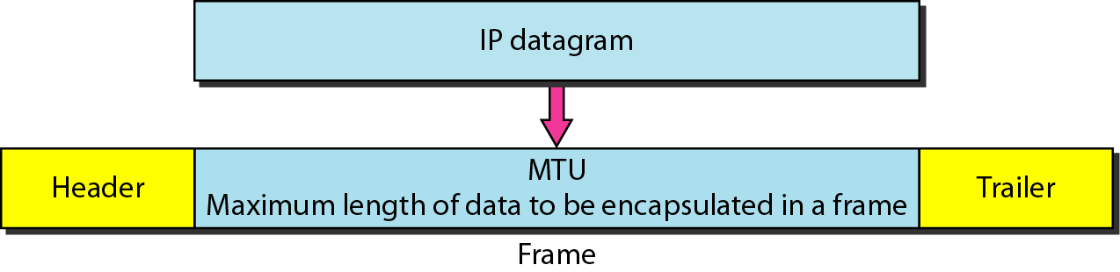
Fragmentation
A datagram can travel through different networks. Each router decapsulates the IPv4 datagram from the frame it receives, processes it, and then encapsulates it in another frame.
The format and size of the received frame depend on the protocol used by the physical network through which the frame has just travelled.

Slide 56
Maximum Transfer Unit (MTU)
Each link-layer protocol has its own frame format. One of the features of each format is the maximum size of the payload that can be encapsulated.
In other words, when a datagram is encapsulated in a frame, the total size of the datagram must be less than this maximum size, which is defined by the restrictions imposed by the hardware and software used in the network.
The value of the MTU differs from one physical network protocol to another. For example, the value for a LAN is normally 1500 bytes.
When a datagram is fragmented, each fragment has its own header with most of the fields repeated, but some have been changed.
A fragmented datagram may itself be fragmented if it encounters a network with an even smaller MTU. In other words, a datagram may be fragmented several times before it reaches the final destination.

Slide 57
Cntd…
A datagram can be fragmented by the source host or any router in the path.
The reassembly of the datagram, however, is done only by the destination host, because each fragment becomes an independent datagram.
Whereas the fragmented datagram can travel through different routes, and we can never control or guarantee which route a fragmented datagram may take, all of the fragments belonging to the same datagram should finally arrive at the destination host.
So it is logical to do the reassembly at the final destination.

Slide 58
Fields Related to Fragmentation
Identification:
This 16-bit field identifies a datagram originating from the source host.
When a datagram is fragmented, the value in the identification field is copied to all fragments.
In other words, all fragments have the same identification number, the same as the original datagram.
The identification number helps the destination in reassembling the datagram. It knows that all fragments having the same identification value must be assembled into one datagram.

Slide 59

Flags
This is a 3-bit field. The first bit is reserved.
The second bit is called the do not fragment bit. If its value is 1, the machine must not fragment the datagram. If it cannot pass the datagram through any available physical network, it discards the datagram and sends an ICMP error message to the source host. If its value is 0, the datagram can be fragmented if necessary.
The third bit is called the more fragment bit. If its value is 1, it means the datagram is not the last fragment; there are more fragments after this one. If its value is 0, it means this is the last or only fragment.

Slide 60
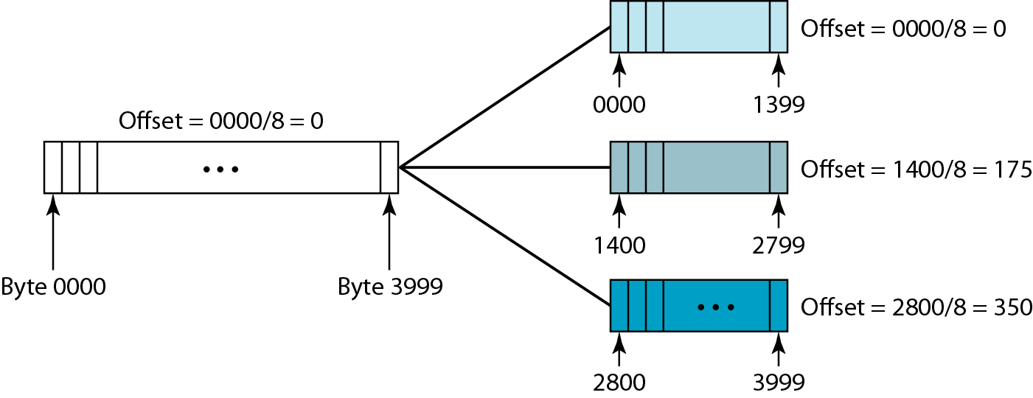
Fragmentation Offset
The 13-bit fragmentation offset field shows the relative position of this fragment with respect to the whole datagram.
It is the offset of the data in the original datagram measured in units of 8 bytes.
Figure below shows a datagram with a data size of 4000 bytes fragmented into three fragments.

Slide 61
Cntd…
Because it is entirely possible that the fragments that comprise a block of data might travel along different paths to the destination, it is possible they might arrive out of sequence.
While the Identification Field serve to mark which IP fragments belong to which block of data, it is the Fragment Offset Field, that tells the receiving device which order to reassemble them in.

Slide 62
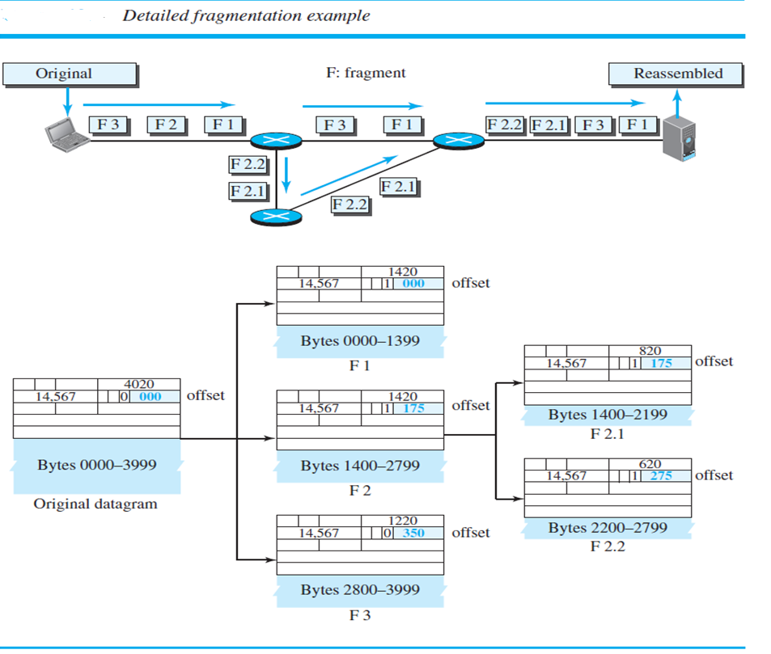

Slide 63
Cntd…
It is obvious that even if each fragment follows a different path and arrives out of order, the final destination host can reassemble the original datagram from the fragments received using the following strategy:
a. The first fragment has an offset field value of zero.
b. Divide the length of the first fragment by 8. The second fragment has an offset value equal to that result.
c. Divide the total length of the first and second fragment by 8. The third fragment has an offset value equal to that result.
d. Continue the process. The last fragment has its M bit set to 0.

Slide 64
Example 1
A packet has arrived with an M bit value of 0. Is this the first fragment, the last fragment, or a middle fragment? Do we know if the packet was fragmented?
Solution
If the M bit is 0, it means that there are no more fragments; the fragment is the last one. However, we cannot say if the original packet was fragmented or not. A non-fragmented packet is considered the last fragment.

Slide 65
Example 2
A packet has arrived with an M bit value of 1. Is this the first fragment, the last fragment, or a middle fragment? Do we know if the packet was fragmented?
Solution
If the M bit is 1, it means that there is at least one more fragment. This fragment can be the first one or a middle one, but not the last one.

Slide 66
Example 3
A packet has arrived with an M bit value of 1 and a fragmentation offset value of 0. Is this the first fragment, the last fragment, or a middle fragment?
Solution
Because the M bit is 1, it is either the first fragment or a middle one. Because the offset value is 0, it is the first fragment.

Slide 67
ICMPv4
The IPv4 has no error-reporting or error-correcting mechanism. What happens if something goes wrong?
What happens if a router must discard a datagram because it cannot find a route to the final destination, or because the time-to-live field has a zero value?
What happens if the final destination host must discard the received fragments of a datagram because it has not received all fragments within a predetermined time limit?
These are examples of situations where an error has occurred and the IP protocol has no built-in mechanism to notify the original host.

Slide 68
MESSAGES
ICMP messages are divided into two broad categories: error-reporting messages and query messages.
The error-reporting messages report problems that a router or a host (destination) may encounter when it processes an IP packet.
The query messages, which occur in pairs, help a host or a network manager get specific information from a router or another host.
Since IP is an unreliable protocol, one of the main responsibilities of ICMP is to report some errors that may occur during the processing of the IP datagram.
ICMP does not correct errors, it simply reports them.

Slide 69
Error Reporting Messages
1. Destination Unreachable
The most widely used error message is the destination unreachable.
This message tells the source that a host is unreachable.
This may happen, for example, when we use the HTTP protocol to access a web page, but the server is down. The message “destination host is not reachable” is created and sent back to the source.
2. Source Quench
Another error message is called the source quench message, which informs the sender that the network has encountered congestion and the datagram has been dropped; the source needs to slow down sending more datagrams.

Slide 70
Error Reporting Messages
3. Redirection Message
The redirection message is used when the source uses a wrong router to send out its message.
The router redirects the message to the appropriate router, but informs the source that it needs to change its default router in the future. The IP address of the default router is sent in the message.
4. Parameter Problem
A parameter problem message can be sent when either there is a problem in the header of a datagram or some options are missing or cannot be interpreted.

Slide 71
Query Messages
Query messages are used to probe or test the liveliness of hosts or routers in the Internet.
Find the one-way or the round-trip time for an IP datagram between two devices, or even find out whether the clocks in two devices are synchronized.
Naturally, query messages come in pairs: request and reply.
The echo request and the echo reply pair of messages are used by a host or a router to test the liveliness of another host or router.
A host or router sends an echo request message to another host or router; if the latter is alive, it responds with an echo reply message.
The timestamp request and the timestamp reply pair of message are used to find the round-trip time between two devices or to check whether the clocks in two devices are synchronized.

Slide 72
Routing Protocols
Routing is the process of learning all the paths through the network (routes) and using routes to forward data from one network to another. A protocol is a standardized way to perform a task. So, a routing protocol would be a standardized way of learning routes and moving data from one network to another.
Routing protocols are used by routers to dynamically learn all paths through a set of networks and forward data between the networks. Routers are specialized computer devices designed to perform routing.
In an interconnected network, a packet travels from the source to destination through various intermediate nodes, which comprises of Routers, Bridges, Gateways, Switches and Firewalls.

Slide 73
Cont.…..
All the information related to forwarding of packets is stored in the router in the form of routing table. A Routing table is a database, which contains information of all the routes and the topology of the network. The routing table contains three fields.
  Network id – Specifies the network ID of the destination
  Cost – Specifies the arbitrary value given to a path, which packet can take to travel from one node to another
  Next hop – Specifies the address of the next destination address

Slide 74
Static Routing
The static routing is manually adding routes in each router's routing table.
The administrator configures the destination network, next hop, and appropriate metrics.
The route doesn't change until the network administrator changes it.
Advantages
Fast and easy to configure in a small network
Cost effective
Secure for transmitting data since routes are added by the system administrator and access to routing is given to particular network only.
Disadvantages
Administrator must be aware of the entire network and must know the connection of each router so that if there is an addition of a new network into the existing network, administrator needs to updates all the routers for adding a router to the new network
It does not work in large networks are maintaining such a network is very complicated and time consuming
If there is a failure in any of the devices between the routes, the sending router will continue to send the packet not knowing that the route does not exist anymore

Slide 75
Dynamic Routing Protocols
There are two distinct categories of dynamic routing protocols:
1. Distance-vector protocols
2. Link-state protocols
3. Path vector protocols
Examples of distance-vector protocols include RIP and IGRP.
Examples of link-state protocols include OSPF and IS-IS.
EIGRP exhibits both distance-vector and link-state characteristics, and is considered a hybrid protocol.
Example of path vector protocol is BGP.

Slide 76
Distance-vector Routing Protocols
All distance-vector routing protocols share several key characteristics:
Periodic updates of the full routing table are sent to routing neighbours.
Distance-vector protocols suffer from slow convergence, and are highly susceptible to loops.
Some form of distance is used to calculate a route’s metric.
The Bellman-Ford algorithm is used to determine the shortest path.

Slide 77
Link-State Routing Protocols
Link-state routing protocols were developed to alleviate the convergence and loop issues of distance-vector protocols. Link-state protocols maintain three separate tables:
Neighbour table
Topology table
Routing table

Slide 78
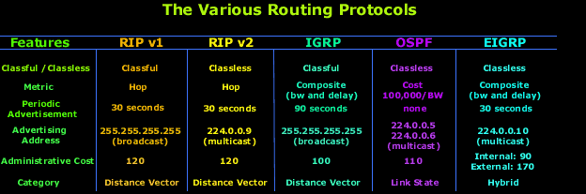
Comparison

Slide 79
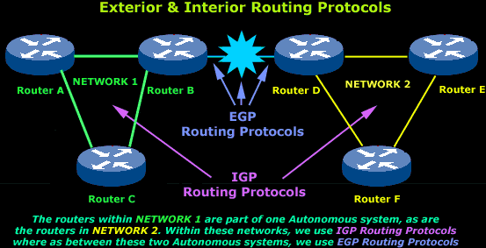
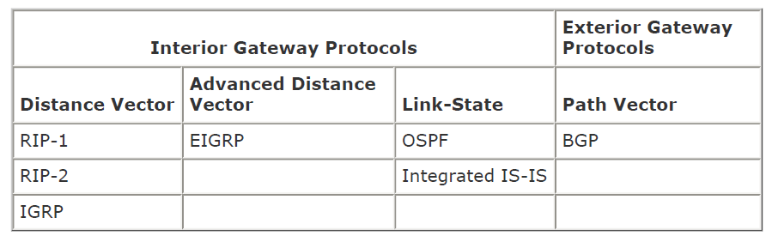

Slide 80
Dynamic Routing -RIP
The Routing Information Protocol (RIP) is a distance-vector protocol that uses hop count as it’s metric.
RIP is widely used for routing traffic in the global Internet and is an interior gateway protocol (IGP), which means that it performs routing within a single autonomous system.
RIP only uses hop count to determine the best route to a remote network, RIP has a maximum hop count of 15, 16 is deemed unreachable. This fact is used by RIP to prevent routing loops.
RIP works well in small internetworks, but is inefficient for large networks. RIP is susceptible to all the problems normally associated with distance vector routing protocols.
It is slow to converge and forces routers to learn network information only from neighbors. RIP version 1 uses classful routing (all devices in the network must use the same subnet mask because RIP version 1 doesn't send updates with subnet information). So it is impossible to subnet a network properly via VLSM if you are running RIP v1.
RIP version 2 uses classless routing (Classless Inter Domain Routing / CIDR) and does send subnet mask information with route updates. RIP networks need the same hop count to load balance multiple links.

Slide 81
Cont….
RIPv1 | RIPv2
It is a classful Routing Protocols | It is a classless Routing Protocols
It does not contain information about the subnet mask | It uses subnet masking
It does not use VLSM | It uses VLSM
It does not provide security | It provide security by enabling plain-text authentication
It sends routing updates to 255.255.255.255 | It sends routing updates 224.0.0.9

Slide 82
RIP Timers
Route Update Timer - The routing-update timer clocks the interval between periodic routing updates. It is usually set to 30 seconds.
Route Invalid Timer - The Route Invalid Timer determines the length of time (90 seconds) before a route is considered invalid. If it doesn't receive an update for the route it sets the route as invalid and notifies its neighbors.
Route Flush Timer - The Route Flush Timer sets the time between when a route becomes invalid and its removal from the routing table (240 seconds). Time must be longer than invalid timer so it can tell its neighbors about the route.

Slide 83
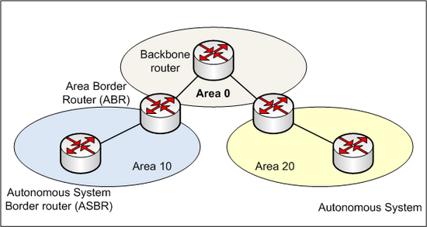
OSPF
Open Shortest Path First (OSPF) is a link state routing protocol used to calculate the shortest path to the destination.
It is designed for large and complex networks to exchange the information with in single autonomous system. It is developed to overcome the shortcomings of the RIP.
OSPF divide the large networks into smaller groups, which are called as areas.

Slide 84
Cont….
Figure shows a typical OSPF simple design. Notice how each router connects to the backbone- called area 0, or the backbone area. OSPF must have an area 0, and all other areas should connect to this area.
Routers that connect other areas to the backbone area within an AS are called Area Border Routers (ABRs). Still, at least one interface of the ABR must be in area 0.
OSPF can run only in single AS but you can also configure it to run on multiple autonomous systems.
This can be done by connecting the Autonomous Systems.
Autonomous System Boundary Router(ASBR) that is located on the boundary of two AS’s is used to connect autonomous system

Slide 85
Features of OSPF
The main features of OSPF includes,
Unlimited hop count
Scalability
Fast Convergence
Support VLSM
Router authentication
Support discontinuous networks

Slide 86
PING
PING (Packet Internet Groper) is a software utility used to determine whether a given IP address is accessible or not.
It measures the round trip time for messages sent from the originating host to a destination computer/device that are echoed back to the source.
The program was written by Mr. Mike Muss in December,1983.
The name originated from active SONAR terminology that sends a pulse sound and listens for the echo to detect objects underwater.

Slide 87
HOW DOES PING COMMAND WORK?
A PING command usually sends a signal to another device one is trying to reach and see if you get a response.
PING operates by sending an ICMP(Internet Control Message Protocol) echo request to a network address at periodic intervals waiting for an echo ICMP response.
It also measures the time it takes for an echo response to arrive.
The request sent using ICMP is nothing but a packet of data
It also indicates errors and packet losses .

Slide 88
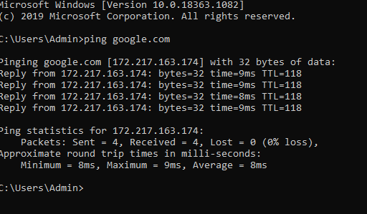
Successful PING Test
Notes:
8.3.2.3 Ping – Testing Connectivity to Remote

Slide 89
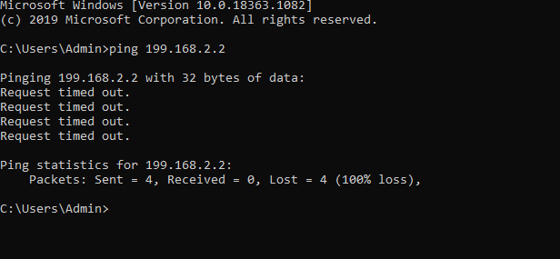
Unsccessful PING Test

Slide 90
Trace route
  Generates a list of hops that were successfully reached along the path.
  Provides important verification and troubleshooting information.
  If the data reaches the destination, then the trace lists the interface of every router in the path between the hosts.
  If the data fails at some hop along the way, the address of the last router that responded to the trace can provide an indication of where the problem or security restrictions are found.
  Provides round-trip time for each hop along the path and indicates if a hop fails to respond.
Notes:
8.3.2.4 Traceroute – Testing the Path

Slide 91
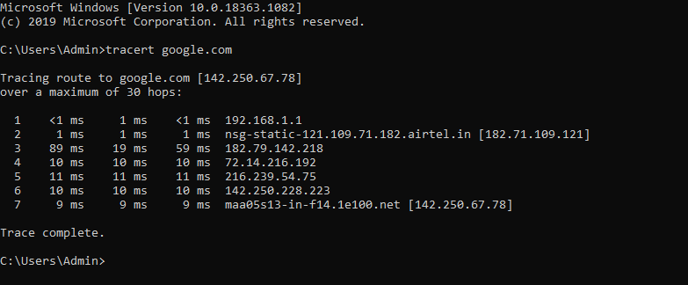
Testing the Path

Slide 92
Introduction
IP version 4 has played a central role in the internetworking environment for many years. It has proved flexible enough to work on many different networking technologies. However it has become victim of its own success- explosive growth.
In the early days of the Internet, people using it were typically researchers and scientists working in academia, high-tech companies and research laboratories, mainly for the purpose of exchanging scientific results through e-mails.
Later the World Wide Web and personal computers shifted the user of the Internet to the general public. This change has created heavy demands for new IP addresses, and the 32 bits of the current IP addresses will be exhausted sooner or later.
Later IETF introduced a new version called IPv6 (also called IP next generation or Ipng). IPv6 was designed to interoperate with IPv4 and support new emerging applications.

Slide 93
Agenda
The address depletion of IPv4 and other shortcomings of this protocol prompted a new version of IP in the early 1990s.
The new version, which is called Internet Protocol version 6 (IPv6) or IP new generation (IPng) was a proposal to augment the address space of IPv4 and at the same time redesign the format of the IP packet and revise some auxiliary protocols such as ICMP.
This chapter is made of four sections:
The first section discusses the addressing mechanism in the new generation of Internet.
The second section discusses IPv6 protocol.
The third section discusses ICMPv6. The section describes how the new protocol replaces several auxiliary protocols in version 4.
The fourth section briefly shows how transition can be made from the current version to the new one smoothly. The section explains three strategies that need to be followed for this smooth transition.

Slide 94
IPv6 ADDRESSING
The main reason for migration from IPv4 to IPv6 is the small size of the address space in IPv4.
In this section, we show how the huge address space of IPv6 prevents address depletion in the future.
Representation
A computer normally stores the address in binary, but it is clear that 128 bits cannot easily be handled by humans.
Several notations have been proposed to represent IPv6 addresses when they are handled by humans. The following shows two of these notations: binary and colon hexadecimal.

Slide 95
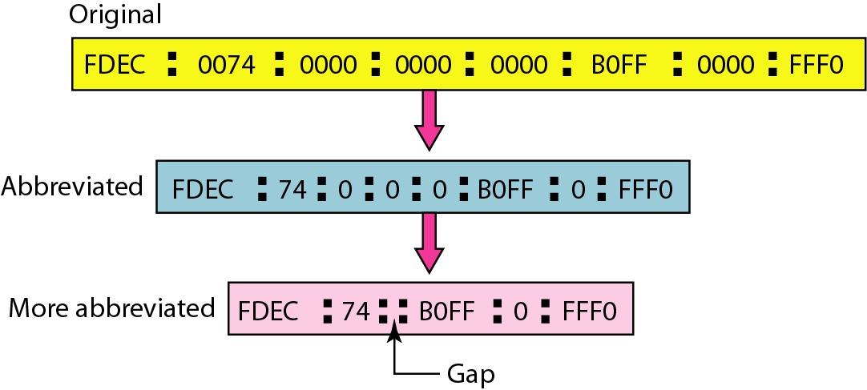
Abbreviated IPv6 addresses
Although an IPv6 address, even in hexadecimal format, is very long, many of the digits are zeros.
In this case, we can abbreviate the address. The leading zeros of a section can be omitted.
Using this form of abbreviation, 0074 can be written as 74, 000F as F, and 0000 as 0.
Note that 3210 cannot be abbreviated.

Slide 96
Cntd…
Further abbreviation, often called zero compression, can be applied to colon hex notation if there are consecutive sections consisting of zeros only.
We can remove all the zeros and replace them with a double semicolon.

Slide 97
Address Space
The address space of IPv6 contains 2¹²⁸ addresses. This address space is 2⁹⁶ times the IPv4 address—definitely no address depletion—as shown, the size of the space is
To give some idea about the number of addresses, we assume that only 1/64 (almost 2 percent) of the addresses in the space can be assigned to the people on planet Earth and the rest are reserved for special purposes.
We also assume that the number of people on the earth is soon to be 2³⁴ (more than 16 billion). Address depletion in this version is impossible.

Slide 98
THE IPv6 PROTOCOL
  The next-generation IP, or IPv6, has some advantages over IPv4 that can be summarized as follows:
Larger address space: An IPv6 address is 128 bits long. Compared with the 32-bit address of IPv4, this is a huge (2^{^96}) increase in the address space.
Better header format: IPv6 uses a new header format in which options are separated from the base header and inserted, when needed, between the base header and the upper-layer data.
New options: IPv6 has new options to allow for additional functionalities.
Fragmentation at source only: Routers are not allowed to fragment packets. If a packet needs to be fragmented, it must be done at the source.

Slide 99
Cntd…
Allowance for extension: IPv6 is designed to allow the extension of the protocol if required by new technologies or applications.
Support for resource allocation: In IPv6, the type-of-service field has been removed, but two new fields, traffic class and flow label, have been added to enable the source to request special handling of the packet. This mechanism can be used to support traffic such as real-time audio and video.
Support for more security. The encryption and authentication options in IPv6 provide confidentiality and integrity of the packet.

Slide 100
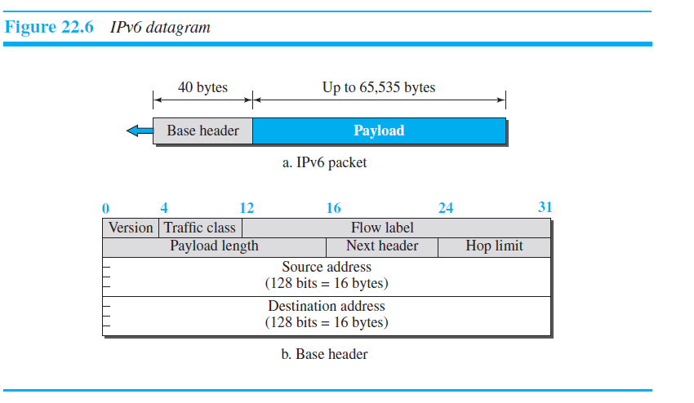
IPv6 Packet Format

Slide 101
Cntd…
Version: The 4-bit version field defines the version number of the IP. For IPv6, the value is 6.
Traffic class: The 8-bit traffic class field is used to distinguish different payloads with different delivery requirements. It replaces the type-of-service field in IPv4.
Flow label: The flow label is a 20-bit field that is designed to provide special handling for a particular flow of data.
Payload length: The 2-byte payload length field defines the length of the IP datagram excluding the base header.
Next Header: The next header field identifies the type of extension header that follows the basic header. The extension header is similar to the options field in IPv4 but is more flexible and efficient. Extension headers are further discussed below.

Slide 102
Cntd…
Hop Limit: The hop limit field replaces the TTL field in IPv4.
Source address: The source address field is a 16-byte (128-bit) Internet address that identifies the original source of the datagram.
Destination address: The destination address field is a 16-byte (128-bit) Internet address that usually identifies the final destination of the datagram.

Slide 103
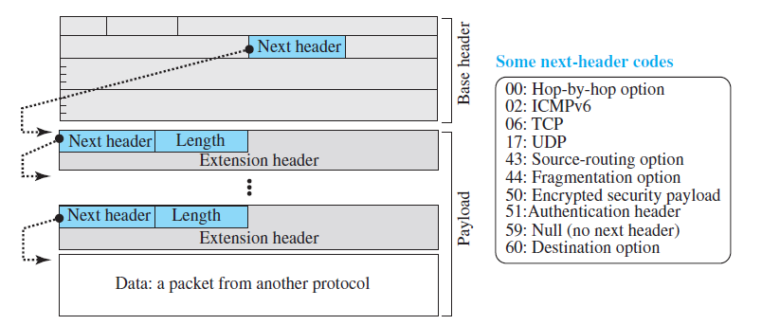
Extension Headers

Slide 104
Cntd…
In IPv6, options, which are part of the header in IPv4, are designed as extension headers.
The payload can have as many extension headers as required by the situation. Each extension header has two mandatory fields, next header and the length, followed by information related to the particular option.
Note that each next header field value (code) defines the type of the next header (hop-by-hop option, source routing option, . . .); the last next header field defines the protocol (UDP, TCP, . . .) that is carried by the datagram.

Slide 105
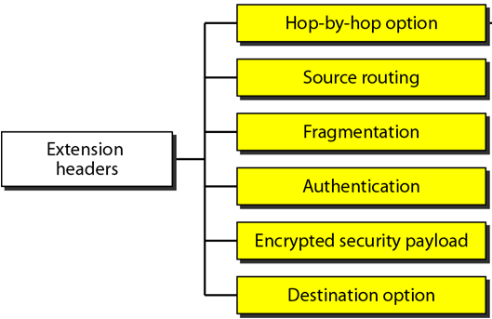
Extension header types

Slide 106
Cntd…
Hop-by-Hop Option: The hop-by-hop option is used when the source needs to pass information to all routers visited by the datagram. For example, perhaps routers must be informed about certain management, debugging, or control functions.
Source Routing: The source routing extension header combines the concepts of the strict source route and the loose source route options of IPv4.
Fragmentation:
  IPv6 allows only a source host to perform fragmentation. Intermediate routers are forbidden to fragment any packet.
  If the packet length is greater than the MTU of the network this packet is to be forwarded to, an intermediate router discards the packet and sends an ICMP error.
  A source can find the minimum MTU along the path from source to destination by performing a “path MTU discovery” procedure.

Slide 107
Cntd…
  An advantage of doing fragmentation at the source only is that routers can process packets faster which is important in an high speed environment.
  A disadvantage is that the path between a source and a destination must remain reasonably static so that the path MTU discovery does not give outdated information.
Authentication: The authentication extension header has a dual purpose: it validates the message sender and ensures the integrity of data.
Encrypted Security Payload: The encrypted security payload (ESP) is an extension that provides confidentiality and guards against eavesdropping.
Destination Option: The destination option is used when the source needs to pass information to the destination only. Intermediate routers are not permitted access to this information.

Slide 108
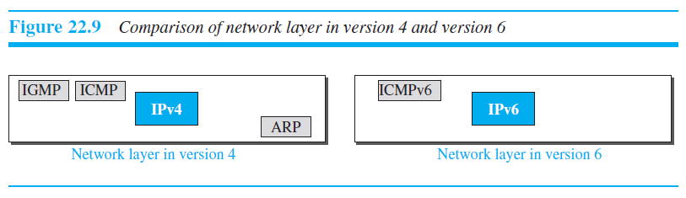
ICMPv6 Protocol
Another protocol that has been modified in version 6 of the TCP/IP protocol suite is ICMP.
Some protocols that were independent in version 4 are now part of ICMPv6 and some new messages have been added to make it more useful.
Figure below compares the network layer of version 4 to that of version 6. The ICMP, ARP and IGMP protocols in version 4 are combined into one single protocol, ICMPv6.

Slide 109
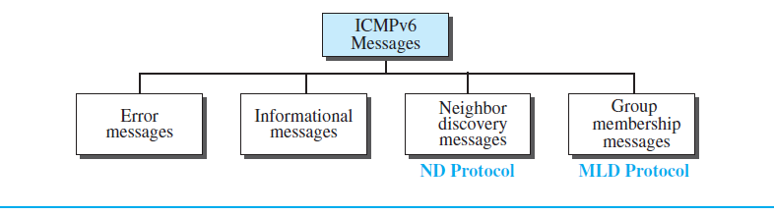
Categories of ICMPv6 messages

Slide 110
Error Reporting Messages
1. Destination-Unreachable Message
The concept of the destination unreachable message is the same as described for ICMPv4. When a router cannot forward a datagram or a host cannot deliver the content of the datagram to the upper layer protocol, the router or the host discards the datagram and sends a destination-unreachable error message to the source host.
2. Packet-Too-Big Message
This is a new type of message added to version 6. Since IPv6 does not fragment at the router, if a router receives a datagram that is larger than the maximum transmission unit (MTU) size of the network through which the datagram should pass, two things happen. First, the router discards the datagram. Second, an ICMP error packet—a packet -too- big message—is sent to the source.

Slide 111
Error Reporting Messages
3. Time-Exceeded Message
A time-exceeded error message is generated in two cases: when the time to live value becomes zero and when not all fragments of a datagram have arrived in the time limit.
4. Parameter-Problem Message
Any ambiguity in the header of the datagram can create serious problems as the datagram travels through the Internet. If a router or the destination host discovers any ambiguous or missing value in any field, it discards the datagram and sends a parameter problem message to the source.

Slide 112
Informational Messages
Two of the ICMPv6 messages can be categorized as informational messages: echo request and echo reply messages.
A host or router can send an echo-request message to another host; the receiving computer or router can reply using the echo-reply message.
1. Echo-Request Message
The idea and format of the echo-request message is the same as the one in version 4.
2. Echo-Reply Message
The idea and format of the echo-reply message is the same as the one in version 4.

Slide 113
Neighbor-Discovery Messages
1. a.)Router-Solicitation Message
The idea behind the router-solicitation message is the same as in version 4. A host uses the router-solicitation message to find a router in the network that can forward an IPv6 datagram for the host.
b.)Router-Advertisement Message
The router-advertisement message is sent by a router in response to a router solicitation message.
2. a.)Neighbor-Solicitation Message
The neighbor solicitation message has the same duty as the ARP request message. This message is sent when a host or router has a message to send to a neighbor. The sender knows the IP address of the receiver, but needs the data-link address of the receiver

Slide 114
Neighbor-Discovery Messages
b.) Neighbor-Advertisement Message
The neighbor-advertisement message is sent in response to the neighbor-solicitation message.
3. a.) Inverse-Neighbor-Solicitation Message
The inverse-neighbor-solicitation message is sent by a node that knows the link layer address of a neighbor, but not the neighbor’s IP address.
b.) Inverse-Neighbor-Advertisement Message
The inverse-neighbor-advertisement message is sent in response to the inverse neighbor discovery message.

Slide 115
Neighbor-Discovery Messages
4. Redirection Message
The purpose of the redirection message is the same as described for version 4.
The redirection message is used when the source uses a wrong router to send out its message.
The router redirects the message to the appropriate router, but informs the source that it needs to change its default router in the future. The IP address of the default router is sent in the message.

Slide 116
Group Membership Messages
Membership-Query Message
A membership-query message is sent by a router to find active group members in the network.
Membership-Report Message
A membership-report message is sent in response to a membership-query message

Slide 117
TRANSITION FROM IPv4 TO IPv6
Although we have a new version of the IP protocol, how can we make the transition to stop using IPv4 and start using IPv6?
The first solution that comes to mind is to define a transition day on which every host or router should stop using the old version and start using the new version. However, this is not practical; because of the huge number of systems in the Internet, the transition from IPv4 to IPv6 cannot happen suddenly.
It will take a considerable amount of time before every system in the Internet can move from IPv4 to IPv6.
The transition must be smooth to prevent any problems between IPv4 and IPv6 systems.

Slide 118
Strategies
Three strategies have been devised for transition: dual stack, tunneling, and header translation.
One or all of these three strategies can be implemented during the transition period.
Dual Stack
It is recommended that all hosts, before migrating completely to version 6, have a dual stack of protocols during the transition.
In other words, a station must run IPv4 and IPv6 simultaneously until all the Internet uses IPv6.
Figure below for the layout of a dual-stack configuration.

Slide 119
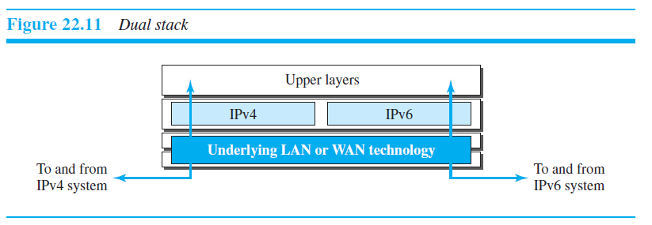
Cntd….
To determine which version to use when sending a packet to a destination, the source host queries the DNS.
If the DNS returns an IPv4 address, the source host sends an IPv4 packet. If the DNS returns an IPv6 address, the source host sends an IPv6 packet.

Slide 120
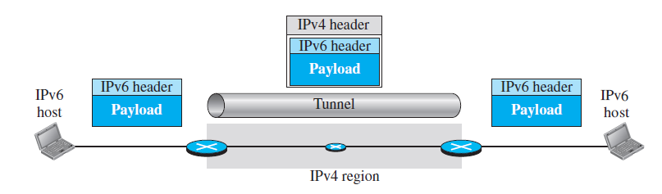
Cntd….
Tunneling
Tunneling is a strategy used when two computers using IPv6 want to communicate with each other and the packet must pass through a region that uses IPv4.
To pass through this region, the packet must have an IPv4 address. So the IPv6 packet is encapsulated in an IPv4 packet when it enters the region, and it leaves its capsule when it exits the region.
It seems as if the IPv6 packet enters a tunnel at one end and emerges at the other end.

Slide 121
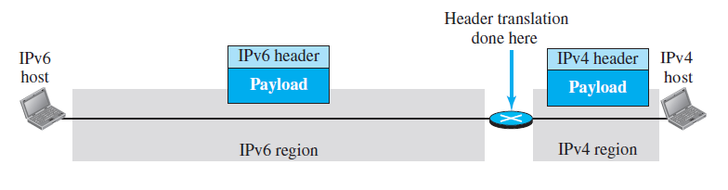
Cntd….
Header Translation
Header translation is necessary when the majority of the Internet has moved to IPv6 but some systems still use IPv4.
The sender wants to use IPv6, but the receiver does not understand IPv6.
Tunneling does not work in this situation because the packet must be in the IPv4 format to be understood by the receiver.
In this case, the header format must be totally changed through header translation. The header of the IPv6 packet is converted to an IPv4 header.

