Slide 1
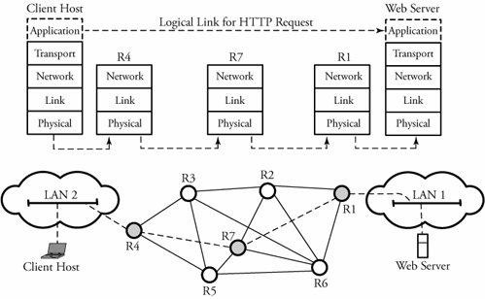
APPLICATIONS Layer
APPLICATION LAYER
This provides network services to user applications,
This provides services such as email, remote access to computers, file transfer, and web etc.
This has its own software dependencies, i.e. when a new application is developed, its software must be able to run on multiple machines.
Web communication between two end systems

Slide 2
DNS (DOMAIN NAME SYSTEM)
This is a distributed hierarchical and global directory that translates domain names into numerical IP address and vice versa.
This is an application-layer protocol.
This is a critical infrastructure, and all hosts contact DNS to access servers and start connections.
This can run over either UDP or TCP. However, running over UDP is preferred, since a fast response is required.
Functions of a DNS server are
Finding the address of a particular host.
Mapping IP addresses to host names.
Finding an alias for the real name of a host.
Finding the host type and the operating-system information.
Naming a host that processes incoming mail for the designated target.
Delegating a subtree of server names to another server.
Denoting the start of the subtree that contains cache and
configuration parameters, and giving corresponding addresses.
Every ISP(Internet Service Provider) has a DNS server.
All hosts contact DNS servers when they initiate connections.
A host sends UDP queries to a DNS server.
DNS server either replies or directs the queries to smarter servers.

Slide 3
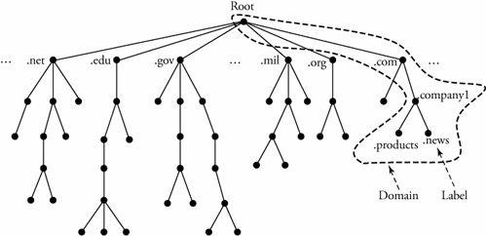
COMPUTER NETWORKS-II
DOMAIN NAME SPACE
Any entity in the internet is uniquely identified by an IP address.
An IP address can also be assigned a domain name.
A domain name is a sequence of labels separated by dots.
A label is a string of characters.
Domain names are defined in a tree-based structure with the root at the top (Figure ).
A tree is a structured with a maximum of 128 levels, starting at level 0(root).
Each level consists of nodes
A node on a tree is identified by a label
A label can be of length up to 63 characters. The root label has empty string.
The last label of a domain name expresses the type of organization.
Figure Hierarchy of domain name space, labels, and domain names

Slide 4
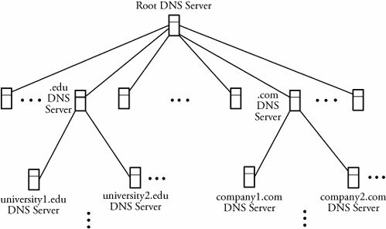
DOMAIN NAME SERVER (DNS SERVER)
The domain name space is divided into subdomains, and each subdomain is assigned a domain-name-server(DNS Server).
A DNS Server has a database consisting of all the information for every node under that domain (Figure ).
The root-server supervises the entire domain name space.
A root-server typically keeps references only to servers over which it has authority.
Figure Hierarchy of DNS domain name servers

Slide 5
REMOTE LOGIN PROTOCOLS
Using client/server model, a user can establish a session on the remote-machine
and then run its applications. This application is known as remote login.
For example, an employee working at home can log into his work-server to
access application programs for doing a project.
Two remote login protocols are TELNET & SSH.
TELNET
This is a TCP/IP standard for establishing a connection to a remote-machine.
This allows a user to log into a remote-machine across the Internet.
This makes a TCP connection and then passes the detail of the application from
the user to the remote- machine.

Slide 6
Logging to Remote Servers
TELNET has the following properties:
Client-programs are built to use the standard client/server interfaces without knowing the details of server-programs.
A client and a server can negotiate data format options.
Once a connection is established, both ends of the connection are treated symmetrically.
When a user logs into a remote-server, the client's terminal-driver accepts the keystrokes and interprets them as characters by its operating-system.
Characters are typically transformed to a universal character set called NVT (network virtual terminal).
The client then establishes a TCP connection to the server.
Texts in the NVT formal are transmitted using a TCP session and are delivered to the operating-system of the remote-server.
The server converts the characters back from NVT to the local client machine's format.
SECURE SHELL (SSH) PROTOCOL
This is based on UNIX programs.
This uses TCP for communications.
This is more powerful and flexible than TELNET.
This allows the user to more easily execute a single command on a remote client.
This has the following advantages over TELNET
Security: SSH provides a secure communication by encrypting and authenticating messages. Security is implemented by using public-key encryption.
Multiplexing: SSH provides several additional data transfers over the same connection by multiplexing multiple channels.

Slide 7
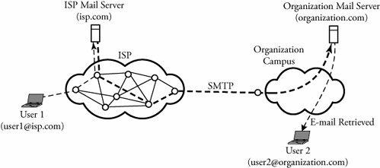
COMPUTER NETWORKS-II
SMTP (SIMPLE MAIL TRANSFER PROTOCOL) & EMAIL (ELECTRONIC MAIL)
SMTP transfers email from the mail-server of a source to the mail-servers of destinations.
A user-mailbox is a space in the mail-server allocated to the user to keep its email.
Begin SMTP between two users
User-1 provides user-2's email address(user2@organization.com) and composes its message(Figure ).
User-1 sends the message to its mail-server(isp.com)
Server isp.com places the message in its queue.
SMTP on user 1's mail-server
→ notices the message in the queue and
→opens a TCP connection with the organization mail-server (organization.com)
Initial SMTP handshaking takes place between the two servers.
The message is sent to organization.com's mail-server.
User-2's mail-server receives the message and then puts it in user-2's mailbox.
Figure Two users exchanging e-mail through SMTP

Slide 8
FILE TRANSFER PROTOCOLS
FTP (File Transfer Protocol)
FTP is used to transfer files from one host to another host over the internet.
TELNET provides broader access to a user, whereas FTP allows access only to certain files.
Begin File Transfer Protocol
A user requests a connection to a remote-server.
The user waits for an acknowledgement.
Once connected, the user must enter a user ID, followed by a password.
The connection is established over a TCP session.
The desired file is transferred.
The user closes the FTP connection.

Slide 9
WORLD WIDE WEB (WWW) AND HTTP (HYPER TEXT TRANSFER PROTOCOL)
Web is a global network of servers.
The servers are linked by a common protocol such as http, ftp & so on.
When a client-host requests an object, a web-server responds by sending the requested-object.
A browser is a user-agent which displays the requested web-page.
HTTP transfers web-page at the application layer.
HTTP uses TCP rather than UDP, since reliable delivery of web-pages with text is important.
The TCP connection-establishment delay is one of the main contributing delay factors associated with downloading web-documents.
Web-page consists of HTML(Hypertext Markup Language) files that can be addressed by a single URL(uniform resource locator).
A URL is a global address of an HTML document and has two parts.
First part indicates what protocol is used, and
Second part determines the IP address of the associated resource.
WEB CACHING (PROXY SERVER)
An HTTP request from a user is first directed to the web-cache.
The web-cache must contain updated-copies of all objects in its defined proximity.
Two reasons for web caching:
To reduce the response-time for a user-request.
To reduce traffic on an organization’s access link to the Internet
Begin Web Caching Algorithm
The user-browser makes a TCP connection to the web-cache (Figure in next slide).
The user-browser transmits its HTTP request to the web-cache.
If web-cache has a copy of the requested-object,
web-cache forwards the object to the user-browser Otherwise,
web-cache establishes a TCP connection to the requested-server and asks for the object. Once it receives the object, the web-cache stores a copy of it and forwards another copy to the user-browser.

Slide 10
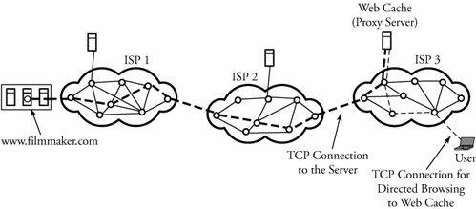
Figure. A user's browser requesting an object through the Web cache

