Slide 1
Introduction to Text Mining
Text Mining is a Discovery
Text Mining is also referred as Text Data Mining (TDM) and Knowledge Discovery in Textual Database (KDT).
Text Mining is used to extract relevant information or knowledge or pattern from different sources that are in unstructured or semi-structured form.
CSE-307-Data Mining

Slide 2
Extract and discover knowledge hidden in text automatically
Helps domain experts by automatically:
  identifying concepts
  extracting facts/relations
  discovering implicit links
  generating hypotheses
CSE-307-Data Mining

Slide 3
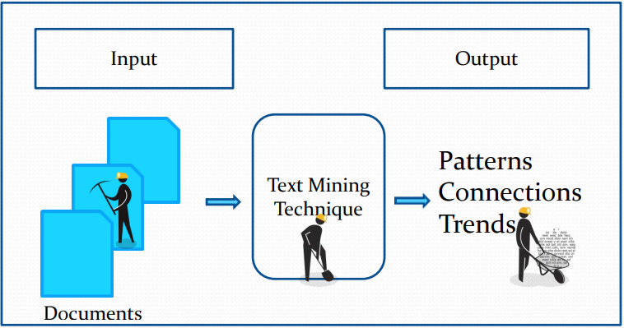
Input-Output Model for Text Mining
CSE-307-Data Mining

Slide 4
Steps for Text Mining
  Pre-Processing the Text
  Applying Text Mining Techniques
    Summarization
    Classification
    Clustering
    Visualization
    Information Extraction
      Analyzing the Text
CSE-307-Data Mining

Slide 5
WEB MINING
WEB Mining is the use of the data mining techniques to automatically discover and extract information from web documents/services Discovering useful information from the World-Wide Web and its usage patterns
Using data mining techniques to make the web more useful and more profitable (for some) and to increase the efficiency of our interaction with the web
CSE-307-Data Mining

Slide 6
Web usage mining is the process of extracting useful information from server logs e.g. use Web usage mining is the process of finding out what users are looking for on the Internet.
Some users might be looking at only textual data, whereas some others might be interested in multimedia data.
Web Usage Mining is the application of data mining techniques to discover interesting usage patterns from Web data in order to understand and better serve the needs of Web-based applications.
CSE-307-Data Mining

Slide 7
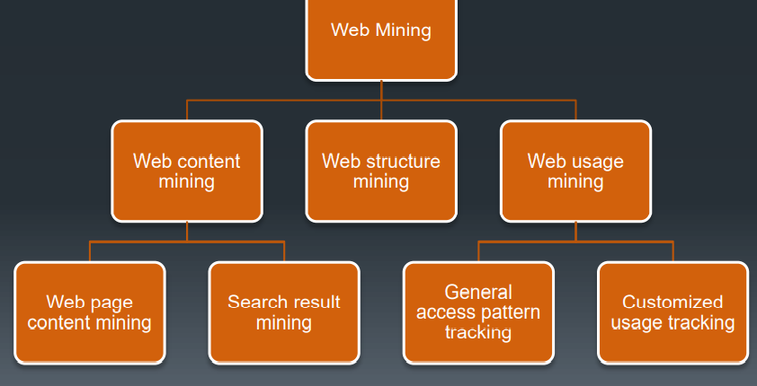
WEB Mining TAXONOMY
CSE-307-Data Mining

