Slide 1
Screening Before the Scan
Can routine primary-care data predict what a DXA scan would say?
1,484 non-Hispanic White women aged 50–65 · six NHANES cycles · 23 predictors · 8 models
Briefing prepared for review by an osteoporosis specialist
All results reproduce from a single script, fixed random seed
Notes:
Goal of this meeting: get clinical review of the design, the variable set, and the referral threshold. I am NOT claiming a DXA replacement - this is a triage question.

Slide 2
THE CLINICAL PROBLEM
Bone loss is silent until it breaks something
1 No symptoms. Nothing a patient notices until a hip or wrist fractures after a minor fall.
2 DXA is accurate but not universally reachable: a fixed, costly machine, an appointment to order and travel to.
3 Routine screening often begins at 65 — yet loss accelerates fastest in the decade right after menopause.
4 So the women in the 50–65 window are largely unscanned unless something else flags them.
The question is triage, not replacement
Given a room of 55-year-olds and a limited number of scanner slots, can cheap information rank them well enough that the slots go to the right women?
A triage tool does not have to be right about individuals. It has to order people better than what is used today.
This project predicts a test result, not a fracture. It is a referral aid — never a diagnosis.

Slide 3
STUDY DESIGN
Build the answer key from DXA — then hide it
NHANES did both halves on the same people: it interviewed and examined participants AND scanned many of them. So the scan can be used twice, in two opposite roles.
ROLE 1 — the answer key
Femoral-neck and total-hip BMD become a T-score, which becomes the yes/no label the model is graded against. Research use only.
ROLE 2 — forbidden input
Every column carrying the scan (BMD, T-scores, both labels, bone_status) is excluded from the feature set. Using them would predict the scan from the scan.
Remove role 1 and what remains is a screening tool that needs no scanner. Feature selection here works by exclusion, so a standing alarm watches for any new BMD-derived column silently re-entering the model.
Leakage check every run: largest standardised coefficient 0.990 (weight) against an alarm threshold of 2.0. Clean.
Notes:
This is the slide to linger on. If a specialist understands only one thing, it should be that the DXA is the grading key and is walled off from the inputs.

Slide 4
DATA
NHANES: fourteen source files per cycle
A continuous CDC survey. Every participant carries one ID (SEQN) and every file keys on it — which is what makes the assembly possible. Six cycles: 2005-06, 07-08, 09-10, 13-14, 17-18, 17-20.
File | Contents | Contributes
DEMO | Demographics | Age, sex, ethnicity (cohort selection); income-to-poverty ratio
BMX | Body measurements | Weight, height, BMI
DXXFEM | Hip DXA scan | THE ANSWER KEY ONLY — femoral-neck + total-hip BMD
RHQ | Reproductive health | Menopause age & cause, hysterectomy, oophorectomy, oestrogen use
OSQ | Osteoporosis module | Prior hip / spine / wrist fracture, long-term steroid use
VID | Vitamin D lab | Serum 25(OH)D (measured, not reported)
DR1TOT + DR2TOT | Two 24-h diet recalls | Two-day average calcium and vitamin D
DSQTOT | Supplements | Calcium and vitamin D from pills
MCQ / SMQ / ALQ | Conditions, smoking, alcohol | Arthritis, ever-smoked, drinks per day
PAQ / DIQ / DPQ | Activity, diabetes, PHQ-9 | Vigorous activity, diabetes, depression score
SLQ | Sleep | Collected, then dropped — too sparse across cycles
All eleven download caches are committed, so the whole pipeline reproduces offline.

Slide 5
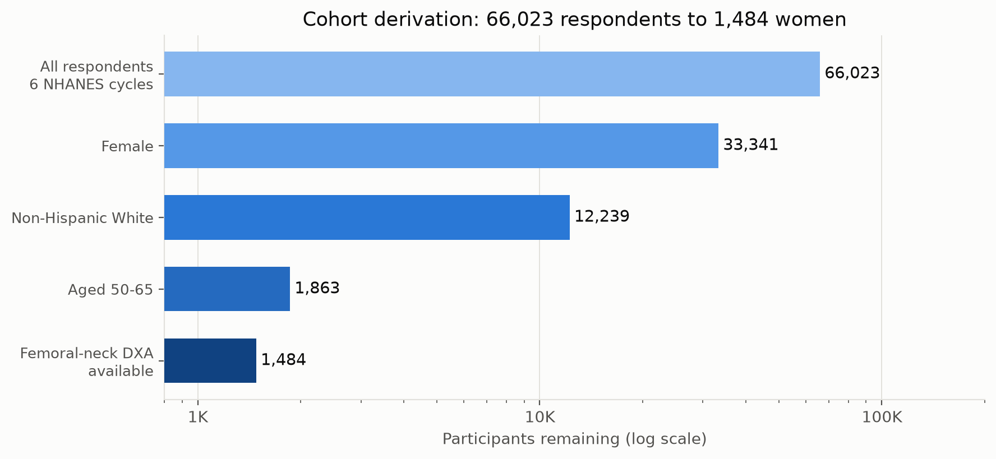
COHORT DERIVATION
Four filters, each one deliberate
Why so narrow?
Holding sex, ancestry and age band fixed means the model does not spend limited statistical power learning those effects — and the T-score reference values are the right ones for this group.
The cost
Nothing here generalises outside this group. The pipeline would have to be re-run and re-validated for any other population.
The last filter
379 otherwise-eligible women had no valid scan. No answer key means nothing to train or grade against.
The script hard-asserts n = 1,484, so any change to cycles or criteria stops the run instead of quietly reporting different numbers.

Slide 6
THE OUTCOME
From bone density to a yes/no label
A raw density of 0.72 g/cm² means nothing alone. The T-score expresses it as standard deviations from a healthy young-adult mean, using fixed NHANES III reference values.
Step | What happens
Femoral neck | T = (BMD − 0.858) / 0.120
Total hip | T = (BMD − 0.942) / 0.122
Combine | Take the LOWER of the two sites — clinical practice classifies by the worst site
Round | To three decimals before thresholding, so women exactly on a cutoff do not land on either side by floating-point noise
Label | at_risk = T ≤ −1.0 · osteoporosis = T ≤ −2.5
at_risk (T ≤ −1.0)
836 / 1,484
osteopenia or worse — 56.3%. PRIMARY target.
osteoporosis (T ≤ −2.5)
94 / 1,484
the WHO threshold — 6.3%. Only 4.1 events per predictor.
T-score distribution
mean −1.08
SD 1.02 — the cohort average sits on the osteopenia line.
The primary target is NOT osteoporosis — it is any measurable bone loss, in over half this cohort. Quote it that way.
Notes:
Be explicit about this. If you say 'we detect osteoporosis with AUC 0.81' that is wrong on two counts: wrong target and wrong (optimistic) number.

Slide 7
VARIABLES USED
The 23 inputs the model may look at
Grouped by where a real clinic would get them. If a variable here is not obtainable in a primary-care visit, the premise fails.
Available from | Variables | Missing
Measured in the room scale, stadiometer, DOB | weight_kg height_cm bmi age | ≤ 0.5%
Reproductive history interview | postmenopausal years_since_menopause hysterectomy oophorectomy menopause_natural ever_used_estrogen | 2.8 – 33.6%
Chart / medication list | any_prior_fracture steroid_use any_arthritis diabetes ever_smoked alcohol_drinks_day vigorous_activity | 0 – 31.7%
Routine labs | serum_vitd_nmol | 23.0%
Diet & supplements | total_calcium_mg total_vitd_mcg supp_data_available | 15.4%
Social | poverty_income_ratio | 5.5%
Mood screen | phq9_score | 80.4%
Two I would flag myself: phq9_score is 80% missing and contributes nothing; supp_data_available is a dataset-provenance flag, not a patient characteristic.

Slide 8
FEATURE ENGINEERING
Variables computed, not collected
Computed variable | How | Why it exists
t_score | min of two site T-scores, rounded to 3 dp | The grading key. Clinical convention classifies by the worst site.
years_since_menopause | age − age at last period (RHQ060), implausible ages screened out | Loss accelerates through the transition then slows. In a 50–65 cohort where timing varies by a decade, age is a weak surrogate.
postmenopausal | 1 − (any period in last 12 months) | Directly separates still-cycling from post-transition.
hysterectomy / oophorectomy | kept as two separate flags, never pooled | Uterus-only leaves ovaries producing oestrogen; bilateral oophorectomy cuts it off abruptly. Pooling buries the signal.
menopause_natural | RHD042 (2005-10) / RHD043 (2013+) coalesced, text parsed | Separates natural from surgical menopause across a mid-study variable rename.
any_prior_fracture | 1 if any site reported; 0 only if all sites answered no; else NaN | Hip (21) and wrist (46) events are too rare to estimate separately. Pooled = 233 positives, and the clinically meaningful construct.
total_calcium_mg / total_vitd_mcg | two-day dietary mean + supplement intake, plain addition | Intake is food plus pills. Plain addition means a missing component yields a missing total, never a fabricated one.
serum_vitd_nmol | LBXVIDMS coalesced with LBDVIDMS | NHANES changed the column name mid-study; one is regression-adjusted to the other.
phq9_score | nine PHQ items clipped 0–3, summed with min_count=5 | Fewer than five answered items yields NaN rather than a falsely low score.
The reproductive variables are where the domain thinking lives — they reflect how bone loss actually works, not what was easiest to code.

Slide 9
EXCLUSIONS
Variables dropped, and exactly why
Dropped | Reason | Category
femoral_neck_bmd total_hip_bmd t_femoral_neck t_total_hip t_score bone_status at_risk osteoporosis | Every column carrying the scan. Using any of them predicts the scan from the scan. | TARGET LEAKAGE
prior_hip_fracture prior_spine_fracture prior_wrist_fracture | Only 21 hip and 46 wrist events. Every tree gave them zero importance while linear models fitted noise. Pooled instead. | TOO RARE
age_at_menopause | age = age_at_menopause + years_since_menopause exactly. All three makes the design rank-deficient. | COLLINEAR
dietary_calcium_mg supp_calcium_mg DR2TCALC dietary_vitd_mcg supp_vitd_mcg DR2TVD | Components superseded by the total_* variables; left in they enter as near-duplicates. | SUPERSEDED
n_recall_days | Encodes whether the person answered a second diet survey — a property of the survey, not the woman. | SURVEY ARTEFACT
DPQ010 … DPQ090 | The nine raw PHQ items, superseded by their sum. | SUPERSEDED
sleep_hrs sleep_risk | Sparse and inconsistent across cycles. Both feature sets are built; only the without-sleep arm is trained. | DATA DENSITY
education | Not an explicit exclusion — survives as text, then swept up by the blanket drop of non-numeric columns. An accidental omission. | ACCIDENTAL
SEQN RIAGENDR RIDRETH1 survey_cycle | IDs and the filter variables, constant by construction. | NOT A PREDICTOR
I am flagging education as a genuine oversight rather than a decision — it is collected but never modelled.
Notes:
If asked 'what would you add next': education is already collected and silently dropped; recovering it is the cheapest improvement available.

Slide 10
VALIDITY GUARDS
Six ways this could have been wrong
Most of these were not hypothetical — they were found and fixed, which is a different and stronger claim than "we were careful".
# | Risk | Guard, and what it caught
1 | Target leakage | Alarm on any standardised coefficient > 2.0. Largest legitimate is 0.990 (weight). Clean every run.
2 | Clinically backwards effects | EXPECTED_SIGNS dictionary flags wrong-direction coefficients. This surfaced the age / menopause collinearity. Currently flags vitamin-D intake — reverse causation.
3 | Fabricated nutrient totals | Plain addition, not fill-value zero. Separately distinguishes "cycle shipped no supplement file" (206 women, unobserved) from "reported no supplements".
4 | A variable under a false name | MCQ160A was named rheumatoid_arthritis. It asks about ANY arthritis — 45.8% prevalence masquerading as a 1–2% FRAX risk factor. Renamed any_arthritis.
5 | Importance measures that lie | Gini importance ranked calcium 7th despite a flat outcome gradient. Replaced entirely with permutation importance (AUC lost when shuffled).
6 | A flattered in-sample score | The forest scores 1.000 in-sample by construction — 0.997 even on shuffled labels. Out-of-bag scoring (0.825) is reported instead.
Leaf size was tuned by nested CV, not by eye: raising it to shrink the train/test gap LOWERS test AUC monotonically, 0.810 → 0.762.

Slide 11
MODELS USED
Eight models across two arms
All wrapped in the same pipeline — median imputation → standardisation → estimator — so preprocessing is always learned inside the training fold, never from the test rows.
Model | What it actually does | Why it is in the set
Logistic regression (L2) | One weight per variable, added up; penalty discourages large weights | The interpretable baseline — its coefficients become the odds ratios a clinician reads
Elastic-net logistic | Same, with a penalty that can push weights to exactly zero | Automatic variable selection. It zeroed phq9_score entirely
Random forest | 500 trees on different bootstrap samples, votes averaged | Captures non-linearity and interactions no additive model can. Wins here
LightGBM | Trees built in sequence, each correcting the last | Usually strongest on tabular data — deliberately constrained here
XGBoost | Same idea, different implementation | Independent check on LightGBM
Ridge → T-score | Predicts the continuous T-score, never a label | Dichotomising discards information: T = −2.4 and T = +0.5 are both "negative"
RF → T-score | Same, non-linear | One fit serves BOTH cutoffs — threshold the predicted T-score twice
LightGBM → T-score | Same, boosted | Third check on the regression arm
Both boosters are deliberately crippled (max_depth 2, reg_lambda 50): at n = 1,484 an unconstrained booster memorises the data and reports a fantasy.

Slide 12
VALIDATION DESIGN
How the numbers were earned
5-fold cross-validation
Split the 1,484 women into five groups holding case proportion equal. Train on four, test on the fifth, rotate five times. Every woman is tested exactly once, on a model that never saw her. Seed fixed at 42 throughout.
The OST baseline — the bar to clear
OST = 0.2 × (weight_kg − age). A validated formula (Koh et al., 2001) needing only a scale and a birthdate. Reporting AUC without a cheap comparator is uninterpretable. Our OST scores 0.747 / 0.773 — inside the published 0.71–0.79 range, which independently validates the implementation.
Nested cross-validation — the honest number
Fitting eight models and reporting the best is biased upward: it was chosen BECAUSE it scored well on those rows. Nested CV moves model selection inside each training fold, so no test row helps pick the model scored on it.
Reported both ways on purpose. Where the two agree, the leaderboard was not flattering itself. Where they diverge, the nested number is the real one.

Slide 13
THE OBVIOUS OBJECTION
Why the benchmark is OST and not FRAX
FRAX uses much the same primary-care inputs, so this needs settling first. The two tools answer different questions at different points in the care pathway.
 | FRAX | This model
Question it answers | Given these risk factors, what is the 10-year probability of fracture? | Is this woman’s bone density low enough to be worth measuring?
Outcome predicted | A future EVENT — major osteoporotic or hip fracture | A present TEST RESULT — DXA T-score category
Time horizon | 10 years forward | Today
Decision it informs | Treat, or do not treat | Scan, or do not scan
Design needed to build it | Prospective cohort with fracture follow-up | Cross-sectional cohort with DXA
Position in the pathway | AFTER the BMD question — FRAX performs better WITH BMD | BEFORE it — deciding who gets the BMD that FRAX then uses
NHANES could not support a FRAX comparison even if we wanted one: it records no parental hip fracture (a required FRAX input) and, being cross-sectional, carries no fracture follow-up at all. OST was built to predict low BMD; FRAX was built to predict fractures. Benchmarking a BMD-prediction model against FRAX would measure it against a tool designed for a different outcome.
Complementary, not competing. A better answer to "who should be scanned" improves the BMD input that FRAX itself depends on.
Notes:
Expect this early. The honest line: we are not claiming to beat FRAX, and we never tested fracture prediction. We chose the comparator that shares our outcome.

Slide 14
EVIDENCE
FRAX is known to be weak at this particular job
Using FRAX-without-BMD to decide who needs a DXA has been tested directly — and in this project’s exact age band it performs poorly.
Finding | Detail | Source
The USPSTF FRAX strategy misses most cases under 65 | Of women < 65 with confirmed osteoporosis, only 45% met the FRAX-without-BMD ≥ 9.3% MOF threshold, though 90% had T < −2.5. Sensitivity 40%. Authors conclude FRAX alone "fails to identify many women under 65 needing BMD testing" | Endocrine Society, 2019
Discrimination for LOW BMD is only modest | FRAX separated osteoporosis (T ≤ −2.5) with AUC 0.72–0.75 in 2,991 adults aged ≥ 60 — below both OST (0.773 on this cohort) and this model (0.806 nested) | Thai cohort, 2025
Its standard thresholds are too conservative for case-finding | A cut-off of 6.6% MOF rather than 9.3% was needed to reach 69% sensitivity and 85% specificity for detecting osteoporosis | Cirrhosis cohort, 2024
OST beat FRAX head-to-head for exactly this purpose | In an elderly Taiwanese cohort OSTA reached 100% sensitivity, outperforming FRAX, GARVAN, ORAI, OSIRIS, SCORE and ABONE at identifying low BMD | OST review, 2018
But BMD is an imperfect target, and that cuts against us | More than 75% of people who sustain a fragility fracture do NOT meet T ≤ −2.5. Predicting BMD means predicting a surrogate, which bounds what this model can ever claim | Reported across cohorts
Say the last row out loud before anyone else does. It is an argument for eventually predicting fractures rather than densities — which needs a prospective cohort this project does not have.
The claim is therefore narrow and defensible: the pre-DXA triage decision in women 50–65, measured against the tool actually designed for it.

Slide 15
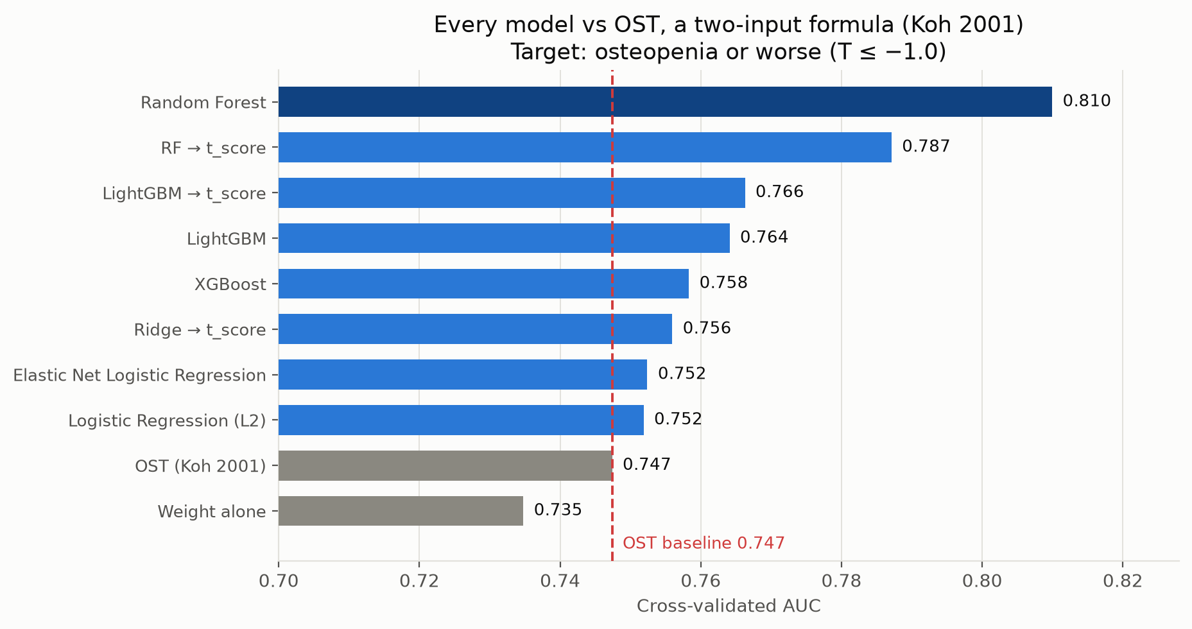
RESULTS — LEADERBOARD
Every model against the OST formula
Reading it
The forest wins clearly — 0.810 vs 0.753 for linear models. That gap says real non-linear structure exists.
The boosters LOSE to the forest, unusual on tabular data and a direct consequence of how hard they were regularised.
L2 and elastic net are identical to three decimals — with 23 chosen predictors there is little for sparsity to remove.
Weight alone (0.735) sits BELOW OST, so the age term earns its place.
All 23 variables, the bloodwork, the diet surveys and 500 trees buy +0.063 AUC over a formula you can do in your head.

Slide 16
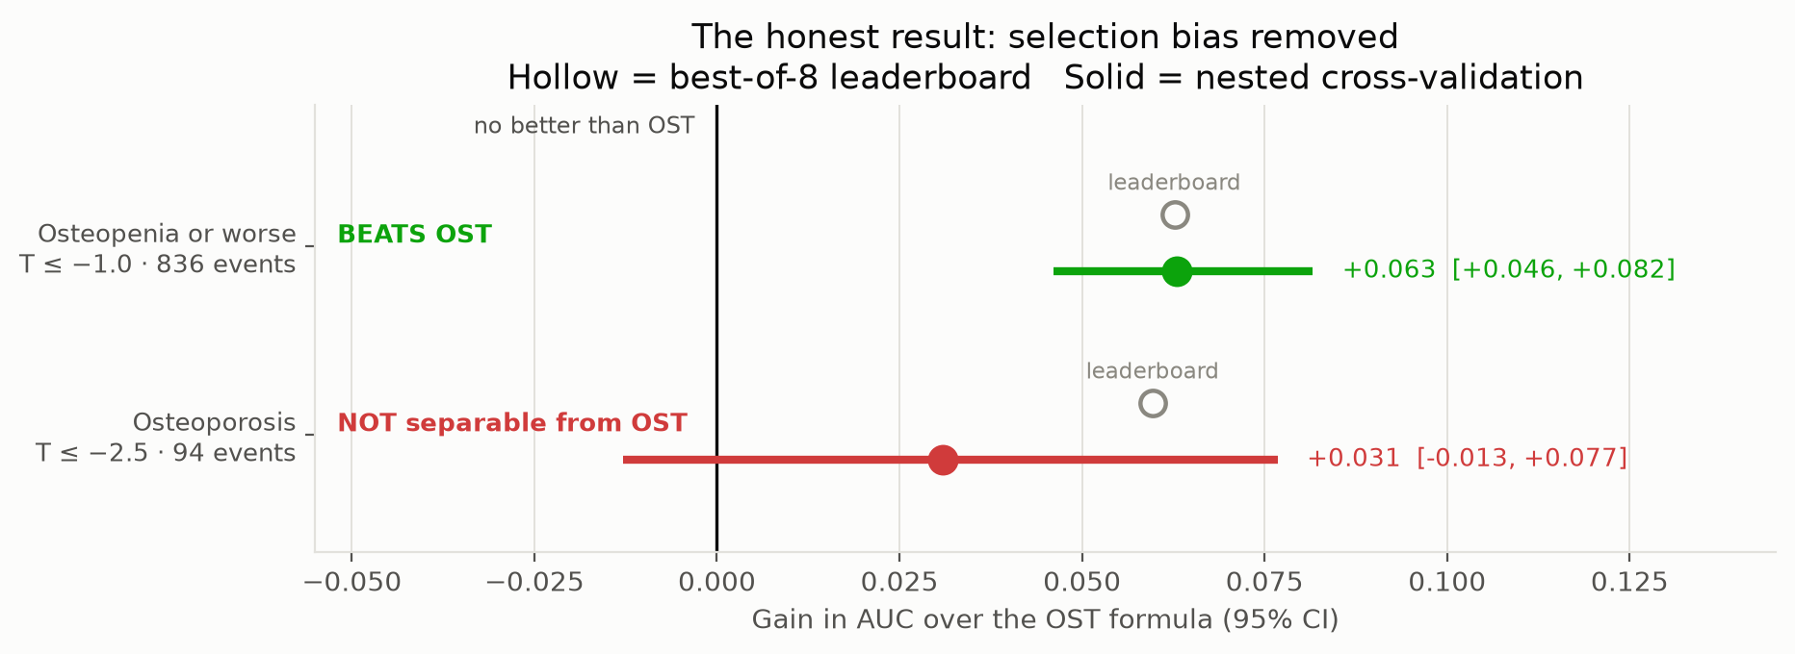
RESULTS — HEADLINE
The result that matters, and it splits by target
Osteopenia or worse: the nested estimate EQUALS the leaderboard (0.810 both ways) and the gain is positive in all five folds (+0.070, +0.063, +0.052, +0.055, +0.074). Nothing to strip out — the same model won everywhere. A solid, reproducible result.
Osteoporosis: 0.833 collapses to 0.806. That 0.027 drop IS the selection bias, caught in the act. The remaining +0.031 spans zero and one fold came out negative. With 94 events, we cannot show the model beats a two-variable formula.
Bringing you "this half works, this half we cannot yet claim" is the whole point of building the machinery.
Notes:
This is the centrepiece slide. A judge or reviewer who has seen many ML posters will recognise immediately that almost nobody does this. Do not rush it.

Slide 17
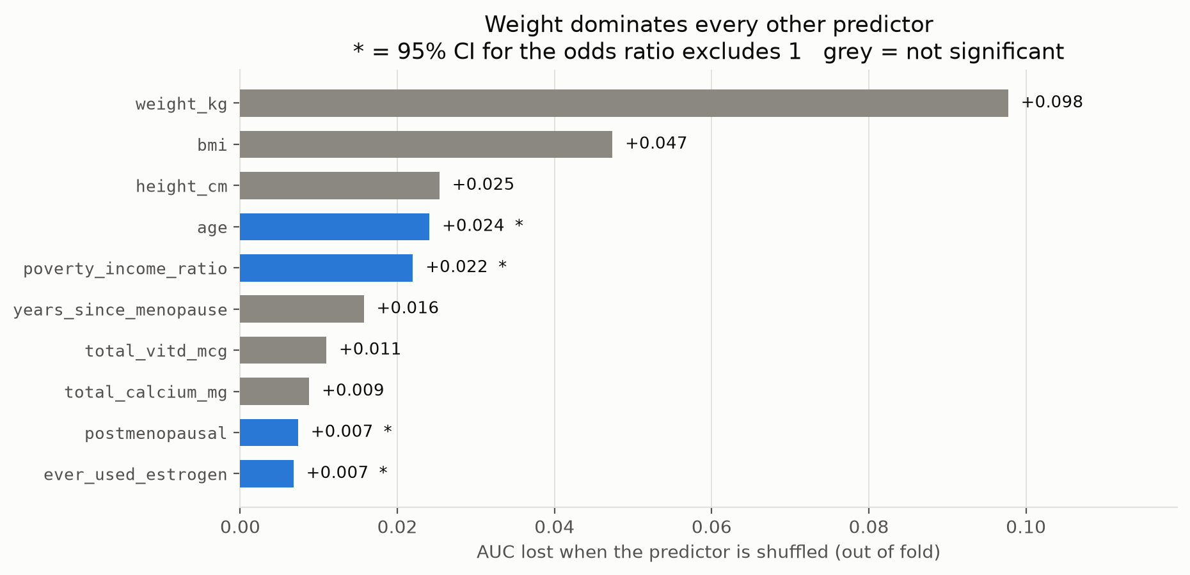
RESULTS — PREDICTORS
Weight dominates everything else
The most instructive row
weight_kg is by far the most predictive single variable — shuffling it costs 0.145 AUC in the linear model, five to ten times anything else.
Yet its odds ratio is NOT significant (0.41–1.05).
Both are true. Weight, BMI and height measure largely the same physical fact, so the model shifts credit freely between them and each interval is wide. Collectively they carry the signal; shuffling weight alone breaks the arrangement.
A wide interval means "we cannot separate this from its neighbours" — not "this does not matter". That is why both columns are reported.

Slide 18
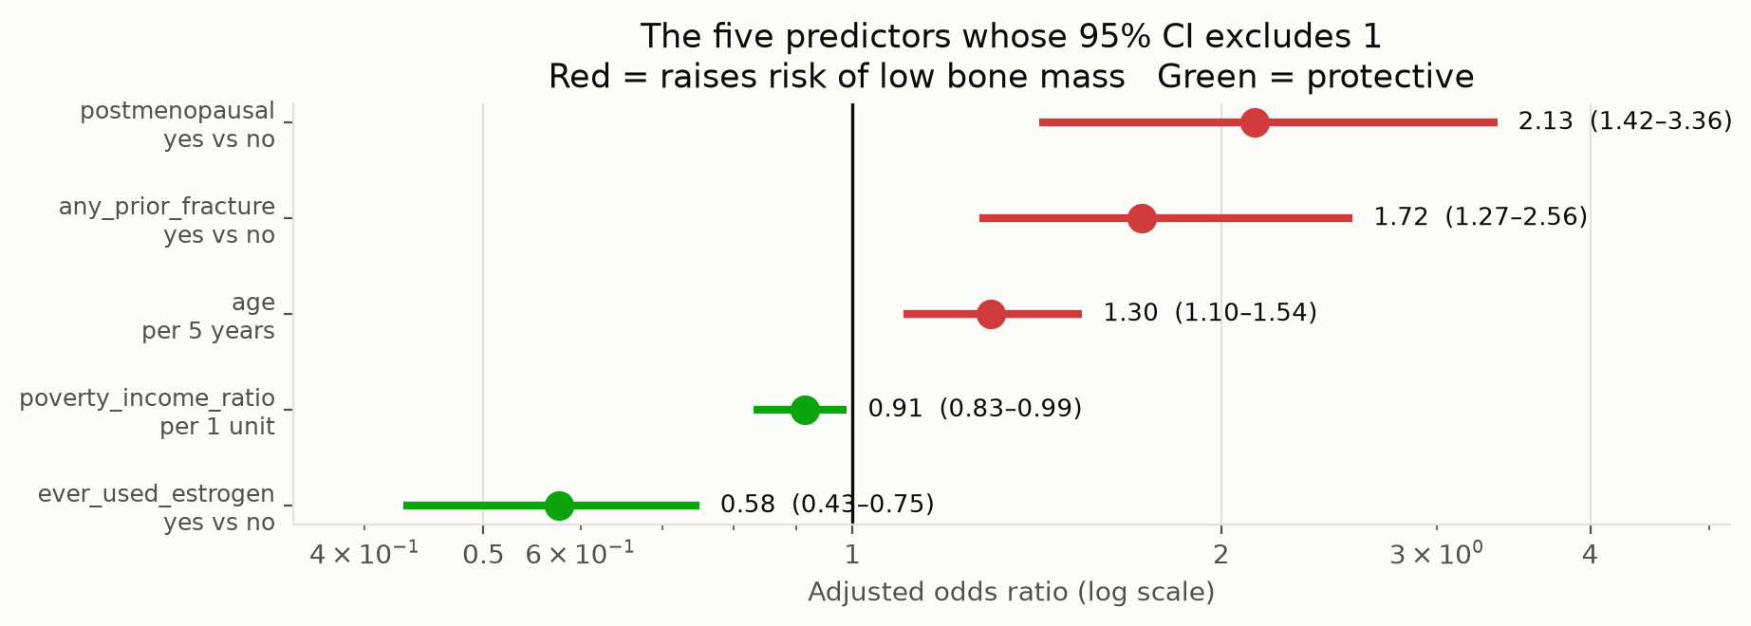
RESULTS — EFFECT SIZES
Five of 23 predictors reach significance
Entirely conventional
Lighter, older, longer-postmenopausal women with a fracture history and no oestrogen exposure are at higher risk.
Nothing here contradicts the osteoporosis literature — which is itself a form of validation. A pipeline this complicated rediscovering the textbook is evidence it is wired up correctly.
Everything else is statistically indistinguishable from no effect at this sample size. Saying so plainly is more useful than a ranked list of 23 apparent effects.
Adjusted odds ratios per clinically meaningful unit, with stratified-bootstrap CIs that carry imputation variability rather than treating imputed values as observed.

Slide 19
RESULTS — NUTRITION
Calcium and vitamin D: a measured null
This is the first thing a bone specialist asks about, so it was measured about as carefully as this dataset allows — supplements added to a TWO-DAY dietary average, plus a blood level.
Predictor | Unit | Odds ratio | 95% CI | Verdict
total_calcium_mg | per 500 mg | 1.01 | 0.90 – 1.11 | no association
total_vitd_mcg | per 10 mcg | 1.01 | 0.99 – 1.08 | no association (+ sign flag)
serum_vitd_nmol | per 25 nmol/L | 0.94 | 0.82 – 1.05 | no association
Removing all three changes cross-validated AUC by +0.004 — well inside the fold-to-fold variation of ±0.027, so indistinguishable from no change. I tested this rather than assuming it.
A null result is not a missing measurement, and the distinction matters: the careful measurement is precisely what licenses the statement. It is also consistent with the reverse causation the sign check flagged — women told their bones are thinning start taking vitamin D.
What it does NOT license: any claim about supplementation CHANGING bone density. That needs a trial, not a cross-sectional survey.
Question for you: is a well-measured null on calcium and vitamin D in this age band interesting, or already known?

Slide 20
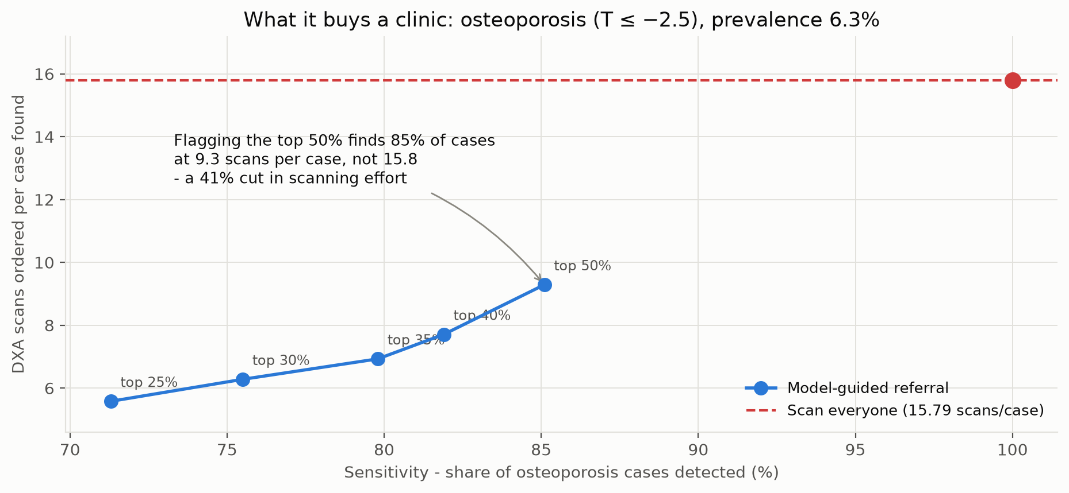
RESULTS — CLINICAL TRANSLATION
What it would buy a clinic
AUC is not a clinical unit
Nobody orders 0.81 of a scan. The only unit that matters is scans ordered per case found.
Osteoporosis, prevalence 6.3%: flagging the top half finds 85% of cases at 9.3 scans per case instead of 15.8 — a 41% cut in scanning effort, missing 14 of 94 cases.
Osteopenia, prevalence 56.3%: the gain is small by construction. You cannot do much better than 1.78 scans per case when half the room is a case.
Tension to state openly: the nested test says this ranking is not separable from OST — so the claim belongs to "a cheap risk score", not to machine learning specifically.

Slide 21
RESULTS — THRESHOLDS
The uncomfortable arithmetic of high sensitivity
A separate, deliberately different forest — shallower, weighted 3:1 toward catching cases, and sigmoid-calibrated so its probabilities mean what they say. Target: osteopenia or worse.
Probability cutoff | Sensitivity | Specificity | PPV | Missed cases | Flagged for DXA
≥ 0.50 | 78.9% | 55.9% | 69.8% | 176 | 946 (64%)
≥ 0.40 | 88.8% | 41.0% | 66.0% | 94 | 1,124 (76%)
≥ 0.35 | 91.3% | 34.4% | 64.2% | 73 | 1,188 (80%)
≥ 0.30 | 94.4% | 27.8% | 62.8% | 47 | 1,257 (85%)
≥ 0.25 | 95.9% | 20.7% | 60.9% | 34 | 1,316 (89%)
At 56% prevalence, high sensitivity and useful triage are close to mutually exclusive. Missing only 34 of 836 cases requires scanning 1,316 of 1,484 women — at which point this is not a triage tool, it is an expensive way of saying "scan almost everyone".
I expect you to spot this immediately. The defensible framing is the osteoporosis target, where prevalence is 6.3% and there is real scanning effort to save.
Calibrated forest ROC-AUC 0.764, PR-AUC 0.813 — lower ranking than the leaderboard model, because it was built for honest probabilities instead.

Slide 22
OUTPUTS
What the pipeline produces, and who each file is for
Every table is written through one helper that stamps a tier as it writes, so the folder is self-describing and cannot drift from the code.
File | Tier | What it holds and how to read it
nested_cv_verdict.csv | PRESENT | The bottom line. One row per clinical threshold with a literal Verdict column: BEATS OST / NOT separable
clinical_predictor_table.csv | PRESENT | Adjusted ORs per clinical unit, bootstrap CIs, permutation importance, missingness per predictor
forest_plot_odds_ratios.png | PRESENT | The same ORs on a log scale; solid marks exclude 1
referral_table.csv | PRESENT | Screening cost both thresholds. Column is "Top fraction flagged" — a quantile, NOT a probability
threshold_sweep.csv | PRESENT | Probability cutoffs for the calibrated forest; carries its model and both AUCs on every row
model_leaderboard.csv | PRESENT | Five models × test / train / OOB AUC, sensitivity, specificity, full confusion matrix
baseline_comparison.csv | METHODS | All ten scores at both thresholds with ΔAUC vs OST and bootstrap intervals
rf_leaf_tuning.csv | METHODS | Nested-tuned vs fixed leaf size — the answer to "why leaf = 1 when train AUC is 1.000?"
coefficient_diagnostics.csv | DIAGNOSTIC | Leak alarm and sign check. Standardised units, unstable across collinear predictors — NOT findings
Thirteen stale files from earlier scripts were removed — one contained the exact tree-importance columns this pipeline dropped for being misleading.

Slide 23
PRIOR WORK
What has already been done in this space
Study | Data | Reported | How this project differs
Stacking ensemble (Comput Biol Med, 2025) | NHANES 2007–14 n = 7,924, 50+ | AUC 0.94 acc 93% | Defined cases using T-scores COMBINED WITH anthropometric risk factors — which were also top predictors. Potential circularity in the outcome definition
PrOsteoporosis (BMC Res Notes, 2025) | NHANES n = 8,766, 223 vars | RF / NN / LGBM / XGB | Feature selection by MRMR + SelectKBest; SMOTE for balance. Authors note important variables lost in cleaning
KNHANES calculator (BioData Mining, 2026) | Korean NHANES 2008–11 | AUC 0.845 spec 0.897 | Closest in spirit — explicitly framed as a high-specificity "rule-in" tool, not a DXA replacement. Includes temporal validation (AUC 0.876)
OST — the benchmark (Koh et al., 2001) | derived in 8 Asian countries; validated in 19 studies | AUC 0.71–0.79 sens 83% spec 63% | Our OST computes to 0.747 / 0.773 — inside the published range, which independently validates our implementation
The honest read: our 0.810 is LOWER than the headline numbers in this literature. That is the point — those numbers come from larger samples, broader cohorts, looser outcome definitions, and in at least one case a label that shares information with its own predictors.
Almost none of this literature reports a cheap-baseline comparison or nested selection. That gap is the opening.

Slide 24
POSITIONING
Where this can genuinely stand out
1. Methodological honesty as the contribution
Not "we got AUC X" but "here is what survives being checked". Nested CV, a cheap-baseline comparator, a leakage alarm, a sign check, and a reported null. Reviewers see very little of this.
2. The negative result is the finding
Showing that 23 variables and 500 trees CANNOT beat 0.2 × (weight − age) for osteoporosis is a real, publishable, decision-relevant claim. It tells clinics not to buy complexity they do not need.
3. Clinical units, not ML units
Scans per case found. Missed cases at each cutoff. That is the language of a referral decision, and it is what makes a specialist able to critique it.
4. Full reproducibility
One script, one fixed seed, committed input caches, an asserted cohort size. A judge can rerun it. Very few science-fair projects can say that.
The strongest version of this project is not a better AUC. It is a trustworthy answer to "does the complexity pay?"

Slide 25
NEXT STEPS
What would strengthen it most, in order
Priority | Action | Why it moves the needle
1 | External validation on a real clinic cohort | Everything so far is internal CV on one survey. This is the single biggest gap and the thing reviewers ask first. Needs your population
2 | Add a calibration curve | Step 13 depends on probabilities meaning what they say. The plot that demonstrates it is currently missing
3 | Report against TRIPOD+AI (27 items) | The BMJ reporting standard for prediction models (Apr 2024); supersedes TRIPOD 2015 and is the current EQUATOR guideline. An orthopaedics audit of 522 studies found only ~40% fully compliant on sample-size and event reporting — so full compliance is a real differentiator
4 | Add the missing established risk factors | Parental hip fracture, height loss, current smoking intensity, weight change since 40 — all established, all absent here
5 | Decision-curve analysis | Moves beyond AUC to net clinical benefit across threshold probabilities — what a guideline committee actually wants
6 | Recover education | Already collected, silently dropped as a string. The cheapest available improvement
ISEF note: analysing NHANES falls under the pre-existing publicly-available data exemption — no IRB pre-approval, no Form 4. Forms 1, 1A and 1B still required. But if YOU supply clinic data, the project becomes a different category and needs written de-identification certification.
The 2026 ISEF rules added AI/ML requirements for the first time — a stated rationale for the model choice and a data-exclusion plan. Both already exist here.

Slide 26
PUBLICATION PATH
How this could get published
Route A — clinical journal, with you as co-author
Target: Osteoporosis International, Archives of Osteoporosis, Journal of Clinical Densitometry, or Bone. Framing: "Does machine learning add incremental value over OST for DXA triage in women 50–65?" The negative osteoporosis result and the nested design are the contribution. Requires TRIPOD+AI reporting and, ideally, external validation. This is the version that carries real weight.
Route B — informatics / methods venue
Target: JAMIA Open, JMIR Medical Informatics, or PLOS ONE. Framing: selection bias in small-sample clinical ML — using this cohort as the worked example where a 0.833 headline becomes 0.806 under nested CV. Lower clinical bar, faster, still peer-reviewed.
Route C — peer-reviewed student journal (do in parallel, not instead)
Journal of Emerging Investigators, STEM Fellowship Journal. Genuine peer review with mentor feedback, and it establishes precedence while Route A proceeds. Do NOT let this substitute for Route A if a specialist is willing to co-author.
Register the analysis plan before external validation. A pre-registered validation of an already-specified model is far stronger than another development study.

Slide 27
QUESTIONS
What I need from you
Ordered by how much your answer changes the work.
1. Is the target right? I predict osteopenia-or-worse (T ≤ −1.0, 56% of the cohort). Is that the clinically useful question, or should the whole project move to T ≤ −2.5 despite only 94 events?
2. What referral cutoff is acceptable? The tables lay out the trade-off, but missed cases per hundred versus scans per case found is a clinical judgement, not one to make from code.
3. Which risk factors do your notes already carry? Parental hip fracture, height loss, weight change since 40, smoking intensity are all established and all absent here. Which are realistically available?
4. Is the calcium / vitamin D null interesting or already known? Well measured, no association, consistent with reverse causation. Worth reporting, or unsurprising?
5. Would you co-author — and can you supply a validation cohort? External validation is the biggest gap. Note that clinic data changes the ISEF category and needs written de-identification.
6. Where would you submit? Osteoporosis International vs a methods venue — and does the negative osteoporosis finding read as a contribution or as a failure to you?
And the one thing I most want challenged: is a triage tool that flags the top 50% actually usable in your clinic, or is that too many referrals to be worth it?
Notes:
Leave time for these. The point of the meeting is their answers, not your slides.

Slide 28
HONEST LIMITATIONS
Limitations I would raise before you do
Limitation | Why it matters | Mitigation / status
Outcome is bone density, not fracture | NHANES is cross-sectional, no follow-up. This predicts a TEST RESULT, not an event. Not comparable to FRAX | Stated everywhere. Not fixable with this dataset
56% prevalence is not a clinic | Survey sample, not a referral population. Sensitivity/specificity travel; PPV and scans-per-case do NOT | Referral tables need recomputing at local prevalence
One narrow demographic | White women 50–65 only. Nothing generalises outside it | Deliberate, to preserve statistical power at n = 1,484
Mostly self-reported predictors | Fractures, steroids, menopause history, smoking. Only weight, height, 25(OH)D are measured | Attenuates real effects — biases toward UNDERstating the ceiling
No external validation | All internal CV on one dataset | Nested CV is the closest honest estimate. Priority 1 above
94 osteoporosis events | 4.1 events per predictor, far below the conventional minimum of 10 | Why that arm is reported as not separable from OST
phq9_score 80% missing | Median-imputed for four in five women; contributes negatively | Should be dropped. Flagged, not hidden
Every one of these is already written into the project documentation. I would rather present them than be asked about them.

Slide 29
SOURCES
References
Prior work in this space, the benchmark this project is measured against, and the reporting and competition standards it follows.
 | Reference | Relevance here
1 | Enhancing osteoporosis risk prediction using machine learning. Comput Biol Med, 2025. NHANES 2007-14, n = 7,924. AUC 0.94 | Highest reported AUC in this space. Defined cases using T-scores combined with anthropometric factors that were also top predictors - potential circularity
2 | PrOsteoporosis: predicting osteoporosis risk using NHANES data and machine learning. BMC Res Notes, 2025. n = 8,766, 223 variables | Closest NHANES comparator. MRMR + SelectKBest selection, SMOTE balancing; authors note important variables lost in cleaning
3 | An online non-radiographic osteoporosis prediction calculator constructed using interpretable machine learning. BioData Mining, 2026. KNHANES 2008-11. AUC 0.845 | Closest in spirit - framed explicitly as a high-specificity "rule-in" tool rather than a DXA replacement, and includes temporal validation (AUC 0.876)
4 | Performance of the Osteoporosis Self-Assessment Tool (OST) in predicting osteoporosis - a review. 2018. Pooled sens 83%, spec 63%; AUC 0.71-0.79 | THE BENCHMARK. Our OST computes to 0.747 / 0.773, inside this published range, which independently validates the implementation
5 | Development and validation of an Osteoporosis Self-Assessment Tool for Taiwan (OSTAi). PLOS One, 2015. n = 12,175. AUC 0.739 | Large single-population OST validation, built by testing each FRAX risk factor against BMD T-score - the same design logic used here
6 | TRIPOD+AI statement: updated guidance for reporting clinical prediction models that use regression or machine learning. BMJ, 2024. doi:10.1136/bmj-2023-078378 | 27-item reporting checklist. Supersedes TRIPOD 2015; the standard this project reports against for publication
7 | Society for Science. ISEF International Rules for Pre-College Science Research: Human Participants; ISEF Forms. 2026 | NHANES analysis is exempt from IRB pre-approval under the pre-existing publicly available data rule. Forms 1, 1A, 1B still required
8 | CDC / National Center for Health Statistics. National Health and Nutrition Examination Survey, cycles 2005-06 through 2017-20 | The data source. Fourteen modules per cycle, merged on SEQN
Full URLs are in Notes/project_walkthrough.html. NHANES is public domain; all analysis code is in OsteoporosisML.py under one fixed seed.

Slide 30
The four-sentence version
Using six NHANES cycles we assembled 1,484 non-Hispanic White women aged 50–65 who received a hip DXA scan, and trained models to predict their bone-density category from clinic-available information alone, with every trace of the scan excluded from the inputs.
A random forest reaches a cross-validated AUC of 0.810 for osteopenia or worse, at 74% sensitivity and 73% specificity.
Tested honestly — model selection moved inside each training fold — that beats OST, a two-variable OST formula by 0.063 AUC, with a confidence interval clear of zero, in every fold.
For osteoporosis specifically we cannot make that claim: the advantage shrinks from +0.060 to +0.031 once selection bias is removed, and the interval crosses zero, because there are only 94 cases.
What I want reviewed is not the AUC. It is whether the complexity pays, and what referral cutoff makes clinical sense.

