Slide 1
Structural Design Patterns II
Seminar 4 – Organizing classes & objects into flexible structures

Slide 2
What I will learn
Adapter
Bridge
Composite
Decorator
Facade
Proxy
Flyweight
Also:
Real-world case study (network security)
Practical exercise: Decorator in Python

Slide 3
Task 1 – Purpose & Use Cases
Adapter – Converts one interface into another (makes incompatible classes work together)
Bridge – Separates abstraction from implementation (both can change independently)
Composite – Treats individual objects and groups the same way (tree structures)
Decorator – Adds new functionality dynamically (without changing original class)
Facade – Provides a simple interface to a complex system
Proxy – Controls access to an object (e.g. security, caching)
Flyweight – Saves memory by sharing common data between objects
(Lott and Phillips, 2021)

Slide 4
Task 2 – How Structural Patterns Help
Modularity
Code is split into smaller, manageable parts
Flexibility
Easy to modify or extend features
Reusability
Components can be reused in different systems
Complexity Management
Simplifies large systems by organizing structure
(Lott and Phillips, 2021)

Slide 5
Task 3 – Practical Exercise (Decorator Pattern)
Goal: Build a coffee shop app where you can add toppings dynamically.

Slide 6
class Coffee:
def cost(self): return 5
class CoffeeDecorator:
def __init__(self, coffee):
self.coffee = coffee
def cost(self):
return self.coffee.cost()
class Milk(CoffeeDecorator):
def cost(self): return self.coffee.cost() + 1
class Sugar(CoffeeDecorator):
def cost(self): return self.coffee.cost() + 0.5
coffee = Coffee()
coffee = Milk(coffee)
coffee = Sugar(coffee)
print(coffee.cost()) # Output: 6.5
(Lott and Phillips, 2021)

Slide 7
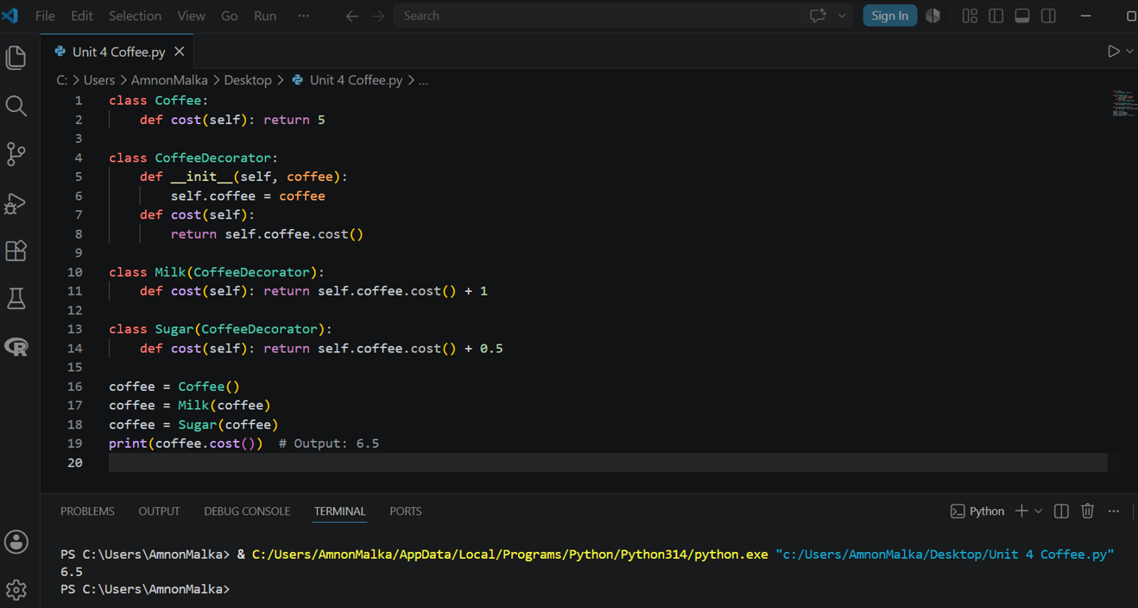
Results:

Slide 8
Explanation :
Base class - Coffee is the existing class being enhanced, with a fixed cost of $5. It’s not being modified directly.
Decorator base - CoffeeDecorator wraps any coffee object and forwards cost() to it.
Dynamic toppings - Milk and Sugar are the concrete decorators. Each one adds its price on top of whatever it wraps, so toppings are applied at runtime, and it is not hardcoded into the class.
Chaining - The three lines below do the dynamic "adding":
python
coffee = Coffee() # plain coffee: $5
coffee = Milk(coffee) # wrap with milk: $5 + $1
coffee = Sugar(coffee)# wrap with sugar: $6 + $0.5
print(coffee.cost()) # → 6.5
Each wrap is a new object layered on the previous one, so no existing class is touched.
One could add more toppings just by creating new decorator subclasses, fully satisfying the open/closed principle.

Slide 9
Seminar Preparation – Done!
Review
Prepare Questions
All structural patterns
Focus on Decorator pattern
When to use Bridge vs Adapter?
When is Decorator better than inheritance?
Environment
Practice OOP
Python or Java installed
Create simple classes
Practice inheritance and composition

Slide 10
Thank you
References
Lott, S. F. & Phillips, D. (2021) Python Object-Oriented Programming: Build robust and maintainable object-oriented Python applications and libraries. Fourth edition. [Online]. Birmingham: Packt Publishing.

