Slide 1
Concurrency & Parallelism
Amnon Malka

Slide 2
Threads
Concurrency and
Parallelism
Processes
Locks
Thread Safety, Synchronization & Python
Safety
Object-Oriented Approaches to Concurrent Programming

Slide 3
Concurrency vs Parallelism
Concurrency
Parallelism
Manages multiple tasks within the same time period
Tasks may not execute at the exact same instant
Suited for I/O-bound work (waiting on network, disk)
Threads share memory space
Executes tasks simultaneously across processor cores
True simultaneous execution on multiple cores
Suited for CPU-intensive (compute-heavy) tasks
Processes use separate memory spaces
VS
(Aslan and Aituov, 2025)
3

Slide 4
Python and the GIL
The GIL (Global Interpreter Lock)
Prevents true thread parallelism in CPython — only one thread executes Python bytecode at a time.
Threads vs Processes
For CPU-bound tasks, use multiprocessing (separate memory spaces, bypass GIL). For I/O-bound tasks, threads work well.
Practical Implication
threading.Thread is effective for web requests and file I/O. multiprocessing.Process suits heavy computation.
OOP Principles Help
Encapsulation exposes shared data only through controlled methods. Abstraction hides synchronization complexity.
(Aslan and Aituov, 2025; McDonald, 2022)

Slide 5
Synchronization Mechanisms
Locks
Enforce mutual exclusion — only one thread accesses a shared resource at a time.
Semaphores
Limit the number of threads that can access a resource concurrently.
Monitors
Combine locking with condition management for coordinated thread access.
Race Conditions
Arise when threads modify shared data simultaneously without synchronization.
Deadlocks
Threads wait indefinitely for each other. Solutions: lock ordering, timeouts, thread-safe data structures.
(McDonald, 2022)

Slide 6
Thread-Safe BankAccount
```python
import threading
class BankAccount:
def __init__(self):
self.balance = 0
self.lock = threading.Lock()
def deposit(self, amount):
with self.lock:
self.balance += amount
def withdraw(self, amount):
with self.lock:
if self.balance >= amount:
self.balance -= amount
account = BankAccount()
t1 = threading.Thread(target=account.deposit, args=(100,))
t2 = threading.Thread(target=account.withdraw, args=(50,))
t1.start(); t2.start()
t1.join(); t2.join()
print(account.balance)
```
Key Concepts
Encapsulation
balance is private; accessed only via deposit/withdraw
Mutual Exclusion
with self.lock ensures one thread at a time
Thread Safety
No race conditions on balance modifications
Context Manager
lock auto-releases even if exception occurs

Slide 7
Explanation:
This Python code deals with thread-safe banking operations employing the threading module.
While the BankAccount class holds the balance and uses a Lock object to control race conditions, when multiple threads access the same data.
The deposit() and withdraw() methods safely modify the balance within with self.lock blocks. Two threads are created: one deposits 100, while the other withdraws 50. After both threads finish, execution using join(), the final account balance is printed as 50

Slide 8
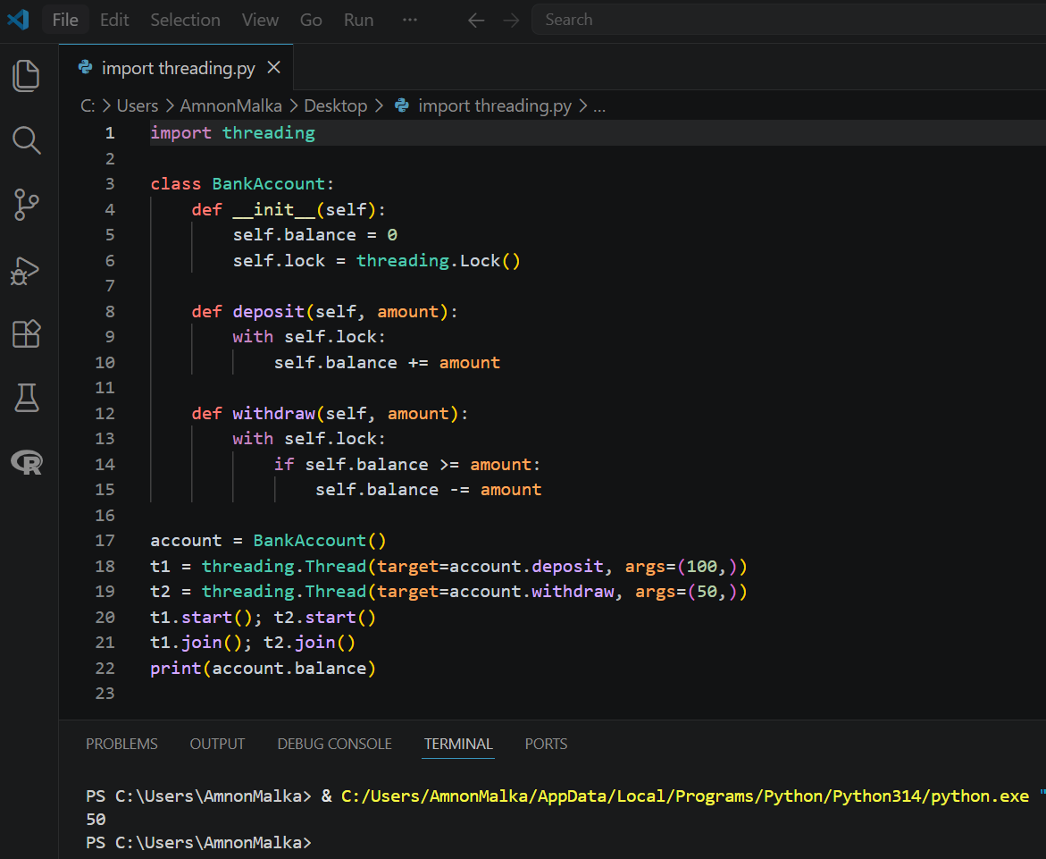

Slide 9
References
McDonald, J. C. (2022) Dead Simple Python: Idiomatic Python for the Impatient Programmer. 1st edition. New York: No Starch Press. Available at: https://essex.primo.exlibrisgroup.com/permalink/44UOES_INST/s7iv0e/cdi_proquest_ebookcentral_EBC7129684 [Accessed: 21 May 2026].
Aslan, Z. and Aituov, A., (2025). EVALUATION OF CUNCURRENCY METHODS IN PYTHON FOR PROCESSOR-INTENSIVE TASKS ON MULTICORE SYSTEMS. Research Reviews, (9). Available at: https://ojs.scipub.de/index.php/RR/article/view/5936 [Accessed: 21 May 2026].

Slide 10
Use of Digital Tools
This document has been produced exclusively for educational purposes. Referenced content, copyrights, and trademarks, remain the sole property of the respective owner.
ChatGPT 5.5 was used for some proofreading and clarity as well as literature exploration, language refinement, coding and programming techniques research.
All academic writing, analysis, argumentation, and conclusions represent the original work of the author. AI tools were used for exploration, same way as academic literature exploration.
Any use of content mentioned in this document is properly referenced to its original author and was used responsibly to ensure integrity and originality. I have used Artificial Intelligence responsibly and ethically, in accordance with the assignment brief.

