Slide 1

MAVERICKS SOCIETY
PRESENTS
RESUME BUILDING
WORKSHOP

Slide 2
RESUME
Look ahead to your future…
Create a tool to market yourself.

Slide 3
WHAT IS A RESUME?
It’s a well organized report of ones accomplishments
It’s like a movie trailer… if it catches your interest, you want to see the movie.
The same holds true for your audience – if your resume peaks their interest, they will want to learn more about you.

Slide 4
WHY DO WE NEED A RESUME?
Scholarship Exam
Internships
Recruitments
Government Jobs
Interviews

Slide 5
WHAT DOES YOUR RESUME SAY ABOUT YOU?
Name, address, phone
Objective
Education
Work Experience
Skills
Extracurricular Activities
Honors and Awards
References

Slide 6
Elements of a Resume
Objective
A targeted statement that clearly states the type of job you are seeking.
Good objectives are very specific— “To work with the design and development of new computer systems with a special interest in microprocessor application.” “Position in public opinion polling or consumer product market research using skills in survey design and statistical analysis.”

Slide 7
Skills
A summary of relevant skills, knowledge and accomplishments.
Be specific. Tailor this section to the job to which you’re applying.
If it is well written, this section can really help a potential employer to focus on your strengths.
Think carefully about what you have to offer.

Slide 8
Educational Qualification
Include degrees, expected date of completion if you have not finished, relevant coursework, and honors and awards (placed under the appropriate degree)
You might also consider placing your “Experience” section first.

Slide 9
Experience
Think in terms of experience, not employment or work history.
Be sure to include internships and unpaid positions if they are relevant.
Be concise in your descriptions of what you did.
Do not use “Responsibilities included” or “Duties were.”
Translate specialised skills and interests into everyday language.

Slide 10
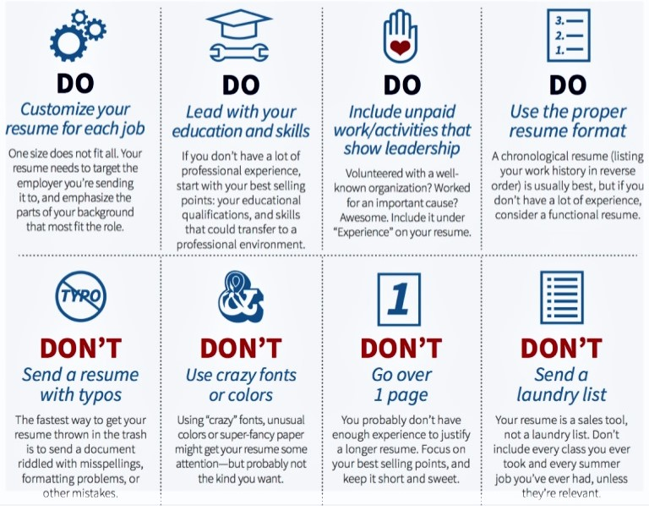
DO’S And DON’T

Slide 11
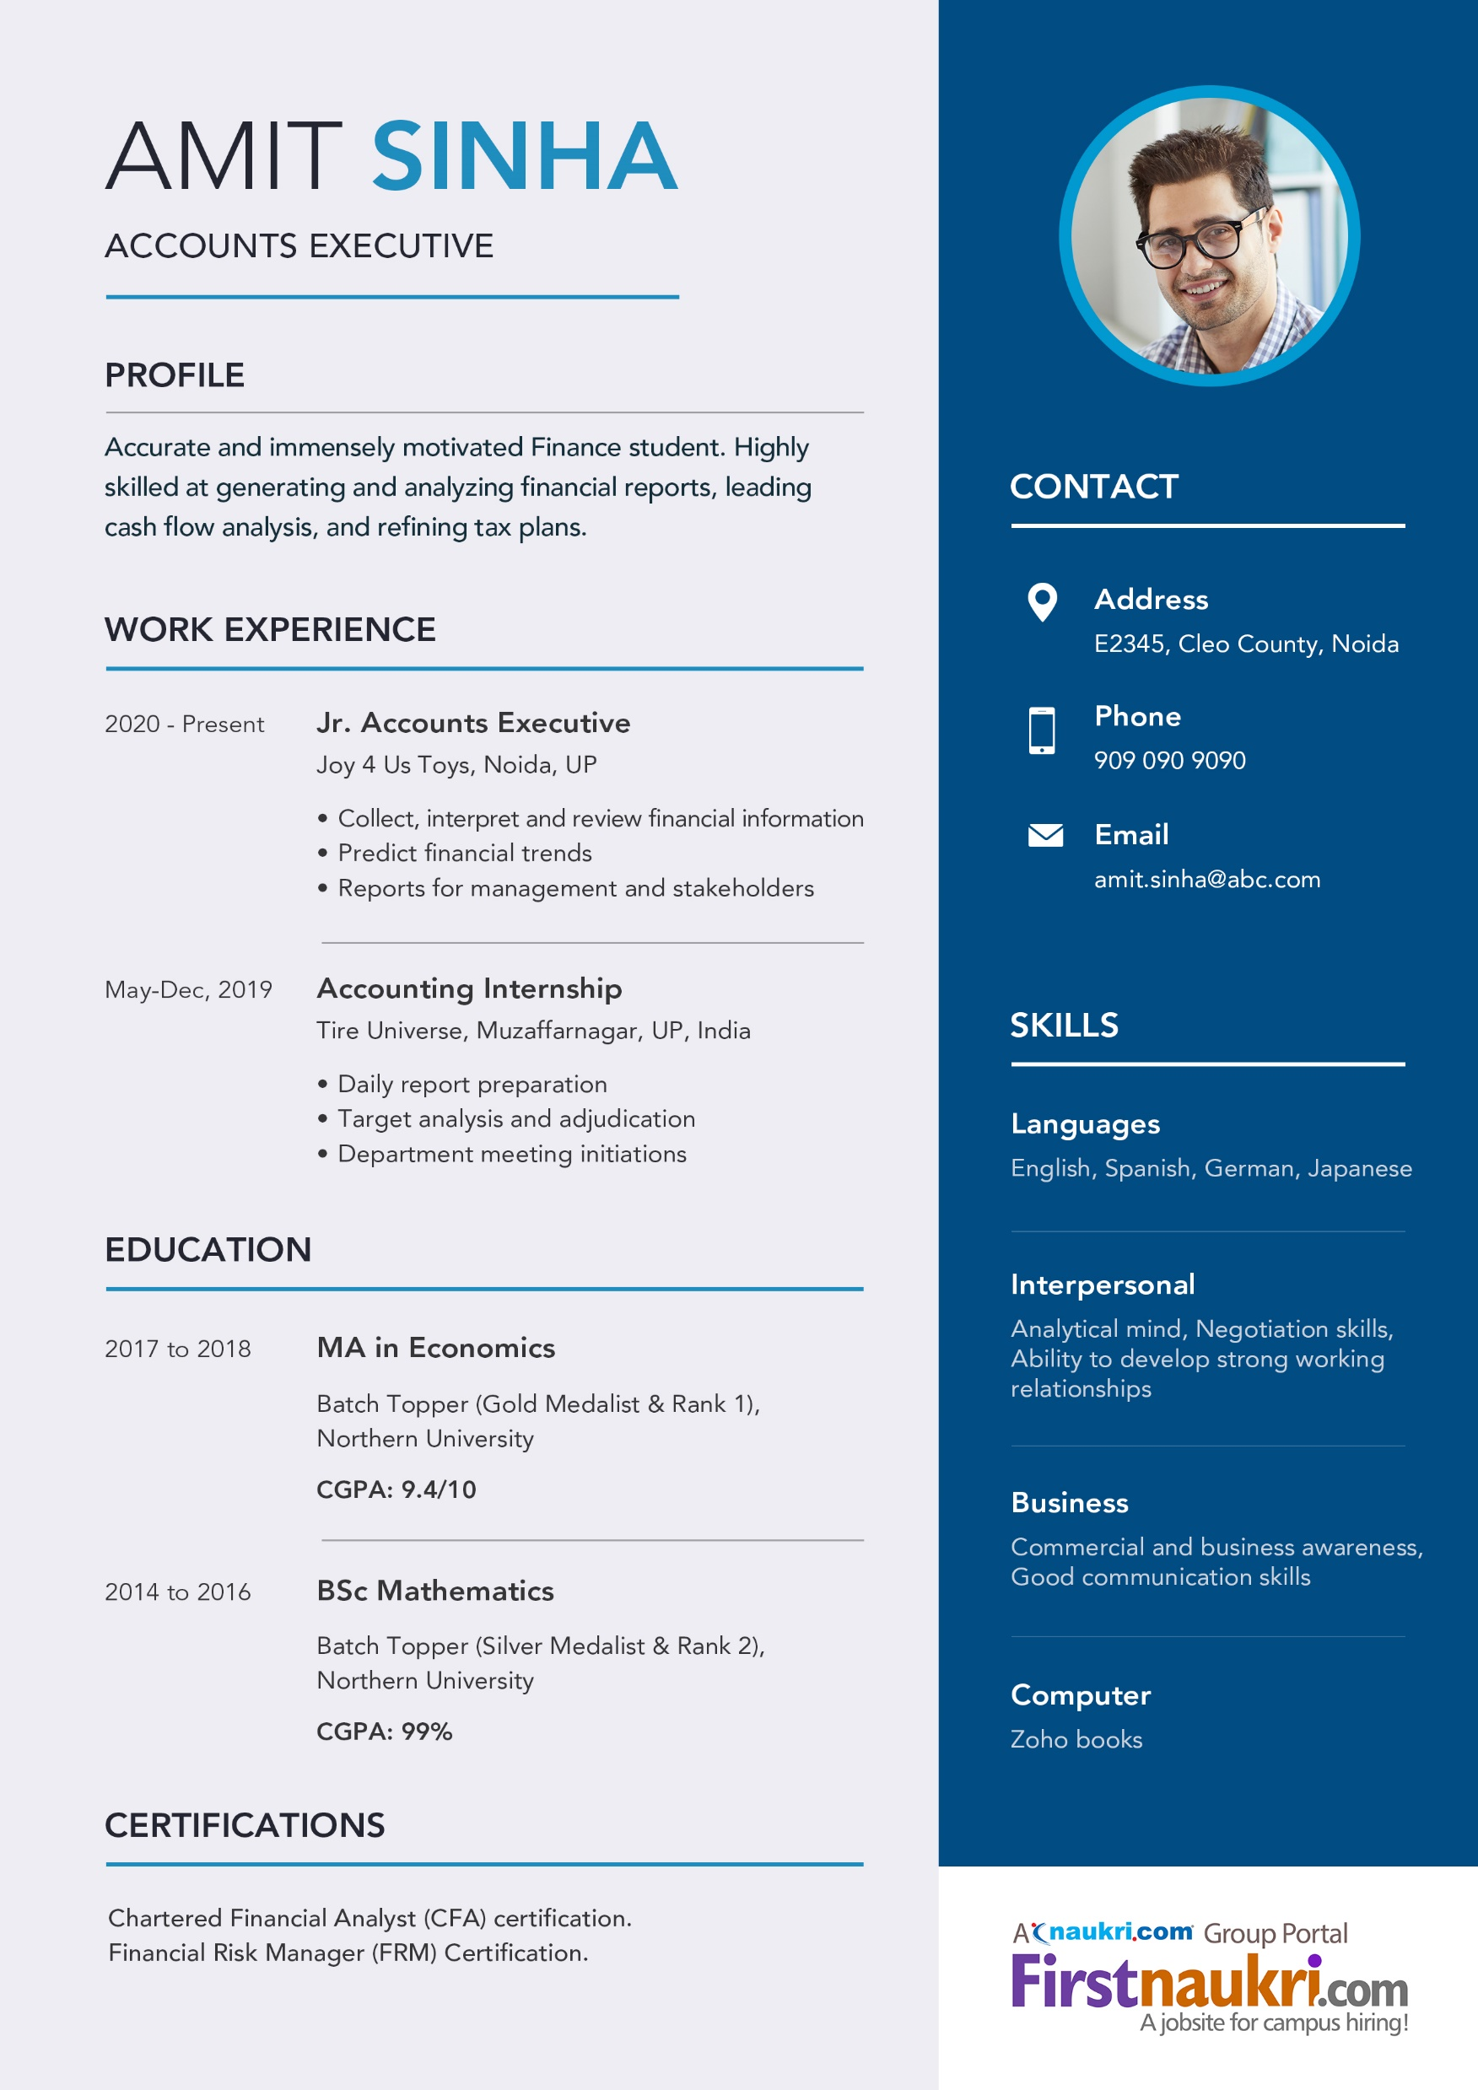

Slide 12
THANK YOU

