Slide 1

Exploring Information-Theoretic Structure in AGN Reverberation Mapping
Traditional cross-correlation methods simplify complex AGN variability to pairwise relationships.
•
Information Decomposition (SURD) offers a richer framework, distinguishing unique, redundant, and synergistic information flow.
•
Aims to provide model-independent insights into multi-band AGN light curve interactions.
•

Slide 2
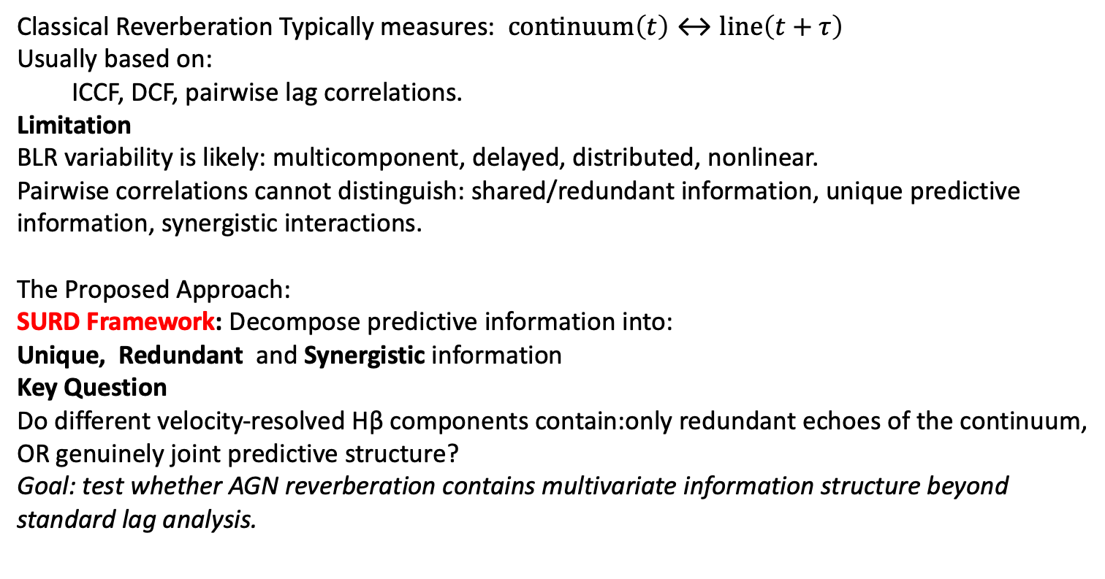
The problem and the approach:
From Pairwise Correlations to Multivariate Information Flow
Classical Reverberation Typically measures: $continuum\left(t\right)↔line\left(t+τ\right)$
Usually based on:
ICCF, DCF, pairwise lag correlations.
Limitation
BLR variability is likely: multicomponent, delayed, distributed, nonlinear.
Pairwise correlations cannot distinguish: shared/redundant information, unique predictive information, synergistic interactions.
The Proposed Approach:
SURD Framework: Decompose predictive information into:
Unique, Redundant and Synergistic information
Key Question
Do different velocity-resolved Hβ components contain:only redundant echoes of the continuum, OR genuinely joint predictive structure?
Goal: test whether AGN reverberation contains multivariate information structure beyond standard lag analysis.

Slide 3
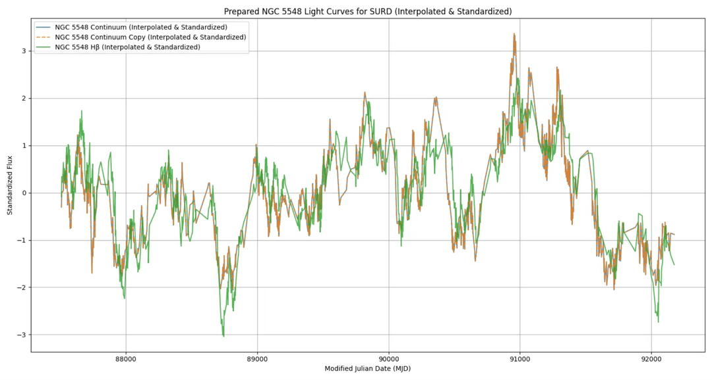
NGC 5548: Data Preparation for SURD
Utilizing NGC 5548 AGN Watch data for continuum and integrated Hβ.
Irregularly sampled light curves were re-sampled onto a uniform grid.
Signals standardized (z-scored) for information-theoretic analysis.

Slide 4
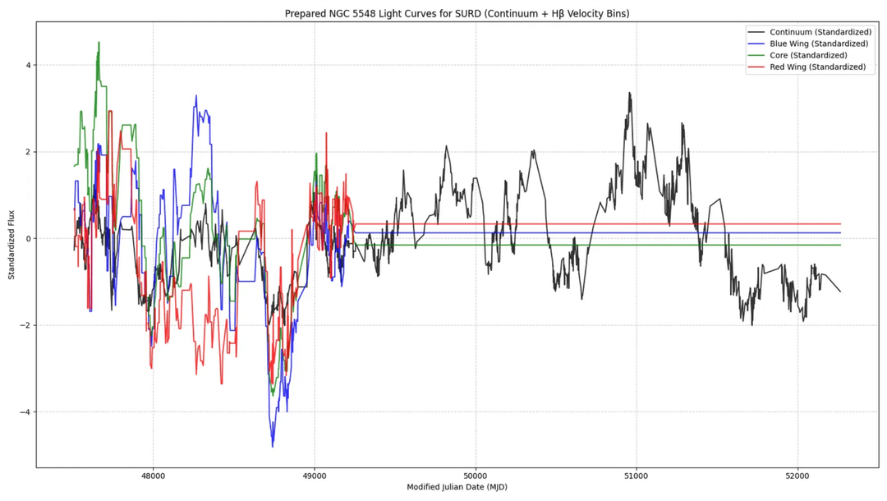
Velocity-Resolved Hβ: Blue, Core, and Red Wings
Hβ spectral profiles processed to create velocity-resolved light curves (blue, core, red wings).
•
Matched to a consistent continuum light curve (c5100.dat) based on MJD range.
•
All four signals (continuum, blue, core, red Hβ) resampled and standardized for SURD.
•

Slide 5

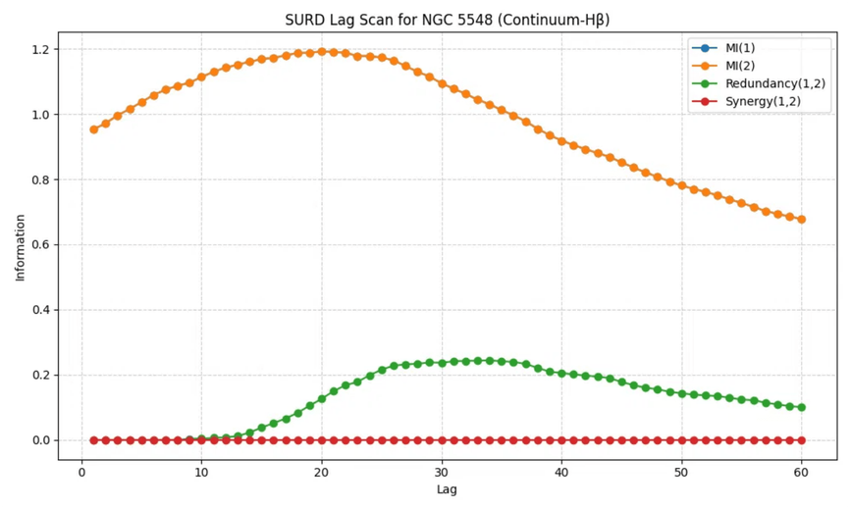
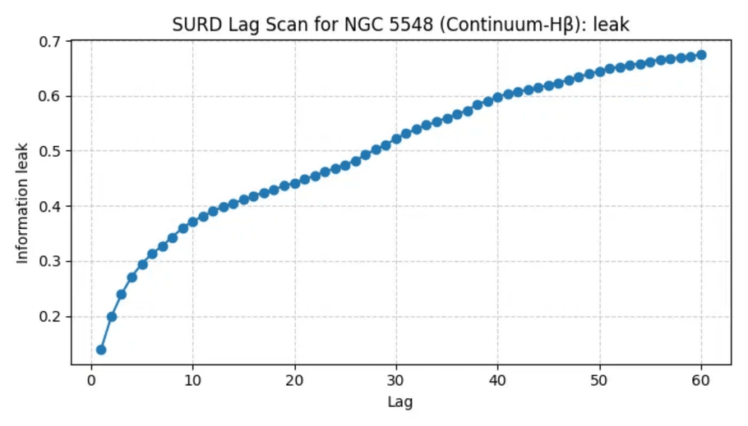
FIRST LOOK: SURD ON NGC 5548 (CONTINUUM-HΒ)
Initial SURD analysis performed on continuum (driver) and integrated Hβ (target) to map information flow.
Observed distinct patterns in Mutual Information, Redundancy, and Synergy across various time lags.
The Information Leak profile provides critical insights into unexplained variance and potential missing drivers.
Fig 4.1: Information Decomposition (MI, Redundancy, Synergy)
Fig 4.2: Information Leak Profile

Slide 6

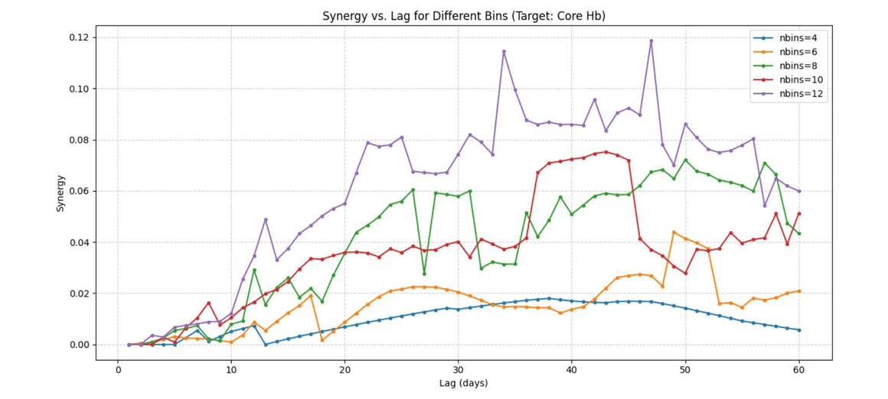
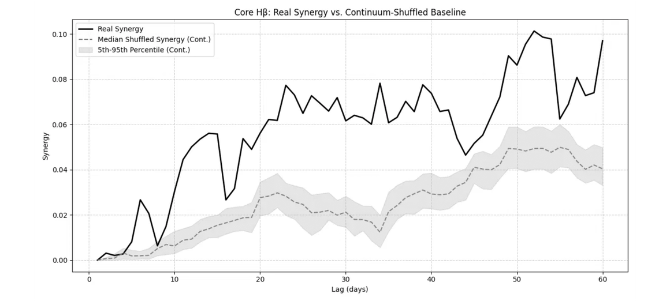
VALIDATING SURD RESULTS: ROBUSTNESS UNDER INVESTIGATION
Test A: Histogram Bin Sensitivity
Synergy and leak curves show qualitative consistency across nbins (4-
12), suggesting robustness to discretization.
Test B: Cadence Sensitivity
Core findings appear preserved with varying interpolation cadences
(1, 2, 5 days), indicating preliminary stability.
Test C: Shuffle/Surrogate Tests
Real synergy values for Hβ components are suggestively higher than
shuffled baselines, hinting at genuine temporal structure
Fig 1: Synergy vs. Lag for Different Bins (Target: Core Hb)
dependence.
Fig 2: Real Synergy vs. Continuum-Shuffled Baseline

Slide 7

Future Directions: Deeper Insights and Cross-Validation
Lag Range Extension: Revealed longer synergy peaks for Core Hβ (111d) and Red Wing Hβ (93d).
Target Name
Old Peak (d)
New Peak (d)
Old Synergy
New Synergy
Core Hβ
52
111
0.101
0.148
Revised Interpretation: Physical modeling needs to reflect these longer temporal scales.
Red Wing Hβ
59
93
0.121
0.147
ICCF Comparison: Benchmarking SURD synergy lags against classical cross-correlation peaks.
Blue Wing Hβ
43
nan
0.113
0.113
Further Null Tests: Implementing Fourier phase-randomized surrogates for significance.
* This is a progress update; conclusions are preliminary and subject to ongoing validation.

Slide 8
Extend lag scans and test edge effects
Use circular-shift/block-shuffle/Fourier surrogates
Compare with ICCF/DCF classical lags
Add confidence intervals
Then interpret blue/core/red differences

