Slide 1

Introduction to Cloud Computing
Amy, Kieron, Sacha, Michael, Viktor

Slide 2
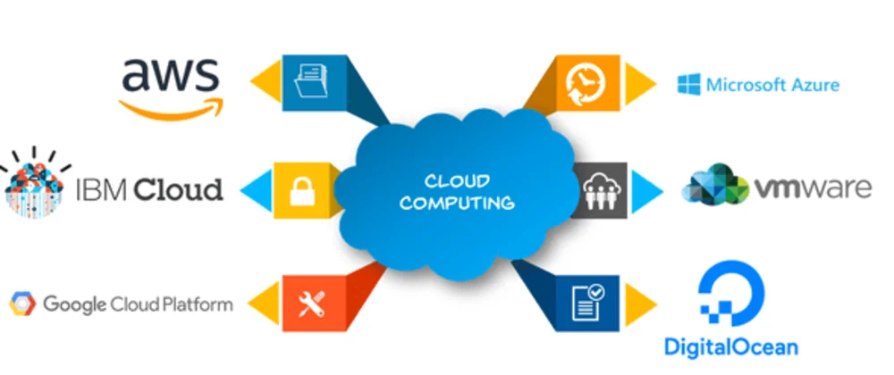
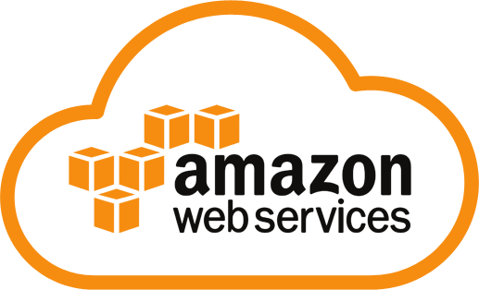
What is Cloud Computing & AWS?
Cloud computing:
Delivery of computing services over the internet
On-demand
AWS:
Most popular cloud computing service in the world
Pay-as-you-go

Slide 3

Pros and Cons of Cloud Computing
PROS
Cost
Adaptable to change
Ease of use
Accessibility
Insight
CONS
Security and privacy
Downtime
Limited control

Slide 4
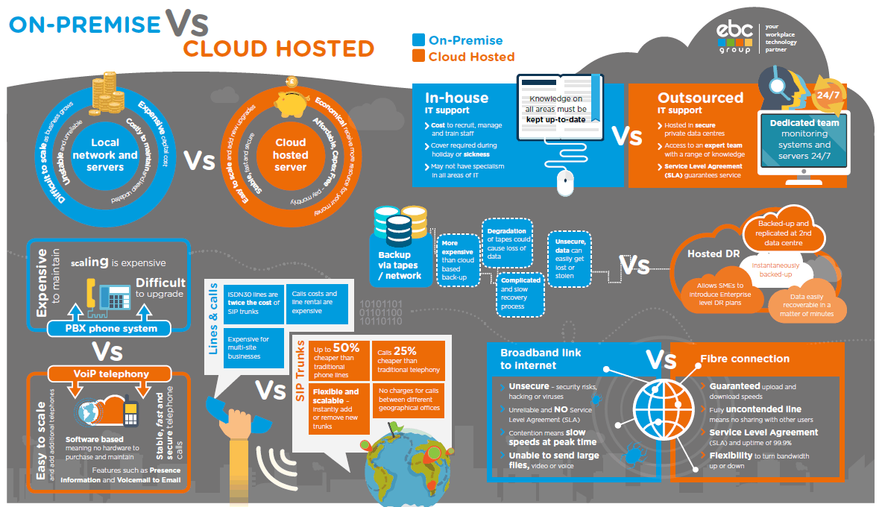
On-Premise vs Public Cloud
For On-Premise
A business will need to invest capital upfront to purchase and replace equipment, land and personnel to have the server running. If on premise goes down, you potentially lose all data which isn't backed up
For Cloud Hosted
A simple subscription fee and resources that are used fee is which is paid to the cloud provider. On cloud data is easily available wherever you are located or any device you are on

Slide 5
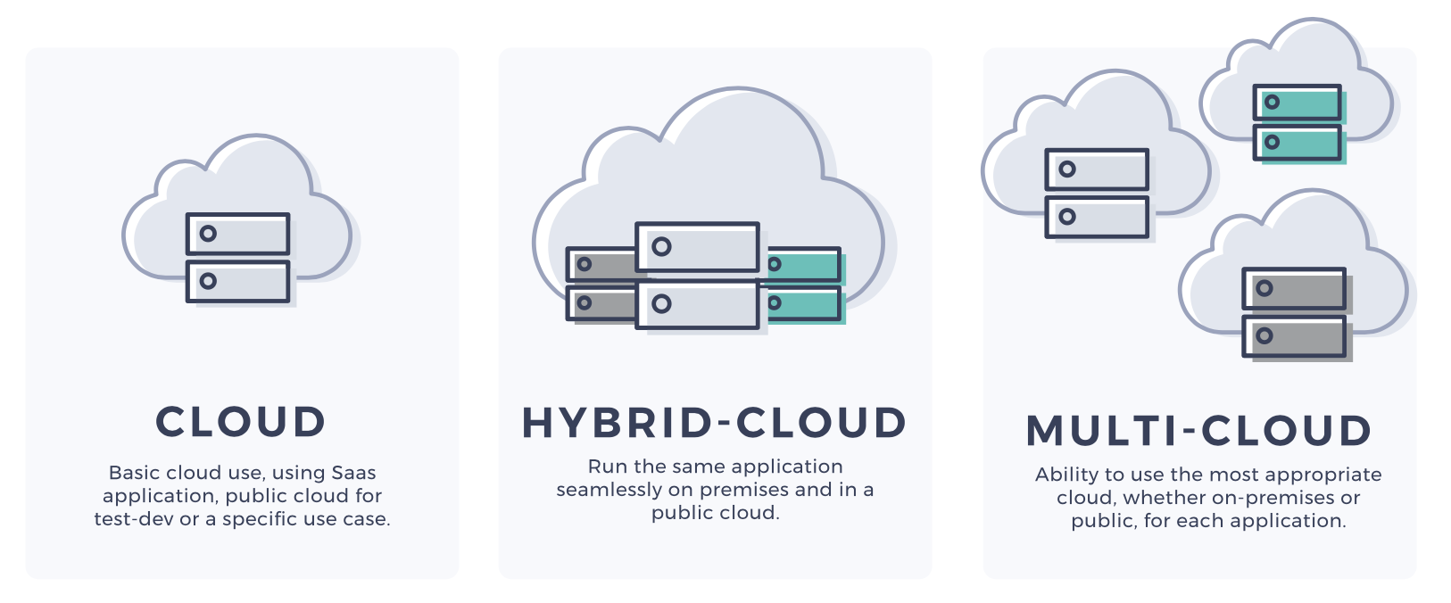
Hybrid-Cloud and Multi-Cloud
Hybrid-Cloud
An IT infrastructure design and environment made up of a mix of on-premises data centres, private clouds and/or public clouds
Use case:
Banks
Multi-Cloud
A company that uses a multi-cloud deployment incorporates multiple public clouds from more than one cloud provider. Instead of a business using one vendor for cloud hosting, storage etc.. in a multi-cloud configuration, they use several.

Slide 6
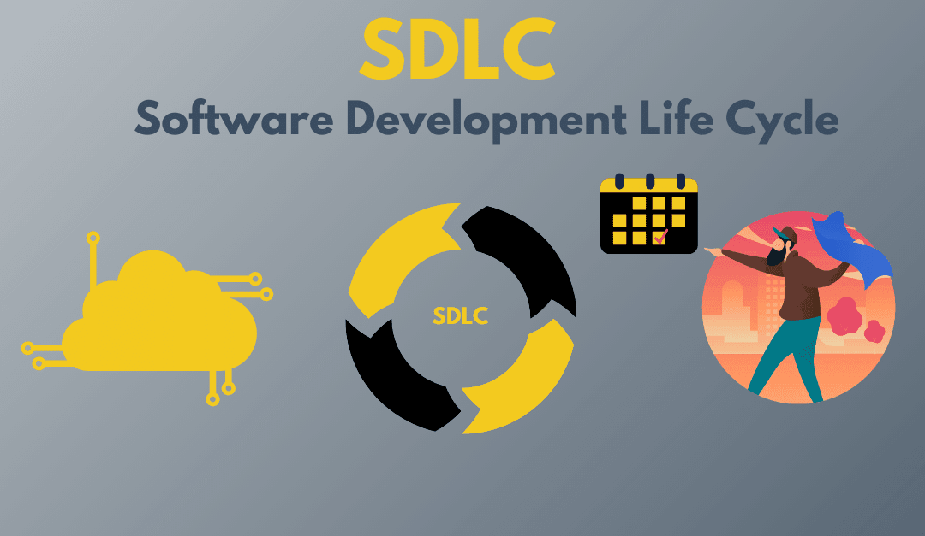
What is SDLC?
Systematic approach
Cost-efficient & high-quality
Least issues possible
Customer satisfaction

Slide 7
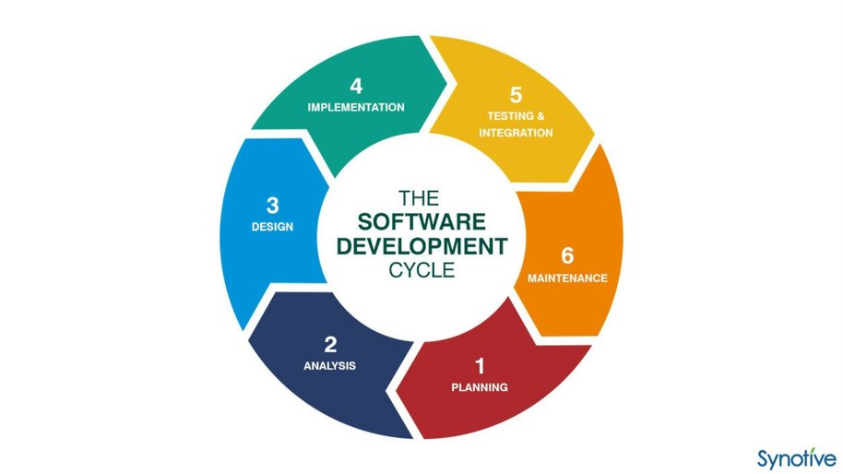
SDLC stages and their risk levels

Slide 8
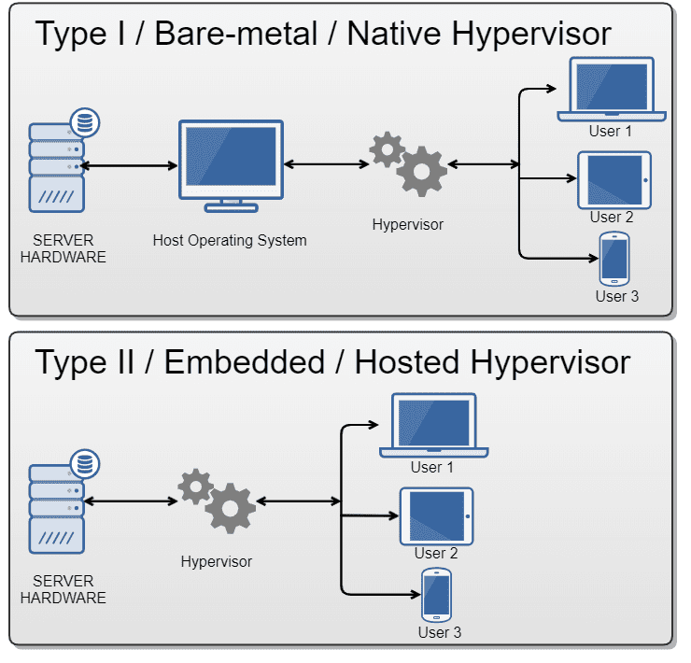
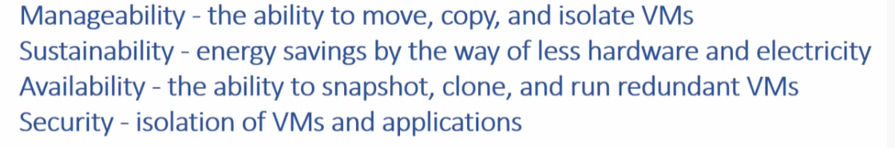
What is Virtualization
- The process of running multiple virtual environments on one infrastructure -
Uses a Hypervisor in order to creates and run virtual machine.
Hypervisors are often divided between Type 1 and Type 2 hypervisors.
Benefits:

Slide 9


Development Environment
Workspace for making changes to software without breaking the live version
Benefits:
Can make changes & fix errors without affecting end users
Can test all features in a safe environment

Slide 10
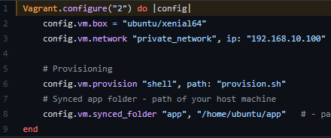
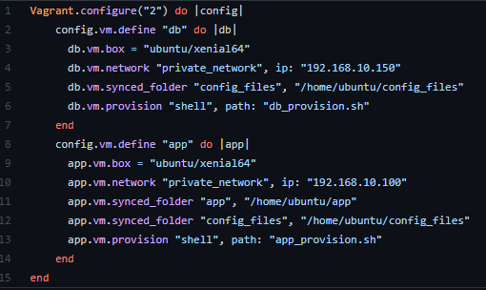
Multi-Server Environment

Slide 11
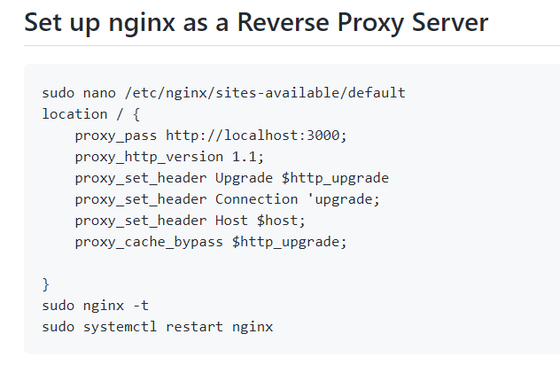
What is NGINX?
NGINX
Is commonly used as a reverse proxy and load balancer to manage incoming traffic and distribute it to slower upstream servers – anything from legacy database servers to microservices.
Use Case – Reverse Proxy
To pass a request to an HTTP proxied server, the proxy pass directive is specified inside a location.
If the URI is specified along with the address, it replaces the part of the request URI that matches the location parameter in our case its / which means the homepage of the address given

Slide 12
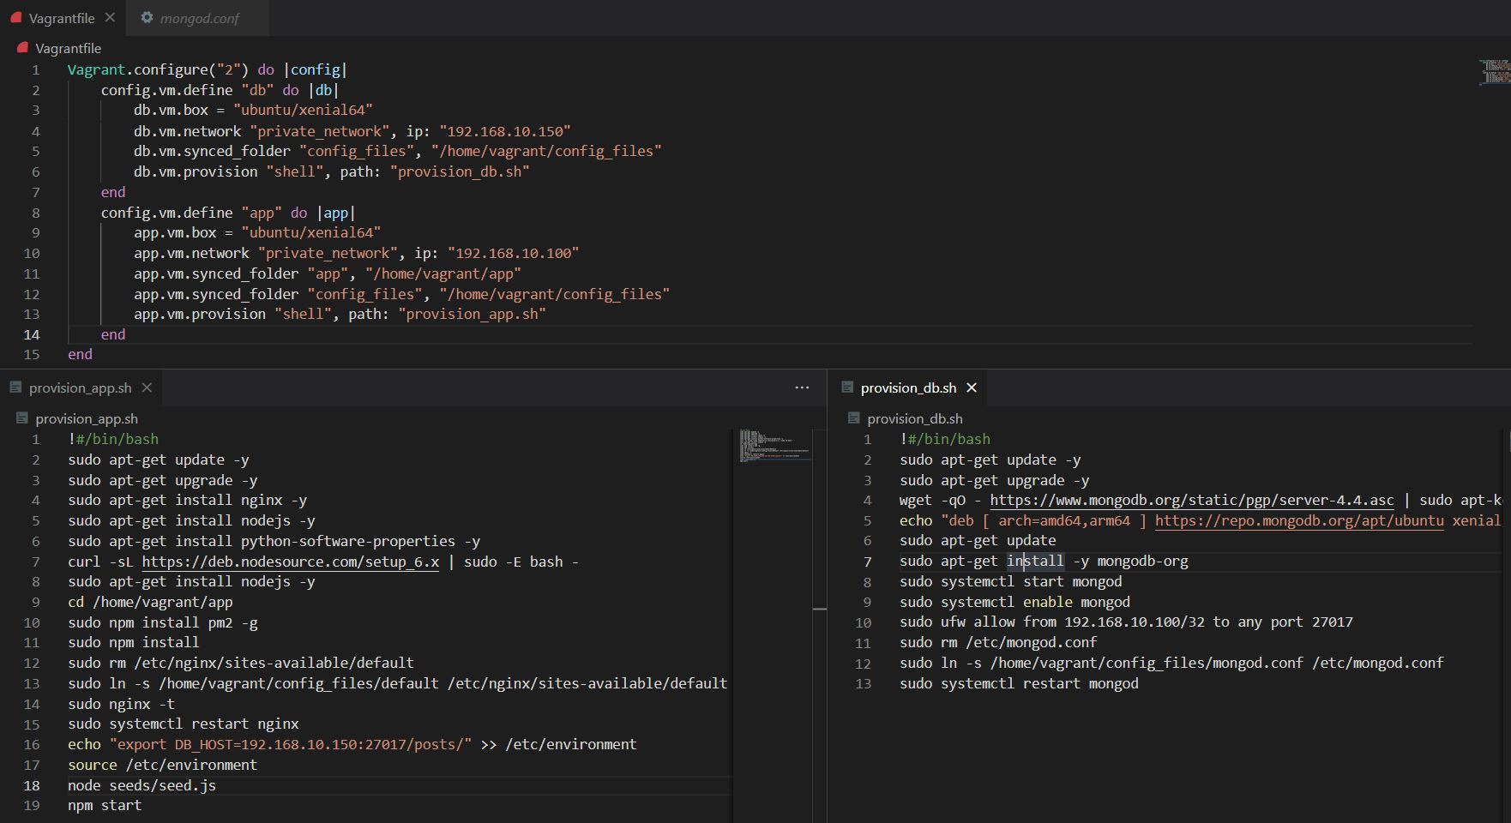
Final Provisioning and Vagrant Files

Slide 13

Live Demonstration

