Slide 1

MENTAL STATUS • NEUROLOGY • REHABILITATION
PRESENTED BY
Cognitive Functions
Choudhary Divya
Group 4009
and Orientation
From awareness of self and surroundings to body awareness and movement control
P · Person
COGNITIVE FUNCTIONS
Mental processes used for thinking, understanding, learning,
remembering, attending, and interpreting information.
Attention
Memory
Perception
Language
Reasoning
Executive functions
Orientation
S · Situation
L · Place
CENTRAL QUESTION
How does a person know who they are, where they
are, when it is, and what is happening?
T · Time
Orientation is a cognitive / mental-status function
ORIENTATION
Mental-state awareness of person, place, time and situation
Sources: APA, DSM-5-TR (2022; APA updates 2025); Campbell & Barohn, DeJong’s The Neurologic Examination, 8e (2020).
Cognitive functions • orientation • body awareness • motor control
Presented by Choudhary Divya · Group 4009
Undergraduate psychiatry / psychology / nursing / allied health
1

Slide 2
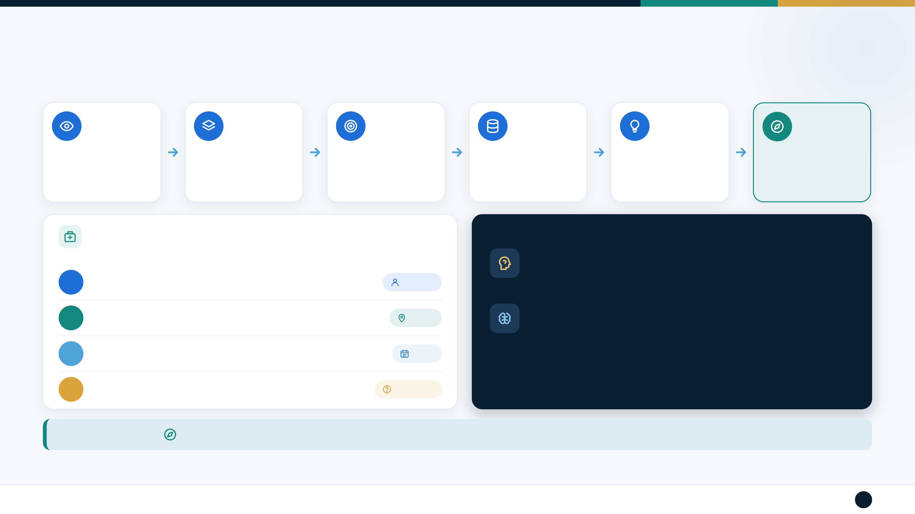
How Does a Person Know Where They Are and What Is Happening?
Awareness emerges from integrated information processing — not a single brain function.
01
02
03
04
05
06
SENSORY INPUT
PERCEPTION
ATTENTION
MEMORY
THINKING
AWARENESS /
Eyes • ears • body
What the input means
Select what matters now
Use stored information
Interpret + reason
ORIENTATION
sensation
Choose an appropriate
response
CLINICAL EXAMPLE — NEW PATIENT ON THE WARD
PSYCHIATRY + NEUROLOGY
Ask:
Psychiatry
Who are you?
Disorientation can occur in delirium and some severe cognitive disorders.
Q1
Person
It is not a feature of every psychiatric condition.
Q2
Where are you?
Place
Neurology
Disorders affecting attention, memory, sensory processing or body-
position pathways can alter awareness or performance.
Q3
What day is it?
Time
Q4
Why are you here?
Situation
Orientation is the brain’s integrated awareness of self + surroundings — not simply “knowing facts”.
Sources: APA, DSM-5-TR (2022; 2025 update); Campbell & Barohn, 8e (2020).
Cognitive functions • orientation • body awareness • motor control
Presented by Choudhary Divya · Group 4009
Undergraduate psychiatry / psychology / nursing / allied health
2

Slide 3

How Do We Assess Orientation?
Bedside mental-status assessment uses conversation, observation and clinical context.
01
02
03
04
PERSON
PLACE
TIME
SITUATION
Name?
Where are you?
Day? Month? Year?
Why are you here?
Who are you?
Which hospital / clinic /
Time or part of day?
What is happening right
Who are the people around
home?
now?
you?
Which city?
Interpret responses in context: consider age, education, language, culture, sensory limitations and the current clinical condition.
Age
Education
Language
Culture
Sensory limitations
Current clinical condition
Orientation questions are part of the mental status examination; they should not be interpreted in isolation.
Sources: APA, DSM-5-TR (2022; 2025 update); Campbell & Barohn, 8e (2020).
Cognitive functions • orientation • body awareness • motor control
Presented by Choudhary Divya · Group 4009
Undergraduate psychiatry / psychology / nursing / allied health
3

Slide 4
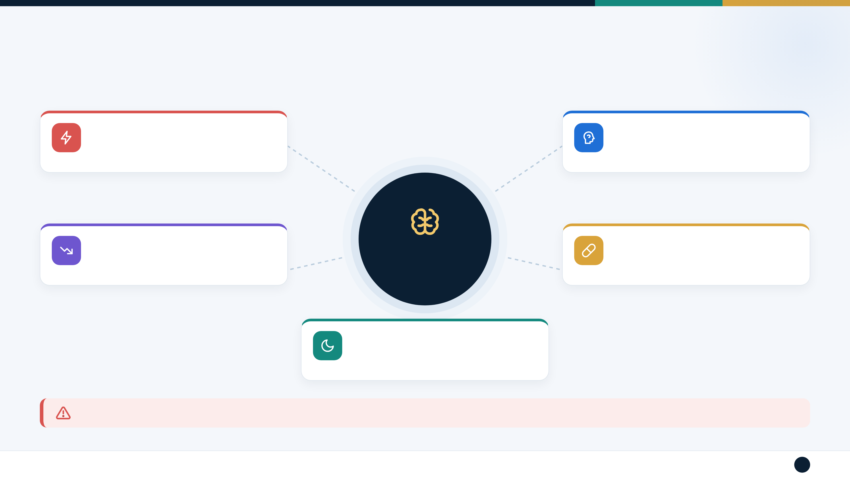
Why Can Orientation Become Impaired?
Many acute, chronic, neurologic, psychiatric and medication-related factors can contribute.
ACUTE / RAPID
PSYCHIATRIC / OTHER
Delirium • acute illness
Severe states may disrupt attention, thought
Drug / toxin effects • metabolic disturbance
organization or interpretation
CHRONIC / PROGRESSIVE
MEDICATION / SUBSTANCE
Major neurocognitive disorders
IMPAIRED
Sedatives, anticholinergic burden and other
Certain neurologic diseases • brain injury
ORIENTATION
medication or substance effects
PHYSIOLOGICAL STRESSORS
Severe sleep loss, dehydration or other
systemic stressors
KEY CLINICAL POINT • Sudden new confusion or disorientation needs assessment for an underlying medical or neurologic cause.
Sources: APA, DSM-5-TR (2022; 2025 update); Campbell & Barohn, 8e (2020).
Cognitive functions • orientation • body awareness • motor control
Presented by Choudhary Divya · Group 4009
Undergraduate psychiatry / psychology / nursing / allied health
4

Slide 5
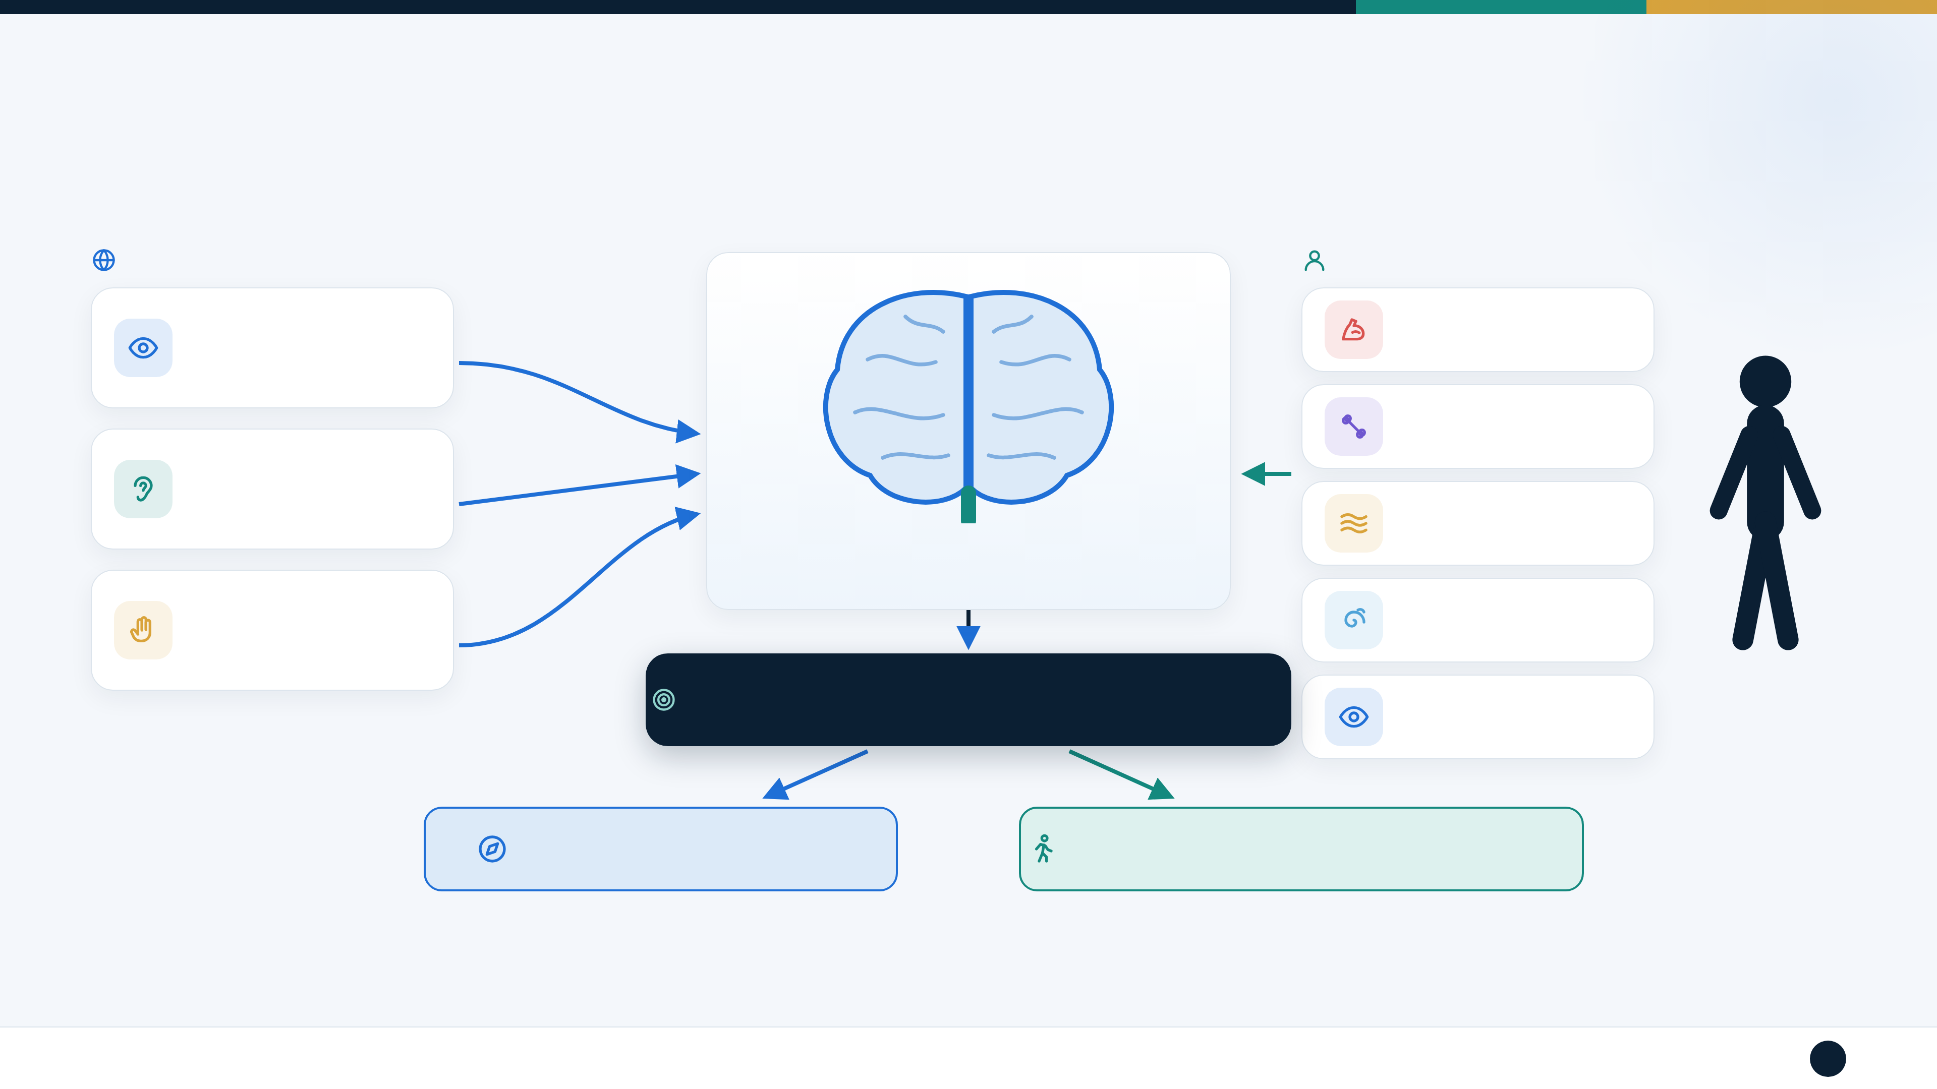
How the Brain Builds Awareness of Self and Environment
A visual model: environmental information and body information are combined by the nervous system.
ENVIRONMENT
BODY INFORMATION
VISION
MUSCLES
JOINTS / TENDONS
HEARING
SKIN
BRAIN INTEGRATION
VESTIBULAR
TOUCH
SYSTEM
ATTENTION + MEMORY + PERCEPTION + THINKING
VISION
ORIENTATION / AWARENESS
BODY AWARENESS + MOVEMENT CONTROL
The brain continuously combines information from the environment and the body to guide behaviour.
Sources: Campbell & Barohn, 8e (2020); Gilman, J Neurol Neurosurg Psychiatry (2002), joint position sense review.
Cognitive functions • orientation • body awareness • motor control
Presented by Choudhary Divya · Group 4009
Undergraduate psychiatry / psychology / nursing / allied health
5

Slide 6
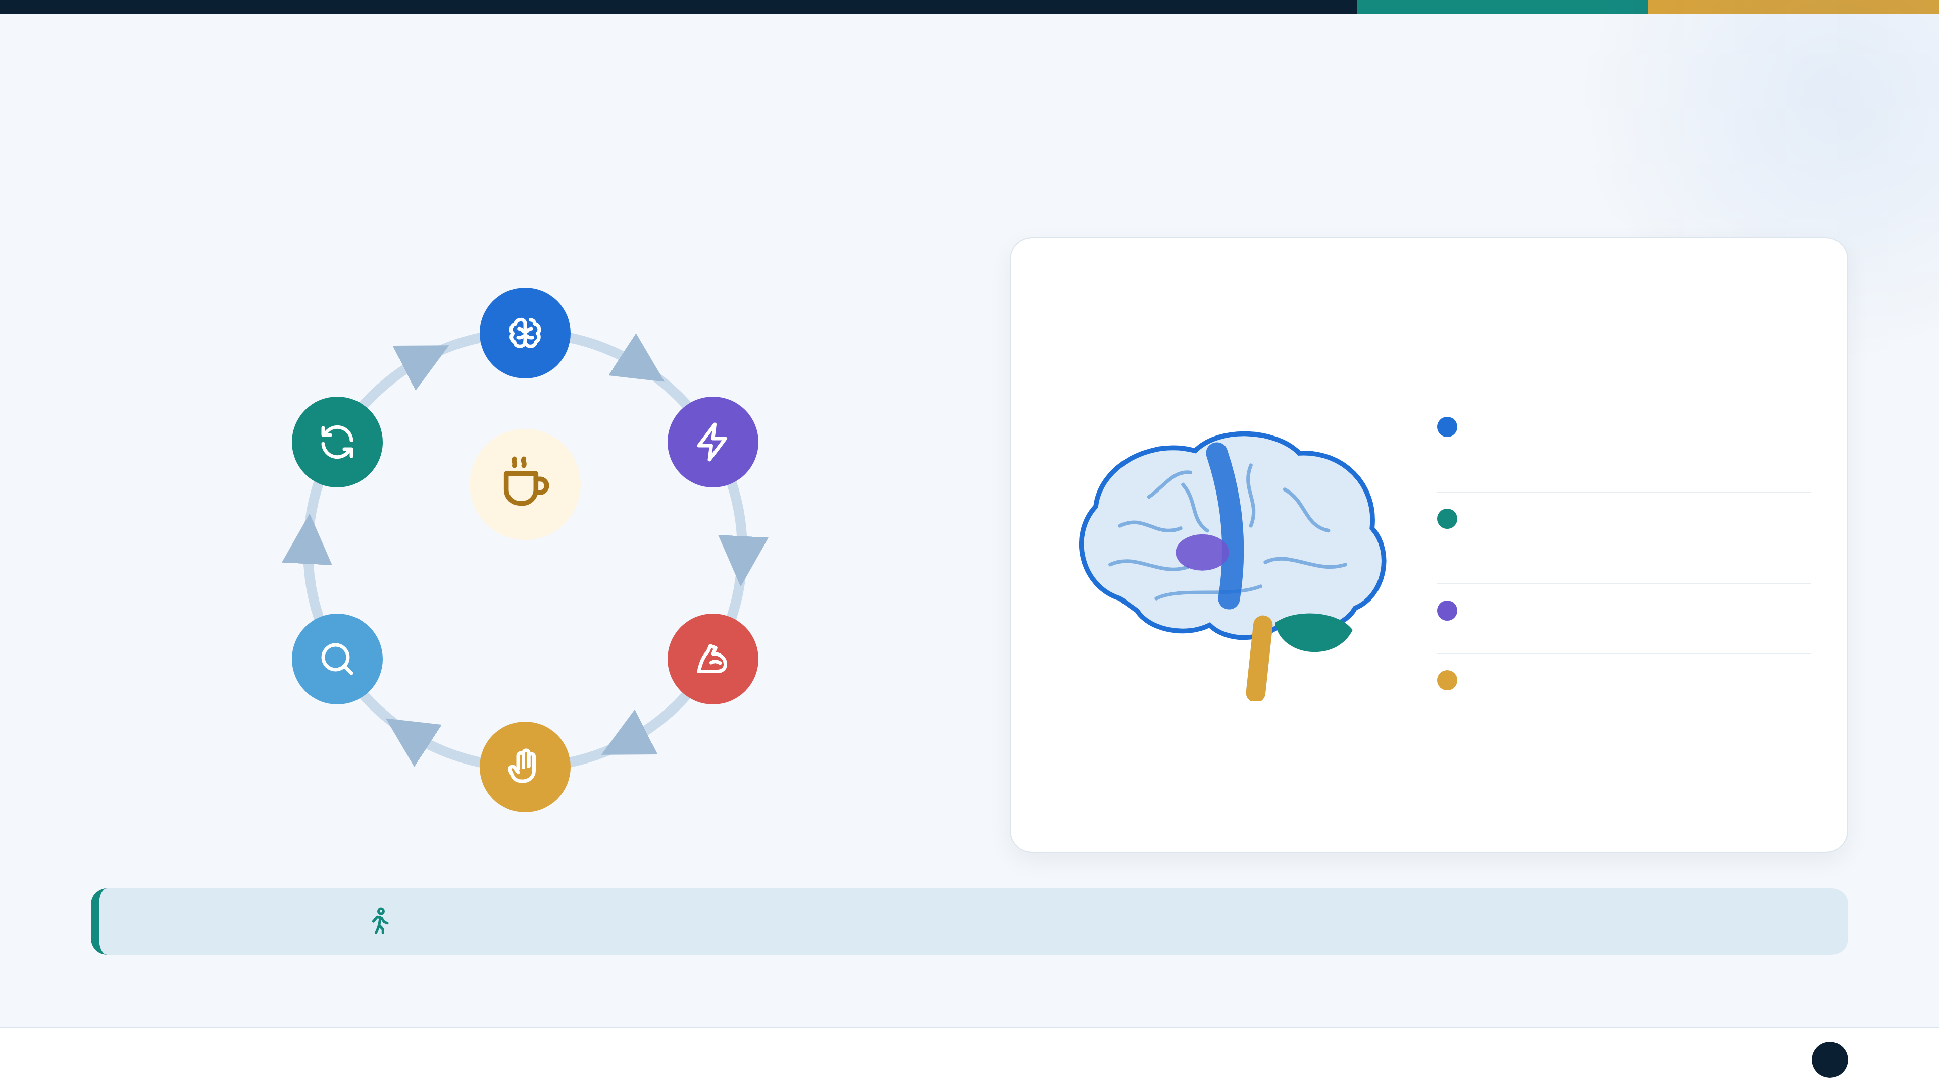
What Is the Role of Motor Control?
Motor control plans, initiates, coordinates and adjusts movement using sensory feedback.
1. BRAIN PLANS
MOVEMENT
MAJOR CONTRIBUTORS
6. CORRECT IF
2. MOTOR COMMAND
Motor cortex
NECESSARY
Voluntary movement planning +
execution
Cerebellum
Reach for a cup
Coordination • timing • error correction •
balance
predict → move →
Basal ganglia
5. BRAIN CHECKS
sense → adjust
3. MUSCLES / JOINTS
Movement initiation + regulation
THE RESULT
MOVE
Spinal cord + peripheral nerves
Carry motor and sensory signals
4. SENSORY
FEEDBACK
Motor control is more than muscle strength; it depends on sensory information and coordination.
Sources: Campbell & Barohn, DeJong’s The Neurologic Examination, 8e (2020).
Cognitive functions • orientation • body awareness • motor control
Presented by Choudhary Divya · Group 4009
Undergraduate psychiatry / psychology / nursing / allied health
6

Slide 7

Body Awareness and Proprioception
Question: How can you know where a limb is even when you cannot see it?
CLASSROOM DEMONSTRATION
KEEP THE TERMS DISTINCT
Proprioception
MUSCLES
Awareness of body position / movement
VISION
TENDONS
Kinesthesia
Awareness specifically of movement
PROPRIOCEPTION
1
Eyes closed
Sense of body position and
Body schema / awareness
movement.
2
Raise an arm
Internal representation and awareness of
the body
3
Touch your nose
VESTIBULAR
JOINTS
4
Identify limb position without looking
SKIN
Proprioception
supplies body-position information
Motor control
uses sensory feedback to guide
Orientation
concerns person, place, time and situation
movement
Sources: Gilman, 2002 (joint position sense); Campbell & Barohn, 8e (2020).
Cognitive functions • orientation • body awareness • motor control
Presented by Choudhary Divya · Group 4009
Undergraduate psychiatry / psychology / nursing / allied health
7

Slide 8
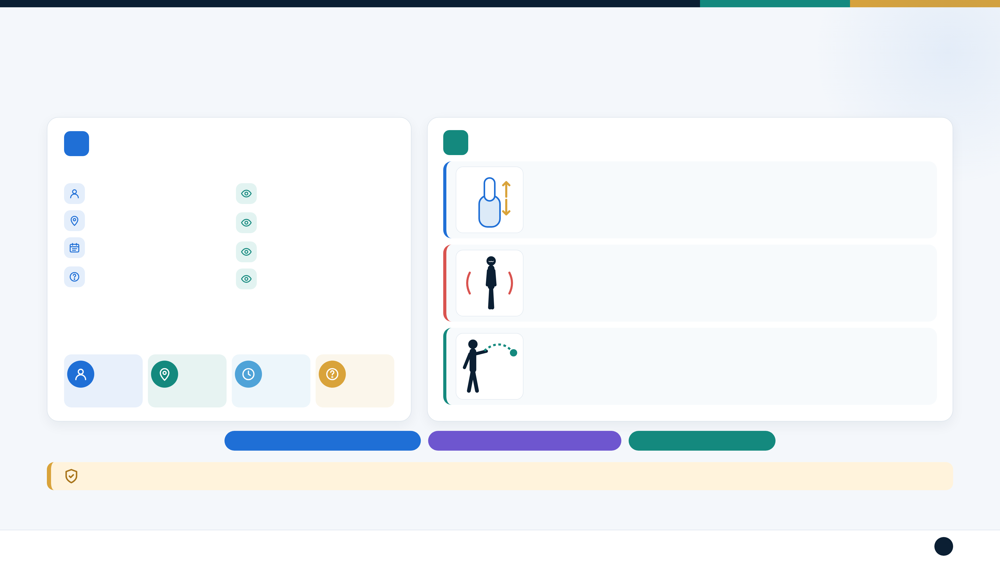
Clinical Tests and Assessment Methods
Separate the cognitive/mental-status questions from sensory and coordination tests.
A
ORIENTATION ASSESSMENT
B
BODY POSITION / PROPRIOCEPTION / COORDINATION
Ask
Observe
Name
Attention
JOINT POSITION SENSE
Understanding of
Eyes closed → move finger/toe up or down → “Up or down?”
Location
questions
Date / day / month / year
Appropriate answers
Current situation / reason
Consistency of responses
ROMBERG
for being there
Feet together, eyes open → close eyes → watch for increased sway / loss of balance.
FINGER–NOSE
Finger to own nose → examiner’s finger → back again. Assesses coordination.
Person
Place
Time
Situation
Orientation = cognitive / mental status
Joint position sense = proprioception
Finger–nose = coordination
Safety: perform balance tests with appropriate support / supervision to reduce fall risk.
Sources: Campbell & Barohn, 8e (2020); NCBI Bookshelf, Romberg Test (updated 2026); Neurologic Exam (2026).
Cognitive functions • orientation • body awareness • motor control
Presented by Choudhary Divya · Group 4009
Undergraduate psychiatry / psychology / nursing / allied health
8

Slide 9
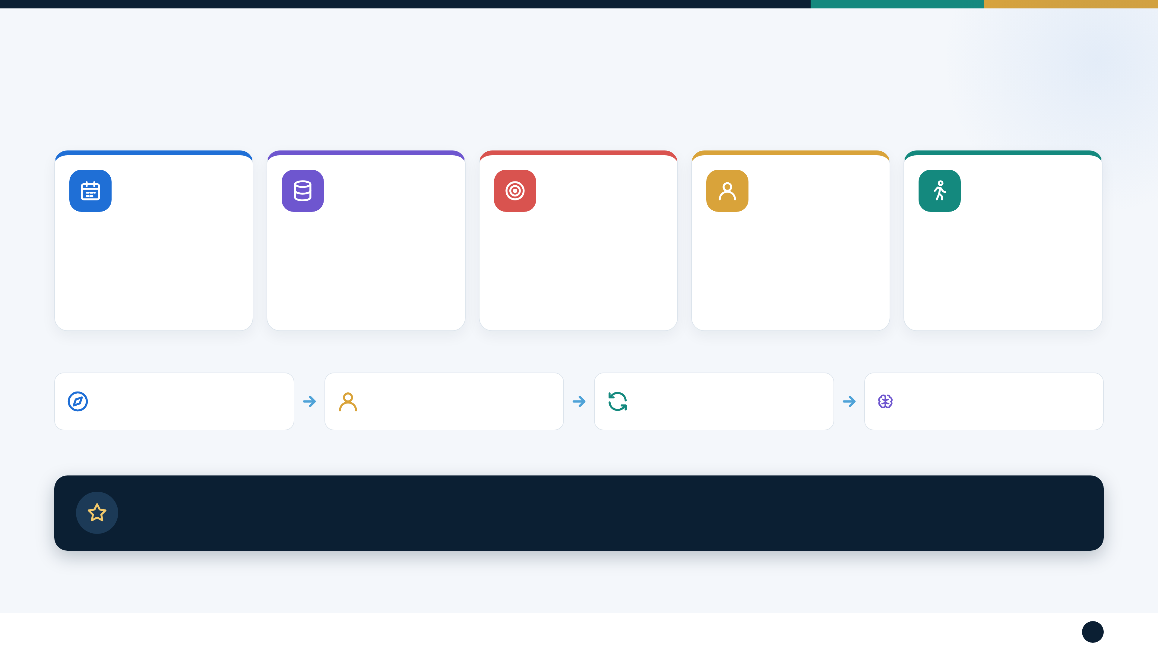
Exercises to Support Orientation, Body Awareness and Cognitive Function
Use rehabilitation / stimulation activities that fit the patient’s diagnosis, goals and safety needs.
1
2
3
4
5
ORIENTATION
MEMORY
ATTENTION
BODY AWARENESS
MOVE + COGNITION
Daily: name • place • date •
Show 3–5 familiar objects →
Count backward • find a target •
Eyes closed: touch nose • raise
“Stand → turn right → take 3
situation
hide → recall
follow a sequence
right hand • identify limb position
steps → sit.”
Use clock, calendar, signs,
schedule
TAKE-HOME FLOW
ORIENTATION
BODY AWARENESS
MOTOR CONTROL
COGNITIVE EXERCISES
Person + place + time + situation
Proprioception + sensory information
Plan + move + feedback + correct
Orientation + attention + memory + body
awareness
Final message: The brain integrates mind, body and environment to maintain awareness and guide appropriate behaviour and
movement.
Sources: ASHA Clinical Practice Guideline, AJSLP (2022); INCOG 2.0 cognitive rehabilitation guidance (2023); Jak, Neurologic Clinics (2024).
Cognitive functions • orientation • body awareness • motor control
Presented by Choudhary Divya · Group 4009
Undergraduate psychiatry / psychology / nursing / allied health
9

Slide 10

Thank You
Questions & discussion
PRESENTED BY
Choudhary Divya
Group 4009

