Slide 1
Mbugua Douglas
C025-01-1199/2019
Photo Essay on Autobiography

Slide 2
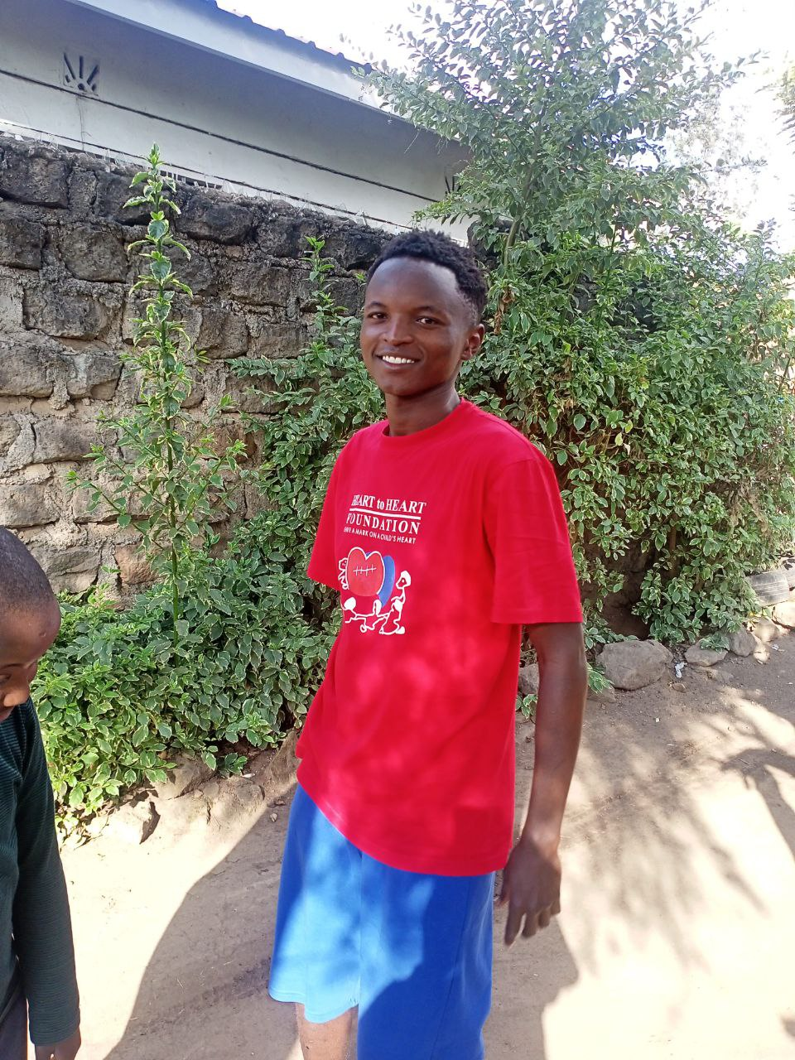
Where I am Now
My names are Mbugua Douglas. Born on the 13th of May 2001. Currently pursuing a Bachelors Degree in Information Technology at the University of Dedan Kimathi.

Slide 3
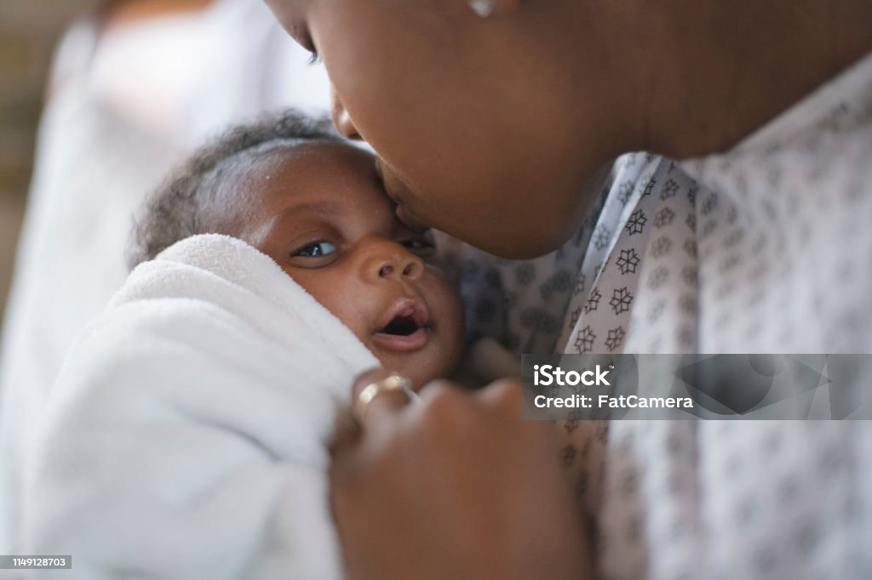
Growing Up
Ipsum Dolor
I was born in a small village on the outskirts of Thika, Gatundu North. I however did not stay there long as I relocated to Nairobi, Ongata Rongai.

Slide 4

School
I went to school in St.Josephs primary school. High School was spent at Thika High School

Slide 5
Everything youv ever wanted lies on the other side of consistency
Mbugua Douglas

Slide 6
Hobbies and Skills
Movies and Shows
Baseball
Coding
I am a big fun of passive hobbies and I do enjoy my own share of movie shows
In my free time, Im an avid player of b.ball,
I enjoy coding

