Slide 1



AutoStockML – Automated Stock Prediction Using AI and DevOps.
DEVOPS IA – 2
Hitanshi Patil – 16010122283
Harikrishnan Gopal – 16010122284
Aditya Raut – 16010122288
Suhrud Korgaokar – 16010122334
Under the Guidance of: Prof. Swapnil Pawar

Slide 2
INTRODUCTION
We used AI + Devops to automate stock price prediction in finance industry
Stock market data changes every second due to global events, news, and sentiment.
Manual model retraining is slow, inconsistent, and error-prone.
There’s a need for an automated system that:
  Fetches fresh market data after market close.
  Retrains predictive models on recent trends.
  Redeploys updated models for real-time predictions without human intervention.

Slide 3
Project Overview
AutoStockML is a fully automated MLOps-driven stock prediction system that intelligently updates itself every day.
Fetches Intraday Stock Data daily after market close from live market APIs, ensuring the model always learns from the most recent trading activity.
Retrains a Machine Learning Model automatically on the combined historical and latest data to capture emerging market trends and price patterns.
Evaluates and Version-Controls Models to maintain transparency and track performance improvements.
Redeploys the Updated Model API on Railway, triggered directly through GitHub Actions, ensuring real-time availability of the latest predictions.

Slide 4
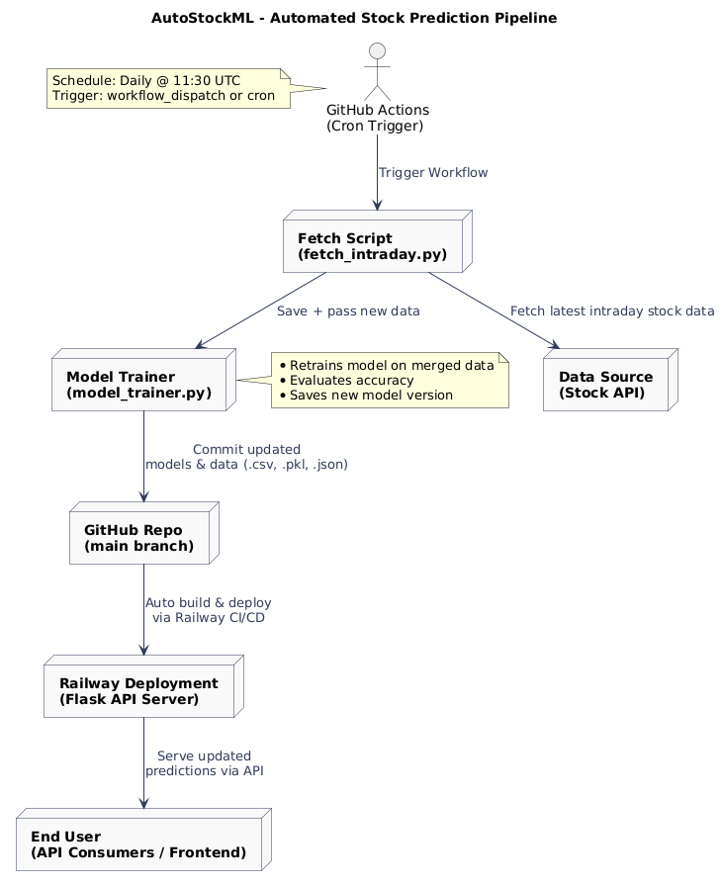
Workflow Architecture

Slide 5
Model & Data
Data:
Intraday stock data fetched daily from Alpha Vantage.
Captures key indicators: Open, High, Low, Close, Volume.
Data is cleaned, validated, and stored as structured CSV files.
Ensures a growing historical dataset for continuous learning.
Model:
Uses LSTM for stock price prediction.
Learns from historical & latest intraday data to capture real-time market patterns.
Predicts next-day or intraday stock prices with adaptive accuracy.
Retrained automatically through GitHub Actions for daily model refresh.

Slide 6
Implementation

Slide 7
Deployment on Railway
Deployment Details:
Flask API exposes /predict endpoint
Hosted on Railway.app
Connected directly to GitHub main branch
New model push → Railway auto rebuilds container → redeploys API

Slide 8
Results & Observations
Daily Automated Retraining:
The model retrains itself every day using the latest intraday data, staying fully in sync with live market movements.
Improving Prediction Accuracy:
Each retraining cycle refines the model, enhancing accuracy and adapting to subtle shifts in market patterns.
Zero Manual Effort:
The entire process runs autonomously, eliminating human error and saving a significant amount of time and effort.
Seamless CI/CD Pipeline:
Integrated with GitHub Actions and Railway, the pipeline automates data fetching, model training, evaluation, and redeployment.
High Efficiency & Reliability:
Ensures consistent performance, quick updates, and a scalable, production-ready financial prediction system.

Slide 9
Conclusion
AutoStockML delivers a fully automated MLOps pipeline that unites Machine Learning, DevOps, and Cloud Deployment.
The system fetches data, retrains models, evaluates results, and redeploys APIs — all automatically.
With daily updates and zero manual effort, the model stays accurate and adaptive to real market trends.
This project demonstrates how automation and intelligence can work together to build scalable, production-ready financial AI solutions.

Slide 10
Thank You

