Slide 1
NeueFische - First Project: EDA

Slide 2
Data
Target:
  Salary
Features:
  Education degree
  Entry wage
  Gender
  Minority
  Job category

Slide 3
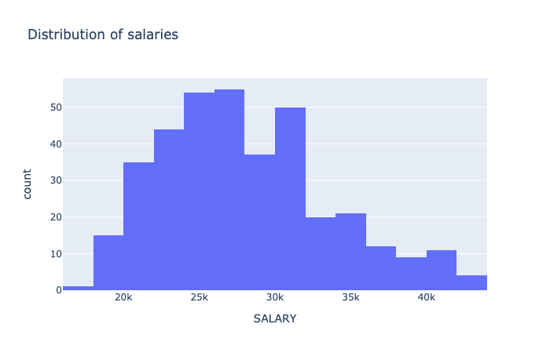
Visualization

Slide 4
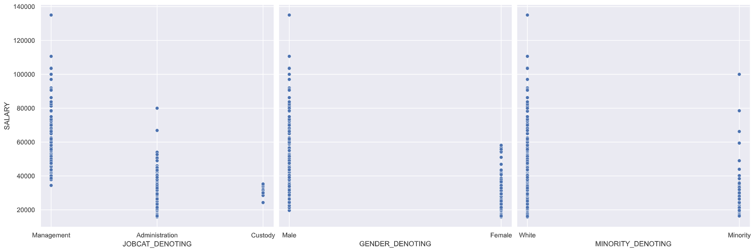
Visualization

Slide 5
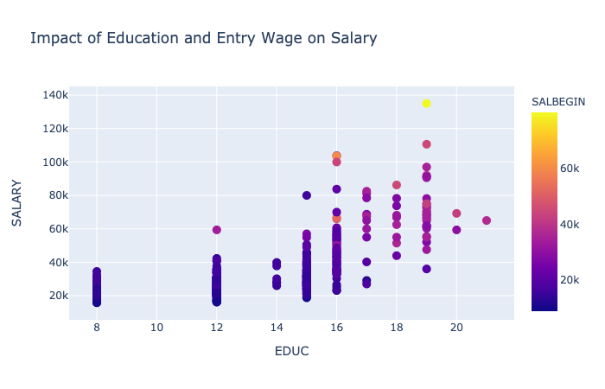
Visualization

Slide 6
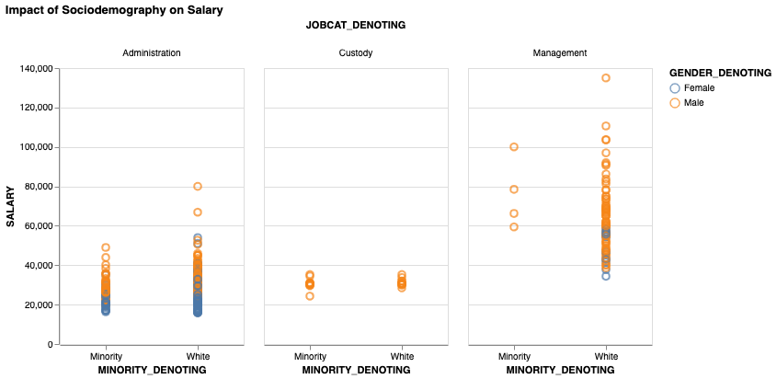
Visualization

Slide 7
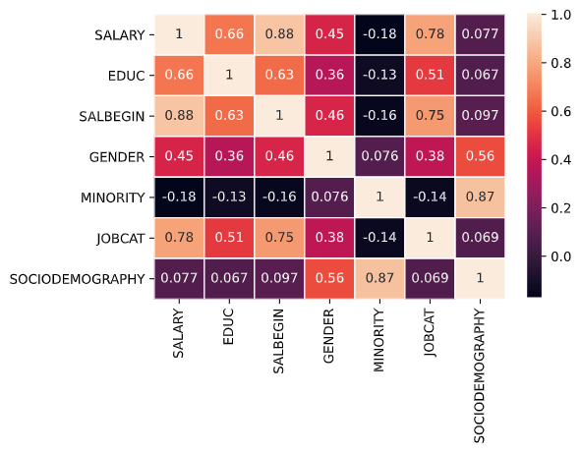
Correlation

Slide 8
Linear Regression
df_X = df[
["EDUC",
"SALBEGIN",
"GENDER",
"MINORITY",
"JOBCAT",
"SOCIODEMOGRAPHY"
]
]
Y = df["SALARY"]
X_train, X_test, y_train, y_test = train_test_split(df_X, Y, test_size=0.4, random_state=17)
model = LinearRegression()
model.fit(X_train,y_train)
predictions = model.predict(X_test)
mean_squared_error(y_test, predictions)**0.5

Slide 9
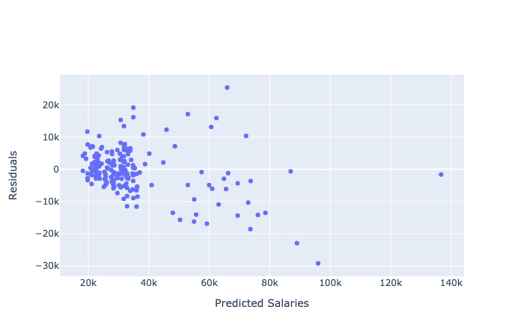
Linear Regression

Slide 10
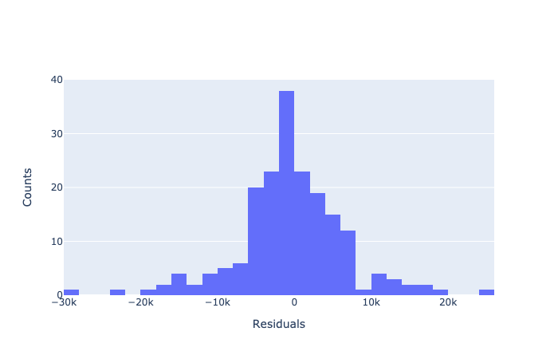
Linear Regression

Slide 11
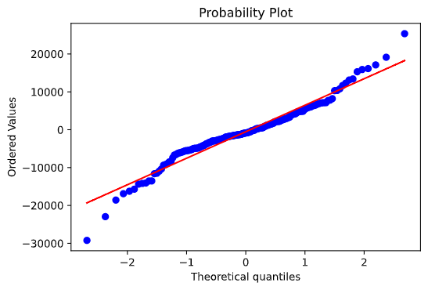
Linear Regression

Slide 12
Linear Regression
OLS Regression Results
================================================
Dep. Variable: SALARY R-squared: 0.548
Model: OLS Adj. R-squared: 0.538
Method: Least Squares F-statistic: 51.90
Date: Fri, 04 Jun 2021 Prob (F-statistic): 4.31e-35
Time: 16:22:17 Log-Likelihood: -2133.0
No. Observations: 220 AIC: 4278.
Df Residuals: 214 BIC: 4298.
Df Model: 5
Covariance Type: nonrobust
strong multicollinearity problems or that the design matrix is singular.
RMSE: 7115.8

Slide 13
Linear Regression
===========================================================
coef std err t P>|t| [0.025 0.975]
-----------------------------------------------------------------------------------
const 5379.0675 1935.169 2.780 0.006 1564.634 9193.501
EDUC 475.6058 130.125 3.655 0.000 219.116 732.096
SALBEGIN 0.9647 0.130 7.402 0.000 0.708 1.222
GENDER 2122.4826 633.179 3.352 0.001 874.417 3370.549
MINORITY -1232.9478 347.817 -3.545 0.000 -1918.533 -547.362
JOBCAT 2307.3362 768.728 3.002 0.003 792.088 3822.584
SOCIODEMOGRAPHY -343.4130 216.306 -1.588 0.114 -769.776 82.950
===========================================================
Omnibus: 14.624 Durbin-Watson: 1.851
Prob(Omnibus): 0.001 Jarque-Bera (JB): 15.935
Skew: 0.657 Prob(JB): 0.000346
Kurtosis: 3.114 Cond. No. 8.52e+19

Slide 14
Clean The Data
q1 = df.describe().loc["75%", "SALARY"]
q3 = df.describe().loc["25%", "SALARY"]
iqr = q1 - q3
mask = (q1 - 1.5*iqr) <= df["SALARY"]
mask &= df["SALARY"] <= (q3 + 1.5*iqr)

Slide 15
Sociodemography
GENDER_DENOTING
Female 26031.921296
Male 41441.782946
Name: SALARY, dtype: float64
GENDER_DENOTING
Female 24300.0
Male 32850.0
Name: 50%, dtype: float64
MINORITY_DENOTING
Minority 28713.942308
White 36023.310811
Name: SALARY, dtype: float64
MINORITY_DENOTING
Minority 26625.0
White 29925.0
Name: 50%, dtype: float64
SOCIODEMOGRAPHY_DENOTING
Minority_Female 23062.500000
Minority_Male 32246.093750
White_Female 26706.789773
White_Male 44475.412371
Name: SALARY, dtype: float64
SOCIODEMOGRAPHY_DENOTING
Minority_Female 23775.0
Minority_Male 29025.0
White_Female 24450.0
White_Male 36000.0
Name: 50%, dtype: float64

Slide 16
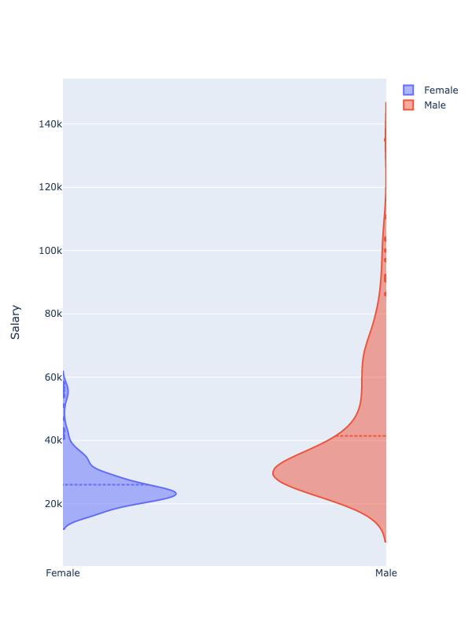
Sociodemography

Slide 17
Sociodemography
RMSE:
SALARY~<allFeatures> = 7,115.8
SALARY~SALBEGIN = 8,510.1
SALARY~GENDER = 15,114.4

Slide 18
Insights
Management earns the highest salary
The vast majority of the management
ain't female nor a minority

Slide 19
Insights
The lesser the education degree
-> the more narrow the constricted range
If You already start with a higher salary
-> You will later get an even higher salary
The linear regression model is not the best model to explain gender or minority pay gaps.

Slide 20
Merci!

