Slide 1
.predict_explain(X)

Slide 2
The Objective
A machine learning model:
  model = … → fit(X,y)
A prediction:
  model.predict(X) → „Iris-virginica“
A prediction that explains itself:
  model.predict_explain(X) → „The prediction is Iris- virginica, because ...“

Slide 3
Start with KNeighborsClassifier
An inherited machine learning model:
  my_knn = my_KneighborsClassifier.fit(X,y)
Add prediction method that explains itself:
  my_knn.predict_explain(X) → Prediction
  Confidence
  Explanation
  Features_Distribution

Slide 4
Nursery Dataset
Target values
  not_recom
  ( recommend )
  very_recom
  priority
  spec_priority
A structured dataset of children conditions
parents Parents' occupation
has_nurs Child's nursery
form Form of the family
children Number of children
housing Housing conditions
finance Financial standing of the family
social Social conditions
health Health conditions (as veto feature)
Counts:
  12960
  all feature combinations - one time
Bohanec, M., Rajkovic, V. (1987). An Expert System Approach to Multi-Attribute Decision Making.

Slide 5
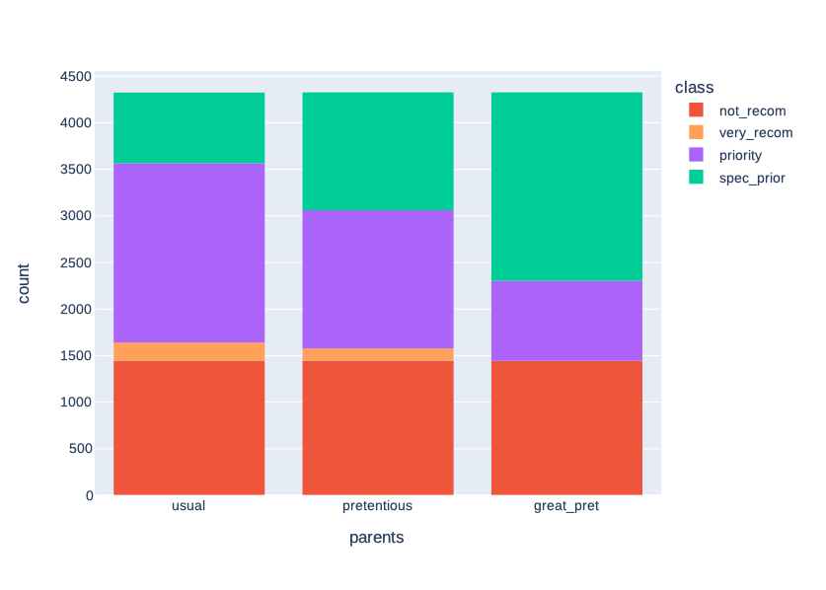
Nursery Dataset

Slide 6
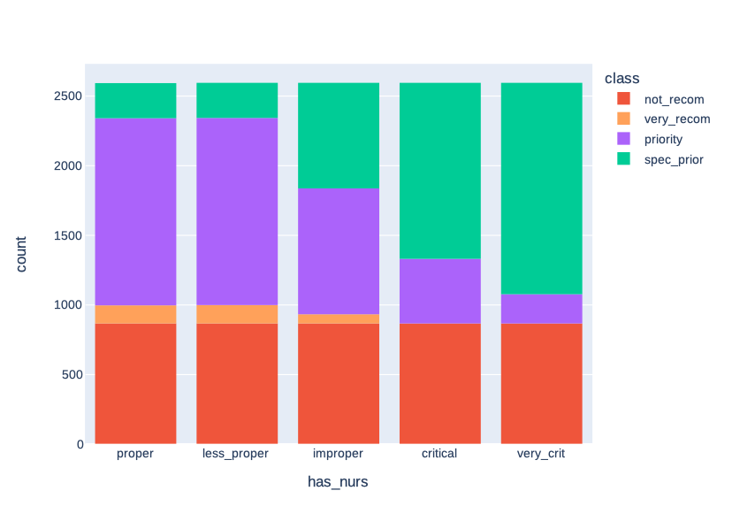
Nursery Dataset

Slide 7
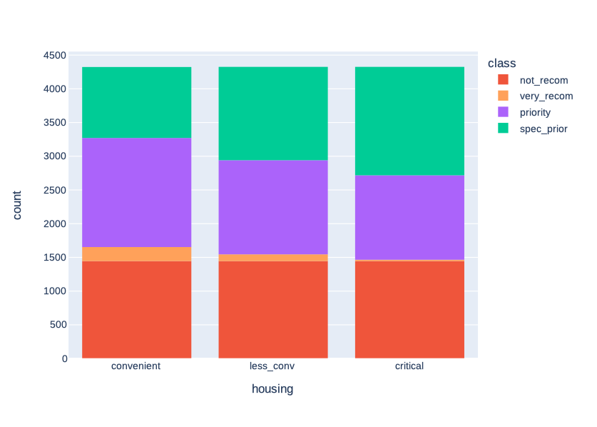
Nursery Dataset

Slide 8
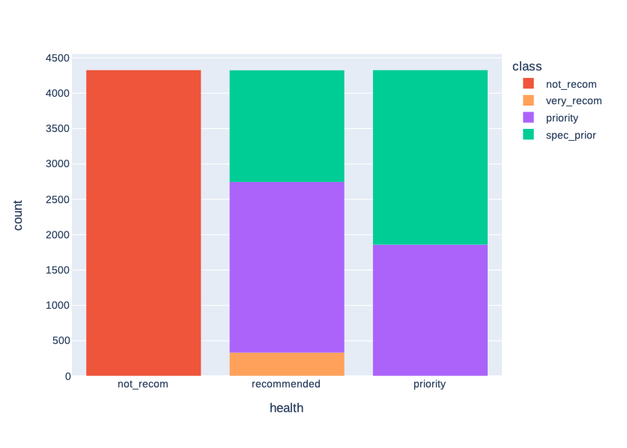
Nursery Dataset

Slide 9
my_knn.predict_explain(child_n)
Should explain its prediction method
  „not_recom“, because [...]
  „very_recom“, because [...]
  „priority“, because [...]
  „spec_priority“, because [...]
Should recognize features structure of child
parents
has_nurs
form
children
housing
finance
social
health (as veto)

Slide 10
my_knn.predict_explain(child_1)
Prediction: 'not_recom'
Confidence: True

Slide 11
my_knn.predict_explain(child_1)
Explanation:
  "The prediction 'not_recom' is quite sure:

Slide 12
my_knn.predict_explain(child_1)
Explanation:
  "The prediction 'not_recom' is quite sure:
  On the one hand the 5 nearest neighbours have homogeneous target values (5x value 'not_recom').

Slide 13
my_knn.predict_explain(child_1)
Explanation:
  "The prediction 'not_recom' is quite sure:
  On the one hand the 5 nearest neighbours have homogeneous target values (5x value 'not_recom').
  And on the other hand the nearest neighbour has the same target value too.",

Slide 14
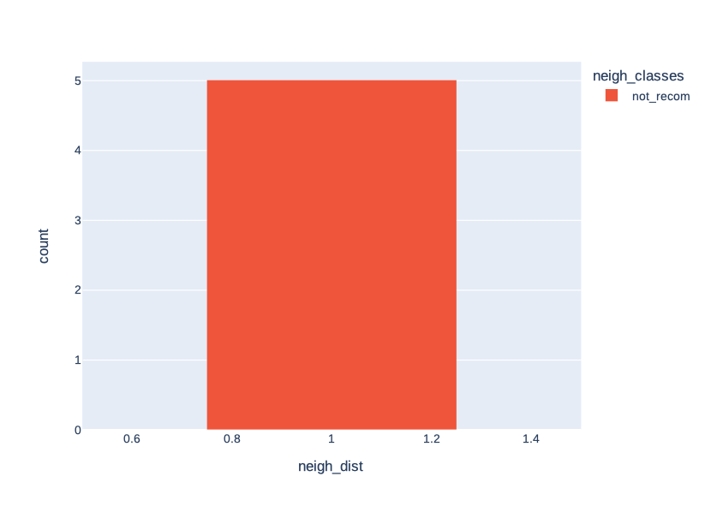
my_knn.predict_explain(child_1)

Slide 15
my_knn.predict_explain(child_2)
Prediction: 'very_recom'
Confidence: False

Slide 16
my_knn.predict_explain(child_2)
Explanation:
  "The prediction 'very_recom' is rather unsure:

Slide 17
my_knn.predict_explain(child_2)
Explanation:
  "The prediction 'very_recom' is rather unsure:
  On the one hand the 5 nearest neighbours have diverse target values (2x value 'priority', 3x value 'very_recom').

Slide 18
my_knn.predict_explain(child_2)
Explanation:
  "The prediction 'very_recom' is rather unsure:
  On the one hand the 5 nearest neighbours have diverse target values (2x value 'priority', 3x value 'very_recom').
  And on the other hand the nearest neighbour has another target value ('priority') as the prediction."

Slide 19
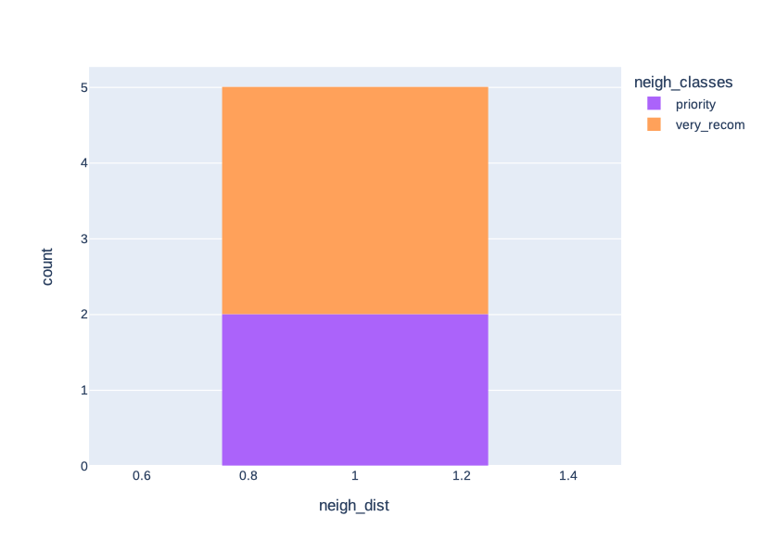
my_knn.predict_explain(child_2)

Slide 20
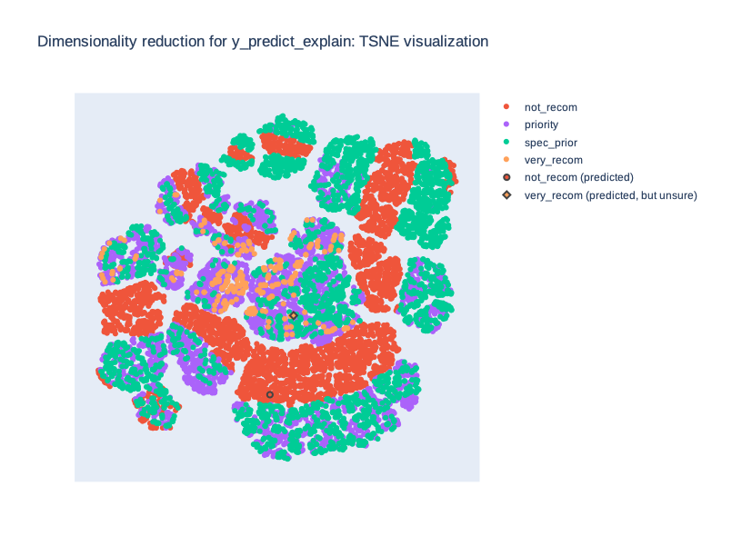
my_knn.predict_explain(child_1,2)

Slide 21
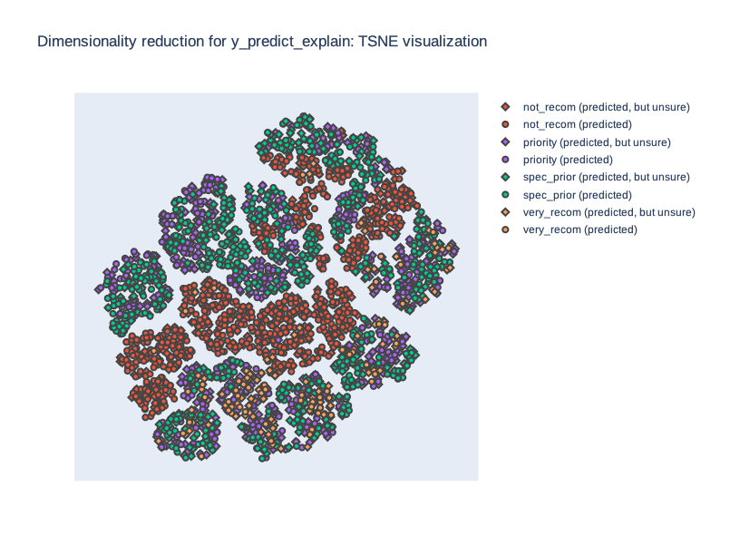
my_knn.predict_explain(all)

Slide 22
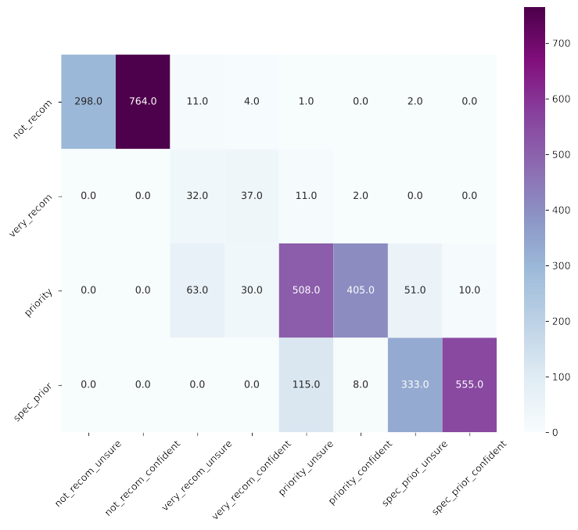
my_knn.predict_explain(all)

Slide 23
my_knn.predict_explain(child_n)
Should explain its prediction method
  „not_recom“, because [...]
  „very_recom“, because [...]
  „priority“, because [...]
  „spec_priority“, because [...]
Should recognize features structure of child
parents
has_nurs
form
children
housing
finance
social
health (as veto)

Slide 24
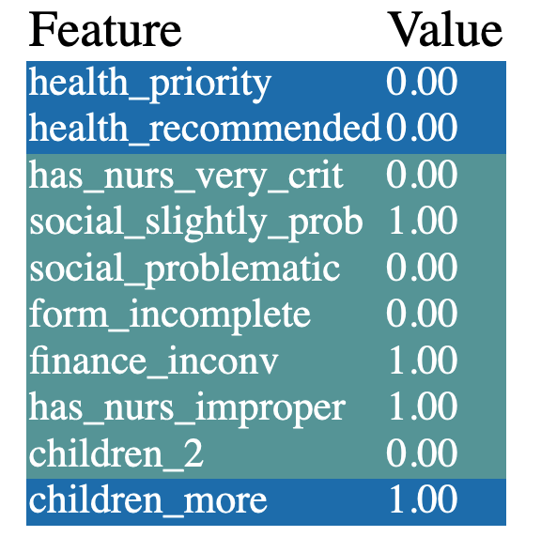
Features(child_1)

Slide 25
Features(child_1)

Slide 26
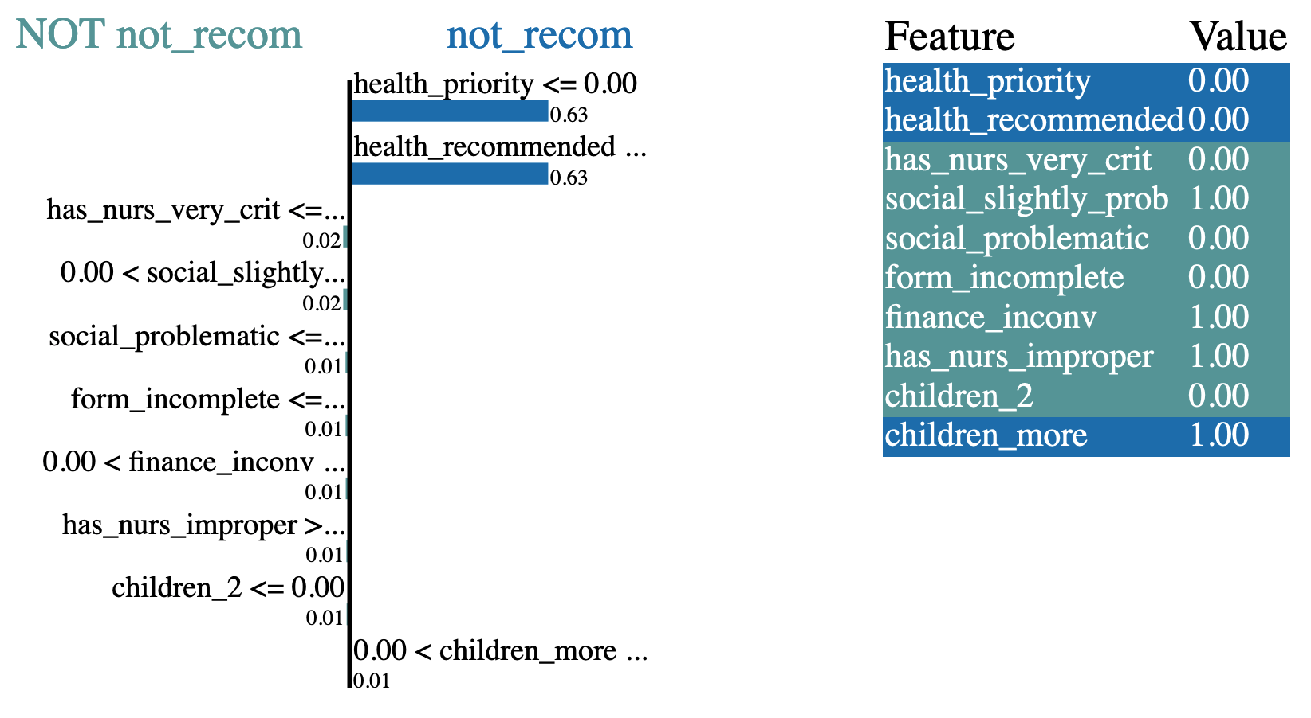
Features(child_1)
LIME

Slide 27
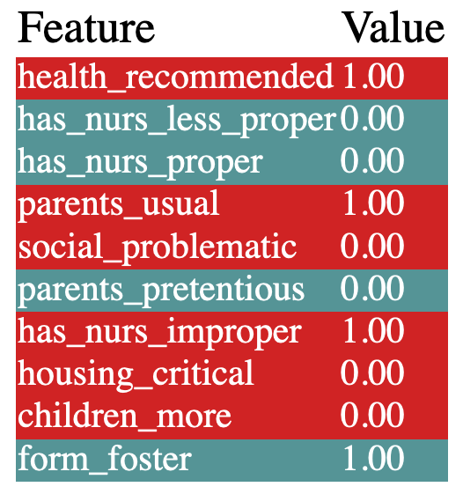
Features(child_2)

Slide 28
Features(child_2)
A structured dataset of children conditions
parents Parents' occupation
has_nurs Child's nursery
form Form of the family
children Number of children
housing Housing conditions
finance Financial standing of the family
social Social conditions
health Health conditions (as veto feature)

Slide 29
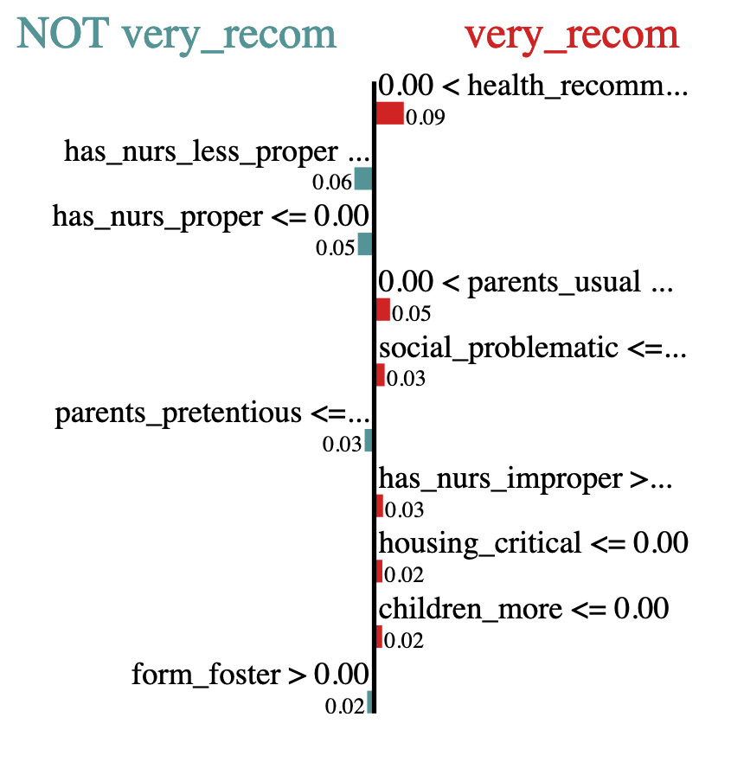
Features(child_2)
Features(child_2)
LIME

Slide 30
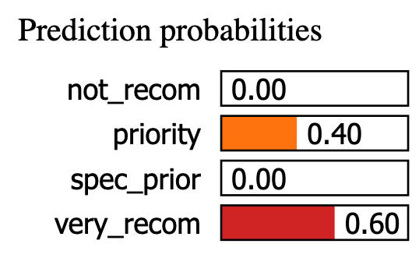
Features(child_2)
Features(child_2)
LIME

Slide 31
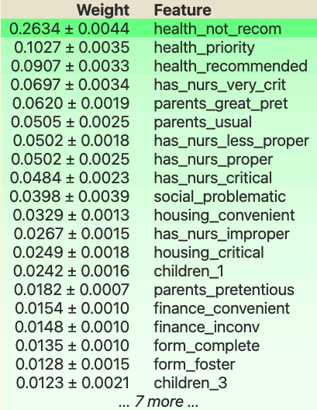
Features(all)
eli5

Slide 32
Features(all)
eli5
A structured dataset of children conditions
parents Parents' occupation
has_nurs Child's nursery
form Form of the family
children Number of children
housing Housing conditions
finance Financial standing of the family
social Social conditions
health Health conditions (as veto feature)

Slide 33
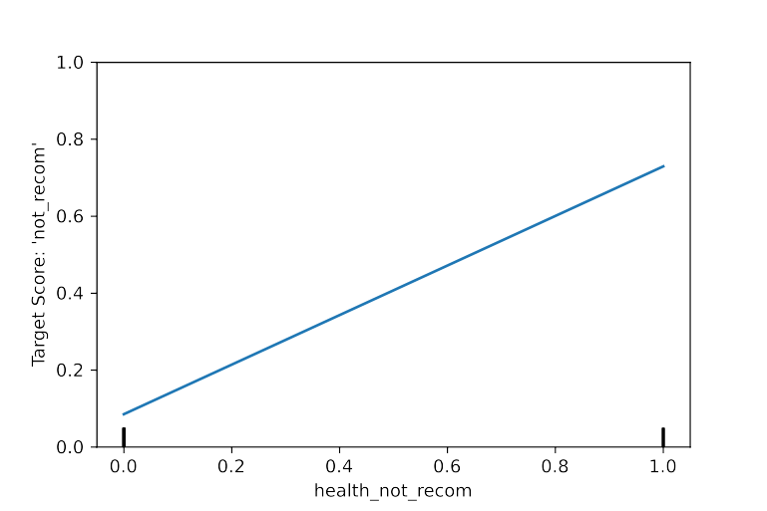
Features(all)
PDP

Slide 34
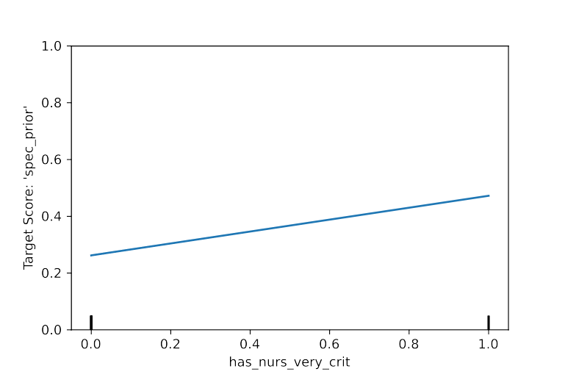
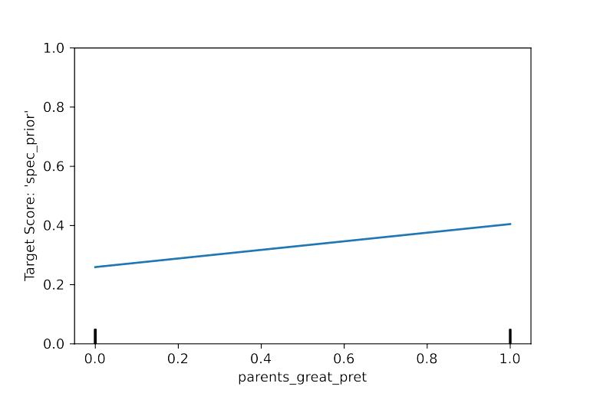
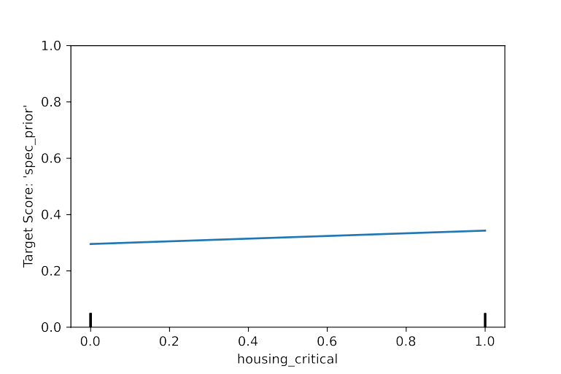
Features(all)
PDP

Slide 35
Merci!

