Slide 1
.explain_predict(X)

Slide 2
The Objective
A machine learning model:
  model = … → fit(X,y)
A prediction:
  model.predict(X) → „Iris-virginica“
A prediction that explains itself:
  model.predict_explain(X) → „The prediction is Iris- virginica, because ...“

Slide 3
Start with KNeighborsClassifier
A personalized machine learning model:
  model = my_KneighborsClassifier.fit(X,y)
Get prediction that explains itself:
  model.predict_explain(X) → Prediction
  Confidence
  Explanation
  Features_Distribution

Slide 4
model.predict_explain(X)
Prediction: „Iris-versicolor“
Confidence: False

Slide 5
model.predict_explain(X)
Explanation:
  „The prediction 'Iris-virginica' is rather unsure:

Slide 6
model.predict_explain(X)
Explanation:
  „The prediction 'Iris-virginica' is rather unsure:
  On the one hand the 5 nearest neighbours have diverse target values (2x value 'Iris-versicolor', 3x value 'Iris-virginica').

Slide 7
model.predict_explain(X)
Explanation:
  „The prediction 'Iris-virginica' is rather unsure:
  On the one hand the 5 nearest neighbours have diverse target values (2x value 'Iris-versicolor', 3x value 'Iris-virginica').
  But on the other hand the nearest neighbour has the same target value too."

Slide 8
model.predict_explain(X)
Features_Distribution:
  The features given for predicting the target value are rather far from any other observations already known.

Slide 9
model.predict_explain(X)
Features_Distribution:
  The features given for predicting the target value are rather far from any other observations already known.
  No feature has the exact same values in the range of the 5 nearest neighbours.

Slide 10
model.predict_explain(X)
Features_Distribution:
  The features given for predicting the target value are rather far from any other observations already known.
  No feature has the exact same values in the range of the 5 nearest neighbours.
  However, the feature 'sepal_length' differs remarkably ('5.6' vs. '6.0') throughout the inspected 5 nearest neighbours.

Slide 11
model.predict_explain(X)
Features_Distribution:
  The features given for predicting the target value are rather far from any other observations already known.
  No feature has the exact same values in the range of the 5 nearest neighbours.
  However, the feature 'sepal_length' differs remarkably ('5.6' vs. '6.0') throughout the inspected 5 nearest neighbours.
  There seems to be an intersection of the target values {'Iris-versicolor', 'Iris-virginica'}."

Slide 12
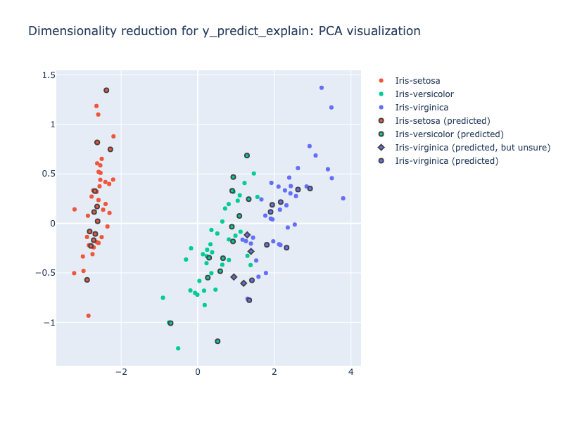
Visualization
Interactive

Slide 13
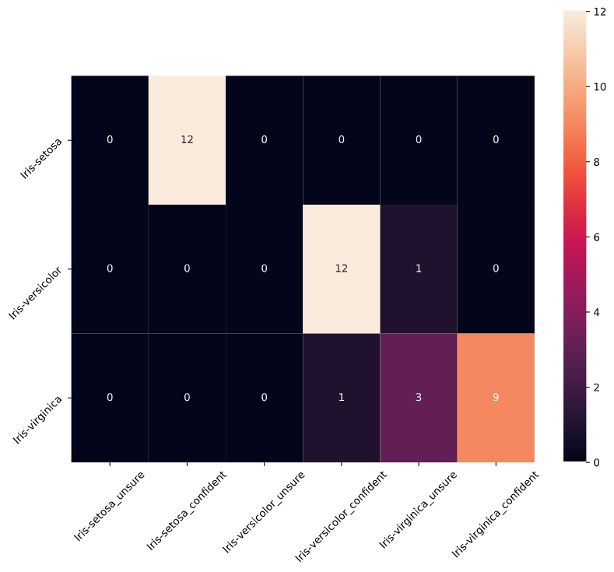
Visualization

Slide 14
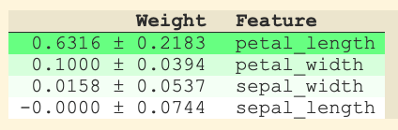
Libraries
from eli5.sklearn import PermutationImportance

Slide 15
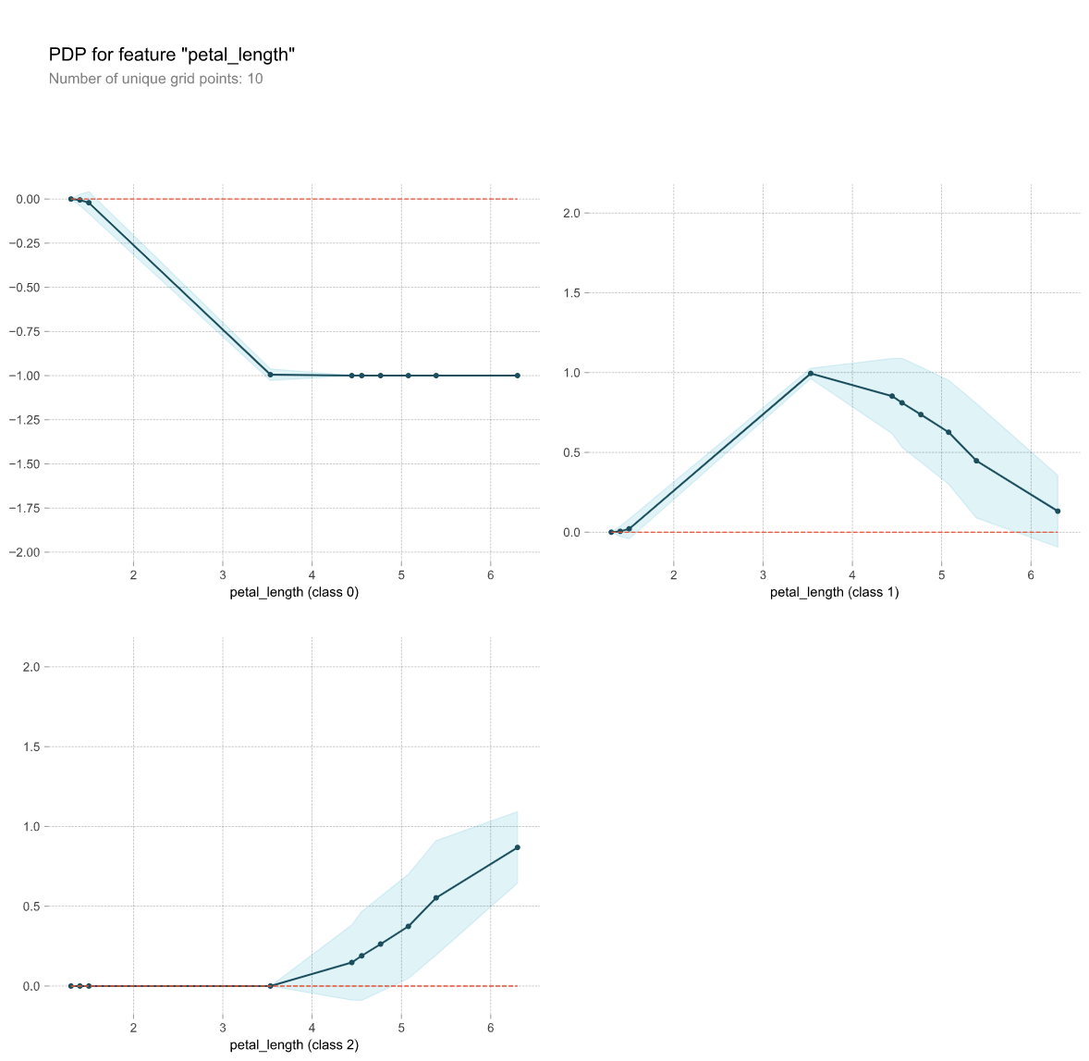
Libraries
from pdpbox import pdp

Slide 16
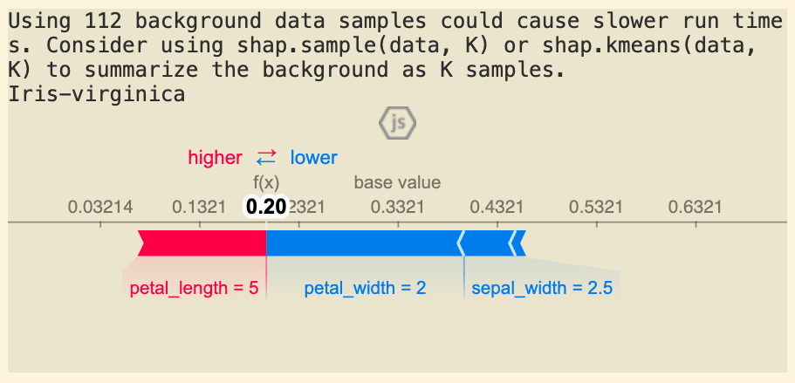
Libraries
import shap

Slide 17
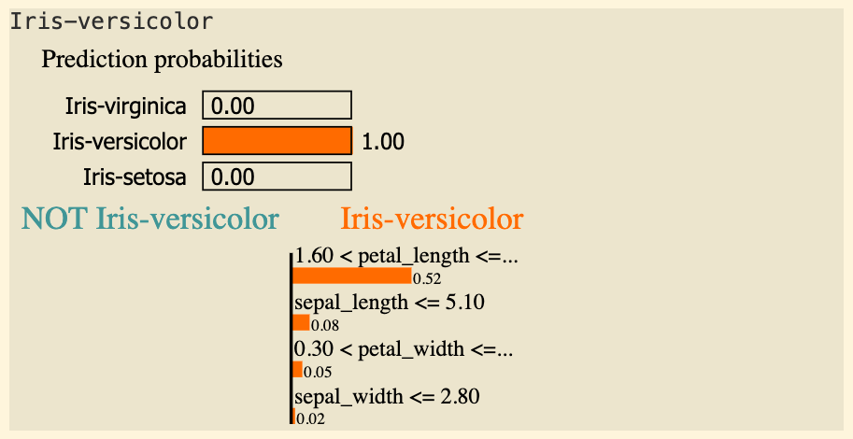
Libraries
import lime, lime.lime_tabular

Slide 18
Näxt steps (?)
Rollout .predict_explain(X) on RandomForestClassifier
Dive into explainability models in more detail
Try it out on a data set
  Get one from the other groups
  Get a new one

Slide 19
Merci!

