Slide 1
MACHINE LEARNING MODEL BUILDING PROCESS
Files
Structured (CSV, Delimited)
Unstructured (Images , plain text)
Data Overview
Supervised/ Unsupervised problem
Data Analysis , Plots
Handling missing values
Encoding
Feature building
Core ML Model
Hyper parameter tuning
Logistic , Trees
Boosting
F1 Score , Precision ,Recall ,AUROC
RMSE , MAE
Business Problem
Database / HDFS
Requirements
Gathering
Datasets Identification
Exploratory Data Analysis
Dataset Cleaning /Data Transformation
Model Implementation
Performance Evaluation

Slide 2
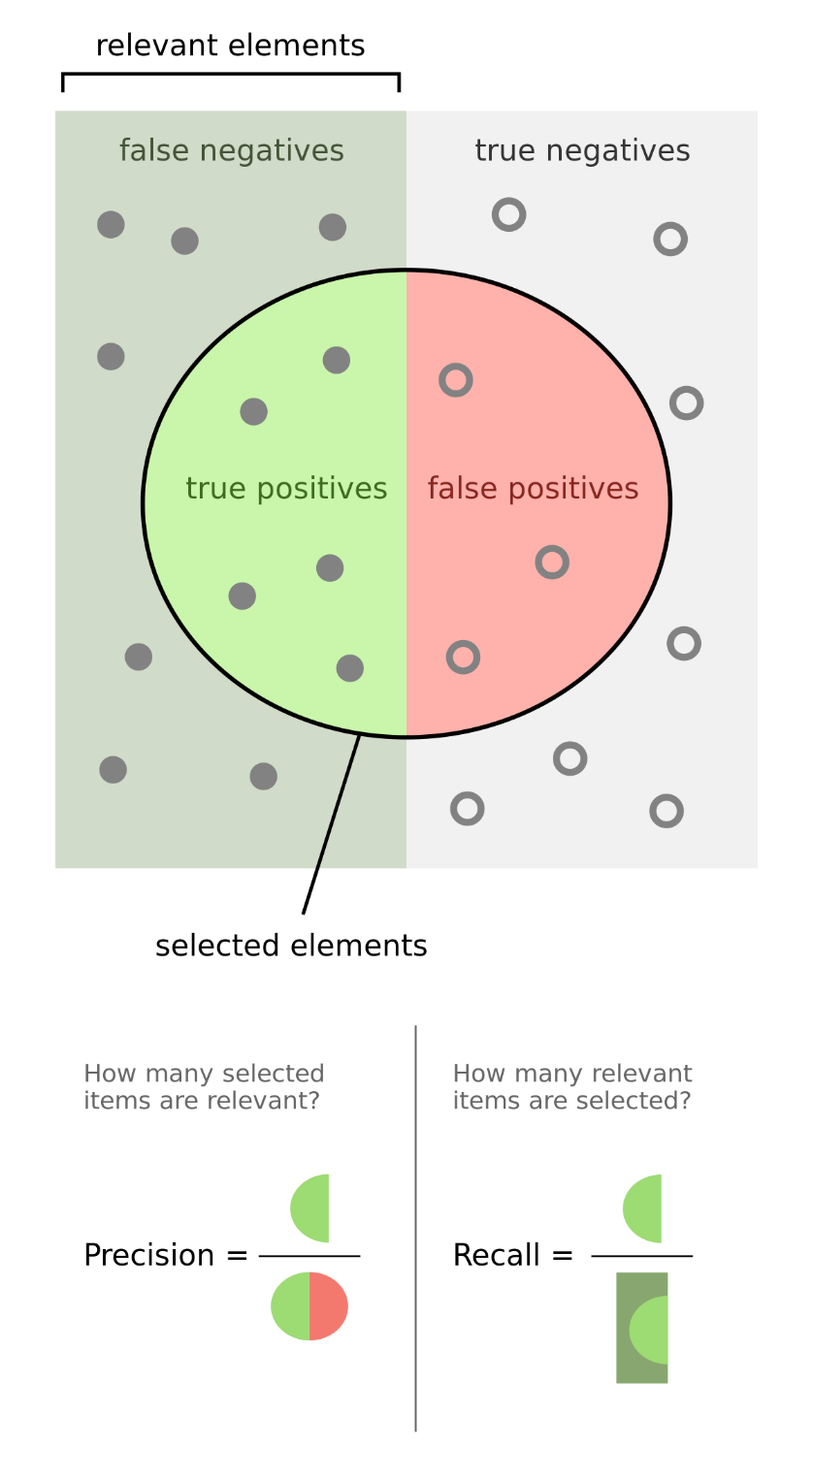
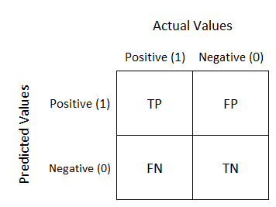
METRICS
Confusion Matrix
Precision & Recall
Precision = TP/(TP+FP)
Recall = TP / (TP+FN)
F1 Score
= 2 * (Precision*Recall)
/(Precision+Recall)
Accuracy
= (TP+TN)/(TP+FP+FN+TN)

Slide 3
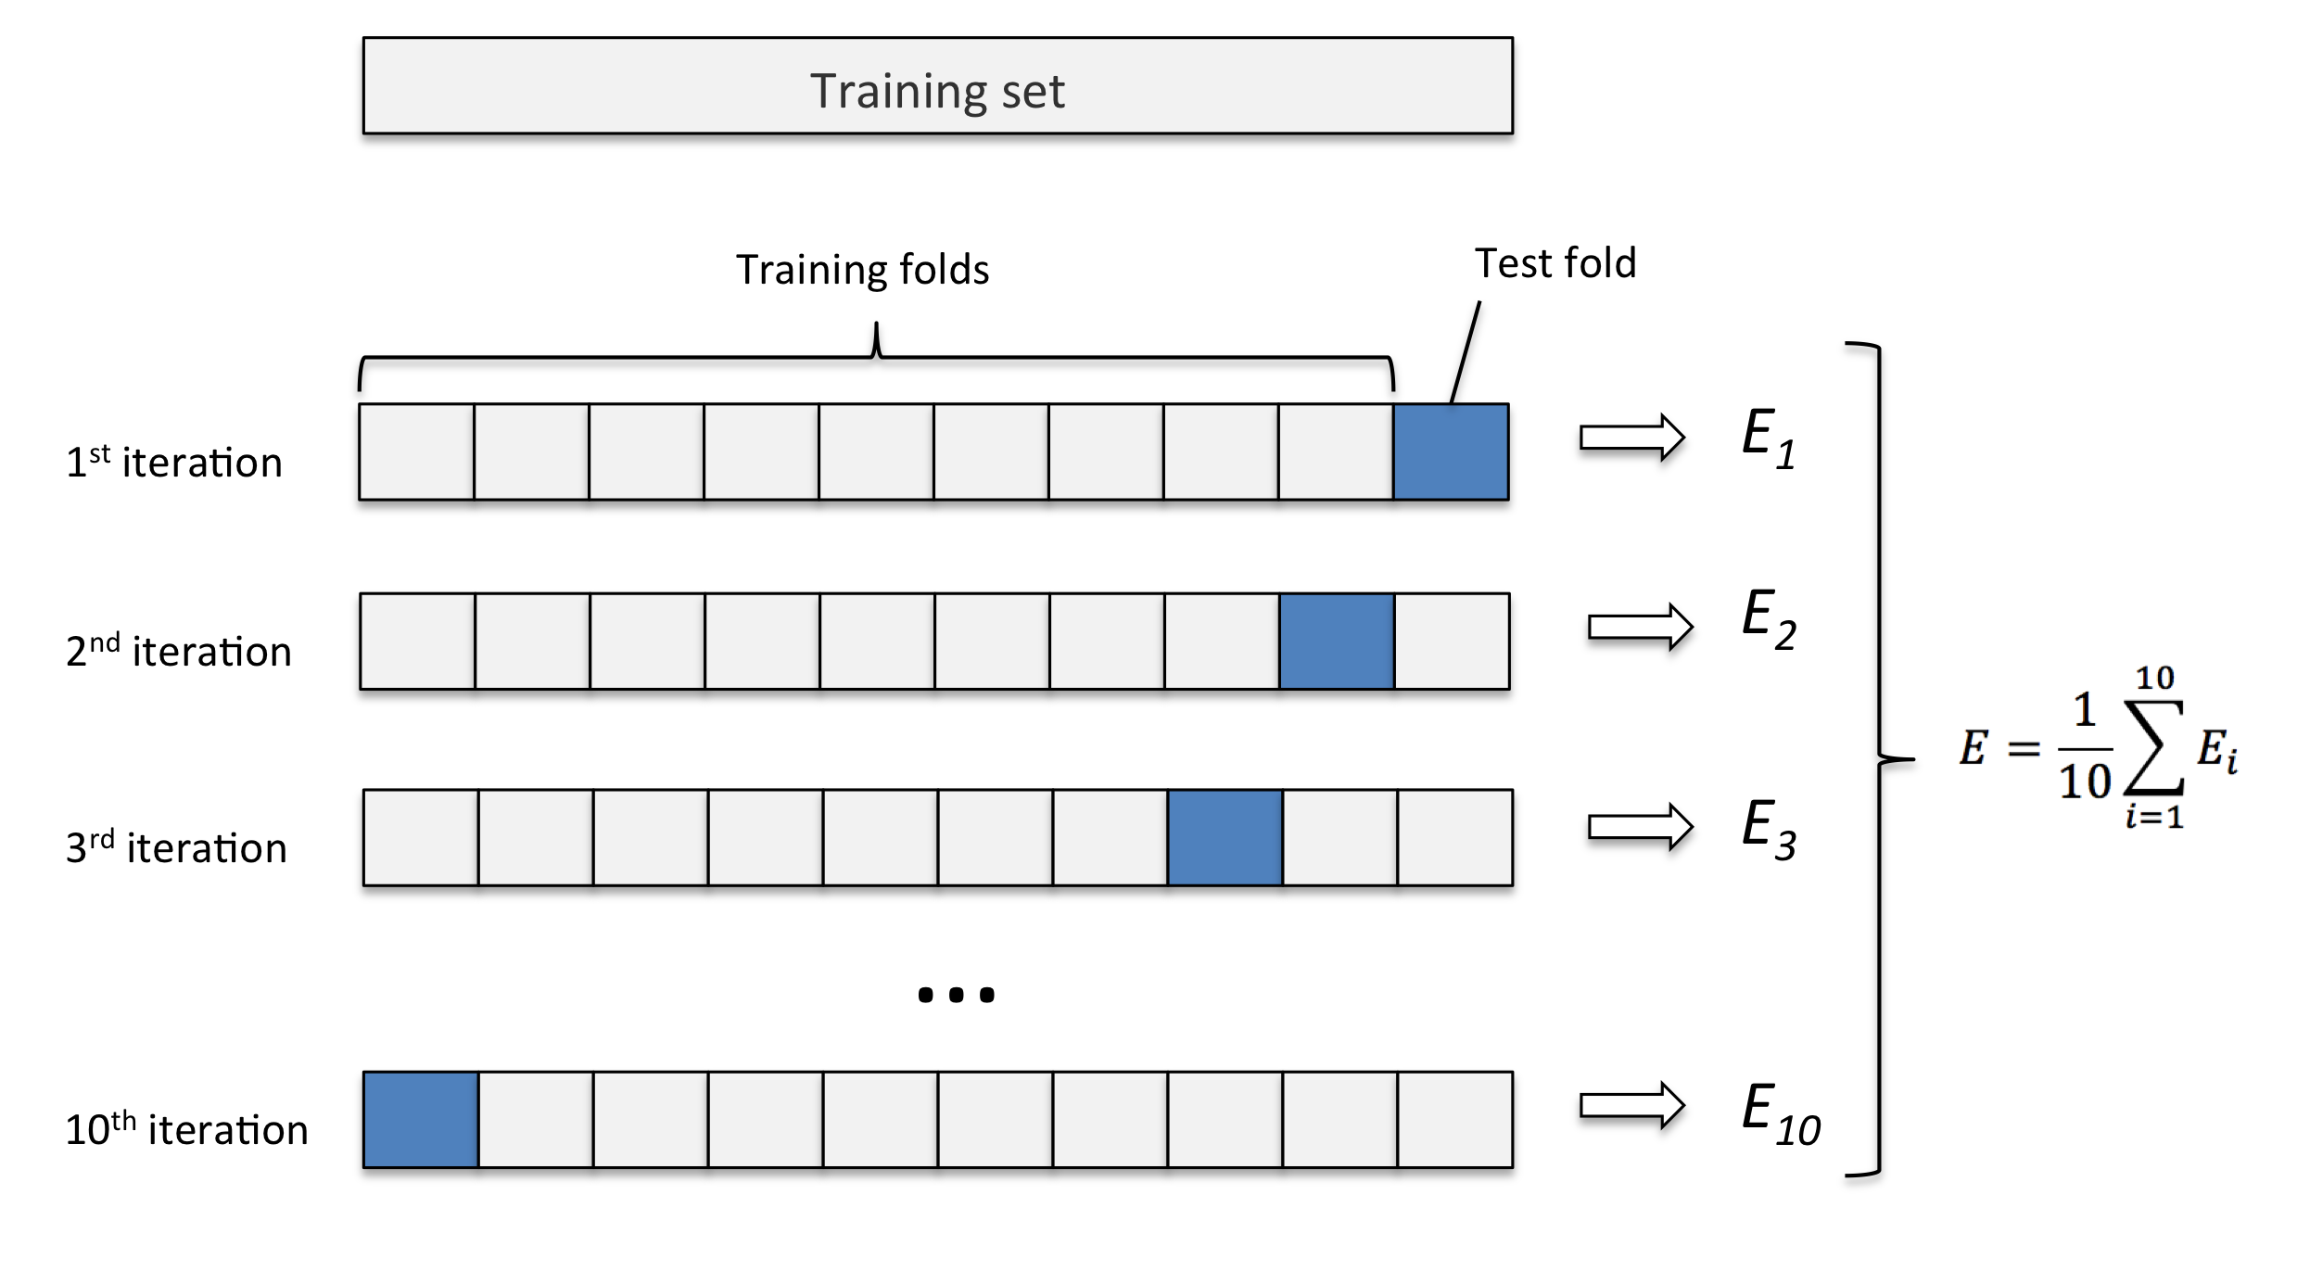
Cross Validation
CV=10

