Slide 1
Mechanics
EPHY108L (2-0-2-3)
Ayan khan
Department of physics

Slide 2
Course Outline
A brief review of vectors, and coordinate systems, with an emphasis on plane polar coordinates.
Velocity, acceleration, and kinematic equations in plane-polar coordinates.
A review of Newton’s laws, momentum, work, and energy.
Conservative and non-conservative forces, connection between force and potential energy through gradient operator.
Angular Momentum and rotational motion.
Noninertial frames of reference and pseudo forces such as centrifugal and Coriolis forces.
Central Force motion: central force motion as a one-body problem, planetary motion, and Kepler’s laws.
Harmonic Oscillator and Damping
Elements of Special Theory of Relativity

Slide 3
Books
Text Book
An Introduction to Mechanics, by Daniel Kleppner and Robert Kolenkow, Second Edition, Cambridge University Press.
Reference Book
Fundamentals of Physics, by David Halliday, Robert Resnick, and Jearl Walker, John Wiley & Sons, 10th Edition.
University Physics, by Hugh D. Young and Roger A. Freedman, Pearson, 13th Edition.

Slide 4
Elementary Vector Analysis

Slide 5

What is Mechanics?

Slide 6
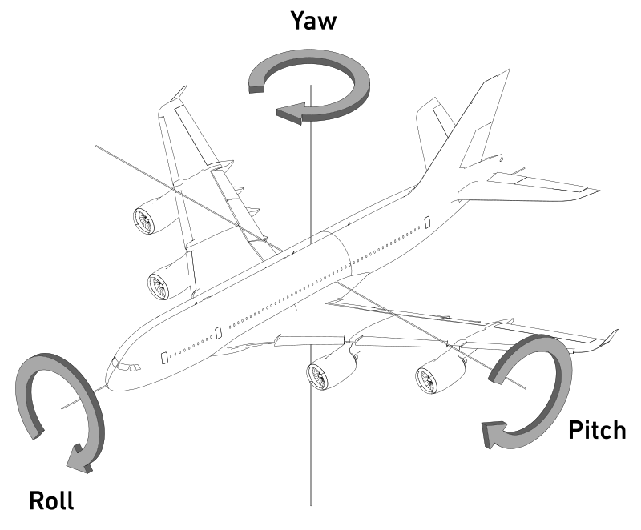
Why Mechanics?
An aircraft in flight is free to rotate in three dimensions: yaw, nose left or right about an axis running up and down; pitch, nose up or down about an axis running from wing to wing; and roll, rotation about an axis running from nose to tail.
These rotations are produced by torques about the principal axes.
The principle axes are named as Normal axis or yaw axis; Transverse axis or pitch axis; and
Longitudinal axis or roll axis.
Accelerometer
Gyroscope

Slide 7

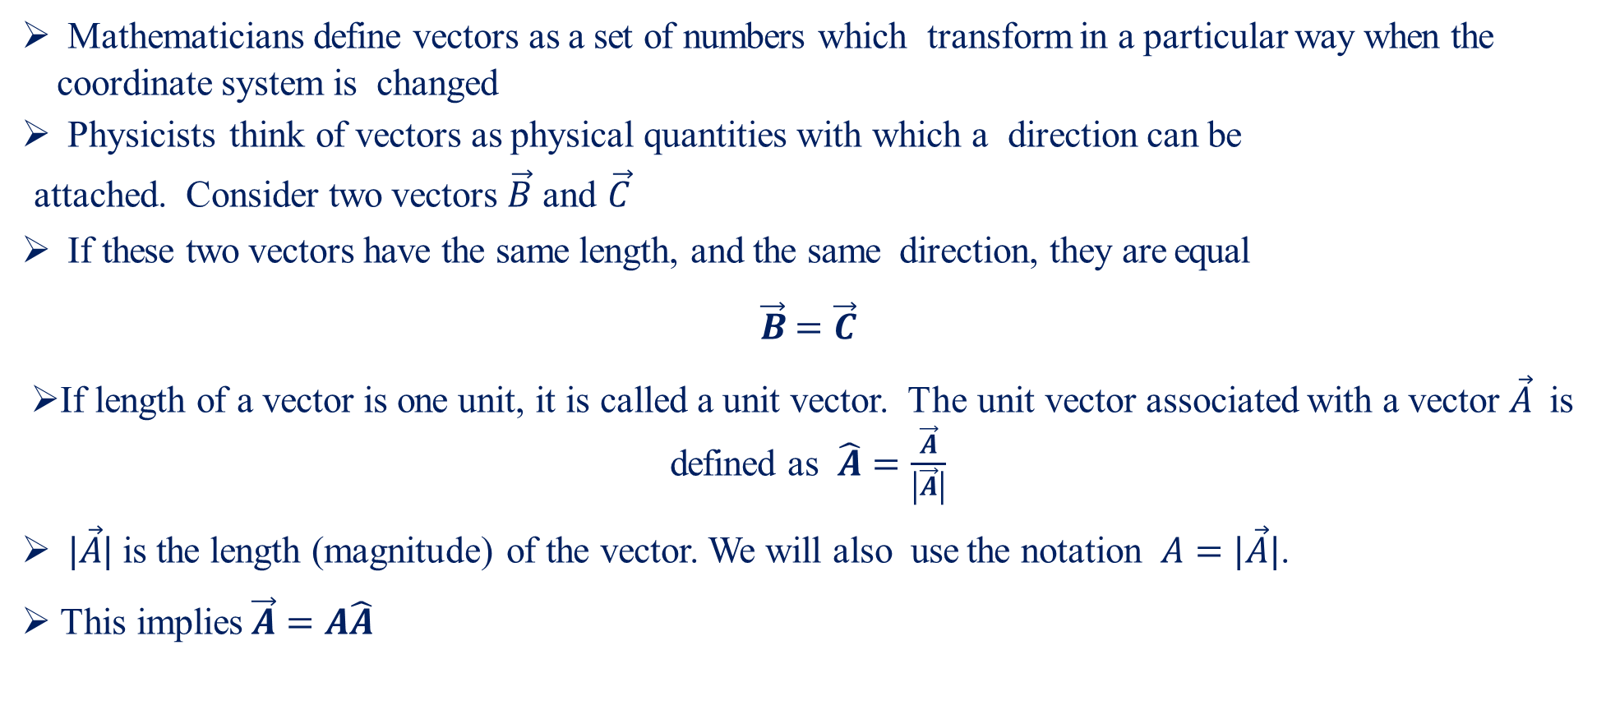
Vectors and Coordinate Systems
Mathematicians define vectors as a set of numbers which transform in a particular way when the coordinate system is changed
Physicists think of vectors as physical quantities with which a direction can be
attached. Consider two vectors $\vec{B}$ and $\vec{C}$
If these two vectors have the same length, and the same direction, they are equal
$\vec{B}=\vec{C}$
If length of a vector is one unit, it is called a unit vector. The unit vector associated with a vector $\vec{A}$ is defined as $\hat{A}=\frac{\vec{A}}{\left|\vec{A}\right|}$
$|\vec{A}|$ is the length (magnitude) of the vector. We will also use the notation $A=|\vec{A}|$.
This implies$\vec{A}=A\hat{A}$

Slide 8
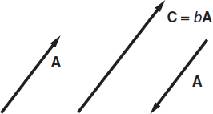
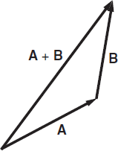
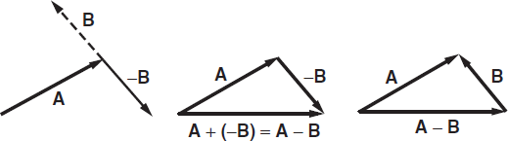
Algebraic Operations on Vectors
One can multiply a vector by a scalar (number)
The operation leads to a change in magnitude of the original vector if b > 0
Will flip the direction as well, if b < 0
Obviously, for b = −1, just a direction flip occurs
Given two vectors A and B, one can add the two, as shown in the second figure
Similarly, one can subtract one from the other.

Slide 9
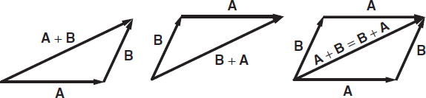
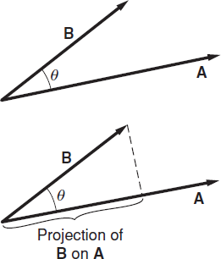
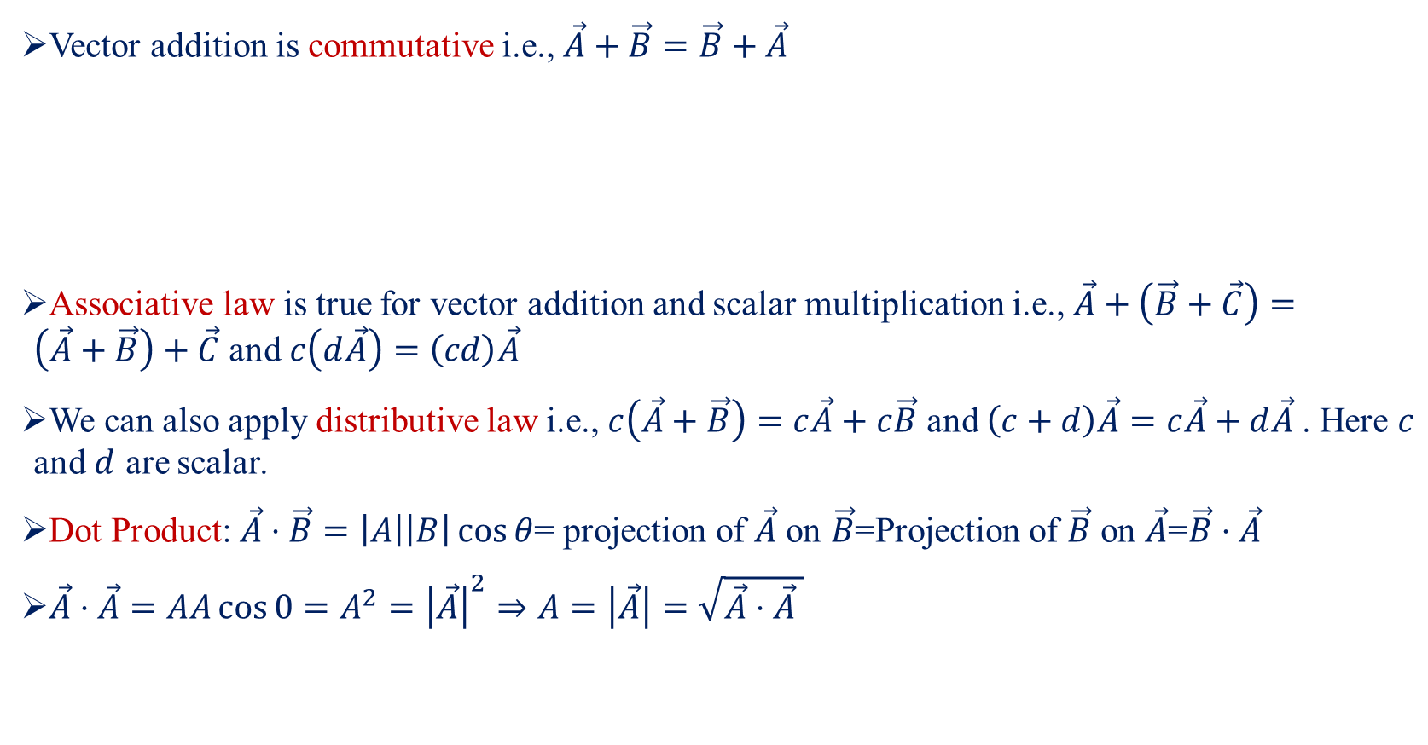
Properties of Vectors-I
Vector addition is commutative i.e., $\vec{A}+\vec{B}=\vec{B}+\vec{A}$
Associative law is true for vector addition and scalar multiplication i.e., $\vec{A}+\left(\vec{B}+\vec{C}\right)=\left(\vec{A}+\vec{B}\right)+\vec{C}$ and $c\left(d\vec{A}\right)=\left(cd\right)\vec{A}$
We can also apply distributive law i.e., $c\left(\vec{A}+\vec{B}\right)=c\vec{A}+c\vec{B}$ and $\left(c+d\right)\vec{A}=c\vec{A}+d\vec{A}$. Here $c$ and $d$ are scalar.
Dot Product: $\vec{A}⋅\vec{B}=\left|A\right|\left|B\right|\cos{θ}$= projection of $\vec{A}$ on $\vec{B}$=Projection of $\vec{B}$ on $\vec{A}$=$\vec{B}⋅\vec{A}$
$\vec{A}⋅\vec{A}=AA\cos{0}=A^{2}={\left|\vec{A}\right|}^{2}⇒A=\left|\vec{A}\right|=\sqrt{\vec{A}⋅\vec{A} }$

Slide 10
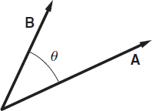
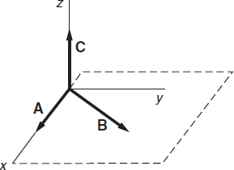

Properties of Vectors-II
Let us again consider the angle between two vectors $\vec{A}$ and $\vec{B}$ is $θ$.
The other type of vector product, known as cross product, yield a third vector $\vec{C}$ (say),
such that $\vec{A}×\vec{B}=\vec{C}$
The magnitude of $C$ is $\left|\vec{A}\right|\left|\vec{B}\right|\sin{θ}$
The direction of $\vec{C}$ is perpendicular of $\vec{A}$ and $\vec{B}$.
$\vec{A}×\vec{A}=0$
$\vec{A}×\vec{B}=−\vec{B}×\vec{A}$

Slide 11
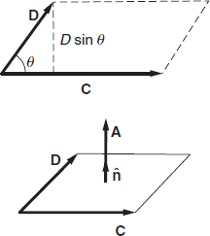
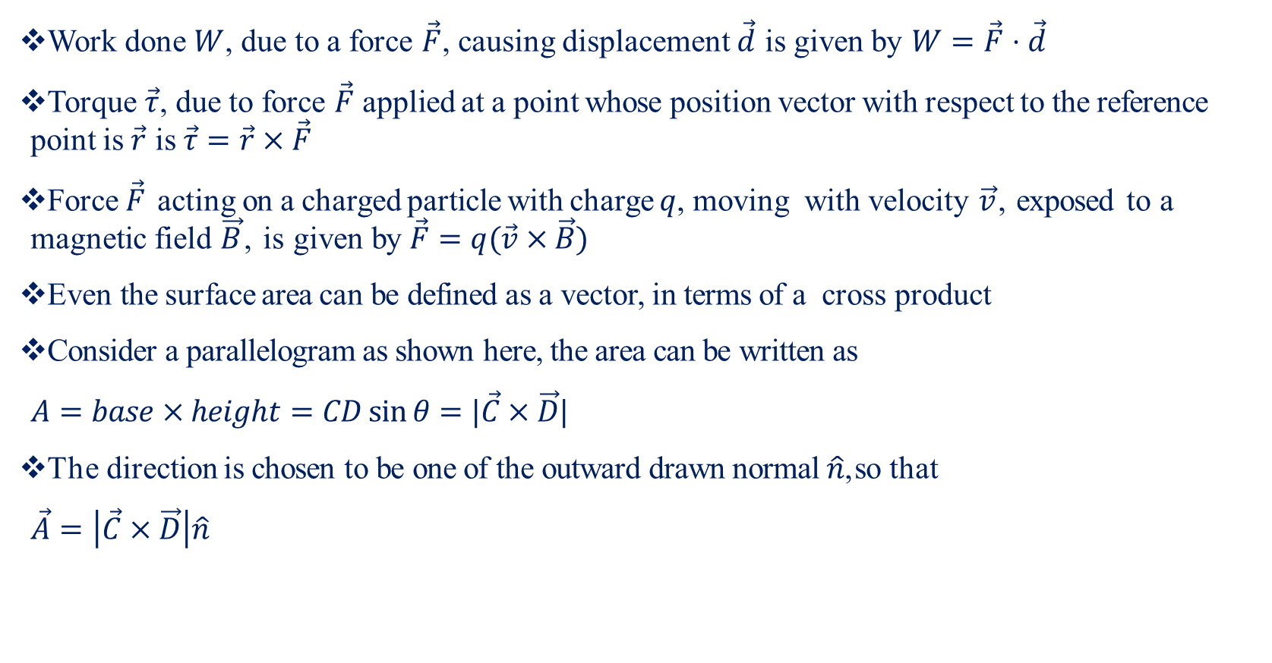
Application in Physics
Work done $W$, due to a force $\vec{F}$, causing displacement $\vec{d}$ is given by $W=\vec{F}⋅\vec{d}$
Torque $\vec{τ}$, due to force $\vec{F}$ applied at a point whose position vector with respect to the reference point is $\vec{r}$ is $\vec{τ}=\vec{r}×\vec{F}$
Force $\vec{F}$ acting on a charged particle with charge $q$, moving with velocity $\vec{v}$, exposed to a magnetic field $\vec{B}$, is given by $\vec{F}=q(\vec{v}×\vec{B})$
Even the surface area can be defined as a vector, in terms of a cross product
Consider a parallelogram as shown here, the area can be written as
$A=base×height=CD\sin{θ}=|\vec{C}×\vec{D}|$
The direction is chosen to be one of the outward drawn normal $\hat{n}$, so that
$\vec{A}=\left|\vec{C}×\vec{D}\right|\hat{n}$

Slide 12
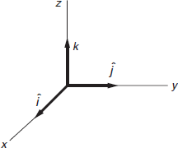
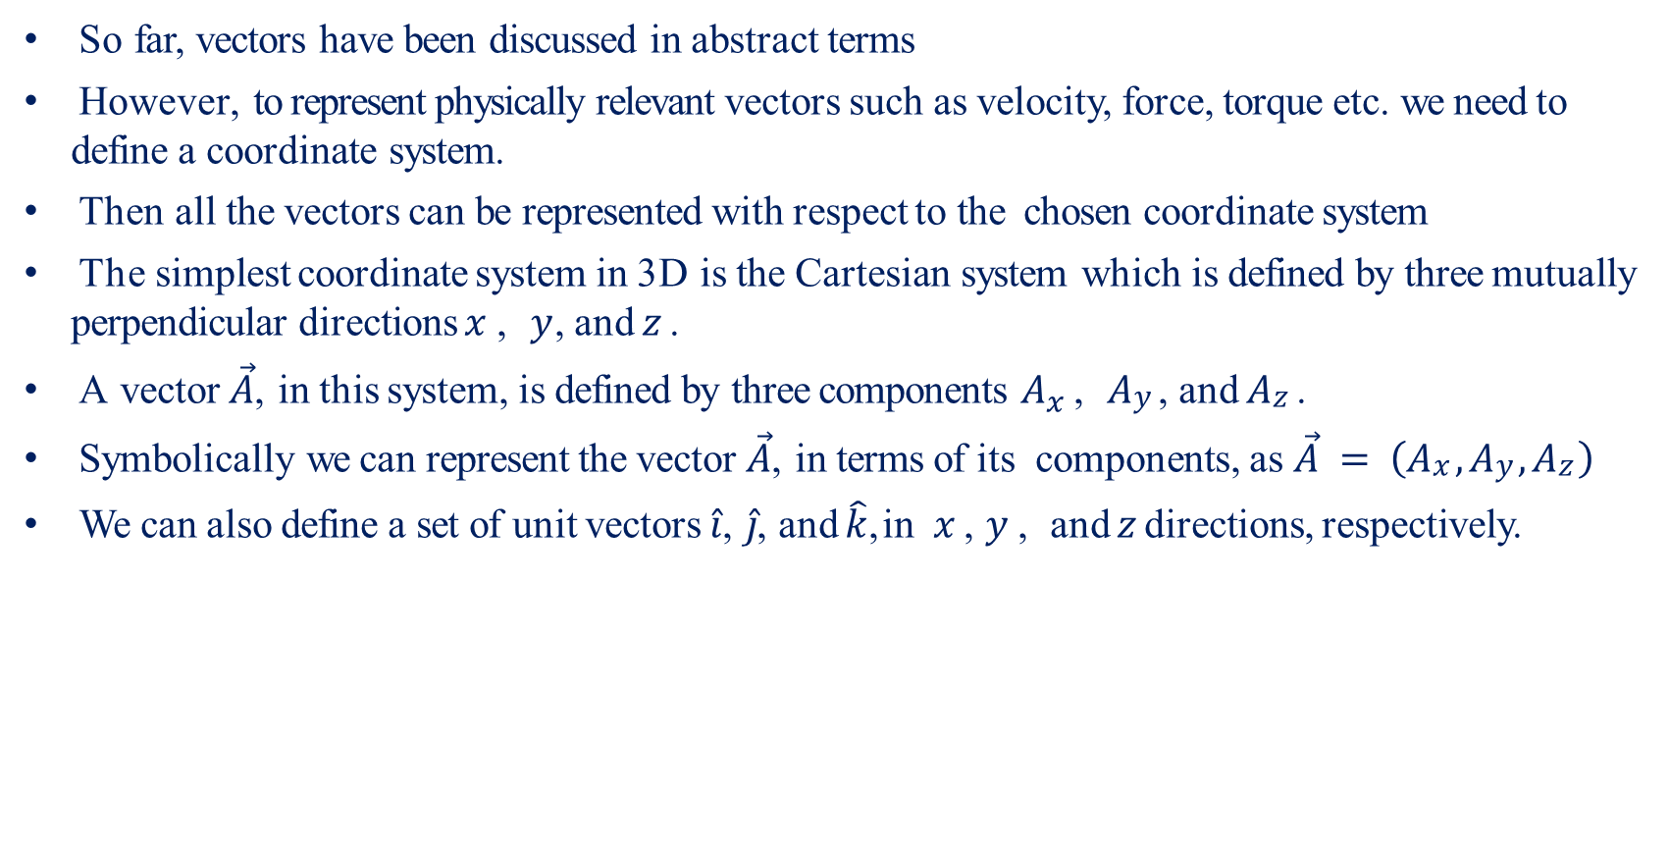
Cartesian Coordinate System-I
So far, vectors have been discussed in abstract terms
However, to represent physically relevant vectors such as velocity, force, torque etc. we need to define a coordinate system.
Then all the vectors can be represented with respect to the chosen coordinate system
The simplest coordinate system in 3D is the Cartesian system which is defined by three mutually perpendicular directions $x$ , $y$, and $z$ .
A vector $\vec{A}$, in this system, is defined by three components $A_{x}$ , $Ay$ , and $Az$ .
Symbolically we can represent the vector $\vec{A}$, in terms of its components, as $\vec{A} = \left(Ax , Ay , Az \right)$
We can also define a set of unit vectors $\hat{i}$, $\hat{j}$, and $\hat{k}$, in $x$ , $y$ , and $z$ directions, respectively.

Slide 13
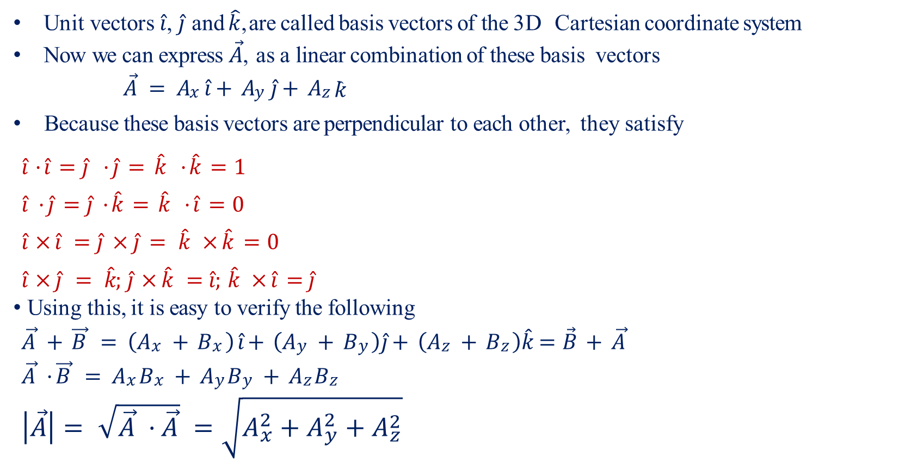
Cartesian Coordinate System-II
Unit vectors $\hat{i}$, $\hat{j}$ and $\hat{k}$, are called basis vectors of the 3D Cartesian coordinate system
Now we can express $\vec{A}$, as a linear combination of these basis vectors
$\vec{A} = Ax \hat{i}+ Ay \hat{j}+ Az \hat{k}$
Because these basis vectors are perpendicular to each other, they satisfy
$\hat{i} ·\hat{i} =\hat{j} ·\hat{j} = \hat{k} ·\hat{k} =1$
$\hat{i} ·\hat{j} =\hat{j} ·\hat{k} = \hat{k} ·\hat{i} =0$
$\hat{i} ×\hat{i} =\hat{j} ×\hat{j} = \hat{k} ×\hat{k} =0$
$\hat{i} ×\hat{j} = \hat{k}; \hat{j} ×\hat{k} =\hat{i}; \hat{k} ×\hat{i} =\hat{j}$
Using this, it is easy to verify the following
$\vec{A} + \vec{B} = \left(Ax + Bx \right) \hat{i}+ \left(Ay + By \right)\hat{j}+ \left(Az + Bz \right)\hat{k}=\vec{B} + \vec{A}$
$\vec{A} · \vec{B} = Ax Bx + Ay By + Az Bz$
$\left|\vec{A}\right|= \sqrt{\vec{A} · \vec{A}} =\sqrt{A_{x}^{2}+A_{y}^{2}+A_{z}^{2}}$

Slide 14

Cartesian Coordinate System-III
Similarly, $\vec{A}×\vec{B}=\left|\begin{matrix}\hat{i} & \hat{j} & \hat{k} \\ A_{x} & A_{y} & A_{z} \\ B_{x} & B_{y} & B_{z}\end{matrix}\right|$
Position vector of a point P, with Cartesian coordinates $(x, y, z )$, is given by $\vec{r} = x \hat{i} + y \hat{j} + z \hat{k}$
Vector connecting two points $(x, y, z )$, and $(x + dx, y + dy, z + dz )$, which are infinitesimally apart from each other, is given by $d\vec{r} = dx \hat{i} + dy \hat{j} + dz \hat{k}$

Slide 15
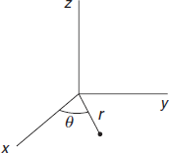
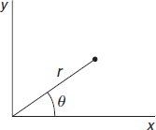
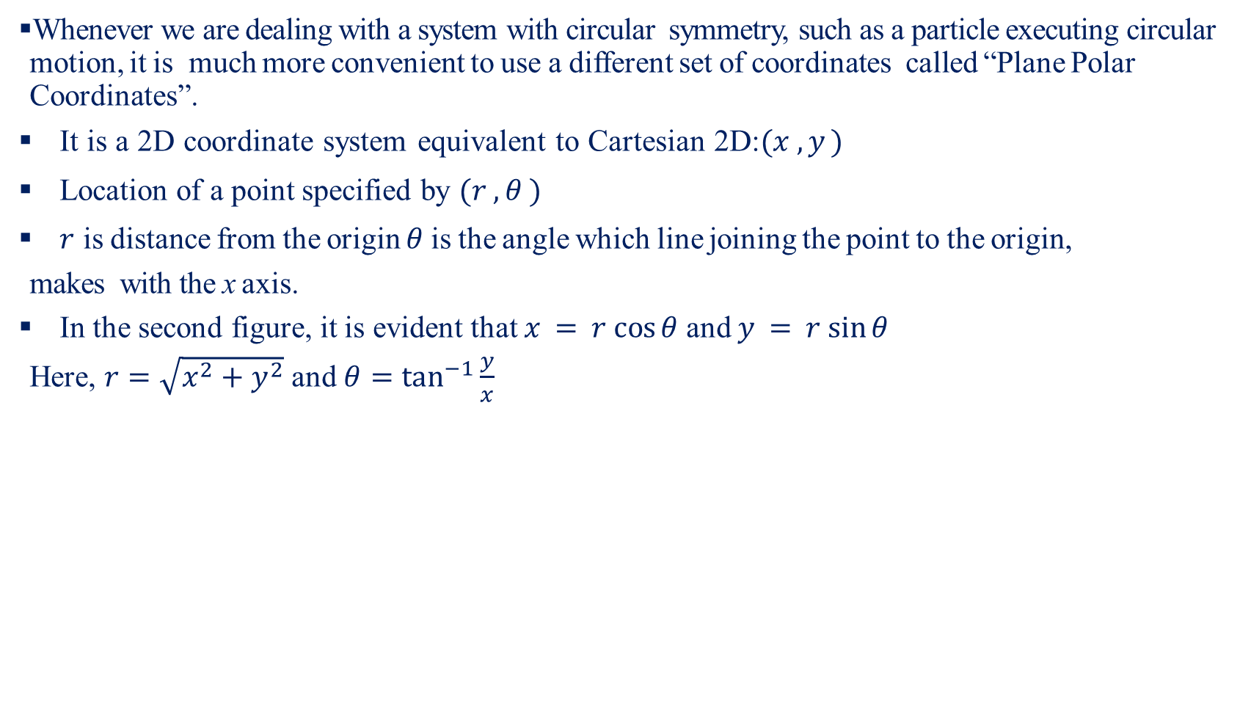
Polar Coordinate System-I
Whenever we are dealing with a system with circular symmetry, such as a particle executing circular motion, it is much more convenient to use a different set of coordinates called “Plane Polar Coordinates”.
It is a 2D coordinate system equivalent to Cartesian 2D:$(x , y )$
Location of a point specified by $(r , θ )$
$r$ is distance from the origin $θ$ is the angle which line joining the point to the origin,
makes with the x axis.
In the second figure, it is evident that $x = r cos⁡θ$ and $y = r sin⁡θ$
Here, $r=\sqrt{x^{2}+y^{2}}$ and $θ=\tan^{−1}{\frac{y}{x}}$

Slide 16
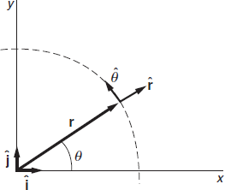
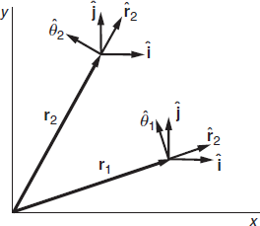
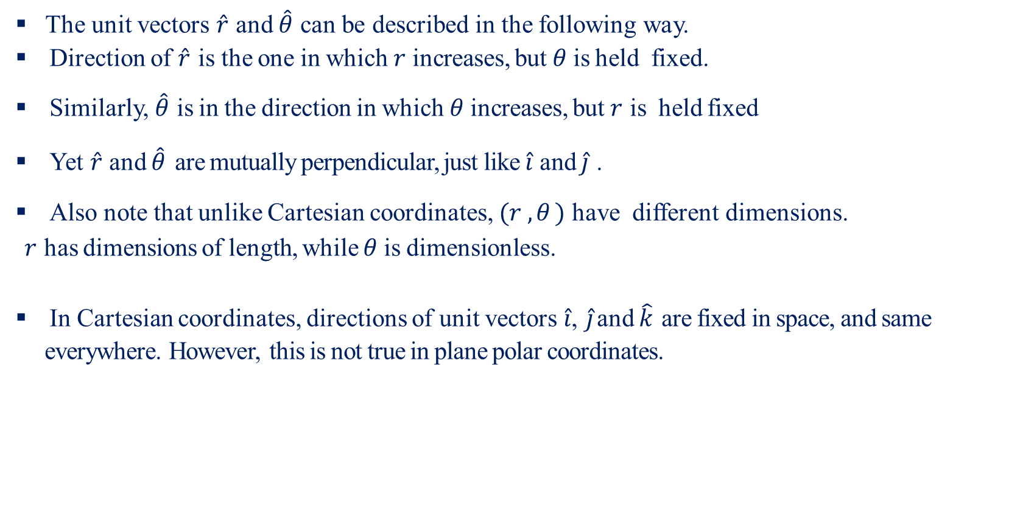
Polar Coordinate System-II
The unit vectors $\hat{r}$ and $\hat{θ}$ can be described in the following way.
Direction of $\hat{r}$ is the one in which $r$ increases, but $θ$ is held fixed.
Similarly, $\hat{θ}$ is in the direction in which $θ$ increases, but $r$ is held fixed
Yet $\hat{r}$ and $\hat{θ}$ are mutually perpendicular, just like $\hat{i}$ and $\hat{j}$ .
Also note that unlike Cartesian coordinates, $(r , θ )$ have different dimensions.
$r$ has dimensions of length, while $θ$ is dimensionless.
In Cartesian coordinates, directions of unit vectors $\hat{i}$, $\hat{j}$ and $\hat{k}$ are fixed in space, and same everywhere. However, this is not true in plane polar coordinates.

Slide 17
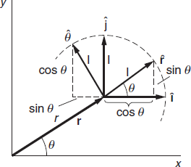
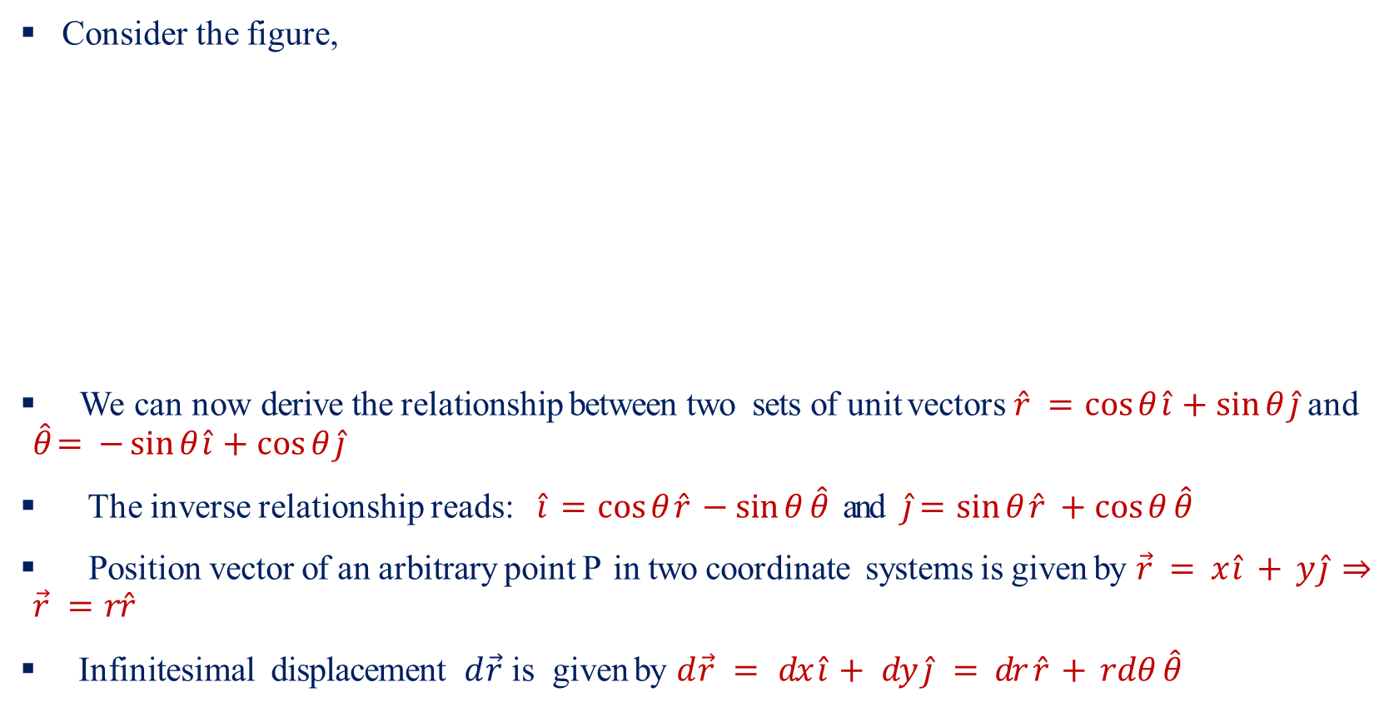
Polar Coordinate System-III
Consider the figure,
We can now derive the relationship between two sets of unit vectors $\hat{r} =\cos{θ}\hat{i} +\sin{θ}\hat{j}$ and $\hat{θ}= −\sin{θ}\hat{i} +\cos{θ}\hat{j}$
The inverse relationship reads: $\hat{i} =\cos{θ}\hat{r} −\sin{θ}\hat{θ}$and $\hat{j}=\sin{θ}\hat{r} +\cos{θ}\hat{θ}$
Position vector of an arbitrary point P in two coordinate systems is given by $\vec{r} = x \hat{i} + y \hat{j} ⇒\vec{r} =r\hat{r}$
Infinitesimal displacement $d\vec{r}$ is given by $d\vec{r} = dx \hat{i} + dy \hat{j} = dr \hat{r} + rdθ \hat{θ}$

