Slide 1
Mechanics
EPHY108L (2-0-2-3)
Ayan khan
Department of physics

Slide 2
Harmonic Oscillator

Slide 3
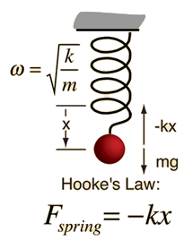
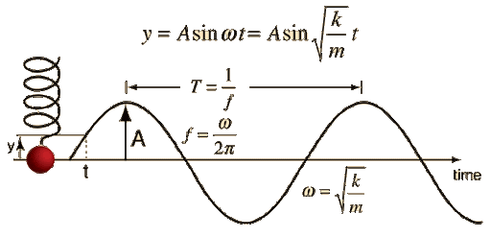
Simple Harmonic Motion-I
The force F needed to extend or compress a spring by some distance X is proportional
to that distance.
F=-kx
Newton’s Second Law, F=ma
x
x

Slide 4
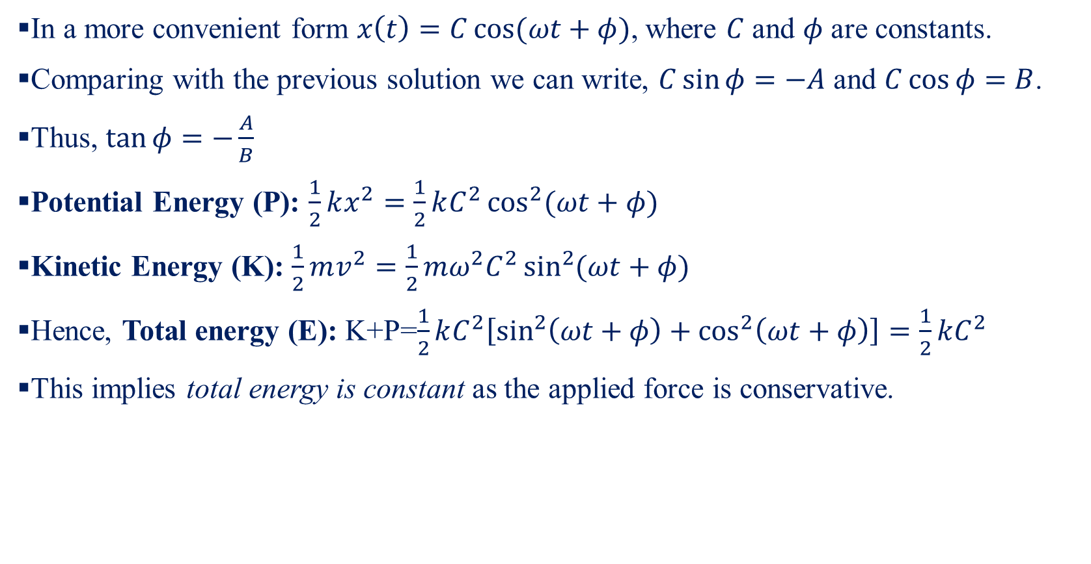
Simple Harmonic Motion-II
In a more convenient form $x\left(t\right)=C\cos{(ωt+φ)}$, where $C$ and $φ$ are constants.
Comparing with the previous solution we can write, $C\sin{φ}=−A$ and $C\cos{φ}=B$.
Thus, $\tan{φ}=−\frac{A}{B}$
Potential Energy (P): $\frac{1}{2}kx^{2}=\frac{1}{2}kC^{2}\cos^{2}{(ωt+φ)}$
Kinetic Energy (K): $\frac{1}{2}mv^{2}=\frac{1}{2}mω^{2}C^{2}\sin^{2}{(ωt+φ)}$
Hence, Total energy (E): K+P=$\frac{1}{2}kC^{2}\left[\sin^{2}\left(ωt+φ\right)+\cos^{2}\left(ωt+φ\right)\right]=\frac{1}{2}kC^{2}$
This implies total energy is constant as the applied force is conservative.

Slide 5
Simple Harmonic Motion-III
If a 4.0-kg mass is suspended from the lower end of a coiled spring, it stretches a distance of 18.0cm. If the spring is then extended farther and released, it will be set vibrating up and down with SHM. Find (a) the spring constant k, (b) the period T, (c) the frequency v, and (d) the total energy stored in the vibrating system.
The spring constant
The period
The frequency
The total energy

Slide 6
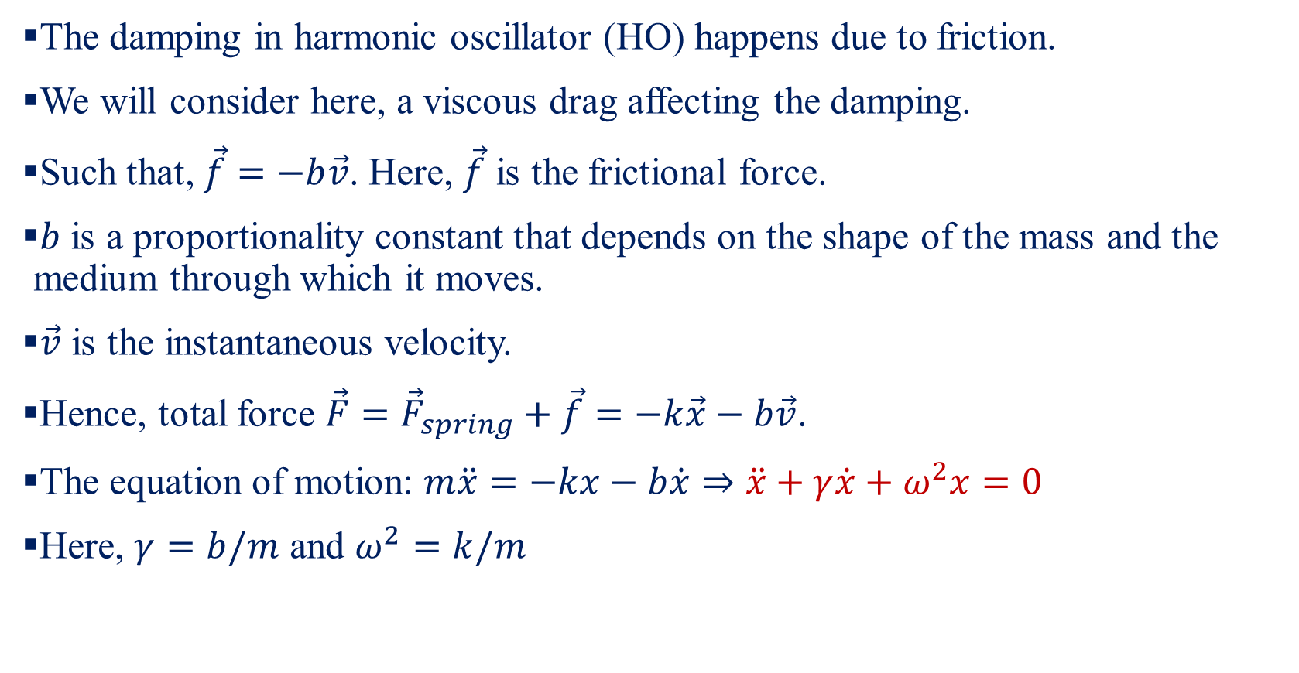
Damped Harmonic Oscillator-I
The damping in harmonic oscillator (HO) happens due to friction.
We will consider here, a viscous drag affecting the damping.
Such that, $\vec{f}=−b\vec{v}$. Here, $\vec{f}$ is the frictional force.
$b$ is a proportionality constant that depends on the shape of the mass and the medium through which it moves.
$\vec{v}$ is the instantaneous velocity.
Hence, total force $\vec{F}={\vec{F}}_{spring}+\vec{f}=−k\vec{x}−b\vec{v}$.
The equation of motion: $m\ddot{x}=−kx−b\dot{x}⇒\ddot{x}+γ\dot{x}+ω^{2}x=0$
Here, $γ=b/m$ and $ω^{2}=k/m$

Slide 7
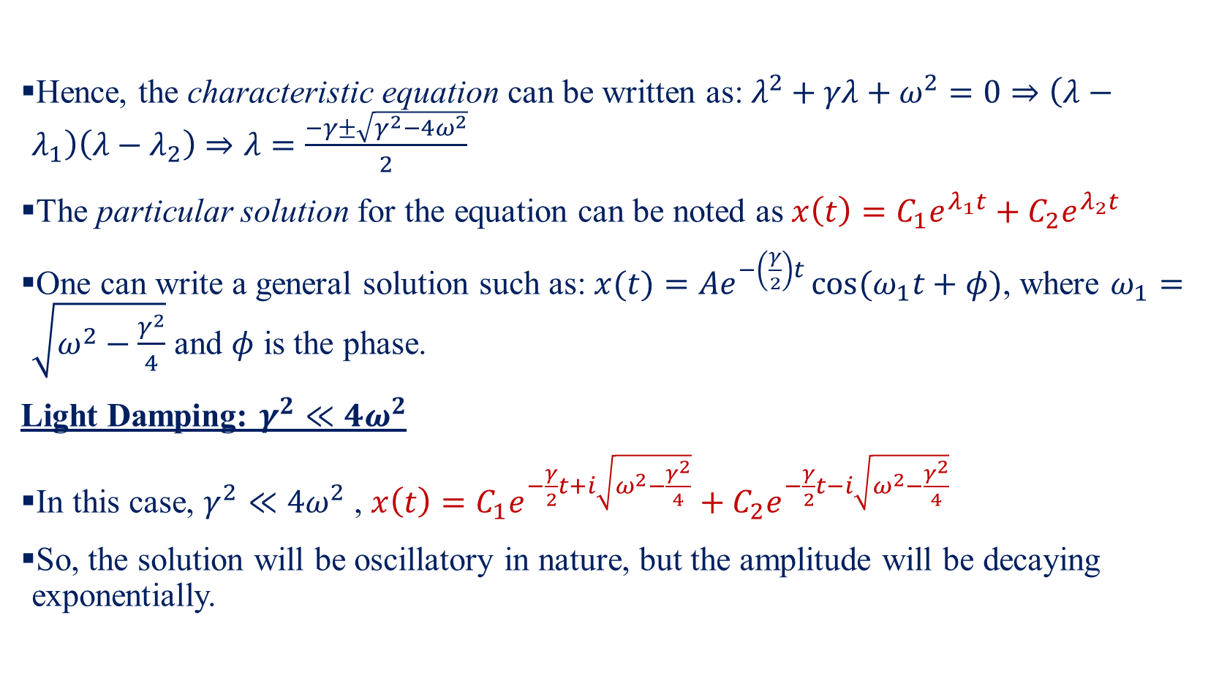
Damped Harmonic Oscillator-II
Hence, the characteristic equation can be written as: $λ^{2}+γλ+ω^{2}=0⇒\left(λ−λ_{1}\right)\left(λ−λ_{2}\right)⇒λ=\frac{−γ±\sqrt{γ^{2}−4ω^{2}}}{2}$
The particular solution for the equation can be noted as $x\left(t\right)=C_{1}e^{λ_{1}t}+C_{2}e^{λ_{2}t}$
One can write a general solution such as: $x(t)=Ae^{−\left(\frac{γ}{2}\right)t}\cos{(ω_{1}t+φ)}$, where $ω_{1}=\sqrt{ω^{2}−\frac{γ^{2}}{4}}$ and $φ$ is the phase.
Light Damping: $γ^{2}≪4ω^{2}$
In this case, $γ^{2}≪4ω^{2}$ , $x\left(t\right)=C_{1}e^{−\frac{γ}{2}t+i\sqrt{ω^{2}−\frac{γ^{2}}{4}}}+C_{2}e^{−\frac{γ}{2}t−i\sqrt{ω^{2}−\frac{γ^{2}}{4}}}$
So, the solution will be oscillatory in nature, but the amplitude will be decaying exponentially.

Slide 8
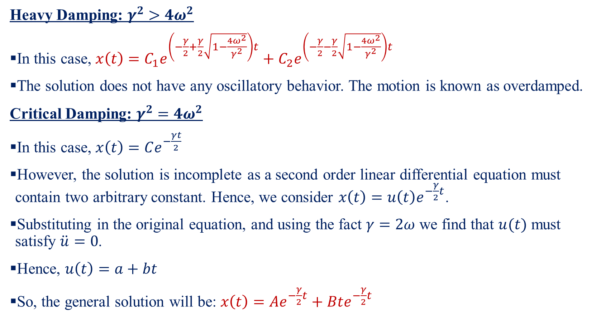
Damped Harmonic Oscillator-III
Heavy Damping: $γ^{2}>4ω^{2}$
In this case, $x\left(t\right)=C_{1}e^{\left(−\frac{γ}{2}+\frac{γ}{2}\sqrt{1−\frac{4ω^{2}}{γ^{2}}}\right)t}+C_{2}e^{\left(−\frac{γ}{2}−\frac{γ}{2}\sqrt{1−\frac{4ω^{2}}{γ^{2}}}\right)t}$
The solution does not have any oscillatory behavior. The motion is known as overdamped.
Critical Damping: $γ^{2}=4ω^{2}$
In this case, $x\left(t\right)=Ce^{−\frac{γt}{2}}$
However, the solution is incomplete as a second order linear differential equation must contain two arbitrary constant. Hence, we consider $x\left(t\right)=u\left(t\right)e^{−\frac{γ}{2}t}$.
Substituting in the original equation, and using the fact $γ=2ω$ we find that $u(t)$ must satisfy $\ddot{u}=0$.
Hence, $u\left(t\right)=a+bt$
So, the general solution will be: $x\left(t\right)=Ae^{−\frac{γ}{2}t}+Bte^{−\frac{γ}{2}t}$

Slide 9
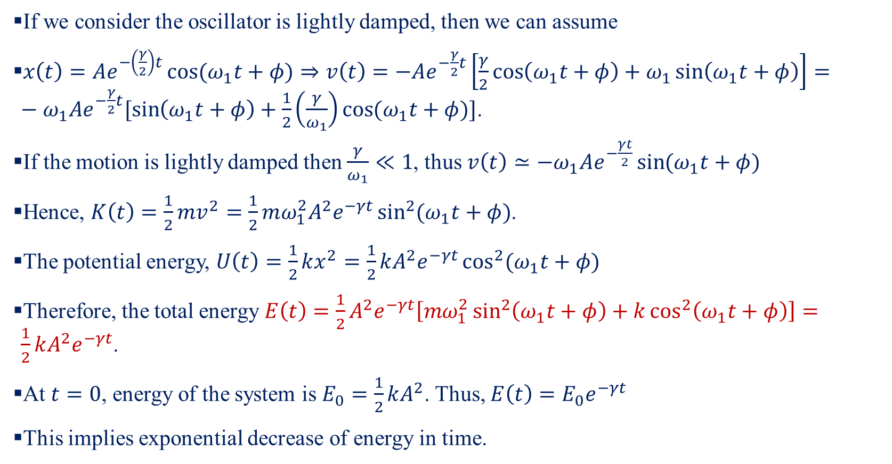
Damped Harmonic Oscillator-IV
If we consider the oscillator is lightly damped, then we can assume
$x\left(t\right)=Ae^{−\left(\frac{γ}{2}\right)t}\cos{(ω_{1}t+φ)}⇒v\left(t\right)=−Ae^{−\frac{γ}{2}t}\left[\frac{γ}{2}\cos\left(ω_{1}t+φ\right)+ω_{1}\sin\left(ω_{1}t+φ\right)\right]=−ω_{1}Ae^{−\frac{γ}{2}t}[\sin\left(ω_{1}t+φ\right)+\frac{1}{2}\left(\frac{γ}{ω_{1}}\right)\cos{(ω_{1}t+φ)}]$.
If the motion is lightly damped then $\frac{γ}{ω_{1}}≪1$, thus $v\left(t\right)≃−ω_{1}Ae^{−\frac{γt}{2}}\sin{(ω_{1}t+φ)}$
Hence, $K\left(t\right)=\frac{1}{2}mv^{2}=\frac{1}{2}mω_{1}^{2}A^{2}e^{−γt}\sin^{2}{(ω_{1}t+φ)}$.
The potential energy, $U\left(t\right)=\frac{1}{2}kx^{2}=\frac{1}{2}kA^{2}e^{−γt}\cos^{2}{(ω_{1}t+φ)}$
Therefore, the total energy $E\left(t\right)=\frac{1}{2}A^{2}e^{−γt}\left[mω_{1}^{2}\sin^{2}\left(ω_{1}t+φ\right)+k\cos^{2}\left(ω_{1}t+φ\right)\right]=\frac{1}{2}kA^{2}e^{−γt}$.
At $t=0$, energy of the system is $E_{0}=\frac{1}{2}kA^{2}$. Thus, $E\left(t\right)=E_{0}e^{−γt}$
This implies exponential decrease of energy in time.

Slide 10
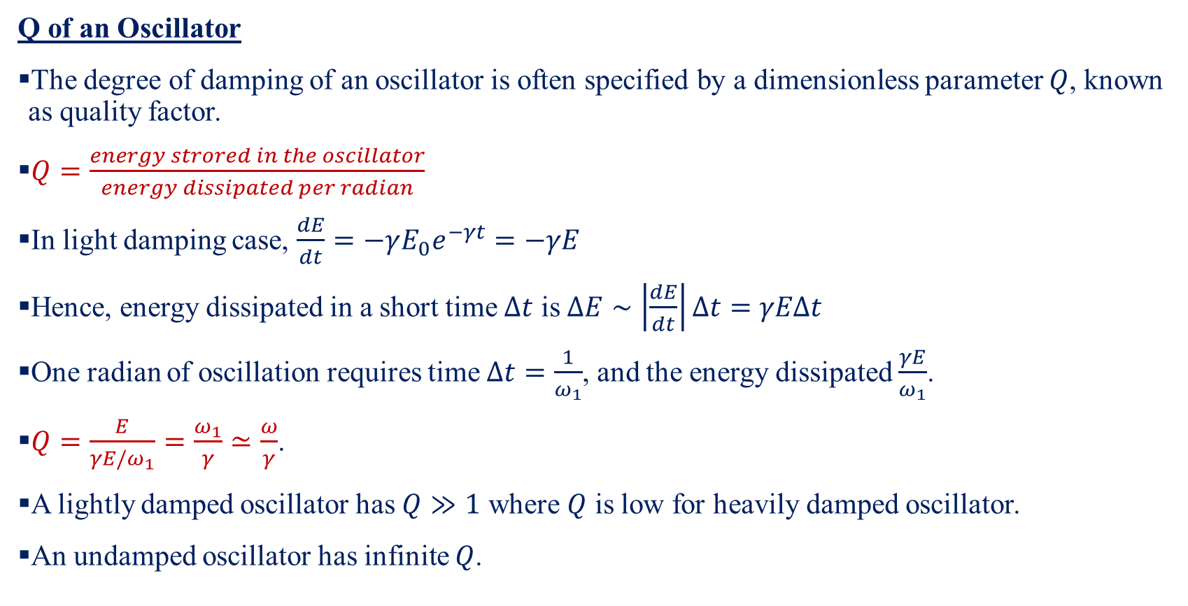
Damped Harmonic Oscillator-V
Q of an Oscillator
The degree of damping of an oscillator is often specified by a dimensionless parameter $Q$, known as quality factor.
$Q=\frac{energy strored in the oscillator}{energy dissipated per radian}$
In light damping case, $\frac{dE}{dt}=−γE_{0}e^{−γt}=−γE$
Hence, energy dissipated in a short time $Δt$ is $ΔE∼\left|\frac{dE}{dt}\right|Δt=γEΔt$
One radian of oscillation requires time $Δt=\frac{1}{ω_{1}}$, and the energy dissipated $\frac{γE}{ω_{1}}$.
$Q=\frac{E}{γE/ω_{1}}=\frac{ω_{1}}{γ}≃\frac{ω}{γ}$.
A lightly damped oscillator has $Q≫1$ where $Q$ is low for heavily damped oscillator.
An undamped oscillator has infinite $Q$.

Slide 11
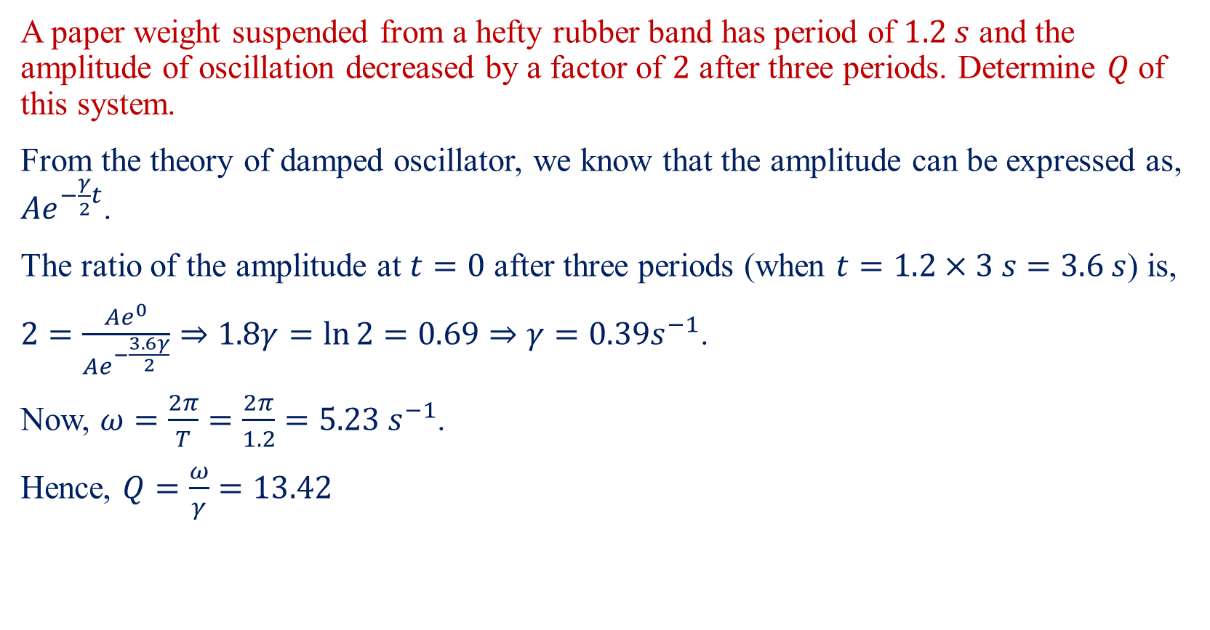
Damped Harmonic Oscillator-VI
A paper weight suspended from a hefty rubber band has period of $1.2 s$ and the amplitude of oscillation decreased by a factor of $2$ after three periods. Determine $Q$ of this system.
From the theory of damped oscillator, we know that the amplitude can be expressed as, $Ae^{−\frac{γ}{2}t}$.
The ratio of the amplitude at $t=0$ after three periods (when $t=1.2×3 s=3.6 s$) is,
$2=\frac{Ae^{0}}{Ae^{−\frac{3.6γ}{2}}}⇒1.8γ=\ln{2}=0.69⇒γ=0.39s^{−1}$.
Now, $ω=\frac{2π}{T}=\frac{2π}{1.2}=5.23 s^{−1}$.
Hence, $Q=\frac{ω}{γ}=13.42$

Slide 12
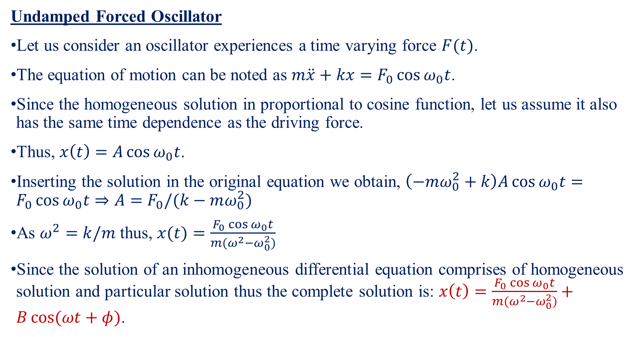
Forced Oscillator-I
Undamped Forced Oscillator
Let us consider an oscillator experiences a time varying force $F(t)$.
The equation of motion can be noted as $m\ddot{x}+kx=F_{0}\cos{ω_{0}t}$.
Since the homogeneous solution in proportional to cosine function, let us assume it also has the same time dependence as the driving force.
Thus, $x\left(t\right)=A\cos{ω_{0}t}$.
Inserting the solution in the original equation we obtain, $\left(−mω_{0}^{2}+k\right)A\cos{ω_{0}t}=F_{0}\cos{ω_{0}t}⇒A=F_{0}/(k−mω_{0}^{2})$
As $ω^{2}=k/m$ thus, $x(t)=\frac{F_{0}\cos{ω_{0}t}}{m(ω^{2}−ω_{0}^{2})}$
Since the solution of an inhomogeneous differential equation comprises of homogeneous solution and particular solution thus the complete solution is: $x\left(t\right)=\frac{F_{0}\cos{ω_{0}t}}{m(ω^{2}−ω_{0}^{2})}+B\cos{(ωt+φ)}$.

Slide 13
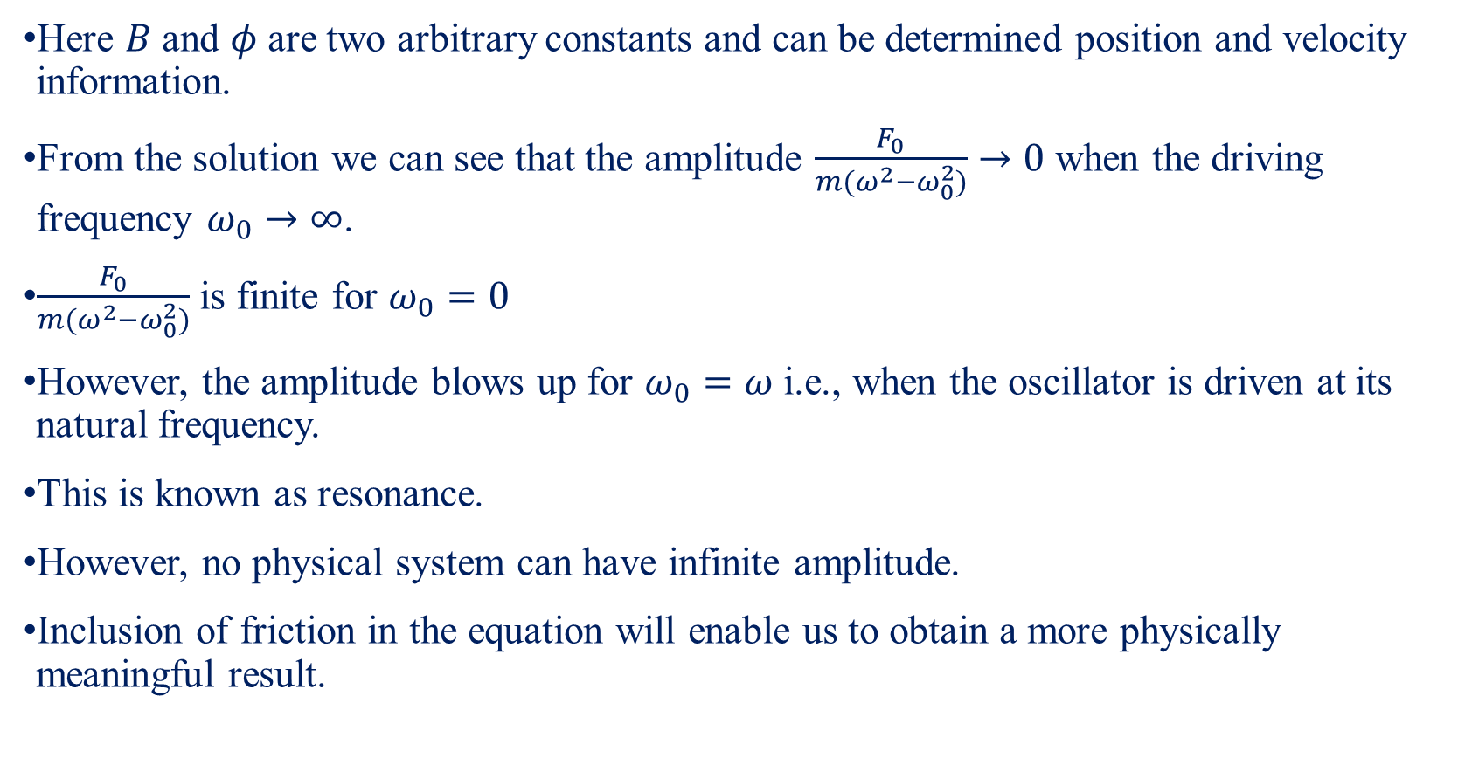
Forced Oscillator-II
Here $B$ and $φ$ are two arbitrary constants and can be determined position and velocity information.
From the solution we can see that the amplitude $\frac{F_{0}}{m(ω^{2}−ω_{0}^{2})}→0$ when the driving frequency $ω_{0}→∞$.
$\frac{F_{0}}{m(ω^{2}−ω_{0}^{2})}$ is finite for $ω_{0}=0$
However, the amplitude blows up for $ω_{0}=ω$ i.e., when the oscillator is driven at its natural frequency.
This is known as resonance.
However, no physical system can have infinite amplitude.
Inclusion of friction in the equation will enable us to obtain a more physically meaningful result.

Slide 14
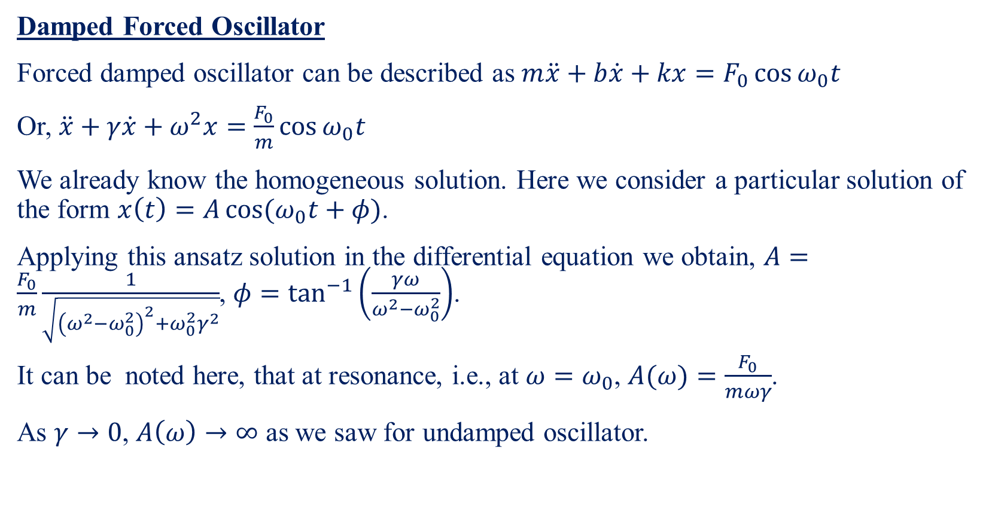
Forced Oscillator-III
Damped Forced Oscillator
Forced damped oscillator can be described as $m\ddot{x}+b\dot{x}+kx=F_{0}\cos{ω_{0}t}$
Or, $\ddot{x}+γ\dot{x}+ω^{2}x=\frac{F_{0}}{m}\cos{ω_{0}t}$
We already know the homogeneous solution. Here we consider a particular solution of the form $x\left(t\right)=A\cos{(ω_{0}t}+φ)$.
Applying this ansatz solution in the differential equation we obtain, $A=\frac{F_{0}}{m}\frac{1}{\sqrt{{\left(ω^{2}−ω_{0}^{2}\right)}^{2}+ω_{0}^{2}γ^{2}}}$, $φ=\tan^{−1}\left(\frac{γω}{ω^{2}−ω_{0}^{2}}\right)$.
It can be noted here, that at resonance, i.e., at $ω=ω_{0}$, $A(ω)=\frac{F_{0}}{mωγ}$.
As $γ→0$, $A\left(ω\right)→∞$ as we saw for undamped oscillator.

Slide 15
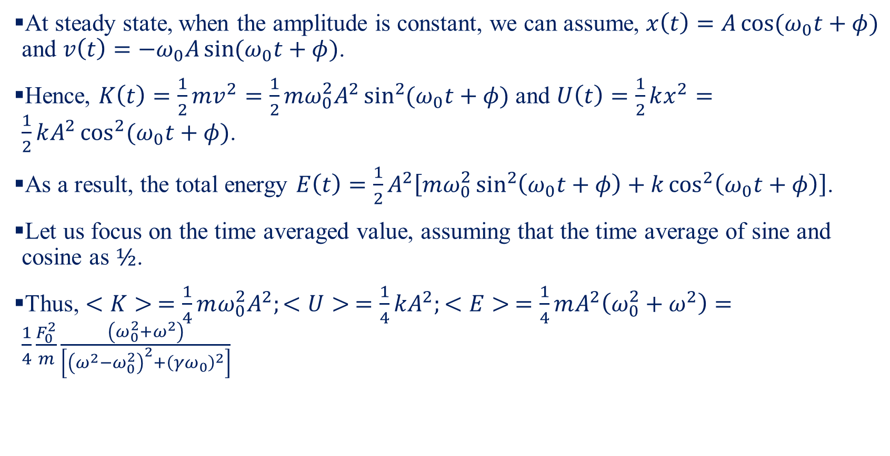
Forced Oscillator-IV
At steady state, when the amplitude is constant, we can assume, $x\left(t\right)=A\cos{(ω_{0}t+φ)}$ and $v\left(t\right)=−ω_{0}A\sin{(ω_{0}t+φ)}$.
Hence, $K\left(t\right)=\frac{1}{2}mv^{2}=\frac{1}{2}mω_{0}^{2}A^{2}\sin^{2}{(ω_{0}t+φ)}$ and $U\left(t\right)=\frac{1}{2}kx^{2}=\frac{1}{2}kA^{2}\cos^{2}{(ω_{0}t+φ)}$.
As a result, the total energy $E\left(t\right)=\frac{1}{2}A^{2}\left[mω_{0}^{2}\sin^{2}\left(ω_{0}t+φ\right)+k\cos^{2}\left(ω_{0}t+φ\right)\right]$.
Let us focus on the time averaged value, assuming that the time average of sine and cosine as $½$.
Thus, $<K> =\frac{1}{4}mω_{0}^{2}A^{2};<U> =\frac{1}{4}kA^{2};<E> =\frac{1}{4}mA^{2}\left(ω_{0}^{2}+ω^{2}\right)=\frac{1}{4}\frac{F_{0}^{2}}{m}\frac{\left(ω_{0}^{2}+ω^{2}\right)}{\left[{\left(ω^{2}−ω_{0}^{2}\right)}^{2}+{\left(γω_{0}\right)}^{2}\right]}$

Slide 16
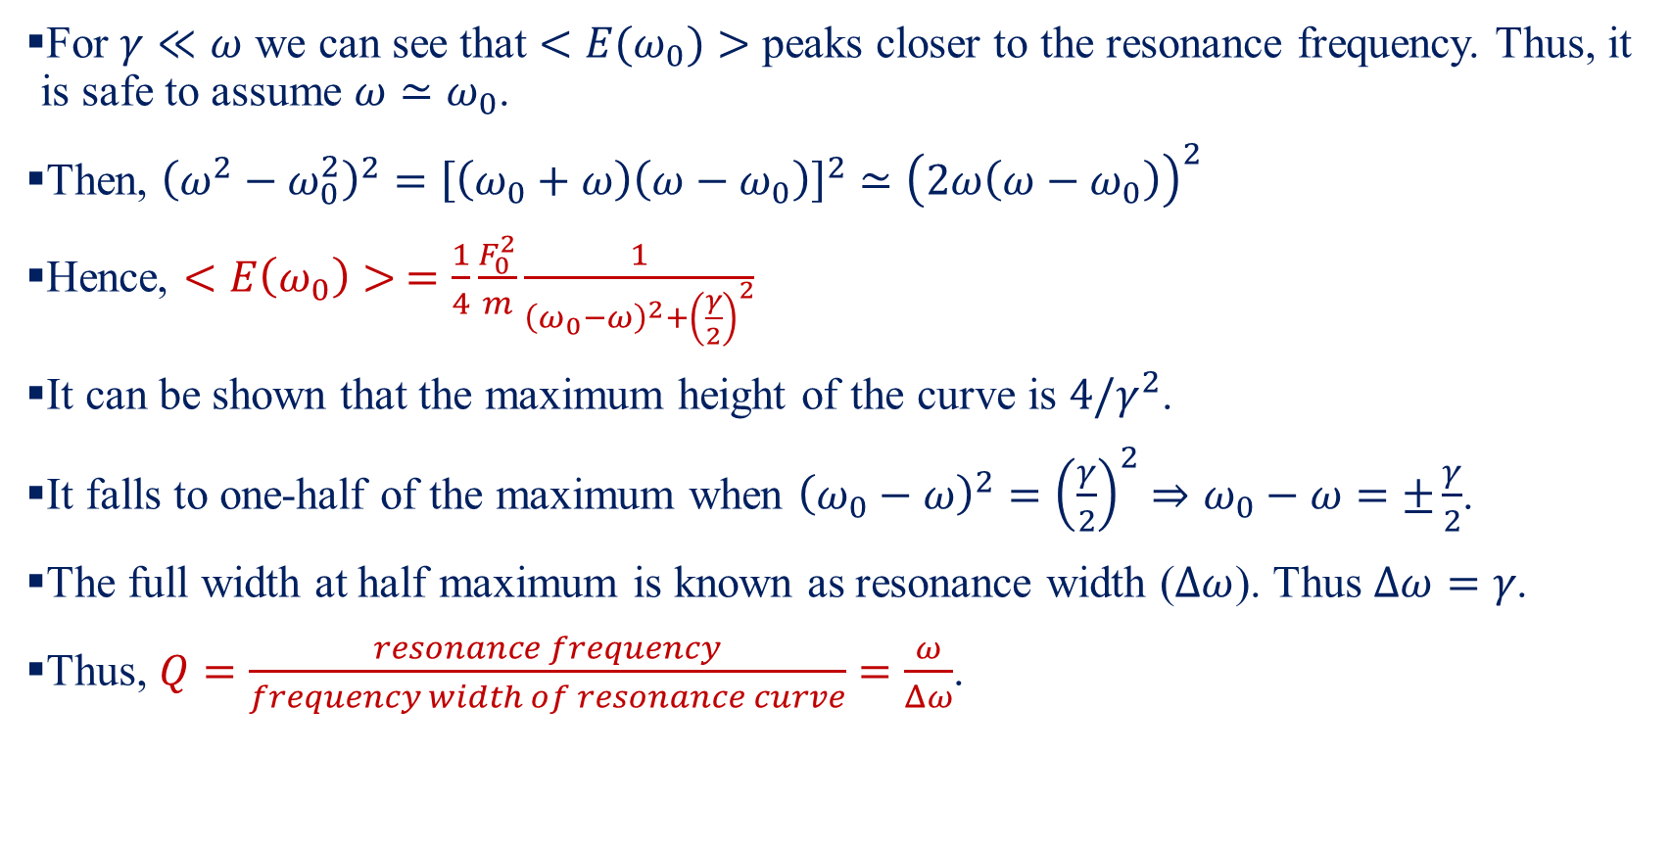
Forced Oscillator-V
For $γ≪ω$ we can see that $<E(ω_{0})>$ peaks closer to the resonance frequency. Thus, it is safe to assume $ω≃ω_{0}$.
Then, ${\left(ω^{2}−ω_{0}^{2}\right)}^{2}={\left[\left(ω_{0}+ω\right)\left(ω−ω_{0}\right)\right]}^{2}≃{\left(2ω\left(ω−ω_{0}\right)\right)}^{2}$
Hence, $<E\left(ω_{0}\right)> =\frac{1}{4}\frac{F_{0}^{2}}{m}\frac{1}{{\left(ω_{0}−ω\right)}^{2}+{\left(\frac{γ}{2}\right)}^{2}}$
It can be shown that the maximum height of the curve is $4/γ^{2}$.
It falls to one-half of the maximum when ${\left(ω_{0}−ω\right)}^{2}={\left(\frac{γ}{2}\right)}^{2}⇒ω_{0}−ω=±\frac{γ}{2}$.
The full width at half maximum is known as resonance width ($Δω$). Thus $Δω=γ$.
Thus, $Q=\frac{resonance frequency}{frequency width of resonance curve}=\frac{ω}{Δω}$.

Slide 17
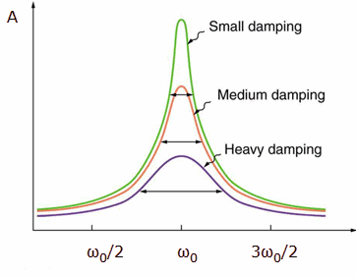






Forced Oscillator-IV
$$Δω$$
$$Δω$$
$$Δω$$
$$ω/2$$
$$ω$$
$$3ω/2$$

Slide 18
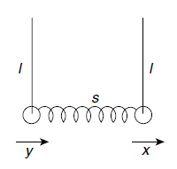
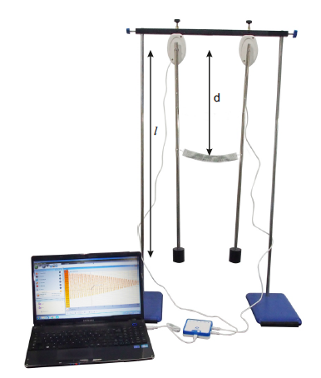
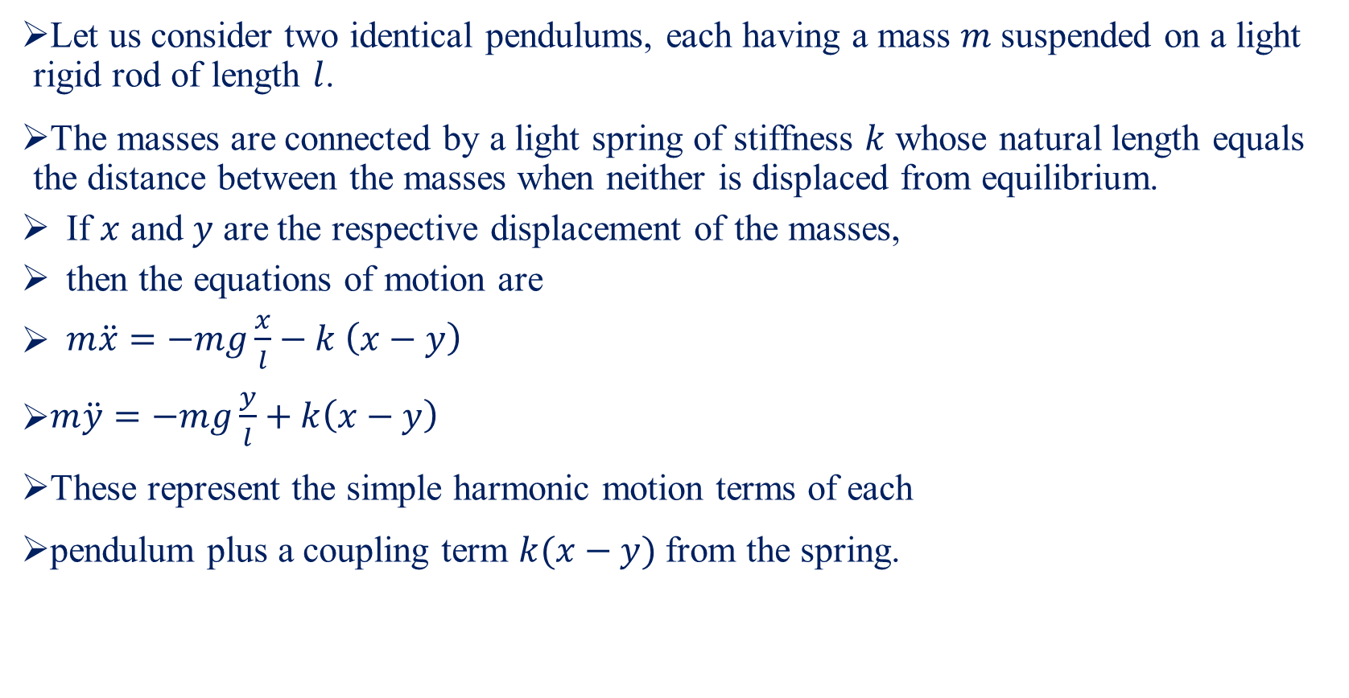
Coupled Pendulum-I
Let us consider two identical pendulums, each having a mass $m$ suspended on a light rigid rod of length $l$.
The masses are connected by a light spring of stiffness $k$ whose natural length equals the distance between the masses when neither is displaced from equilibrium.
If $x$ and $y$ are the respective displacement of the masses,
then the equations of motion are
$\begin{aligned}m\ddot{x}=−mg\frac{x}{l}−k \left(x−y\right)\#\end{aligned}$
$\begin{aligned}m\ddot{y}=−mg\frac{y}{l}+k\left(x−y\right)\#\end{aligned}$
These represent the simple harmonic motion terms of each
pendulum plus a coupling term $k(x−y)$ from the spring.

Slide 19
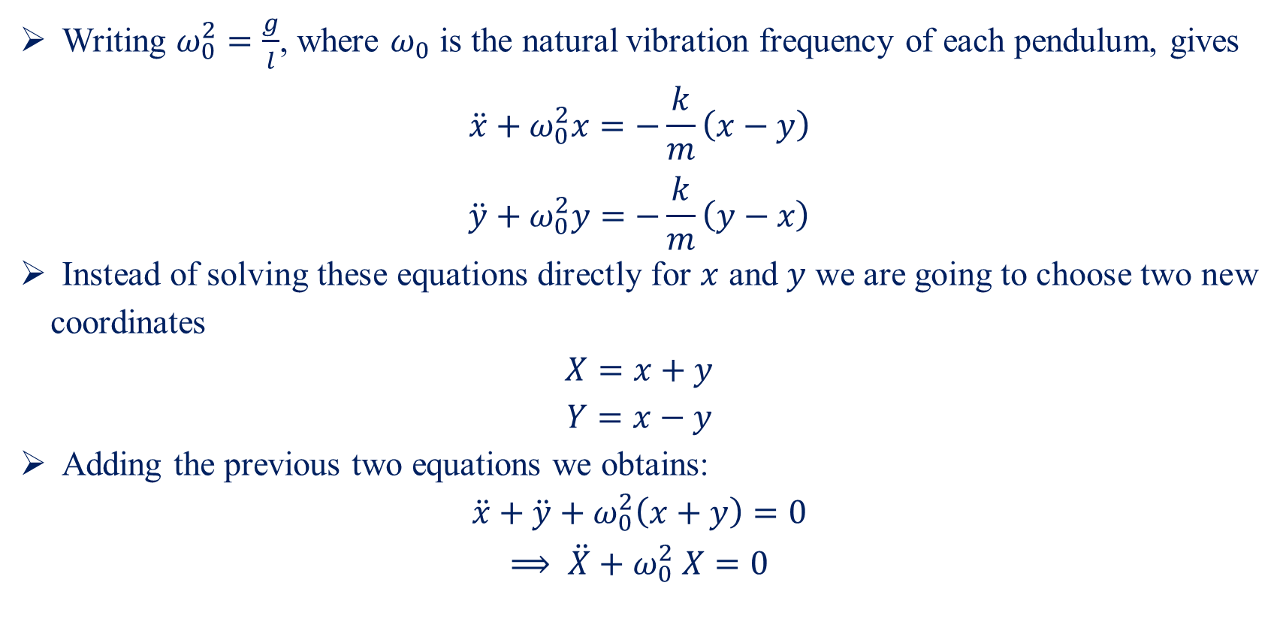
Coupled Pendulum-II
Writing $ω_{0}^{2}=\frac{g}{l}$, where $ω_{0}$ is the natural vibration frequency of each pendulum, gives
$$\begin{aligned}\ddot{x}+ω_{0}^{2}x=−\frac{k}{m}\left(x−y\right)\#\end{aligned}$$
$$\begin{aligned}\ddot{y}+ω_{0}^{2}y=−\frac{k}{m}\left(y−x\right)\#\end{aligned}$$
Instead of solving these equations directly for $x$ and $y$ we are going to choose two new coordinates
$$X=x+y$$
$$Y=x−y$$
Adding the previous two equations we obtains:
$$\ddot{x}+\ddot{y}+ω_{0}^{2}\left(x+y\right)=0$$
$$\begin{aligned}⟹ \ddot{X}+ω_{0}^{2} X=0\#\end{aligned}$$

Slide 20
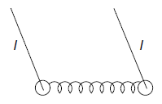
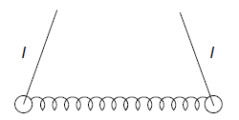
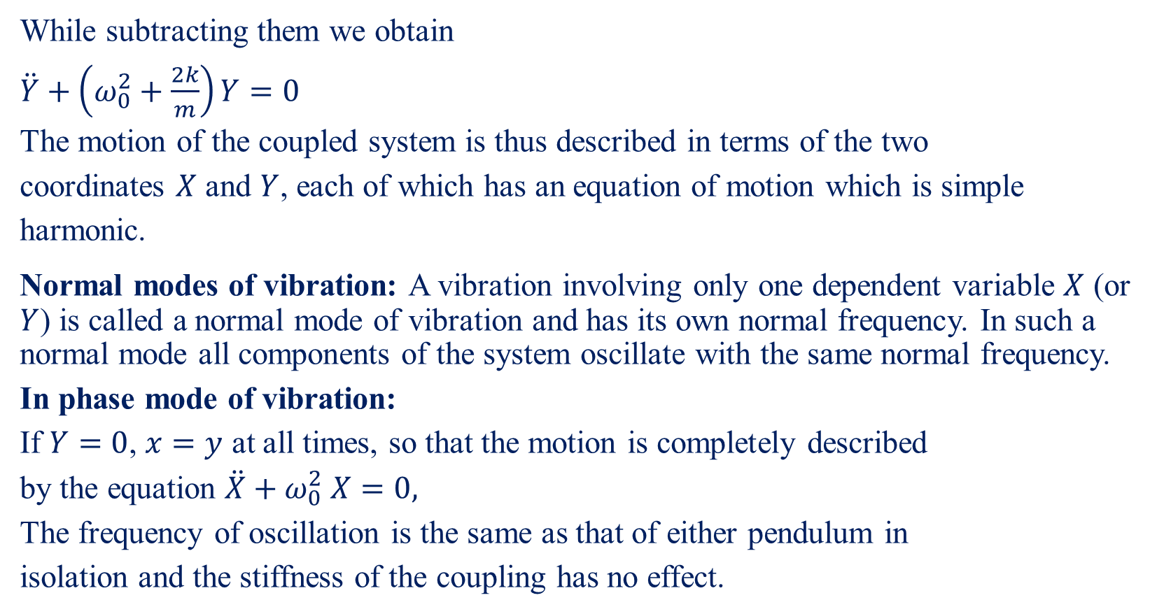
Coupled Pendulum-III
While subtracting them we obtain
$\begin{aligned}\ddot{Y}+\left(ω_{0}^{2}+\frac{2k}{m}\right)Y=0\end{aligned}$
The motion of the coupled system is thus described in terms of the two
coordinates $X$ and $Y$, each of which has an equation of motion which is simple
harmonic.
Normal modes of vibration: A vibration involving only one dependent variable $X$ (or $Y$) is called a normal mode of vibration and has its own normal frequency. In such a normal mode all components of the system oscillate with the same normal frequency.
In phase mode of vibration:
If $Y=0$, $x=y$ at all times, so that the motion is completely described
by the equation $\ddot{X}+ω_{0}^{2} X=0,$
The frequency of oscillation is the same as that of either pendulum in
isolation and the stiffness of the coupling has no effect.

Slide 21
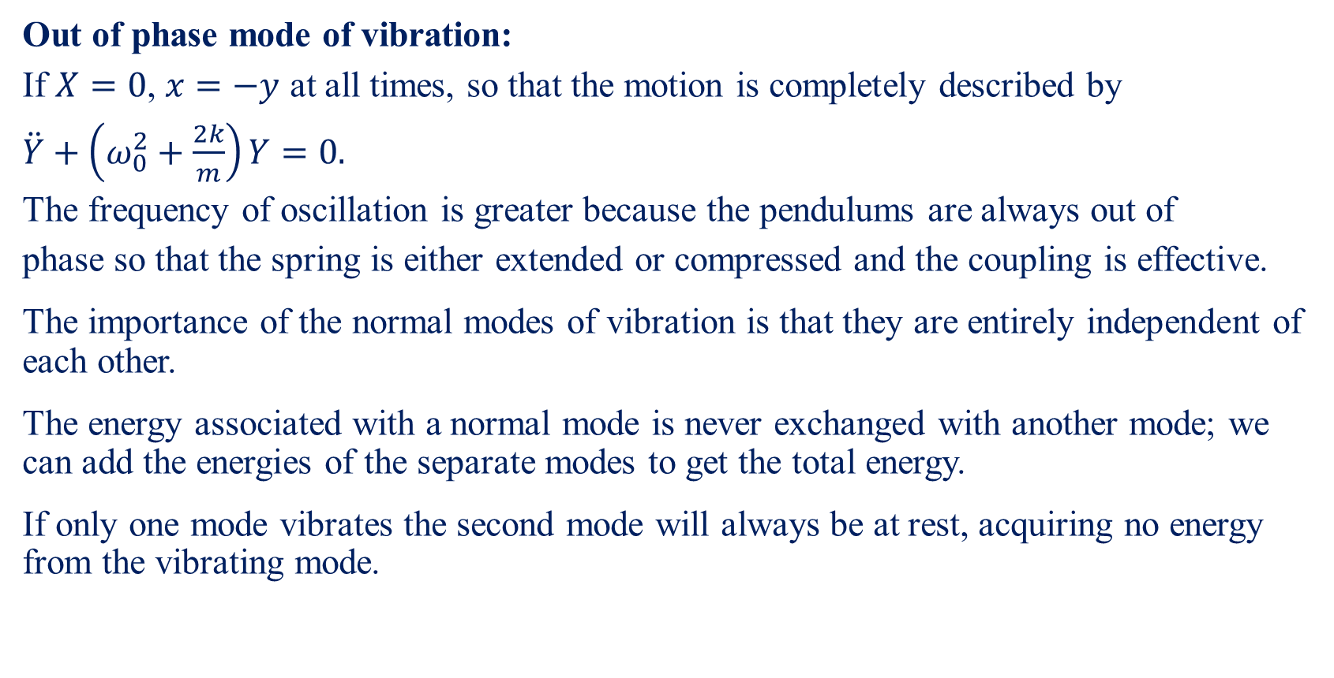
Coupled Pendulum-IV
Out of phase mode of vibration:
If $X=0$, $x=−y$ at all times, so that the motion is completely described by
$\ddot{Y}+\left(ω_{0}^{2}+\frac{2k}{m}\right)Y=0.$
The frequency of oscillation is greater because the pendulums are always out of
phase so that the spring is either extended or compressed and the coupling is effective.
The importance of the normal modes of vibration is that they are entirely independent of each other.
The energy associated with a normal mode is never exchanged with another mode; we can add the energies of the separate modes to get the total energy.
If only one mode vibrates the second mode will always be at rest, acquiring no energy from the vibrating mode.

Slide 22
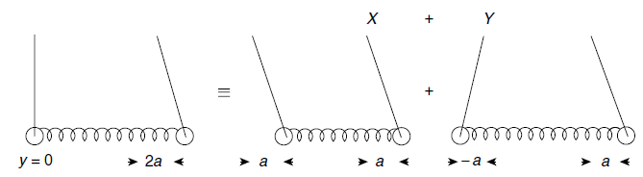
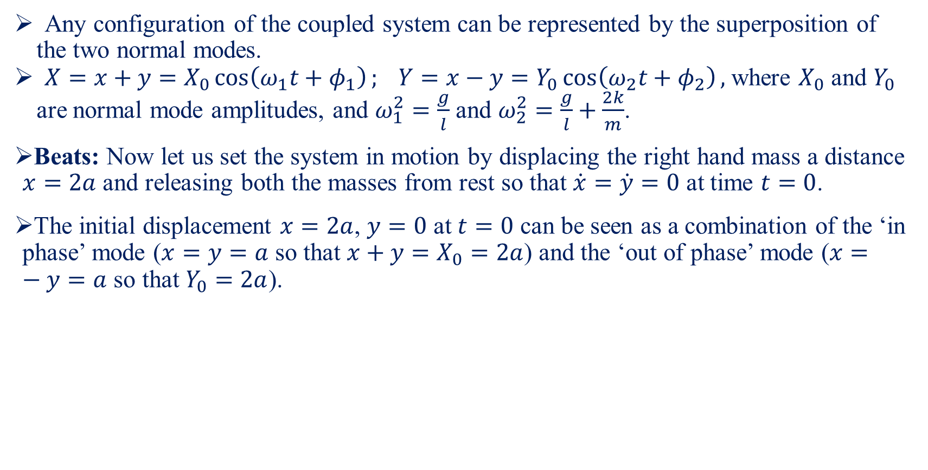
Coupled Pendulum-V
Any configuration of the coupled system can be represented by the superposition of the two normal modes.
$X=x+y=X_{0}\cos\left(ω_{1}t+φ_{1}\right); Y=x−y=Y_{0}\cos\left(ω_{2}t+φ_{2}\right),$ where $X_{0}$ and $Y_{0}$ are normal mode amplitudes, and $ω_{1}^{2}=\frac{g}{l}$ and $ω_{2}^{2}=\frac{g}{l}+\frac{2k}{m}$.
Beats: Now let us set the system in motion by displacing the right hand mass a distance $x=2a$ and releasing both the masses from rest so that $\dot{x}=\dot{y}=0$ at time $t=0$.
The initial displacement $x=2a$, $y=0$ at $t=0$ can be seen as a combination of the ‘in phase’ mode ($x=y=a$ so that $x+y=X_{0}=2a$) and the ‘out of phase’ mode ($x=−y=a$ so that $Y_{0}=2a$).

Slide 23
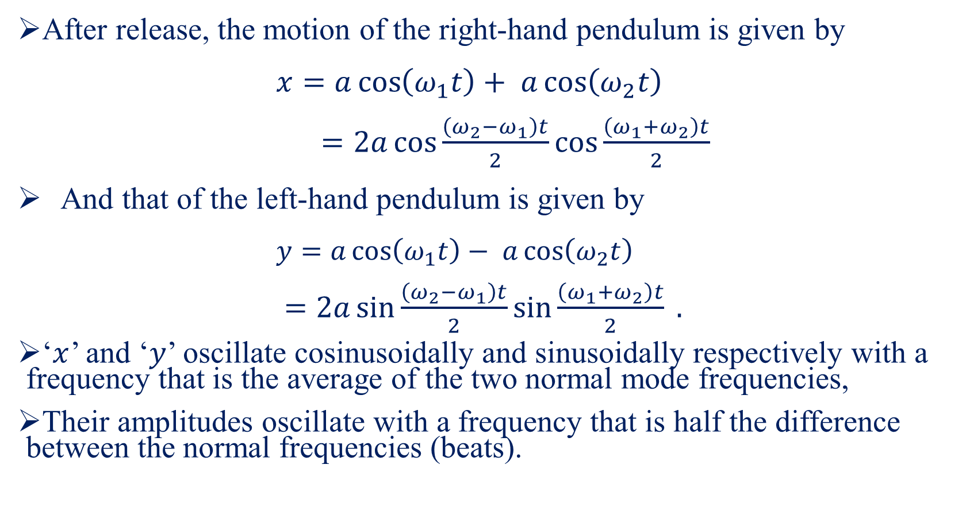
Coupled Pendulum-VI
After release, the motion of the right-hand pendulum is given by
$x=a\cos\left(ω_{1}t\right)+ a\cos\left(ω_{2}t\right)$
$\begin{aligned}=2a\cos{\frac{\left(ω_{2}−ω_{1}\right)t}{2}}\cos{\frac{\left(ω_{1}+ω_{2}\right)t}{2}} \#\end{aligned}$
And that of the left-hand pendulum is given by
$y=a\cos\left(ω_{1}t\right)− a\cos\left(ω_{2}t\right)$
$\begin{aligned}=2a\sin{\frac{\left(ω_{2}−ω_{1}\right)t}{2}}\sin{\frac{\left(ω_{1}+ω_{2}\right)t}{2}} .\#\end{aligned}$
‘$x$’ and ‘$y$’ oscillate cosinusoidally and sinusoidally respectively with a frequency that is the average of the two normal mode frequencies,
Their amplitudes oscillate with a frequency that is half the difference between the normal frequencies (beats).

