Slide 1
Mechanics
EPHY108L (2-0-2-3)
Ayan khan
Department of physics

Slide 2
Non-Inertial Frames and Pseudo Forces

Slide 3
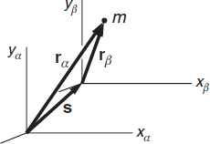
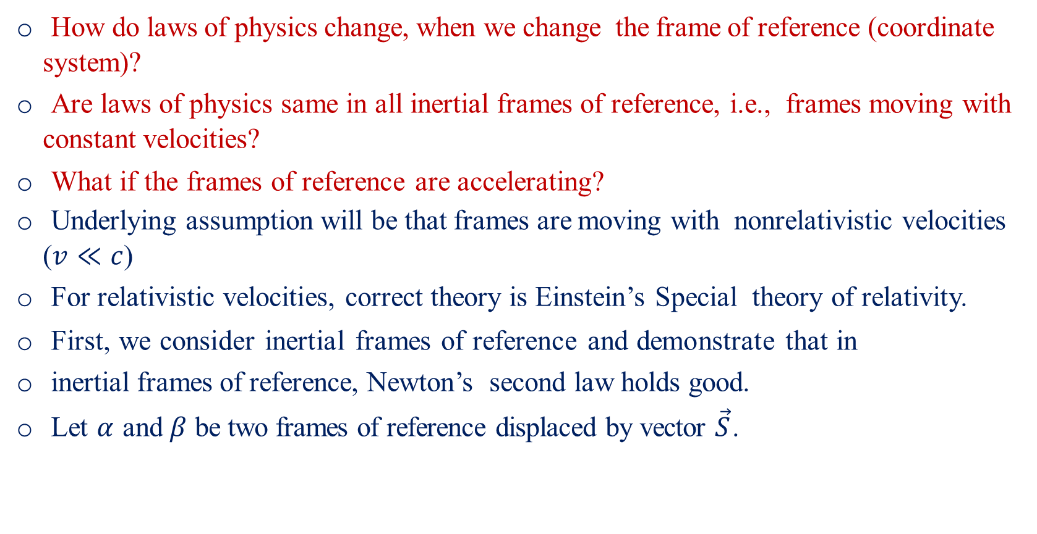
Inertial and Non-Inertial Frame of Reference-I
How do laws of physics change, when we change the frame of reference (coordinate system)?
Are laws of physics same in all inertial frames of reference, i.e., frames moving with constant velocities?
What if the frames of reference are accelerating?
Underlying assumption will be that frames are moving with nonrelativistic velocities ($v≪c$)
For relativistic velocities, correct theory is Einstein’s Special theory of relativity.
First, we consider inertial frames of reference and demonstrate that in
inertial frames of reference, Newton’s second law holds good.
Let $α$ and $β$ be two frames of reference displaced by vector $\vec{S}$.

Slide 4
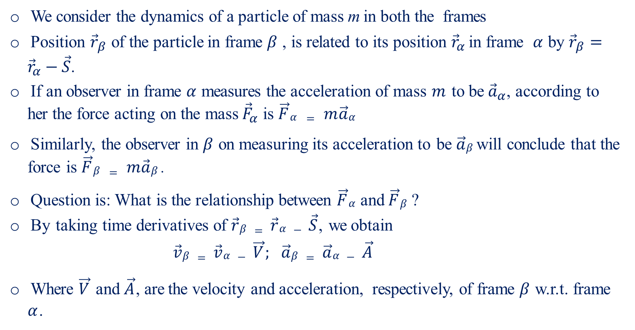
Inertial and Non-Inertial Frame of Reference-II
We consider the dynamics of a particle of mass m in both the frames
Position ${\vec{r}}_{β}$ of the particle in frame $β$ , is related to its position ${\vec{r}}_{α}$ in frame $α$ by ${\vec{r}}_{β}={\vec{r}}_{α}−\vec{S}$.
If an observer in frame $α$ measures the acceleration of mass $m$ to be ${\vec{a}}_{α}$, according to her the force acting on the mass ${\vec{F}}_{α}$ is $\vec{F}α = m\vec{a}α$
Similarly, the observer in $β$ on measuring its acceleration to be $\vec{a}β$ will conclude that the force is $\vec{F}β = m\vec{a}β$ .
Question is: What is the relationship between $\vec{F}α$ and $\vec{F}β$ ?
By taking time derivatives of $\vec{r}β = \vec{r}α − \vec{S}$, we obtain
$$\vec{v}β = \vec{v}α − \vec{V}; \vec{a}β = \vec{a}α − \vec{A}$$
Where $\vec{V}$and $\vec{A}$, are the velocity and acceleration, respectively, of frame $β$ w.r.t. frame $α$.

Slide 5
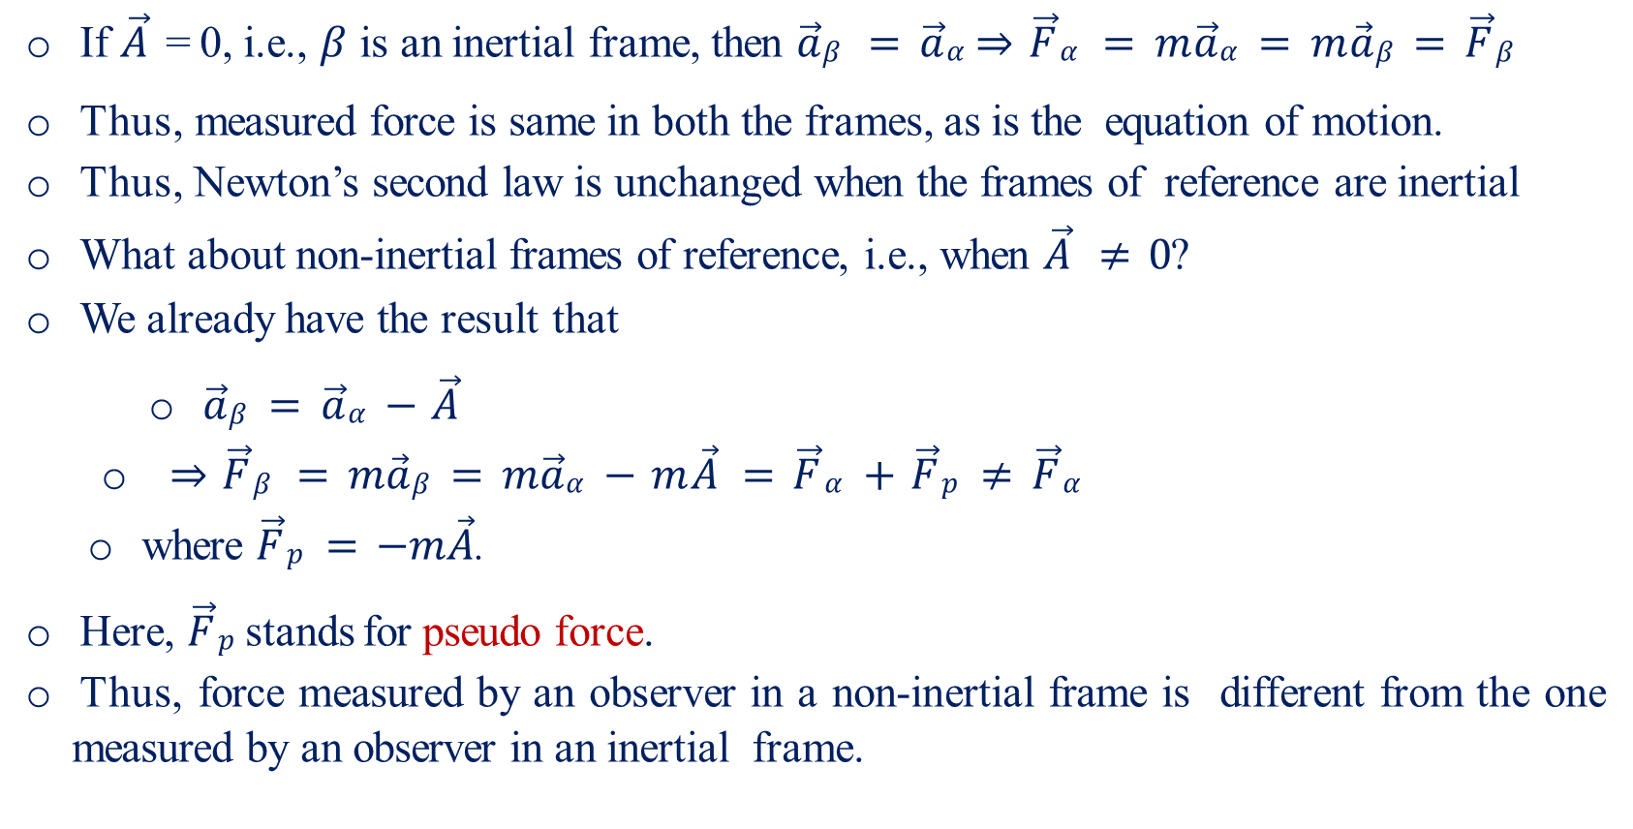
Inertial and Non-Inertial Frame of Reference-III
If $\vec{A}$ = 0, i.e., $β$ is an inertial frame, then $\vec{a}β = \vec{a}α$ $⇒\vec{F}α = m\vec{a}α = m\vec{a}β = \vec{F}β$
Thus, measured force is same in both the frames, as is the equation of motion.
Thus, Newton’s second law is unchanged when the frames of reference are inertial
What about non-inertial frames of reference, i.e., when $\vec{A} ≠ 0$?
We already have the result that
$\vec{a}β = \vec{a}α − \vec{A}$
$⇒\vec{F}β = m\vec{a}β = m\vec{a}α − m\vec{A} = \vec{F}α + \vec{F}p ≠ \vec{F}α$
where $\vec{F}p = −m\vec{A}$.
Here, $\vec{F}p$ stands for pseudo force.
Thus, force measured by an observer in a non-inertial frame is different from the one measured by an observer in an inertial frame.

Slide 6
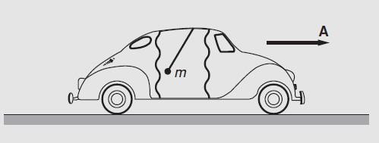
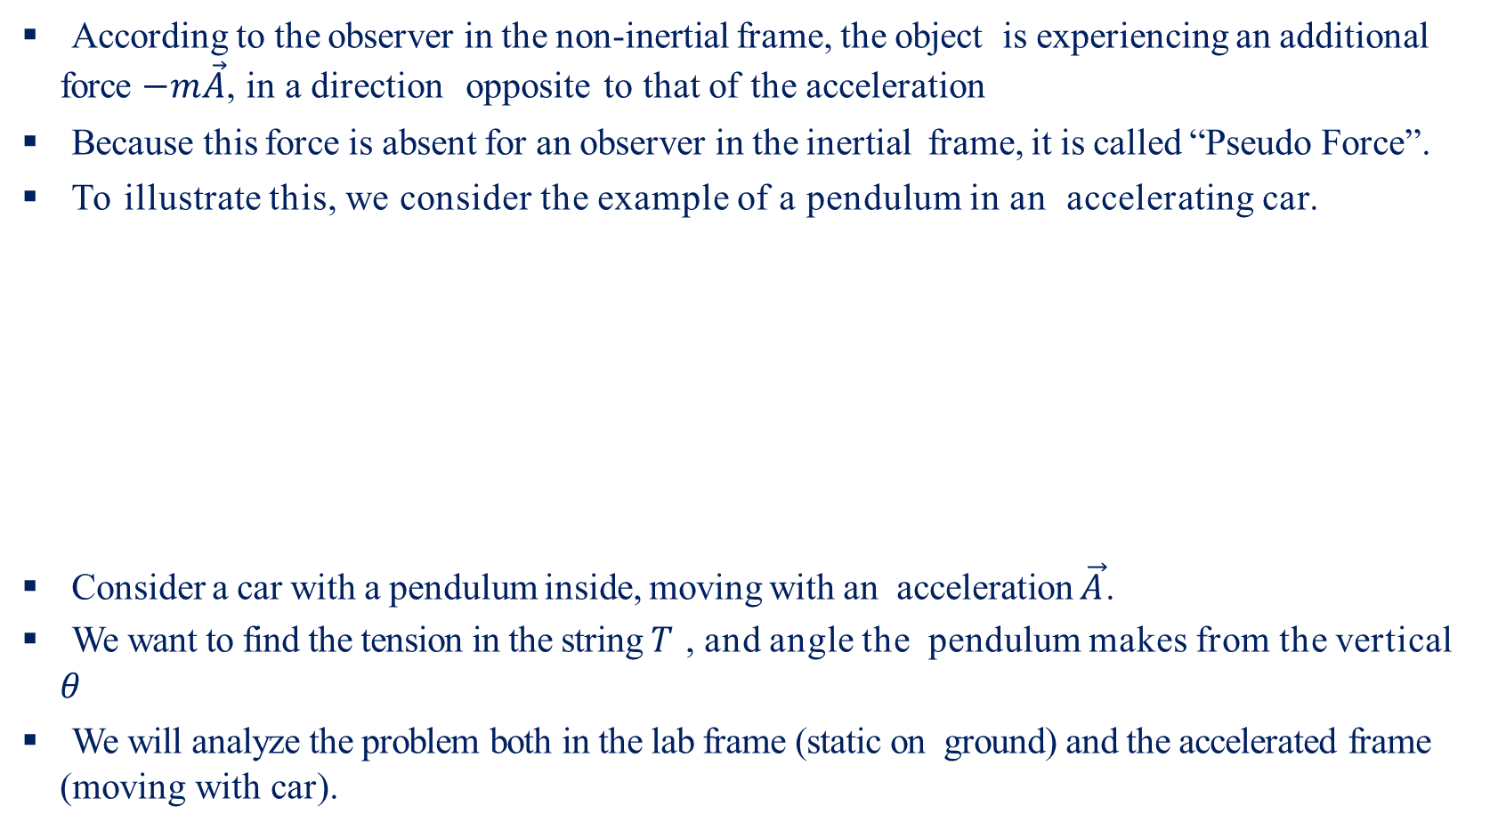
Inertial and Non-Inertial Frame of Reference-IV
According to the observer in the non-inertial frame, the object is experiencing an additional force $−m\vec{A}$, in a direction opposite to that of the acceleration
Because this force is absent for an observer in the inertial frame, it is called “Pseudo Force”.
To illustrate this, we consider the example of a pendulum in an accelerating car.
Consider a car with a pendulum inside, moving with an acceleration $\vec{A}$.
We want to find the tension in the string $T$ , and angle the pendulum makes from the vertical $θ$
We will analyze the problem both in the lab frame (static on ground) and the accelerated frame (moving with car).

Slide 7
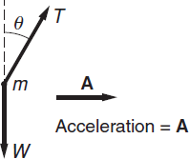
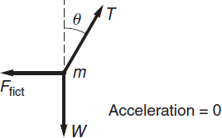
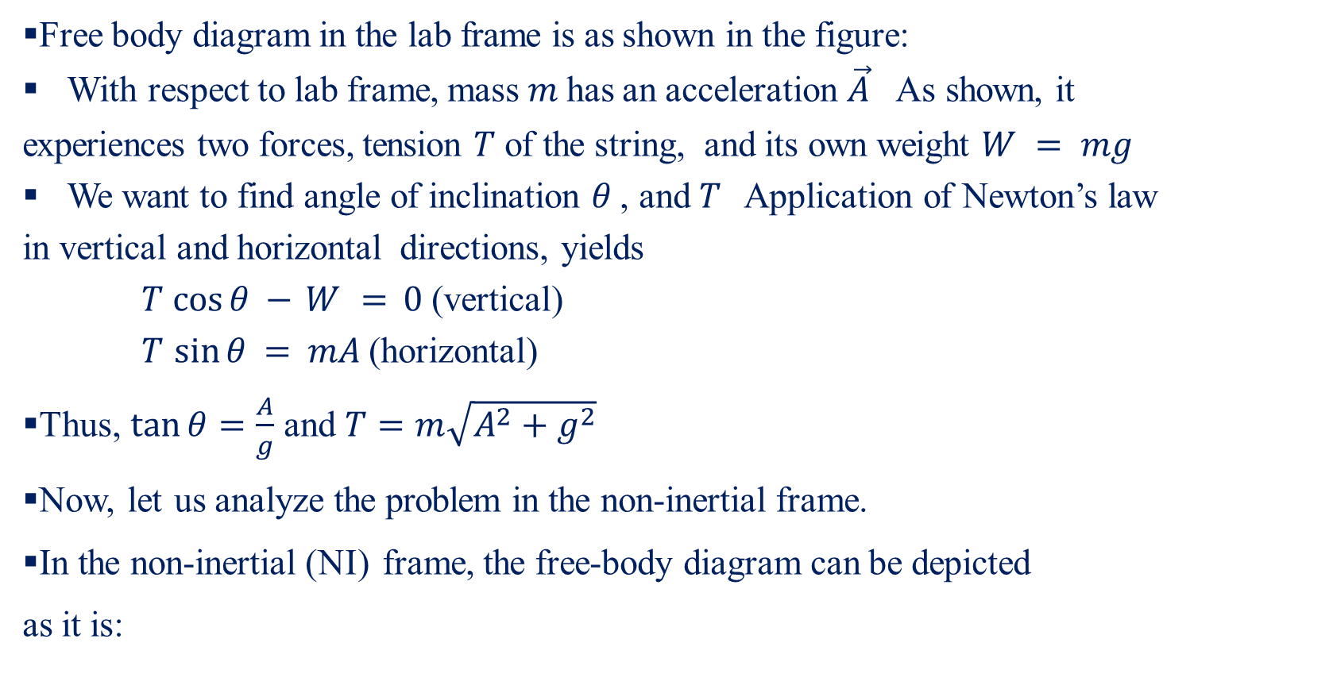
Inertial and Non-Inertial Frame of Reference-V
Free body diagram in the lab frame is as shown in the figure:
With respect to lab frame, mass $m$ has an acceleration $\vec{A}$ As shown, it
experiences two forces, tension $T$ of the string, and its own weight $W = mg$
We want to find angle of inclination $θ$ , and $T$ Application of Newton’s law
in vertical and horizontal directions, yields
$T cos⁡θ − W = 0$ (vertical)
$T sin⁡θ = mA$ (horizontal)
Thus, $\tan{θ}=\frac{A}{g}$ and $T=m\sqrt{A^{2}+g^{2}}$
Now, let us analyze the problem in the non-inertial frame.
In the non-inertial (NI) frame, the free-body diagram can be depicted
as it is:

Slide 8
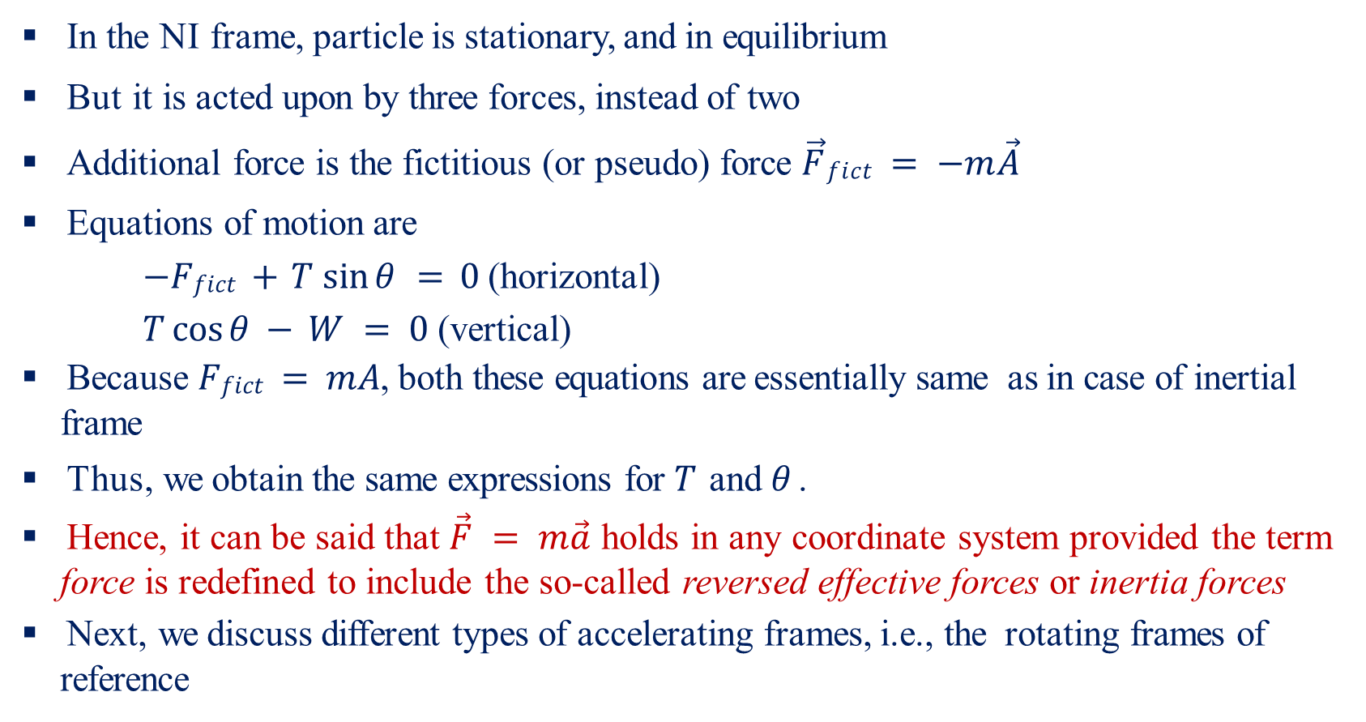
Inertial and Non-Inertial Frame of Reference-VI
In the NI frame, particle is stationary, and in equilibrium
But it is acted upon by three forces, instead of two
Additional force is the fictitious (or pseudo) force $\vec{F}fict = −m\vec{A}$
Equations of motion are
$−Ffict + T sin⁡θ = 0$ (horizontal)
$T cos⁡θ − W = 0$ (vertical)
Because $Ffict = mA$, both these equations are essentially same as in case of inertial frame
Thus, we obtain the same expressions for $T$ and $θ$ .
Hence, it can be said that $\vec{F} = m\vec{a}$ holds in any coordinate system provided the term force is redefined to include the so-called reversed effective forces or inertia forces
Next, we discuss different types of accelerating frames, i.e., the rotating frames of reference

Slide 9
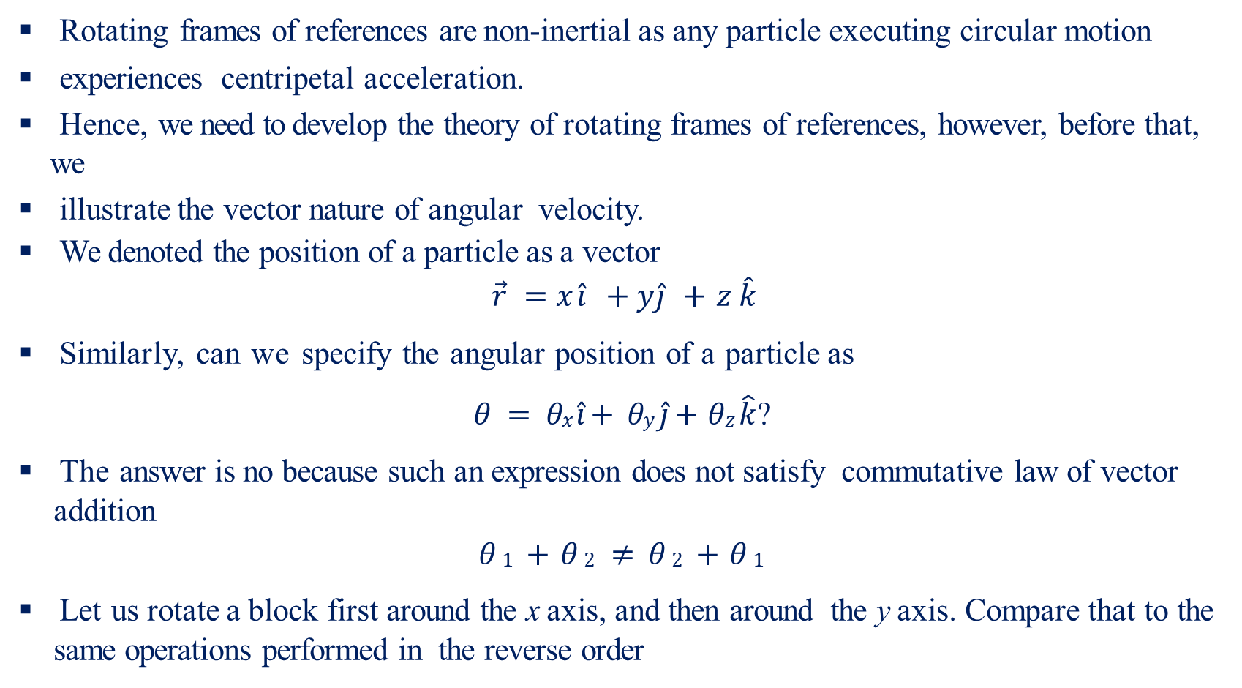
Rotating Frame of Reference-I
Rotating frames of references are non-inertial as any particle executing circular motion
experiences centripetal acceleration.
Hence, we need to develop the theory of rotating frames of references, however, before that, we
illustrate the vector nature of angular velocity.
We denoted the position of a particle as a vector
$$\vec{r} =x \hat{i} +y \hat{j} + z \hat{k}$$
Similarly, can we specify the angular position of a particle as
$θ = θx \hat{i}+ θy \hat{j}+ θz \hat{k}$ ?
The answer is no because such an expression does not satisfy commutative law of vector addition
$$θ 1 + θ 2 ≠ θ 2 + θ 1$$
Let us rotate a block first around the x axis, and then around the y axis. Compare that to the same operations performed in the reverse order

Slide 10
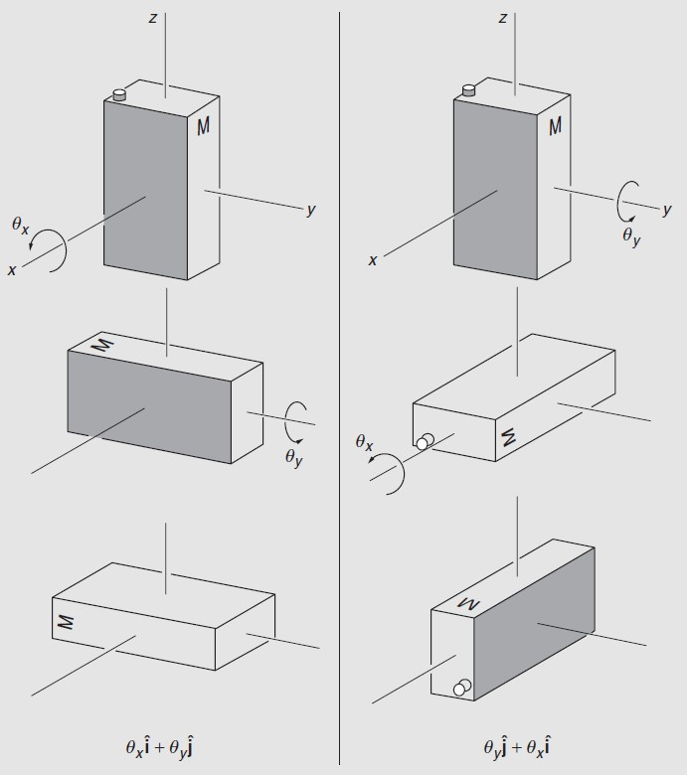
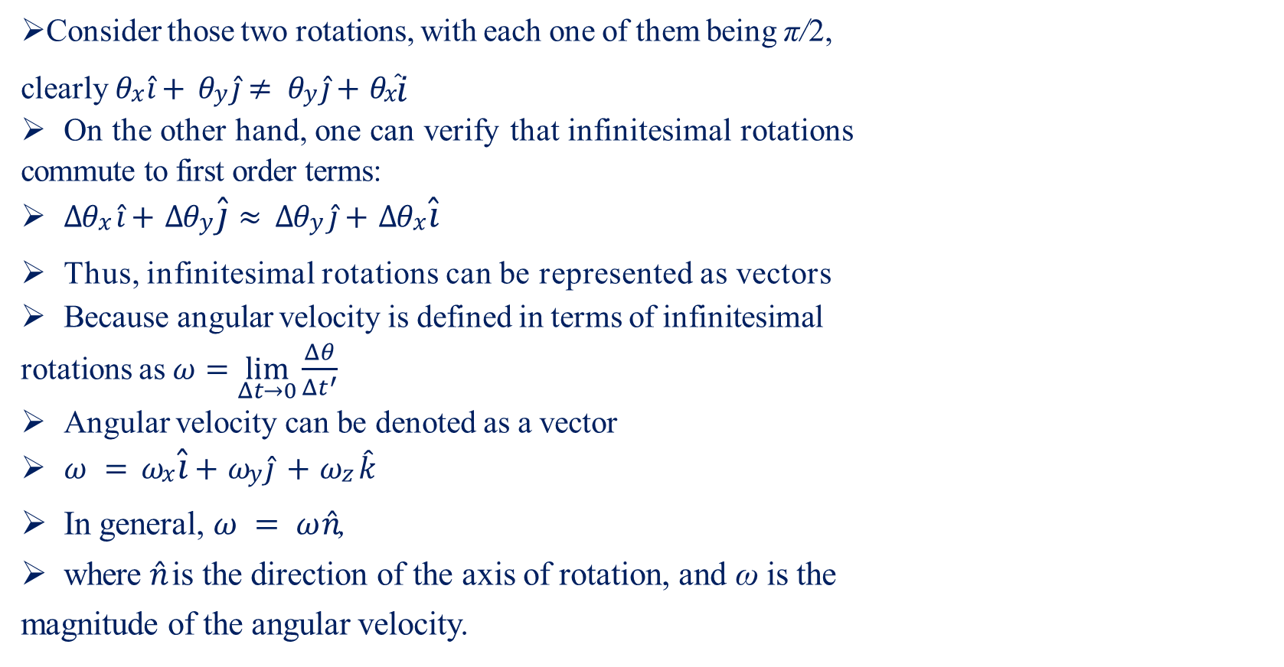
Rotating Frame of Reference-II
Consider those two rotations, with each one of them being π/2,
clearly $θx \hat{i}+ θy \hat{j}≠ θy \hat{j}+ θx\hat{ i}$
On the other hand, one can verify that infinitesimal rotations
commute to first order terms:
$∆θx \hat{i}+ ∆θy \hat{j}≈ ∆θy \hat{j}+ ∆θx \hat{i}$
Thus, infinitesimal rotations can be represented as vectors
Because angular velocity is defined in terms of infinitesimal
rotations as $ω=\lim_{Δt→0}{\frac{Δθ}{Δt^{′}}}$
Angular velocity can be denoted as a vector
$ω = ωx \hat{i}+ ωy \hat{j} + ωz \hat{k}$
In general, $ω = ω \hat{n}$,
where $\hat{n}$ is the direction of the axis of rotation, and ω is the
magnitude of the angular velocity.

Slide 11
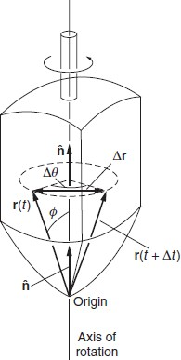
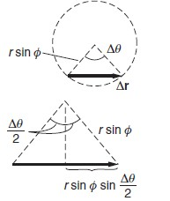
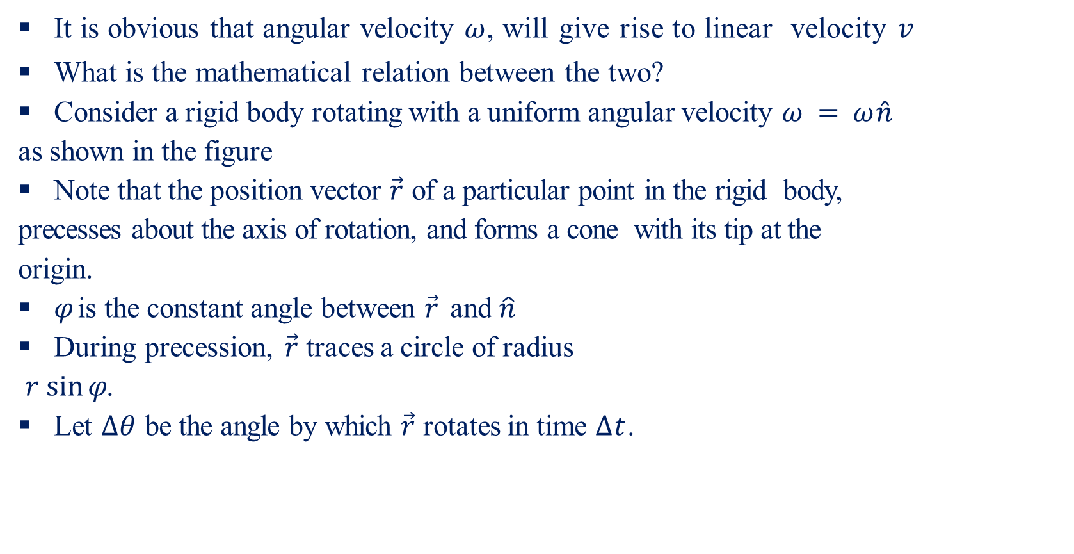
Rotating Frame of Reference-III
It is obvious that angular velocity $ω$, will give rise to linear velocity $v$
What is the mathematical relation between the two?
Consider a rigid body rotating with a uniform angular velocity $ω = ω \hat{n}$
as shown in the figure
Note that the position vector $\vec{r}$ of a particular point in the rigid body,
precesses about the axis of rotation, and forms a cone with its tip at the
origin.
$φ$ is the constant angle between $\vec{r}$ and $\hat{n}$
During precession, $\vec{r}$ traces a circle of radius
$r sin⁡φ$.
Let $∆θ$ be the angle by which $\vec{r}$ rotates in time $∆t$.

Slide 12
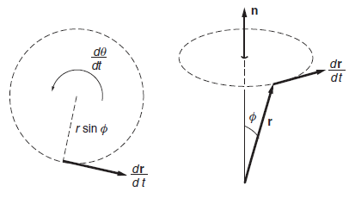
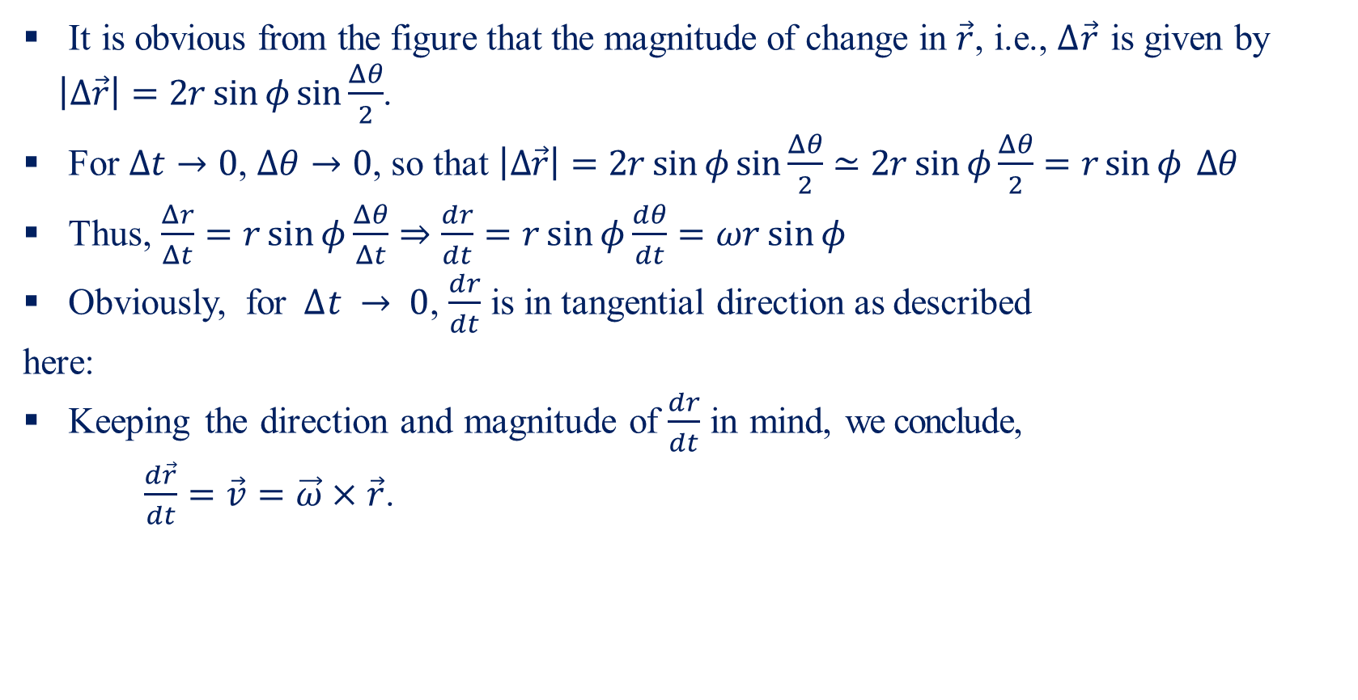
Rotating Frame of Reference-IV
It is obvious from the figure that the magnitude of change in $\vec{r}$, i.e., $∆\vec{r}$ is given by $\left|Δ\vec{r}\right|=2r\sin{φ}\sin{\frac{Δθ}{2}}$.
For $Δt→0$, $Δθ→0$, so that $\left|Δ\vec{r}\right|=2r\sin{φ}\sin{\frac{Δθ}{2}}≃2r\sin{φ}\frac{Δθ}{2}=r\sin{φ} Δθ$
Thus, $\frac{Δr}{Δt}=r\sin{φ}\frac{Δθ}{Δt}⇒\frac{dr}{dt}=r\sin{φ}\frac{dθ}{dt}=ωr\sin{φ}$
Obviously, for $∆t → 0$, $\frac{dr}{dt}$ is in tangential direction as described
here:
Keeping the direction and magnitude of $\frac{dr}{dt}$ in mind, we conclude,
$\frac{d\vec{r}}{dt}=\vec{v}=\vec{ω}×\vec{r}$.

Slide 13
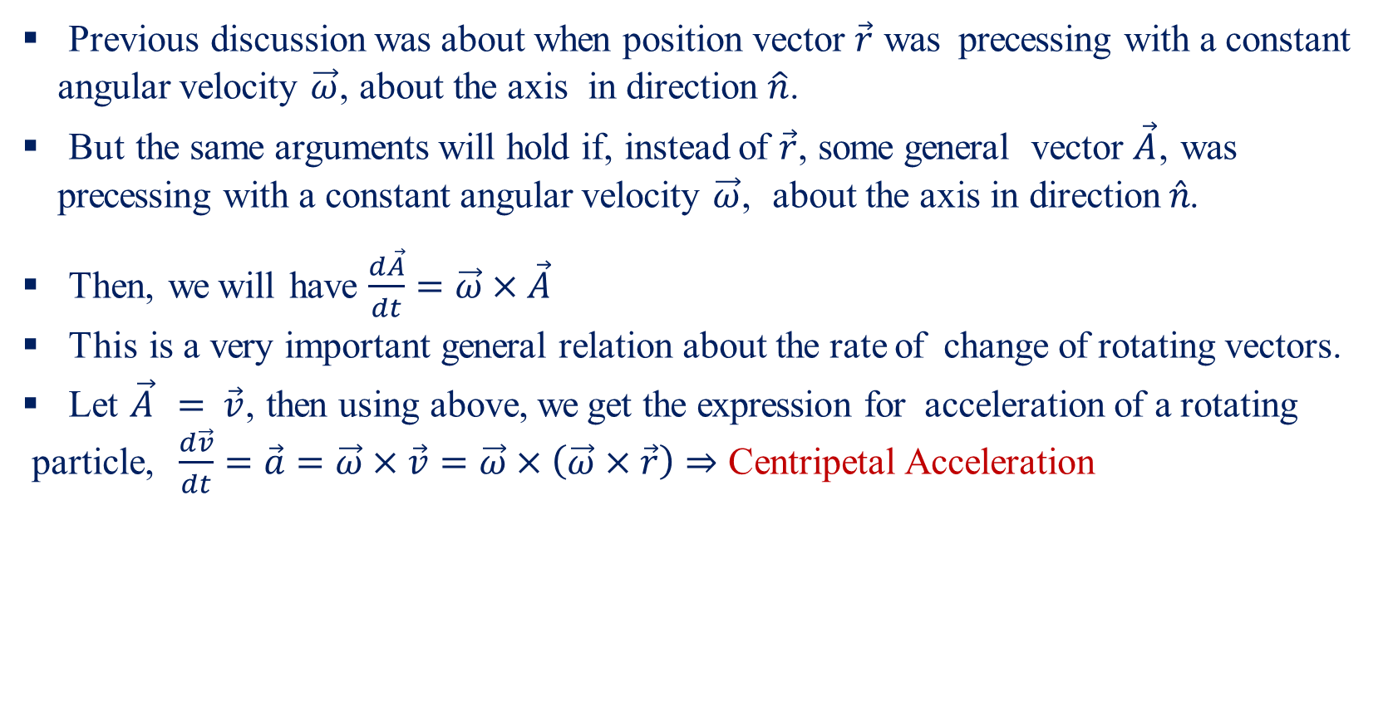
Rotating Frame of Reference-V
Previous discussion was about when position vector $\vec{r}$ was precessing with a constant angular velocity $\vec{ω}$, about the axis in direction $\hat{n}$.
But the same arguments will hold if, instead of $\vec{r}$, some general vector $\vec{A}$, was precessing with a constant angular velocity $\vec{ω}$, about the axis in direction $\hat{n}$.
Then, we will have $\frac{d\vec{A}}{dt}=\vec{ω}×\vec{A}$
This is a very important general relation about the rate of change of rotating vectors.
Let $\vec{A} = \vec{v}$, then using above, we get the expression for acceleration of a rotating
particle, $\frac{d\vec{v}}{dt}=\vec{a}=\vec{ω}×\vec{v}=\vec{ω}×\left(\vec{ω}×\vec{r}\right)⇒$ Centripetal Acceleration

Slide 14
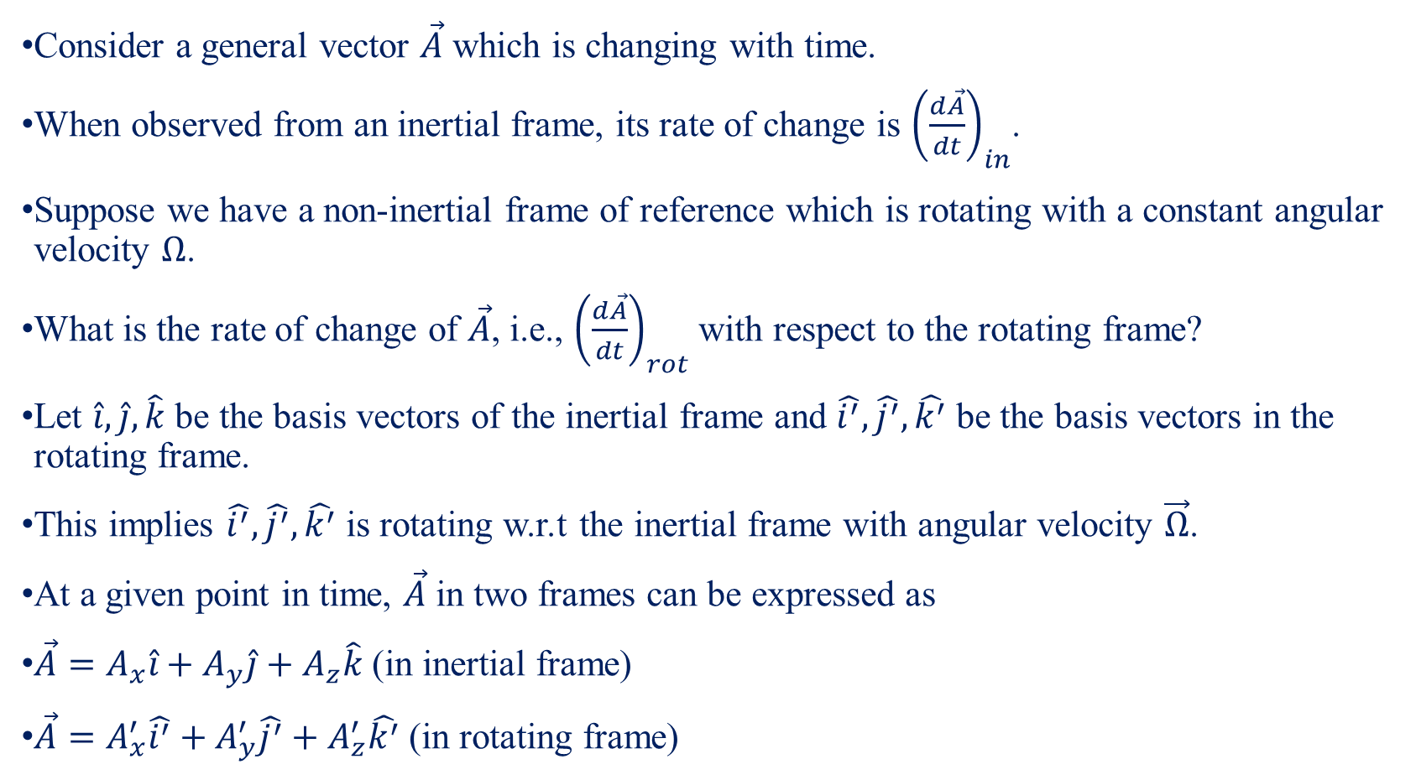
Physics of Rotating Reference Frame-I
Consider a general vector $\vec{A}$ which is changing with time.
When observed from an inertial frame, its rate of change is ${\left(\frac{d\vec{A}}{dt}\right)}_{in}$.
Suppose we have a non-inertial frame of reference which is rotating with a constant angular velocity $Ω$.
What is the rate of change of $\vec{A}$, i.e., ${\left(\frac{d\vec{A}}{dt}\right)}_{rot}$ with respect to the rotating frame?
Let $\hat{i}, \hat{j}, \hat{k}$ be the basis vectors of the inertial frame and $\hat{i^{′}}, \hat{j^{′}}, \hat{k^{′}}$ be the basis vectors in the rotating frame.
This implies $\hat{i^{′}}, \hat{j^{′}}, \hat{k^{′}}$ is rotating w.r.t the inertial frame with angular velocity $\vec{Ω}$.
At a given point in time, $\vec{A}$ in two frames can be expressed as
$\vec{A}=A_{x}\hat{i}+A_{y}\hat{j}+A_{z}\hat{k}$ (in inertial frame)
$\vec{A}=A_{x}^{′}\hat{i^{′}}+A_{y}^{′}\hat{j^{′}}+A_{z}^{′}\hat{k^{′}}$ (in rotating frame)

Slide 15
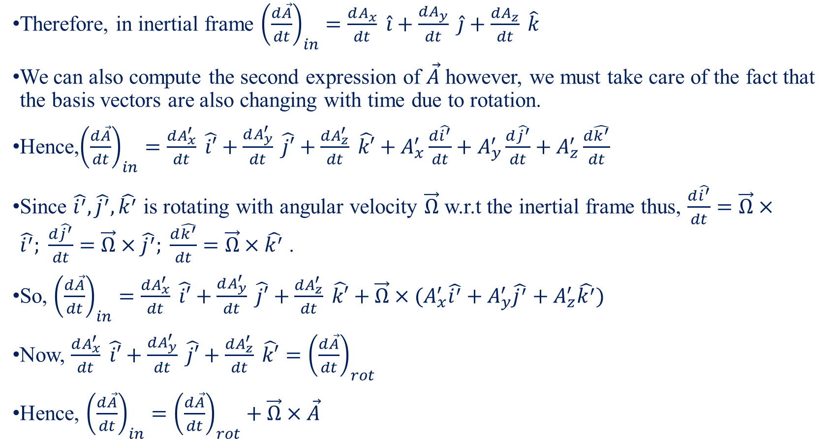
Physics of Rotating Reference Frame-II
Therefore, in inertial frame ${\left(\frac{d\vec{A}}{dt}\right)}_{in}=\frac{dA_{x}}{dt} \hat{i}+\frac{dA_{y}}{dt} \hat{j}+\frac{dA_{z}}{dt} \hat{k}$
We can also compute the second expression of $\vec{A}$ however, we must take care of the fact that the basis vectors are also changing with time due to rotation.
Hence,${\left(\frac{d\vec{A}}{dt}\right)}_{in}=\frac{dA_{x}^{′}}{dt} \hat{i′}+\frac{dA_{y}^{′}}{dt} \hat{j′}+\frac{dA_{z}^{′}}{dt} \hat{k′}+A_{x}^{′}\frac{d\hat{i^{′}}}{dt}+A_{y}^{′}\frac{d\hat{j^{′}}}{dt}+A_{z}^{′}\frac{d\hat{k^{′}}}{dt}$
Since $\hat{i^{′}}, \hat{j^{′}}, \hat{k^{′}}$ is rotating with angular velocity $\vec{Ω}$ w.r.t the inertial frame thus, $\frac{d\hat{i^{′}}}{dt}=\vec{Ω}×\hat{i^{′}}; \frac{d\hat{j^{′}}}{dt}=\vec{Ω}×\hat{j^{′}}; \frac{d\hat{k^{′}}}{dt}=\vec{Ω}×\hat{k^{′}}$.
So, ${\left(\frac{d\vec{A}}{dt}\right)}_{in}=\frac{dA_{x}^{′}}{dt} \hat{i′}+\frac{dA_{y}^{′}}{dt} \hat{j′}+\frac{dA_{z}^{′}}{dt} \hat{k′}+\vec{Ω}×(A_{x}^{′}\hat{i^{′}}+A_{y}^{′}\hat{j^{′}}+A_{z}^{′}\hat{k^{′}})$
Now, $\frac{dA_{x}^{′}}{dt} \hat{i′}+\frac{dA_{y}^{′}}{dt} \hat{j′}+\frac{dA_{z}^{′}}{dt} \hat{k′}={\left(\frac{d\vec{A}}{dt}\right)}_{rot}$
Hence, ${\left(\frac{d\vec{A}}{dt}\right)}_{in}={\left(\frac{d\vec{A}}{dt}\right)}_{rot}+\vec{Ω}×\vec{A}$

Slide 16
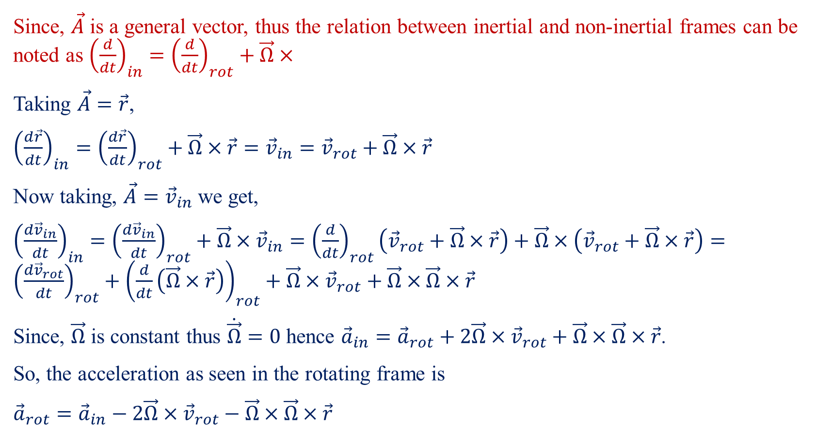
Physics of Rotating Reference Frame-III
Since, $\vec{A}$ is a general vector, thus the relation between inertial and non-inertial frames can be noted as ${\left(\frac{d}{dt}\right)}_{in}={\left(\frac{d}{dt}\right)}_{rot}+\vec{Ω}×$
Taking $\vec{A}=\vec{r}$,
${\left(\frac{d\vec{r}}{dt}\right)}_{in}={\left(\frac{d\vec{r}}{dt}\right)}_{rot}+\vec{Ω}×\vec{r}={\vec{v}}_{in}={\vec{v}}_{rot}+\vec{Ω}×\vec{r}$
Now taking, $\vec{A}={\vec{v}}_{in}$ we get,
${\left(\frac{d{\vec{v}}_{in}}{dt}\right)}_{in}={\left(\frac{d{\vec{v}}_{in}}{dt}\right)}_{rot}+\vec{Ω}×{\vec{v}}_{in}={\left(\frac{d}{dt}\right)}_{rot}\left({\vec{v}}_{rot}+\vec{Ω}×\vec{r}\right)+\vec{Ω}×\left({\vec{v}}_{rot}+\vec{Ω}×\vec{r}\right)={\left(\frac{d{\vec{v}}_{rot}}{dt}\right)}_{rot}+{\left(\frac{d}{dt}\left(\vec{Ω}×\vec{r}\right)\right)}_{rot}+\vec{Ω}×{\vec{v}}_{rot}+\vec{Ω}×\vec{Ω}×\vec{r}$
Since, $\vec{Ω}$ is constant thus $\dot{\vec{Ω}}=0$ hence ${\vec{a}}_{in}={\vec{a}}_{rot}+2\vec{Ω}×{\vec{v}}_{rot}+\vec{Ω}×\vec{Ω}×\vec{r}$.
So, the acceleration as seen in the rotating frame is
${\vec{a}}_{rot}={\vec{a}}_{in}−2\vec{Ω}×{\vec{v}}_{rot}−\vec{Ω}×\vec{Ω}×\vec{r}$

Slide 17
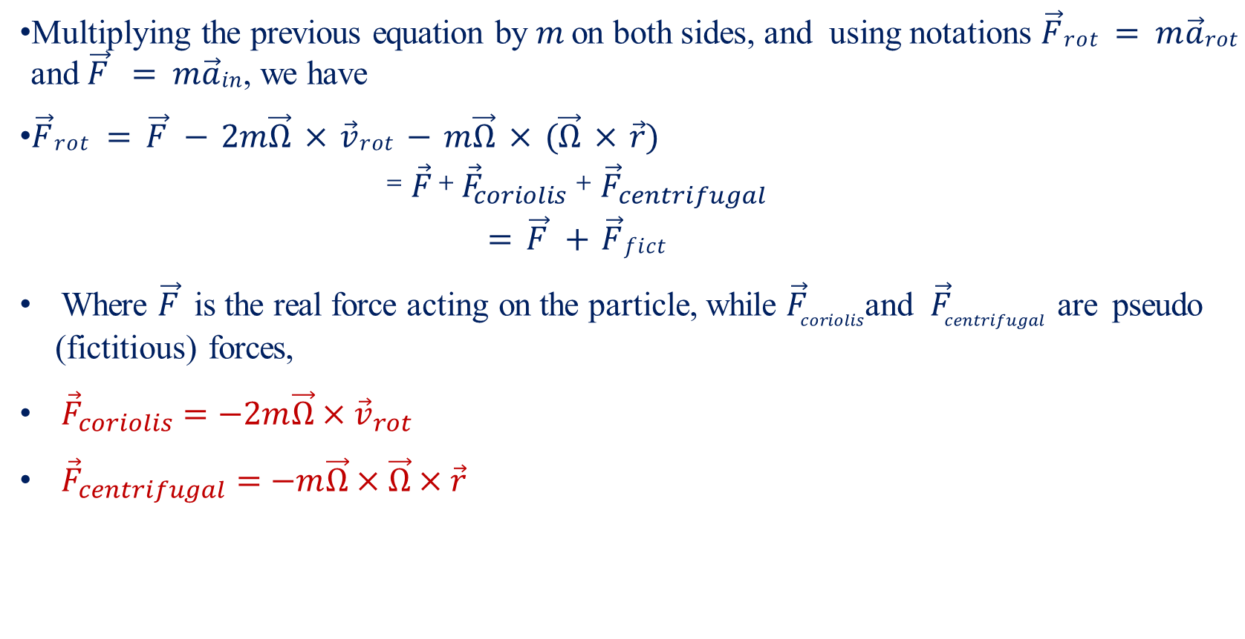
Physics of Rotating Reference Frame-IV
Multiplying the previous equation by $m$ on both sides, and using notations $\vec{F}rot = m\vec{a}rot$ and $\vec{F} = m\vec{a}in$, we have
$\vec{F}rot = \vec{F} − 2m\vec{Ω} × \vec{v}rot − m\vec{Ω} × (\vec{Ω} × \vec{r})$
$$=\vec{F}+{\vec{F}}_{coriolis}+ {\vec{F}}_{centrifugal}$$
$$= \vec{F} + \vec{F}fict$$
Where $\vec{F}$ is the real force acting on the particle, while ${\vec{F}}_{coriolis}$and ${\vec{F}}_{centrifugal}$ are pseudo (fictitious) forces,
${\vec{F}}_{coriolis}=−2m\vec{Ω}×{\vec{v}}_{rot}$
${\vec{F}}_{centrifugal}=−m\vec{Ω}×\vec{Ω}×\vec{r}$

Slide 18

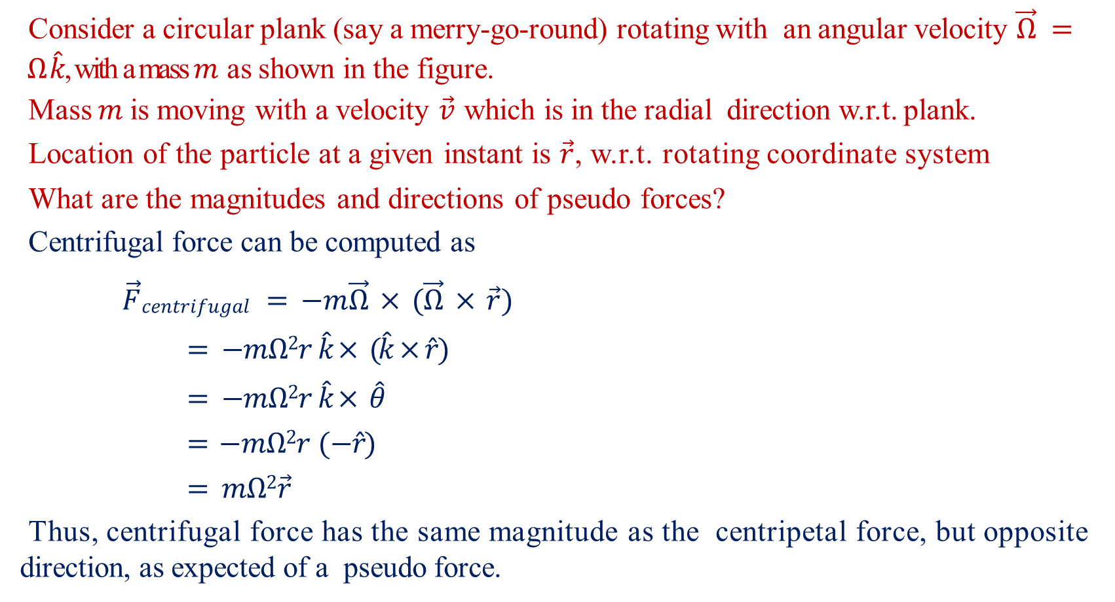


Physics of Rotating Reference Frame-V
Consider a circular plank (say a merry-go-round) rotating with an angular velocity $\vec{Ω} = Ω \hat{k}$, with a mass $m$ as shown in the figure.
Mass $m$ is moving with a velocity $\vec{v}$ which is in the radial direction w.r.t. plank.
Location of the particle at a given instant is $\vec{r}$, w.r.t. rotating coordinate system
What are the magnitudes and directions of pseudo forces?
Centrifugal force can be computed as
$\vec{F}centrifugal = −m\vec{Ω} × (\vec{Ω} × \vec{r})$
$= −mΩ2r \hat{k}× (\hat{k}×\hat{r})$
$= −mΩ2r \hat{k}× \hat{θ}$
$= −mΩ2r (−\hat{r})$
$= mΩ2\vec{r}$
Thus, centrifugal force has the same magnitude as the centripetal force, but opposite direction, as expected of a pseudo force.
y
v
r
$$θ$$
o
x
$$Ω$$

Slide 19



Physics of Rotating Reference Frame-VI
Coriolis force exists only when the particle moves with respect to the rotating frame. Here $\vec{v}rot = vr ̂$.
Therefore,
${\vec{F}}_{coriolis} = −2m\vec{Ω}×{\vec{v}}_{rot}$
$= −2mΩv (\hat{k}×\hat{r})$
$= −2mΩv \hat{θ}$
Thus, the direction of the forces can be noted as described.
y
Centrifugal
v
r
$$θ$$
Coriolis
O
x
$$Ω$$

Slide 20
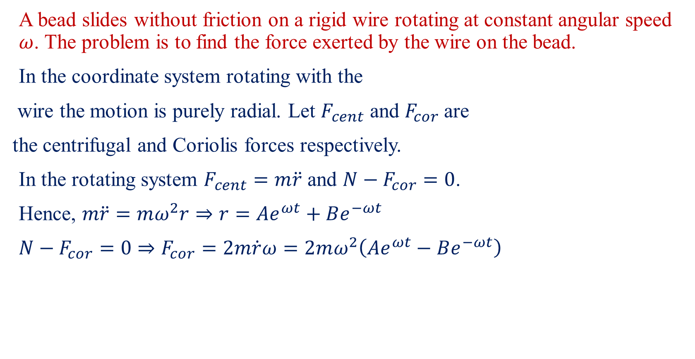
Coriolis Force Example
A bead slides without friction on a rigid wire rotating at constant angular speed $ω$. The problem is to find the force exerted by the wire on the bead.
In the coordinate system rotating with the
wire the motion is purely radial. Let $F_{cent}$ and $F_{cor}$ are
the centrifugal and Coriolis forces respectively.
In the rotating system $F_{cent}=m\ddot{r}$ and $N−F_{cor}=0$.
Hence, $m\ddot{r}=mω^{2}r⇒r=Ae^{ωt}+Be^{−ωt}$
$N−F_{cor}=0⇒F_{cor}=2m\dot{r}ω=2mω^{2}\left(Ae^{ωt}−Be^{−ωt}\right)$

Slide 21
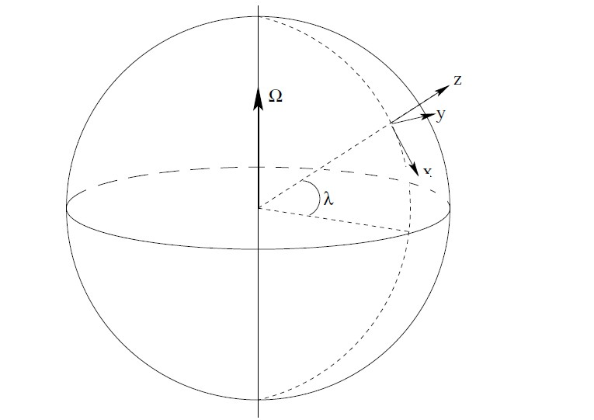
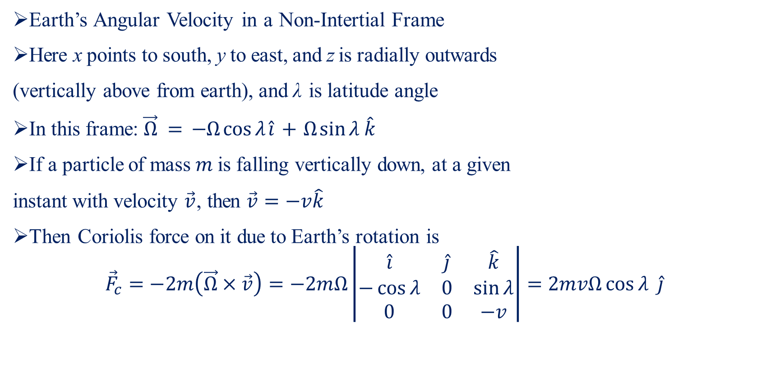
Coriolis Force and Earth Rotation-I
Earth’s Angular Velocity in a Non-Intertial Frame
Here x points to south, y to east, and z is radially outwards
(vertically above from earth), and λ is latitude angle
In this frame: $\vec{Ω} = −Ω\cos{λ}\hat{i} + Ω\sin{λ}\hat{k}$
If a particle of mass $m$ is falling vertically down, at a given
instant with velocity $\vec{v}$, then $\vec{v}=−v\hat{k}$
Then Coriolis force on it due to Earth’s rotation is
$${\vec{F}}_{c}=−2m\left(\vec{Ω}×\vec{v}\right)=−2mΩ\left|\begin{matrix}\hat{i} & \hat{j} & \hat{k} \\ −\cos{λ} & 0 & \sin{λ} \\ 0 & 0 & −v\end{matrix}\right|=2mvΩ\cos{λ} \hat{j}$$

Slide 22

Coriolis Force and Earth Rotation-II
Thus, the object will experience a force towards east, and will get deviated in that direction
Another example: away from equator, wind flow becomes circular due to Coriolis force
Note $\vec{F}c ⊥ \vec{v}rot$ , so it will lead to a circular motion.

Slide 23
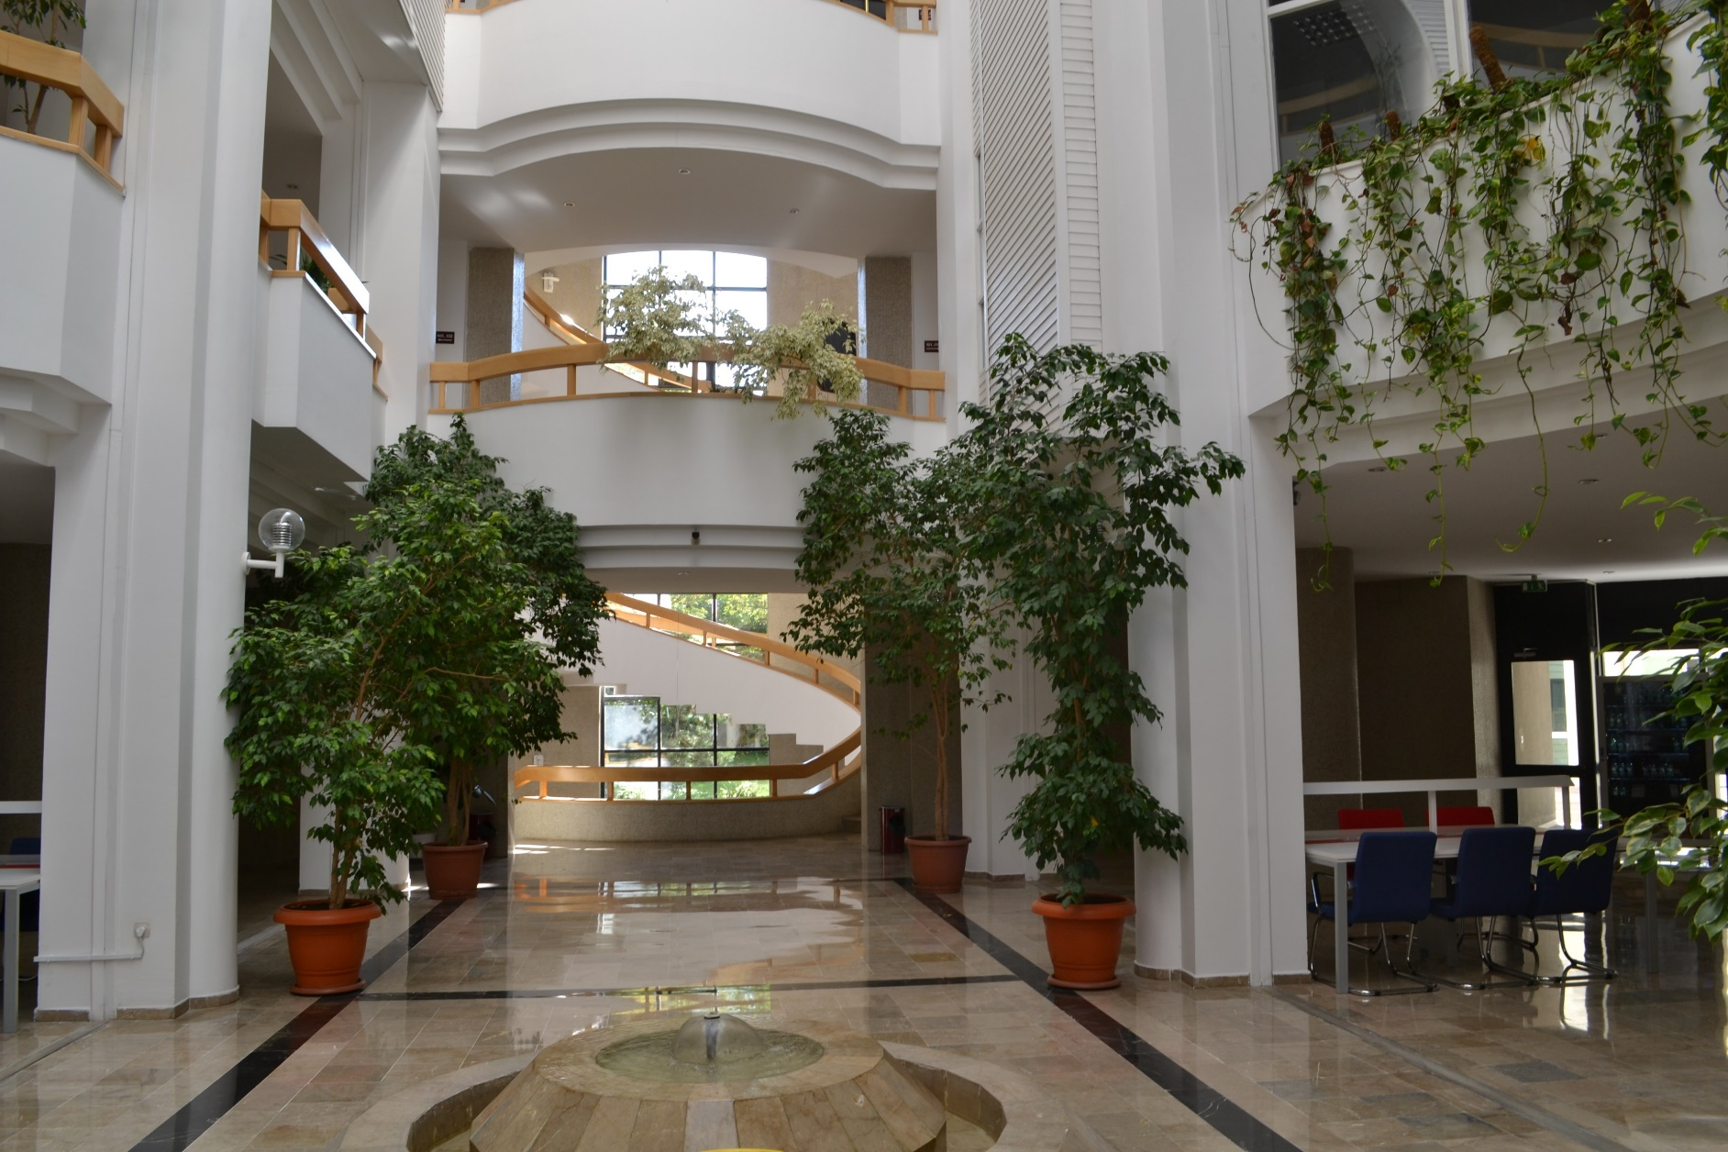
Fizik Bolum @ Bilknet Universitesi

Slide 24
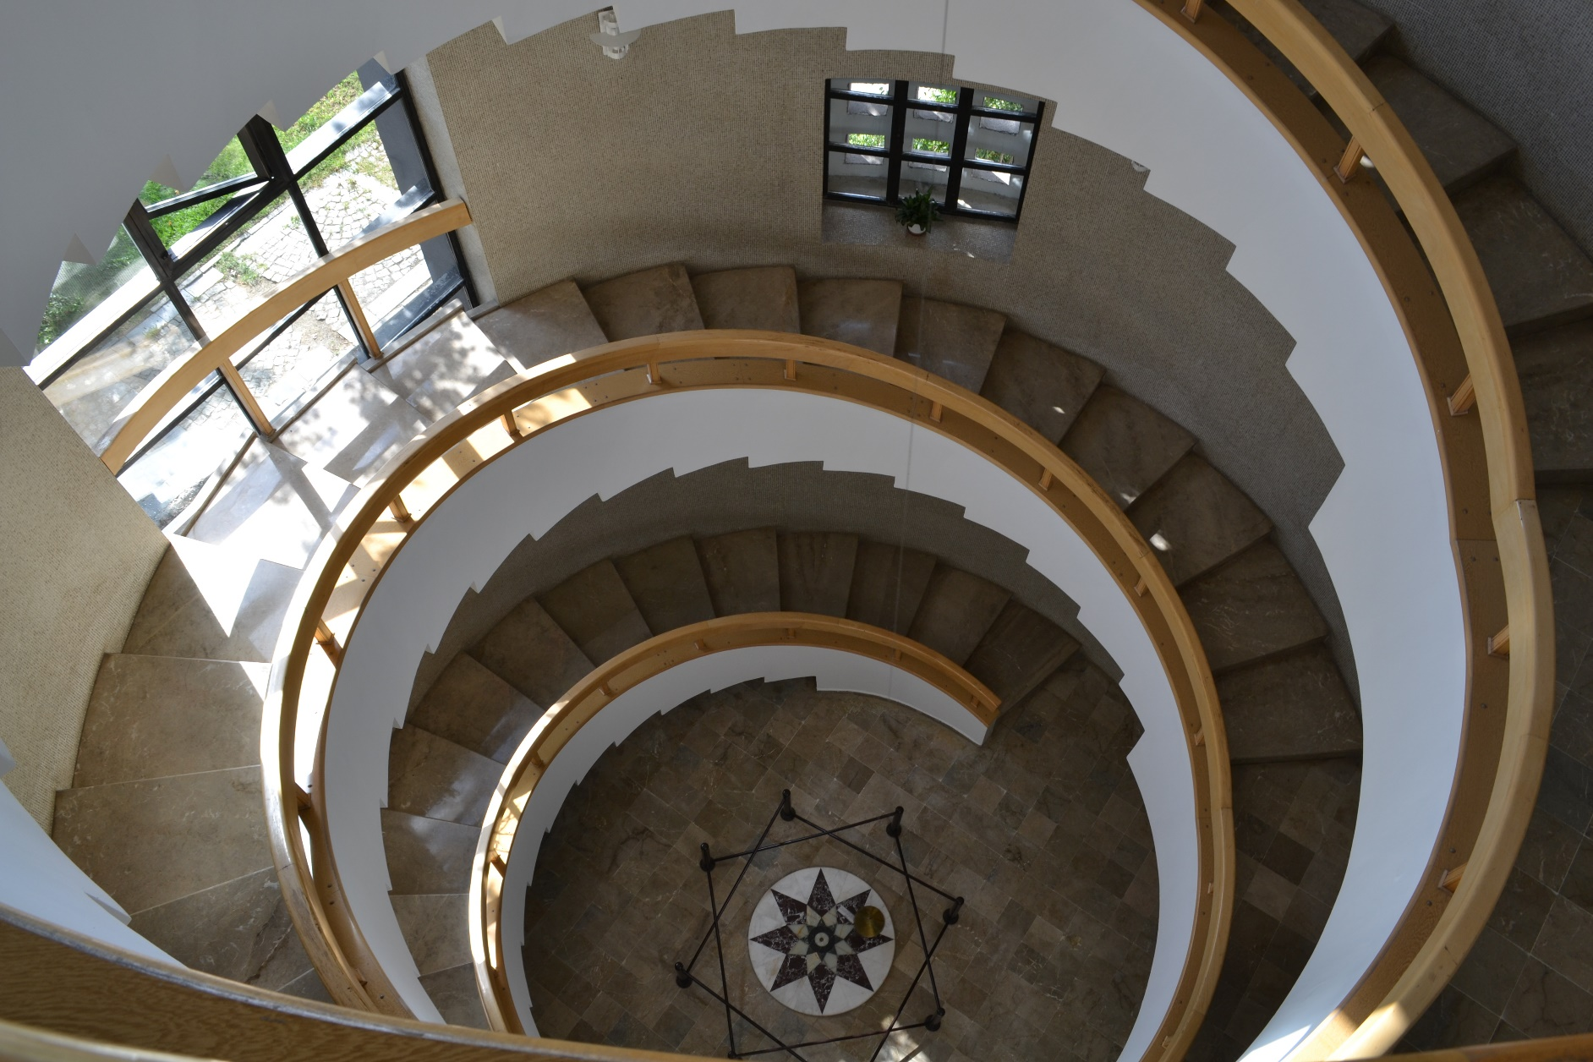
Foucault Pendulum @ Bilkent University

Slide 25
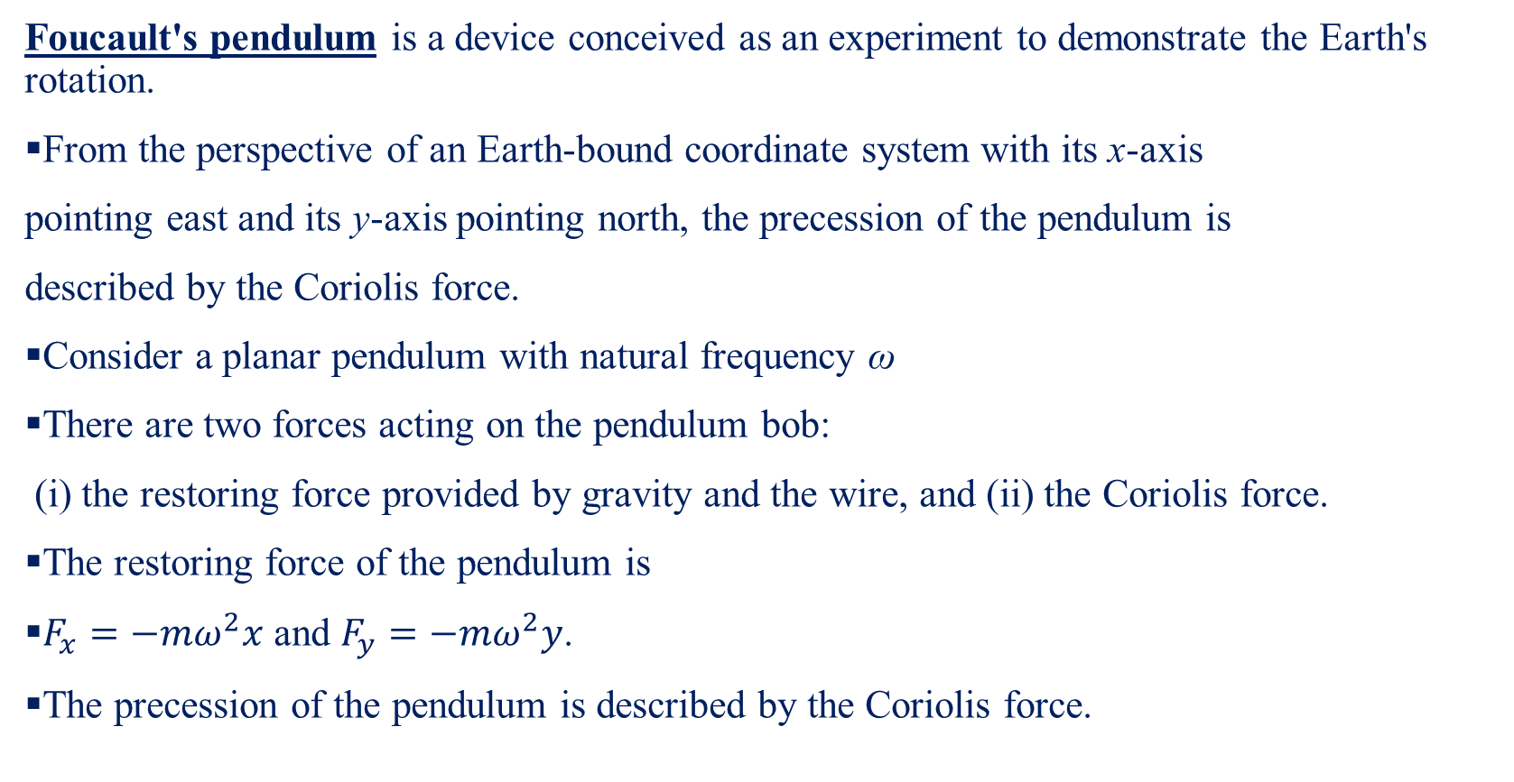
Foucault Pendulum
Foucault's pendulum is a device conceived as an experiment to demonstrate the Earth's rotation.
From the perspective of an Earth-bound coordinate system with its x-axis
pointing east and its y-axis pointing north, the precession of the pendulum is
described by the Coriolis force.
Consider a planar pendulum with natural frequency ω
There are two forces acting on the pendulum bob:
(i) the restoring force provided by gravity and the wire, and (ii) the Coriolis force.
The restoring force of the pendulum is
$F_{x}=−mω^{2}x$ and $F_{y}=−mω^{2}y$.
The precession of the pendulum is described by the Coriolis force.

