Slide 1
Mechanics
EPHY108L (2-0-2-3)
Ayan khan
Department of physics

Slide 2
Rigid Body Dynamics

Slide 3
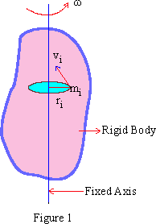
Introduction
What is a rigid body?
Any extended object which retains its shape during motion is called a rigid body.
How can one mathematically define a rigid body?
Mathematically, a rigid body can be seen as an assembly of a large number of point masses, whose interparticle distance remains unchanged during the motion of the body.
In what type of ways can a rigid body move?
A rigid body can exhibit strictly translational motion, strictly rotational
motion, or a combination the both. For example, a cylinder which is rolling
without slipping on a surface, is undergoing both translational and
rotational motion.

Slide 4
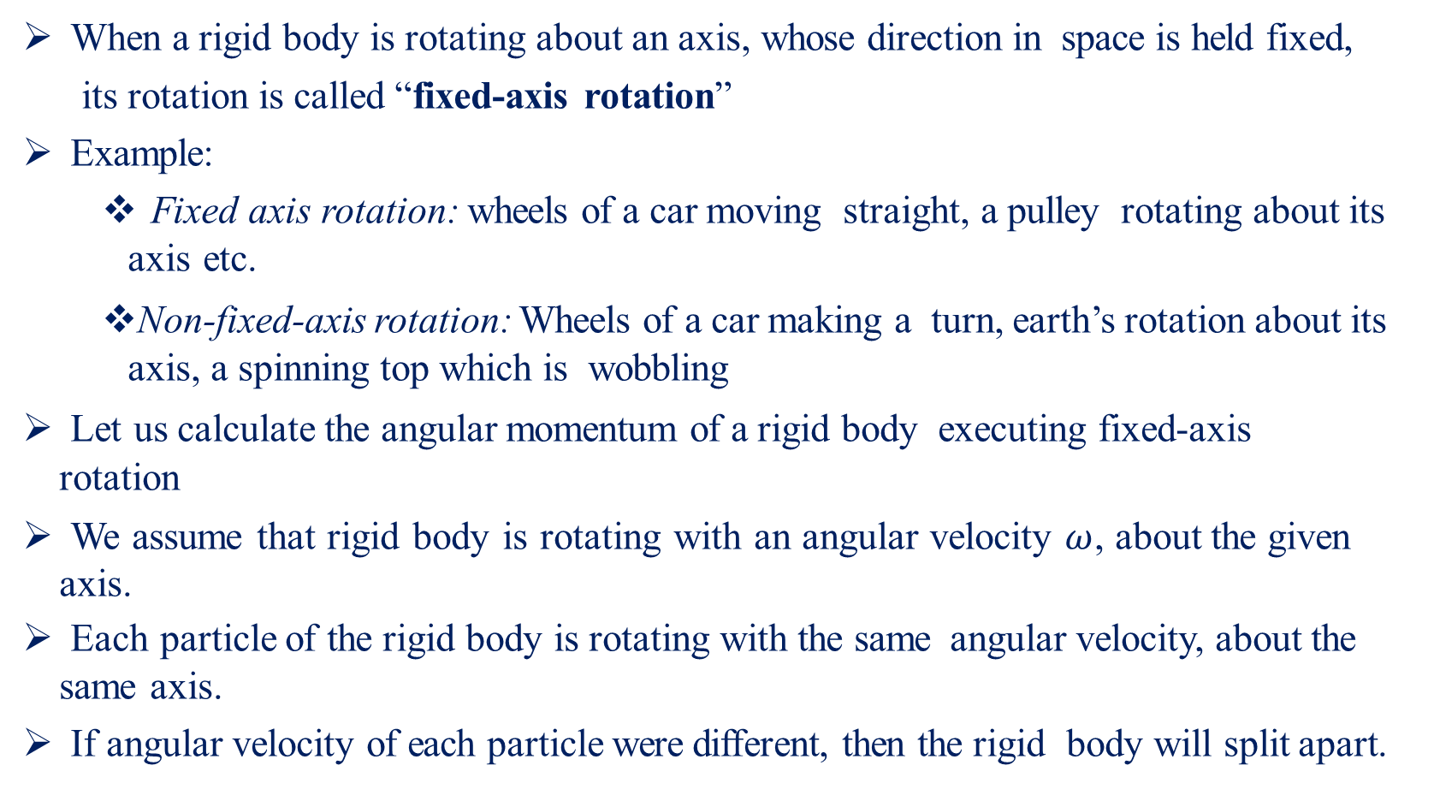
Rotation
When a rigid body is rotating about an axis, whose direction in space is held fixed,
its rotation is called “fixed-axis rotation”
Example:
Fixed axis rotation: wheels of a car moving straight, a pulley rotating about its axis etc.
Non-fixed-axis rotation: Wheels of a car making a turn, earth’s rotation about its axis, a spinning top which is wobbling
Let us calculate the angular momentum of a rigid body executing fixed-axis rotation
We assume that rigid body is rotating with an angular velocity $ω$, about the given axis.
Each particle of the rigid body is rotating with the same angular velocity, about the same axis.
If angular velocity of each particle were different, then the rigid body will split apart.

Slide 5
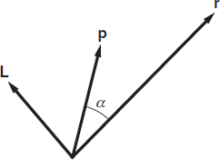
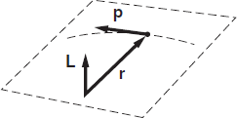
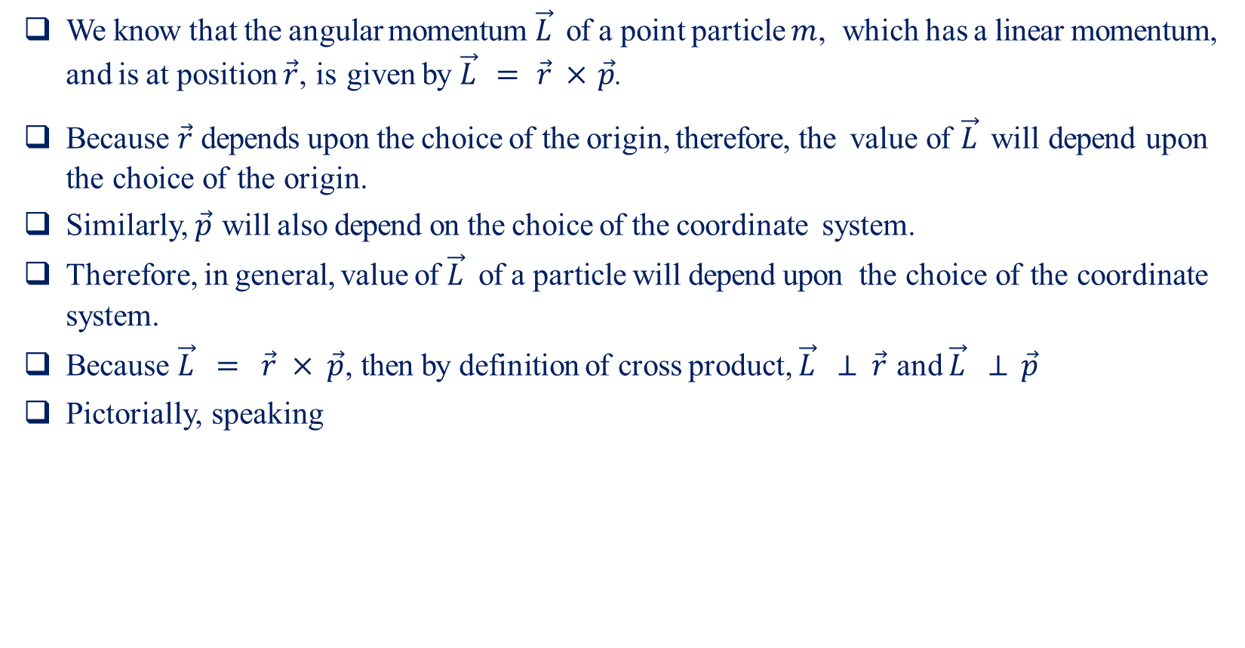
Angular Momentum of a Particle-I
We know that the angular momentum $\vec{L}$ of a point particle $m$, which has a linear momentum, and is at position $\vec{r}$, is given by $\vec{L} = \vec{r} × \vec{p}$.
Because $\vec{r}$ depends upon the choice of the origin, therefore, the value of $\vec{L}$ will depend upon the choice of the origin.
Similarly, $\vec{p}$ will also depend on the choice of the coordinate system.
Therefore, in general, value of $\vec{L}$ of a particle will depend upon the choice of the coordinate system.
Because $\vec{L} = \vec{r} × \vec{p}$, then by definition of cross product, $\vec{L} ⊥ \vec{r}$ and $\vec{L} ⊥ \vec{p}$
Pictorially, speaking

Slide 6


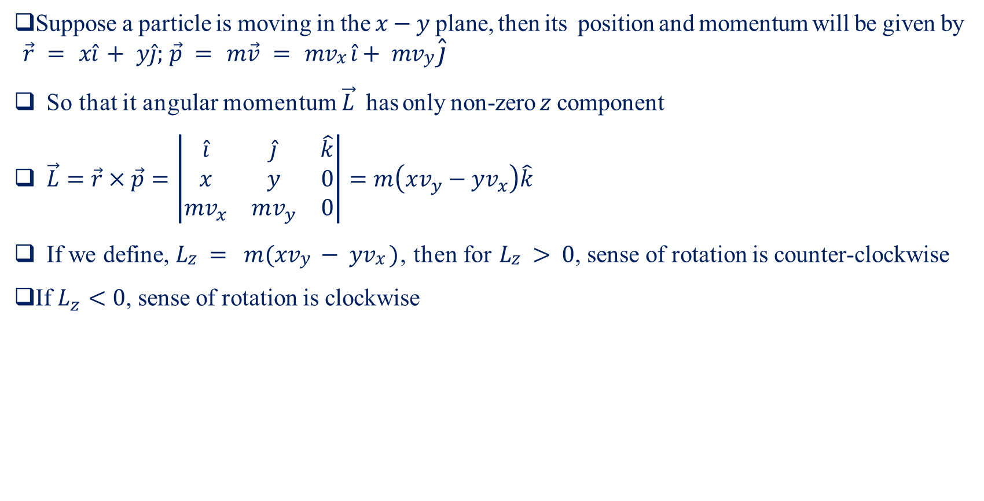
Angular Momentum of a Particle-II
Suppose a particle is moving in the $x−y$ plane, then its position and momentum will be given by $\vec{r} = x\hat{i} + y\hat{j}; \vec{p} = m\vec{v} = mvx \hat{i}+ mvy \hat{j}$
So that it angular momentum $\vec{L}$ has only non-zero $z$ component
$\vec{L}=\vec{r}×\vec{p}=\left|\begin{matrix}\hat{i} & \hat{j} & \hat{k} \\ x & y & 0 \\ {mv}_{x} & mv_{y} & 0\end{matrix}\right|=m\left(xv_{y}−yv_{x}\right)\hat{k}$
If we define, $Lz = m(xvy − yvx )$, then for $Lz > 0$, sense of rotation is counter-clockwise
If $L_{z}<0$, sense of rotation is clockwise
Y
L_{z} > 0
p
Sense of rotation
Y
L_{z} < 0
Sense of rotation
p
r
X
r
X

Slide 7
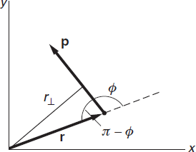
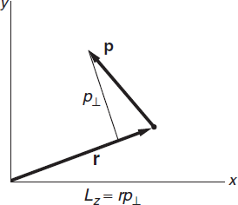
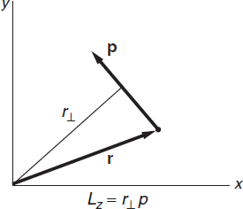

Angular Momentum of a Particle-III
Consider the right-side figure
Clearly, $r⊥ = r sin⁡(π − φ ) = r sin⁡φ$
Therefore $Lz = rp sin⁡φ = r⊥p$, as shown next,
Alternatively, we can write $Lz = rp sin⁡φ = rp⊥$, as shown below

Slide 8
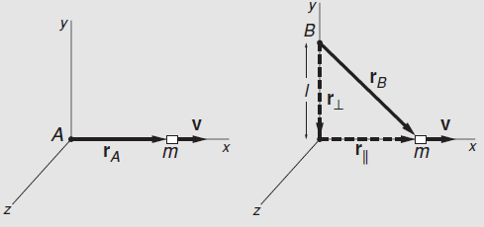
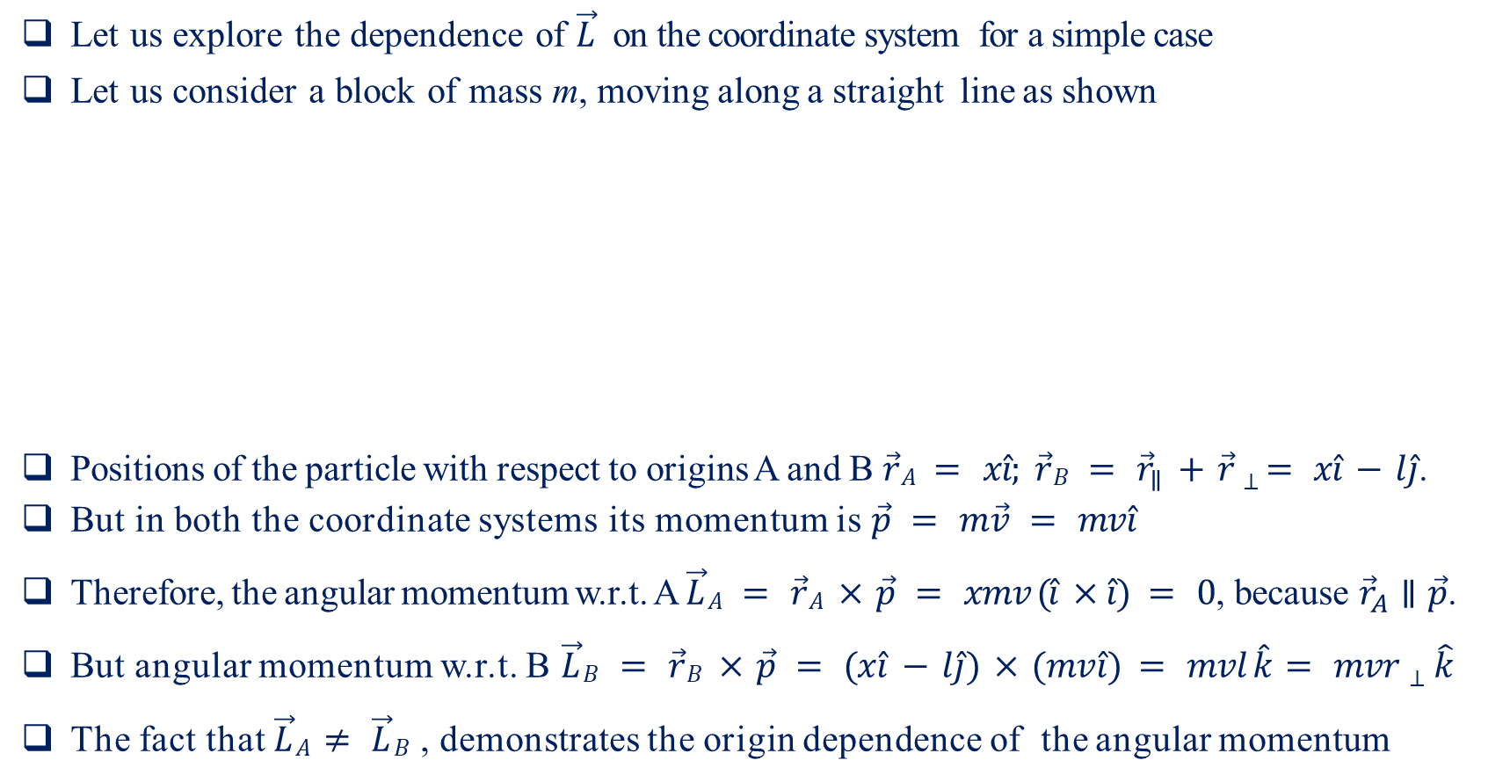
Angular Momentum of a Sliding Block
Let us explore the dependence of $\vec{L}$ on the coordinate system for a simple case
Let us consider a block of mass m, moving along a straight line as shown
Positions of the particle with respect to origins A and B $\vec{r}A = x\hat{i}; \vec{r}B = {\vec{r}}_{∥} +\vec{r}⊥ = x\hat{i} − l\hat{j}$.
But in both the coordinate systems its momentum is $\vec{p} = m\vec{v} = mv\hat{i}$
Therefore, the angular momentum w.r.t. A $\vec{L}A = \vec{r}A × \vec{p} = xmv (\hat{i} ×\hat{i}) = 0$, because ${\vec{r}}_{A}∥\vec{p}$.
But angular momentum w.r.t. B $\vec{L}B = \vec{r}B × \vec{p} = (x\hat{i} − l\hat{j}) × (mv\hat{i}) = mvl \hat{k} = mvr⊥\hat{k}$
The fact that $\vec{L}A≠ \vec{L}B$ , demonstrates the origin dependence of the angular momentum

Slide 9
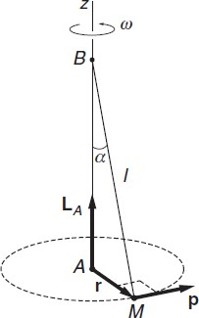
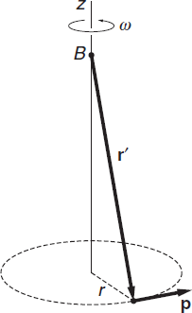
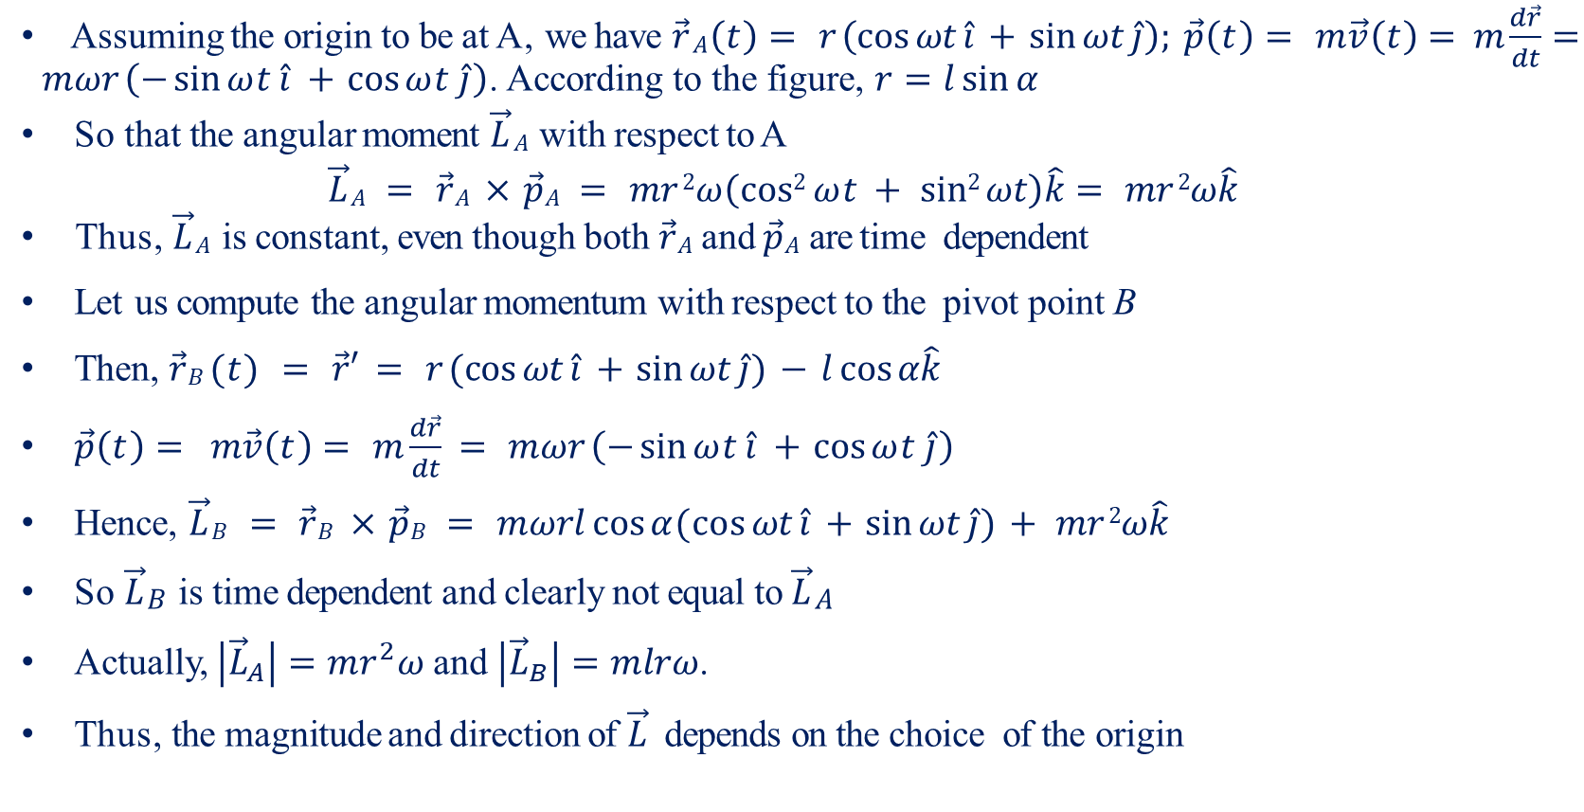
Conical Pendulum
Assuming the origin to be at A, we have $\vec{r}A\left(t\right)= r \left(\cos{ωt}\hat{i} +\sin{ωt}\hat{j}\right); \vec{p}\left(t\right)= m\vec{v}\left(t\right)= m \frac{d\vec{r}}{dt}= mωr \left(−\sin{ωt}\hat{i} +\cos{ωt}\hat{j}\right)$. According to the figure, $r=l\sin{α}$
So that the angular moment $\vec{L}A$ with respect to A
$$\vec{L}A = \vec{r}A × \vec{p}A = mr 2ω\left(cos2 ωt + sin2 ωt\right)\hat{k}= mr 2ω\hat{k}$$
Thus, $\vec{L}A$ is constant, even though both $\vec{r}A$ and $\vec{p}A$ are time dependent
Let us compute the angular momentum with respect to the pivot point B
Then, $\vec{r}B (t) = \vec{r}′ = r (\cos{ωt}\hat{i} +\sin{ωt}\hat{j}) − l cos⁡α\hat{k}$
$\vec{p}\left(t\right)= m\vec{v}\left(t\right)= m\frac{d\vec{r}}{dt} = mωr \left(−\sin{ωt}\hat{i} +\cos{ωt}\hat{j}\right)$
Hence, $\vec{L}B = \vec{r}B × \vec{p}B = mωrl cos⁡α(\cos{ωt}\hat{i} +\sin{ωt}\hat{j}) + mr 2ω\hat{k}$
So $\vec{L}B$ is time dependent and clearly not equal to $\vec{L}A$
Actually, $\left|{\vec{L}}_{A}\right|=mr^{2}ω$ and $\left|{\vec{L}}_{B}\right|=mlrω$.
Thus, the magnitude and direction of $\vec{L}$ depends on the choice of the origin

Slide 10
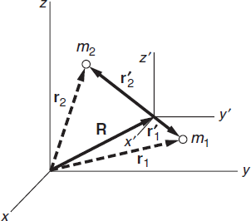
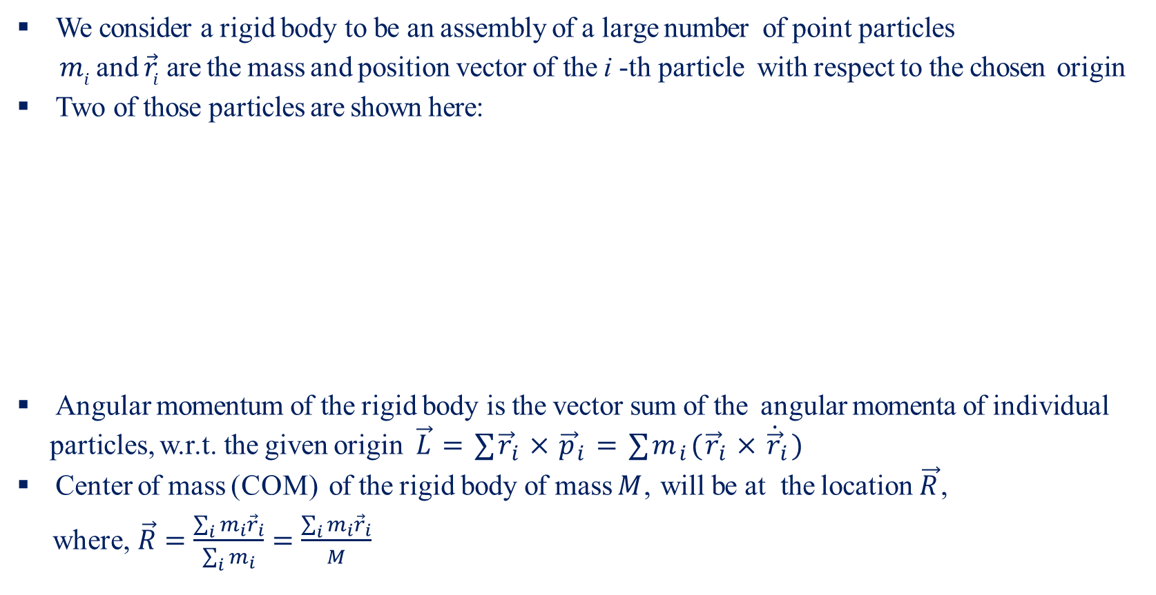
Angular Momentum of Rigid Body-I
We consider a rigid body to be an assembly of a large number of point particles
$m_{i}$ and ${\vec{r}}_{i}$ are the mass and position vector of the i -th particle with respect to the chosen origin
Two of those particles are shown here:
Angular momentum of the rigid body is the vector sum of the angular momenta of individual particles, w.r.t. the given origin $\vec{L}=∑{\vec{r}}_{i}×{\vec{p}}_{i}=∑m_{i}({\vec{r}}_{i}×{\dot{\vec{r}}}_{i})$
Center of mass (COM) of the rigid body of mass $M$, will be at the location $\vec{R}$,
where, $\vec{R}=\frac{\sum_{i}{m_{i}}{\vec{r}}_{i}}{\sum_{i}{m_{i}}}=\frac{\sum_{i}{m_{i}}{\vec{r}}_{i}}{M}$

Slide 11
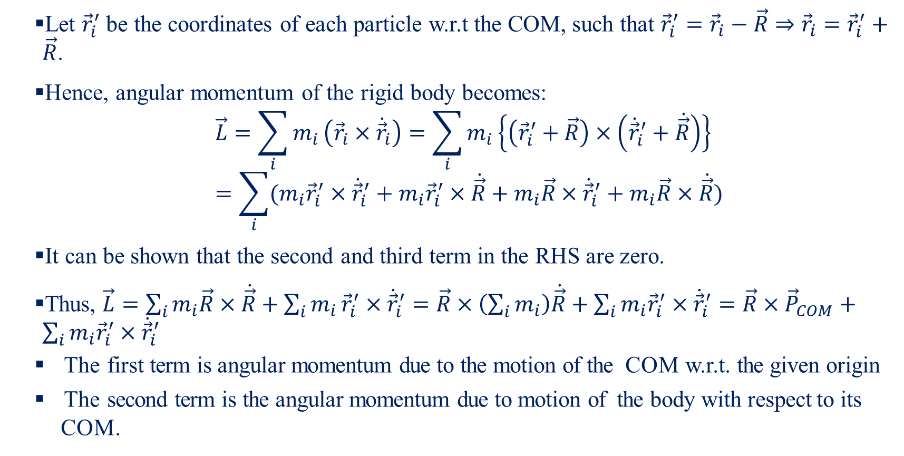
Angular Momentum of Rigid Body-II
Let ${\vec{r}}_{i}^{′}$ be the coordinates of each particle w.r.t the COM, such that ${\vec{r}}_{i}^{′}={\vec{r}}_{i}−\vec{R}⇒{\vec{r}}_{i}={\vec{r}}_{i}^{′}+\vec{R}$.
Hence, angular momentum of the rigid body becomes:
$$\vec{L}=\sum_{i}{m_{i}}\left({\vec{r}}_{i}×{\dot{\vec{r}}}_{i}\right)=\sum_{i}{m_{i}}\left\{\left({\vec{r}}_{i}^{′}+\vec{R}\right)×\left({\dot{\vec{r}}}_{i}^{′}+\dot{\vec{R}}\right)\right\}=\sum_{i}{(m_{i}{\vec{r}}_{i}^{′}×{\dot{\vec{r}}}_{i}^{′}+m_{i}{\vec{r}}_{i}^{′}×\dot{\vec{R}}+m_{i}\vec{R}×{\dot{\vec{r}}}_{i}^{′}+m_{i}\vec{R}×\dot{\vec{R}})}$$
It can be shown that the second and third term in the RHS are zero.
Thus, $\vec{L}=\sum_{i}{m_{i}\vec{R}×\dot{\vec{R}}}+\sum_{i}{m_{i}}{\vec{r}}_{i}^{′}×{\dot{\vec{r}}}_{i}^{′}=\vec{R}×\left(\sum_{i}{m_{i}}\right)\dot{\vec{R}}+\sum_{i}{m_{i}{\vec{r}}_{i}^{′}}×{\dot{\vec{r}}}_{i}^{′}=\vec{R}×{\vec{P}}_{COM}+\sum_{i}{m_{i}{\vec{r}}_{i}^{′}}×{\dot{\vec{r}}}_{i}^{′}$
The first term is angular momentum due to the motion of the COM w.r.t. the given origin
The second term is the angular momentum due to motion of the body with respect to its COM.

Slide 12
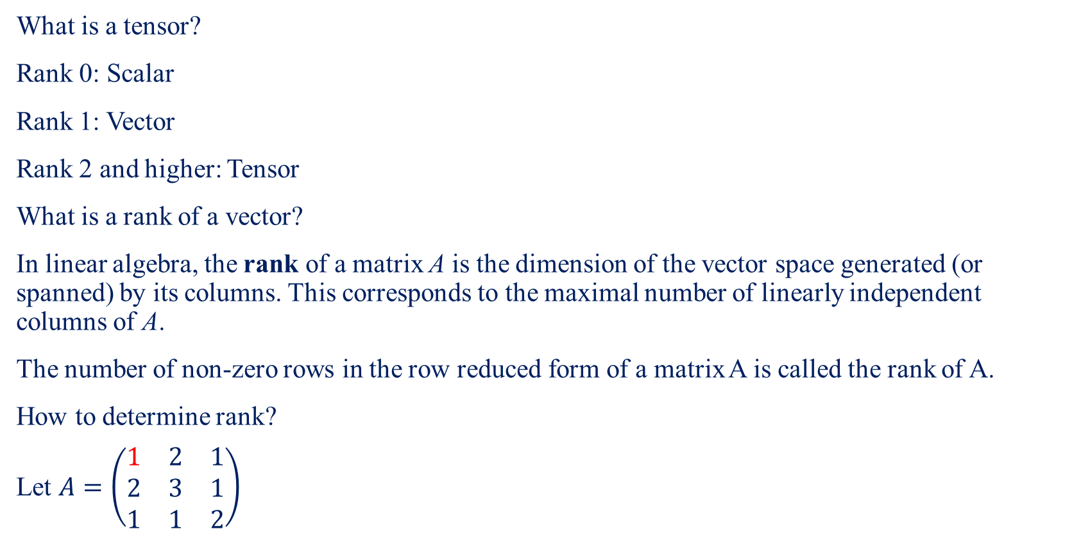
Tensor-I
What is a tensor?
Rank 0: Scalar
Rank 1: Vector
Rank 2 and higher: Tensor
What is a rank of a vector?
In linear algebra, the rank of a matrix A is the dimension of the vector space generated (or spanned) by its columns. This corresponds to the maximal number of linearly independent columns of A.
The number of non-zero rows in the row reduced form of a matrix A is called the rank of A.
How to determine rank?
Let $A=\left(\begin{matrix}1 & 2 & 1 \\ 2 & 3 & 1 \\ 1 & 1 & 2\end{matrix}\right)$

Slide 13
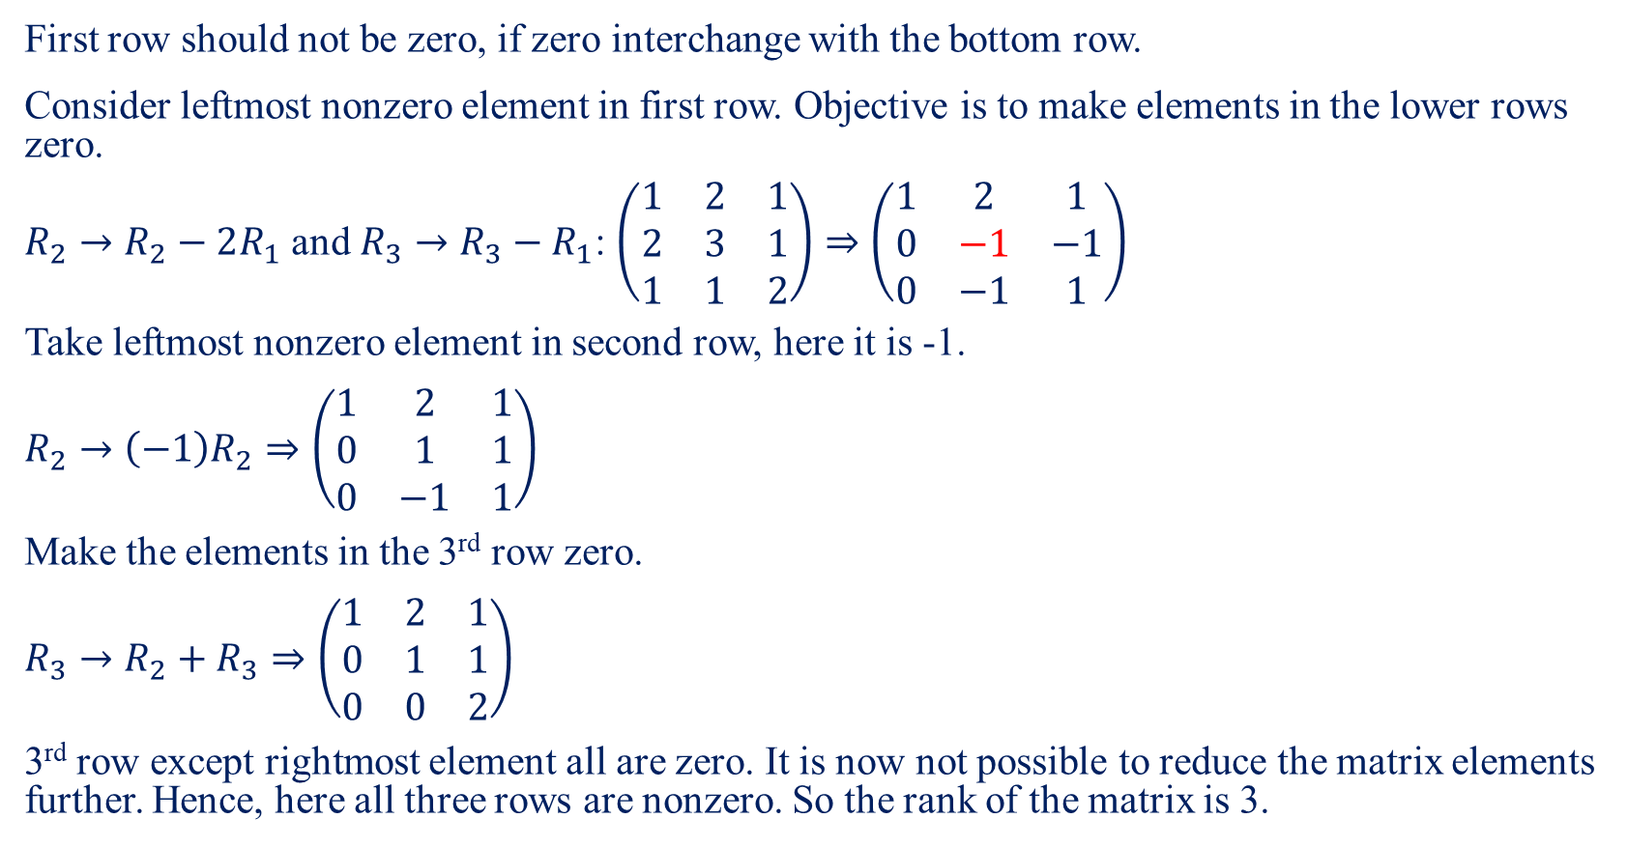
Tensor-II
First row should not be zero, if zero interchange with the bottom row.
Consider leftmost nonzero element in first row. Objective is to make elements in the lower rows zero.
$R_{2}→R_{2}−2R_{1}$ and ${R_{3}→R}_{3}−R_{1}$: $\left(\begin{matrix}1 & 2 & 1 \\ 2 & 3 & 1 \\ 1 & 1 & 2\end{matrix}\right)⇒\left(\begin{matrix}1 & 2 & 1 \\ 0 & −1 & −1 \\ 0 & −1 & 1\end{matrix}\right)$
Take leftmost nonzero element in second row, here it is -1.
$R_{2}→\left(−1\right)R_{2}⇒\left(\begin{matrix}1 & 2 & 1 \\ 0 & 1 & 1 \\ 0 & −1 & 1\end{matrix}\right)$
Make the elements in the 3rd row zero.
$R_{3}→R_{2}+R_{3}⇒\left(\begin{matrix}1 & 2 & 1 \\ 0 & 1 & 1 \\ 0 & 0 & 2\end{matrix}\right)$
3rd row except rightmost element all are zero. It is now not possible to reduce the matrix elements further. Hence, here all three rows are nonzero. So the rank of the matrix is 3.

Slide 14

Tensor-III
Determine the rank of the matrix: $\left(\begin{matrix}1 & 0 & 1 \\ −2 & −3 & 1 \\ 3 & 3 & 0\end{matrix}\right)$
$\left(\begin{matrix}1 & 0 & 1 \\ −2 & −3 & 1 \\ 3 & 3 & 0\end{matrix}\right)⇒R_{2}→R_{2}+2R_{1}$
$⇒\left(\begin{matrix}1 & 0 & 1 \\ 0 & −3 & 3 \\ 3 & 3 & 0\end{matrix}\right)⇒R_{3}→R_{3}−3R_{1}$
$⇒\left(\begin{matrix}1 & 0 & 1 \\ 0 & −3 & 3 \\ 0 & 3 & −3\end{matrix}\right)⇒R_{3}→R_{2}+R_{3}$
$⇒\left(\begin{matrix}1 & 0 & 1 \\ 0 & −3 & 3 \\ 0 & 0 & 0\end{matrix}\right)$
Rank is 2

Slide 15
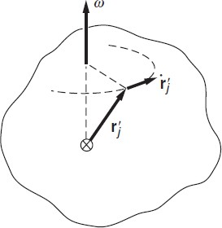
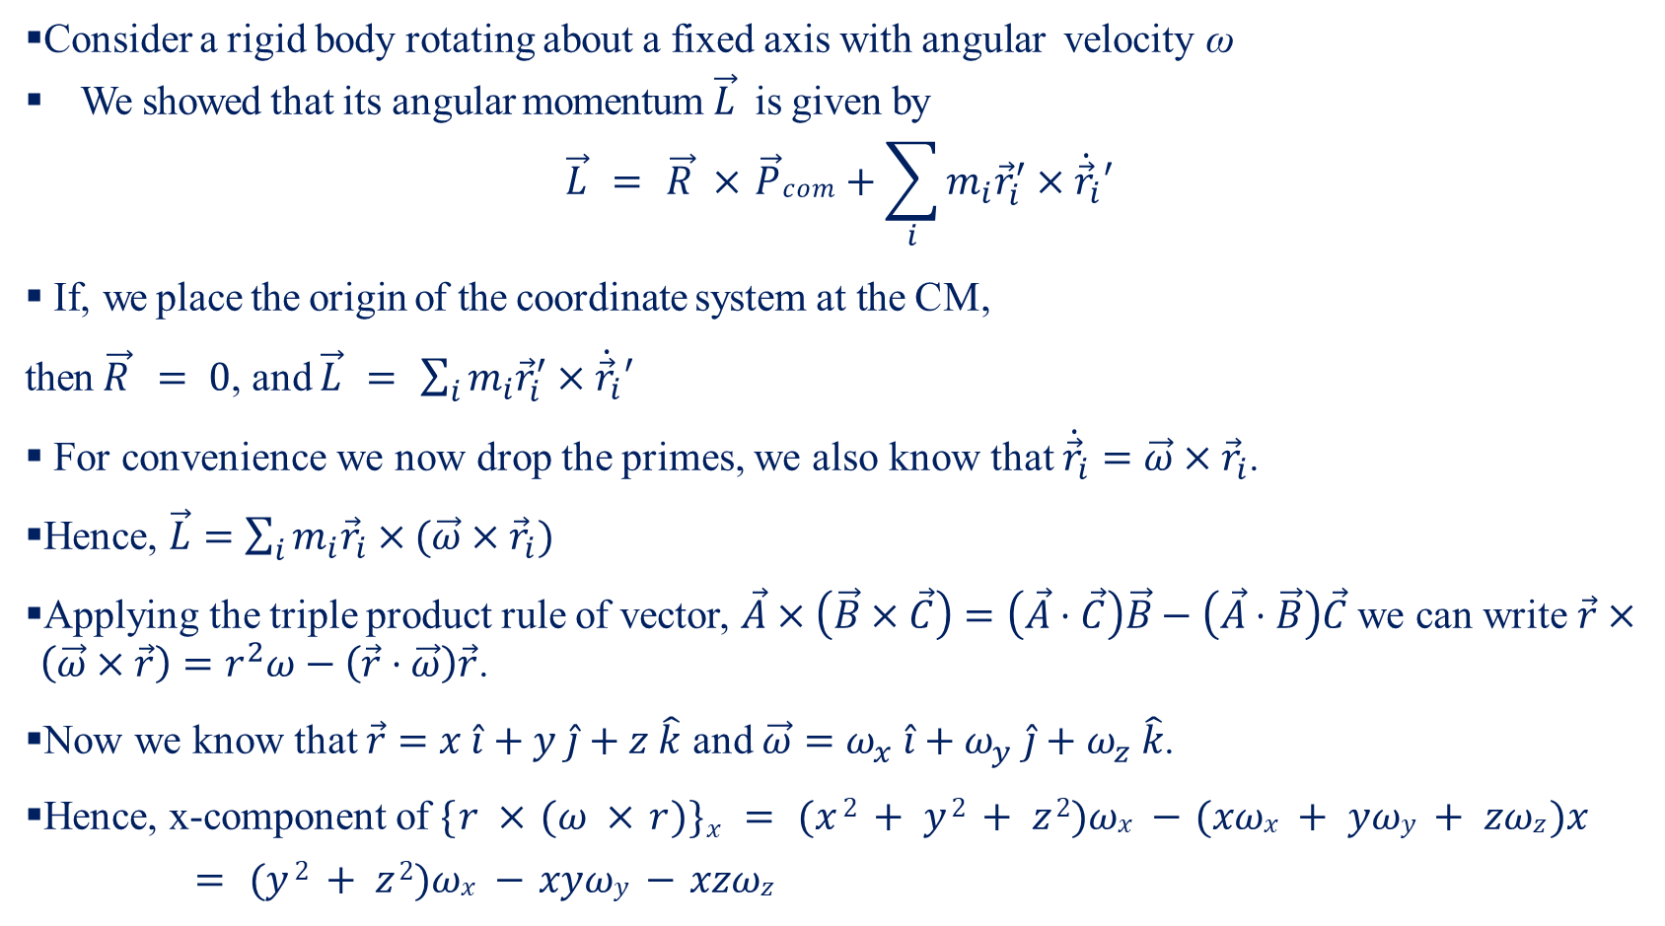
Inertia Tensor-I
Consider a rigid body rotating about a fixed axis with angular velocity ω
We showed that its angular momentum $\vec{L}$ is given by
$$\vec{L} = \vec{R} × \vec{P}com+\sum_{i}{m_{i}{\vec{r}}_{i}^{′}×{\dot{\vec{r}}}_{i}′}$$
If, we place the origin of the coordinate system at the CM,
then $\vec{R} = 0$, and $\vec{L} = \sum_{i}{m_{i}{\vec{r}}_{i}^{′}×{\dot{\vec{r}}}_{i}′}$
For convenience we now drop the primes, we also know that ${\dot{\vec{r}}}_{i}=\vec{ω}×{\vec{r}}_{i}$.
Hence, $\vec{L}=\sum_{i}{m_{i}{\vec{r}}_{i}×(\vec{ω}×{\vec{r}}_{i})}$
Applying the triple product rule of vector, $\vec{A}×\left(\vec{B}×\vec{C}\right)=\left(\vec{A}⋅\vec{C}\right)\vec{B}−\left(\vec{A}⋅\vec{B}\right)\vec{C}$ we can write $\vec{r}×\left(\vec{ω}×\vec{r}\right)=r^{2}ω−\left(\vec{r}⋅\vec{ω}\right)\vec{r}$.
Now we know that $\vec{r}=x \hat{i}+y \hat{j}+z \hat{k}$ and $\vec{ω}=ω_{x} \hat{i}+ω_{y} \hat{j}+ω_{z} \hat{k}$.
Hence, x-component of $\{r × (ω × r)\}x = (x 2 + y 2 + z 2)ωx − (xωx + yωy + zωz )x$
$= (y 2 + z 2)ωx − xyωy − xzωz$

Slide 16
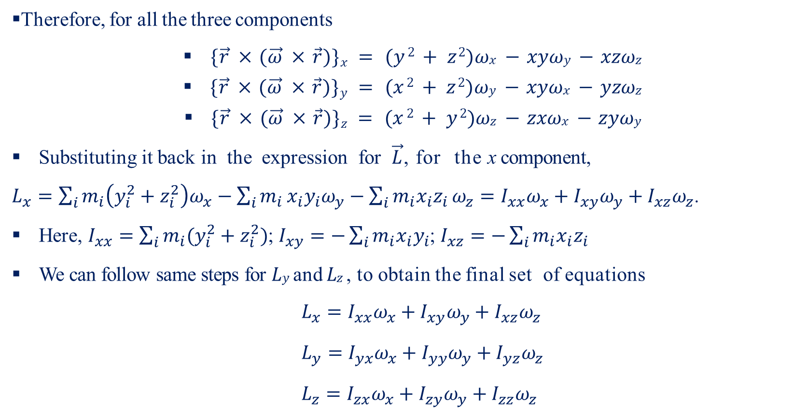
Inertia Tensor-II
Therefore, for all the three components
$\{\vec{r} × (\vec{ω} × \vec{r})\}x = (y 2 + z 2)ωx − xyωy − xzωz$
$\{\vec{r} × (\vec{ω} × \vec{r})\}y = (x 2 + z 2)ωy − xyωx − yzωz$
$\{\vec{r} × (\vec{ω} × \vec{r})\}z = (x 2 + y 2)ωz − zxωx − zyωy$
Substituting it back in the expression for $\vec{L}$, for the x component,
$L_{x}=\sum_{i}{m_{i}\left(y_{i}^{2}+z_{i}^{2}\right)ω_{x}}−\sum_{i}{m_{i}}x_{i}y_{i}ω_{y}−\sum_{i}{m_{i}x_{i}z_{i}}ω_{z}=I_{xx}ω_{x}+I_{xy}ω_{y}+I_{xz}ω_{z}$.
Here, $I_{xx}=\sum_{i}{m_{i}(y_{i}^{2}+z_{i}^{2})}$; $I_{xy}=−\sum_{i}{m_{i}x_{i}y_{i}}$; $I_{xz}=−\sum_{i}{m_{i}x_{i}z_{i}}$
We can follow same steps for $Ly$ and $Lz$ , to obtain the final set of equations
$L_{x}=I_{xx}ω_{x}+I_{xy}ω_{y}+I_{xz}ω_{z}$
$L_{y}=I_{yx}ω_{x}+I_{yy}ω_{y}+I_{yz}ω_{z}$
$L_{z}=I_{zx}ω_{x}+I_{zy}ω_{y}+I_{zz}ω_{z}$

Slide 17
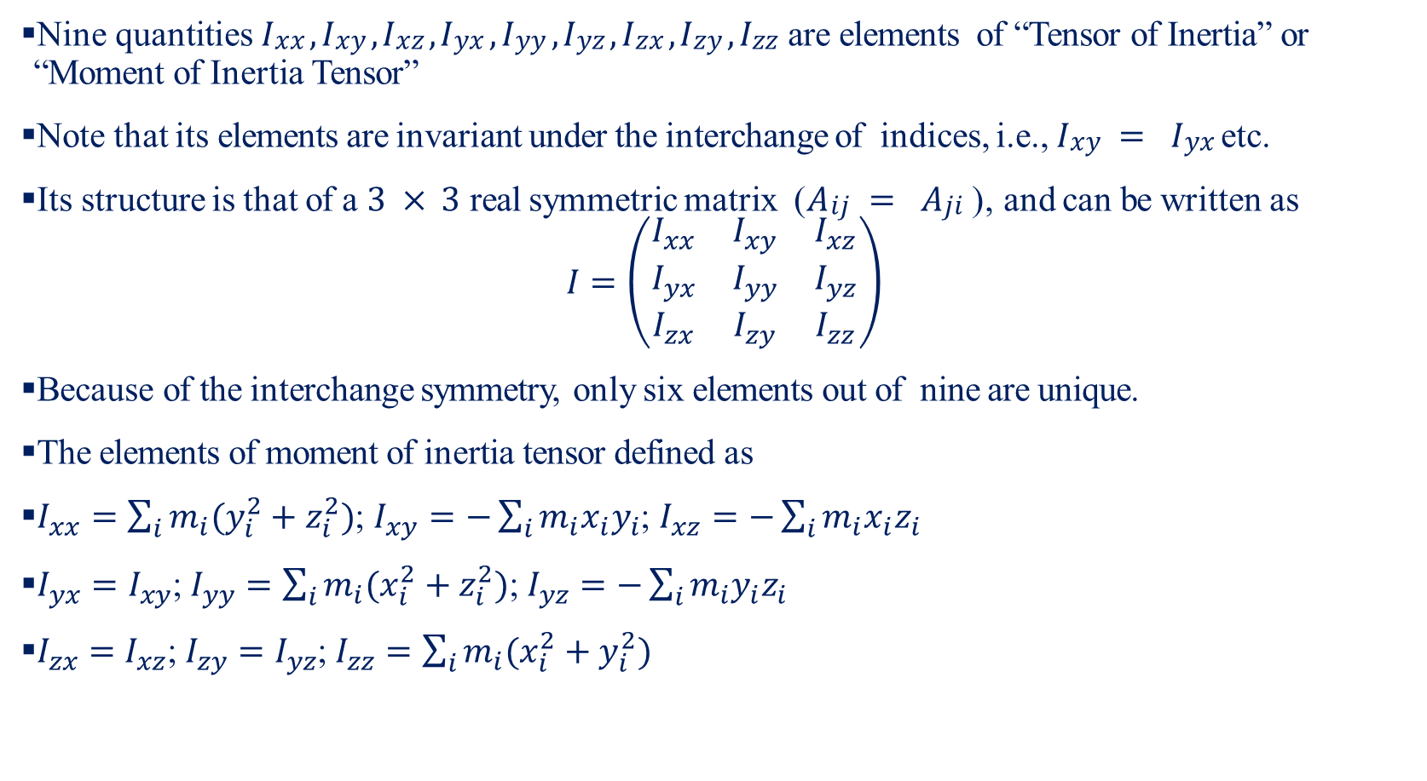
Inertia Tensor-III
Nine quantities $Ixx , Ixy , Ixz , Iyx , Iyy , Iyz , Izx , Izy , Izz$ are elements of “Tensor of Inertia” or “Moment of Inertia Tensor”
Note that its elements are invariant under the interchange of indices, i.e., $Ixy = Iyx$ etc.
Its structure is that of a $3 × 3$ real symmetric matrix ($Aij = Aji$ ), and can be written as
$$I=\left(\begin{matrix}I_{xx} & I_{xy} & I_{xz} \\ I_{yx} & I_{yy} & I_{yz} \\ I_{zx} & I_{zy} & I_{zz}\end{matrix}\right)$$
Because of the interchange symmetry, only six elements out of nine are unique.
The elements of moment of inertia tensor defined as
$I_{xx}=\sum_{i}{m_{i}(y_{i}^{2}+z_{i}^{2})}$; $I_{xy}=−\sum_{i}{m_{i}x_{i}y_{i}}$; $I_{xz}=−\sum_{i}{m_{i}x_{i}z_{i}}$
$I_{yx}=I_{xy}$; $I_{yy}=\sum_{i}{m_{i}(x_{i}^{2}+z_{i}^{2})}$; $I_{yz}=−\sum_{i}{m_{i}y_{i}z_{i}}$
$I_{zx}=I_{xz}$; $I_{zy}=I_{yz}$; $I_{zz}=\sum_{i}{m_{i}(x_{i}^{2}+y_{i}^{2})}$

Slide 18
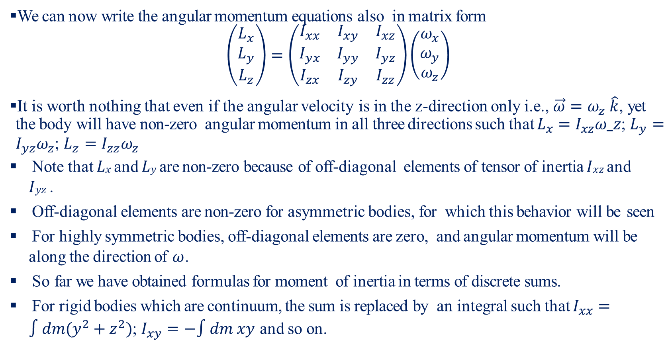
Inertia Tensor-IV
We can now write the angular momentum equations also in matrix form
$$\left(\begin{matrix}L_{x} \\ L_{y} \\ L_{z}\end{matrix}\right)=\left(\begin{matrix}I_{xx} & I_{xy} & I_{xz} \\ I_{yx} & I_{yy} & I_{yz} \\ I_{zx} & I_{zy} & I_{zz}\end{matrix}\right)\left(\begin{matrix}ω_{x} \\ ω_{y} \\ ω_{z}\end{matrix}\right)$$
It is worth nothing that even if the angular velocity is in the z-direction only i.e., $\vec{ω}=ω_{z} \hat{k}$, yet the body will have non-zero angular momentum in all three directions such that $L_{x}=I_{xz}ω_z$; $L_{y}=I_{yz}ω_{z}$; $L_{z}=I_{zz}ω_{z}$
Note that $Lx$ and $Ly$ are non-zero because of off-diagonal elements of tensor of inertia $Ixz$ and $Iyz$ .
Off-diagonal elements are non-zero for asymmetric bodies, for which this behavior will be seen
For highly symmetric bodies, off-diagonal elements are zero, and angular momentum will be along the direction of $ω$.
So far we have obtained formulas for moment of inertia in terms of discrete sums.
For rigid bodies which are continuum, the sum is replaced by an integral such that $I_{xx}=∫dm(y^{2}+z^{2})$; $I_{xy}=−∫dm xy$ and so on.

Slide 19
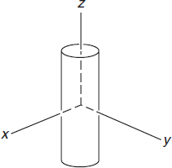
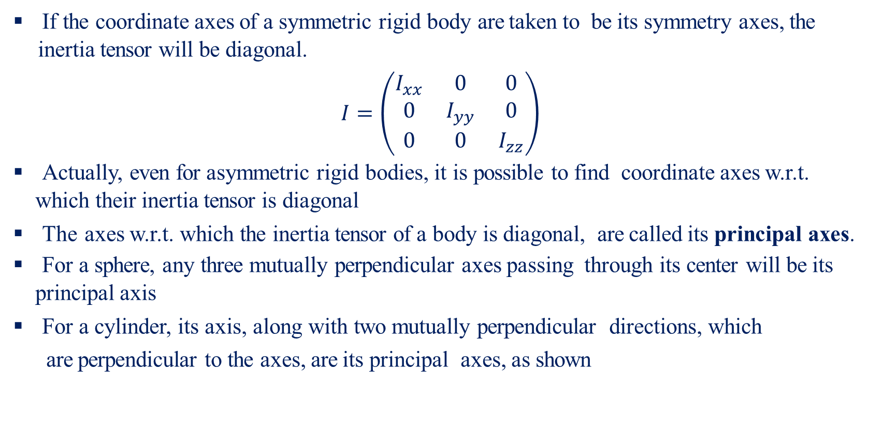
Principle Axes of Rigid Body-I
If the coordinate axes of a symmetric rigid body are taken to be its symmetry axes, the inertia tensor will be diagonal.
$$I=\left(\begin{matrix}I_{xx} & 0 & 0 \\ 0 & I_{yy} & 0 \\ 0 & 0 & I_{zz}\end{matrix}\right)$$
Actually, even for asymmetric rigid bodies, it is possible to find coordinate axes w.r.t. which their inertia tensor is diagonal
The axes w.r.t. which the inertia tensor of a body is diagonal, are called its principal axes.
For a sphere, any three mutually perpendicular axes passing through its center will be its principal axis
For a cylinder, its axis, along with two mutually perpendicular directions, which
are perpendicular to the axes, are its principal axes, as shown

Slide 20
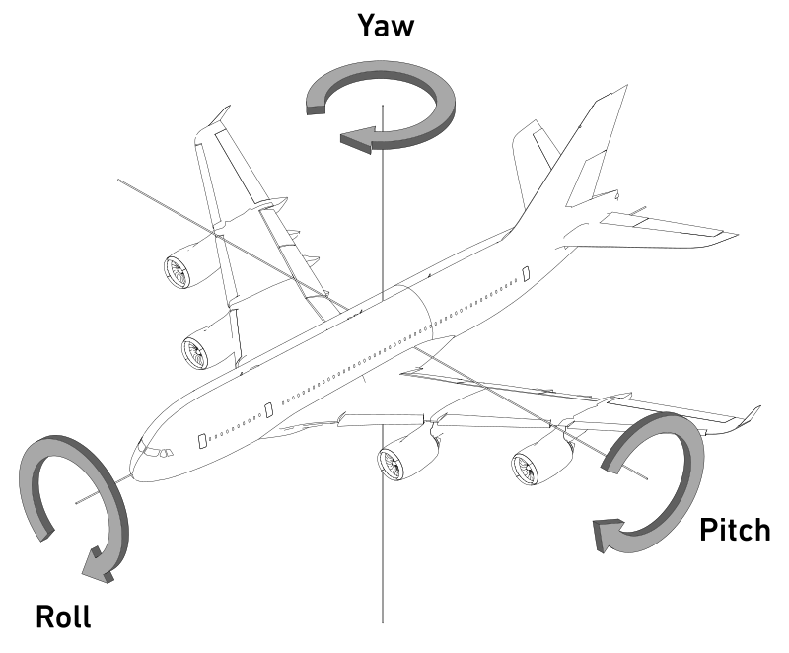
Principle Axes of Rigid Body-II
An aircraft in flight is free to rotate in three dimensions: yaw, nose left or right about an axis running up and down; pitch, nose up or down about an axis running from wing to wing; and roll, rotation about an axis running from nose to tail.
These rotations are produced by torques about the principal axes.
The principle axes are named as Normal axis or yaw axis; Transverse axis or pitch axis; and
Longitudinal axis or roll axis.

Slide 21
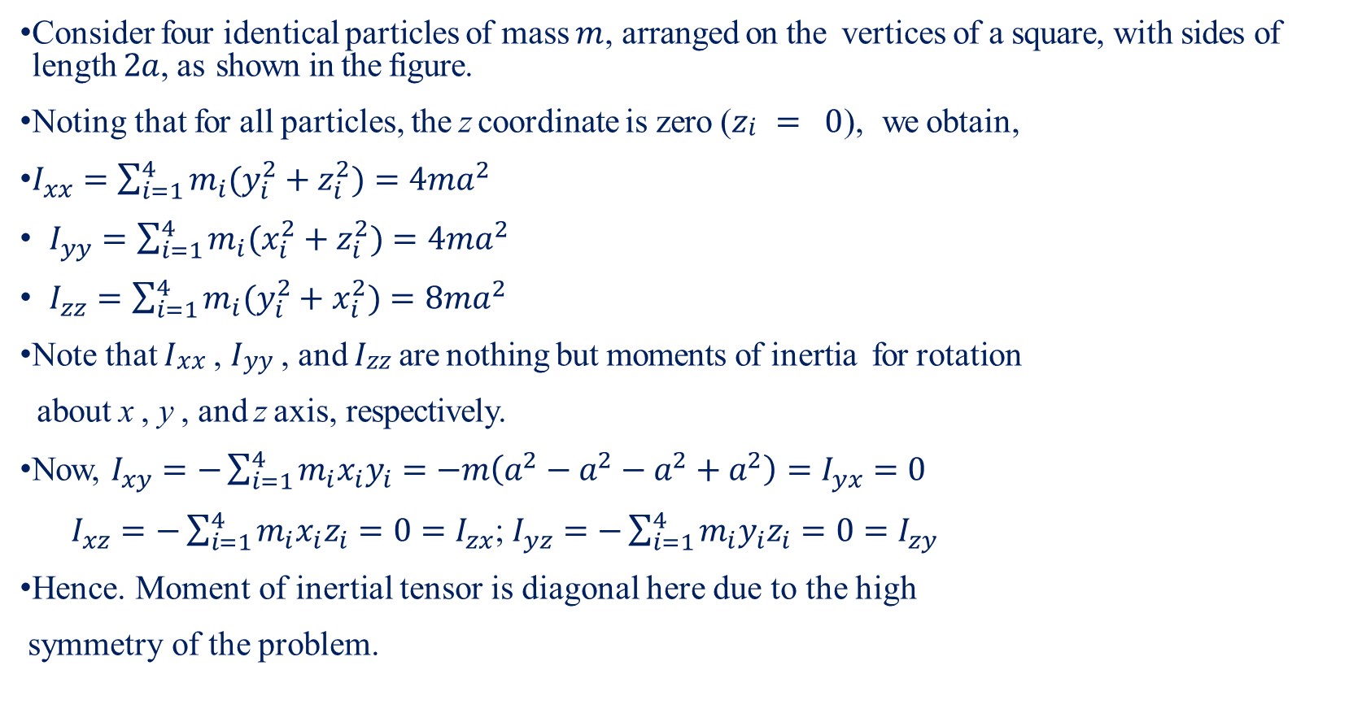
Calculation of Inertia Tensor
Consider four identical particles of mass $m$, arranged on the vertices of a square, with sides of length $2a$, as shown in the figure.
Noting that for all particles, the z coordinate is zero ($zi = 0$), we obtain,
$I_{xx}=\sum_{i=1}^{4}{m_{i}(y_{i}^{2}+z_{i}^{2})}=4ma^{2}$
$I_{yy}=\sum_{i=1}^{4}{m_{i}(x_{i}^{2}+z_{i}^{2})}=4ma^{2}$
$I_{zz}=\sum_{i=1}^{4}{m_{i}(y_{i}^{2}+x_{i}^{2})}=8ma^{2}$
Note that $Ixx$ , $Iyy$ , and $Izz$ are nothing but moments of inertia for rotation
about x , y , and z axis, respectively.
Now, $I_{xy}=−\sum_{i=1}^{4}{m_{i}x_{i}y_{i}}=−m\left(a^{2}−a^{2}−a^{2}+a^{2}\right)=I_{yx}=0$
$I_{xz}=−\sum_{i=1}^{4}{m_{i}x_{i}z_{i}}=0=I_{zx}$; $I_{yz}=−\sum_{i=1}^{4}{m_{i}y_{i}z_{i}}=0=I_{zy}$
Hence. Moment of inertial tensor is diagonal here due to the high
symmetry of the problem.

Slide 22
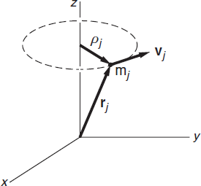
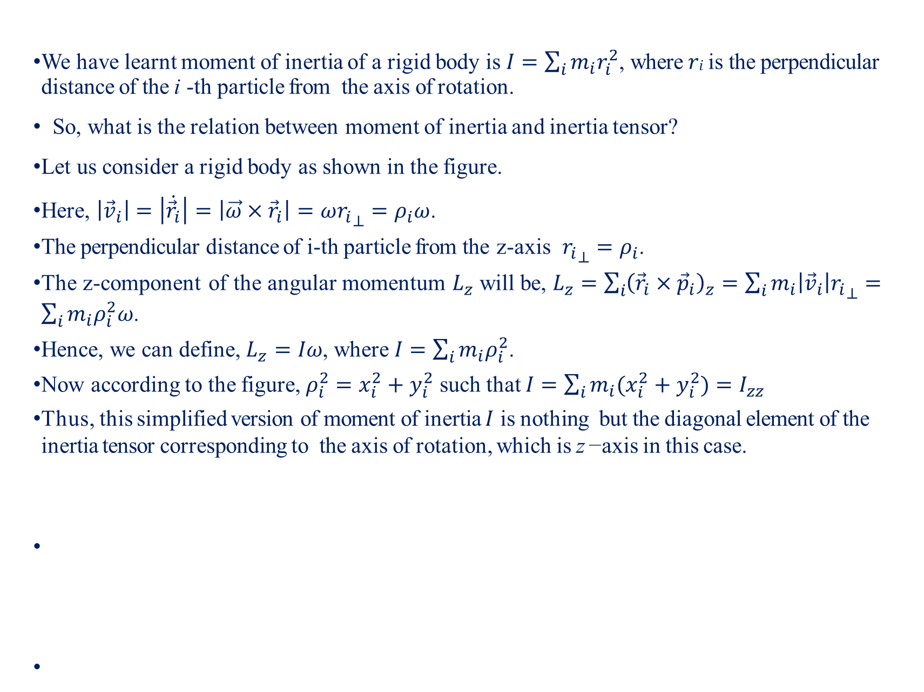
Inertia Tensor and Moment of Inertia
We have learnt moment of inertia of a rigid body is $I=\sum_{i}{m_{i}r_{i}^{2}}$, where $ri$ is the perpendicular distance of the i -th particle from the axis of rotation.
So, what is the relation between moment of inertia and inertia tensor?
Let us consider a rigid body as shown in the figure.
Here, $\left|{\vec{v}}_{i}\right|=\left|\dot{{\vec{r}}_{i}}\right|=\left|\vec{ω}×{\vec{r}}_{i}\right|=ω{r_{i}}_{⊥}=ρ_{i}ω$.
The perpendicular distance of i-th particle from the z-axis ${r_{i}}_{⊥}=ρ_{i}$.
The z-component of the angular momentum $L_{z}$ will be, $L_{z}=\sum_{i}{{\left({\vec{r}}_{i}×{\vec{p}}_{i}\right)}_{z}}=\sum_{i}{m_{i}\left|{\vec{v}}_{i}\right|{r_{i}}_{⊥}}=\sum_{i}{m_{i}ρ_{i}^{2}ω}$.
Hence, we can define, $L_{z}=Iω$, where $I=\sum_{i}{m_{i}ρ_{i}^{2}}$.
Now according to the figure, $ρ_{i}^{2}=x_{i}^{2}+y_{i}^{2}$ such that $I=\sum_{i}{m_{i}(x_{i}^{2}+y_{i}^{2})}=I_{zz}$
Thus, this simplified version of moment of inertia $I$ is nothing but the diagonal element of the inertia tensor corresponding to the axis of rotation, which is z −axis in this case.

Slide 23
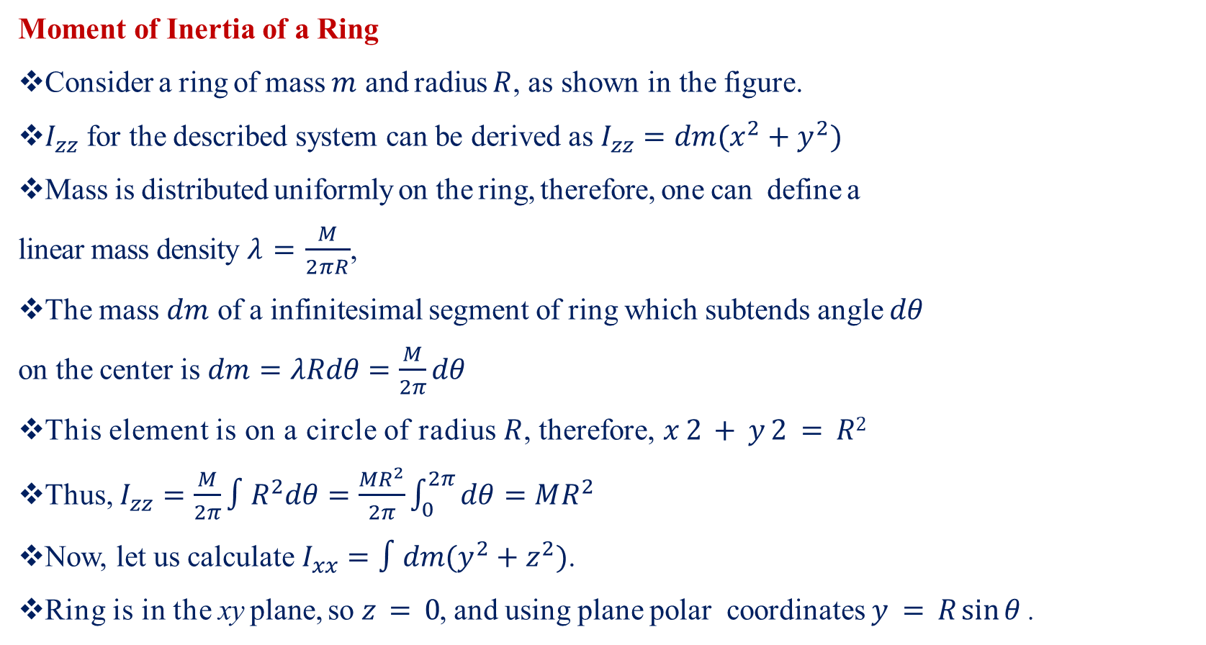
Moment of Inertia of Continuum System-I
Moment of Inertia of a Ring
Consider a ring of mass $m$ and radius $R$, as shown in the figure.
$I_{zz}$ for the described system can be derived as $I_{zz}=dm(x^{2}+y^{2})$
Mass is distributed uniformly on the ring, therefore, one can define a
linear mass density $λ=\frac{M}{2πR}$,
The mass $dm$ of a infinitesimal segment of ring which subtends angle $dθ$
on the center is $dm=λRdθ=\frac{M}{2π}dθ$
This element is on a circle of radius $R$, therefore, $x 2 + y 2 = R2$
Thus, $I_{zz}=\frac{M}{2π}∫R^{2}dθ=\frac{MR^{2}}{2π}\int_{0}^{2π}{dθ}=MR^{2}$
Now, let us calculate $I_{xx}=∫dm(y^{2}+z^{2})$.
Ring is in the xy plane, so $z = 0$, and using plane polar coordinates $y = R sin⁡θ$ .

Slide 24
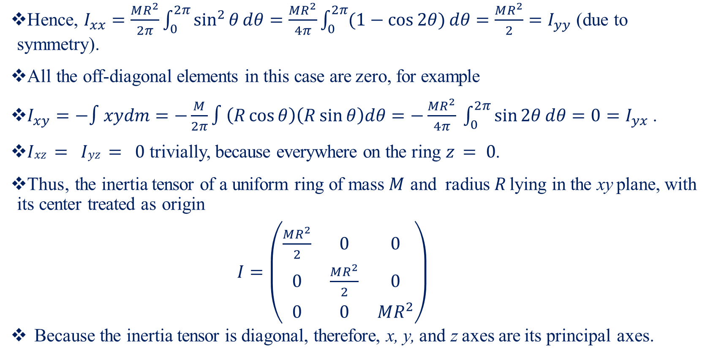
Moment of Inertia of Continuum System-II
Hence, $I_{xx}=\frac{MR^{2}}{2π}\int_{0}^{2π}{\sin^{2}{θ}}dθ=\frac{MR^{2}}{4π}\int_{0}^{2π}{(1−\cos{2θ})}dθ=\frac{MR^{2}}{2}=I_{yy}$ (due to symmetry).
All the off-diagonal elements in this case are zero, for example
$I_{xy}=−∫xydm=−\frac{M}{2π}∫\left(R\cos{θ}\right)\left(R\sin{θ}\right)dθ=−\frac{MR^{2}}{4π} \int_{0}^{2π}{\sin{2θ}}dθ=0=I_{yx}$.
$Ixz = Iyz = 0$ trivially, because everywhere on the ring $z = 0$.
Thus, the inertia tensor of a uniform ring of mass $M$ and radius $R$ lying in the xy plane, with its center treated as origin
$I=\left(\begin{matrix}\frac{MR^{2}}{2} & 0 & 0 \\ 0 & \frac{MR^{2}}{2} & 0 \\ 0 & 0 & MR^{2}\end{matrix}\right)$
Because the inertia tensor is diagonal, therefore, x, y, and z axes are its principal axes.

Slide 25
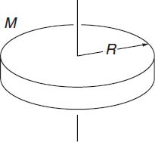
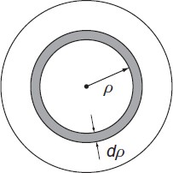
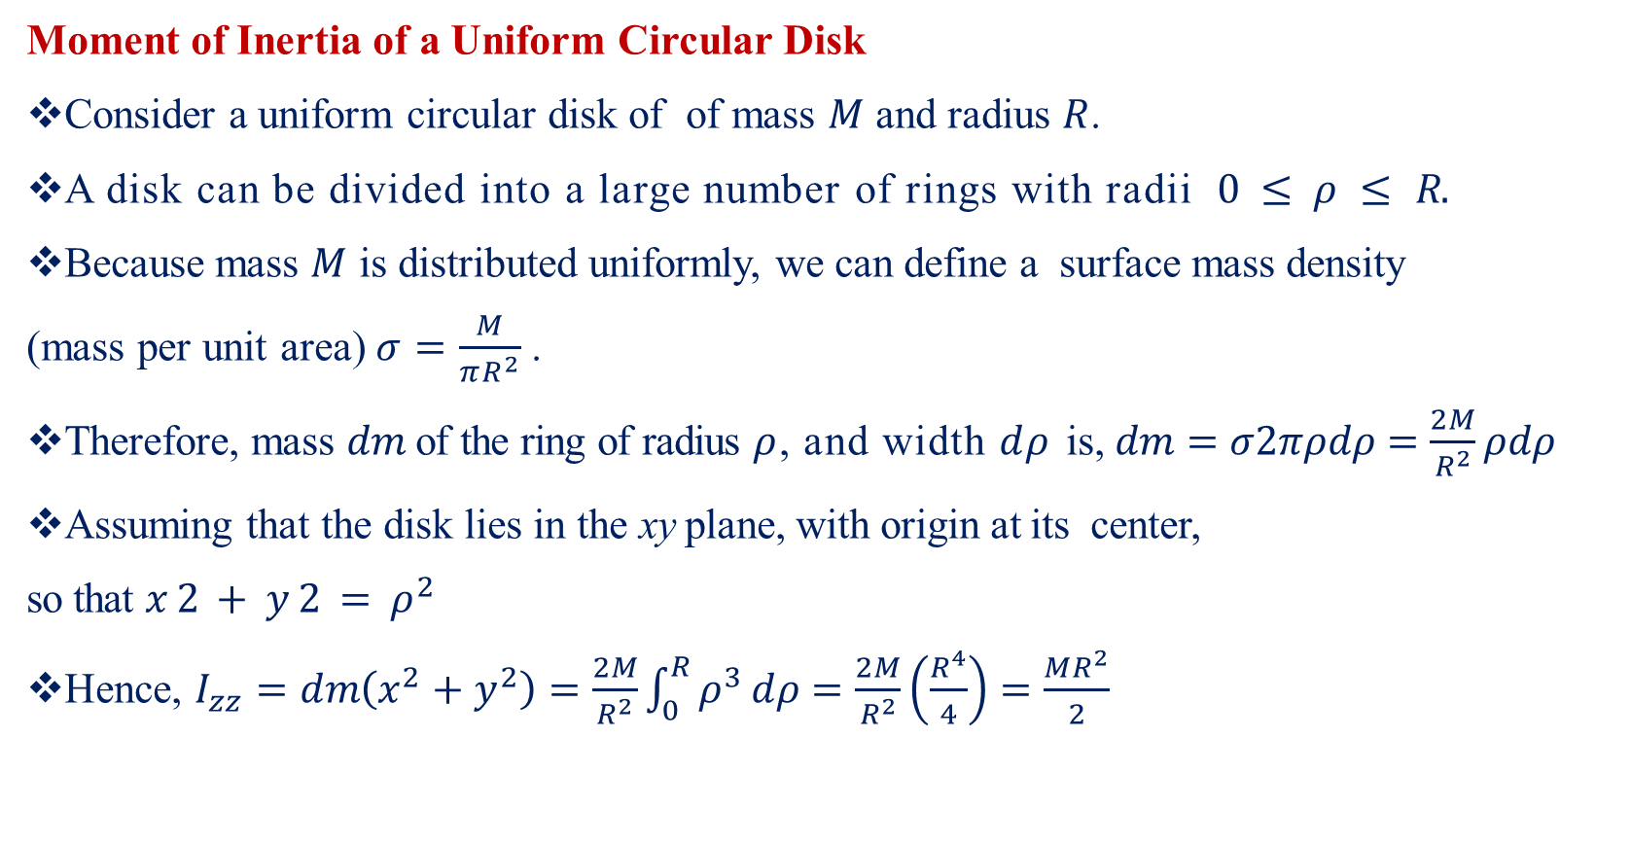
Moment of Inertia of Continuum System-III
Moment of Inertia of a Uniform Circular Disk
Consider a uniform circular disk of of mass $M$ and radius $R$.
A disk can be divided into a large number of rings with radii $0 ≤ ρ ≤ R.$
Because mass $M$ is distributed uniformly, we can define a surface mass density
(mass per unit area)$σ=\frac{M}{πR^{2}}$ .
Therefore, mass $dm$ of the ring of radius $ρ$, and width $dρ$ is, $dm=σ2πρdρ=\frac{2M}{R^{2}}ρdρ$
Assuming that the disk lies in the xy plane, with origin at its center,
so that $x 2 + y 2 = ρ^{2}$
Hence, $I_{zz}=dm\left(x^{2}+y^{2}\right)=\frac{2M}{R^{2}}\int_{0}^{R}{ρ^{3}}dρ=\frac{2M}{R^{2}}\left(\frac{R^{4}}{4}\right)=\frac{MR^{2}}{2}$

Slide 26
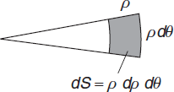
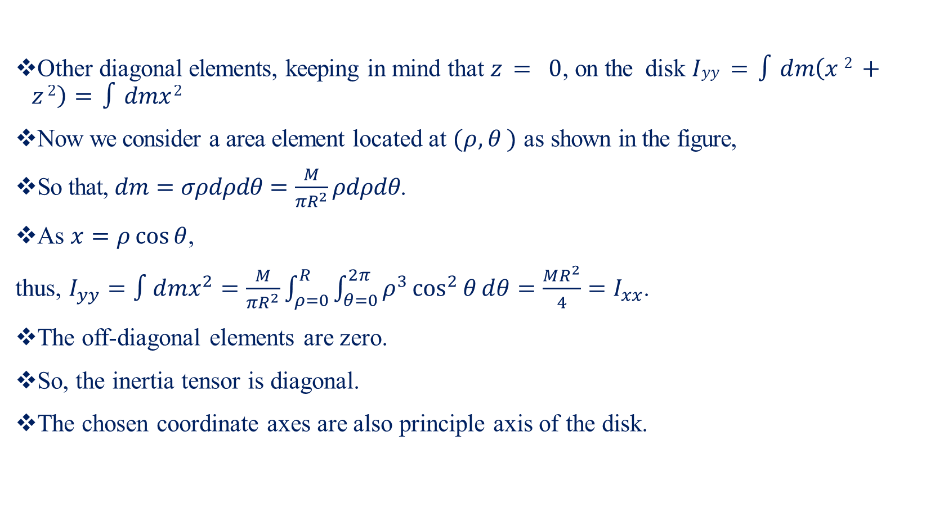
Moment of Inertia of Continuum System-IV
Other diagonal elements, keeping in mind that $z = 0$, on the disk $Iyy =∫dm\left(x 2 + z 2\right)=∫dmx 2$
Now we consider a area element located at $(ρ, θ )$ as shown in the figure,
So that, $dm=σρdρdθ=\frac{M}{πR^{2}}ρdρdθ$.
As $x=ρ\cos{θ}$,
thus, $I_{yy}=∫dmx^{2}=\frac{M}{πR^{2}}\int_{ρ=0}^{R}{\int_{θ=0}^{2π}{ρ^{3}}}\cos^{2}{θ}dθ=\frac{MR^{2}}{4}=I_{xx}$.
The off-diagonal elements are zero.
So, the inertia tensor is diagonal.
The chosen coordinate axes are also principle axis of the disk.

Slide 27
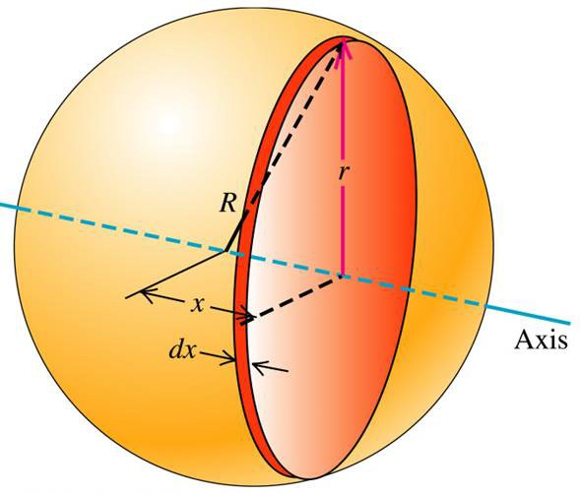
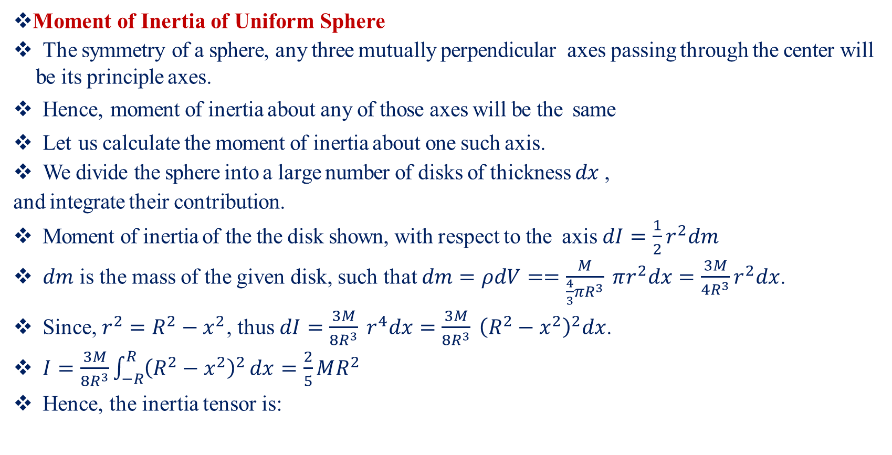
Moment of Inertia of Continuum System-V
Moment of Inertia of Uniform Sphere
The symmetry of a sphere, any three mutually perpendicular axes passing through the center will be its principle axes.
Hence, moment of inertia about any of those axes will be the same
Let us calculate the moment of inertia about one such axis.
We divide the sphere into a large number of disks of thickness $dx$ ,
and integrate their contribution.
Moment of inertia of the the disk shown, with respect to the axis $dI=\frac{1}{2}r^{2}dm$
$dm$ is the mass of the given disk, such that $dm=ρdV==\frac{M}{\frac{4}{3}πR^{3}} πr^{2}dx=\frac{3M}{4R^{3}}r^{2}dx$.
Since, $r^{2}=R^{2}−x^{2}$, thus $dI=\frac{3M}{8R^{3}} r^{4}dx=\frac{3M}{8R^{3}} {\left(R^{2}−x^{2}\right)}^{2}dx$.
$I=\frac{3M}{8R^{3}}\int_{−R}^{R}{{\left(R^{2}−x^{2}\right)}^{2}}dx=\frac{2}{5}MR^{2}$
Hence, the inertia tensor is:

Slide 28
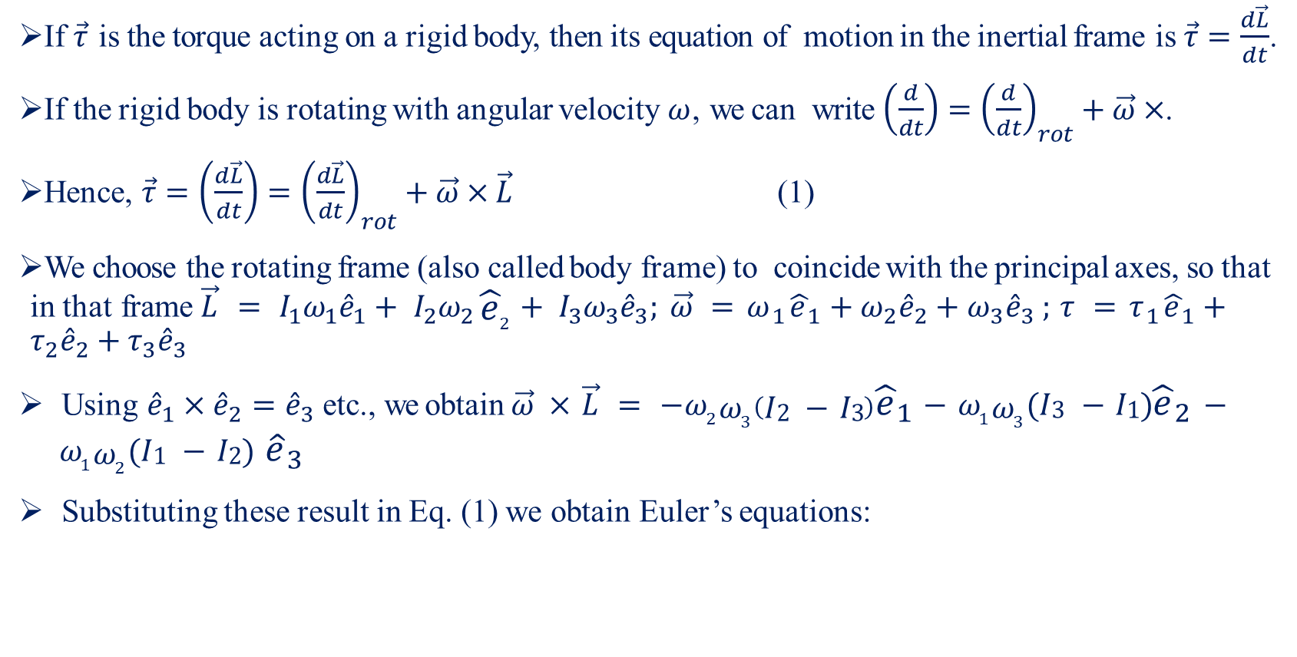
Rigid Body Dynamics: Euler’s Equation-I
If $\vec{τ}$ is the torque acting on a rigid body, then its equation of motion in the inertial frame is $\vec{τ}=\frac{d\vec{L}}{dt}$.
If the rigid body is rotating with angular velocity $ω$, we can write $\left(\frac{d}{dt}\right)={\left(\frac{d}{dt}\right)}_{rot}+\vec{ω}×$.
Hence, $\vec{τ}=\left(\frac{d\vec{L}}{dt}\right)={\left(\frac{d\vec{L}}{dt}\right)}_{rot}+\vec{ω}×\vec{L}$ (1)
We choose the rotating frame (also called body frame) to coincide with the principal axes, so that in that frame $\vec{L} = I_{1}ω_{1}{\hat{e}}_{1}+ I_{2}ω_{2} {\hat{e}}_{2}+ I_{3}ω_{3}{\hat{e}}_{3}; \vec{ω} =ω_{1}{\hat{e}}_{1}+ω_{2}{\hat{e}}_{2}+ω_{3}{\hat{e}}_{3} ; τ =τ_{1}{\hat{e}}_{1}+τ_{2}{\hat{e}}_{2}+τ_{3}{\hat{e}}_{3}$
Using ${\hat{e}}_{1}×{\hat{e}}_{2}={\hat{e}}_{3}$ etc., we obtain $\vec{ω} × \vec{L} = −ω_{2}ω_{3}\left(I2 − I3\right){\hat{e}}_{1}− ω_{1}ω_{3}(I3 − I1){\hat{e}}_{2}− ω_{1}ω_{2}(I1 − I2)$ ${\hat{e}}_{3}$
Substituting these result in Eq. (1) we obtain Euler’s equations:

Slide 29
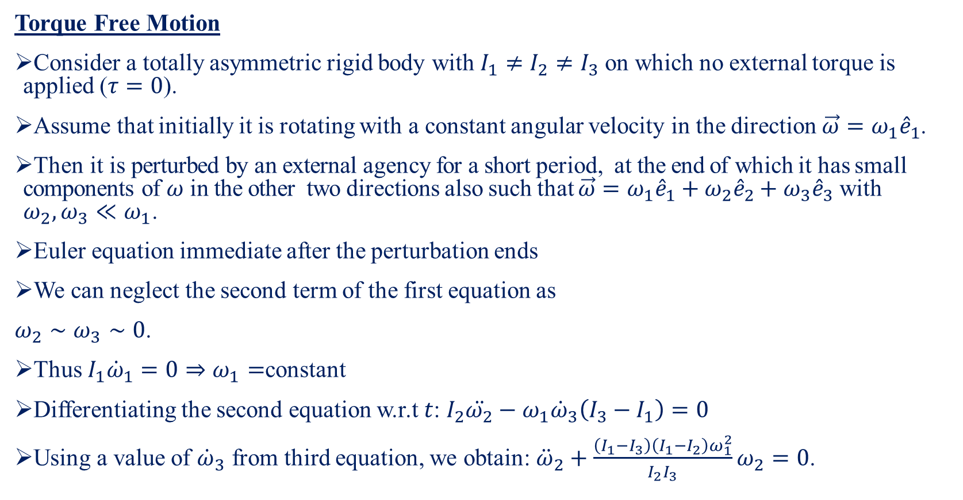
Rigid Body Dynamics: Euler’s Equation-II
Torque Free Motion
Consider a totally asymmetric rigid body with $I_{1}≠I_{2}≠I_{3}$ on which no external torque is applied ($τ=0$).
Assume that initially it is rotating with a constant angular velocity in the direction $\vec{ω}=ω_{1}{\hat{e}}_{1}$.
Then it is perturbed by an external agency for a short period, at the end of which it has small components of $ω$ in the other two directions also such that $\vec{ω}=ω_{1}{\hat{e}}_{1}+ω_{2}{\hat{e}}_{2}+ω_{3}{\hat{e}}_{3}$ with $ω_{2}, ω_{3}≪ω_{1}$.
Euler equation immediate after the perturbation ends
We can neglect the second term of the first equation as
$ω_{2}∼ω_{3}∼0$.
Thus $I_{1}{\dot{ω}}_{1}=0⇒ω_{1}=$constant
Differentiating the second equation w.r.t $t$: $I_{2}\ddot{ω_{2}}−ω_{1}{\dot{ω}}_{3}\left(I_{3}−I_{1}\right)=0$
Using a value of ${\dot{ω}}_{3}$ from third equation, we obtain: ${\ddot{ω}}_{2}+\frac{\left(I_{1}−I_{3}\right)\left(I_{1}−I_{2}\right)ω_{1}^{2}}{I_{2}I_{3}}ω_{2}=0$.

Slide 30
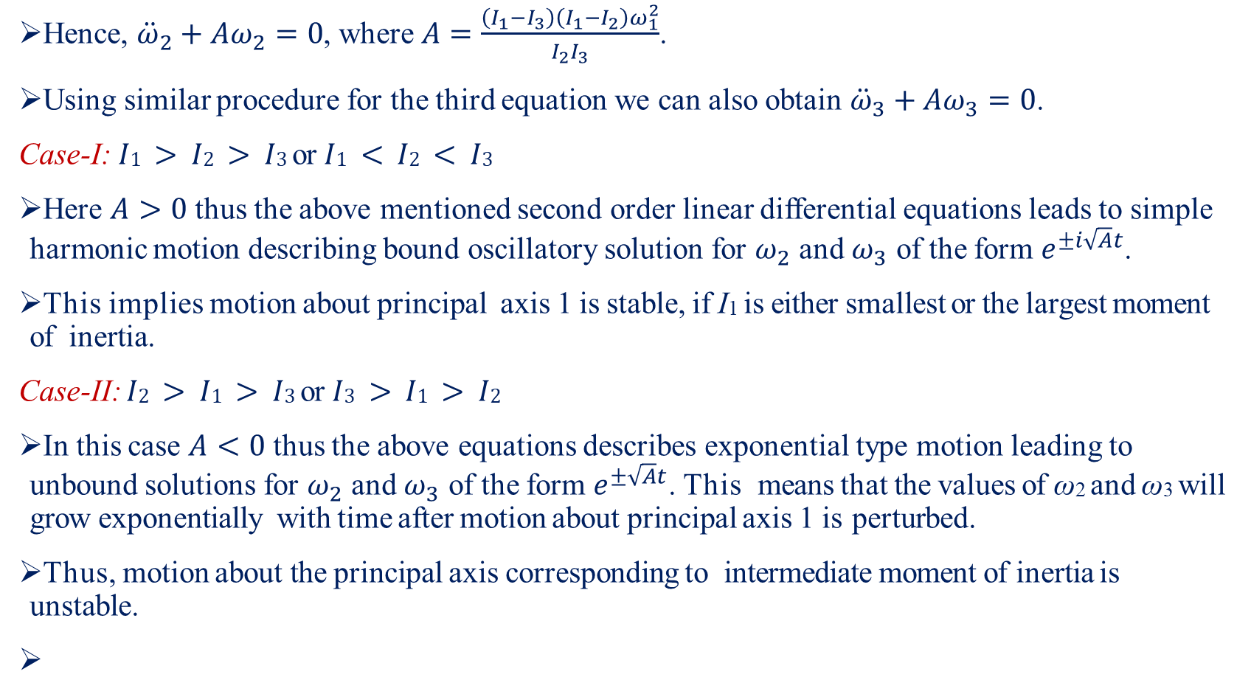
Rigid Body Dynamics: Euler’s Equation-III
Hence, ${\ddot{ω}}_{2}+Aω_{2}=0$, where $A=\frac{\left(I_{1}−I_{3}\right)\left(I_{1}−I_{2}\right)ω_{1}^{2}}{I_{2}I_{3}}$.
Using similar procedure for the third equation we can also obtain ${\ddot{ω}}_{3}+Aω_{3}=0$.
Case-I: $I1 > I2 > I3$ or $I1 < I2 < I3$
Here $A>0$ thus the above mentioned second order linear differential equations leads to simple harmonic motion describing bound oscillatory solution for $ω_{2}$ and $ω_{3}$ of the form $e^{±i\sqrt{A}t}$.
This implies motion about principal axis 1 is stable, if I₁ is either smallest or the largest moment of inertia.
Case-II: $I2 > I1 > I3$ or $I3 > I1 > I2$
In this case $A<0$ thus the above equations describes exponential type motion leading to unbound solutions for $ω_{2}$ and $ω_{3}$ of the form $e^{±\sqrt{A}t}$. This means that the values of ω₂ and ω₃ will grow exponentially with time after motion about principal axis 1 is perturbed.
Thus, motion about the principal axis corresponding to intermediate moment of inertia is unstable.

Slide 31
Gyroscope
A gyroscope is a device used for measuring or maintaining
orientation and angular velocity.
It is a spinning wheel or disc in which the axis of rotation is
free to assume any orientation by itself.
Applications of gyroscopes include inertial navigation systems,
such as in the Hubble telescope, or inside the steel hull of a
submerged submarine.

