Slide 1
Mechanics
EPHY108L (2-0-2-3)
Ayan khan
Department of physics

Slide 2
Central Force Problem

Slide 3
Introduction
Question: What is a central force?
Answer: Any force which is directed towards a center, and depends only on the distance between the center and the particle in question.
Question: Any examples of central forces in nature?
Answer: Two fundamental forces of nature, gravitation, and Coulomb forces are central forces
Question: But gravitation and Coulomb forces are two body forces, how could they be central?
Answer: Correct, these two forces are indeed two-body forces, but they can be reduced to central forces by a mathematical trick.

Slide 4
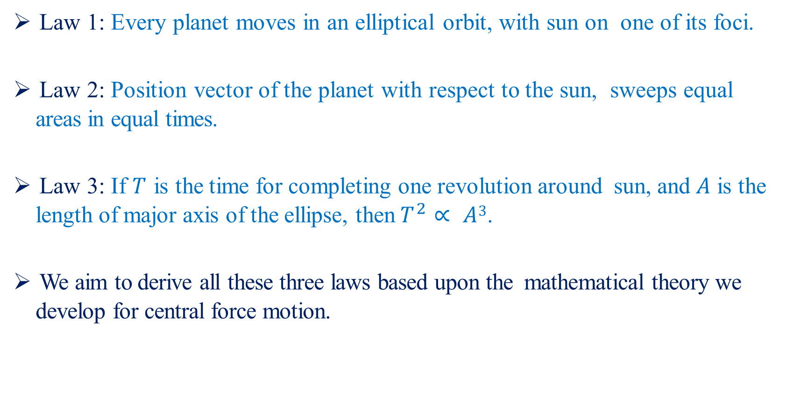
Kepler’s Laws
Law 1: Every planet moves in an elliptical orbit, with sun on one of its foci.
Law 2: Position vector of the planet with respect to the sun, sweeps equal areas in equal times.
Law 3: If $T$ is the time for completing one revolution around sun, and $A$ is the length of major axis of the ellipse, then $T^{2}∝ A3$.
We aim to derive all these three laws based upon the mathematical theory we develop for central force motion.

Slide 5
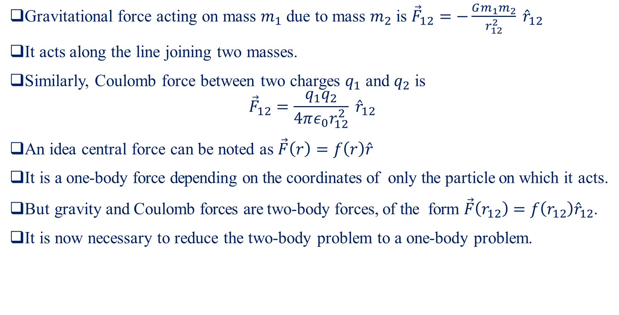
Two-body Problem
Gravitational force acting on mass $m_{1}$ due to mass $m_{2}$ is ${\vec{F}}_{12}=−\frac{Gm_{1}m_{2}}{r_{12}^{2}} {\hat{r}}_{12}$
It acts along the line joining two masses.
Similarly, Coulomb force between two charges $q_{1}$ and $q_{2}$ is
$${\vec{F}}_{12}=\frac{q_{1}q_{2}}{4πε_{0}r_{12}^{2}} {\hat{r}}_{12}$$
An idea central force can be noted as $\vec{F}\left(r\right)=f\left(r\right)\hat{r}$
It is a one-body force depending on the coordinates of only the particle on which it acts.
But gravity and Coulomb forces are two-body forces, of the form $\vec{F}\left(r_{12}\right)=f\left(r_{12}\right){\hat{r}}_{12}$.
It is now necessary to reduce the two-body problem to a one-body problem.

Slide 6
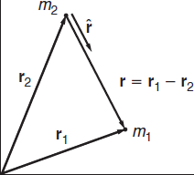
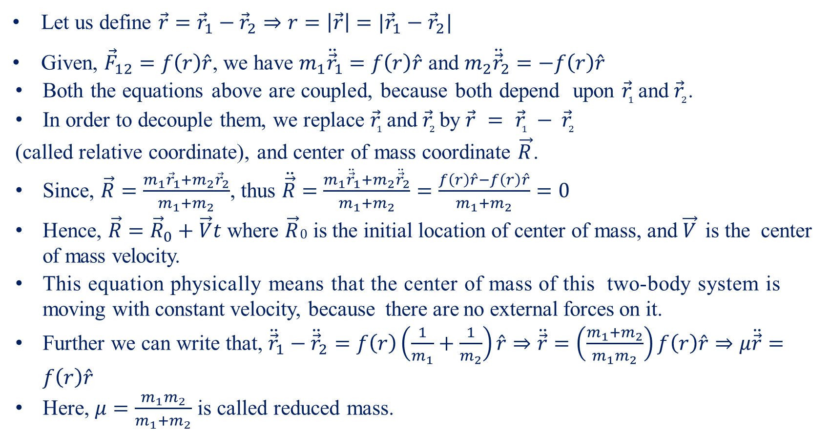
Reduction to One-body-I
Let us define $\vec{r}={\vec{r}}_{1}−{\vec{r}}_{2}⇒r=\left|\vec{r}\right|=|{\vec{r}}_{1}−{\vec{r}}_{2}|$
Given, ${\vec{F}}_{12}=f\left(r\right)\hat{r}$, we have $m_{1}{\ddot{\vec{r}}}_{1}=f\left(r\right)\hat{r}$ and $m_{2}{\ddot{\vec{r}}}_{2}=−f\left(r\right)\hat{r}$
Both the equations above are coupled, because both depend upon ${\vec{r}}_{1}$ and ${\vec{r}}_{2}$.
In order to decouple them, we replace ${\vec{r}}_{1}$ and ${\vec{r}}_{2}$ by $\vec{r} = {\vec{r}}_{1} − {\vec{r}}_{2}$
(called relative coordinate), and center of mass coordinate $\vec{R}$.
Since, $\vec{R}=\frac{m_{1}{\vec{r}}_{1}+m_{2}{\vec{r}}_{2}}{m_{1}+m_{2}}$, thus $\ddot{\vec{R}}=$ $\frac{m_{1}{\ddot{\vec{r}}}_{1}+m_{2}{\ddot{\vec{r}}}_{2}}{m_{1}+m_{2}}=\frac{f\left(r\right)\hat{r}−f\left(r\right)\hat{r}}{m_{1}+m_{2}}=0$
Hence, $\vec{R}={\vec{R}}_{0}+\vec{V}t$ where $\vec{R}0$ is the initial location of center of mass, and $\vec{V}$ is the center of mass velocity.
This equation physically means that the center of mass of this two-body system is moving with constant velocity, because there are no external forces on it.
Further we can write that, ${\ddot{\vec{r}}}_{1}−{\ddot{\vec{r}}}_{2}=f\left(r\right)\left(\frac{1}{m_{1}}+\frac{1}{m_{2}}\right)\hat{r}⇒\ddot{\vec{r}}=\left(\frac{m_{1}+m_{2}}{m_{1}m_{2}}\right)f\left(r\right)\hat{r}⇒μ\ddot{\vec{r}}=f\left(r\right)\hat{r}$
Here, $μ=\frac{m_{1}m_{2}}{m_{1}+m_{2}}$ is called reduced mass.

Slide 7
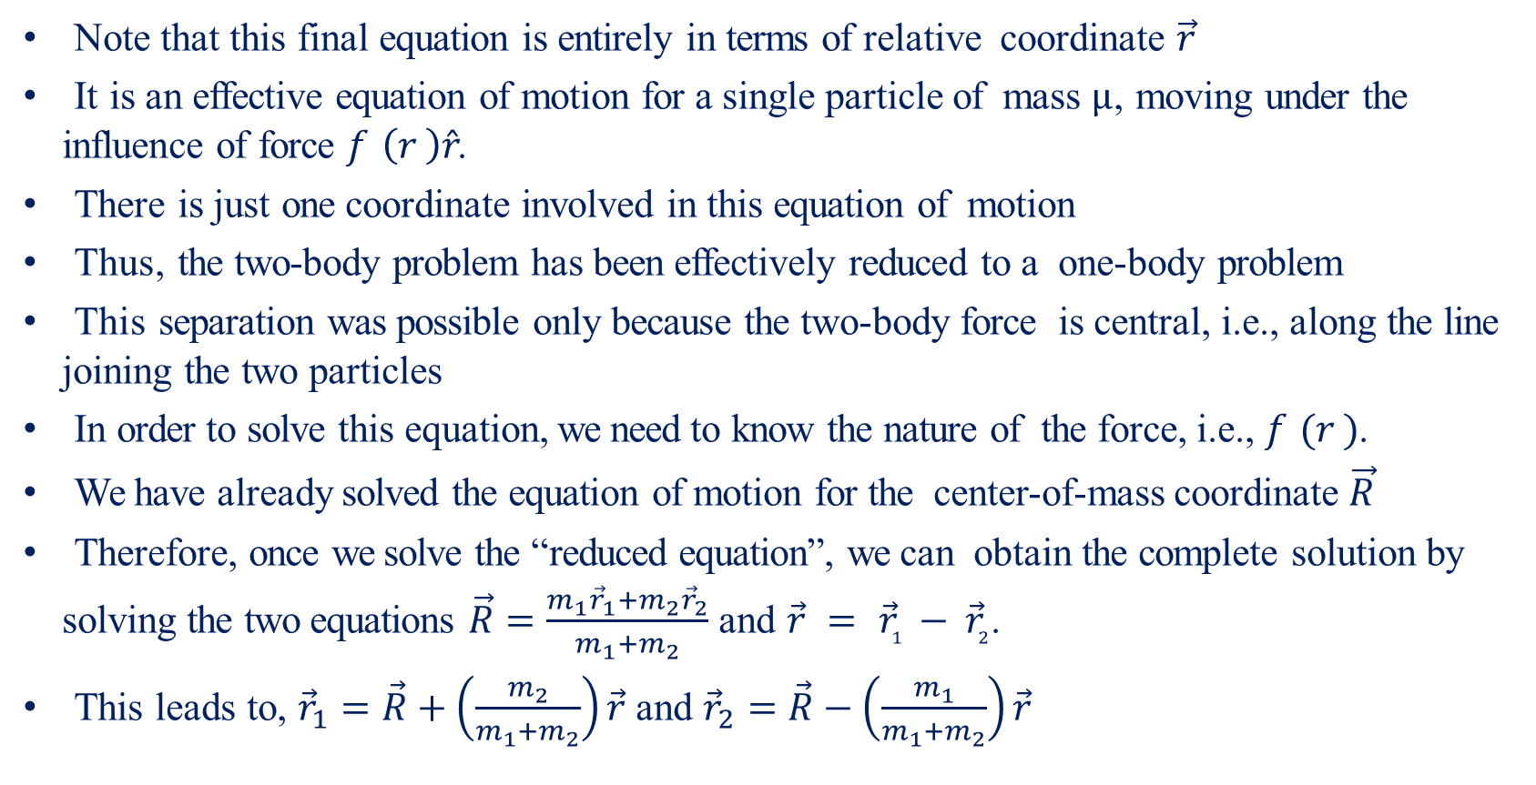
Reduction to One-body-II
Note that this final equation is entirely in terms of relative coordinate $\vec{r}$
It is an effective equation of motion for a single particle of mass $µ$, moving under the influence of force $f \left(r \right)\hat{r}$.
There is just one coordinate involved in this equation of motion
Thus, the two-body problem has been effectively reduced to a one-body problem
This separation was possible only because the two-body force is central, i.e., along the line joining the two particles
In order to solve this equation, we need to know the nature of the force, i.e., $f (r )$.
We have already solved the equation of motion for the center-of-mass coordinate $\vec{R}$
Therefore, once we solve the “reduced equation”, we can obtain the complete solution by solving the two equations $\vec{R}=\frac{m_{1}{\vec{r}}_{1}+m_{2}{\vec{r}}_{2}}{m_{1}+m_{2}}$ and $\vec{r} = {\vec{r}}_{1} − {\vec{r}}_{2}$.
This leads to, ${\vec{r}}_{1}=\vec{R}+\left(\frac{m_{2}}{m_{1}+m_{2}}\right)\vec{r}$ and ${\vec{r}}_{2}=\vec{R}−\left(\frac{m_{1}}{m_{1}+m_{2}}\right)\vec{r}$

Slide 8
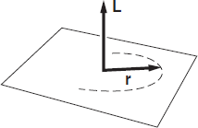
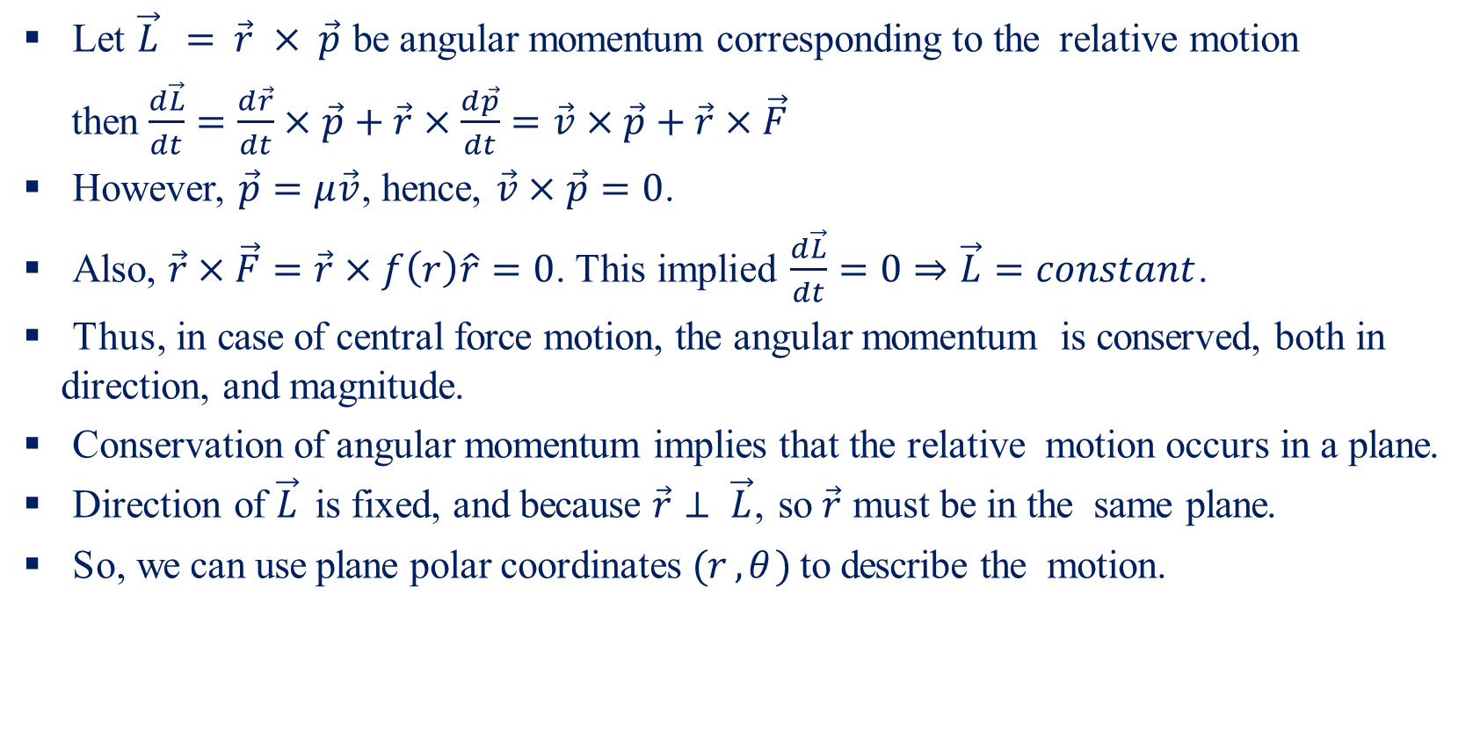
General Properties of Central Force Motion
Let $\vec{L} = \vec{r} × \vec{p}$ be angular momentum corresponding to the relative motion
then $\frac{d\vec{L}}{dt}=\frac{d\vec{r}}{dt}×\vec{p}+\vec{r}×\frac{d\vec{p}}{dt}=\vec{v}×\vec{p}+\vec{r}×\vec{F}$
However, $\vec{p}=μ\vec{v}$, hence, $\vec{v}×\vec{p}=0$.
Also, $\vec{r}×\vec{F}=\vec{r}×f\left(r\right)\hat{r}=0$. This implied $\frac{d\vec{L}}{dt}=0⇒\vec{L}=constant$.
Thus, in case of central force motion, the angular momentum is conserved, both in direction, and magnitude.
Conservation of angular momentum implies that the relative motion occurs in a plane.
Direction of $\vec{L}$ is fixed, and because $\vec{r}⊥ \vec{L}$, so $\vec{r}$ must be in the same plane.
So, we can use plane polar coordinates $(r , θ )$ to describe the motion.

Slide 9
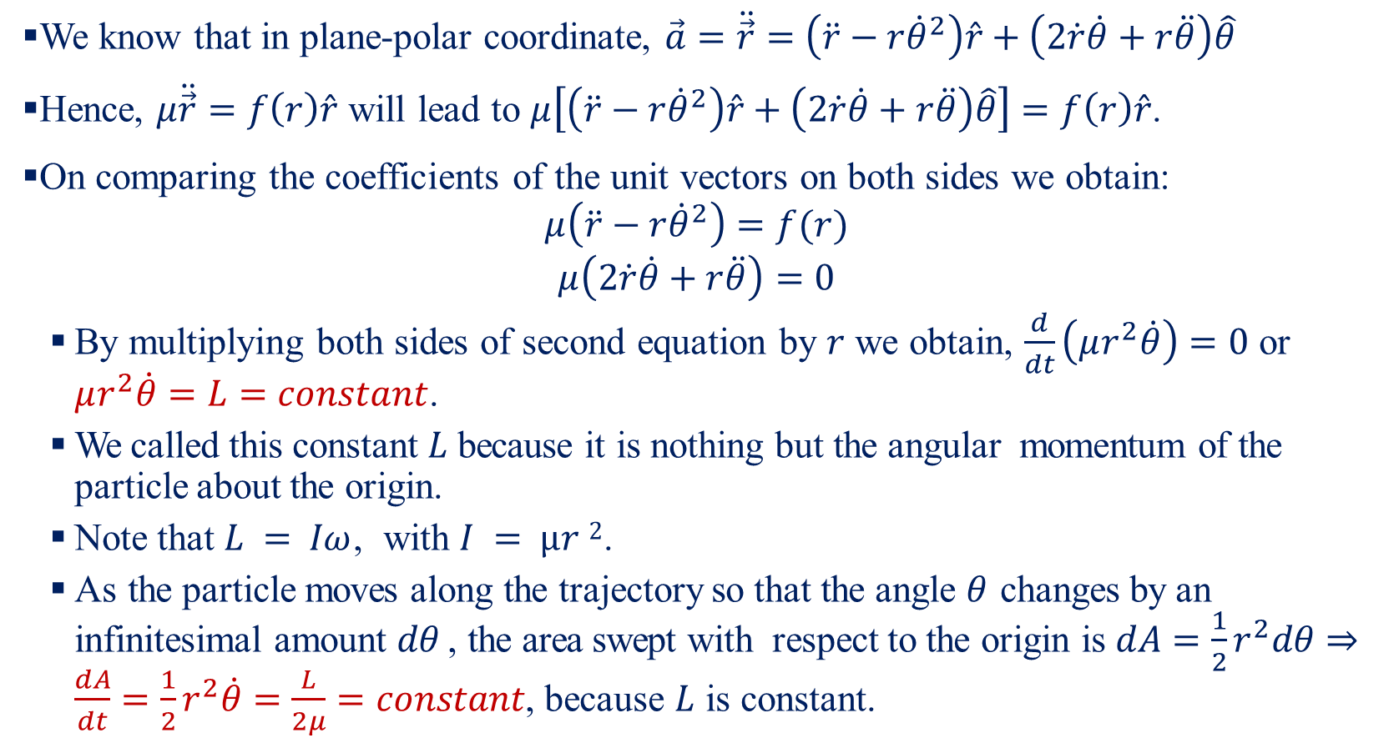
Equation of Motion & Energy Conservation-I
We know that in plane-polar coordinate, $\vec{a}=\ddot{\vec{r}}=\left(\ddot{r}−r{\dot{θ}}^{2}\right)\hat{r}+\left(2\dot{r}\dot{θ}+r\ddot{θ}\right)\hat{θ}$
Hence, $μ\ddot{\vec{r}}=f\left(r\right)\hat{r}$ will lead to $μ\left[\left(\ddot{r}−r{\dot{θ}}^{2}\right)\hat{r}+\left(2\dot{r}\dot{θ}+r\ddot{θ}\right)\hat{θ}\right]=f\left(r\right)\hat{r}$.
On comparing the coefficients of the unit vectors on both sides we obtain:
$$μ\left(\ddot{r}−r{\dot{θ}}^{2}\right)=f(r)$$
$$μ\left(2\dot{r}\dot{θ}+r\ddot{θ}\right)=0$$
By multiplying both sides of second equation by $r$ we obtain, $\frac{d}{dt}\left(μr^{2}\dot{θ}\right)=0$ or $μr^{2}\dot{θ}=L=constant$.
We called this constant $L$ because it is nothing but the angular momentum of the particle about the origin.
Note that $L = Iω$, with $I = µr 2$.
As the particle moves along the trajectory so that the angle $θ$ changes by an infinitesimal amount $dθ$ , the area swept with respect to the origin is $dA=\frac{1}{2}r^{2}dθ⇒\frac{dA}{dt}=\frac{1}{2}r^{2}\dot{θ}=\frac{L}{2μ}=constant$, because $L$ is constant.

Slide 10
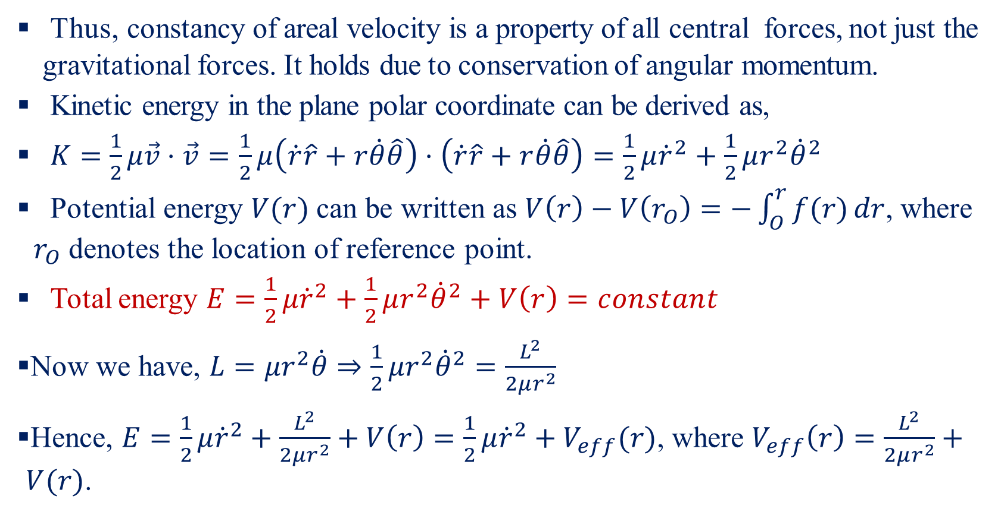
Equation of Motion & Energy Conservation-II
Thus, constancy of areal velocity is a property of all central forces, not just the gravitational forces. It holds due to conservation of angular momentum.
Kinetic energy in the plane polar coordinate can be derived as,
$K=\frac{1}{2}μ\vec{v}⋅\vec{v}=\frac{1}{2}μ\left(\dot{r}\hat{r}+r\dot{θ}\hat{θ}\right)⋅\left(\dot{r}\hat{r}+r\dot{θ}\hat{θ}\right)=\frac{1}{2}μ{\dot{r}}^{2}+\frac{1}{2}μr^{2}{\dot{θ}}^{2}$
Potential energy $V(r)$can be written as $V\left(r\right)−V\left(r_{O}\right)=−\int_{O}^{r}{f(r)}dr$, where $r_{O}$ denotes the location of reference point.
Total energy $E=\frac{1}{2}μ{\dot{r}}^{2}+\frac{1}{2}μr^{2}{\dot{θ}}^{2}+V\left(r\right)=constant$
Now we have, $L=μr^{2}\dot{θ}⇒\frac{1}{2}μr^{2}{\dot{θ}}^{2}=\frac{L^{2}}{2μr^{2}}$
Hence, $E=\frac{1}{2}μ{\dot{r}}^{2}+\frac{L^{2}}{2μr^{2}}+V\left(r\right)=\frac{1}{2}μ{\dot{r}}^{2}+V_{eff}(r)$, where $V_{eff}\left(r\right)=\frac{L^{2}}{2μr^{2}}+V(r)$.

Slide 11
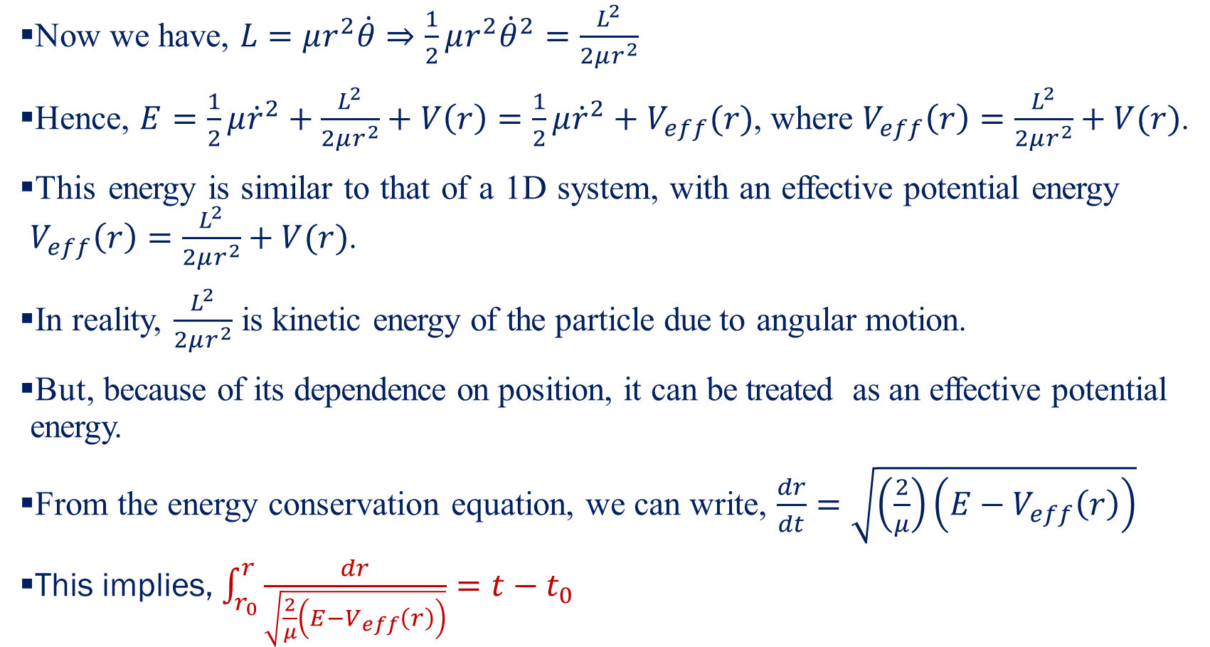
Equation of Motion & Energy Conservation-III
Now we have, $L=μr^{2}\dot{θ}⇒\frac{1}{2}μr^{2}{\dot{θ}}^{2}=\frac{L^{2}}{2μr^{2}}$
Hence, $E=\frac{1}{2}μ{\dot{r}}^{2}+\frac{L^{2}}{2μr^{2}}+V\left(r\right)=\frac{1}{2}μ{\dot{r}}^{2}+V_{eff}(r)$, where $V_{eff}\left(r\right)=\frac{L^{2}}{2μr^{2}}+V(r)$.
This energy is similar to that of a 1D system, with an effective potential energy $V_{eff}\left(r\right)=\frac{L^{2}}{2μr^{2}}+V(r)$.
In reality, $\frac{L^{2}}{2μr^{2}}$ is kinetic energy of the particle due to angular motion.
But, because of its dependence on position, it can be treated as an effective potential energy.
From the energy conservation equation, we can write, $\frac{dr}{dt}=\sqrt{\left(\frac{2}{μ}\right)\left(E−V_{eff}\left(r\right)\right)}$
This implies, $\int_{r_{0}}^{r}{\frac{dr}{\sqrt{\frac{2}{μ}\left(E−V_{eff}\left(r\right)\right)}}}=t−t_{0}$

Slide 12
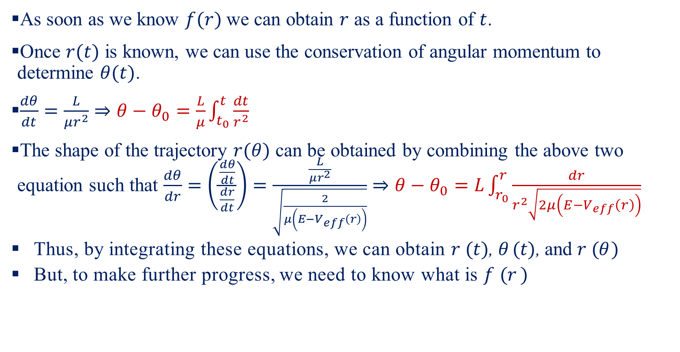
Equation of Motion & Energy Conservation-IV
As soon as we know $f(r)$ we can obtain $r$ as a function of $t$.
Once $r(t)$ is known, we can use the conservation of angular momentum to determine $θ(t)$.
$\frac{dθ}{dt}=\frac{L}{μr^{2}}⇒θ−θ_{0}=\frac{L}{μ}\int_{t_{0}}^{t}{\frac{dt}{r^{2}}}$
The shape of the trajectory $r(θ)$ can be obtained by combining the above two equation such that $\frac{dθ}{dr}=\left(\frac{\frac{dθ}{dt}}{\frac{dr}{dt}}\right)=\frac{\frac{L}{μr^{2}}}{\sqrt{\frac{2}{μ\left(E−V_{eff}\left(r\right)\right)}}}⇒θ−θ_{0}=L\int_{r_{0}}^{r}{\frac{dr}{r^{2}\sqrt{2μ\left(E−V_{eff}\left(r\right)\right)}}}$
Thus, by integrating these equations, we can obtain $r (t)$, $θ (t)$, and $r (θ )$
But, to make further progress, we need to know what is $f (r )$

Slide 13
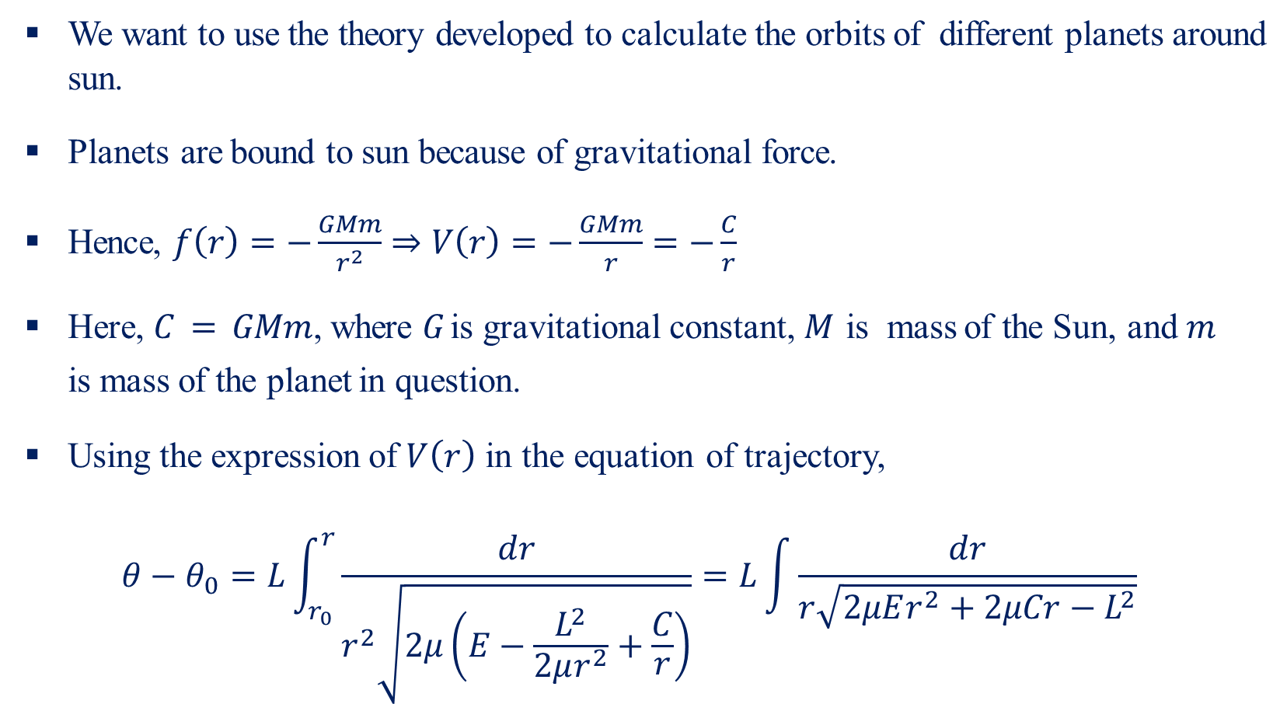
Keplerian Orbits-I
We want to use the theory developed to calculate the orbits of different planets around sun.
Planets are bound to sun because of gravitational force.
Hence, $f\left(r\right)=−\frac{GMm}{r^{2}}⇒V\left(r\right)=−\frac{GMm}{r}=−\frac{C}{r}$
Here, $C = GMm$, where $G$ is gravitational constant, $M$ is mass of the Sun, and $m$ is mass of the planet in question.
Using the expression of $V\left(r\right)$ in the equation of trajectory,
$$θ−θ_{0}=L\int_{r_{0}}^{r}{\frac{dr}{r^{2}\sqrt{2μ\left(E−\frac{L^{2}}{2μr^{2}}+\frac{C}{r}\right)}}}=L\int{\frac{dr}{r\sqrt{2μEr^{2}+2μCr−L^{2}}}}$$

Slide 14
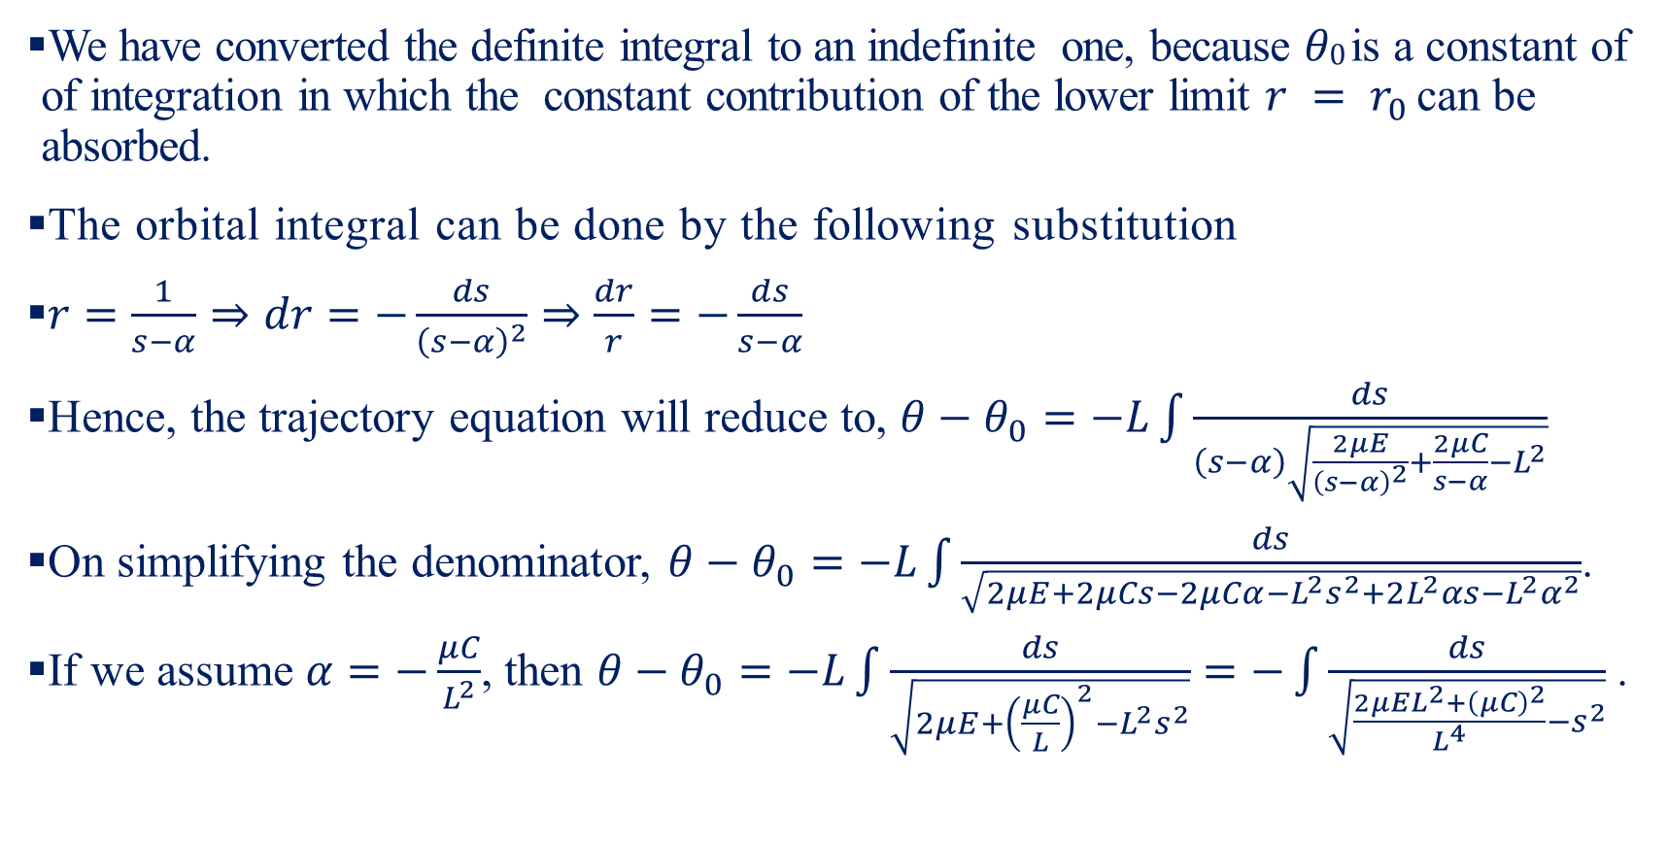
Keplerian Orbits-II
We have converted the definite integral to an indefinite one, because $θ0$ is a constant of integration in which the constant contribution of the lower limit $r = r_{0}$ can be absorbed.
The orbital integral can be done by the following substitution
$r=\frac{1}{s−α}⇒dr=−\frac{ds}{{\left(s−α\right)}^{2}}⇒\frac{dr}{r}=−\frac{ds}{s−α}$
Hence, the trajectory equation will reduce to, $θ−θ_{0}=−L\int{\frac{ds}{\left(s−α\right)\sqrt{\frac{2μE}{{\left(s−α\right)}^{2}}+\frac{2μC}{s−α}−L^{2}}}}$
On simplifying the denominator, $θ−θ_{0}=−L\int{\frac{ds}{\sqrt{2μE+2μCs−2μCα−L^{2}s^{2}+2L^{2}αs−L^{2}α^{2}}}}$.
If we assume $α=−\frac{μC}{L^{2}}$, then $θ−θ_{0}=−L\int{\frac{ds}{\sqrt{2μE+{\left(\frac{μC}{L}\right)}^{2}−L^{2}s^{2}}}}=−\int{\frac{ds}{\sqrt{\frac{2μEL^{2}+{\left(μC\right)}^{2}}{L^{4}}−s^{2}}}}$.

Slide 15
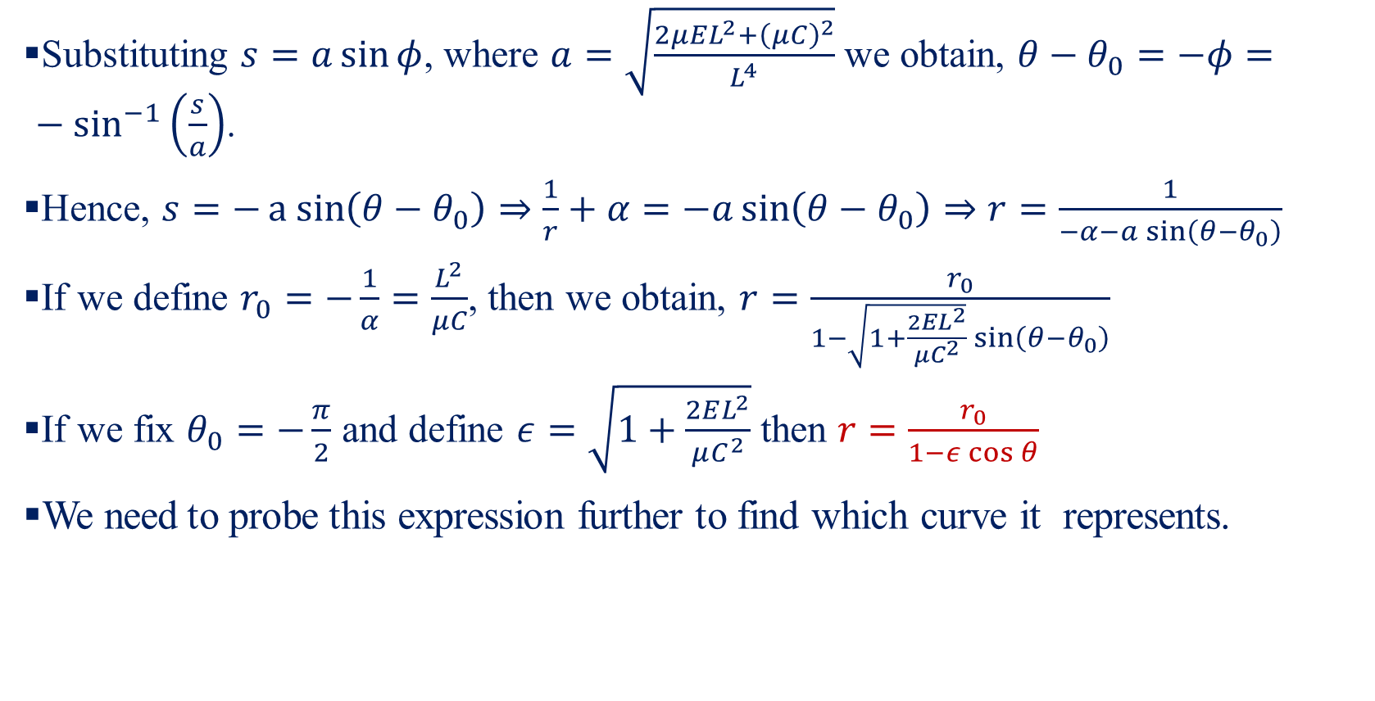
Keplerian Orbits-III
Substituting $s=a\sin{φ}$, where $a=\sqrt{\frac{2μEL^{2}+{\left(μC\right)}^{2}}{L^{4}}}$ we obtain, $θ−θ_{0}=−φ=−\sin^{−1}\left(\frac{s}{a}\right)$.
Hence, $s=−a sin\left(θ−θ_{0}\right)⇒\frac{1}{r}+α=−a\sin\left(θ−θ_{0}\right)⇒r=\frac{1}{−α−a\sin\left(θ−θ_{0}\right)}$
If we define $r_{0}=−\frac{1}{α}=\frac{L^{2}}{μC}$, then we obtain, $r=\frac{r_{0}}{1−\sqrt{1+\frac{2EL^{2}}{μC^{2}}}\sin\left(θ−θ_{0}\right)}$
If we fix $θ_{0}=−\frac{π}{2}$ and define $ε=\sqrt{1+\frac{2EL^{2}}{μC^{2}}}$ then $r=\frac{r_{0}}{1−ε\cos{θ}}$
We need to probe this expression further to find which curve it represents.

Slide 16
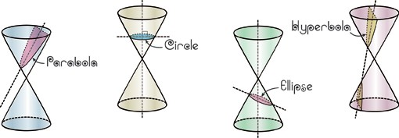
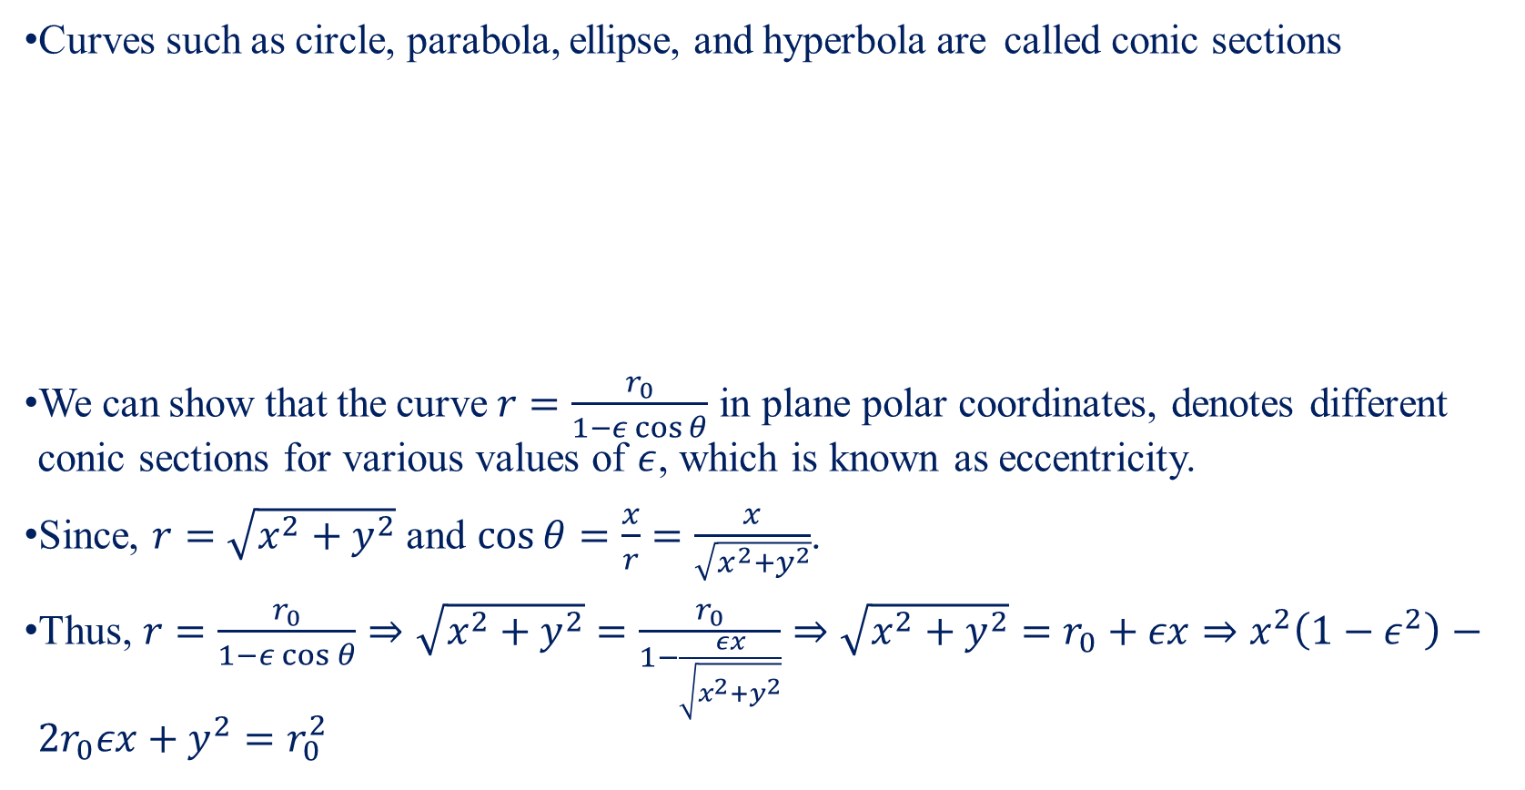
Conic Section-I
Curves such as circle, parabola, ellipse, and hyperbola are called conic sections
We can show that the curve $r=\frac{r_{0}}{1−ε\cos{θ}}$ in plane polar coordinates, denotes different conic sections for various values of $ε$, which is known as eccentricity.
Since, $r=\sqrt{x^{2}+y^{2}}$ and $\cos{θ}=\frac{x}{r}=\frac{x}{\sqrt{x^{2}+y^{2}}}$.
Thus, $r=\frac{r_{0}}{1−ε\cos{θ}}⇒\sqrt{x^{2}+y^{2}}=\frac{r_{0}}{1−\frac{εx}{\sqrt{x^{2}+y^{2}}}}⇒\sqrt{x^{2}+y^{2}}=r_{0}+εx⇒x^{2}\left(1−ε^{2}\right)−2r_{0}εx+y^{2}=r_{0}^{2}$

Slide 17
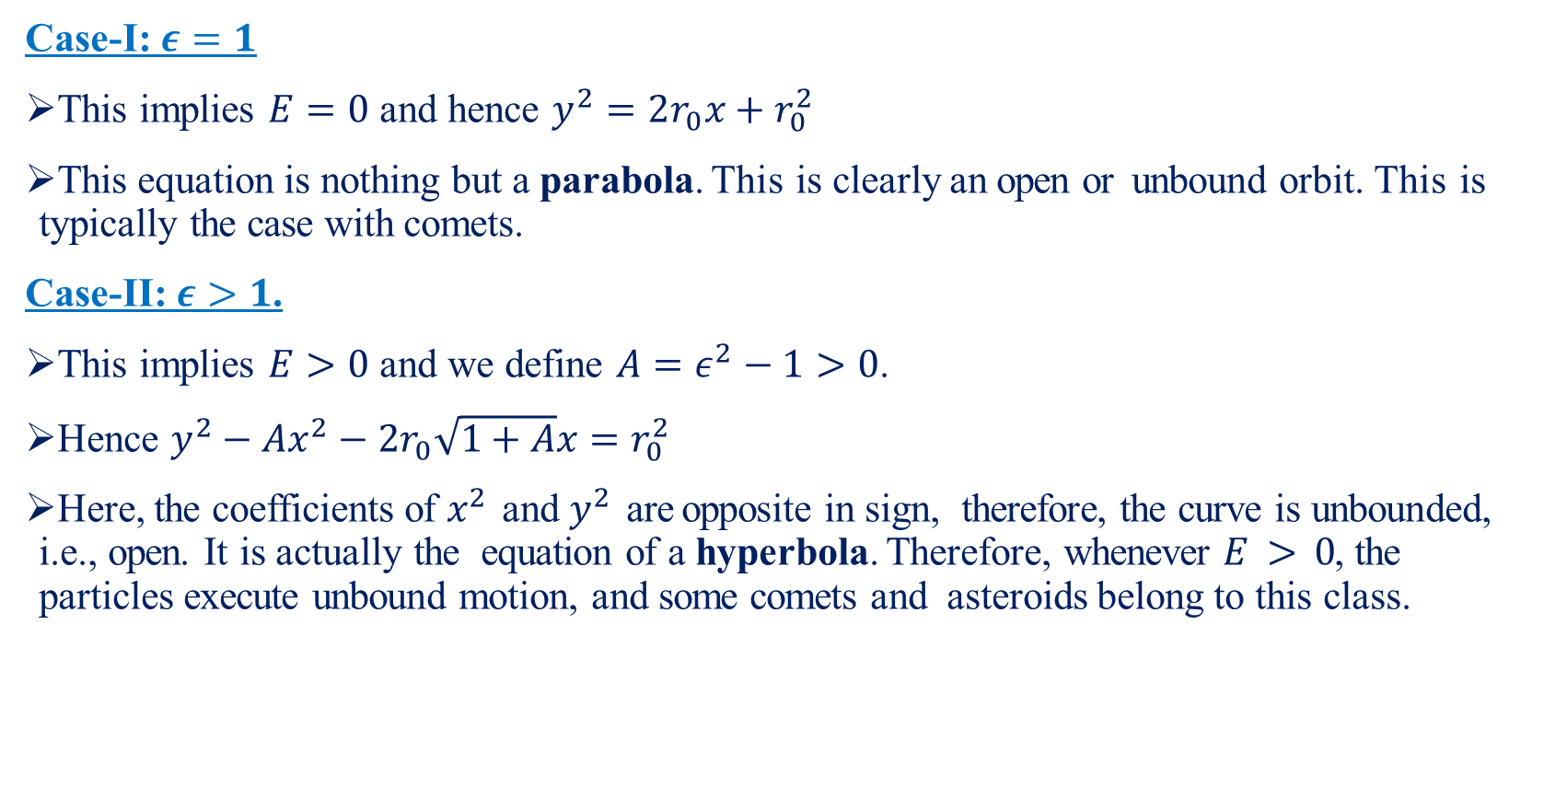
Conic Section-II
Case-I: $ε=1$
This implies $E=0$ and hence $y^{2}=2r_{0}x+r_{0}^{2}$
This equation is nothing but a parabola. This is clearly an open or unbound orbit. This is typically the case with comets.
Case-II: $ε>1$.
This implies $E>0$ and we define $A=ε^{2}−1>0$.
Hence $y^{2}−Ax^{2}−2r_{0}\sqrt{1+A}x=r_{0}^{2}$
Here, the coefficients of $x^{2}$ and $y^{2}$ are opposite in sign, therefore, the curve is unbounded, i.e., open. It is actually the equation of a hyperbola. Therefore, whenever $E > 0$, the particles execute unbound motion, and some comets and asteroids belong to this class.

Slide 18
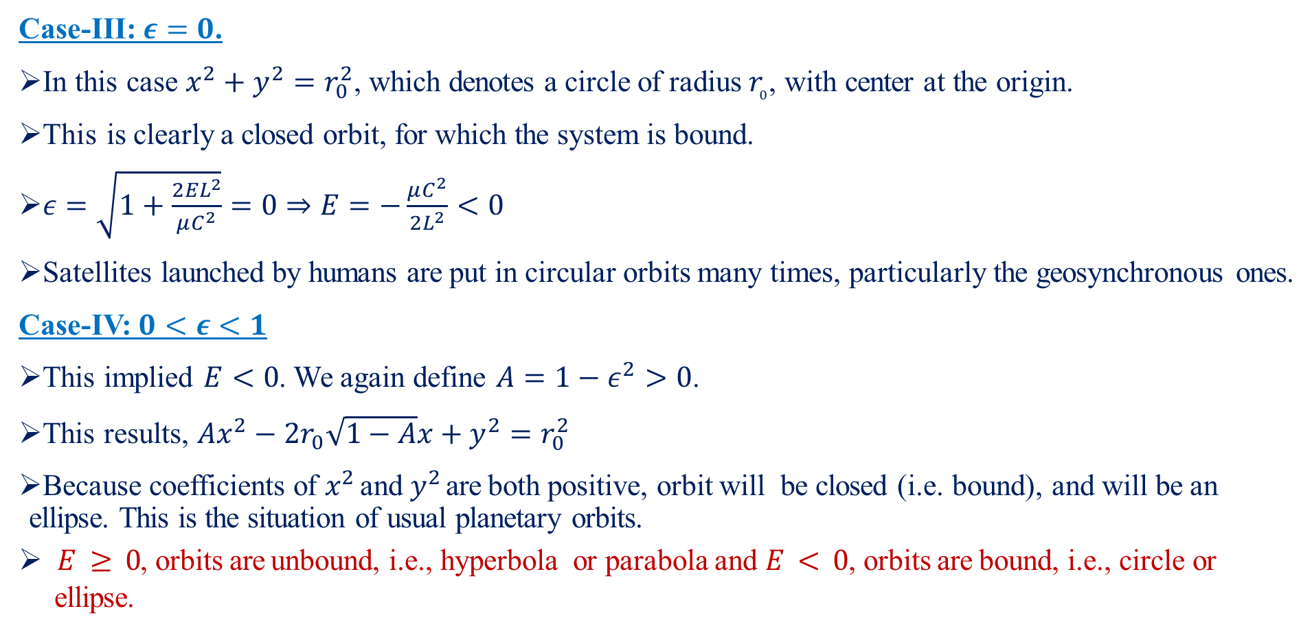
Conic Section-III
Case-III: $ε=0$.
In this case $x^{2}+y^{2}=r_{0}^{2}$, which denotes a circle of radius $r_{0}$, with center at the origin.
This is clearly a closed orbit, for which the system is bound.
$ε=\sqrt{1+\frac{2EL^{2}}{μC^{2}}}=0⇒E=−\frac{μC^{2}}{2L^{2}}<0$
Satellites launched by humans are put in circular orbits many times, particularly the geosynchronous ones.
Case-IV: $0<ε<1$
This implied $E<0$. We again define $A=1−ε^{2}>0$.
This results, $Ax^{2}−2r_{0}\sqrt{1−A}x+y^{2}=r_{0}^{2}$
Because coefficients of $x^{2}$ and $y^{2}$ are both positive, orbit will be closed (i.e. bound), and will be an ellipse. This is the situation of usual planetary orbits.
$E ≥ 0$, orbits are unbound, i.e., hyperbola or parabola and $E < 0$, orbits are bound, i.e., circle or ellipse.

Slide 19
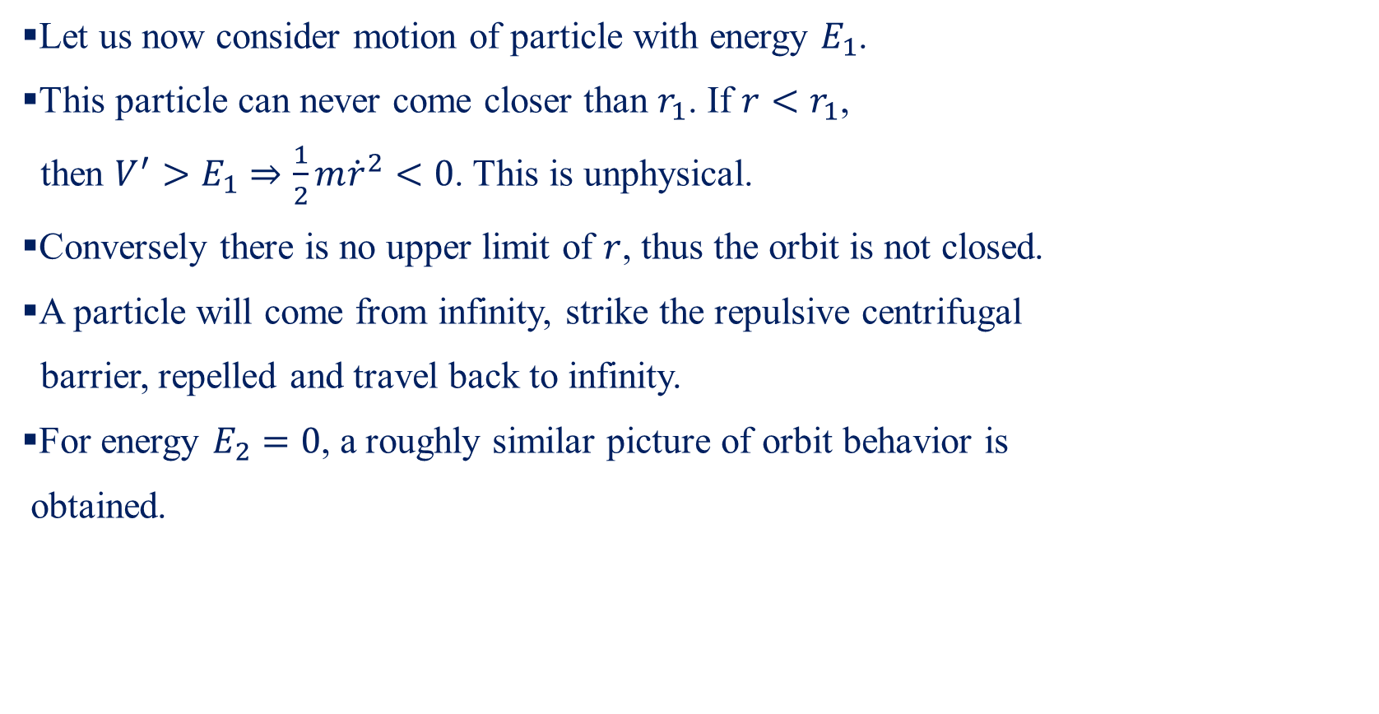
Graphical Description-I
Let us now consider motion of particle with energy $E_{1}$.
This particle can never come closer than $r_{1}$. If ${r<r}_{1}$,
then $V^{′}>E_{1}⇒\frac{1}{2}m{\dot{r}}^{2}<0$. This is unphysical.
Conversely there is no upper limit of $r$, thus the orbit is not closed.
A particle will come from infinity, strike the repulsive centrifugal
barrier, repelled and travel back to infinity.
For energy $E_{2}=0$, a roughly similar picture of orbit behavior is
obtained.

Slide 20

Graphical Description-II
But for any lower energy such as $E_{3}$ situation is different.
In addition to the lower bound $r_{1}$, there is also a maximum value $r_{2}$ which can not be exceeded by $r$ with positive kinetic energy.
The motion is then bounded and there are two turning points, $r_{1}$ and $r_{2}$.
If the energy is $E_{4}$, at the minimum of $V′$, then two bound state coincides. $\dot{r}=0$ and the orbit is a circle.

Slide 21
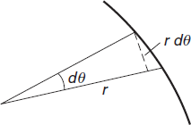
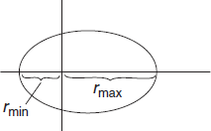
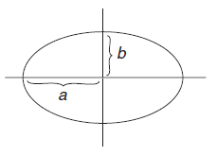
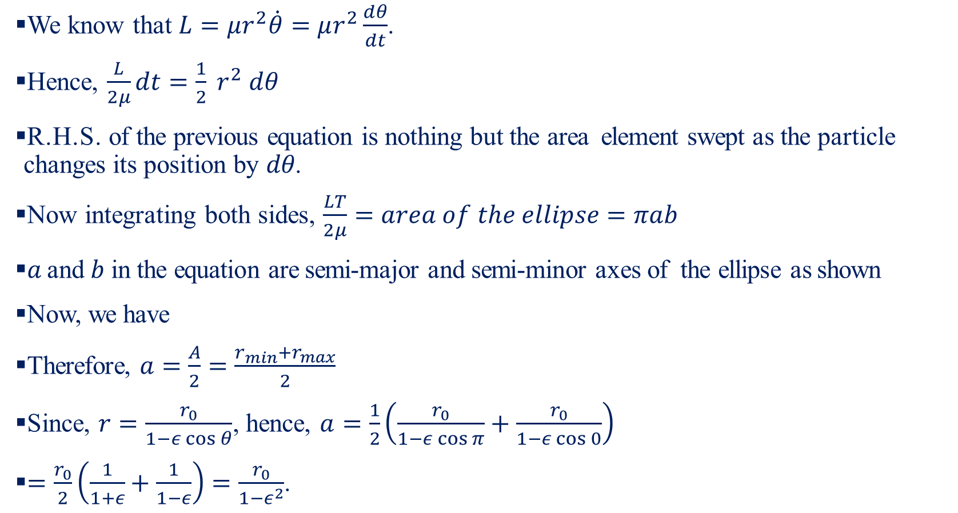
Time Period of Elliptic Orbit-I
We know that $L=μr^{2}\dot{θ}=μr^{2}\frac{dθ}{dt}$.
Hence, $\frac{L}{2μ}dt=\frac{1}{2} r^{2} dθ$
R.H.S. of the previous equation is nothing but the area element swept as the particle changes its position by $dθ$.
Now integrating both sides, $\frac{LT}{2μ}=area of the ellipse=πab$
$a$ and $b$ in the equation are semi-major and semi-minor axes of the ellipse as shown
Now, we have
Therefore, $a=\frac{A}{2}=\frac{r_{min}+r_{max}}{2}$
Since, $r=\frac{r_{0}}{1−ε\cos{θ}}$, hence, $a=\frac{1}{2}\left(\frac{r_{0}}{1−ε\cos{π}}+\frac{r_{0}}{1−ε\cos{0}}\right)$
$=\frac{r_{0}}{2}\left(\frac{1}{1+ε}+\frac{1}{1−ε}\right)=\frac{r_{0}}{1−ε^{2}}$.

Slide 22
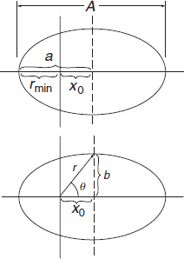
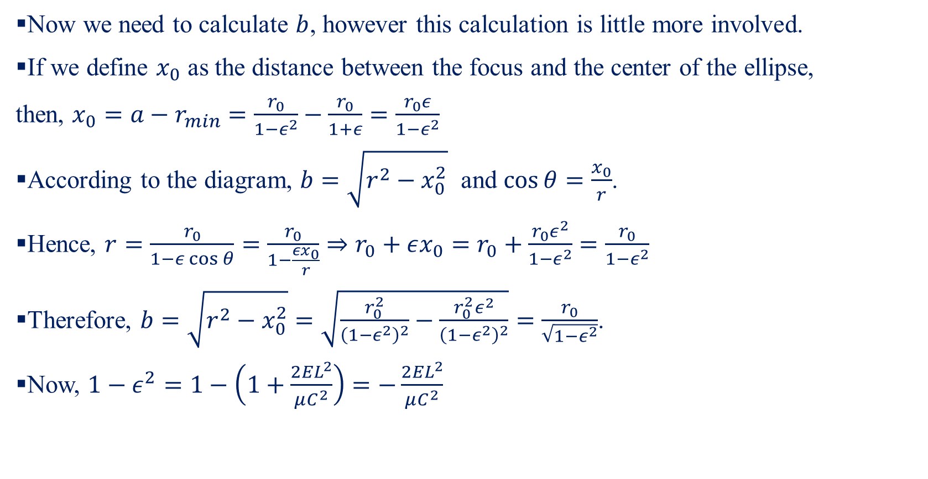
Time Period of Elliptic Orbit-II
Now we need to calculate $b$, however this calculation is little more involved.
If we define $x_{0}$ as the distance between the focus and the center of the ellipse,
then, $x_{0}=a−r_{min}=\frac{r_{0}}{1−ε^{2}}−\frac{r_{0}}{1+ε}=\frac{r_{0}ε}{1−ε^{2}}$
According to the diagram, $b=\sqrt{r^{2}−x_{0}^{2}}$ and $\cos{θ}=\frac{x_{0}}{r}$.
Hence, $r=\frac{r_{0}}{1−ε\cos{θ}}=\frac{r_{0}}{1−\frac{εx_{0}}{r}}⇒r_{0}+εx_{0}=r_{0}+\frac{r_{0}ε^{2}}{1−ε^{2}}=\frac{r_{0}}{1−ε^{2}}$
Therefore, $b=\sqrt{r^{2}−x_{0}^{2}}=\sqrt{\frac{r_{0}^{2}}{{\left(1−ε^{2}\right)}^{2}}−\frac{r_{0}^{2}ε^{2}}{{\left(1−ε^{2}\right)}^{2}}}=\frac{r_{0}}{\sqrt{1−ε^{2}}}$.
Now, $1−ε^{2}=1−\left(1+\frac{2EL^{2}}{μC^{2}}\right)=−\frac{2EL^{2}}{μC^{2}}$

Slide 23
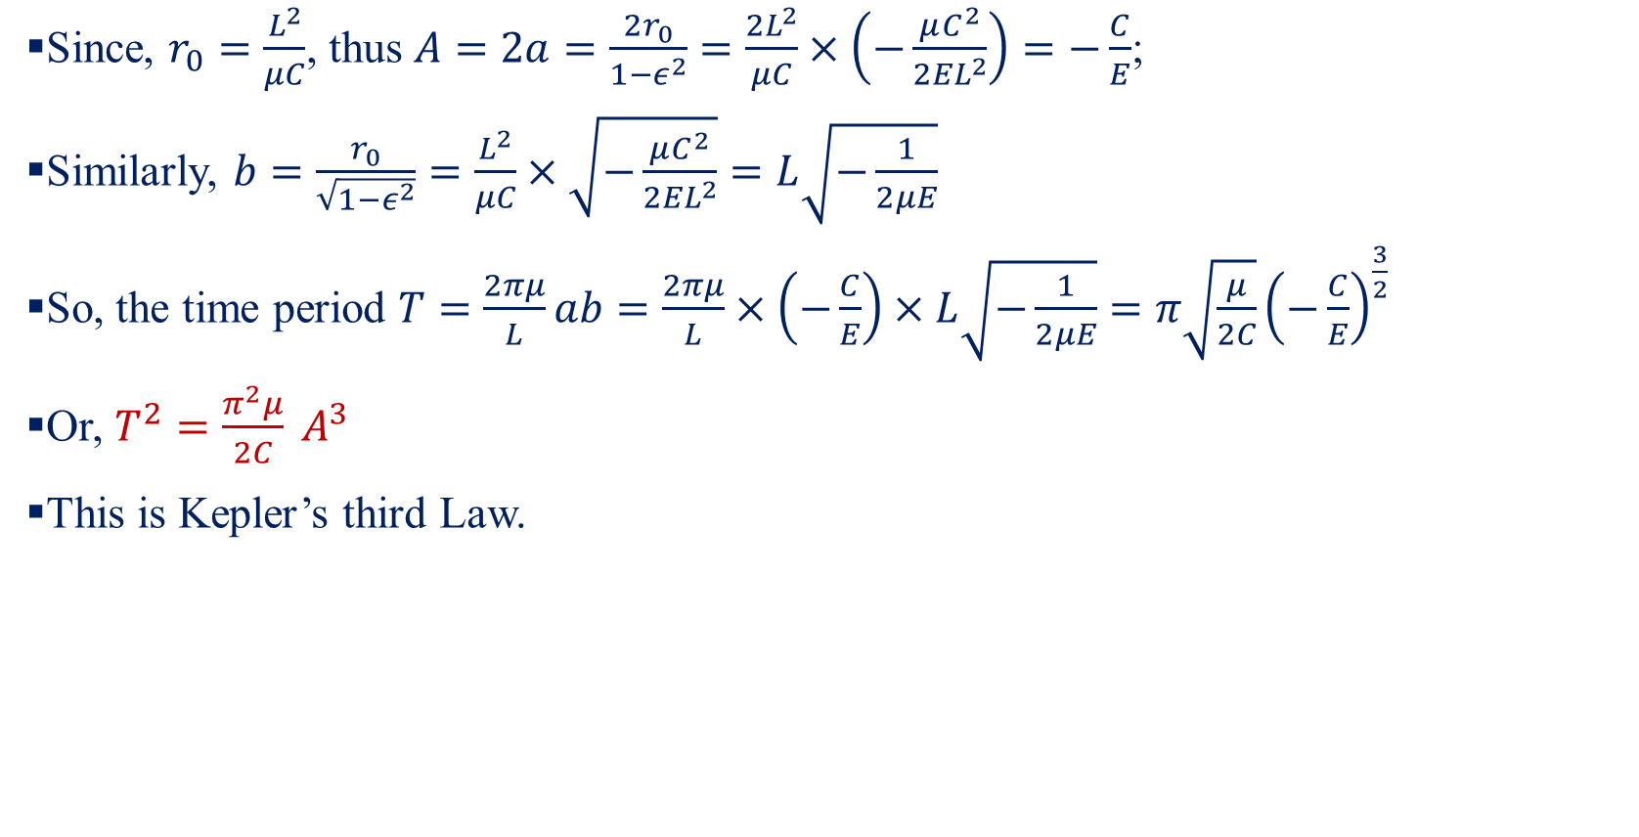
Time Period of Elliptic Orbit-III
Since, $r_{0}=\frac{L^{2}}{μC}$, thus $A=2a=\frac{2r_{0}}{1−ε^{2}}=\frac{2L^{2}}{μC}×\left(−\frac{μC^{2}}{2EL^{2}}\right)=−\frac{C}{E}$;
Similarly, $b=\frac{r_{0}}{\sqrt{1−ε^{2}}}=\frac{L^{2}}{μC}×\sqrt{−\frac{μC^{2}}{2EL^{2}}}=L\sqrt{−\frac{1}{2μE}}$
So, the time period $T=\frac{2πμ}{L}ab=\frac{2πμ}{L}×\left(−\frac{C}{E}\right)×L\sqrt{−\frac{1}{2μE}}=π\sqrt{\frac{μ}{2C}}{\left(−\frac{C}{E}\right)}^{\frac{3}{2}}$
Or, $T^{2}=\frac{π^{2}μ}{2C} A^{3}$
This is Kepler’s third Law.

